Slide 1
Social Sports

Slide 2
SOCIAL SPORTS
RETURN OF LIVE SPORTS: TWITTER REACTS!
When live sports returned in July of 2020, the jubilation among fans was evident on social media as fans finally had something to cheer for (and about) amid the ongoing pandemic. Twitter released a report sharing some metrics relating to fan response on the popular social media platform as leagues like NASCAR, PGA Tour, MLB and NBA announced their restart plans.
The statistics shared in the next few slides represent the time period from May of 2020, without live sports, to July of 2020, after sports began to resume play. Twitter used this data and these graphics to promote its advertising opportunities to brands looking to connect with sports fans.

Slide 5
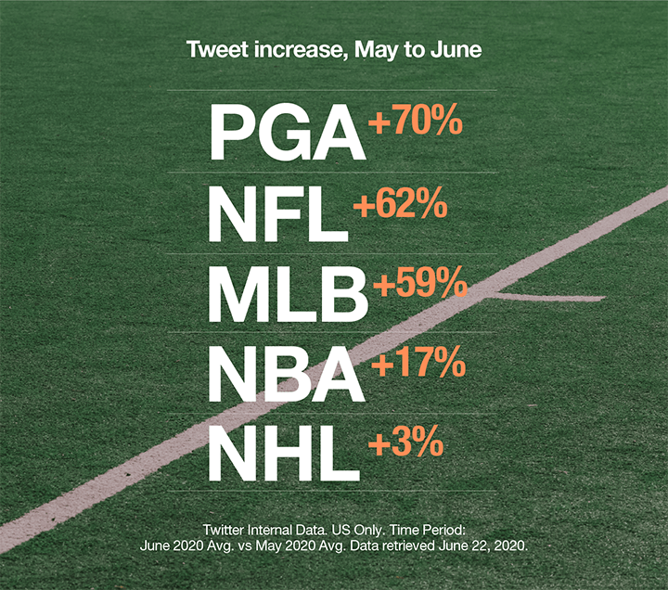
All the sports. All the leagues.
Season openers are usually spread throughout the year. But 2020 is giving us a once-in-a-lifetime frenzy, with leagues starting all at once. Now action-starved fans are talking about every major sport at the same time. It’s a smorgasbord of predictions, rivalries, and a whole lot of Tweets.

Slide 6
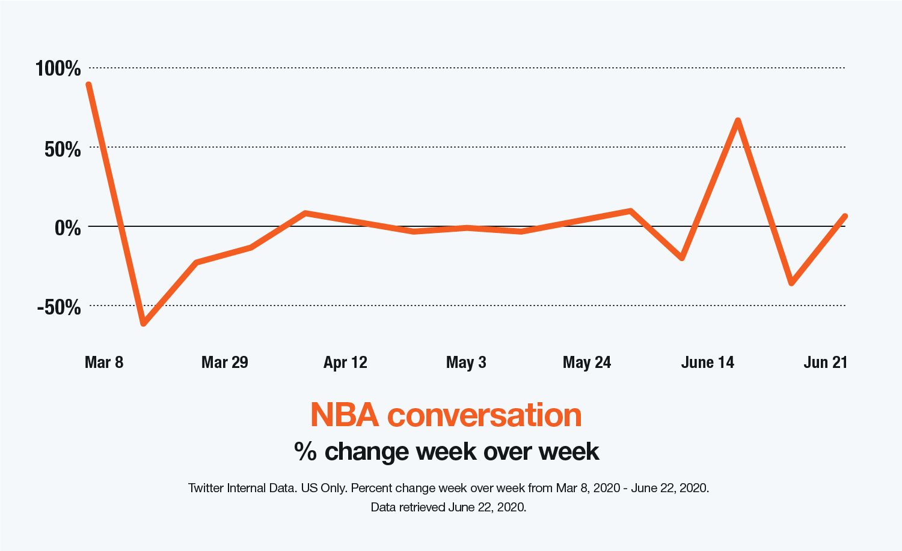
Of course, some fans never stop
#NBATwitter is a massive community that’s one of the most engaged anywhere. Fueled by a hit documentary, classic highlights, and endless GOAT debates, these fans barely missed a beat. And now with teams about to hit the court again, they’re upping their Tweet game too.

Slide 7
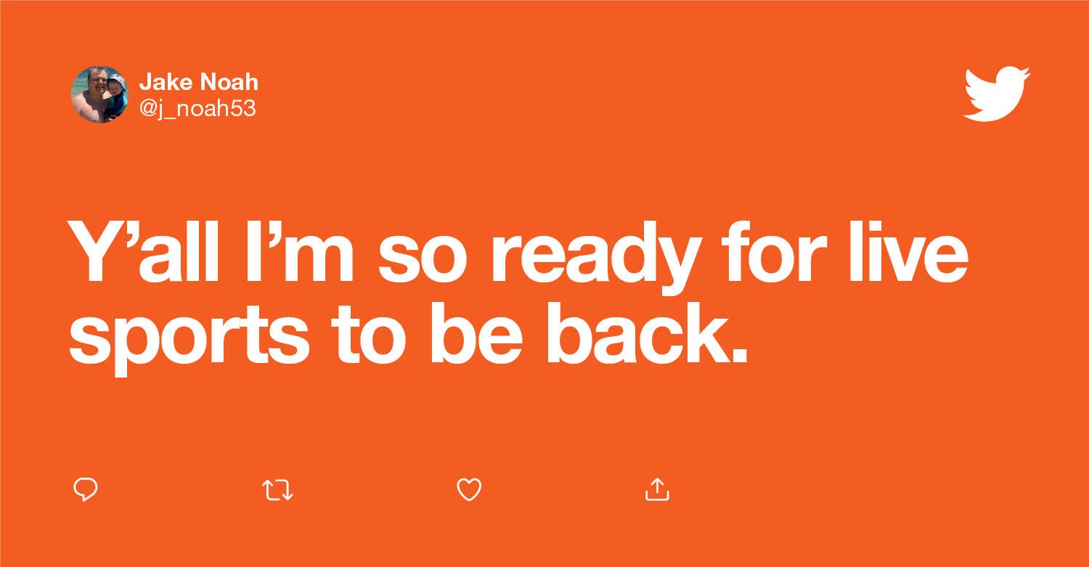
In the past month, Tweets about “following live sports” are up 32%.¹ Even without packed venues and crowded sports bars, people are finding that shared edge-of-your-seat connection on Twitter. For fans today, Twitter is the roar of the stadium. Passionate fans, eager to connect, all in one place? Yes, please. Don’t miss your chance to be part of this major cultural moment.

Slide 8
DISCUSSION
What is the difference between the marketing of sports and entertainment and marketing through sports and entertainment?
How might the information in this PPT represent an example of both?
What is fan engagement? How do social media hashtags help sports teams to engage their fanbase?

Slide 9
DISCUSSION
How do you think social media in general can help sports teams to engage fans? How can it help brands to engage consumers?
With the NBA Playoffs winding down, just a few teams are still playing. If you were the social media marketing manager for one of the teams who has been eliminated from championship contention, what would you do to continue to engage your fans on social media when the team is no longer playing games?

