Slide 1
THANKSGIVING
The Brands Behind
Thanksgiving Celebrations

Slide 2
Thanksgiving Marketing
A Houston Chronicle story suggests that much of what we celebrate on Thanksgiving is the direct result of marketing.
Over time, some brands have become synonymous with Thanksgiving feasts, with consumers filling supermarket shopping carts with these products every year.

Slide 3
Thanksgiving Marketing
For example, millions of green bean casseroles are served during the holiday season. That’s why French’s French Fried Onions, a core ingredient to the holiday classic, was ranked third of all branded edible items the week of Thanksgiving, according to data provider IRI. (Ocean Spray Jellied Cranberry Sauce was fourth.)
The brand’s French fried onions brought in nearly $14 million in sales the week of Thanksgiving, with total sales in a three-week span of the holiday coming in at $30 million.

Slide 4
Thanksgiving Marketing
What brands played a role in your Thanksgiving Day meals? There are far more than you probably considered!
Which brands do you think are big sellers over the Thanksgiving holiday?
Try to create a list of at least five popular Thanksgiving related food brands, then review the following slides for some examples.

Slide 5
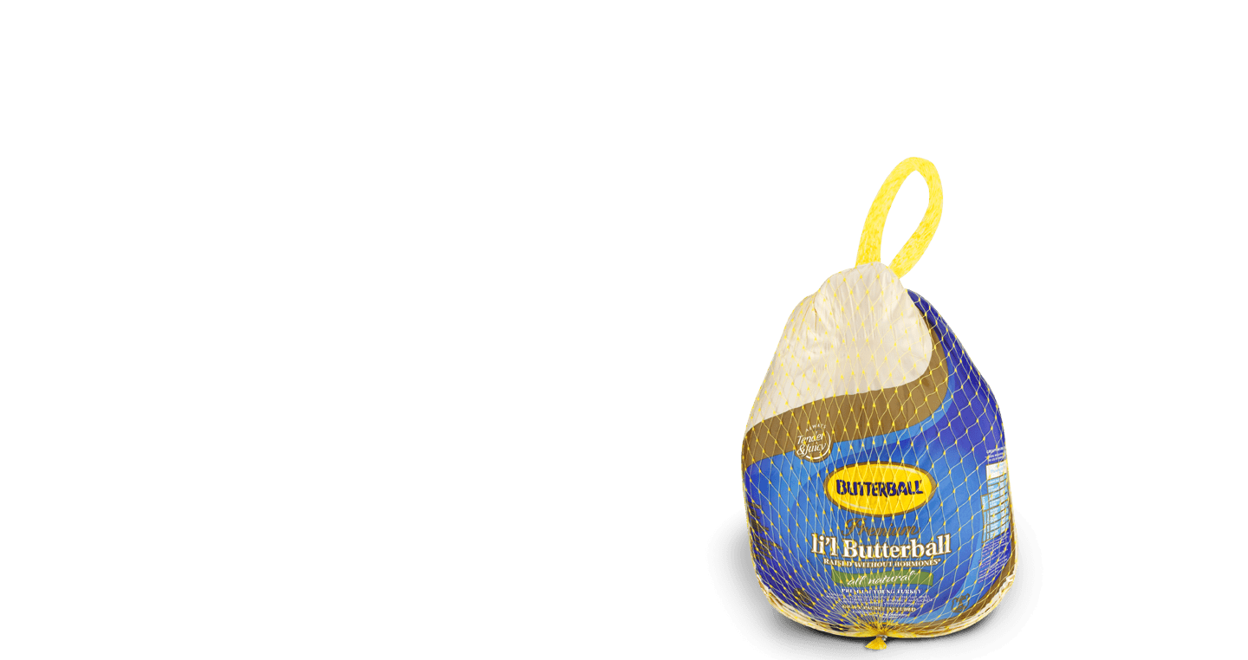
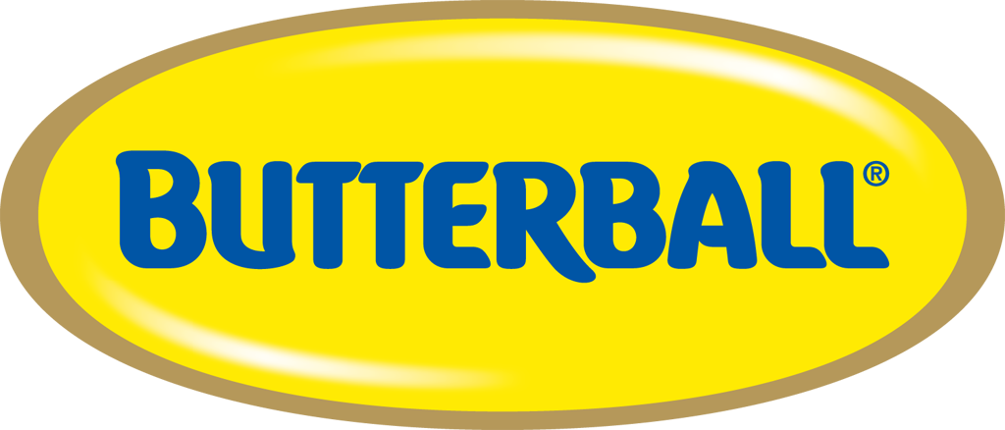
Turkey: Butterball

Slide 6
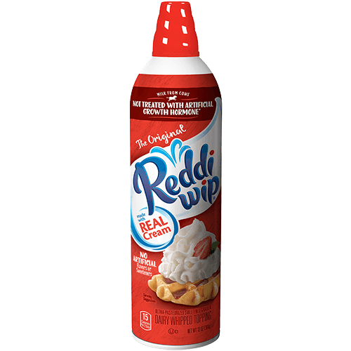
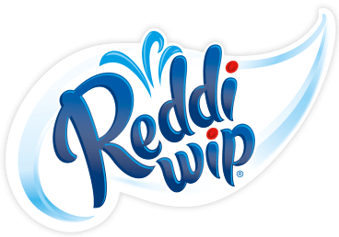
Whipped Cream: Reddi Wip

Slide 7
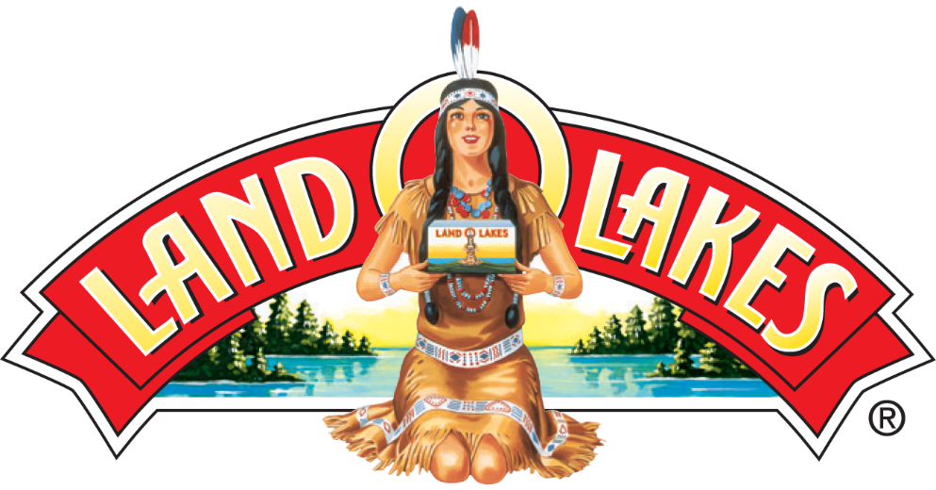
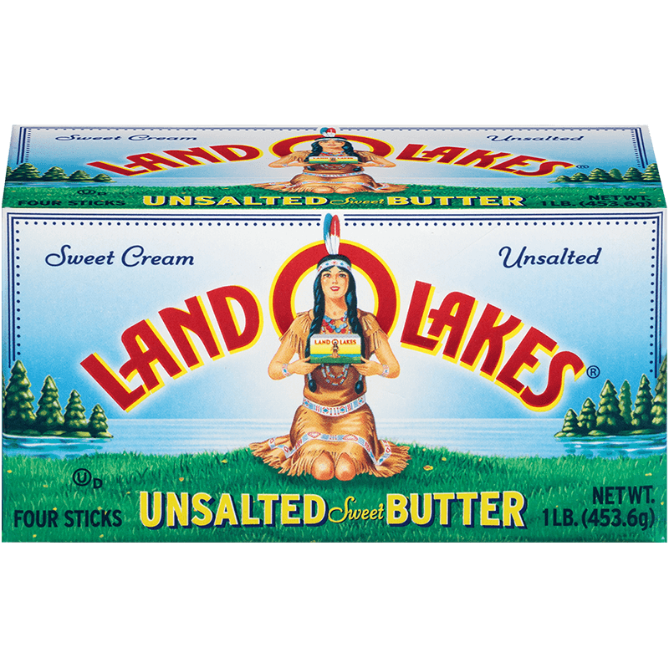
Butter: Land-O-Lakes

Slide 8
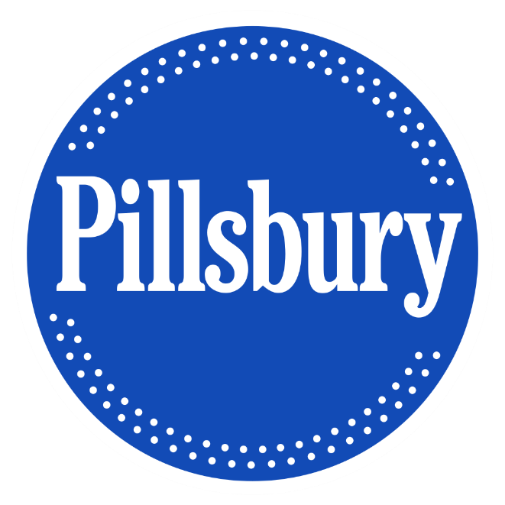
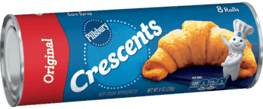
Butter: Land-O-Lakes

Slide 9
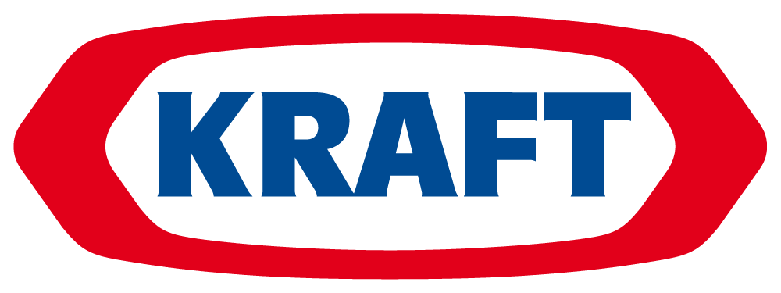
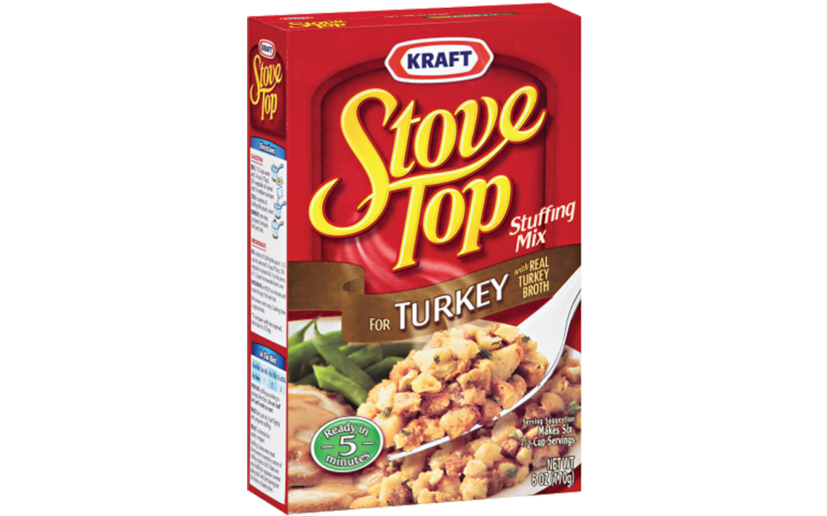
Stuffing: Kraft (Stove Top)

Slide 10
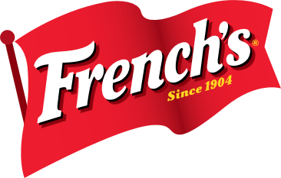
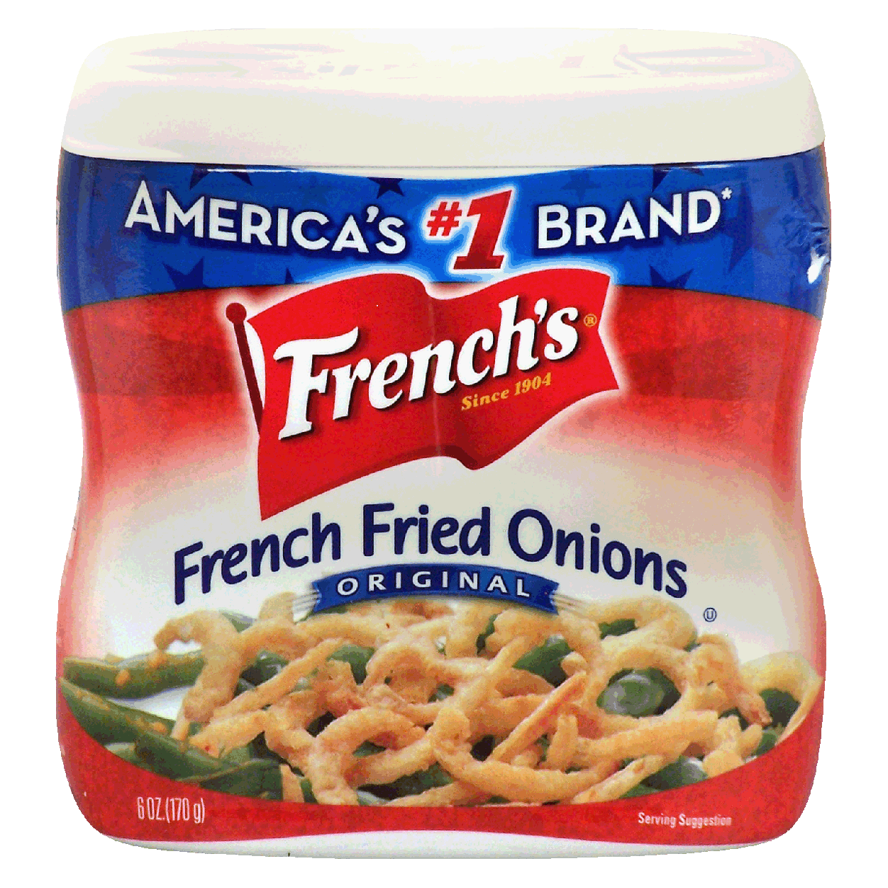
Toppings: French’s

Slide 11
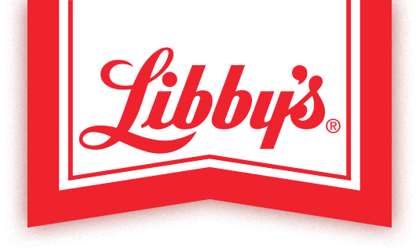
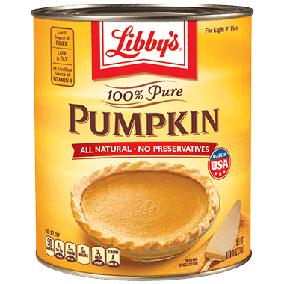
Pumpkin: Libby’s

Slide 12
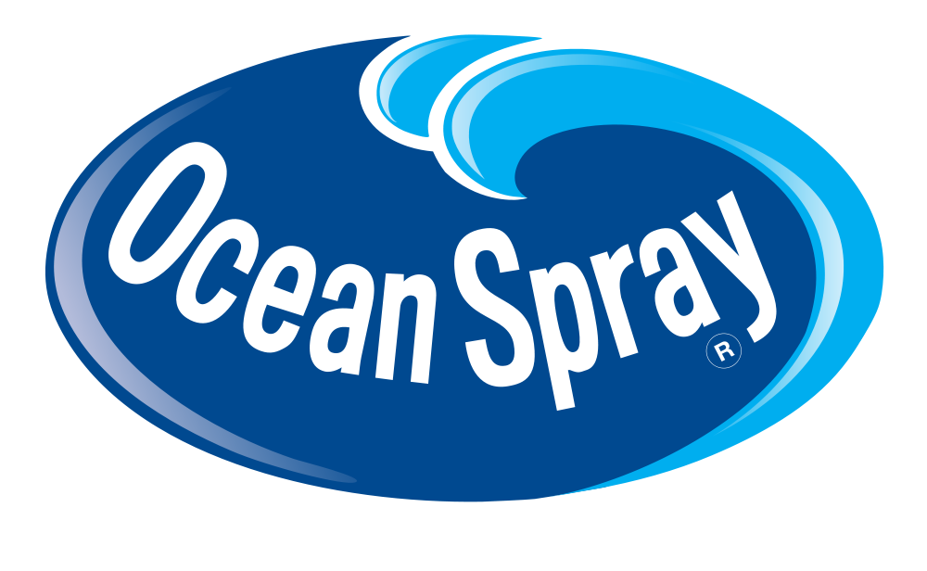
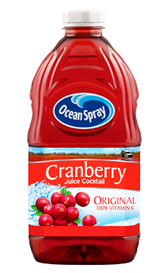
Cranberry Juice/Sauce: Ocean Spray

Slide 13
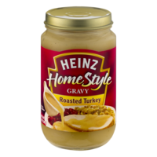
Gravy: Heinz

Slide 14
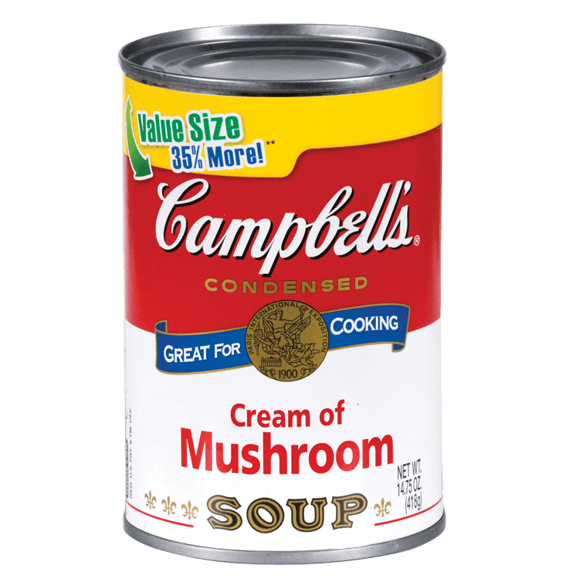
Cream of Mushroom Soup: Heinz

Slide 15
How many could
You identify?

