Slide 1
Super Displays
Super Bowl
Sales & Promotion

Slide 2
SUPER DISPLAYS
Every year, sales of consumer goods like soda, snacks, pizza, chicken wings, avocados, beer and even televisions spike in the week leading up to the Super Bowl.
Not coincidentally, vendors work with supermarkets around the country and go all out to create elaborate point-of-purchase displays.
The following slides provide examples of ways brands have demonstrated creative ways to capitalize on the hype surrounding the Super Bowl in an effort to boost sales at retail.

Slide 3
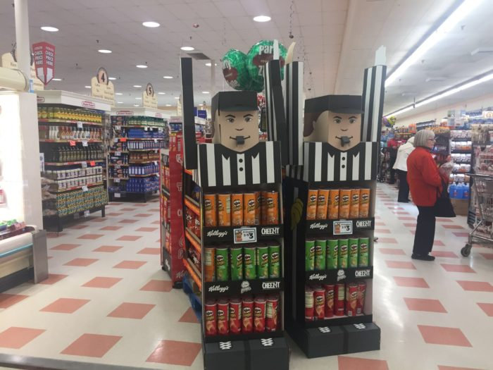

Slide 4
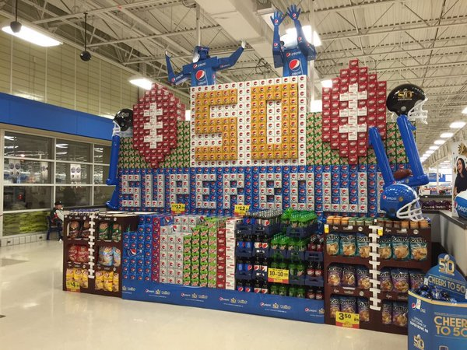

Slide 5
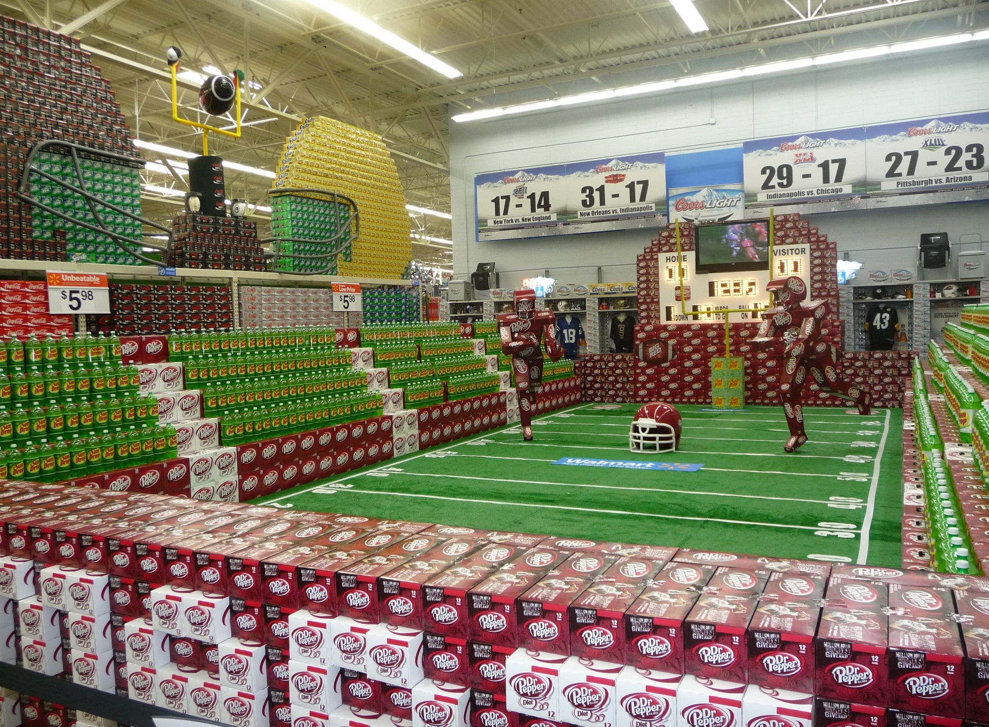

Slide 6
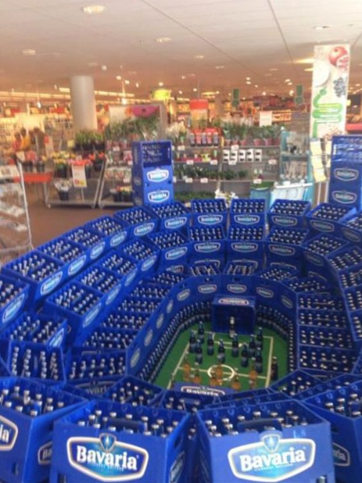

Slide 7
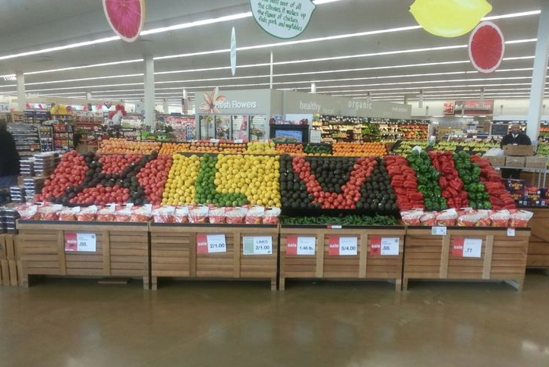

Slide 8
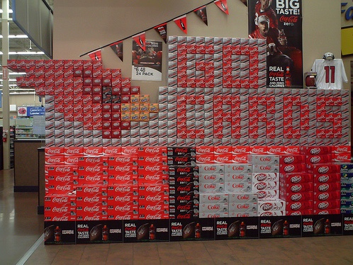

Slide 9
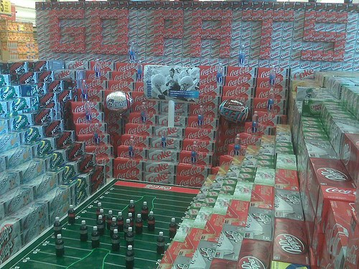

Slide 10
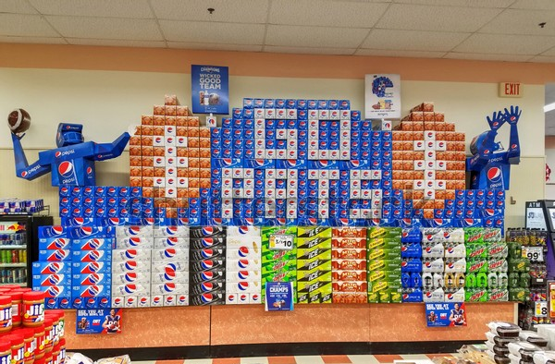

Slide 11
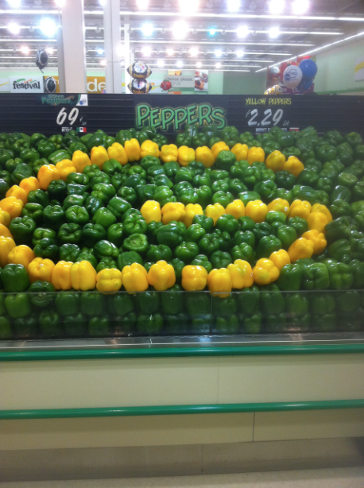

Slide 12
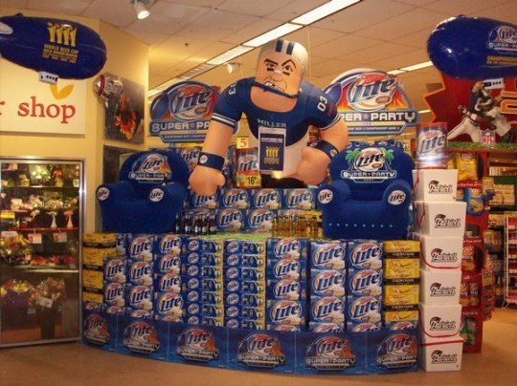

Slide 13
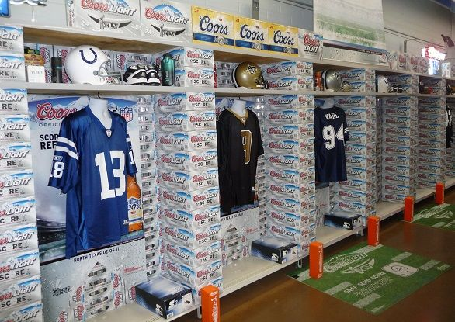

Slide 14
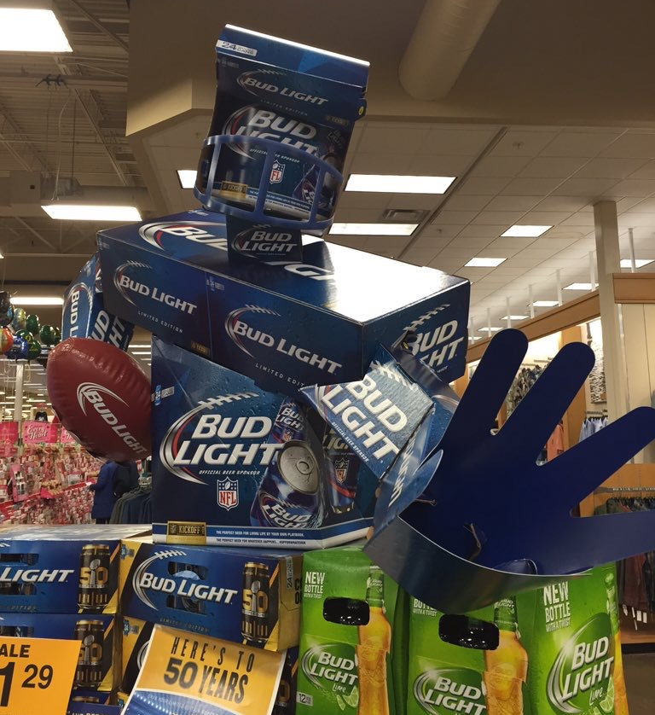

Slide 15
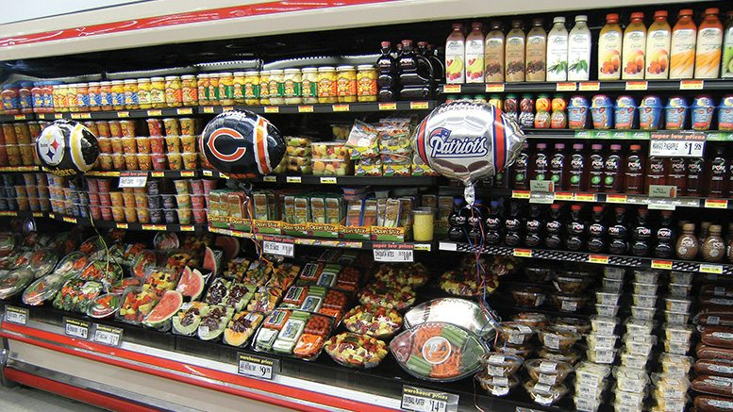

Slide 16
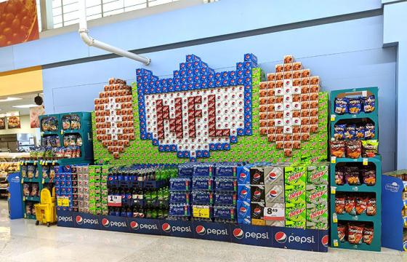

Slide 17
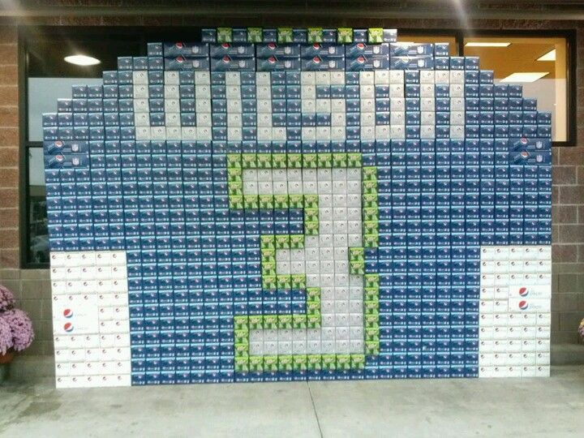

Slide 18
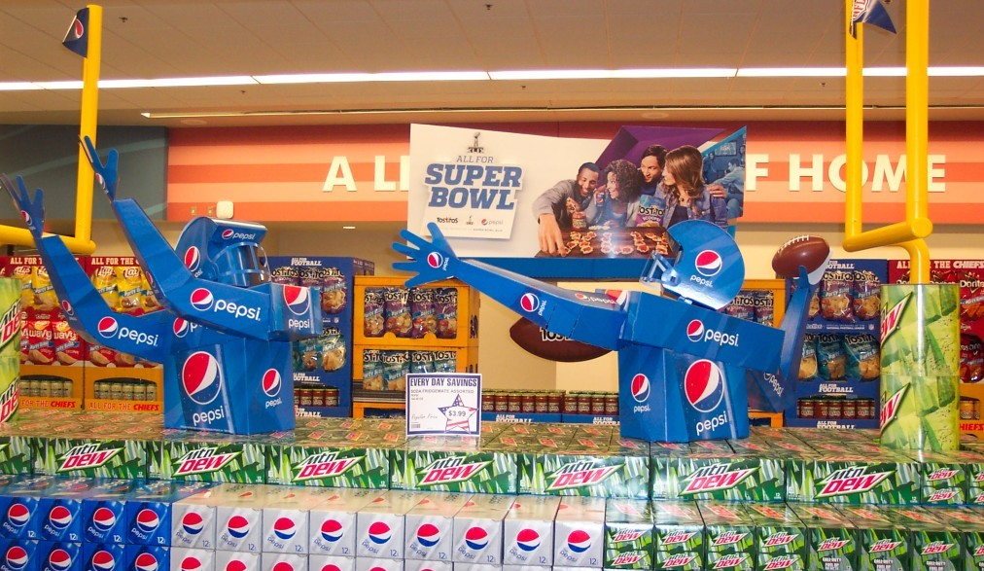

Slide 19
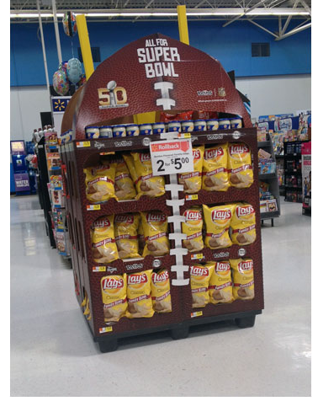

Slide 20
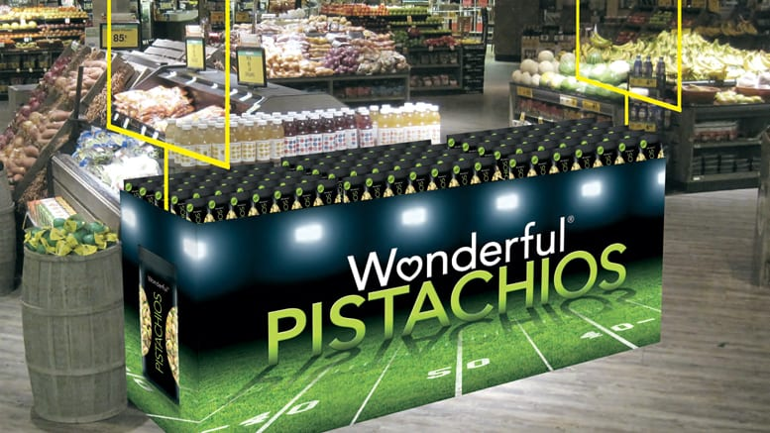

Slide 21
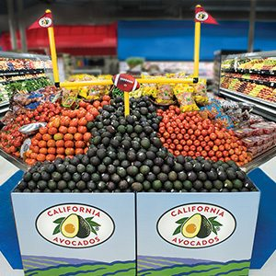

Slide 22
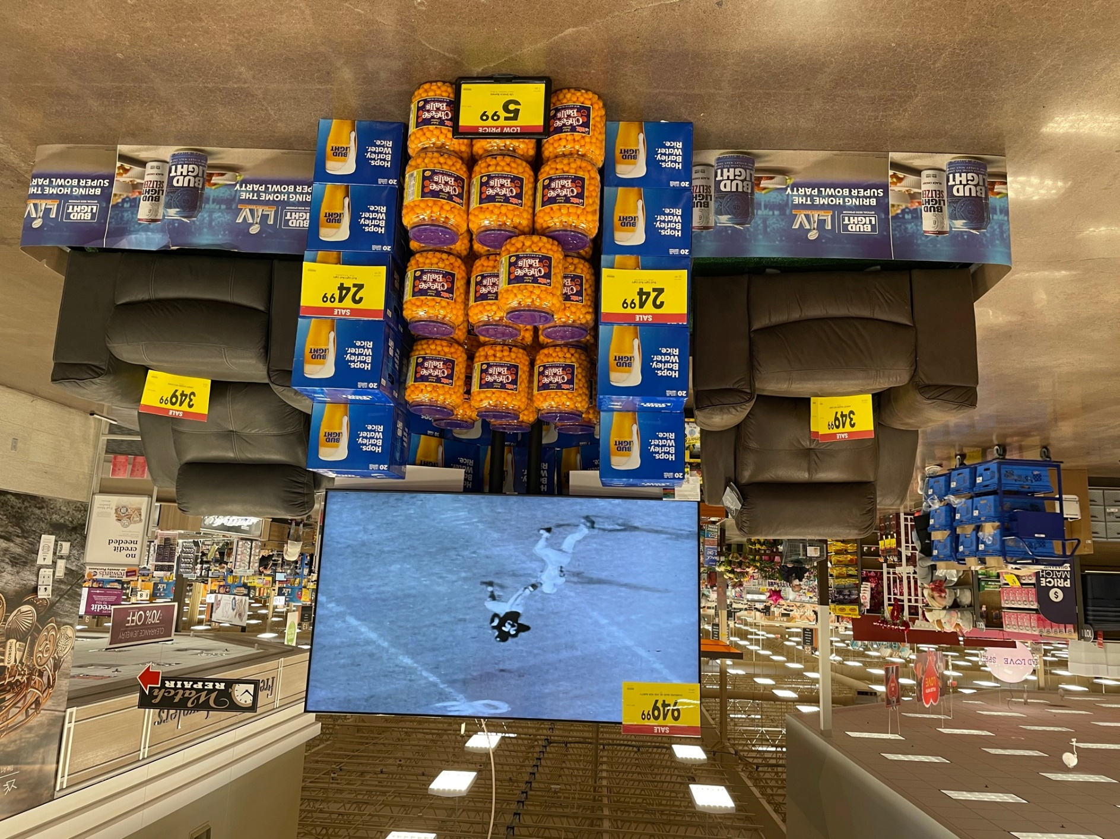

Slide 23
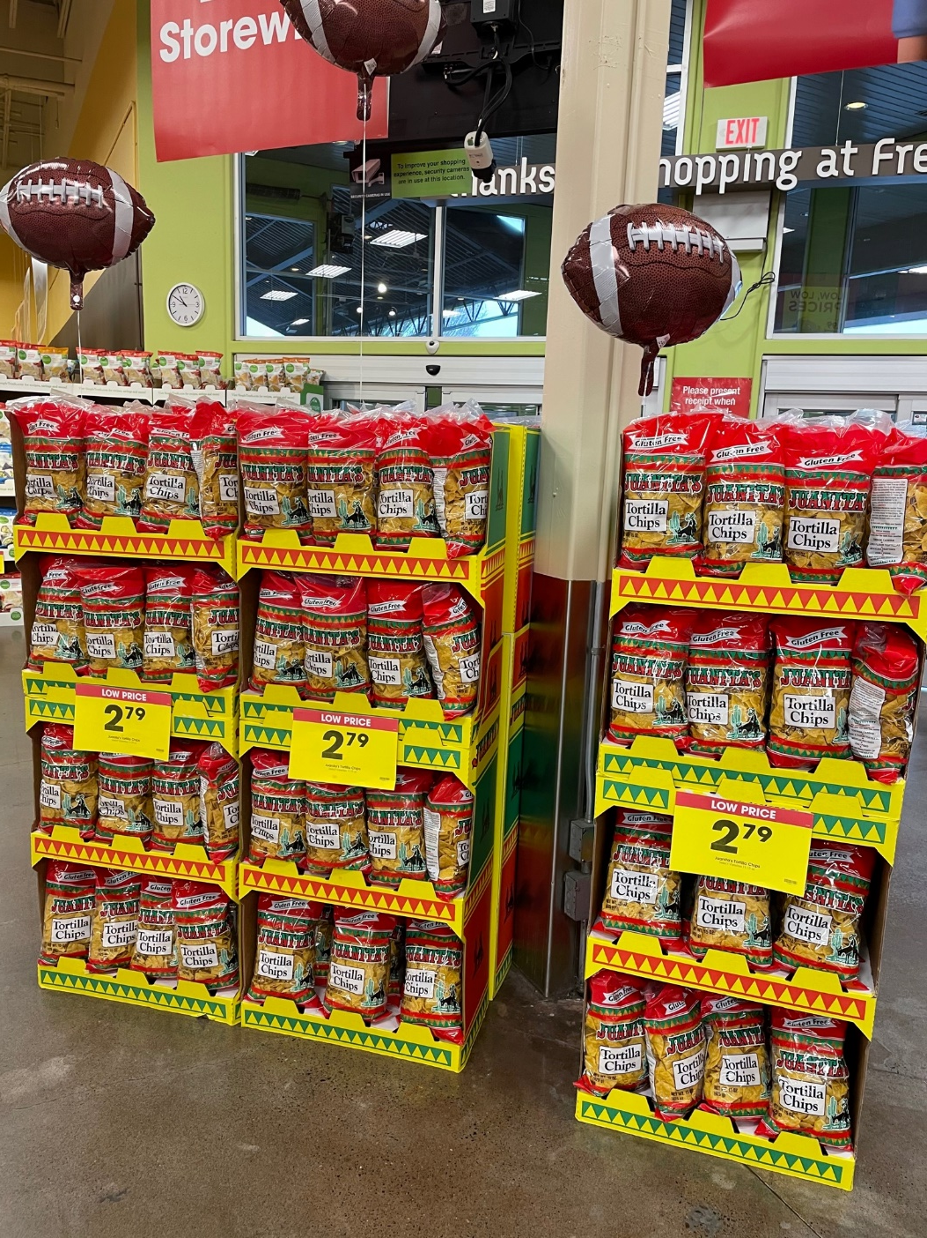
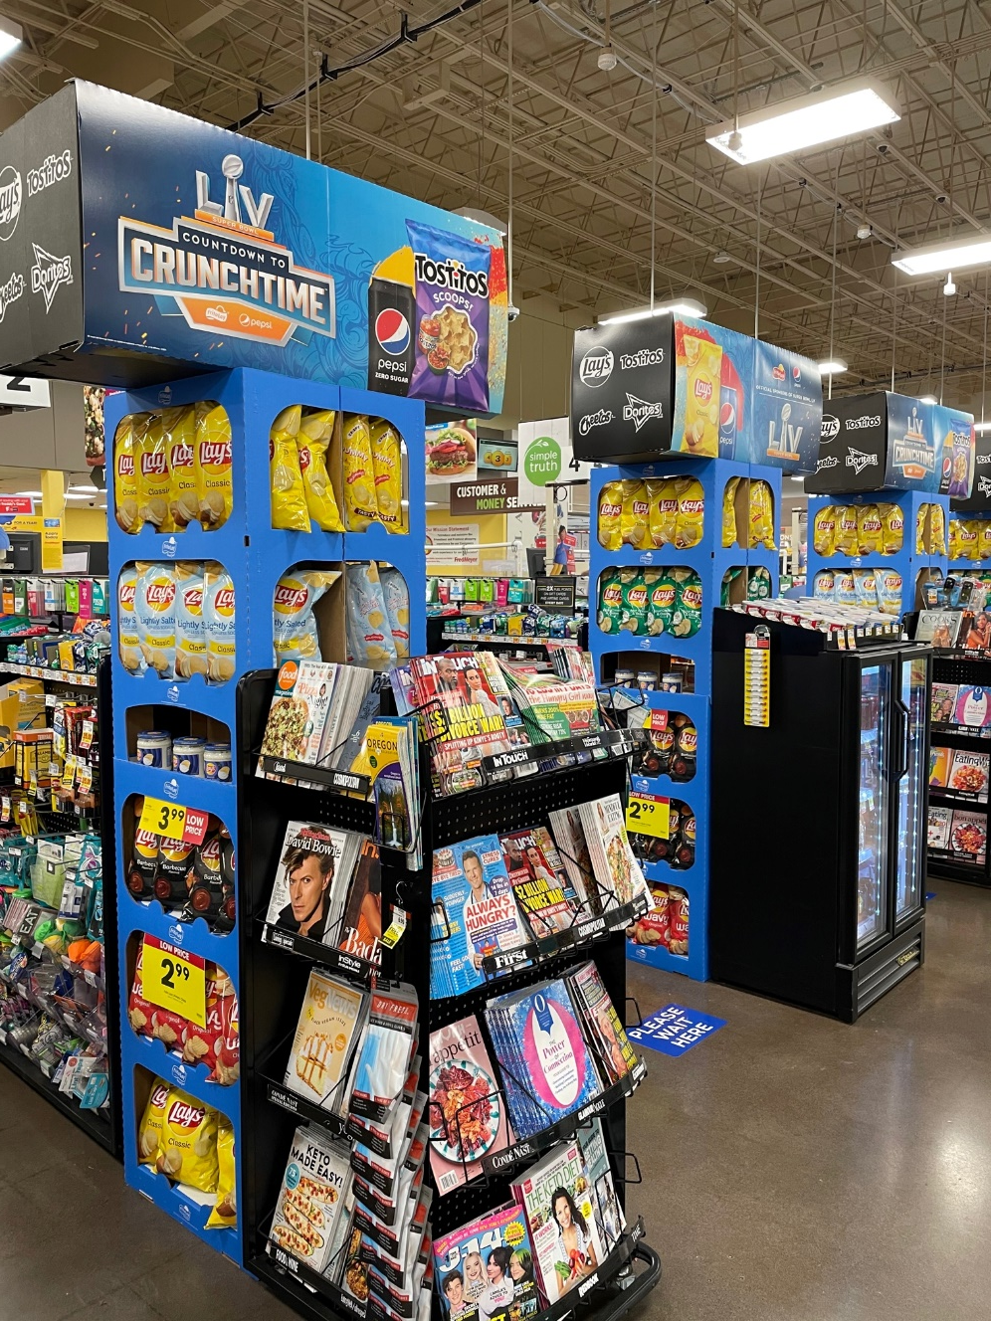

Slide 24
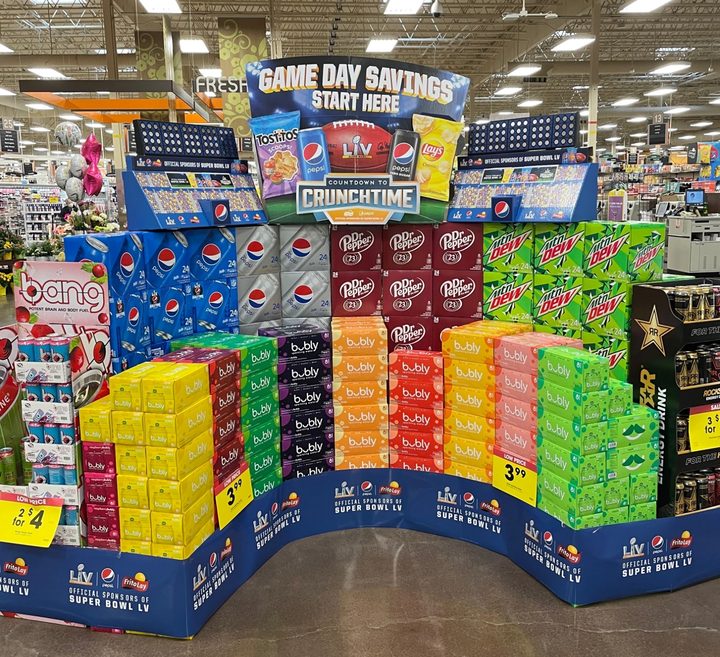

Slide 25
DISCUSSION QUESTIONS
What types of displays have you seen at your local grocery store?
What is a “vendor” and why would they spend the time to build a Super Bowl display at a supermarket?
Why might a supermarket allow a brand like Coke or Doritos to build an elaborate display in their store?
What type of consumer are these brands targeting with displays like these?

Slide 26
DISCUSSION QUESTIONS
What types of products do you think typically see a sales boost in the lead up to the Super Bowl?
What types of products might benefit from the added exposure that a point-of-purchase display can provide in a retail setting?
Do you think the placement of the display has an impact on sales? Why or why not?
Have you seen any displays at your local supermarket or retail store?

Slide 27
DISCUSSION QUESTIONS
What is sponsorship?
Why do you think a brand might want to be an official sponsor of the NFL?
What is ambush marketing?
Based on the images of supermarket and retail displays in the previous slide show, can you tell which brands are NFL sponsors and which brands are not?

Slide 28
STUDENT ACTIVITY
Choose a consumer product category (snack foods, soda, pizza or TVs) and one of your favorite brands in that category
Explain how a supermarket or retail display could help increase product sales for the brand leading up to this year’s Super Bowl
Create your own point-of-purchase display with either a physical model, sketch/drawing, or digital design
Describe where in the store you will position your display and how it will draw consumer attention, along with an explanation of how it will increase sales

Slide 29
STUDENT COMPETITION
Following the criteria presented in the previous slide, we will be awarding prizes to the top three point-of-purchase displays.
Entries will be evaluated based on creativity and effectiveness. In other words, do the judges believe the display would actually help the brand to increase sales? How well did you describe the promotion and explain why it would be effective (including location of the display in the supermarket or store)?
Entries should be emailed to chris@sportscareerconsulting.com with the subject “Super Bowl LV Competition” in the subject line.
DUE DATE: TUESDAY, FEBRUARY 9TH!!!

