Slide 1
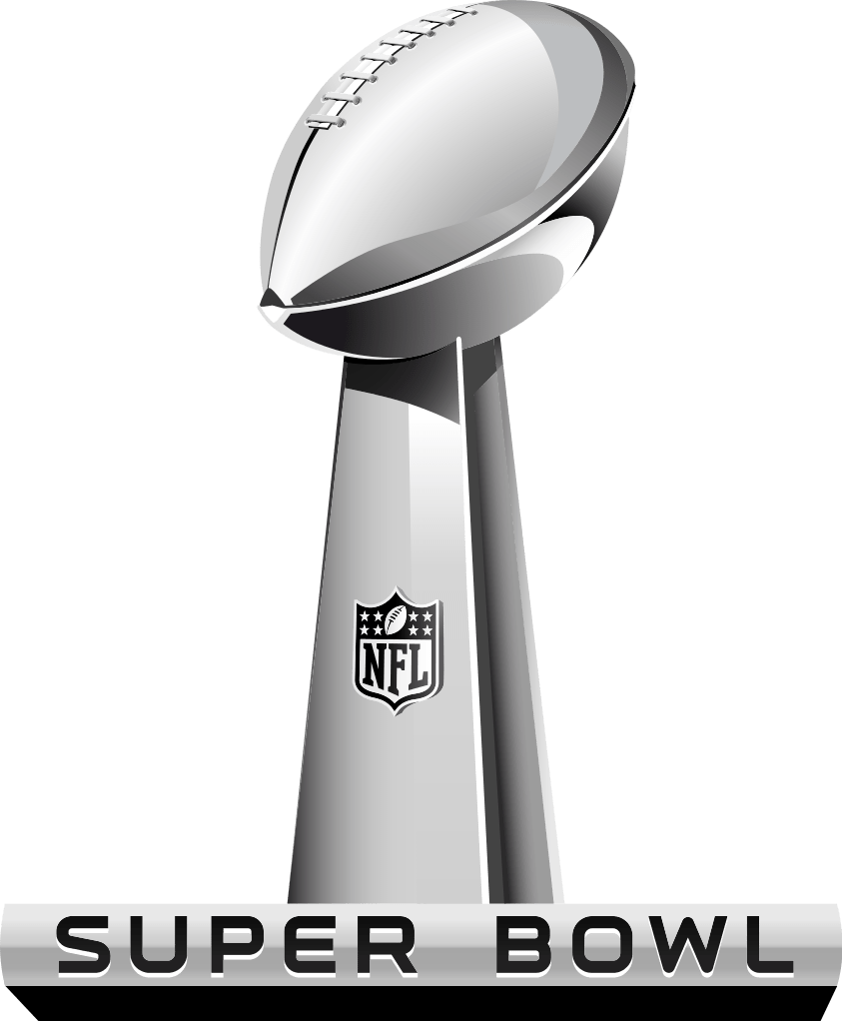
Super Bowl LV
FUN FACTS

Slide 2
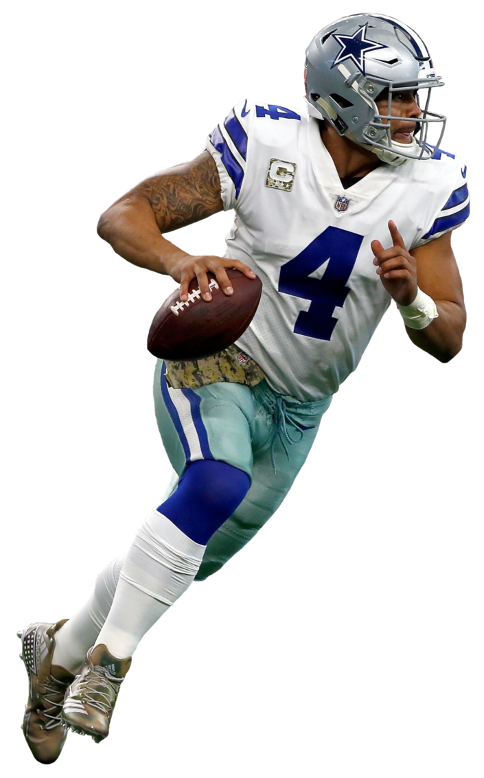
$31.4 million
According to Spotrac, Dallas Cowboys’ Dak Prescott was the highest paid player in the NFL this season, earning a base salary of $31.4 million

Slide 3
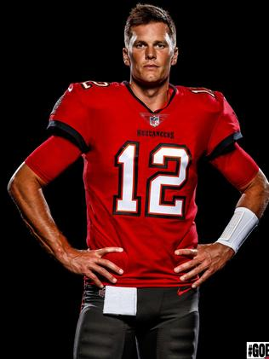
$27.875 million
Tom Brady earned $27.875 million this season in salary, making him the 6th highest paid QB in the league

Slide 4
$450 million
Patrick Mahomes signed a 10-year, $450 million contract extension with the Chiefs last summer making him the highest paid QB in NFL history

Slide 5
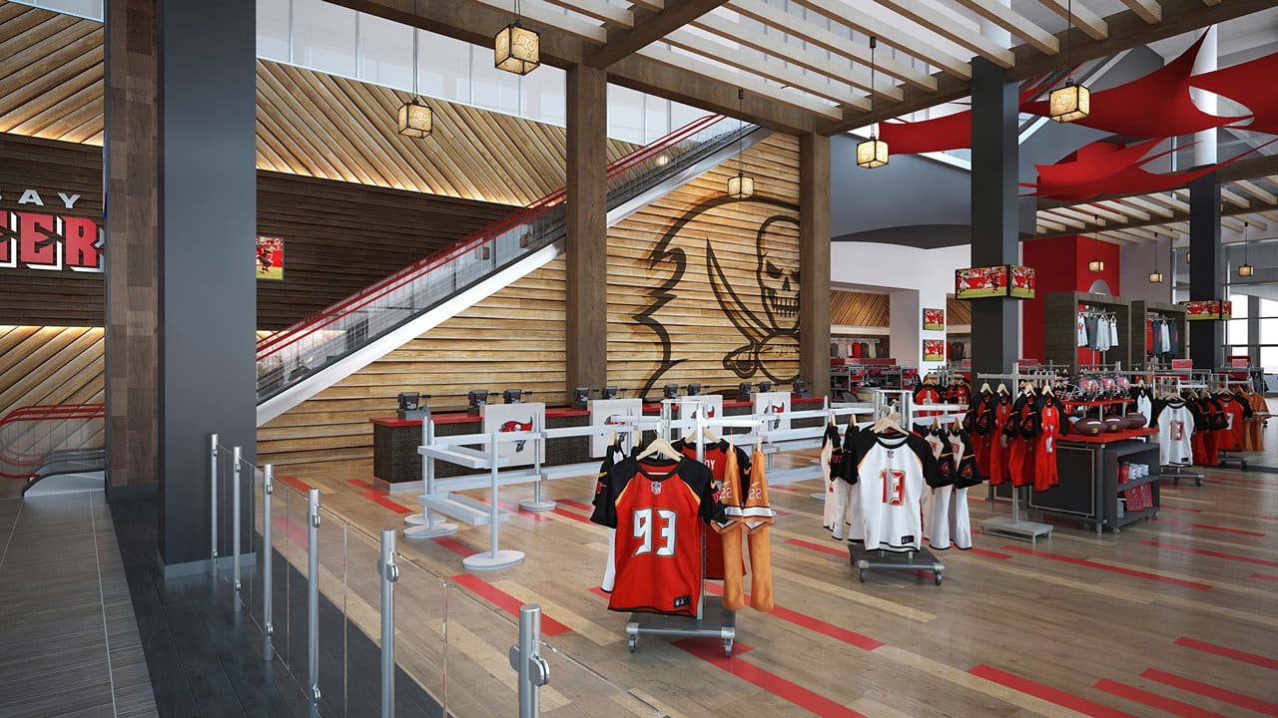
$160 million
The city of Tampa invested $160 million in renovations and upgrades to Raymond James Stadium in preparation for the Super Bowl

Slide 6
$7 million
The stadium has seen $7 million worth of enhancements designed to provide a safer atmosphere for fans during this pandemic

Slide 7
8,000
A Community Ambassador program was created in Tampa, consisting of 8,000 volunteers who will meet, greet and guide Super Bowl LV visitors while they are in town for the Big Game.

Slide 8
55
Super Bowl LV is at Raymond James Stadium -- where the Buccaneers play their home games -- making Tampa Bay the first team to play the Super Bowl in its home stadium in the 55 years the game has been held.

Slide 9
65,890
Raymond James Stadium, at full capacity, can hold up to 65,890 fans for a Buccaneers home game

Slide 10
22,000
However, due to the pandemic, the NFL is limiting capacity at Super Bowl LV to 22,000, including 7,500 health care workers who have received the COVID-19 vaccine

Slide 11
12
The Tampa Bay Buccaneers announced in 2016 that Raymond James Financial will keep its name on the NFL team's home stadium through 2028, thanks to a 12-year extension to their naming-rights agreement.

Slide 12
$32.5 million
Raymond James Financial has held naming rights to the stadium since its opening, originally investing $32.5 million for a 13–year deal. Terms of the recent extension were not been disclosed.

Slide 13
$168.5 million
Upon its completion in 1998, the final cost to build Raymond James Stadium was $168.5 million, with the entire project being publicly financed.

Slide 14
99.9 million
The Chiefs' 31-20 win over the 49ers in last year’s Super Bowl averaged 99.9 million viewers on Fox. When you include digital viewers who streamed the game, that total jumped up to 102.1 million, making the game the 10th most watched Super Bowl of all-time and the 11th most-watched TV show ever.

Slide 15
$0
How much did J. Lo & Shakira earn for last year’s half-time show performance? NOTHING. The NFL enforces a strict policy and does not pay any performers for half-time shows. This year’s halftime show will feature The Weeknd.

Slide 16
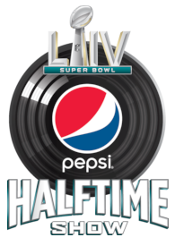
1,013%
That’s not to say artists don’t benefit.
After last year’s halftime show, sales of songs performed by J. Lo & Shakira saw an immediate 1,013% increase in sales.

Slide 17
22,000
Only 14,500 tickets are available for sale (the NFL is giving 7,500 of 22,000 available seats to healthcare workers), sending ticket prices into the stratosphere for this year’s Big Game.

Slide 18
$9,492
Currently, the cheapest seats for the game (often referred to as the “get-in” price) cost more than $9,400 – a massive 111% increase over last year. This illustrates the impact supply and demand can have on sports and entertainment events!

Slide 19
$12
Compare that to the very first Super Bowl in 1967 when tickets were just $12.00 (and even then fans were outraged at the high cost of the tickets). This illustrates the economic principle of inflation.

Slide 20
$365,000
One seller on Vivid Seats (secondary market) is offering one ticket in a Raymond James Stadium luxury suite for a whopping $365,148 (another seller is offering a luxury suite ticket for $334,602).

Slide 21
$4 - $32
Concessions items at Hard Rock Stadium for last year’s Super Bowl ranged from $4 for a “value” hot dog to $32 for steak kan-kan ... on a stick

Slide 22
$14 -16
Typical stadium foods were priced at between $14 and $16. Brats, pizza and footlong hot dogs were $14, popcorn was $15, burgers with chips and chicken fingers with fries were $16.

Slide 23
100
100 chefs and 2,400 culinary staff comprised the food services team at Hard Rock Stadium, serving more than 2,700 Maine lobster tails, 6,000 servings of short ribs, 1,500 servings of beef tenderloin, 10,000 hot dogs, and enough nachos to fill a swimming pool at last year’s Super Bowl.

Slide 24
26.42 TB
26.42 TB of data was used at the stadium during last year’s Big Game, the equivalent of approximately 68 million selfies posted from the stands, setting a new record for any event in history despite having 8,000 fewer fans in attendance the previous Super Bowl

Slide 25
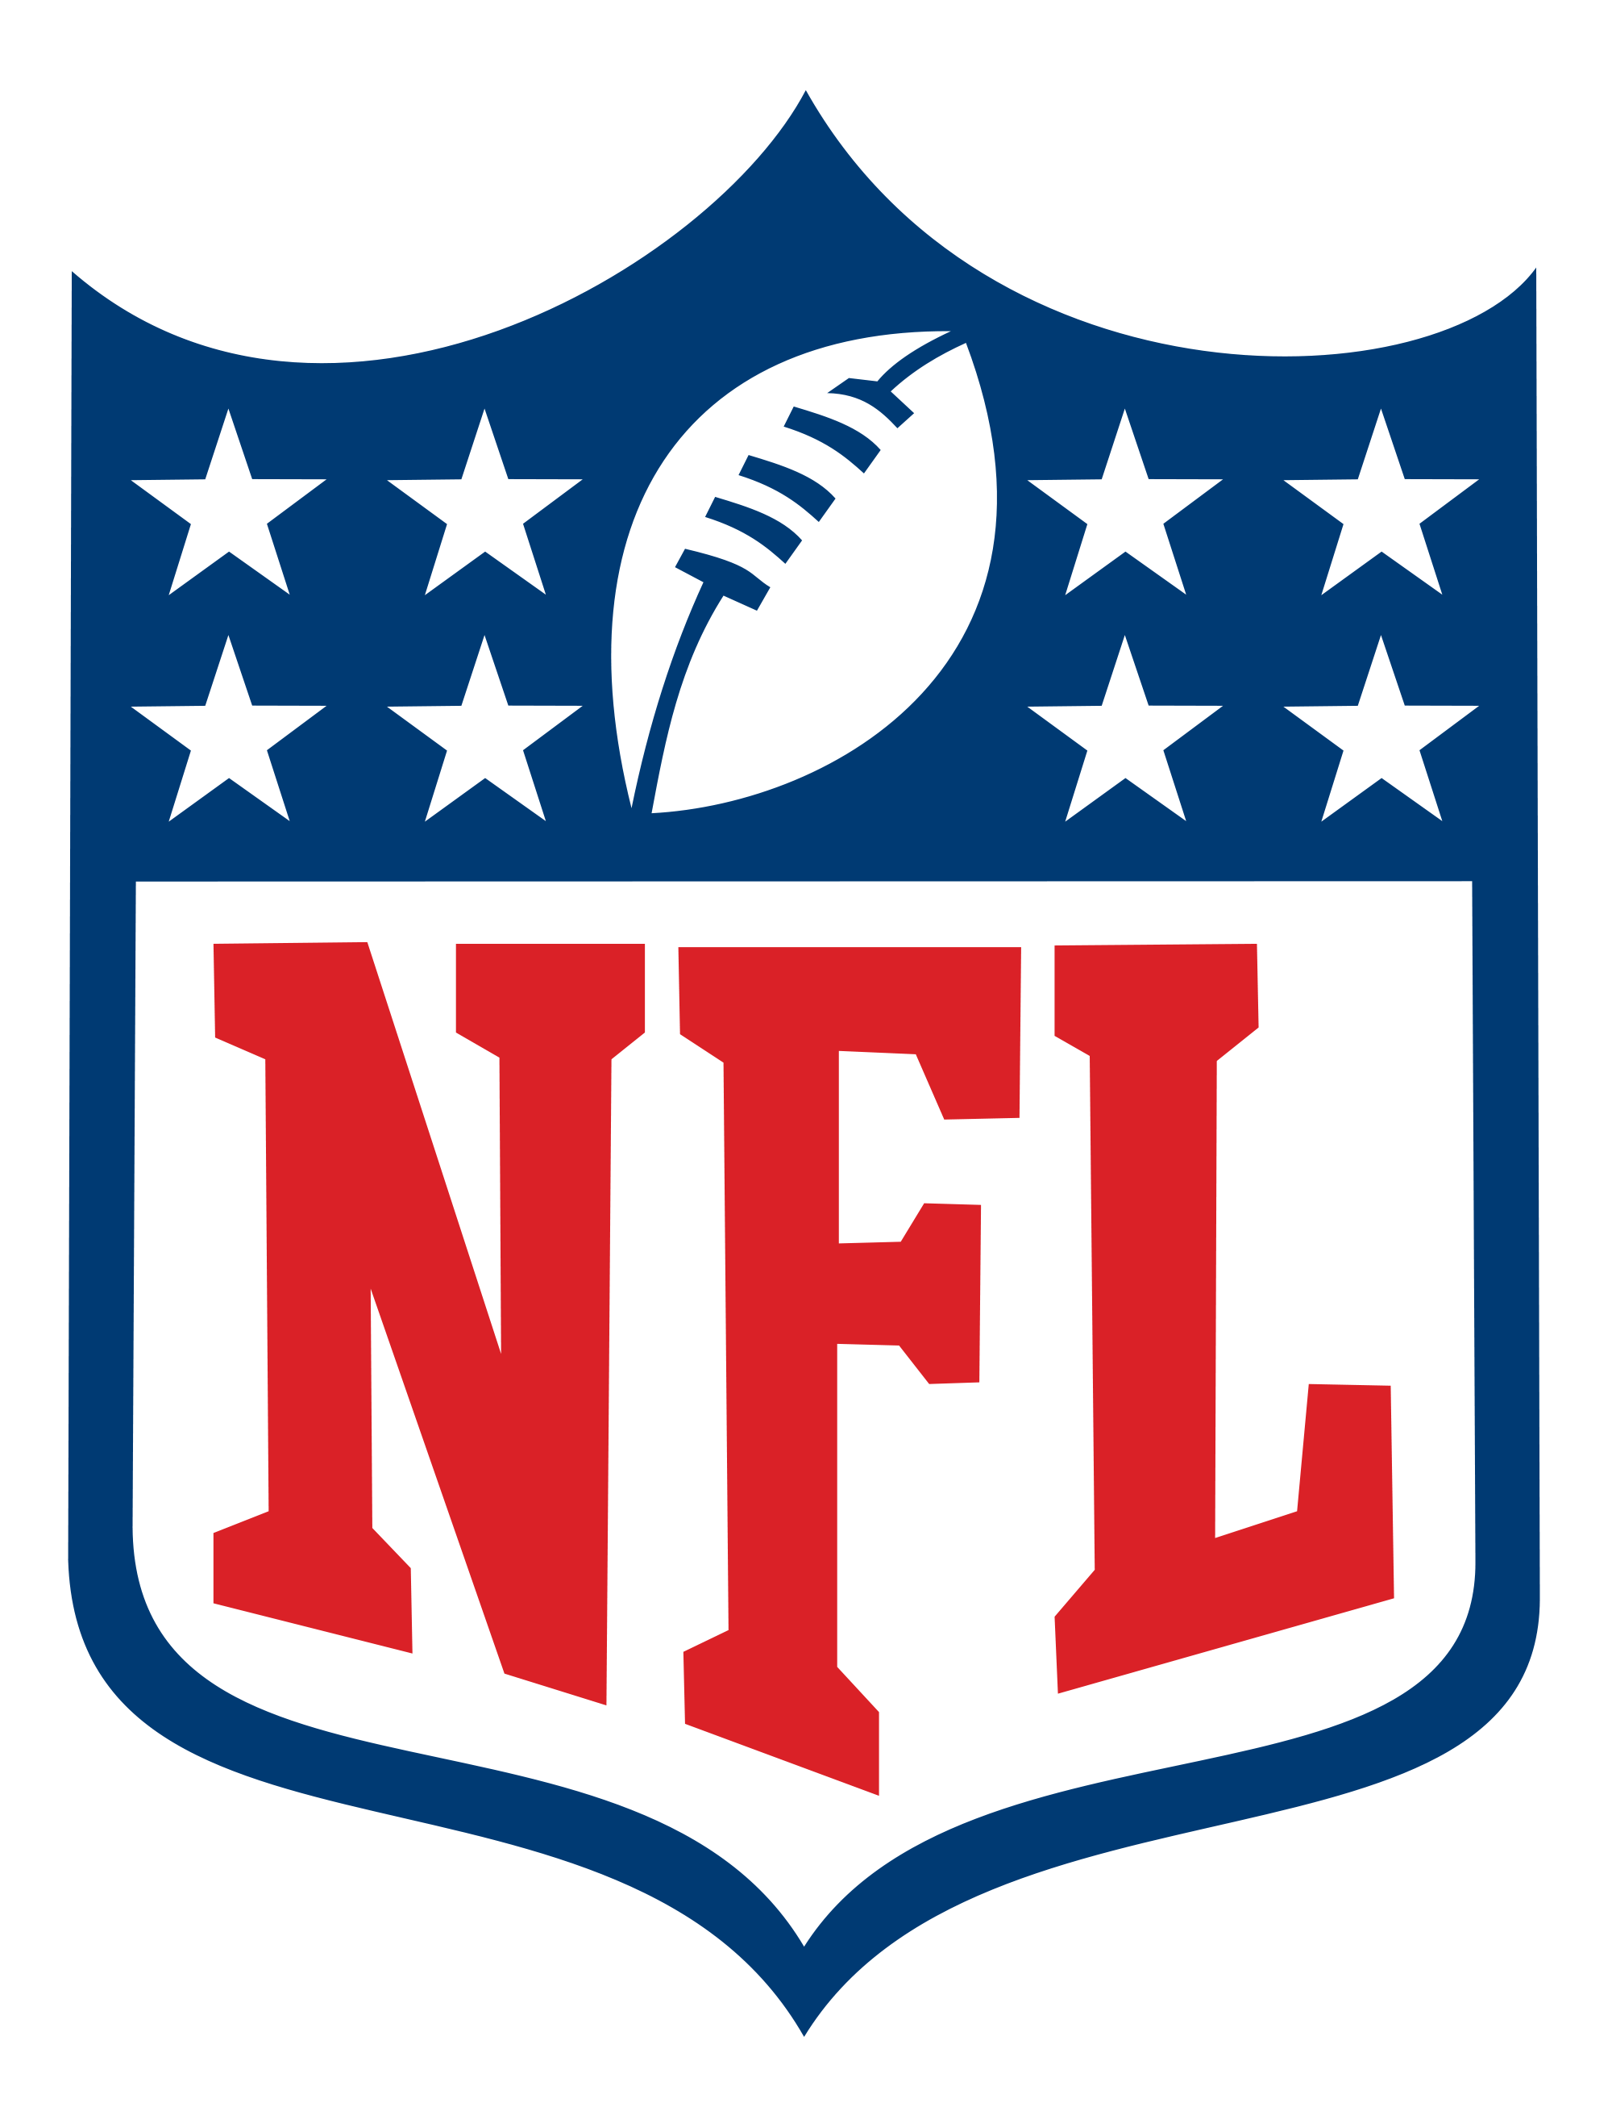
180
Super Bowl LIV will be broadcast in 180 different countries around the world and in 25 different languages

Slide 26
1.5 million
On average, 1.5 million people call in sick to work the day after the Super Bowl. Two years ago, in a creative marketing stunt, Heinz (makers of the popular ketchup brand) created a petition to convert the Monday following last year’s Super Bowl to a National Holiday.

Slide 28
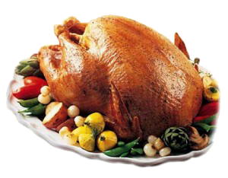
2
The Super Bowl is the second highest day of food consumption in the United States next to the Thanksgiving holiday

Slide 29
62%
Super Bowl Sunday is the most popular grilling day of winter with 62% of BBQ owners firing up their grills for the Big Game!

Slide 30
#1
Vegetables at a Super Bowl party? That's right! In fact, the healthy treat is the top food eaten in homes during Super Bowl. However, various forms of dips are also a favorite among Super Bowl snackers with 32% saying they plan on eating some form of the snack.

Slide 31
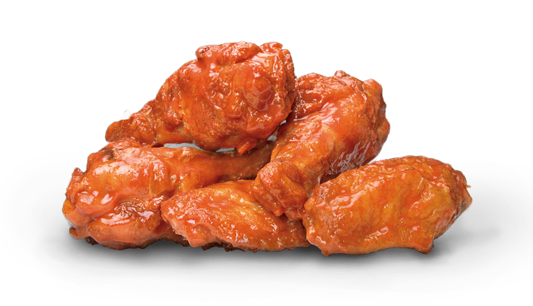
1.42 billion
The National Chicken Council predicts Americans will eat 1.42 billion chicken wings during Super Bowl LV weekend, which would set a new record.

Slide 32
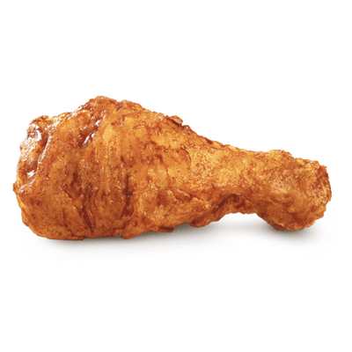
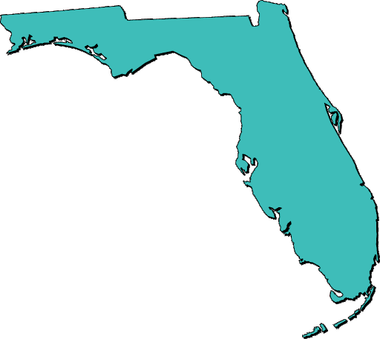
9
If that many wings were laid end to end, they would stretch the entire Florida coastline more than nine times

Slide 33
30%
The Super Bowl is one of the biggest day of the year for pizza sales. According to Domino’s website, the popular chain typically sells around 2 million pizzas on Super Bowl Sunday – about 30% more than on a normal Sunday.

Slide 34
12.5 million
The American Pizza Community (a pizza industry news organization) predicts Super Bowl sales this year will exceed the estimated 12.5 million pizzas sold during last year’s Big Game.

Slide 35
17
In a non-pandemic year, the number of people, on average, at a typical Super Bowl party is 17.

Slide 36
28%
This year, just 28 percent of respondents to a National Retail Federation survey said they planned to throw or attend a party or watch the game at a bar this year, by far the lowest in the survey’s history.

Slide 37
$74.55
American adults plan to spend an average of $74.55 per person and a total of $13.9 billion nationwide as they watch Super Bowl LV, according to the National Retail Federation

Slide 38
$700,000
The average cost of a 30 second commercial during a national TV broadcast of a NFL game during the regular season is $700,000

Slide 39
$5.5 million
CBS’s asking price for a 30 second Super Bowl spot this year is reportedly around $5.5 million. For comparison, the average price of a 30-second ad during Game 7 of the 2016 World Series was just over $500,000. The price for a similar spot during last year’s Oscars cost about $2.2 million.

Slide 40
78%
78% of fans would rather watch the Super Bowl with commercials. 70% will pay attention to ads before the game and 45% will seek out ads before kickoff (A 350% increase since 2010).

Slide 41
$450 million
According to an analysis conducted by Kantar, the 2020 Super Bowl generated a record-breaking $448.7 million in ad revenue in under four hours of game time. This represented an increase of 33% over the Super Bowl in 2019 and exceeded the previous in-game record of $430 million seen in 2017 when an overtime period led to extra commercial airings.

Slide 42
52%
Post-game, viewers are as likely to talk about Super Bowl ads as they are plays. More than half (52%) will re-watch ads after the game.

Slide 43
$572 million
According to a study conducted by the Miami Super Bowl Host Committee, last year’s Big Game Super delivered a $572 million economic boost for the South Florida region, including more than 368,000 visitor night stays.

Slide 44
23
23 different stadiums have played host to the Super Bowl over the years. Miami has been the site of the Big Game 11 different times, more than any other city.

Slide 45
$50,000
The Vince Lombardi Trophy, awarded to the Super Bowl winner, costs $50,000 to and its iconic design is featured in the Super Bowl logo. Tiffany’s has been producing the trophy since the first Super Bowl way back in 1967.

Slide 46
Discussion Questions, Fun Facts & Trivia

Slide 47
Trivia Question
Only three state capital cities have played host to a Super Bowl.
Who are they?

Slide 48
Trivia Answer
Indianapolis, Atlanta and Minneapolis-St. Paul (last year) are the only U.S. capital cities to host a NFL Super Bowl

Slide 49
Trivia Question
Why does each Super Bowl contain a unique set of roman numerals in the game’s name?

Slide 50
Trivia Answer
The Super Bowl is measured in Roman numerals because a football season runs over two calendar years

Slide 51
Trivia Question
Only four NFL teams have NEVER played in a Super Bowl.
Who are they?

Slide 52
Trivia Answer
The Detroit Lions, Cleveland Browns, Jacksonville Jaguars and Houston Texans have never appeared in the Super Bowl.

Slide 53
Fun Facts!
According to msn.com, today’s Super Bowl rings cost an estimated $6,000 to make on average (and are worth far more on the open market as collectors' items).
Compare that to the average NFL salary in 1958 which was $10,000.

Slide 54
Show of Hands:
* How many plan to watch the game?
* How many will watch on a mobile device?
* How many will watch with friends?
* How many will attend a party or gathering?
* How many will buy food or snacks?

Slide 55
Questions for Class Discussion
Why does the NFL bring in “big name” performers (like The Weeknd) for the Super Bowl halftime show?
Can you name five other performers who have played the halftime show in the past?

Slide 56
Questions for Class Discussion
What are naming rights? Why do companies invest in naming rights?
Who owns the naming rights to the stadium playing host to this year’s Super Bowl? What type of business is it?

Slide 57
Questions for Class Discussion
How do you think hosting the Super Bowl in a stadium bearing the name “Raymond James Stadium” might benefit the company and their brand?
What are the different ways stadium projects are usually financed? Who paid for Raymond James Stadium?

Slide 58
Questions for Class Discussion
Hosting a mega-event like the Super Bowl is a massive undertaking for a host city like Tampa. Create a list of factors the city must consider when planning an event like this to insure a successful event (security, staffing, lodging, safety etc). Why might volunteers be important to the event?

Slide 59
Questions for Class Discussion
Based on the figures you saw in this PowerPoint, the Super Bowl is obviously big business. What types of companies stand to gain the most during the Super Bowl from a sales perspective?

Slide 60
Questions for Class Discussion
What is supply and demand?
How do you think supply and demand impacts the ticket prices for the Super Bowl?
Why do you think this year’s Super Bowl tickets are setting record high prices?

Slide 61
Questions for Class Discussion
What are ratings? Why is viewership an important figure to consider?
Who are those numbers important to?
What are broadcast rights?

Slide 62
Questions for Class Discussion
Why do you think CBS is charging so much for a 30 second advertisement during the game?
Why would a company spend that much (in some cases purchasing more than one ad slot)?

Slide 63
Questions for Class Discussion
The concept of “ambush marketing” was not addressed in the previous slides.
What is ambush marketing and why is it relevant when it comes to discussing the business of the Super Bowl?

Slide 64
Questions for Class Discussion
What is economic impact?
How do you think the Super Bowl can impact the economy of the event’s host city? How might this year be different than most from an economic impact perspective?

Slide 65
Questions for Class Discussion
Do you think Super Bowl advertisers invest only in the cost of the advertisement during the game or do they spend more money on tying other promotions to the Big Game as well? Can you think of an examples?

Slide 66
Questions for Class Discussion
Who do you think will win Super Bowl LIV???

