Slide 1
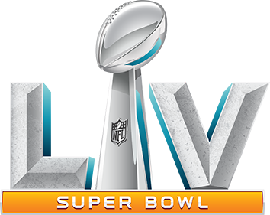
Super Bowl Ad Trivia
Brand Identification, 2021 Super Bowl Ads

Slide 2
QUESTIONS

Slide 3
Commercial #1

Slide 4
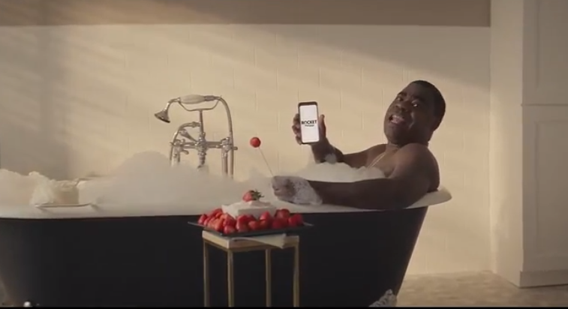
One company placed first and second in USA TODAY's Ad Meter with spots featuring comedian Tracy Morgan, who used humorous situations to illustrate the distinction between "pretty sure" and "certain."
What company was it?

Slide 5
Commercial #2

Slide 6
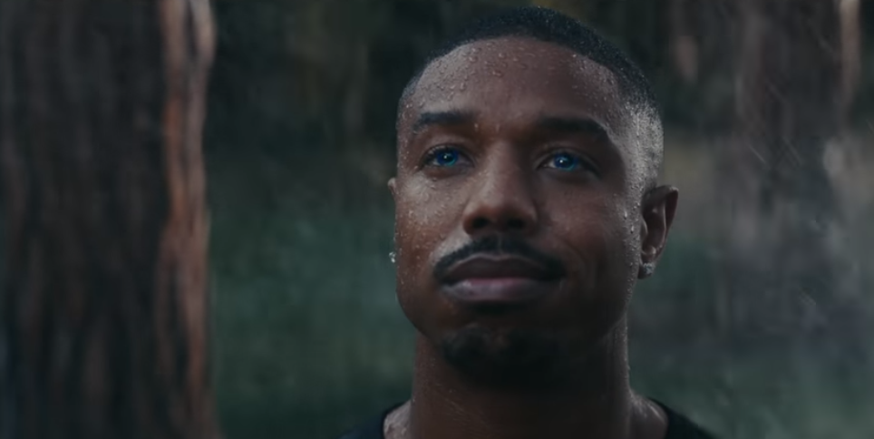
Actor Michael B. Jordan appeared in a Super Bowl commercial this year in a rather “seductive” role…
What was the company?

Slide 7
Commercial #3

Slide 8
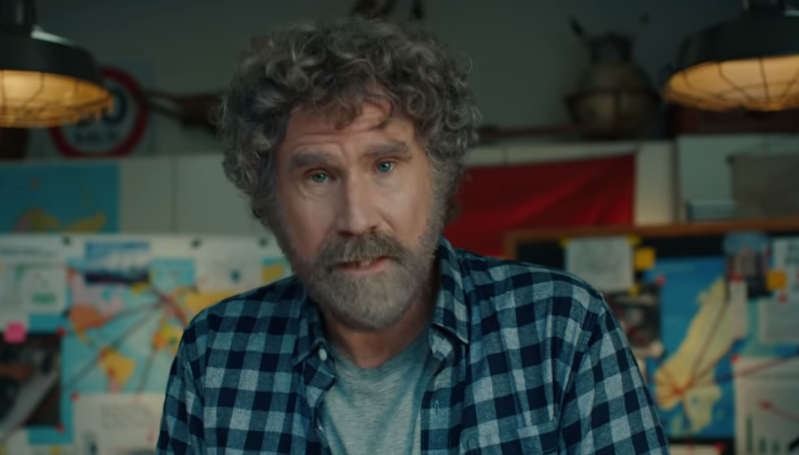
One advertiser chose actor Will Ferrell to be the face of this year’s Super Bowl commercial…
What was being advertised?

Slide 9
Commercial #4

Slide 10
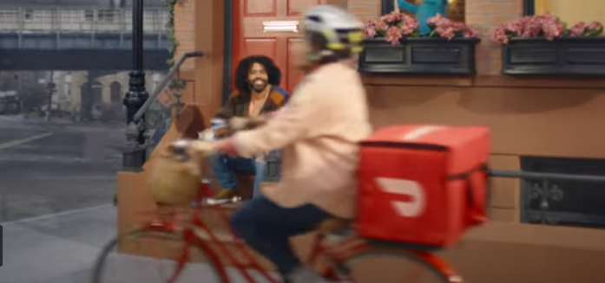
DoorDash advertised during the Super Bowl for the first time this year
Who was featured in the brand’s minute-long spot?

Slide 11
Commercial #5

Slide 12
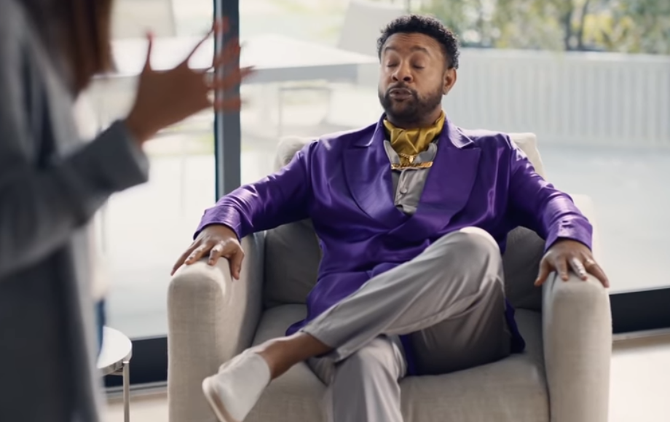
One brand licensed the song “It Wasn’t Me” by Shaggy for their Super Bowl commercial…
What was the brand and what famous Hollywood couple was featured in the ad?

Slide 13
Commercial #6

Slide 14
Jeep introduced the longest commercial in this year’s Super Bowl, clocking in at over 2 minutes.
What was the ad’s theme and who did they choose to narrate the commercial?

Slide 15
Commercial #7

Slide 16
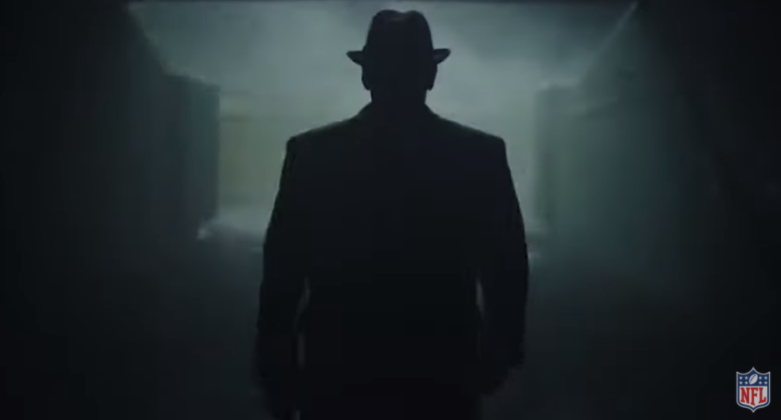
The NFL used augmented reality to create an ad featuring legendary coach Vince Lombardi
The ad featured a slogan that the league has promoted all season. What was it?

Slide 17
Commercial #8

Slide 18
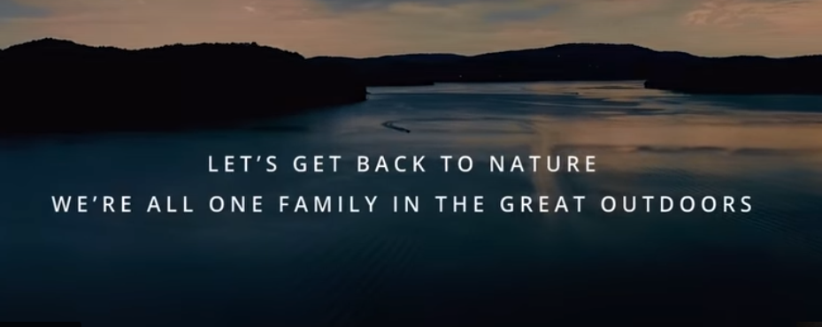
Two competing brands collaborated on pandemic-themed ad and encouraged consumers to get outdoors
Who were the two brands?

Slide 19
Commercial #9

Slide 20
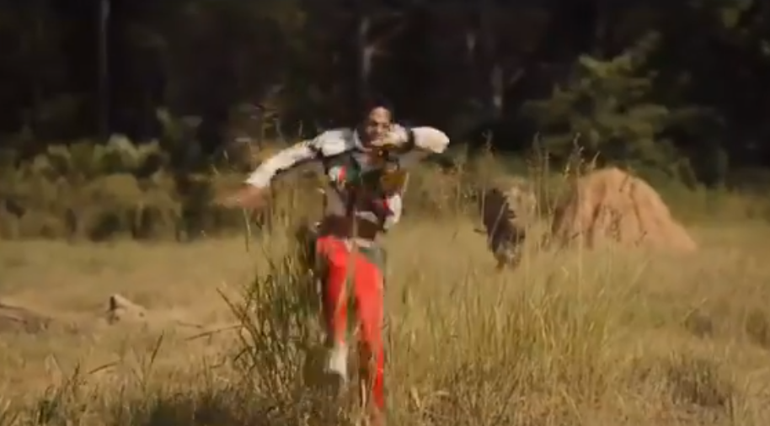
Amazon Prime Video aired a film trailer for an upcoming movie release during the Super Bowl
What movie was it?

Slide 21
Commercial #10

Slide 22
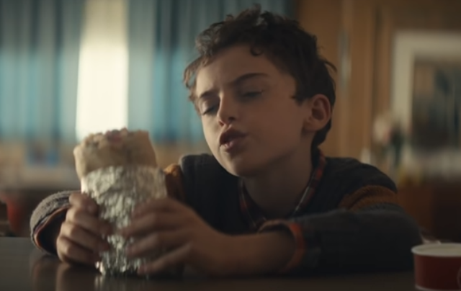
One brand focused on a sustainability theme with their first ever Super Bowl commercial, asking if a burrito could change the world.
What was the brand?

Slide 23
ANSWERS

Slide 24
Commercial #1

Slide 25
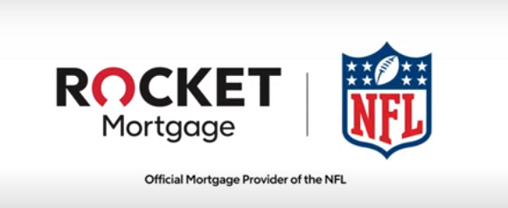
Rocket Mortgage placed first and second in USA TODAY's Ad Meter with spots featuring comedian Tracy Morgan, who used humorous situations to illustrate the distinction between "pretty sure" and "certain." This marked the first time since 2007 that one brand took the top-two spots in the USA TODAY Ad Meter ratings, an achievement that first occurred way back in 1995 when Pepsi had two commercials that ranked 1 & 2.

Slide 26
Commercial #2

Slide 27
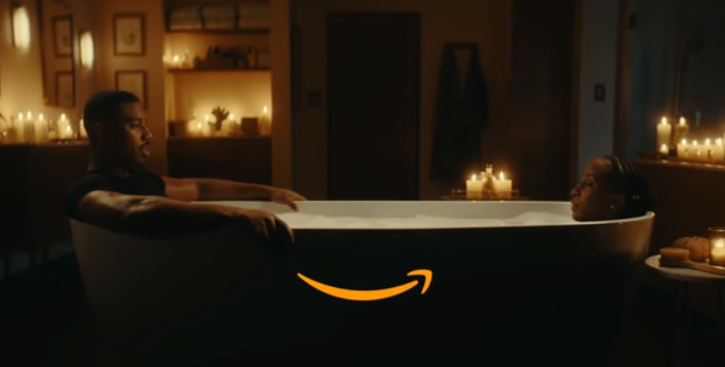
Actor Michael B. Jordan appeared in a Super Bowl commercial this year in a rather “seductive” role…
The Amazon Alexa ad ranked third this year in USA Today’s Ad Meter.

Slide 28
Commercial #3

Slide 29
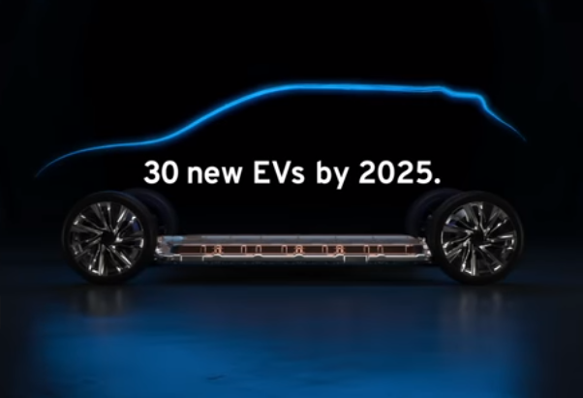
One advertiser chose actor Will Ferrell to be the face of this year’s Super Bowl commercial…
General Motors touted its investment in electric vehicles in this year’s Super Bowl spot. It ranked 6th in the USA Today Ad Meter.

Slide 30
Commercial #4

Slide 31
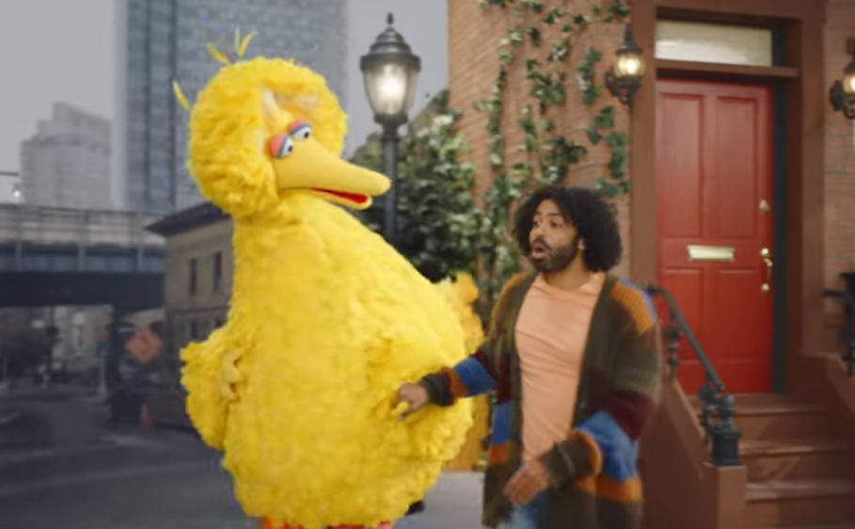
DoorDash advertised during the Super Bowl for the first time this year
The ad featured Daveed Diggs and popular Sesame Street characters like Big Bird, Cookie Monster & Oscar the Grouch

Slide 32
Commercial #5

Slide 33
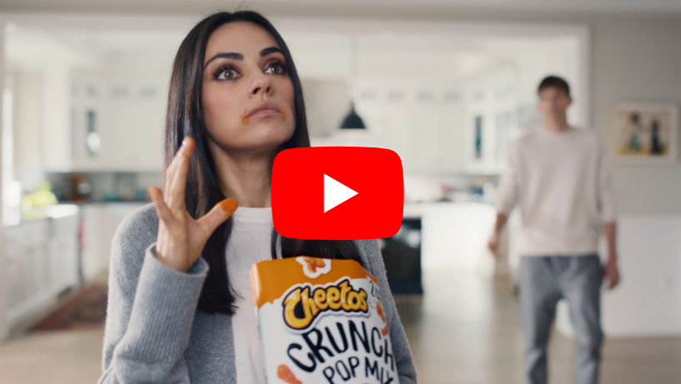
What was the brand and what famous Hollywood couple was featured an ad that used Shaggy’s famous “It Wasn’t Me” song?
Mila Kunis and Ashton Kutcher starred in Cheetos’ “It Wasn’t Me” themed Super Bowl LV spot

Slide 34
Commercial #6

Slide 35
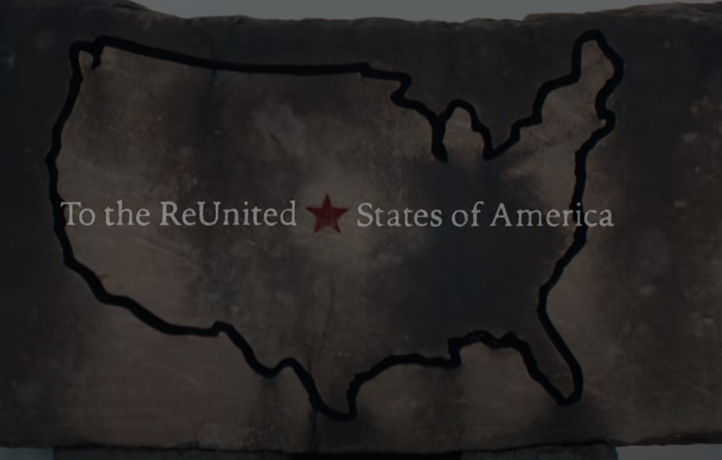
What was the theme of Jeep’s Super Bowl spot and who was the commercial’s narrator?
This year’s Jeep ad featured Bruce Springsteen communicating a message of unity

Slide 36
Commercial #7

Slide 37
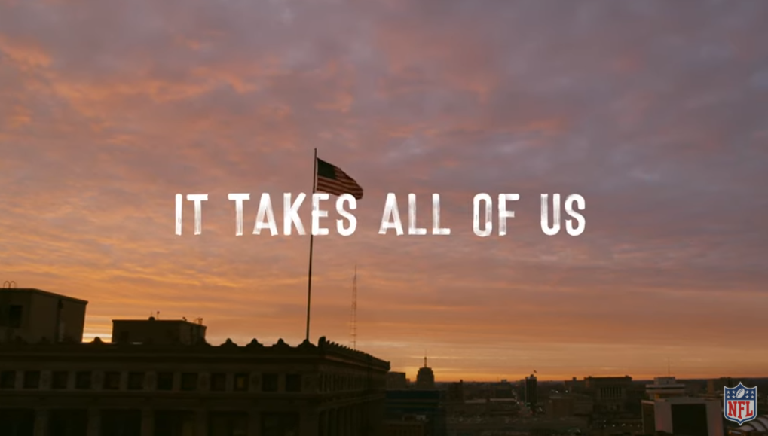
The NFL used augmented reality to create an ad featuring legendary coach Vince Lombardi
The ad featured the “It Takes All Of Us” slogan that the league has promoted all season.

Slide 38
Commercial #8

Slide 39
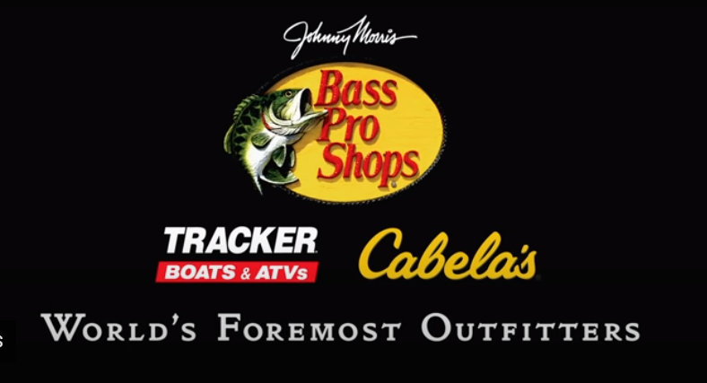
Two competing brands collaborated on pandemic-themed ad and encouraged consumers to get outdoors
Bass Pro Shops & Cabela’s

Slide 40
Commercial #9

Slide 41
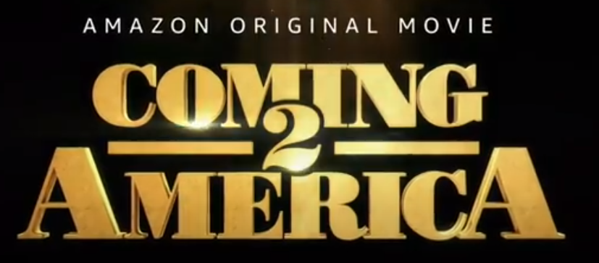
Amazon Prime Video aired a film trailer for an upcoming movie release during the Super Bowl. What was it?
Coming to America 2

Slide 42
Commercial #10

Slide 43
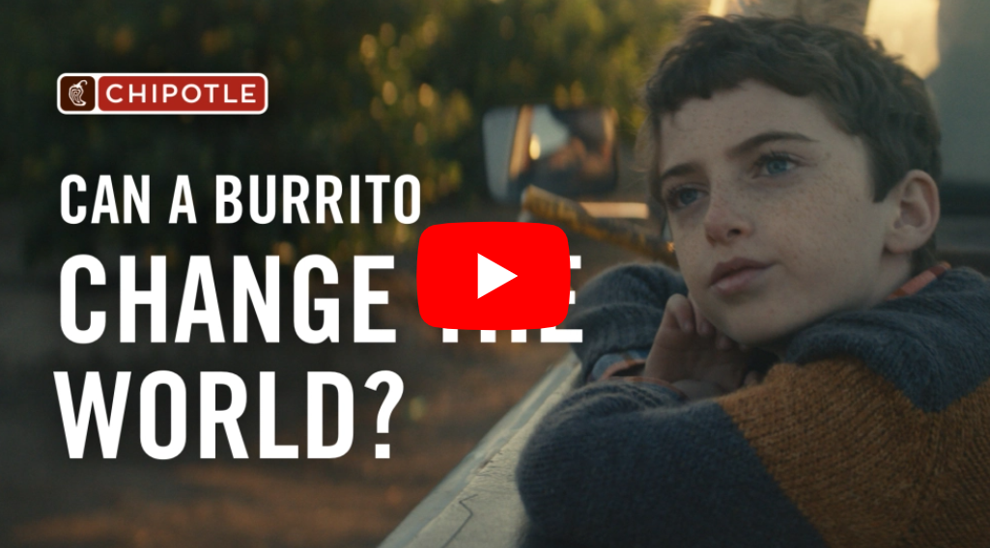
Chipotle’s spot focused on a sustainability theme in their first ever Super Bowl commercial, asking if a burrito could change the world.

Slide 44
Discussion Questions

Slide 45
Discussion Questions
What is advertising recall?
Why is it important to advertisers?
What is ROI as it relates to advertising?
Why is ROI important to advertisers?
Why do you think it is especially important when it comes to advertising during the Super Bowl?

