Slide 1
By the numbers
The Academy Awards

Slide 2
4
The 2021 Academy Awards will mark just the 4th time in history that the show was postponed.

Slide 3
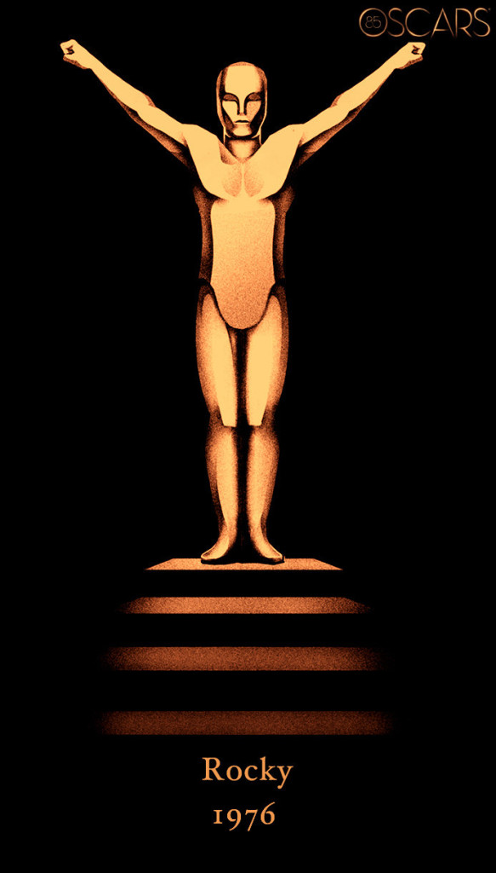
$75 million
ABC has televised every Oscars telecast since 1976, the network has a $75 million-a-year contract with the Motion Pictures Academy to air the awards show through 2028.

Slide 4
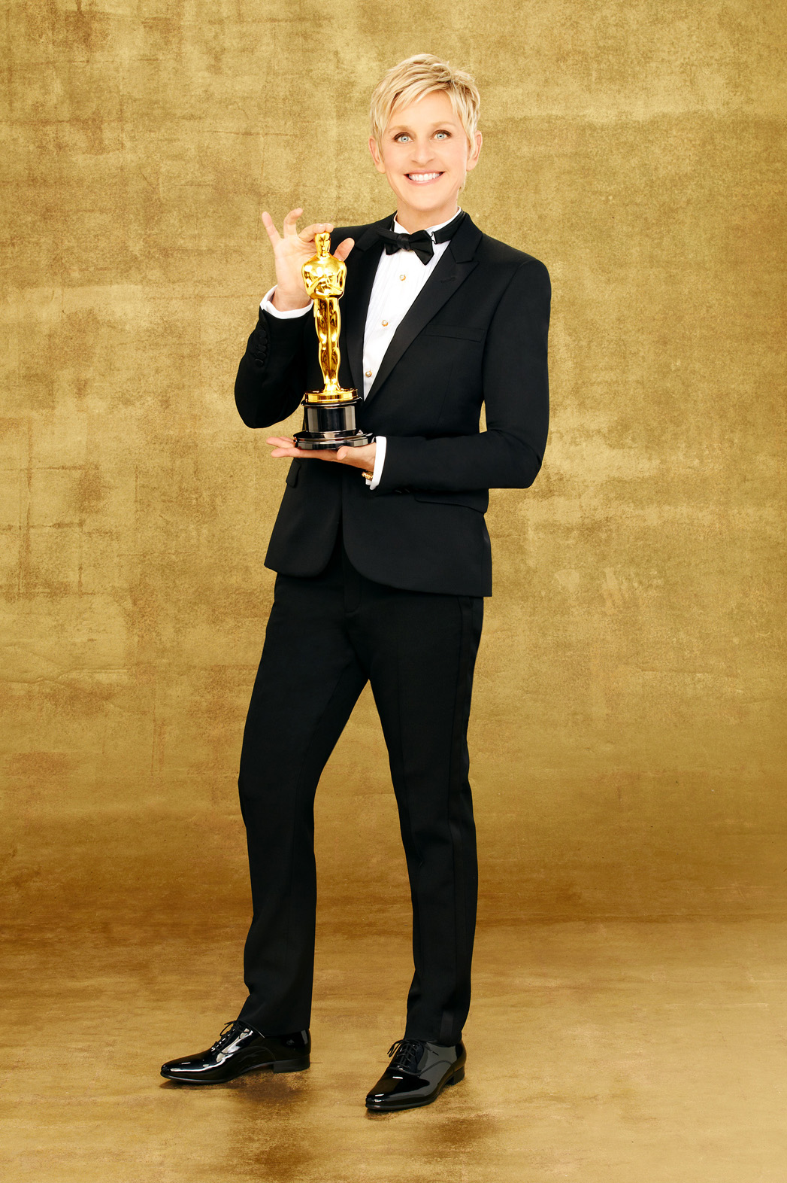
43,000,000
In 2014, 43 million people tuned in to watch the broadcast of the Academy Awards show, hosted by Ellen DeGeneres

Slide 5
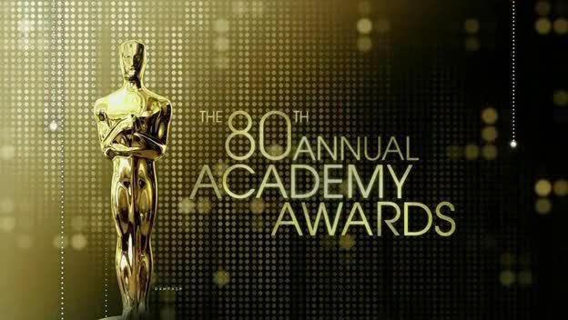
23,600,000
In 2019, the Oscars telecast recorded its lowest rated broadcast all-time when 26.6 million viewers tuned in for the 90th anniversary of the Academy Awards…until last year when just 36.6 million people watched the show (a 20% drop in viewership from the previous year)

Slide 6
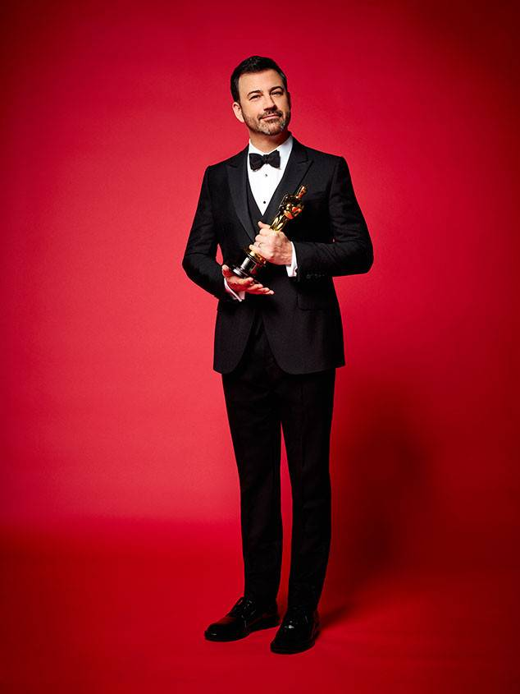
$15,000
Late night host Jimmy Kimmel was the last host of the Oscars. He earned a fee of $15,000 for the job, according to US Magazine.

Slide 7
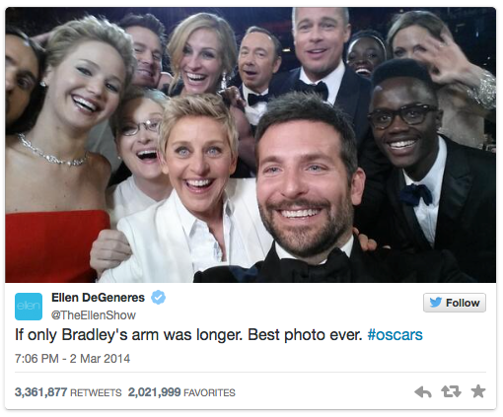
$1 billion
According to a CNBC report, Ellen’s “impromptu” selfie in 2014 (and subsequent tweet) provided a value of between $800 million and $1 billion in exposure for Samsung (the pic was taken on a Samsung Galaxy device and tweeted during the broadcast)

Slide 8
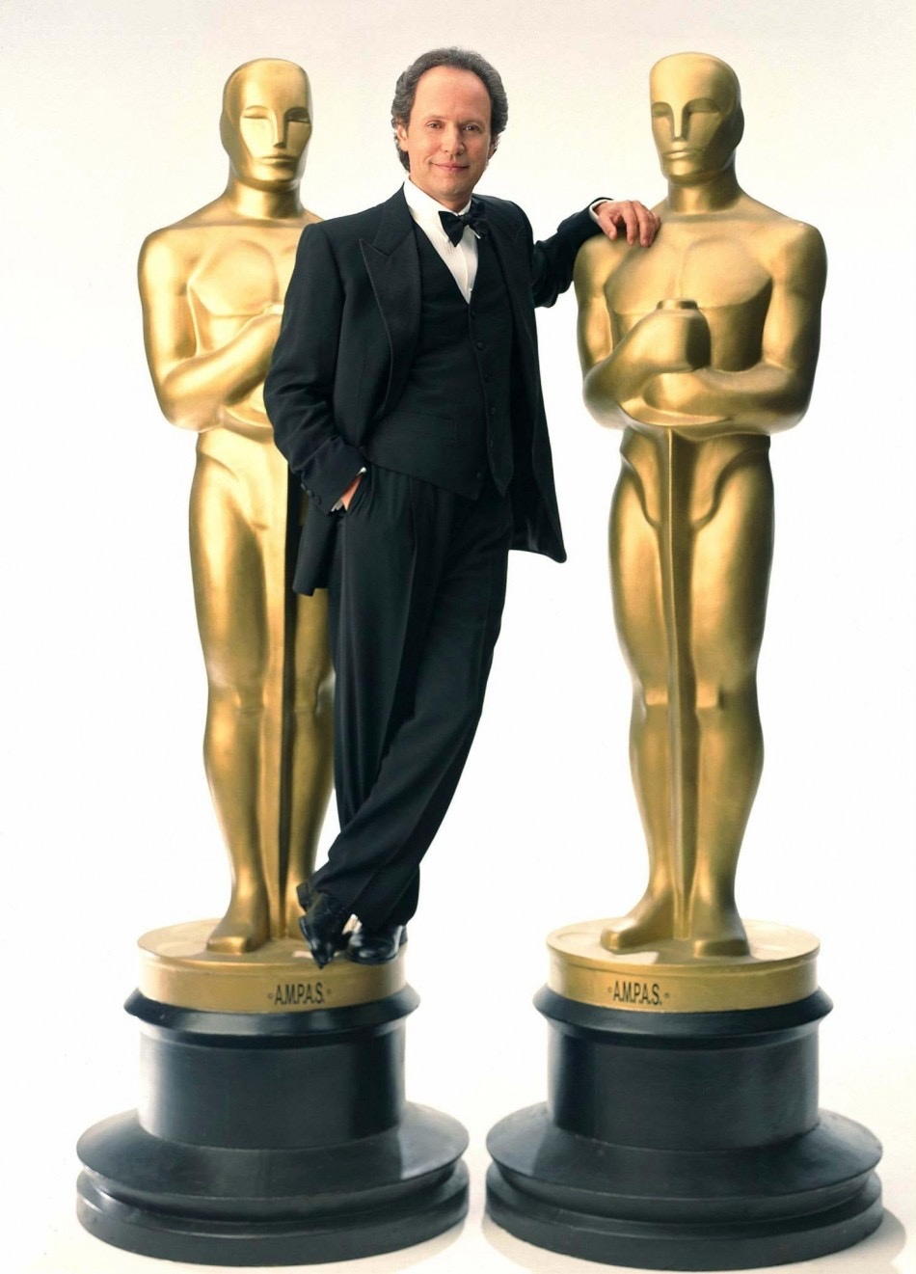
55,000,000
The most watched Oscars telecast was in 1998 which drew 55 million viewers.
That year Titanic won for Best Picture and Billy Crystal was the evening’s host.

Slide 9
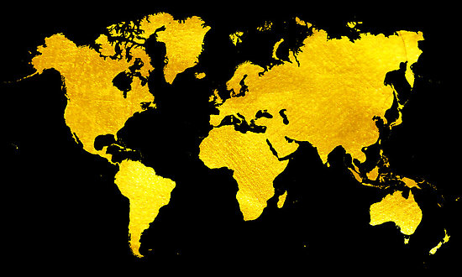
225
It is estimated that viewers will tune in from more than 225 different countries to watch this year's Oscars

Slide 10
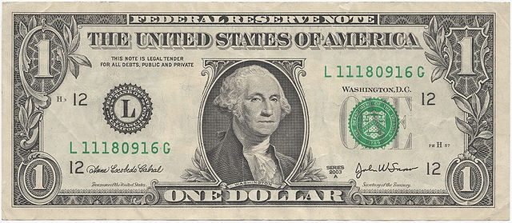
$1.00
Oscar winners are not allowed to sell their statue to anyone other than back to the Academy… And what does the Academy charge to buy the award? One dollar.

Slide 11
$900
The current estimated value of the 24-karat gold-plated Oscar statuette is around $900..

Slide 12
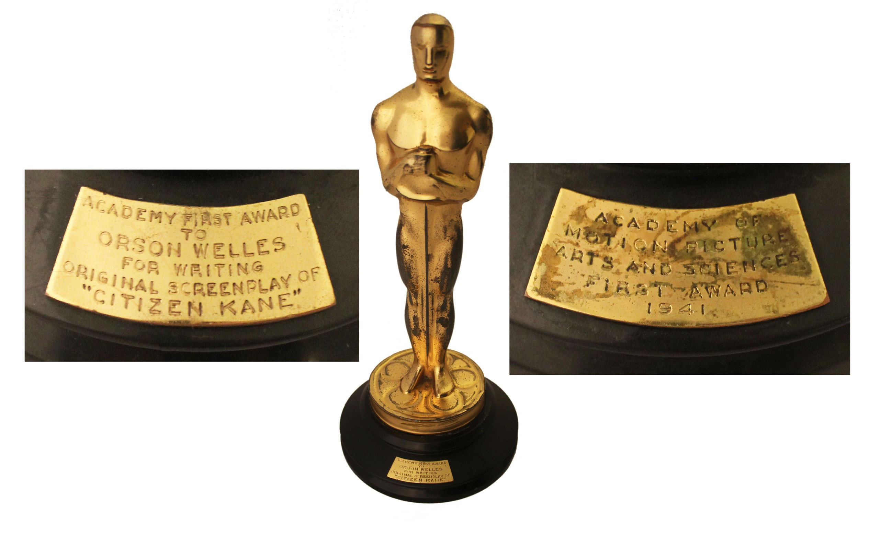
$861,542
In 1941, Orson Welles's won an Oscar for "Citizen Kane" (Best Original Screenplay). His heirs would later sell the statue at an auction for $861,542 after winning a lawsuit granting them permission to sell it.

Slide 13
$60,000
The Oscar nominee “swag” bags given away in 2015 contained a record $232,000 worth of gifts, continuing the trend of overly extravagant gifts for celebrity attendees.
This year, Forbes estimates the giveaways are valued at $60,000, including stays at the Kahari Resort in the Bahamas, Casa del Campo in the Dominican Republic and Raiwasa Resort in Fiji. Also included is a PETA hammer for breaking into cars (to save overheated dogs of course).

Slide 14
$129 million
According to Forbes, ABC will earn an estimated $129 million in ad revenue for airing the Oscars this Sunday, including spots that will air during the show and throughout its red carpet coverage.

Slide 15
$2 million
According to Variety, ABC is charging roughly $2 million per 30-second advertising spot in its April 25th broadcast of the 93rd annual Academy Awards. That’s down from the $2.8 million they reportedly charged in 2018.

Slide 16
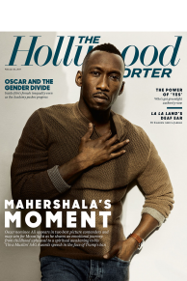
$72,000
Advertising isn’t limited to television. The cost for a one-page ad in the Hollywood Reporter during Oscar season comes in at $72,000.

Slide 17
$9 million
On average, a film will see a $9 million average increase in box office sales for winning an Oscar for Best Picture

Slide 18
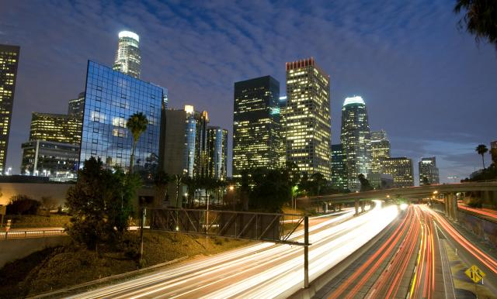
$40 million
The total cost of production for the 2021 Oscars? A whopping $40 million.

Slide 19
32%
This year, 32% of the Oscar nominees are women, the highest percentage in the history of the Academy Awards

Slide 20
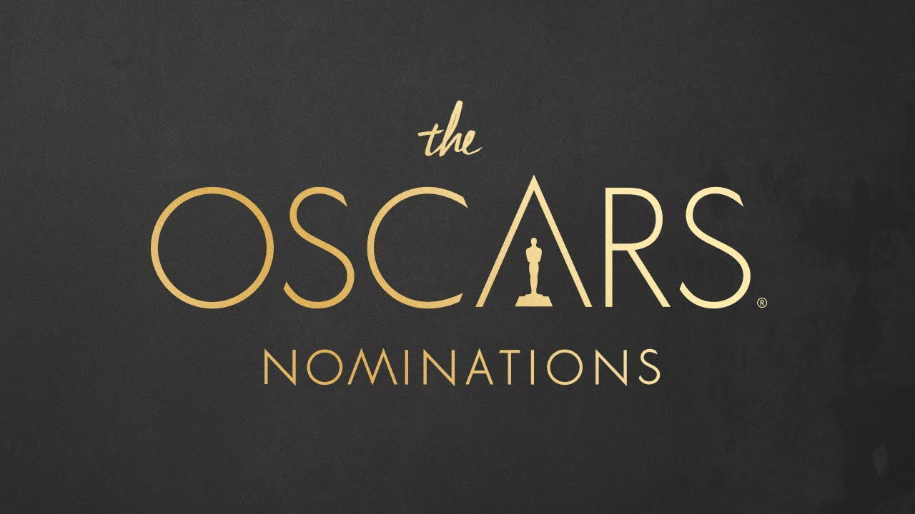
$10-20 million
According to Variety, Oscar campaign budgets for films seeking nominations in multiple categories can run from $10 to $20 million

Slide 21
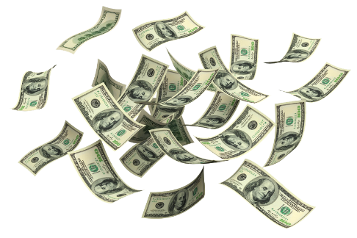
$130 million
According to reports, the greater Los Angeles area’s economy receives a $130 million boost annually from hosting the Academy Awards

Slide 22
questions for class
discussion
The Academy Awards

Slide 23
1) Why do advertisers spend so much advertising during the academy awards
2) Why do you think the academy refuses to allow winners to sell their statue?
3) How do you think social media influences the way marketers approach award shows like the oscars?
discussion questions

Slide 24
4) What kind of economic impact can winning an academy award have on a particular film?
5) What kind of economic impact can winning an academy award have on the career for individual winners (producers, directors, screenwriters, actors, actresses etc.)?
6) how do you think the idea of viewers throwing oscars parties might influence marketers of particular brands?
discussion questions

Slide 25
7) How do major events like the Oscars impact the economy of the host city (los angeles in the case of the academy awards)? 8) do you think brands will approach advertising during the 2021 academy awards in the same way they might have in 2019? Why or why not?
discussion questions

