Slide 1
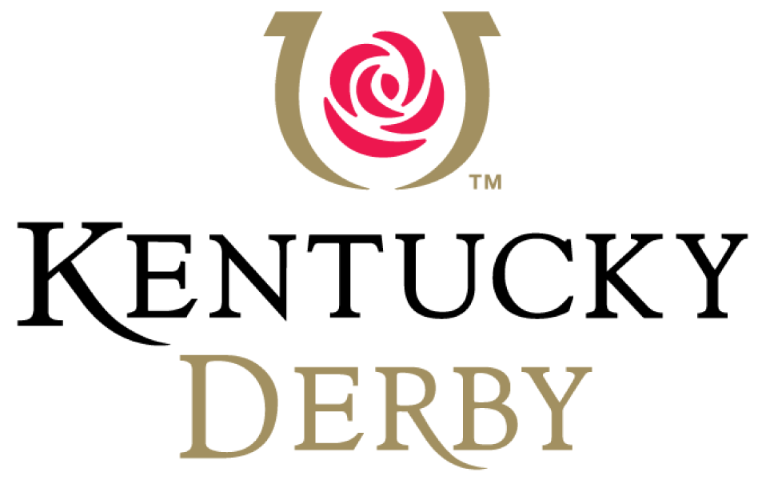
Fun Facts
20
21

Slide 2
Fun Facts: 2021 Kentucky Derby
147
* The event has been held every consecutive year since 1875, including last year despite the ongoing pandemic, with this year’s race marking the 147th running of the Kentucky Derby

Slide 3
Fun Facts: 2021 Kentucky Derby
2:00
* The event lasts just two minutes, hence the reason the Kentucky Derby is known as the “Greatest 2 Minutes in Sports”

Slide 4
Fun Facts: 2021 Kentucky Derby
564
* The Derby is also called the"The Run for the Roses," because a lush blanket of 564 red roses is awarded to the Kentucky Derby winner each year

Slide 5
Fun Facts: 2021 Kentucky Derby
$3 million
* The total prize purse for the 2021 race is a guaranteed $3 million (up from $2 million from the 2018 race)
* Compare that to 1954 when the purse was $100,000!

Slide 6
Fun Facts: 2021 Kentucky Derby
$1.86 million
* Of the $3 million total Kentucky Derby prize purse, $1.86 million will go to the winner

Slide 7
Fun Facts: 2021 Kentucky Derby
$200,000
* The winner of the race will receive a gold trophy that carries an estimated value of nearly $200,000 (nearly double the value of the entire prize purse from 1954)

Slide 8
Fun Facts: 2021 Kentucky Derby
$4 billion
* Horse racing generates an estimated $4 billion annually for the state of Kentucky while creating nearly 60,000 jobs
* According to Reuters, the most recent economic impact study commissioned shows the Kentucky Derby has a $400 million economic impact on the Louisville region

Slide 9
Fun Facts: 2021 Kentucky Derby
Burgoo?
* One of the most popular culinary items at the event?
Burgoo, a thick stew of beef, chicken, pork and vegetables, which is a popular dish in the state of Kentucky…

Slide 10
Fun Facts: 2021 Kentucky Derby
$500-$1,000
* One of the most historic traditions in all of sports is the attire of Kentucky Derby spectators who wear elaborate hats to the event
* One designer says she sells custom hats that typically fetch between $500 and $1,000

Slide 11
Fun Facts: 2021 Kentucky Derby
30,000
* In 1875, the inaugural race drew 10,000 spectators
* The attendance record of 170,513 was set in 2015
* This year, just 30,000 Derby fans will be in attendance due to COVID-19

Slide 12
Fun Facts: 2021 Kentucky Derby
61,000
* On Derby Day, the number of people inside the track at Churchill Downs is nearly double the entire population of Kentucky’s third largest city (Bowling Green has 61,000 residents)

Slide 13
Fun Facts: 2021 Kentucky Derby
$122 million
* An estimated $122 million in ticket revenue was lost during Derby Week in 2020 due to COVID-19

Slide 14
Fun Facts: 2021 Kentucky Derby
142,000
* According to a press release, Kentucky Derby fans typically scarf down approximately 142,000 hot dogs at Churchill Downs on race day
* Churchill Downs chefs will go through 1,100 gallons of salad dressing and 9,400 sticks of butter during Derby Day

Slide 15
Fun Facts: 2021 Kentucky Derby
Yum!
* In 2006, the Louisville-based fast-food company Yum! Brands, Inc. announced a corporate sponsorship deal to call the race "The Kentucky Derby presented by Yum! Brands"

Slide 16
Fun Facts: 2021 Kentucky Derby
2004
* The 2004 Derby marked the first time that jockeys, as a result of a court order, were allowed to wear corporate advertising logos on their clothing

Slide 17
Fun Facts: 2021 Kentucky Derby
15.5 hours
* In 2014, NBC signed a 10-year extension with Churchill Downs on the broadcast rights to the Kentucky Derby through 2025
* In 2018, NBC broadcast a record 15.5 hours of Kentucky Derby coverage

Slide 18
Fun Facts: 2021 Kentucky Derby
107
* According to Forbes, Kentucky is the birth state of the most winners of horse racing’s most prestigious race with 107 winners hailing from the Kentucky Derby’s namesake state

Slide 19
Fun Facts: 2021 Kentucky Derby
$126 million
* Last year, $126 million was wagered on the Kentucky Derby, down 50% from the previous year

Slide 20
Fun Facts: 2021 Kentucky Derby
1 million
* The LED screen installed at Churchill Downs in 2018 is larger than three NBA courts and weighs more than 1 million pounds.
* Cnet.com says “The images are so clear they almost look three-dimensional”

Slide 21
Fun Facts: 2021 Kentucky Derby
Sponsorship
* The Wall Street Journal reports that the Kentucky “sponsorship revenue has ‘increased significantly since 2010” in large part because of the event’s mass appeal that attracts a wide range of sponsors

Slide 22
Fun Facts: 2021 Kentucky Derby
16
* There are 16 “official” sponsors of the Kentucky Derby (up from 14 in 2019), including Ford, Coca Cola, LaCroix and a variety of alcohol brands

Slide 23
Fun Facts: 2021 Kentucky Derby
9.8 million
* Why the interest from sponsors and advertisers?
* In addition to drawing one of the largest crowds annually for a live sporting event, the Kentucky Derby brings in a massive television audience. However, last year’s race was watched by 9.8 million viewers on NBC during the pandemic, a massive 49% drop from the previous year’s telecast.

Slide 24
Fun Facts: 2021 Kentucky Derby
52%
* Of the viewers from the 2018 race, 52% were women

Slide 25
Discussion

Slide 26
1
Have you ever watched the Kentucky Derby?
2
What is a presenting sponsor? Who is this year’s presenting
sponsor and why would they invest in those rights?
3
Do you think traditions add any value to sporting events for
spectators? Why or why not?

Slide 27
4
What is economic impact? How does this event impact the
economy in the Louisville, KY area?
5
Why do you think NBC chose to extend their deal for
broadcast rights to an event that features just two
minutes of action?
6
What type of consumer might sponsors be targeting by
connecting their brands to the Kentucky Derby?

