Slide 1
Tokyo 2020
by the numbers
The Business of Sports & Entertainment
www.sportscareerconsulting.com

Slide 2
WHAT WILL WE LEARN IN A SPORTS AND ENTERTAINMENT MARKETING CLASS?
www.sportscareerconsulting.com

Slide 3
LET'S LOOK AT THE SUMMER OLYMPICS TO ILLUSTRATE SOME OF THE TOPICS WE WILL EXPLORE IN CLASS...
www.sportscareerconsulting.com

Slide 4
THE BUSINESS OF SPORTS & ENTERTAINMENT
SPORTS
ENTERTAINMENT
BUSINESS
ECONOMICS
GLOBAL CONSUMERS
FANDOM
PRODUCTS
TICKETS
SALES
PRICING
MARKETING
MANAGEMENT
CAREERS
SOCIAL ISSUES
ATHLETES
ENTERTAINERS
VIEWERSHIP
STADIUMS
BALLPARKS
ARENAS
CONCERTS
SOCIAL MEDIA
STREAMING
SPONSORSHIP
BRANDING
LICENSING
MERCHANDISE
EVENTS
PUBLICITY
PR
SUSTAINABILITY
www.sportscareerconsulting.com

Slide 5
TOKYO 2020

Slide 6
11,000
More than 11,000 athletes will compete in the Tokyo Games
2
This is the second time Tokyo has hosted the Olympic Games (the first was in 1964)
www.sportscareerconsulting.com

Slide 7
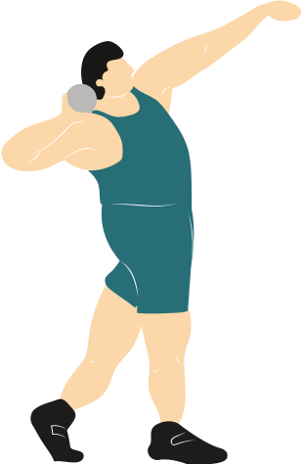
1
The Summer Games are taking place one year later than originally planned as the result of the COVID-19 pandemic (although the branding remains "Tokyo 2020")
205
Athletes representing 205 different countries will be competing, demonstrating the global nature of sports and entertainment
www.sportscareerconsulting.com

Slide 8
4
Four sports – karate, sport climbing, skateboarding and surfing – were included in Olympic competition for the first in history
33
The Tokyo Games featured 33 different sports
www.sportscareerconsulting.com

Slide 9
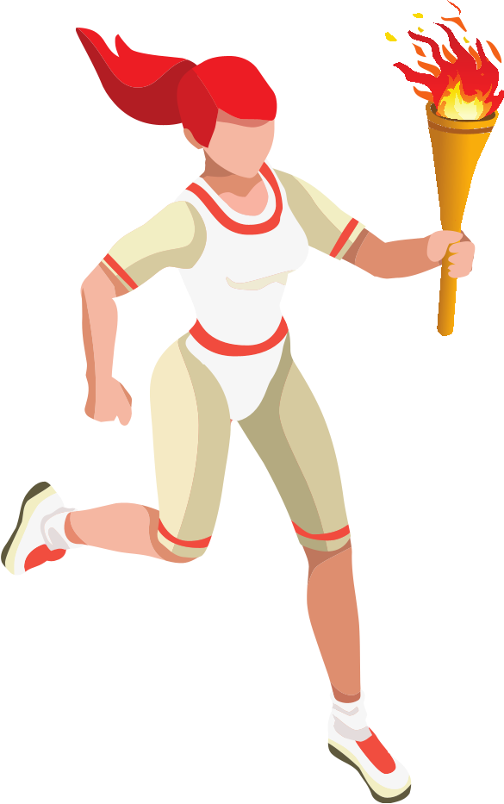
22
When women made their Olympic debut at the Paris Games in 1900, only 22 out of 997 athletes were women, and they competed across five sports. Women did not make up more than 10% of participants until 1952 and weren’t allowed to compete in every sport until 2012. Despite progress, professional women athletes continue to fight for equal footing at the games.

Slide 10
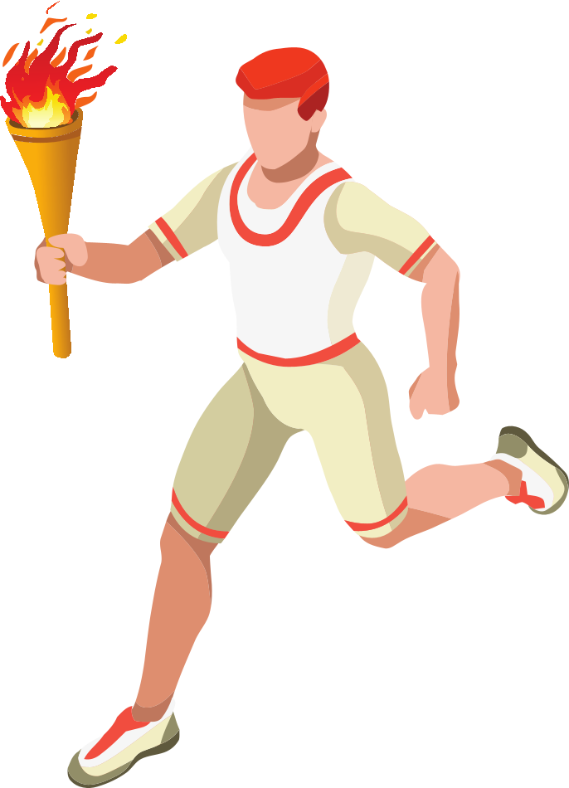
1ST
This represents the most gender-equality the Olympic Games have seen in history...progress, but still work to be done
51%
Of the participating athletes in Tokyo for the 2020 Games, 51% are male and 49% are female
www.sportscareerconsulting.com

Slide 11
329
$1,700
Of the 613 athletes competing for Team USA this summer, 329 are women and 284 are men. The roster marks the third straight Olympic Games with more women on the USA roster.
In a tournament just prior to the Tokyo Games, the Norwegian women’s beach handball team was fined $1,700 by the European Handball Association's Disciplinary Commission for refusing to play in bikini bottoms during a game for “improper clothing”
www.sportscareerconsulting.com

Slide 12
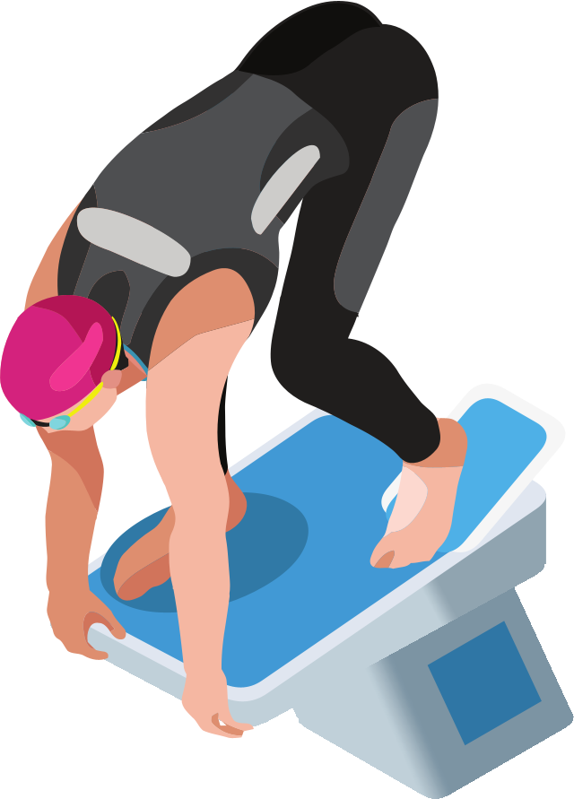
18
33%
A total of 18 new events were added to the Tokyo Games to help establish more equality between the number of men and women competing in the Summer Olympics
The IOC (International Olympic Committee) is reportedly working toward creating more opportunities for women; currently just 33.3% of the executive board and 37.5% of IOC members are female
www.sportscareerconsulting.com

Slide 13
EVENT MANAGEMENT
THE BUSINESS OF SPORTS & ENTERTAINMENT

Slide 14
42
Athletes at the 2020 Summer Games will compete in 42 different venues around Japan, including 33 in Tokyo and 9 in co-host cities)
339
Across the Games' 33 sports, organizers of thee Tokyo 2020 Games will award 339 medals
www.sportscareerconsulting.com

Slide 15
3
Non-athlete participants in the Summer Games were required to quarantine for three days upon arrival in Japan
$900M
The country spent $900 million on coronavirus countermeasures to help protect Tokyo 2020 participants and Japanese citizens
www.sportscareerconsulting.com

Slide 16
44K
10,000
Overall, more than 44,000 security personnel were on staff for the Tokyo Games, or roughly half the number required for the 2016 Summer Olympics in Rio
About 10,000 of the 80,000 registered volunteers supporting athletic events quit just before the Games began because of health and safety concerns relating to COVID-19
www.sportscareerconsulting.com

Slide 17
1ST
The Tokyo Games became the first to implement security features managed through Artificial Intelligence using a facial recognition system
$500M
Overall, the Tokyo Metropolitan Government spent $500 million on Olympic Games' security
www.sportscareerconsulting.com

Slide 18
SUSTAINABILITY
THE BUSINESS OF SPORTS & ENTERTAINMENT

Slide 19
79,000
Through a program dubbed "The Tokyo 2020 Medal Project", event organizers received 78,985 tons of electronic devices in donationsfrom Japanese citizens
100%
Every single medal awarded at the 2020 Summer Games was made from recycled electronics
www.sportscareerconsulting.com

Slide 20
6M
As part of the 79,000 tons of electronic devices collected, 6.21 million were used cell phones
100%
One hundred percent of the energy used at all Olympic and Paralympic venues was renewable energy
www.sportscareerconsulting.com

Slide 21
1964
$100M
An Olympic rings structure created for the Opening Ceremony was made from trees grown from seeds donated from around the world by athletes who competed in Tokyo’s first Olympics in 1964.
The Olympics have increasingly come under fire for their lack of sustainability. The Olympic Stadium for the Pyeongchang Winter Olympics in 2018 cost $100 million to make and was torn down after the Games.
www.sportscareerconsulting.com

Slide 22
24.5
24.5 tons of used plastic were collected and re-used to create the podiums used for Tokyo's Victory Ceremony Podiums
65%
Event organizers have a goal of reusing or recycling 65% of the waste generated from operations of the Games (plastic, paper, food, etc.)
www.sportscareerconsulting.com

Slide 23
PUBLIC RELATIONS
THE BUSINESS OF SPORTS & ENTERTAINMENT

Slide 24
79,000
50%
Nearly 80,000 officials from overseas, including journalists, media representatives and support staff were in attendance for the Tokyo Games
The capacity of all press areas at the Tokyo 2020 Olympic and Paralympics Games was cut in half as part of measures to "guarantee a safe environment" for reporters and photographers covering the event
www.sportscareerconsulting.com

Slide 25
31%
By contrast, just 31% of the Japanese public had received at least one dose of the COVID-19 vaccine by the time the Games began
80%
By July, 80% of those staying in the Olympic village (athletes, staff etc.) had been fully vaccinated
www.sportscareerconsulting.com

Slide 26
415K
415,000 Japanese residents signed a petition to cancel the Tokyo Games and more than 6,000 doctors also called for cancellation
80%
According to a poll prior to the start of the Tokyo Games, 80% of the Japanese public wanted the Olympics to be concelled or postponed again as the pandemic continued to surge around the country
www.sportscareerconsulting.com

Slide 27
SPONSORSHIP
THE BUSINESS OF SPORTS & ENTERTAINMENT

Slide 28
14
The Tokyo Games featured 14 official "Worldwide" Olympic corporate partners, the most expensive sponsorship tier
60
Overall, the 2020 Olympics secured more than 60 sponsor and partner brands at various levels of endorsement
www.sportscareerconsulting.com

Slide 29
$835M
One report suggested that Toyota committed $835 million for an Olympic Games sponsorship deal from 2017 through ‘24
$200M
Basic, four-year sponsorship packages begin at around $200 million, but that price point is expected to increase for the 2024 and 2028 Summer Games
www.sportscareerconsulting.com

Slide 30
BROADCASTING
THE BUSINESS OF SPORTS & ENTERTAINMENT

Slide 31
$1.45B
NBCUniversal spent an estimated $1.45 billion to secure the broadcast rights to the Tokyo Games
$1.25B
By the start of the Games, NBC had already raked in $1.25 billion in advertising sales
www.sportscareerconsulting.com

Slide 32
61%
In the lead up to Tokyo 2020, one poll suggested that 61% of adults in the U.S. planned to watch at least part of the Games
7,000
NBCUniversal provided over 7,000 hours of Olympics coverage for Tokyo 2020, more than any other Olympic Games in history
www.sportscareerconsulting.com

Slide 33
17M
The opening ceremony, attracted approximately 17 million viewers, down from 23.5 million for the 2016 ceremony. The 2012 opening ceremony for the London Games attracted 41 million viewers.
$1.3M
The average cost for a 30-second primetime TV advertisement for the Tokyo Olympics was roughly $1.3 million
www.sportscareerconsulting.com

Slide 34
ECONOMICS
THE BUSINESS OF SPORTS & ENTERTAINMENT

Slide 35
$26B
The cost of hosting the 2020 Tokyo Summer Games is estimated to be more than $26 billion
$5.5B
An estimated $5.5 billion was invested in improving infrastructure in the Tokyo urban area for the 2020 Games
www.sportscareerconsulting.com

Slide 36
$23B
$1.4B
A study has estimated that hosting the Olympic and Paralympic Games in Tokyo without spectators would result in $23.1 billion economic loss for Japan.
The 68,000 seat stadium used to host the Opening and Closing Ceremonies at the 2020 Olympics cost $1.4 billion. Specators were banned from attending the event because of the pandemic.
www.sportscareerconsulting.com

Slide 37
TICKETS & HOSPITALITY
THE BUSINESS OF SPORTS & ENTERTAINMENT

Slide 38
$112
Before spectators were banned from attending, the cost of a ticket to see the Tokyo Olympics Opening Ceremony ranged from $112 to $2,808
$20
Ticket prices to see various athletic events at the Tokyo Games cost anywhere between $20 and $1,217
www.sportscareerconsulting.com

Slide 39
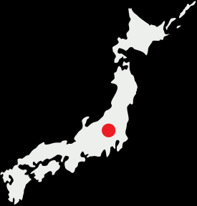
1M
4.5M
An estimated 1 million tickets were sold to foreign spectators, all which needed to be refunded after specators were banned
Before spectators were banned, organizers had sold 4.5 million tickets to Japanese residents
www.sportscareerconsulting.com

Slide 40
Athlete compensation
THE BUSINESS OF SPORTS & ENTERTAINMENT

Slide 41
$37,500
$737k
A gold winner for Team USA earns $37,500 for the achievement, paid by the United States Olympic & Paralympic Committee (USOPC)
A gold medal winner from Singapore would receive an Olympic medal bonus of $737,000 — nearly 20 times more, driven by the government.
www.sportscareerconsulting.com

Slide 42
SOURCES
https://www.cnbc.com/2021/07/26/tokyo-olympics-ratings-19point8-million-viewers-watched-sunday.html
https://www.weforum.org/agenda/2021/07/tokyo-2020-olympics-numbers
https://www.cnn.com/2021/06/03/sport/tokyo-olympics-volunteers-covid-intl-hnk/index.html
https://adage.com/article/special-report-olympics/faq-everything-you-need-know-advertising-marketing-sponsorship-athlete-pay-nbc-olympics-2020-2021/2351056
https://www.insider.com/tokyo-olympics-medals-recycled-cell-phones-2021-7
https://www.northjersey.com/story/sports/olympics/2021/07/22/women-tokyo-olympics-team-usa-men/8025869002
https://wallethub.com/blog/olympics-fun-facts/22356
https://www.globalcitizen.org/en/content/tokyo-olympics-2020-gender-equality-women
https://www.nbcnews.com/news/sports/norwegian-women-s-beach-handball-team-fined-not-playing-bikinis-n1274453

