Slide 1
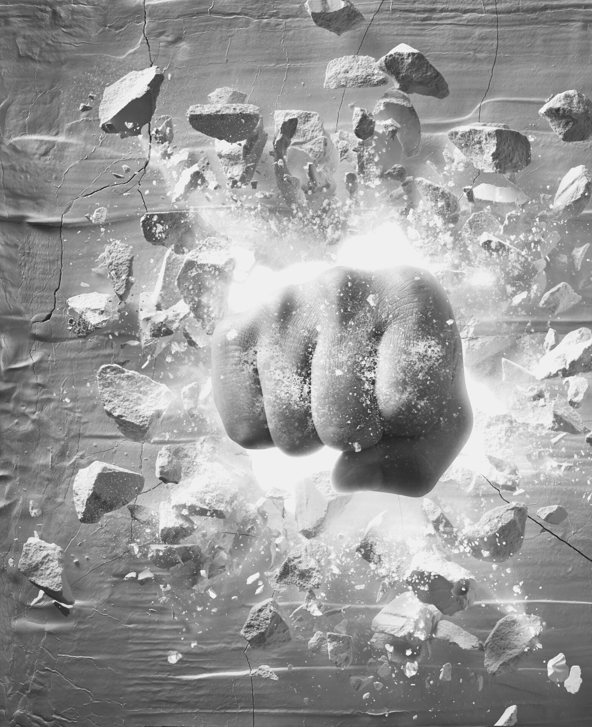
THE BUSINESS OF SPORTS & ENTERTAINMENT
PAY-PER-VIEW
NOTABLE PPTV EVENTS IN
SPORTS & ENTERTAINMENT HISTORY
WWW.SPORTSCAREERCONSULTING.COM

Slide 2
THE BUSINESS OF SPORTS & ENTERTAINMENT
PAY-PER-VIEW
WHAT IS
PPV?
Pay-per-view refers to a satellite, streaming or cable television service by which customers can order access to a specific broadcast for a set, one-time fee. Certain sports and entertainment properties rely on a business model where pay-per-view generates a significant amount of revenue. WWE, UFC and boxing generate millions each year by broadcasting some of their biggest events on a pay-per-view basis.
WWW.SPORTSCAREERCONSULTING.COM

Slide 3
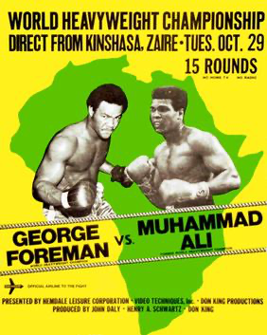
PPV HISTORY
According to Wikipedia, the earliest form of pay-per-view was closed-circuit television, also known as theatre television, where professional boxing telecasts were broadcast live to a select a number of venues, mostly theaters, where viewers paid for tickets to watch the fight live.
The first fight with a closed-circuit telecast was Joe Louis vs. Jersey Joe Walcott in 1948. Closed-circuit telecasts peaked in popularity with Muhammad Ali in the 1960s and 1970s, with "The Rumble in the Jungle" fight drawing 50 million buys worldwide in 1974, and the "Thrilla in Manila" drawing 100 million buys worldwide in 1975.
Closed-circuit television was gradually replaced by pay-per-view home television in the 1980s and 1990s.

Slide 4
PPV HISTORY
1975
"Thrilla in Manila"
Professional boxing was largely introduced to pay-per-view cable television with the "Thrilla in Manila" fight between Muhammad Ali and Joe Frazier in September 1975. The fight sold 500,000 pay-per-view buys on HBO.
Several notable events helped shape the future of pay-per-view events. The business model took hold primarily in the sport of boxing, with Muhammad Ali and Joe Frazier's iconic 1975 fight, the "Thrilla in Manila", paving the way for the future.
In the 1980s, Sugar Ray Leonard became not only one of the most recognized boxers, but one of the most famous athletes in the world. Sports fans were willing to pay to see his matches. In the 90s, Mike Tyson would take things to a whole new level and all of his fights became must-see TV, helping to drive PPV sales to new heights.
1981
Sugar Ray Leonard v. "Hitman" Hearns
Another major title fight aired on pay-per-view in 1980, when Roberto Durán defeated Sugar Ray Leonard. Cable companies offered the match for $10, and about 155,000 customers paid to watch the fight.
1997
Tyson vs. Holyfield II
"Iron" Mike Tyson dominated his opponents throughout the 90s, but finally met his match in Evander Holyfield in 1996 when Holyfield beat him. The rematch ended in controversy when Tyson bit Holyfield's ear not once, but twice. Not only did the fight generate 1.9 million pay-per-view buys, the fight also drove $100 million in ticket revenue.
WWW.SPORTSCAREERCONSULTING.COM

Slide 5
THE BUSINESS OF SPORTS & ENTERTAINMENT
PAY-PER-VIEW
PPV
The term "pay-per-view" did not come into general use until the late 1980s when companies such as Viewer's Choice, HBO and Showtime started using the system to show movies and some of their productions. Viewer's Choice carried movies, concerts and other events, with live sporting events such as WrestleMania being the most predominant programming. Prices ranged from $3.99 to $49.99, while HBO and Showtime, with their event production legs TVKO and SET Pay Per View, would offer championship boxing matches ranging from $14.99 to $54.99.
WWW.SPORTSCAREERCONSULTING.COM

Slide 6
THE BUSINESS OF SPORTS & ENTERTAINMENT
PAY-PER-VIEW
ESPN &
PPV
ESPN later began to broadcast college football and basketball games on pay-per-view through its services ESPN GamePlan and ESPN Full Court, which were eventually sold as full-time out-of-market sports packages.
WWW.SPORTSCAREERCONSULTING.COM

Slide 7
THE BUSINESS OF SPORTS & ENTERTAINMENT
PAY-PER-VIEW
FUN FACT
WWE chairman and Chief Executive Officer Vince McMahon is considered by many as one of the icons of pay-per-view promotion.
Mr. McMahon owns the domain name payperview.com, which redirects to the WWE Network website.
WWW.SPORTSCAREERCONSULTING.COM

Slide 8
THE BUSINESS OF SPORTS & ENTERTAINMENT
PAY-PER-VIEW
WHERE
ARE WE
NOW?
Historically, sports and entertainment properties have generated millions of dollars through PPV events.
Do you think that is still a successful business model in today's sports and entertainment industry?
Let's explore how sports like boxing, MMA, wrestling, and golf have benefitted from pay-per-view in the last few years.
WWW.SPORTSCAREERCONSULTING.COM

Slide 9
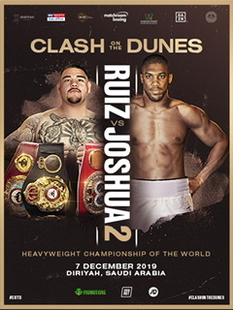
2015
Floyd Mayweather vs Manny Pacquiao
BOXING
Dubbed the "Fight of the Century", Mayweather vs. Pacquiao was one of the most hyped fights in the history of the sport
The bout drew 5.77 million pay-per-view buys, a new record that still stands today
2017
Canelo Álvarez vs. Gennady Golovkin
Álvarez has been a part of some of the biggest grossing fights of all time and the bout vs. Golovkin was one of the biggest, generating 1.3 million PPV buys and more than $110 million in total revenue
Anthony Joshua vs. Andy Ruiz Jr.
2019
The Joshua/Ruiz Jr. rematch broke the all-time UK pay-per-view (PPV) record, totaling 1.575 million buys in the United Kingdom
In the U.S., the fight was live-streamed on DAZN with an audience of 1.8 million viewers
WWW.SPORTSCAREERCONSULTING.COM

Slide 10
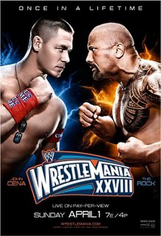
2009
WrestleMania 25
WWE
The success of WrestleMania 25 saw the attraction of Shawn Michaels vs The Undertaker as one of the best matches in WWE history, helping the event to attract 960,000 PPV buys
2012
WrestleMania 28
WrestleMania XXVIII generated more than 1.2 million buys, more than any other WWE event ever, when John Cena and The Rock squared off in one of the most-hyped events in WWE history
WrestleMania 29
2013
The Rock vs John Cena squared off in a rematch for the WWE Championship, generating another huge buyrate for the event with a PPV audience of more than one million
WWW.SPORTSCAREERCONSULTING.COM

Slide 11
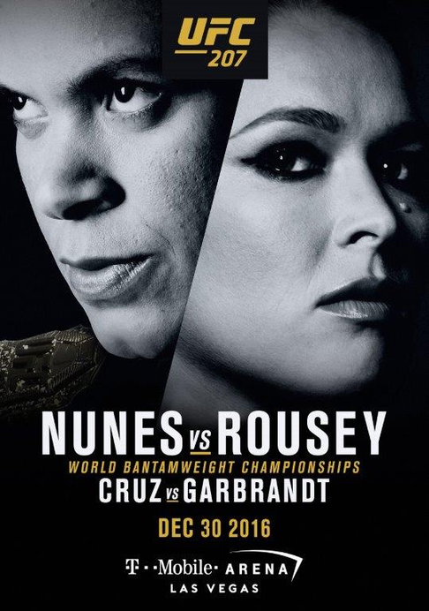
2016
Rhonda Rousey vs. Amanda Nunes
UFC
At her peak, Rhonda Rousey was one of the biggest draws in the entire sports world, racking up massive PPV numbers for every event she participated in. Her last fight, a knockout loss to Amanda Nunes in 2016, generated 1.1 million PPV buys.
2020
Kamaru Usman vs. Jorge Masvidal
Usman vs. Masvidal generated over a million PPV buys, putting it in the top 10 UFC events all-time. Perhaps more significantly, it was the first UFC event in five years to cross the one million PPV buys threshold that did not feature Conor McGregor.
2021
Conor McGregor vs. Dustin Poirier III
The third matchup between Poirier and McGregor generated 1.8 million PPV buys globally, becoming the second-highest selling PPV event in UFC history.
The only event with more overall sales was UFC 229 between McGregor and Khabib Nurmagomedov. That event drew a record 2.4 million PPV buys.
WWW.SPORTSCAREERCONSULTING.COM

Slide 12
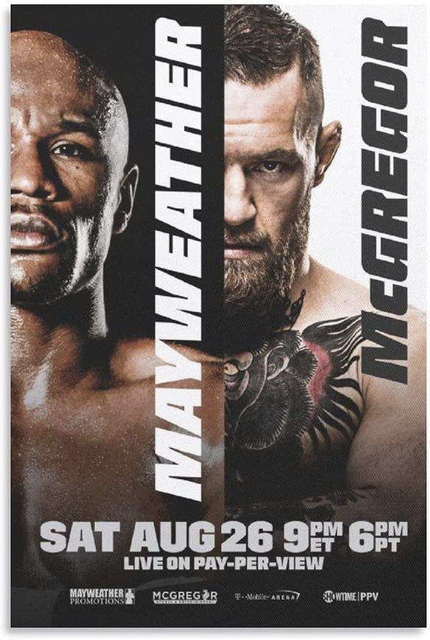
EXHIBITIONS
2017
Floyd Mayweather Jr. vs. Conor McGregor
Pitting the most popular boxer and most popular UFC fighter together in an exhibition boxing match proved to be a recipe for success
The event resulted in 5.17 million PPV buys, the 4th largest PPV event in history
2018
"The Match" (Tiger Woods vs. Phil Mickelson)
Several broadcasters streamed “The Match” via PPV, a one-on-one match between two of the most iconic golfers of all time (Phil Mickelson and Tiger Woods)
The event generated more than one million PPV buys
Floyd Mayweather Jr. vs. Logan Paul
2021
Floyd Mayweather cashed in again in 2021 in a made-for-PPV boxing match with YouTube star, Logan Paul
The event generated over a million PPV buys, and Mayweather took home more than $50 million for his efforts
WWW.SPORTSCAREERCONSULTING.COM

Slide 13
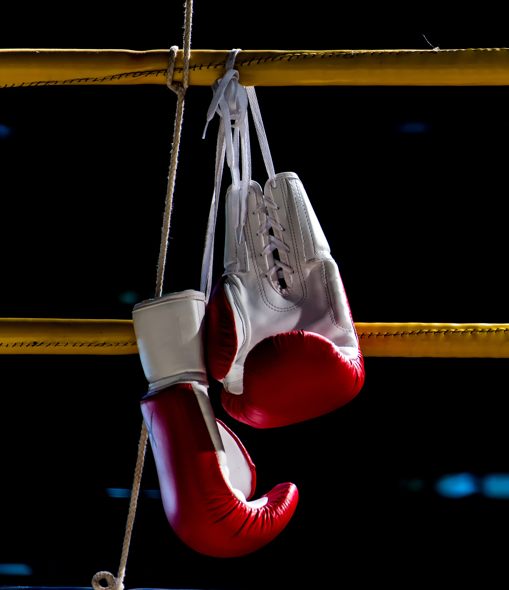
DISCUSSION
Business Model
What sports and entertainment properties benefit most from a PPV business model?
Why do you think other sports and entertainment properties choose to broadcast events through traditional cable rather than on pay-per-view?
Promotion
What is promotion?
Why is promotion important to PPV events?
How do you think event organizers promote events to help maximize the number of PPV buys?
Deep Dive
Can you think of an event that might succeed as a pay-per-view event?
How would you promote the event? Be prepared to share your promotion plan in class.
WWW.SPORTSCAREERCONSULTING.COM

Slide 14
SOURCES
https://en.wikipedia.org/wiki/Pay-per-view#History
https://en.wikipedia.org/wiki/Evander_Holyfield_vs._Mike_Tyson_II
https://www.businessinsider.com/the-50-best-selling-pay-per-view-events-boxing-ufc-wrestling-tv-history-2017-8
https://www.worldboxingnews.net/2021/05/13/floyd-mayweather-pacquiao-ppv-record
https://www.sportspromedia.com/news/mayweather-logan-paul-boxing-fight-ppv-buys-showtime
https://bolavip.com/en/offside/the-5-biggest-canelo-alvarez-ppv-fights-20210219-0013.html
https://www.thesportster.com/wrestling/wwe-highest-grossing-ppv-buyrate
https://www.tapology.com/search/mma-event-figures/ppv-pay-per-view-buys-buyrate

