Slide 1
Sports Career Consulting
The Business of Sports & Entertainment
WHAT IS
POSITIONING?
Positioning refers to the fixing of a sports or entertainment entity in the minds of consumers in the target market.
Positioning is really about perception. To be successful, sports business professionals must carefully craft a positioning strategy that influences the way consumers view their products and services.
Positioning is important to all sports and entertainment marketing professionals as it helps the consumer to distinguish between competing products.

Slide 2
Sports Career Consulting
The Business of Sports & Entertainment
WHAT IS
POSITIONING?
Positioning examples could include:
Sports leagues (NBA vs. G-League)
Sports drinks (Gatorade as a performance beverage)
Movie studios (Dreamworks as a leader in animated films)
Entertainers (Will Ferrell as a comedic actor)
Entertainment products (Fortnight “Battle Royale” as a multiplayer video game vs. “Save the World” as a single-player experience)
Nutritional foods (Wheaties as "The Breakfast of Champions"

Slide 3
Sports Career Consulting
The Business of Sports & Entertainment
WHEATIES
A BRIEF HISTORY
"THE BREAKFAST OF CHAMPIONS"

Slide 4
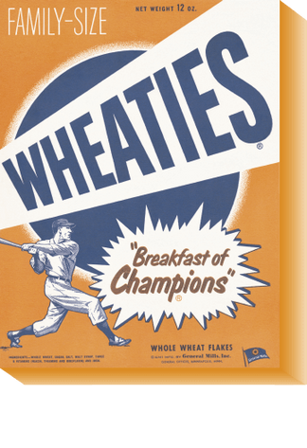
Sports Career Consulting
1921
PRODUCT IS CREATED: "Washburn’s Gold Medal Whole Wheat Flakes” is created after a health clinician spilled wheat gruel on a hot stove and watched it transform into delicious wheat flakes.
The Business of Sports & Entertainment
1924
PRODUCT DEVELOPMENT
PRODUCT IS INTRODUCED: The product is launched, now known as "Wheaties" breakfast cereal
1927
PRODUCT IS ADVERTISED: Wheaties begins marketing the product, beginning with signage at a minor league baseball stadium (The Minneapolis Millers) and also including a sponsorship of the team's radio broadcasts. The brand's first slogan would appear in these ads and "Breakfast of Champions" was born.
TIMELINE
1934
PRODUCT IS POSITIONED: Wheaties positions the product in a way that communicates to consumers that the cereal is something the greatest athletes in the world include as part of their diet by placing photos of athletes on the box.
1958
It wasn't until 1958 that an athlete appeared on the front of the box. That athlete was Olympic pole vaulter Bob Richards, who became the brand's first official spokesperson, paving the way for endorsement deals with athletes like Bruce Jenner, Mary Lou Retton, Walter Payton, Chris Evert, Michael Jordan and Tiger Woods.

Slide 5
Sports Career Consulting
The Business of Sports & Entertainment
WATCH THIS
Bruce Jenner set a new world record in the decathlon at the Montreal Summer Games in one of the more memorable moments in Olympics history. After earning the title as best athlete in the world, Jenner declared Wheaties as “The Breakfast of Champions” in this 1978 Wheaties television commercial.

Slide 6
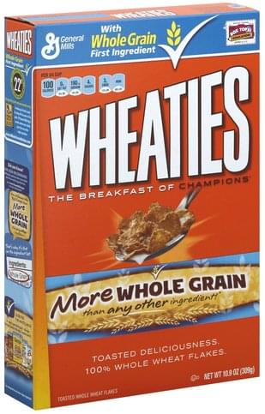
Sports Career Consulting
The Business of Sports & Entertainment
POSITIONING STRATEGY
General Mills consistently positioned Wheaties as a nutritious product that provides fuel for athletes. Much of the brand’s advertising over the years focused on product ingredients, communicating to consumers that Wheaties is 100% whole grain, offering a healthier alternative to other breakfast cereals.

Slide 7
Sports Career Consulting
The Business of Sports & Entertainment
WATCH THIS
In 1999, Tiger Woods was arguably the most famous athlete on the planet. Wheaties featured the golf superstar in an advertising campaign that year, touting the ”100% Whole Grain” product benefit. Notice the brand continued to feature the tagline “The Breakfast of Champions” with its advertising.

Slide 8
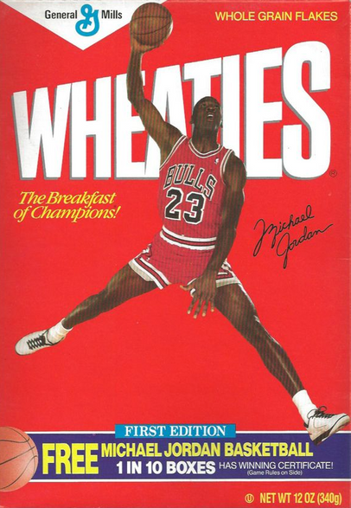
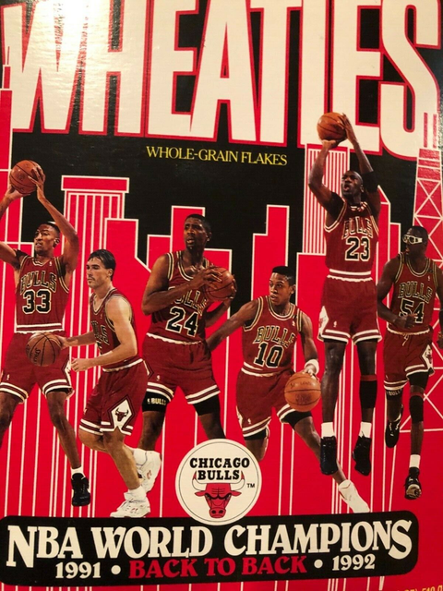
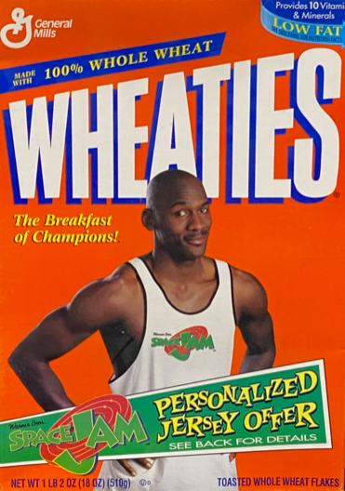
Sports Career Consulting
The Business of Sports & Entertainment
11
Michael Jordan's sponsorship deal with General Mills made him the official spokesperson for the Wheaties brand for eleven years. He even graced the cover in his "Space Jam" uniform.
1st
M.J.
18
In 1992, in celebration of the Chicago Bulls back-to-back championship, Wheaties introduced its first non-orange Wheaties box, instead using the same red and black color scheme synonymous with the Chicago Bulls franchise.
With 18 appearances on Wheaties boxes, NBA legend Michael Jordan has graced the cover of the iconic brand more than any other athlete.

Slide 9
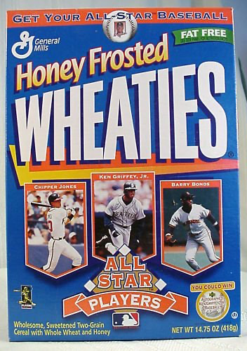
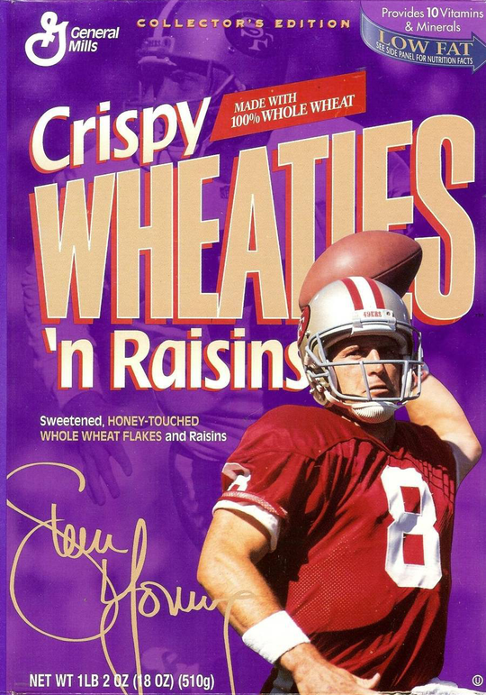
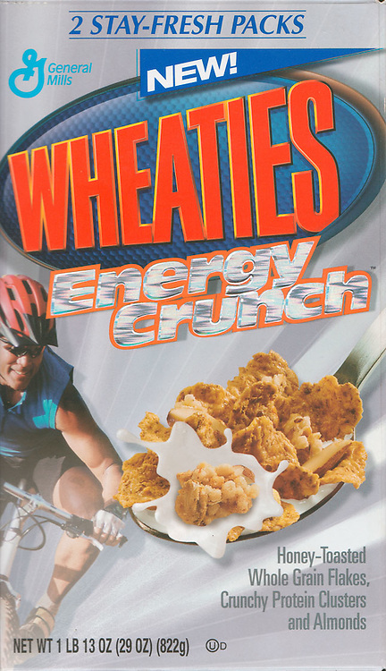
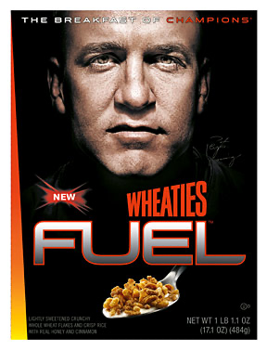
Not every new product is guaranteed to succeed!
#FAIL
Even the most iconic brands in the world inevitably face challenges. When product sales began declining in the 80s, Wheaties would introduce several spinoff cereals. The brand's attempts to boost sales included the launch of Honey Frosted Wheaties, Crispy Wheaties 'n Raisins, Wheaties Energy Crunch and Wheaties Fuel. None of the new products sold very well, and eventually every single one of them would be discontinued. All that remains now is the original "Breakfast of Champions" cereal.

Slide 10
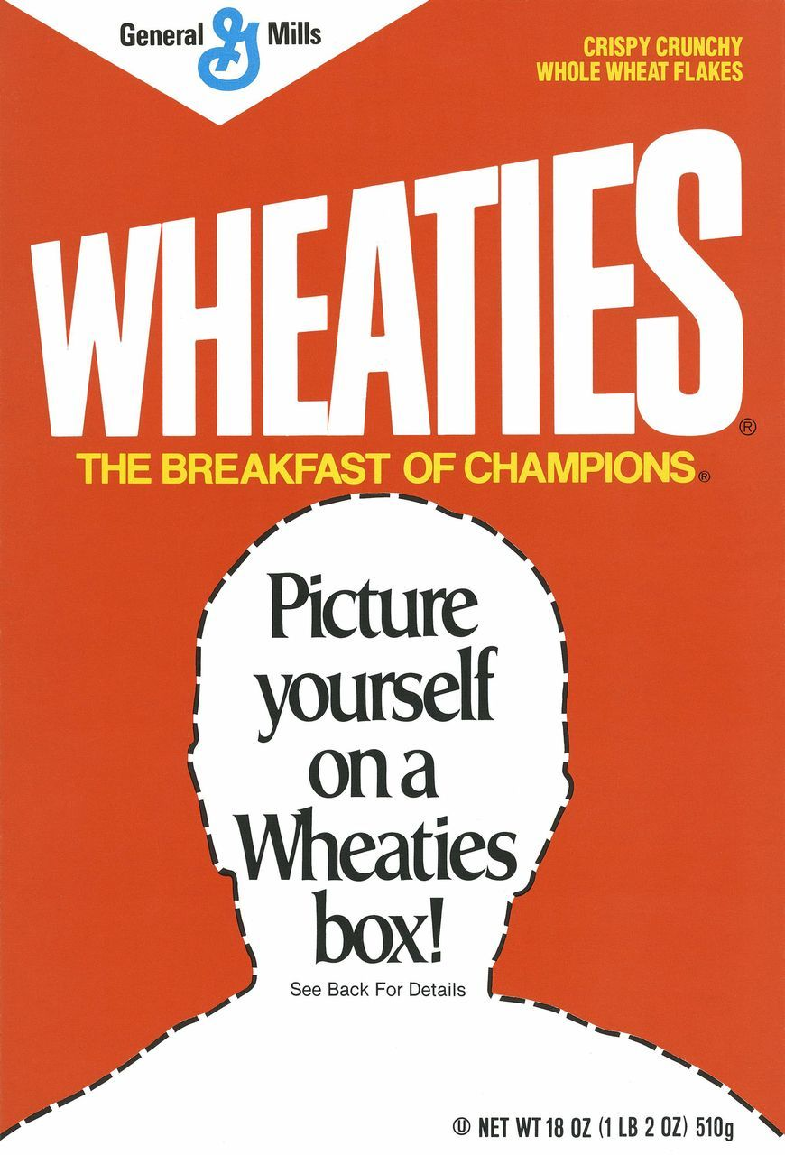
Sports Career Consulting
The Business of Sports & Entertainment
POSITIONING
AND
PROMOTION
In the early 1990s, General Mills launched a “Picture Yourself on a Wheaties Box” promotion, where, for a fee, the brand would create a custom Wheaties box using the consumer's own photograph, allowing anyone to become the face of "The Breakfast of Champions".

Slide 11
Sports Career Consulting
The Business of Sports & Entertainment
DISCUSSION QUESTIONS
*
What is positioning?
*
Why is positioning important in the business of sports and entertainment?
*
Did you know Wheaties was known as “The Breakfast of Champions”?
*
How important was advertising and promotion to the overall success of Wheaties’ positioning strategy?
*
Who might represent competition to Wheaties? How might a competing brand position their product against Wheaties?

Slide 12
Sports Career Consulting
The Business of Sports & Entertainment
DISCUSSION QUESTIONS
*
Over time, consumer preferences have shifted, and Wheaties is no longer a dominant brand in the breakfast foods market. Things like protein bars, smoothies, Greek yogurt and avocado toast have become popular, with sales of healthier breakfast cereals slumping in the last decade. If you were a marketing professional tasked with giving Wheaties a sales boost, what would you do?
*
Create your own advertising campaign and develop a positioning strategy that supports your messaging. How will you position the product relative to both direct and indirect competitors? Will you continue to use athletes as part of the brand marketing? Would you introduce a new product? Be prepared to present your ad campaign in class.

