Slide 1
THANKSGIVING
The Brands Behind
Thanksgiving Celebrations

Slide 2
Thanksgiving Marketing
A Houston Chronicle story suggests that much of what we celebrate on Thanksgiving is the direct result of marketing.
Over time, some brands have become synonymous with Thanksgiving feasts, with consumers filling supermarket shopping carts with these products every year.

Slide 3
Thanksgiving Marketing
For example, millions of green bean casseroles are served during the holiday season. That’s why French’s French-Fried Onions, a core ingredient to the holiday classic, was ranked third of all branded edible items the week of Thanksgiving, according to data provider IRI. (Ocean Spray Jellied Cranberry Sauce was fourth.)
The brand’s French-Fried onions brought in nearly $14 million in sales the week of Thanksgiving, with total sales in a three-week span of the holiday coming in at $30 million.

Slide 4
Thanksgiving Marketing
What brands played a role in your Thanksgiving Day meals? There are far more than you probably considered!
Which brands do you think are big sellers over the Thanksgiving holiday?
Try to create a list of at least five popular Thanksgiving related food brands, then see if you were able to identify some of the most popular brands by category (like turkey or butter).

Slide 5
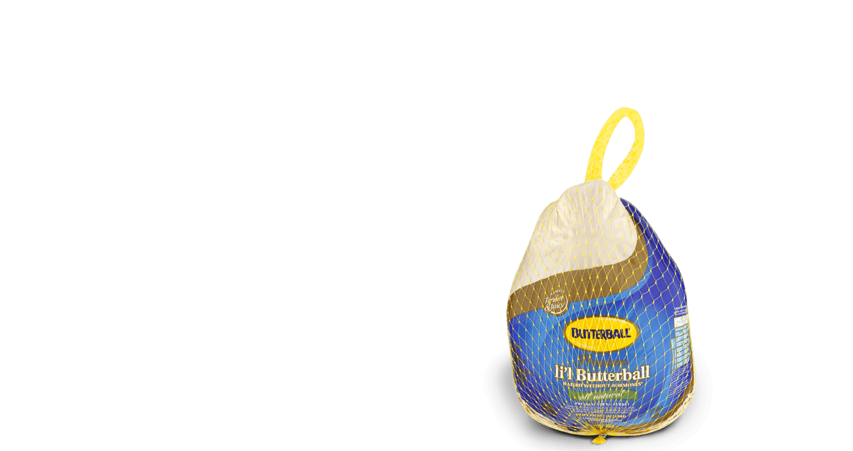
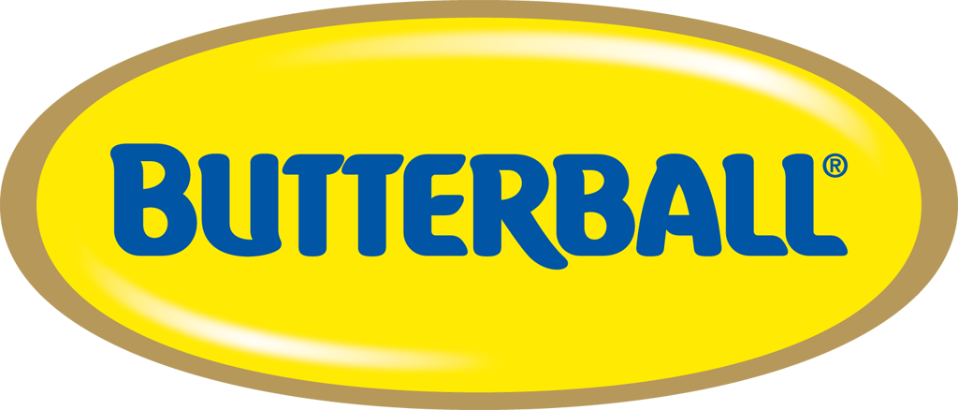
Most popular Thanksgiving brands: Turkey

Slide 6
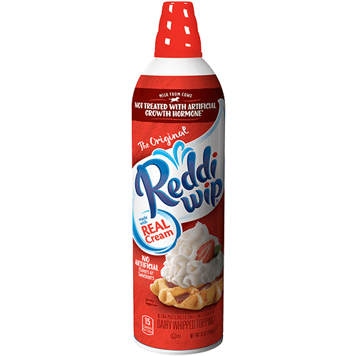

Most popular Thanksgiving brands: Whipped Cream

Slide 7
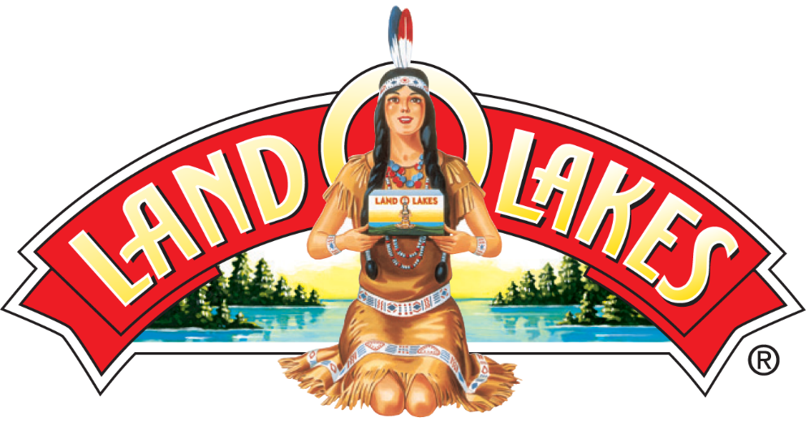
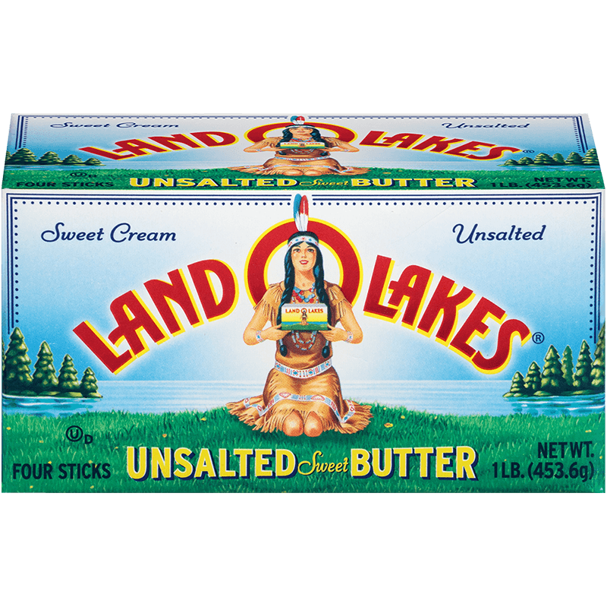
Most popular Thanksgiving brands: Butter

Slide 8
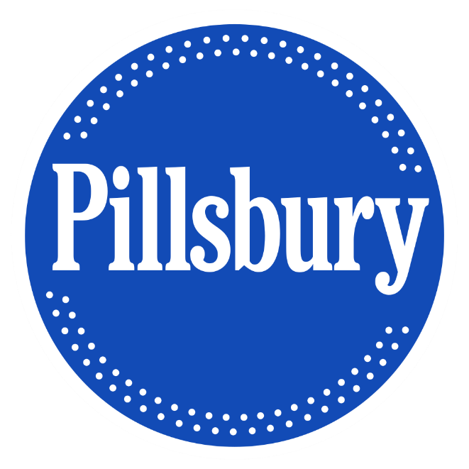
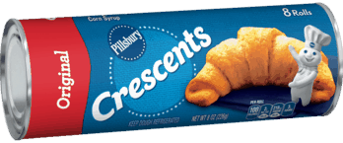
Most popular Thanksgiving brands: Rolls

Slide 9
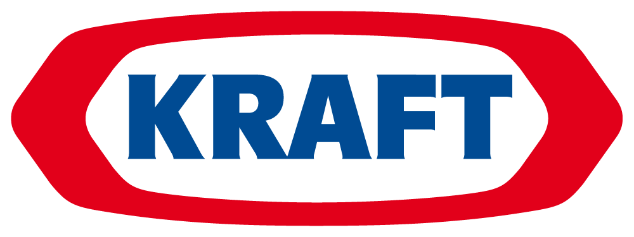
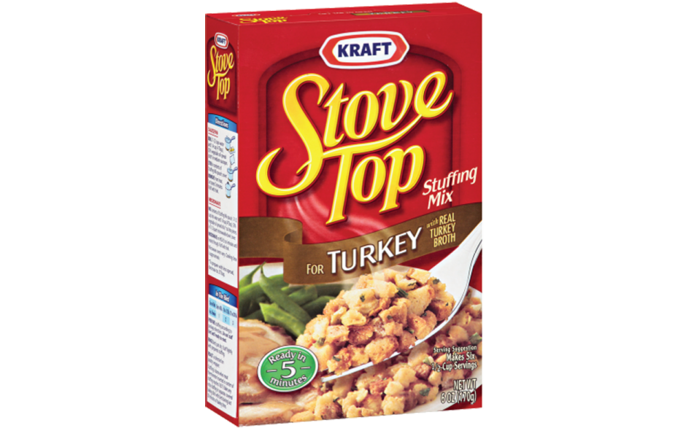
Most popular Thanksgiving brands: Stuffing

Slide 10
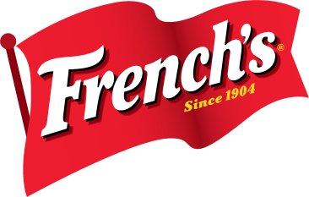
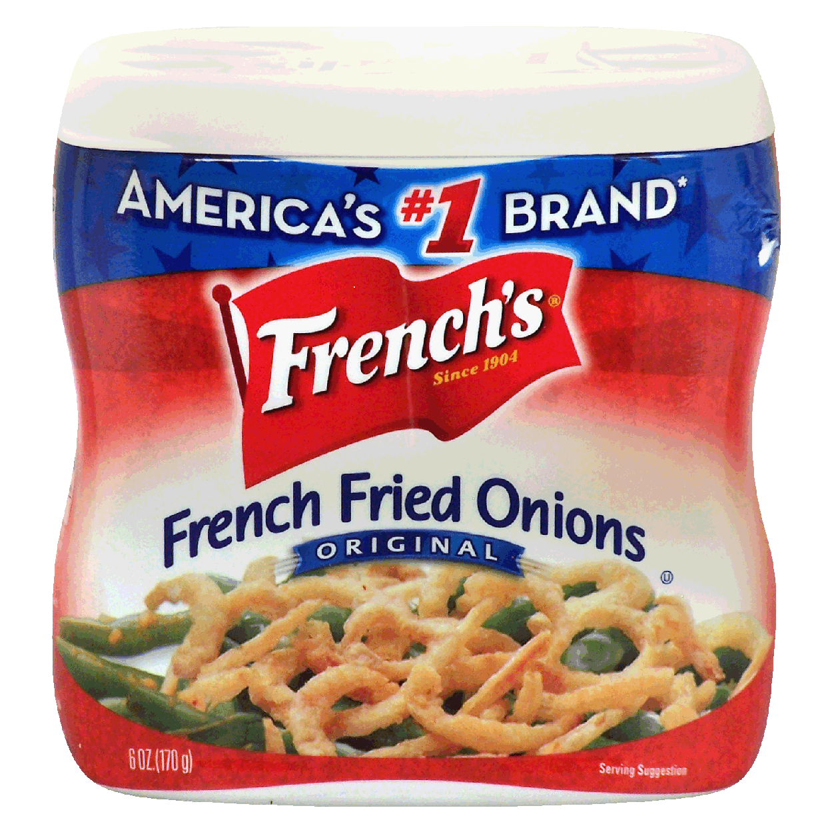
Most popular Thanksgiving brands: Toppings

Slide 11
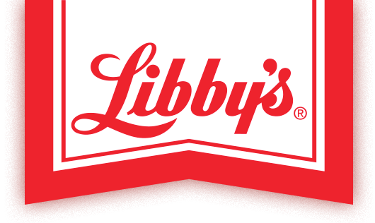
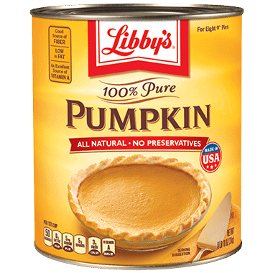
Most popular Thanksgiving brands: Pumpkin

Slide 12
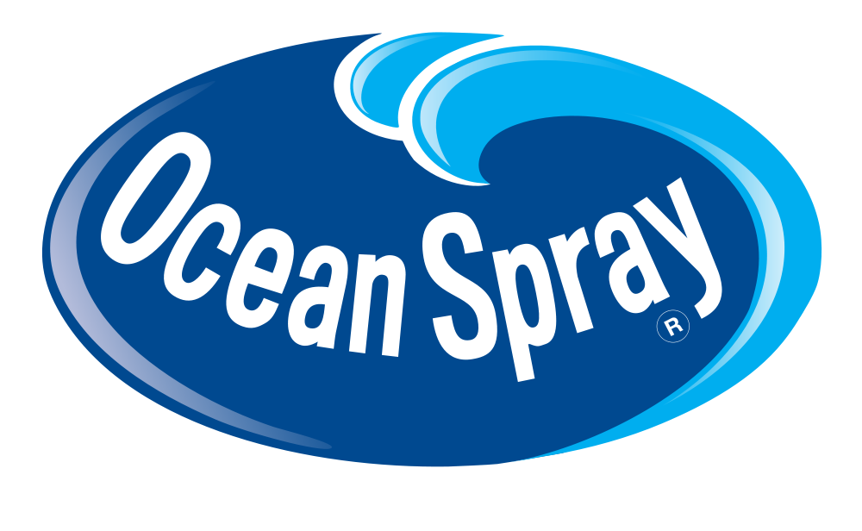
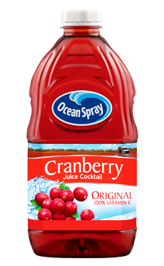
Most popular Thanksgiving brands: Cranberry Products

Slide 13

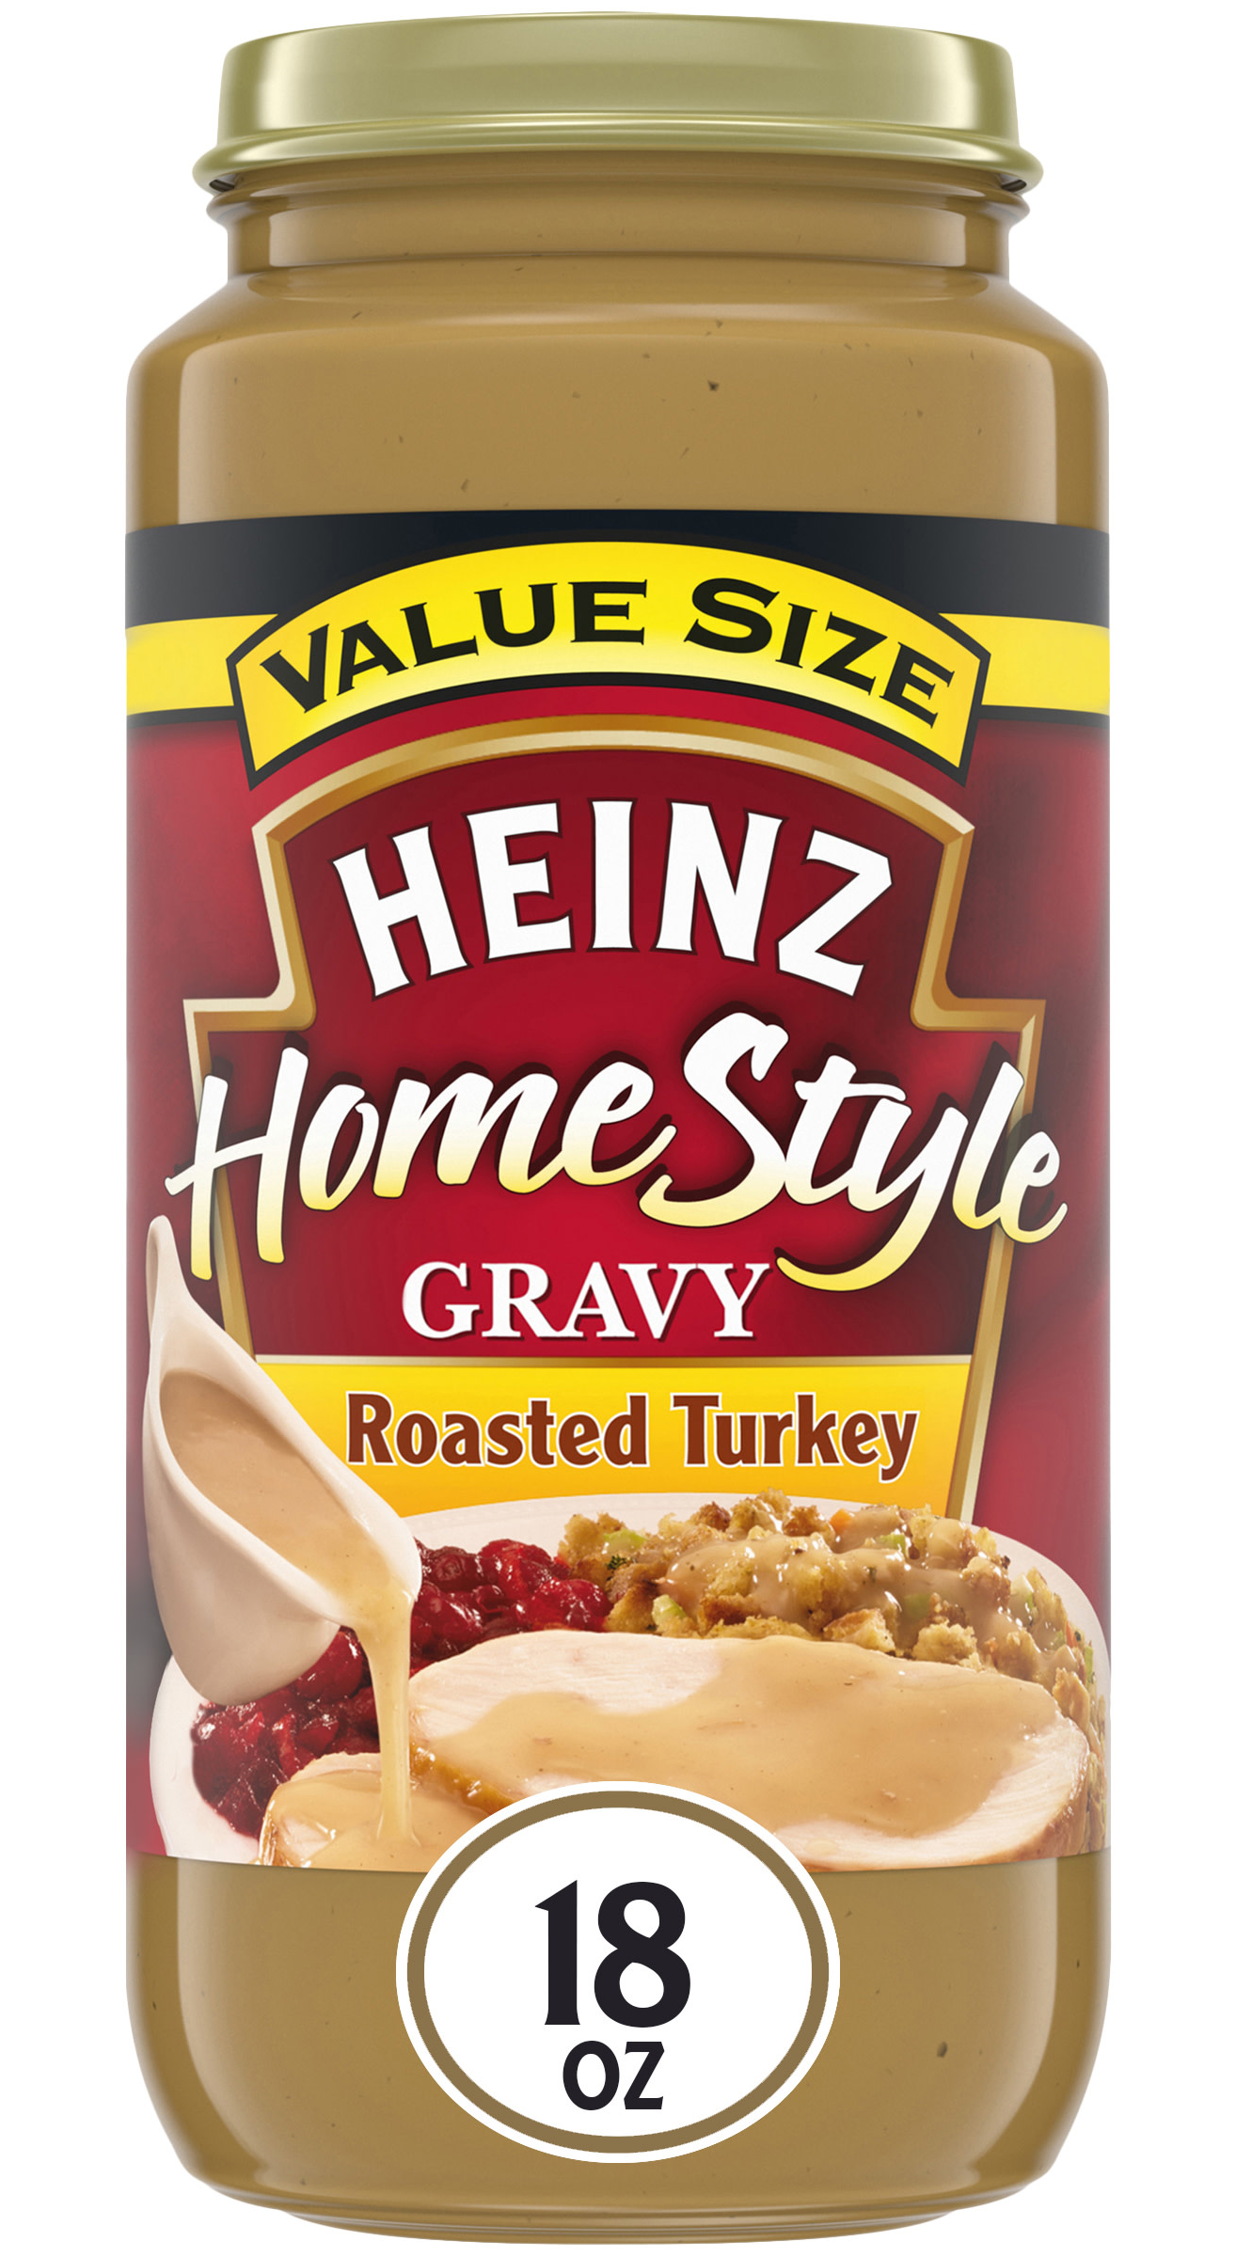
Most popular Thanksgiving brands: Gravy

Slide 14
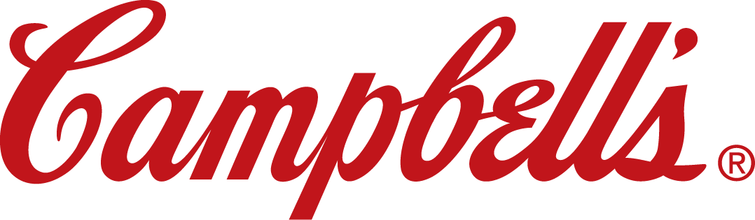
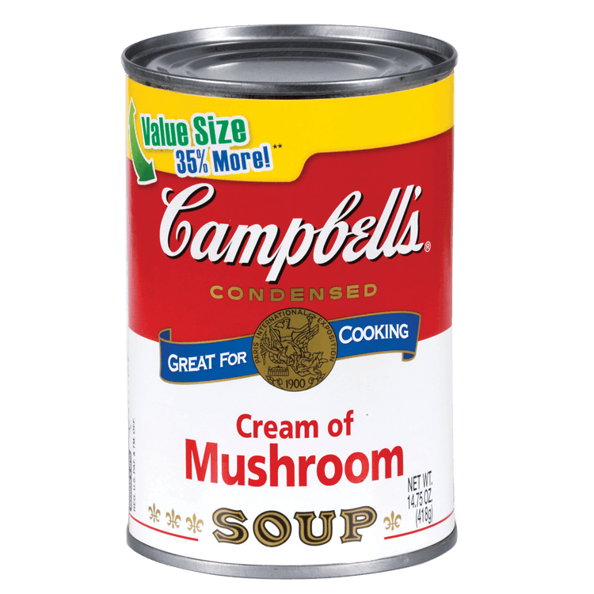
Most popular Thanksgiving brands: Soup

Slide 15
How many were you able to identify?

