Slide 1
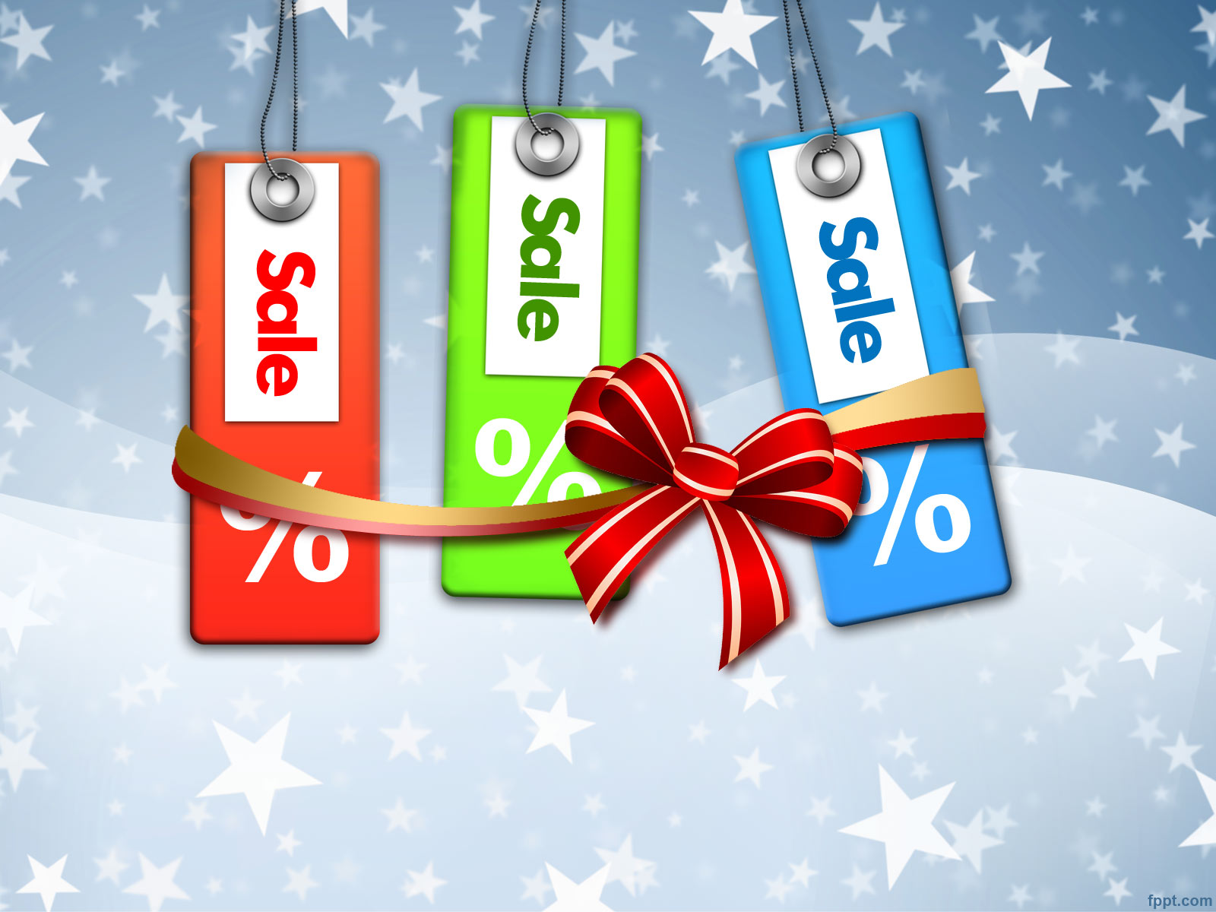
SPORTS MARKETING
Holiday Promotions

Slide 2
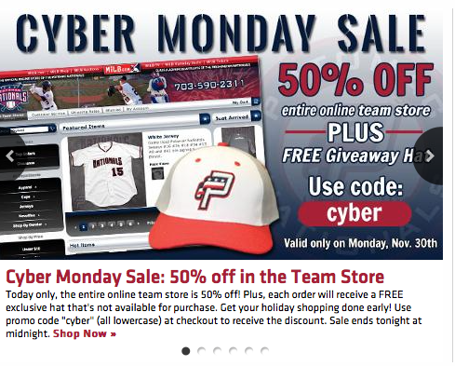
Many sports teams offer “Cyber Monday” deals to help sell merchandise

Slide 3
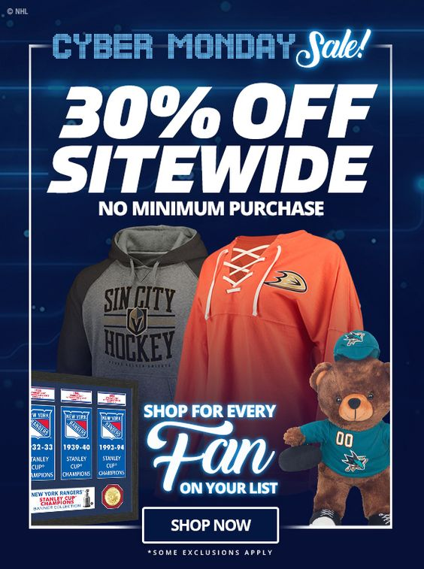
The NHL’s website offered a Cyber Monday deal with discounts on team branded merchandise

Slide 4
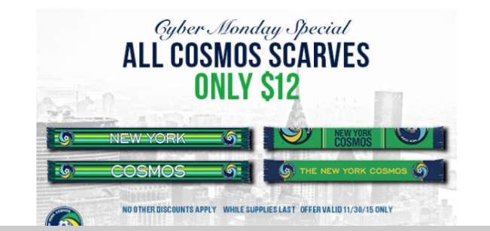
In this case, the Cosmos decided to focus on one specific item for their Cyber Monday promotion

Slide 5
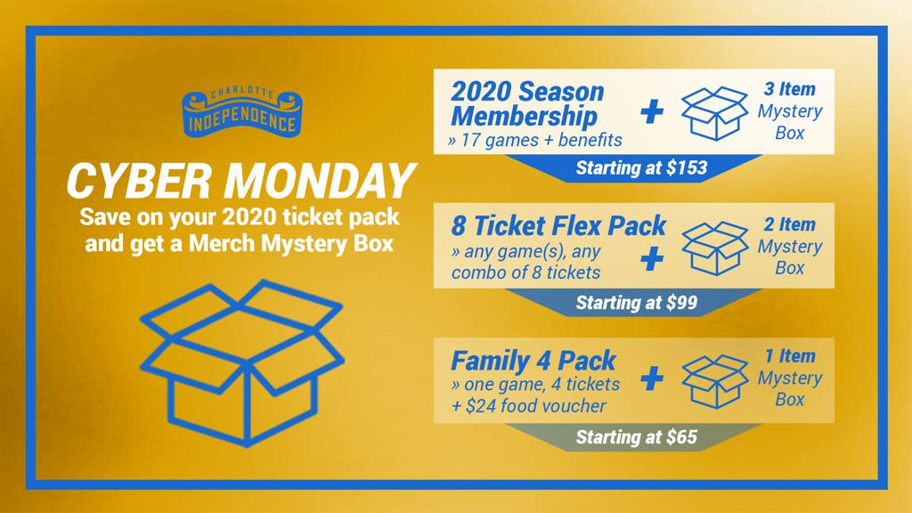
The Charlotte Independence bundled a “Merch Mystery Box” with their ticket packages

Slide 6
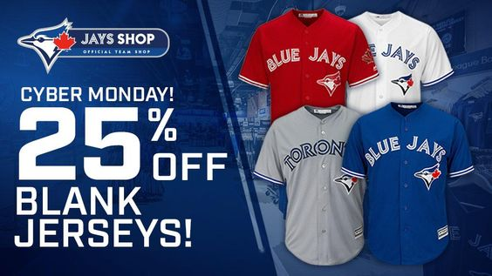
A Toronto Blue Jays’ Cyber Monday promo encouraged fans to buy blank jerseys

Slide 7

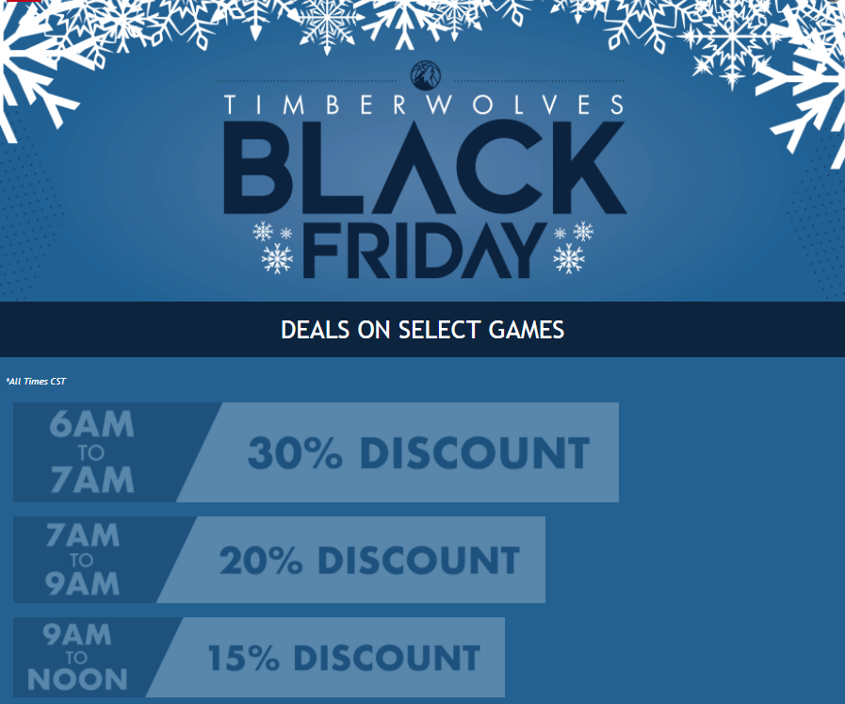
The Timberwolves encouraged shoppers to buy early, offering bigger discounts for purchases earlier in the morning

Slide 8
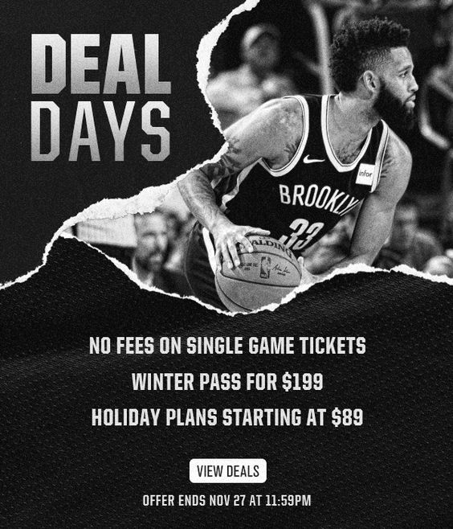
The Brooklyn Nets discounted several ticket packages and offered no fees on single game ticket purchases

Slide 9
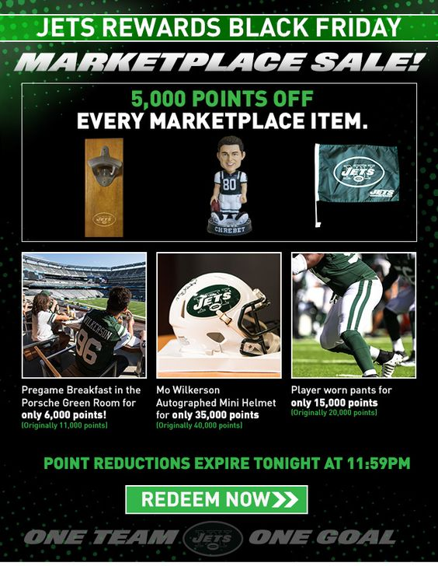
The Jets opened their “marketplace” for special Black Friday promotional offers

Slide 10
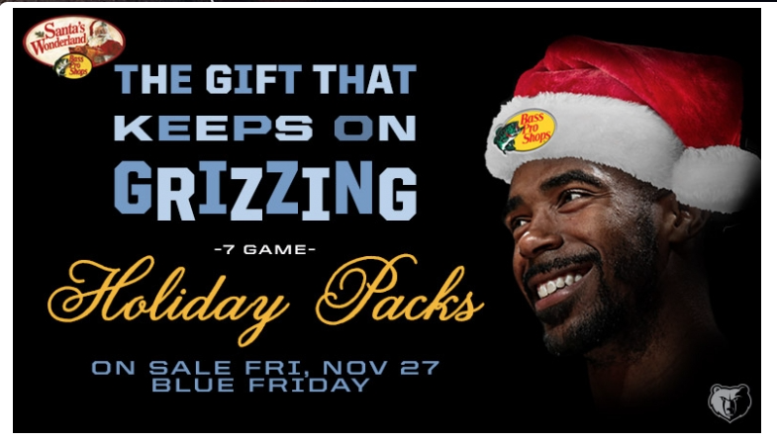
Creative branding from the Grizzlies: Not a “Black Friday” sale but rather “BLUE Friday” in celebration of the team colors for their Holiday Pack sales promotion

Slide 11
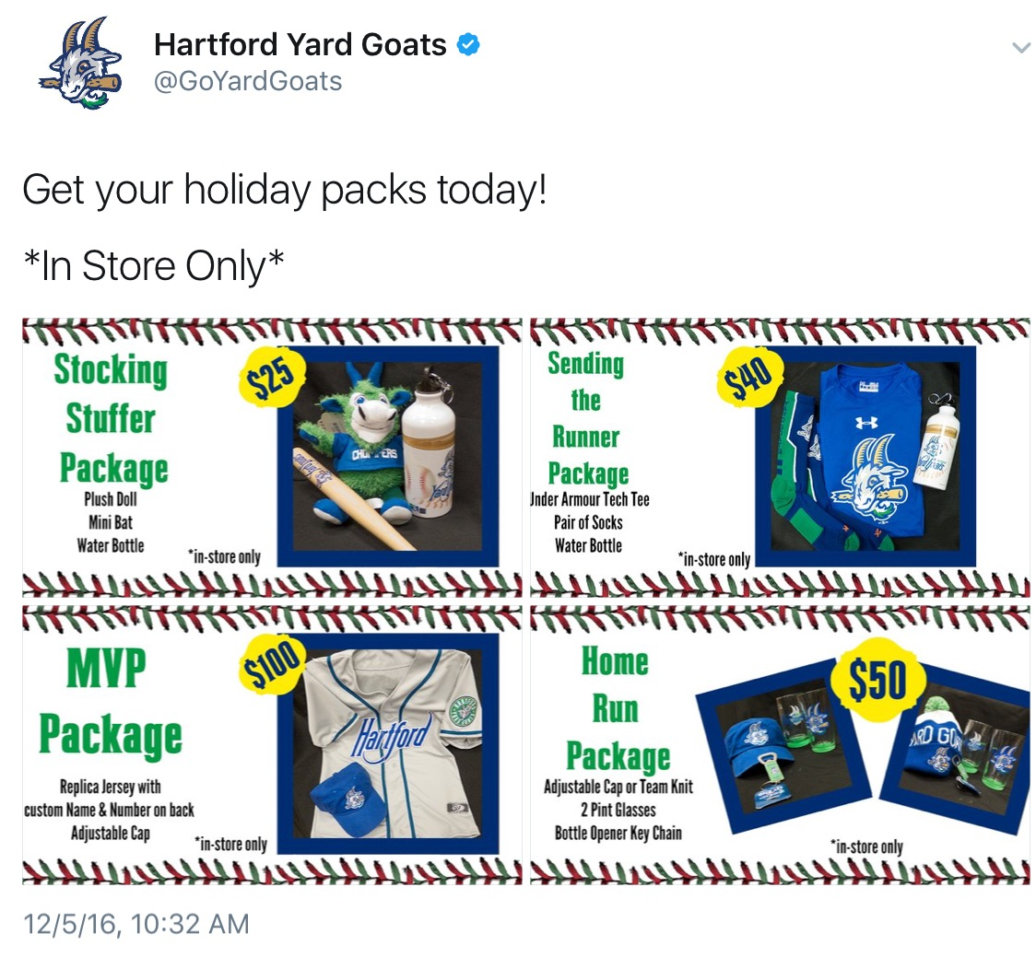
Not all teams offer online specials…some, like the Hartford Yard Goats, encourage fans to visit the team store

Slide 12
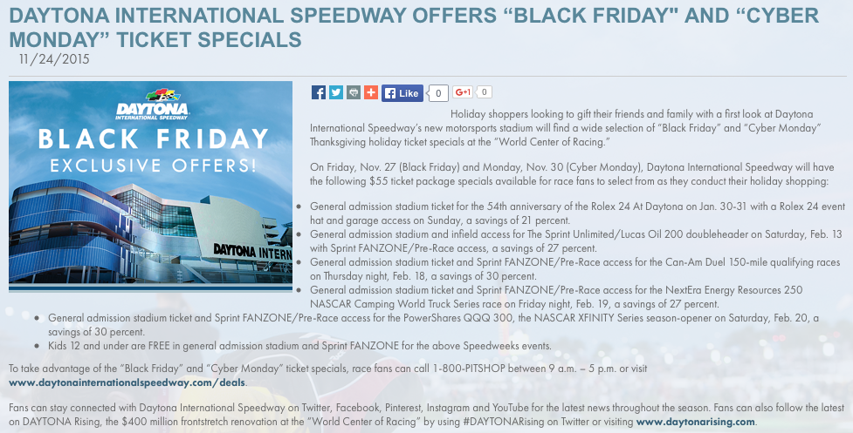
Daytona Int. Speedway offered Black Friday & Cyber Monday specials…

Slide 13
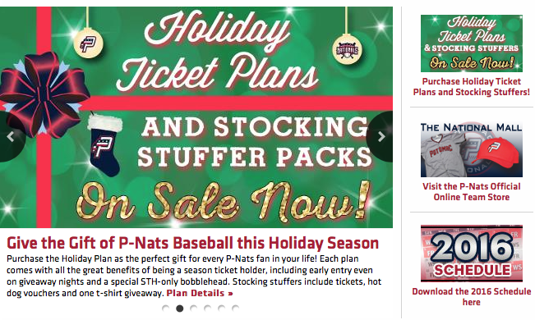
Some teams will position their holiday ticket packages as “stocking stuffer” gift ideas

Slide 14
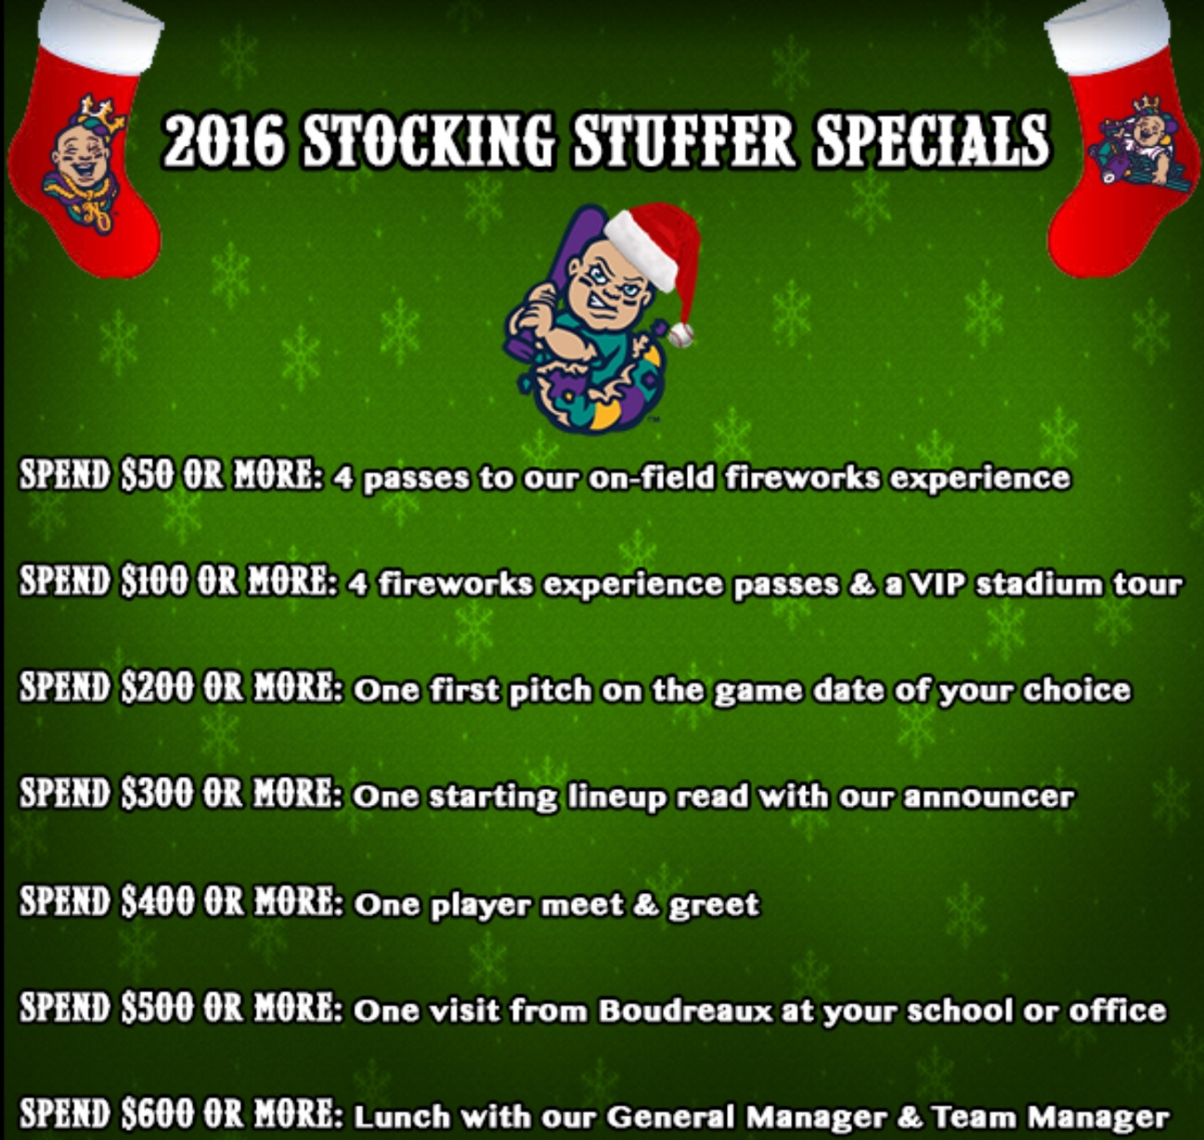
This Minor League Baseball team offers incentives for fans to spend more!

Slide 15
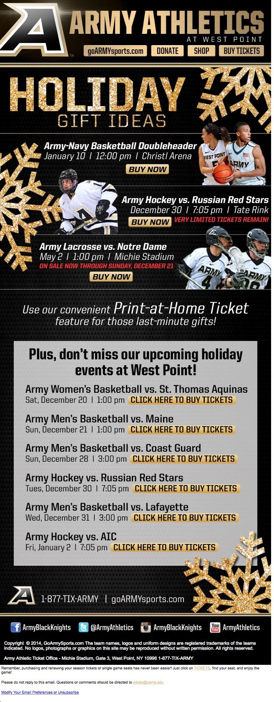
Others simply refer to them as “holiday gift ideas”, offering a number of different purchase options

Slide 16
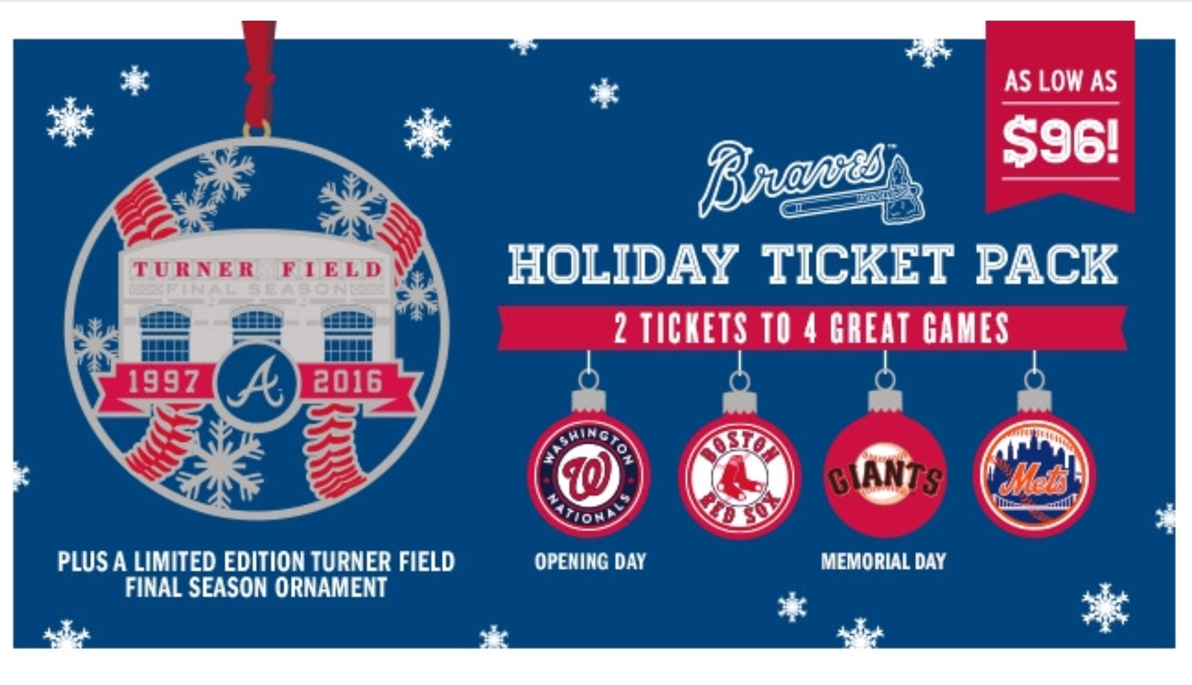
Most ”Holiday Ticket Packs” offer special purchase incentives such as the Braves’ inclusion of a commemorative ornament

Slide 17
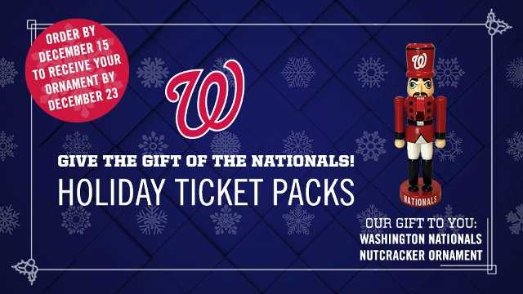
The Nationals offered a Nutcracker ornament, available exclusively through Holiday packages w/ limited availability

Slide 18
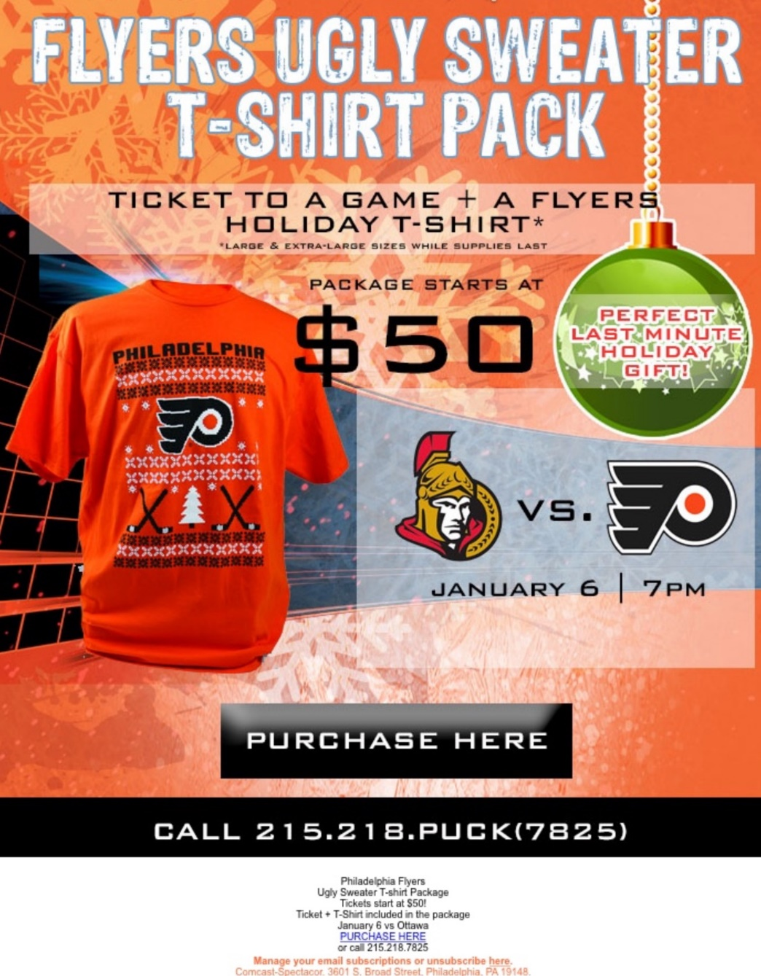
It isn’t just ornament giveaways that are included in Holiday Packs to incentivize fans to purchase ticket plans…

Slide 19
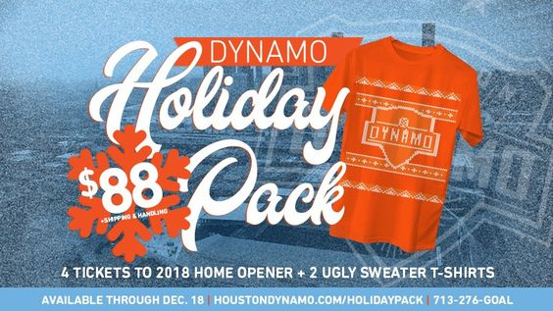
The Dynamo also included “ugly sweater” t-shirts as part of their holiday ticket pack sales promotion

Slide 20
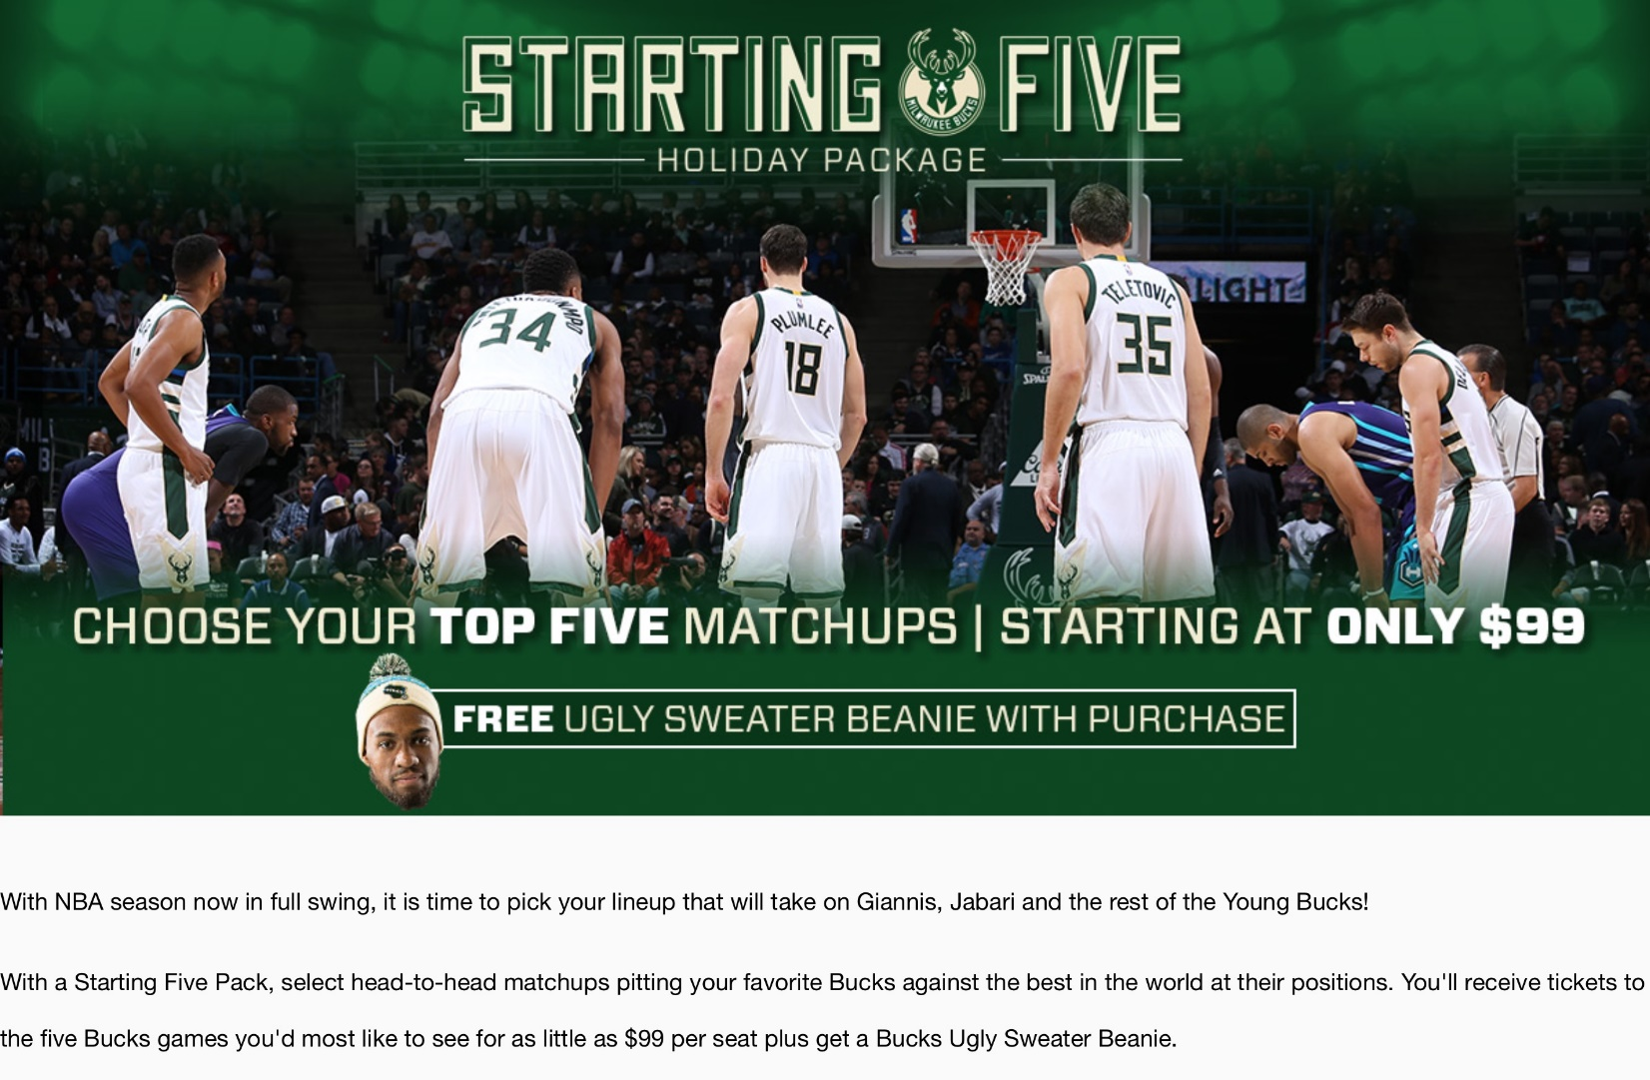
The Milwaukee Bucks w/ unique giveaway in Holiday Packs with inclusion of an “ugly sweater” beanie hat

Slide 21
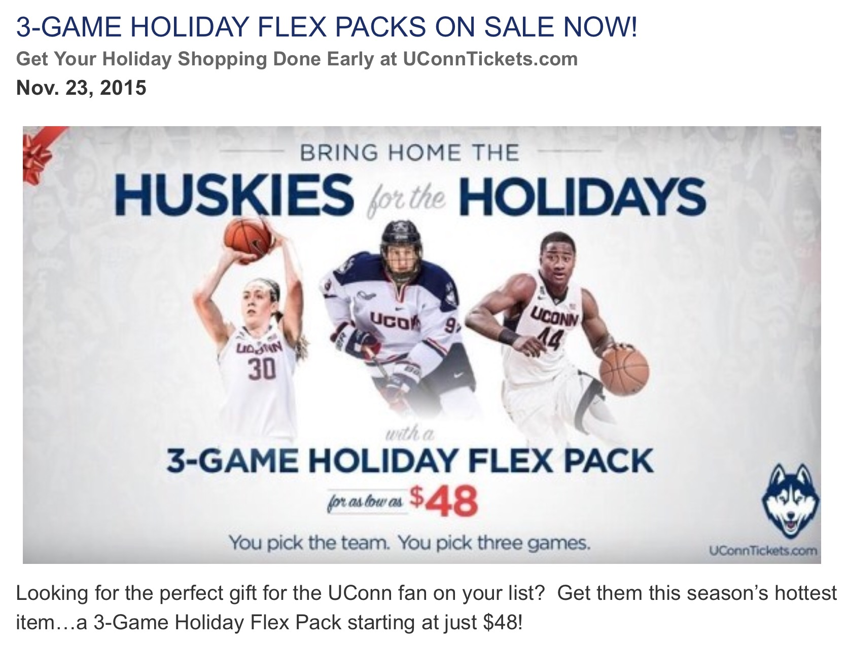
Some collegiate packages allow fans to choose which teams they want to include

Slide 22
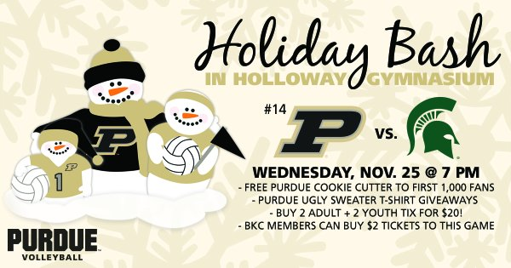
Another great way to tie into the holidays is to create a themed promo like this one from Purdue

Slide 23
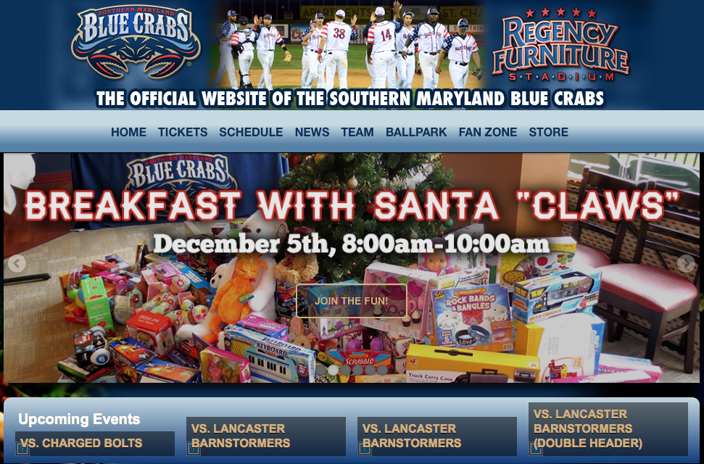
Make it an event: Creative holiday branding from the Blue Crabs baseball club!

Slide 24
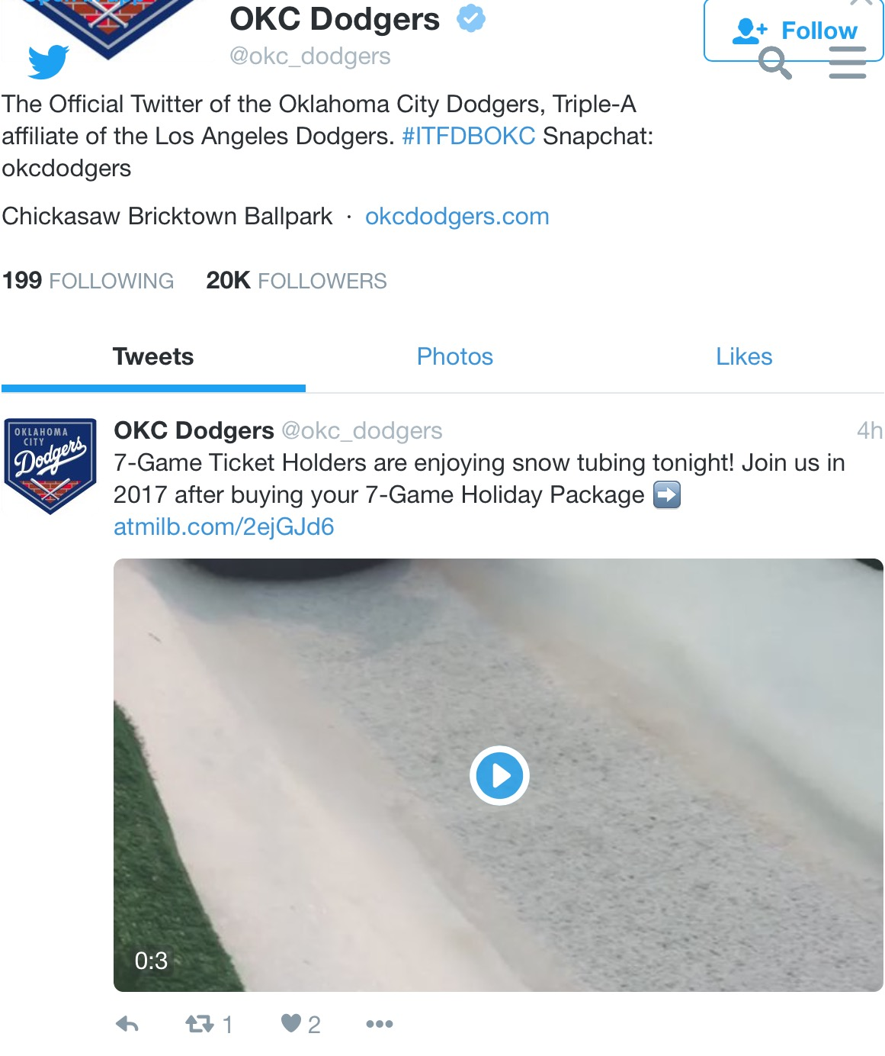
The OKC Dodgers rewarded ticket buyers with a snow tubing event…great way to sell more ticket packages and create loyalty with existing fans

Slide 25
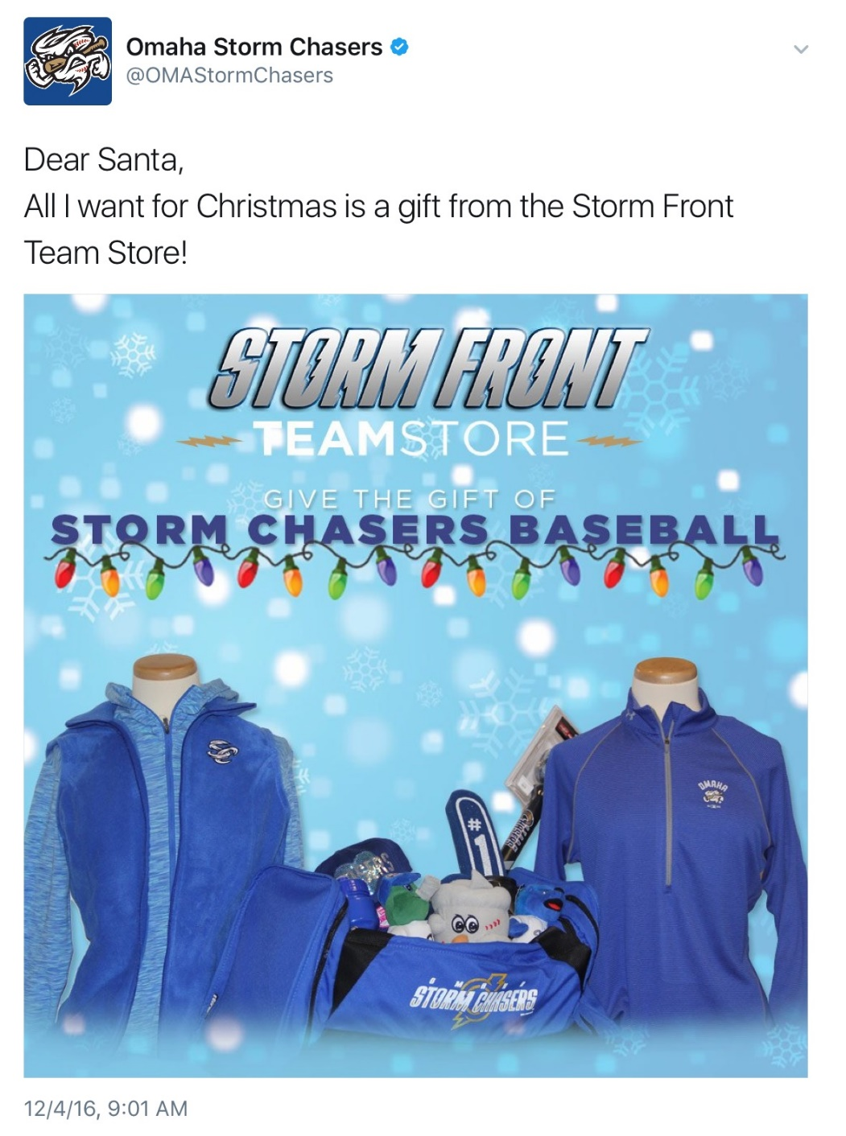
Like almost any good sports marketing promotion, spreading the word through social media is key!

Slide 26
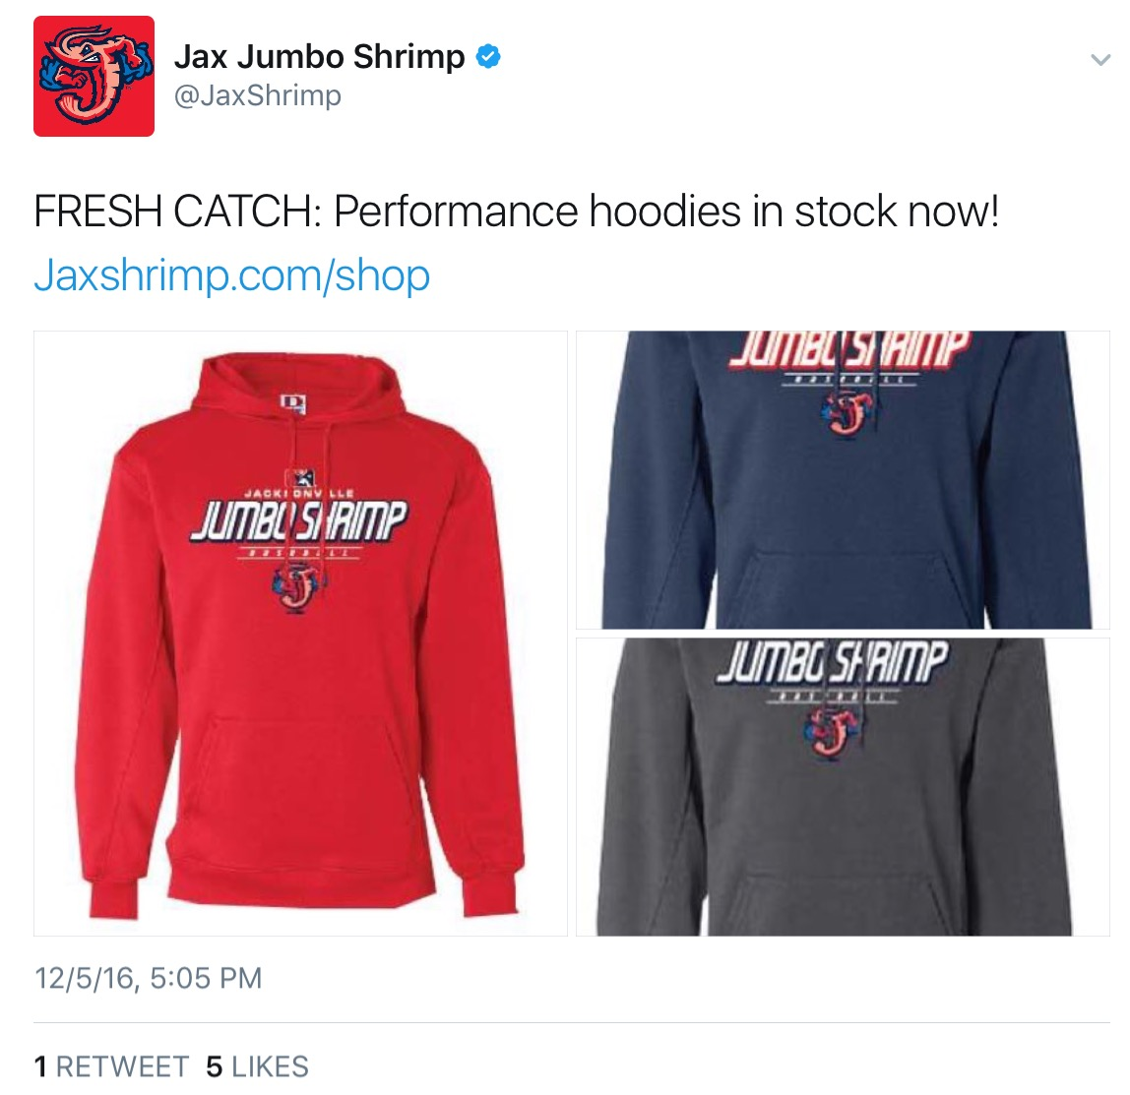
Creativity is key to grabbing the attention of fans like the Jacksonville Jumbo Shrimp’s “FRESH CATCH” Twitter post!

Slide 27
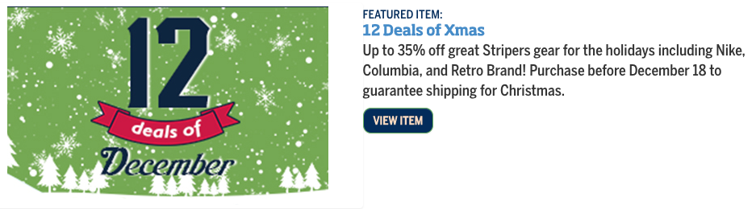
The Gwinnett Stripers didn’t limit their promotion to a single day, instead launching a “12 Deals of December” promotion on team-branded merchandise

Slide 28
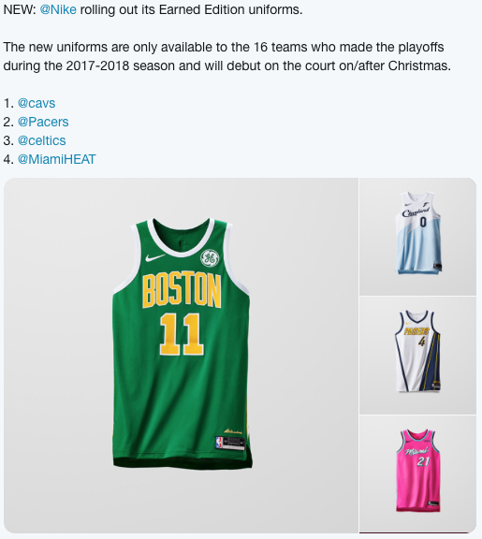
Nike once leveraged Xmas Day games to generate buzz for NBA gear w/ the debut of these “Earned Edition” uniforms

Slide 29
Since 1997, Taylor University's "Silent Night" game promotion has featured fans keeping quiet until the 10th point, an event that generates national publicity for the school
https://youtu.be/YSiumKaPnyc
Click here for a short ESPN video story about the promotion.
Could your school come up with a similar tradition for a home game?

Slide 30
Sports Marketing Holiday Promotions
DISCUSSION QUESTIONS

Slide 31
1) What is promotion? What are the different forms of promotion?
2) Why do teams offer promotional discounts on products like tickets and merchandise?
3) Why do you think some teams might choose not to participate in sales events like Black Friday or Cyber Monday?
4) Why do you think teams build promotions with holiday-based themes?

Slide 32
5) Do you think it is more difficult to attract crowds to sporting events during the holidays? Why or why not?
6) Review each of the promotional slides included in this presentation. What makes each promotion unique?
7) What were they trying to sell? What incentive were they giving to encourage consumers to purchase?
8) If your class was responsible for building a holiday-themed marketing campaign for your high school athletics, what types of promotions would you offer?

