Slide 1
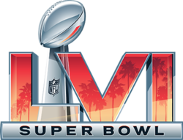
Super Bowl Ad Trivia
Brand Identification, 2022 Super Bowl Ads

Slide 2
Commercial #1

Slide 3
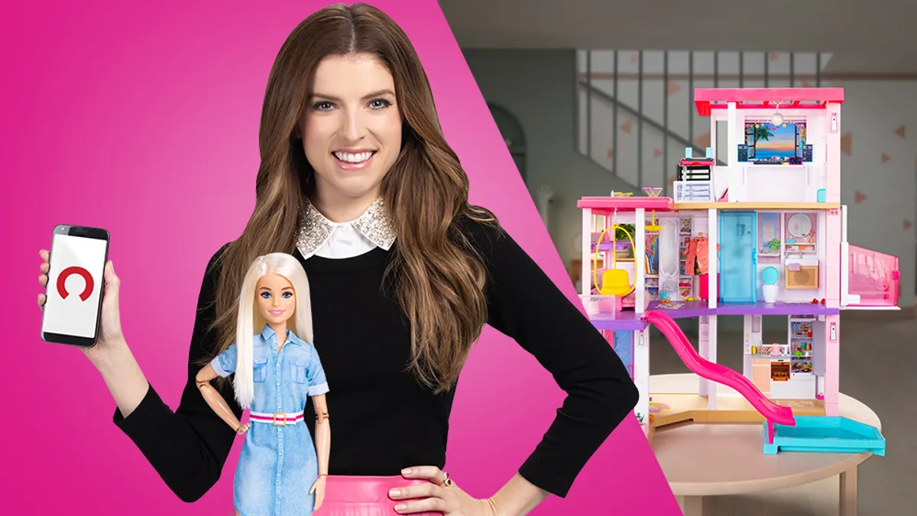
One company placed first in USA TODAY's Ad Meter with a spot that featuring Anna Kendrick & Barbie.
What company was it?

Slide 4
Commercial #2

Slide 5

One company aired a Super Bowl commercial with a product that could read minds.
What was the company?

Slide 6
Commercial #3

Slide 7
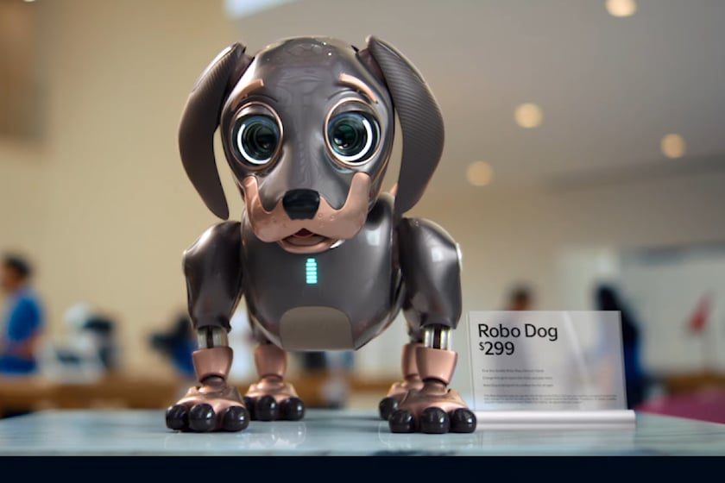
Kia Motors chose feature a “RoboDog” in its Super Bowl LVI commercial…
What was being advertised?

Slide 8
Commercial #4

Slide 9

A cryptocurrency ad included a QR code that crashed the company’s app.
What was the name of the company?

Slide 10
Commercial #5

Slide 11
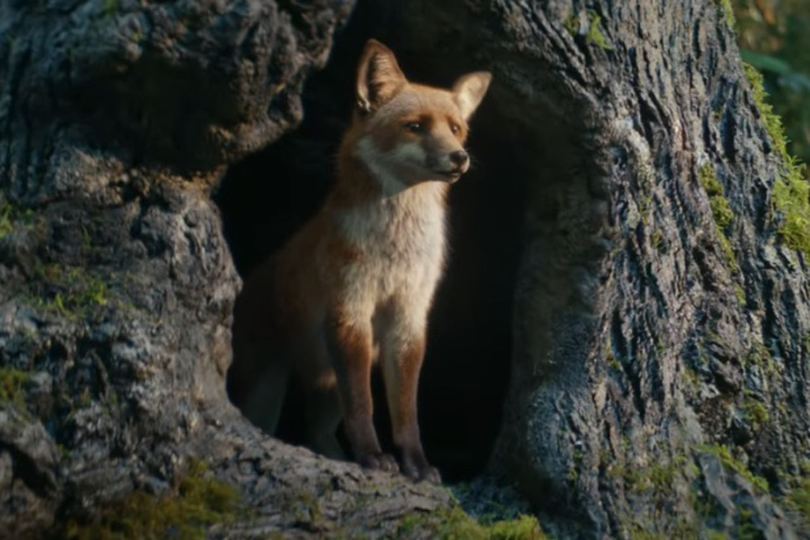
One brand licensed the song “Push It” by Salt-N-Pepa for their Super Bowl commercial…the ad featured a beatboxing fox (voiced by Charlie Puth)
What products were being advertised?

Slide 12
Commercial #6

Slide 13
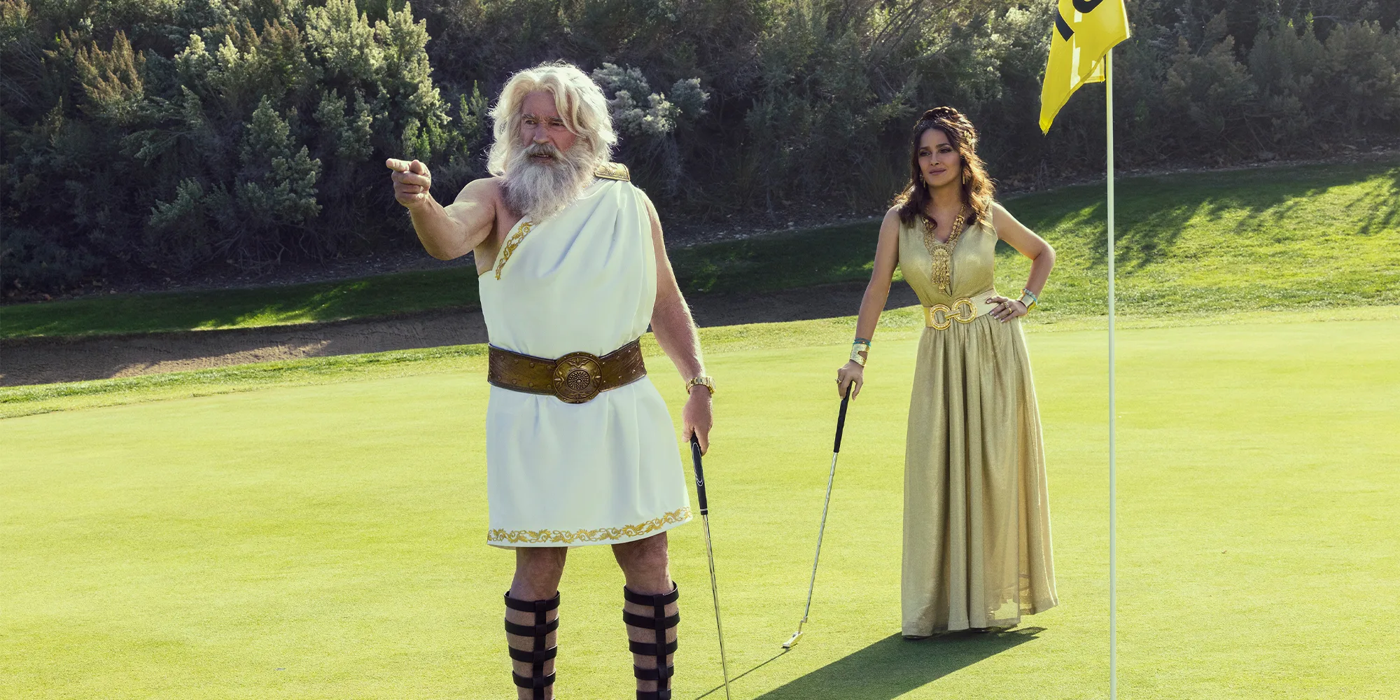
BMW’s ad has been viewed 9.7 million times on YouTube, more views than almost any other Super Bowl ad so far. The spot featured Greek Gods Zeus and Hera.
What brand was it and what were they advertising?

Slide 14
Commercial #7

Slide 15
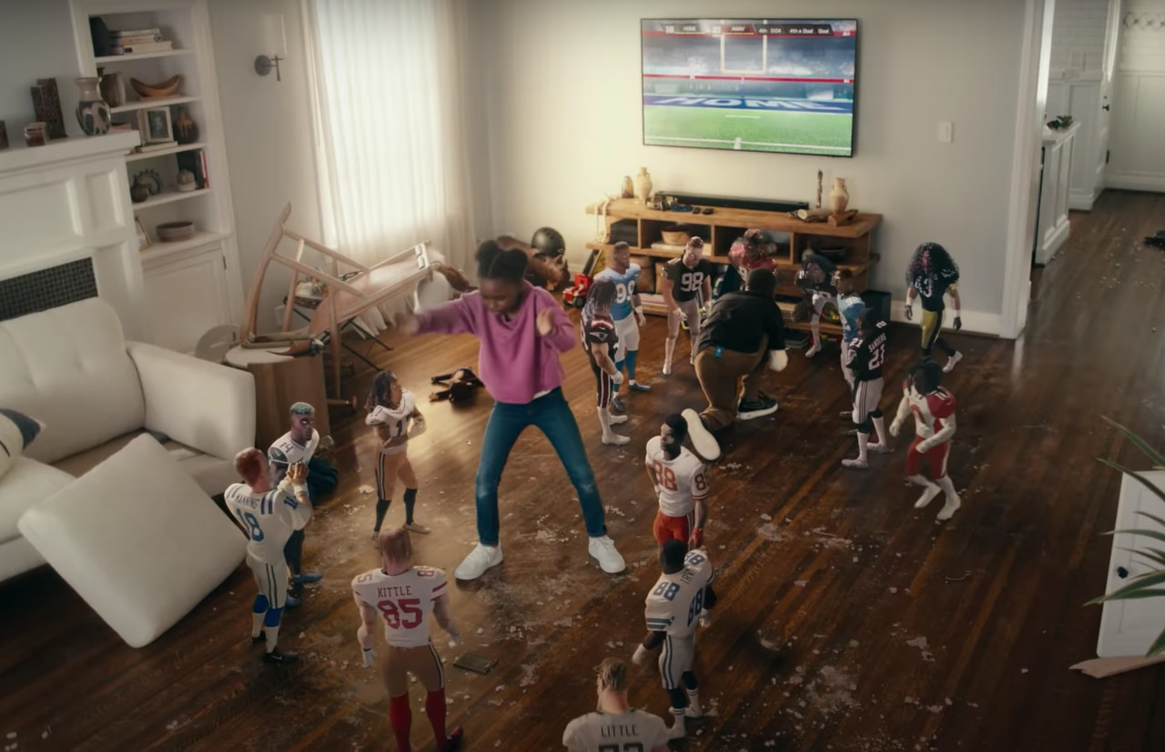
One commercial used 3D technology to animate some of the most popular NFL players, both current and all-time.
Who was the advertiser?

Slide 16
Commercial #8

Slide 17
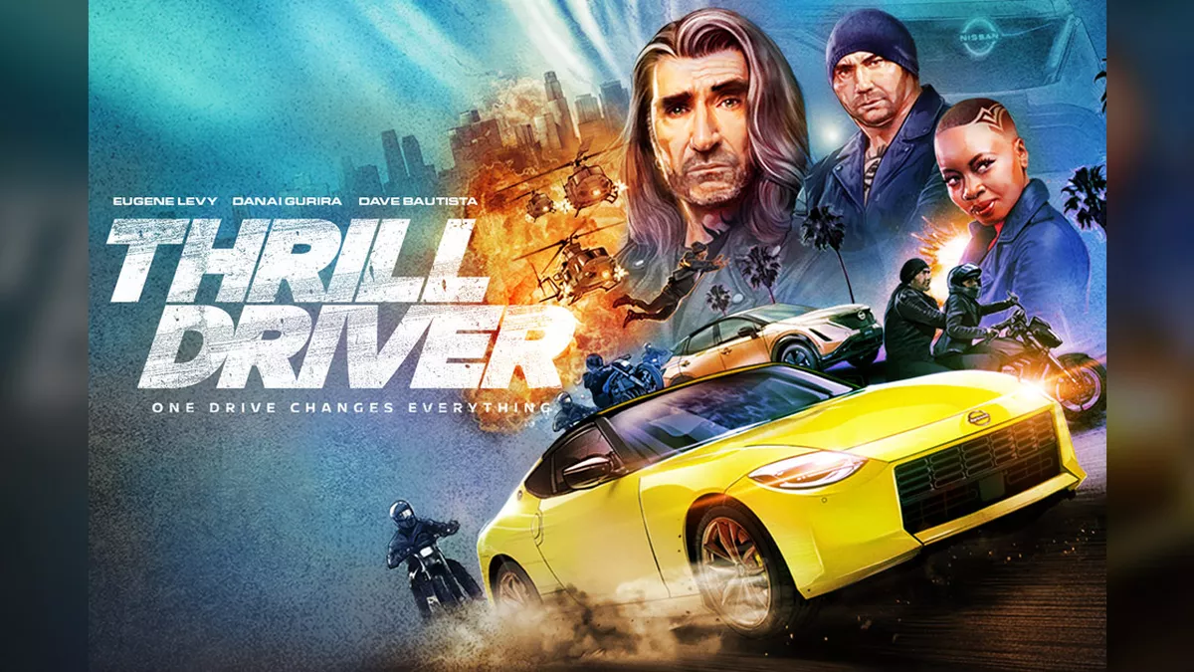
One ad featured a star-studded cast of actors, starring Eugene Levy as a stunt driver, called “Thrill Driver”
What brand of vehicle was being advertised?

Slide 18
Commercial #9

Slide 19
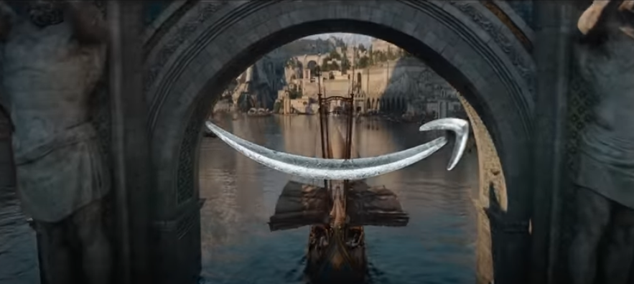
Amazon Prime Video aired a film trailer for an upcoming series during the Super Bowl.
What is the name of the new series?

Slide 20
Commercial #10

Slide 21
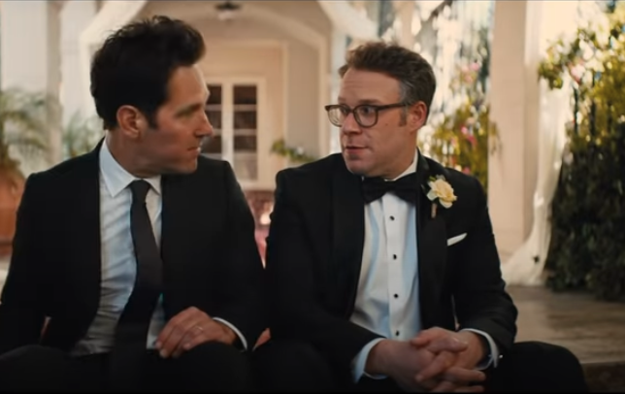
Which brand featured Seth Rogen and Paul Rudd in their spot entitled “Golden Memories”?

Slide 22
ANSWERS

Slide 23
Commercial #1

Slide 24
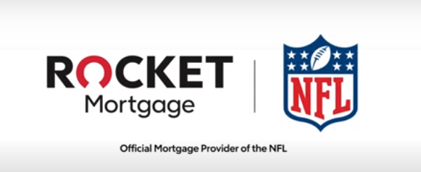
Rocket Homes / Rocket Mortgage placed first in USA TODAY's Ad Meter with a spot featuring Anna Kendrick and Barbie shopping for a “Dream Home.” The company also scored the top spot in last year’s Super Bowl, according to USA Today’s Ad Meter rankings.

Slide 25
Commercial #2

Slide 26
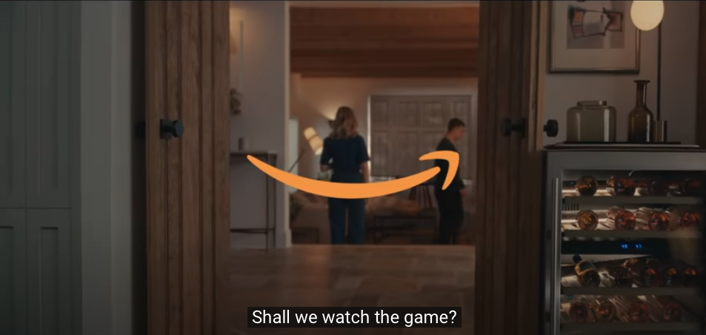
Amazon’s Super Bowl commercial featured a version of Alexa that knew what the characters were thinking by reading their minds…

Slide 27
Commercial #3

Slide 28
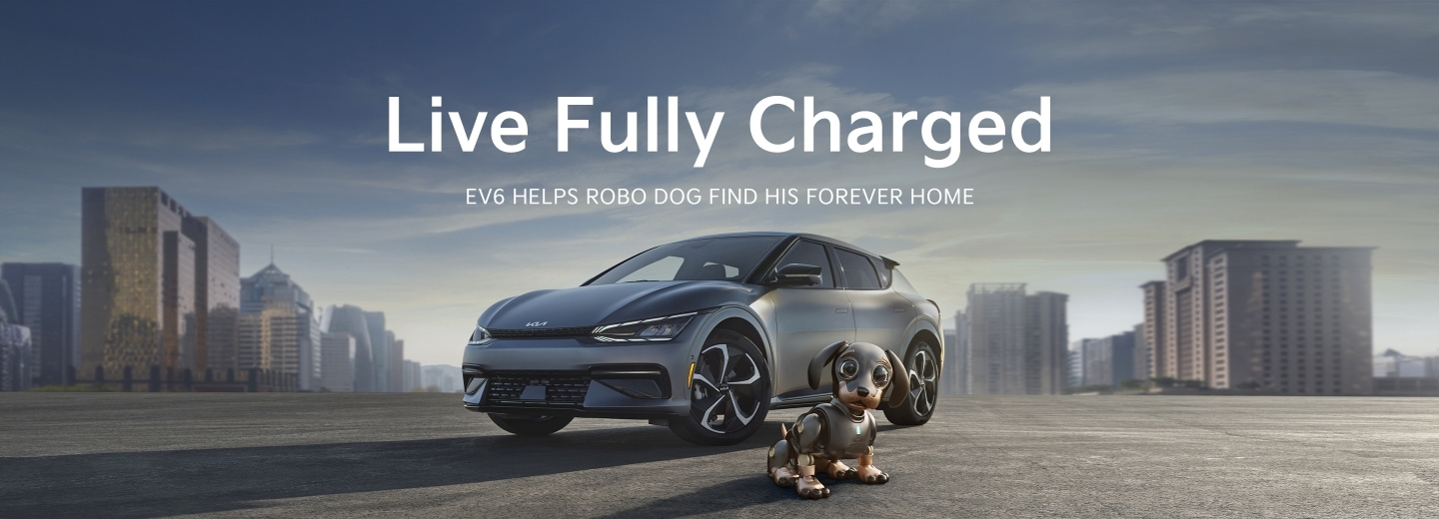
Kia was promoting its electric vehicles with this year’s “RoboDog” Super Bowl spot. It ranked 6th in the USA Today Ad Meter.

Slide 29
Commercial #4

Slide 30
Coinbase, a cryptocurrency company, aired an that featured a QR code that crashed the company’s app.

Slide 31
Commercial #5

Slide 32
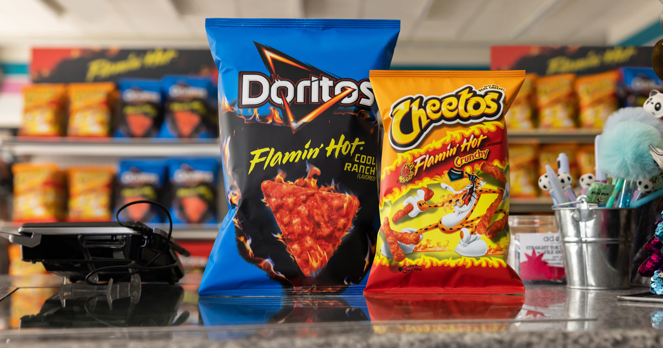
Flamin’ hot Cheetos AND Doritos were featured in the “Push It” themed Super Bowl LVI spot

Slide 33
Commercial #6

Slide 34
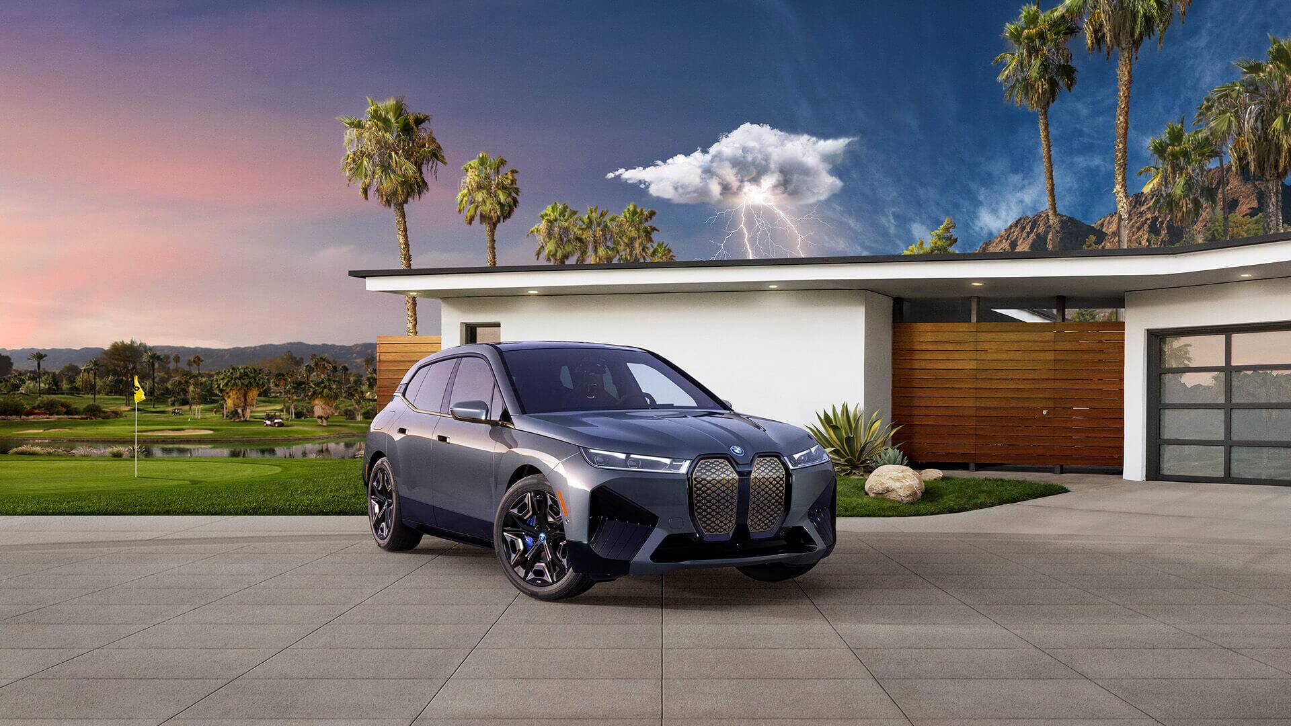
BMW’s ad has been viewed 9.7 million times on YouTube, more views than almost any other Super Bowl ad so far. The spot featured Greek Gods Zeus and Hera.
They were advertising the brand’s new fully electric vehicle

Slide 35
Commercial #7

Slide 36
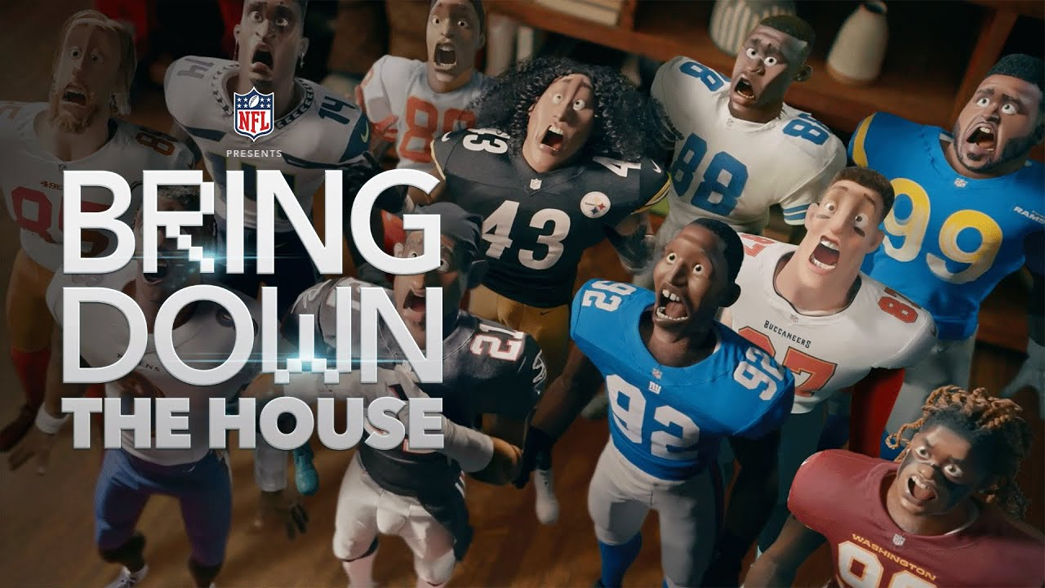
The NFL’s own commercial, called “Bring Down the House”, used 3D technology to animate some of the most popular players in league history.

Slide 37
Commercial #8

Slide 38
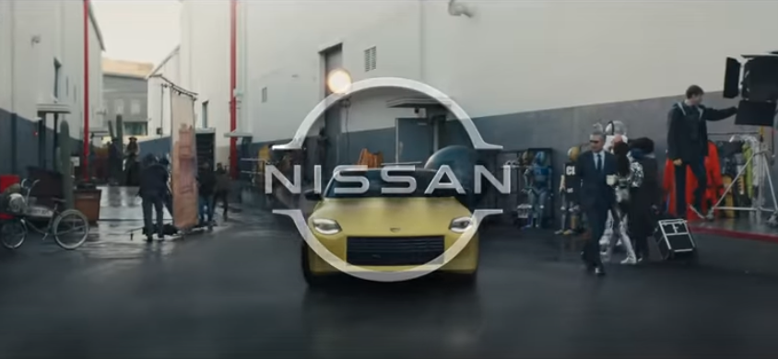
Nissan’s ad featured a star-studded cast of actors, starring Eugene Levy as a stunt driver, called “Thrill Driver”

Slide 39
Commercial #9

Slide 40
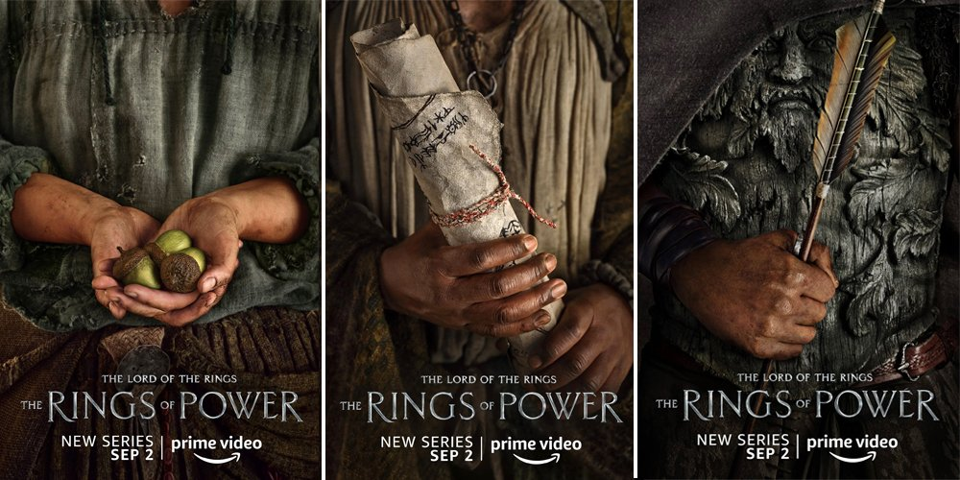
Amazon Prime Video aired a film trailer for the upcoming series The Lord of the Rings - The Rings of Power during the Super Bowl.

Slide 41
Commercial #10

Slide 42
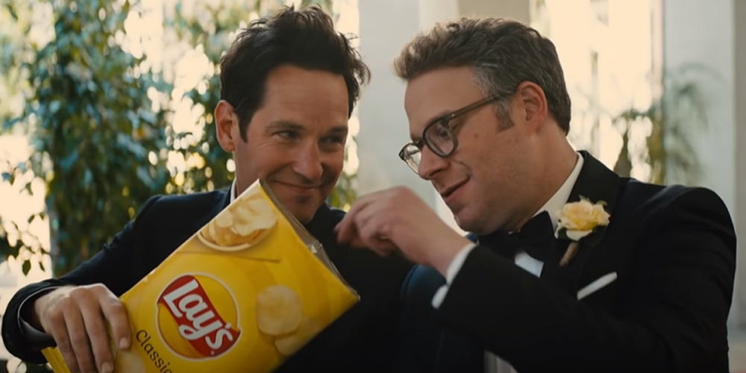
Lay’s featured Seth Rogen and Paul Rudd in their spot entitled “Golden Memories”?

Slide 43
Discussion Questions

Slide 44
Discussion Questions
What is advertising recall?
Why is it important to advertisers?
What is ROI as it relates to advertising?
Why is ROI important to advertisers?
Why do you think it is especially important when it comes to advertising during the Super Bowl?

