Slide 1
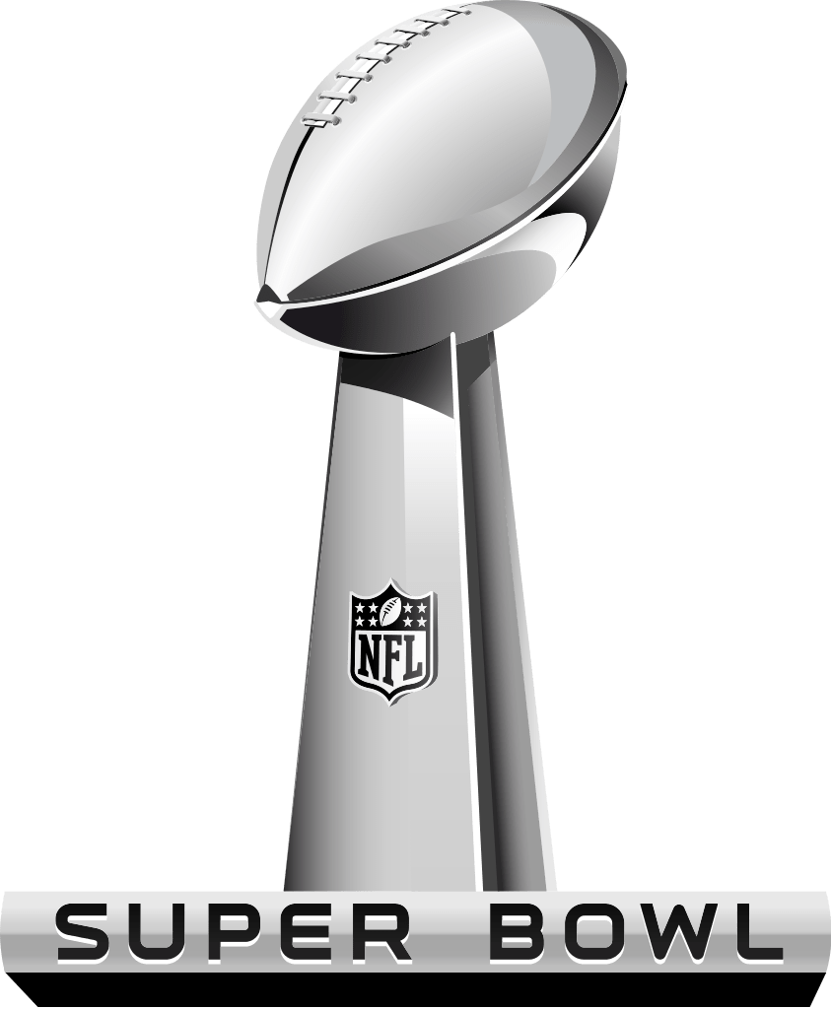
Super Bowl LVI
FUN FACTS

Slide 2
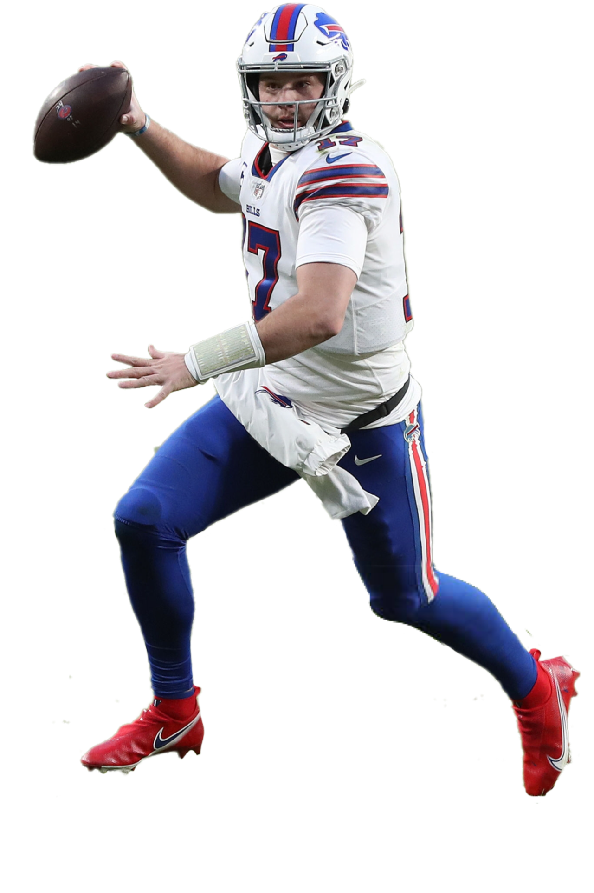
$35 million
According to Spotrac, Buffalo Bills’ QB Josh Allen was the highest paid NFL player this season, earning nearly $47 million in salary and incentives.

Slide 3
$23 million
Earning $23 million, Los Angles Rams’ Matt Stafford was the 15th highest paid player in the league and 13th among quarterbacks.

Slide 4
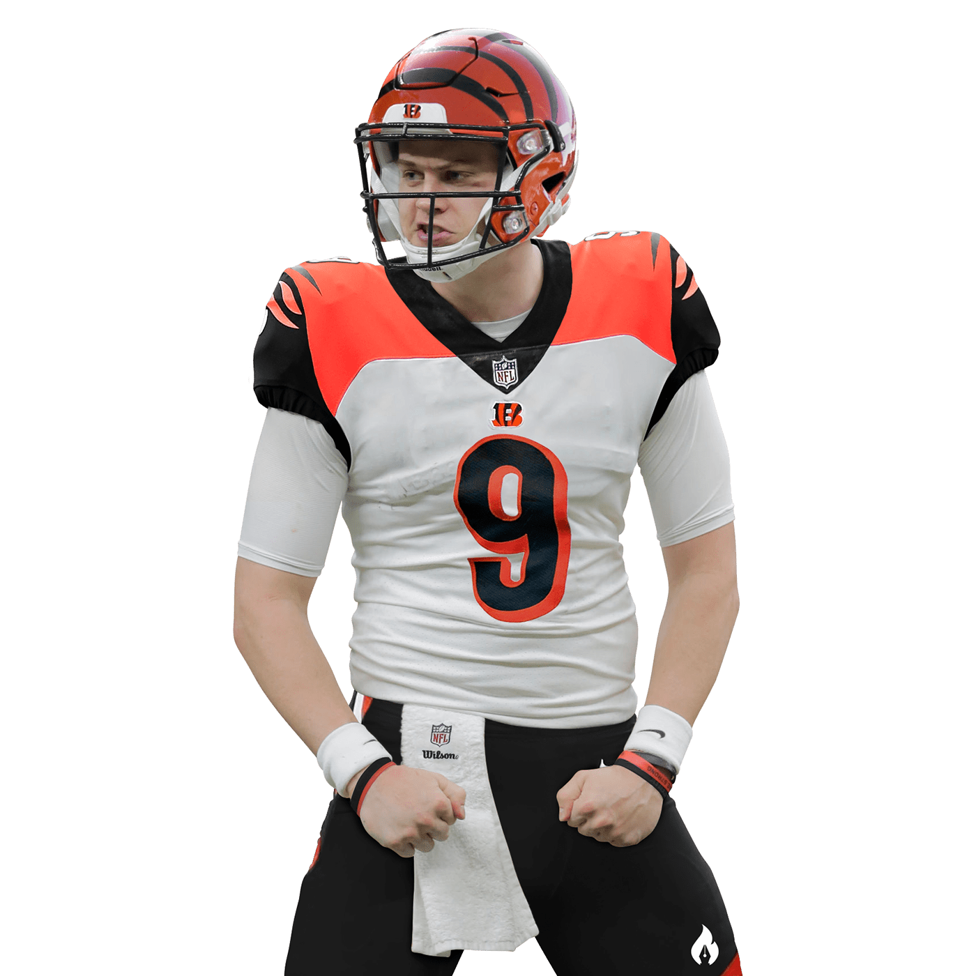
309th
In the second year of his first NFL contract, Bengals’ QB Joe Burrow earned $3.9 million, making him the 309th highest-paid NFL player.

Slide 5
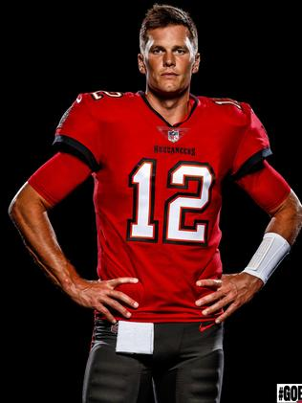
$475 million
Tom Brady retired at the end of the season after raking in $477 million in salary and endorsements throughout his 22-year storied NFL career.

Slide 6
$450 million
In 2020, Patrick Mahomes signed a 10-year, $450 million contract extension with the Chiefs, making him the highest paid QB in NFL history.

Slide 7
1%
At a league average of nearly $900,000 in salary, most NFL players rank within the top 1% of income earners globally.

Slide 8
$150,000
Players on teams who play in the Conference Championship Game earn a $65,000 bonus while the losing team in the Super Bowl receives $75,000 and players on the winning team get $150,000.

Slide 9
$750,000
Prior to this year’s game at SoFi Stadium in L.A., the most ever paid for a luxury suite at the Super Bowl was $750,000 for a box at Super Bowl LIV in Miami, in February 2020, according to the NFL.

Slide 10
$1 million+
This year, however, the NFL says that they have already sold multiple luxury suites for more than $1 million, despite SoFi Stadium having 90-plus more suites than Hard Rock Stadium in Miami.

Slide 11
26
In the last decade (2010-2020) Bud Light has aired more Super Bowl commercials than any other brand, advertising during the Big Game 26 times (Doritos is second on the last with 19 commercials).

Slide 12
$42,500
In 1967, the first-ever Super Bowl, the cost of a 30-second commercial was $42,500. Like this year, the game took place in the city of Los Angeles.

Slide 13
$525,000
By 1985, the going rate had increased to $525,000 for a 30-second spot.

Slide 14
$1.15 million
Fast forward ten years to 1995 and the rate had nearly doubled to $1.15 million, marking the first time Super Bowl commercials commanded a seven-figure investment.

Slide 15
$5.5 million
Over the next 25 years, those prices would skyrocket:
2000: $2.1 million
2005: $2.4 million
2010: $2.95 million
2015: $4.25 million
2021: $5.5 million

Slide 16
1,995%
This year, at least one 30-second Super Bowl ad reportedly sold for over $7 million, representing a 1,995% increase from 1967 after adjusting for inflation.

Slide 17
$5.5 billion
At a total cost of $5.5 billion, SoFi is by far the most expensive stadium ever built. Metlife Stadium in New Jersey was built in 2010 at a cost of $2.03 billion. Allegiant Stadium in Las Vegas cost $1.9 billion and Wembley Stadium in London cost $1.88 billion.

Slide 18
$684 million
Compare that to Paul Brown Stadium, home to the Cincinnati Bengals, which cost $455 million ($684 million in 2020 dollars when adjusted for inflation) to build in 1998.

Slide 19
2
The Los Angeles Rams call the City of Los Angeles and SoFi Stadium home, making Super Bowl LVI just the second team to play the Super Bowl in its home stadium in NFL history. Oddly enough, the first team it ever happened was last year when the Tampa Bay Bucaneers hosted (and won) Super Bowl LV.

Slide 20
70,240
SoFi Stadium, at full capacity, can hold up to 70,240 fans for regular season football games. However, the stadium was designed with features that would allow capacity to expand to nearly 100,000 visitors for big events.

Slide 21
2
From 1995 to 2015, the city of Los Angeles did not have an NFL franchise. Now, they have two (the Rams and the Chargers), and both play their home games at SoFi Stadium.

Slide 22
2028
The stadium will also host the Summer Olympic Games in 2028 and the College Football championship in 2023. The venue also remains a possible host for the 2026 FIFA World Cup.

Slide 23
300
The area surrounding the stadium is known as “Hollywood Park”, part of a 300-acre development that will eventually include condos, a retail district, hotel and more.

Slide 24
3.5
In addition to the stadium, Hollywood Park now features a 6,000-seat YouTube Theater, a six-acre lake and a 12-acre park. The site is 3.5 times larger than Disneyland.

Slide 25
100%
Along with the lake and bioswales on site, the stadium's roof and underground cisterns collect and store rainwater for 100% of the site's irrigation needs.

Slide 26
120 yards
SoFi Stadium’s double-sided 4K videoboard which hangs from the center of the venue is 120-yards-long and weighs nearly 2.2-million-pounds.

Slide 27
96.4 million
The Bucs' 31-9 win over the Chiefs in last year’s Super Bowl averaged 96.4 million viewers on CBS. It was the least-watched Super Bowl since 2007.

Slide 28
102.1 million
When you include digital viewers who streamed the game, that total jumped up to 102.1 million, making the game the 11th most watched Super Bowl of all-time and the 12th most-viewed TV show of all time.

Slide 29
$0
How much did The Weeknd earn for last year’s half-time show performance? NOTHING. The NFL enforces a strict policy and does not pay any performers for half-time shows. This year’s halftime show will feature Dr. Dre, Snoop Dogg, Eminem, Kendrick Lamar and Mary J. Blige.

Slide 30
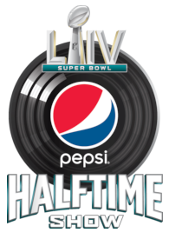
1,140%
That’s not to say artists don’t benefit.
After last year’s halftime show, streams of The Weeknd’s “House Of Balloons / Glass Table Girls” saw more than a 1,140% increase.

Slide 31
$5,300
Currently, the cheapest seats for the game (often referred to as the “get-in” price) cost more than $5,300. This illustrates the impact supply and demand can have on sports and entertainment events!

Slide 32
$9,086
Currently, the average price of tickets to Super Bowl LVI at SoFi Stadium is $9,086 on the secondary market, according to data from TicketIQ.

Slide 33
$12
Compare that to the very first Super Bowl in 1967 when tickets were just $12.00 (and even then, fans were outraged at the high cost of the tickets). This illustrates the economic principle of inflation.

Slide 34
$70,891
The most expensive ticket on the secondary market for Super Bowl LVI sold for nearly $71,000 on Seat Geek while Ticketmaster is selling “VIP” seats that $60,000, and that is before they tack on service fees.

Slide 35
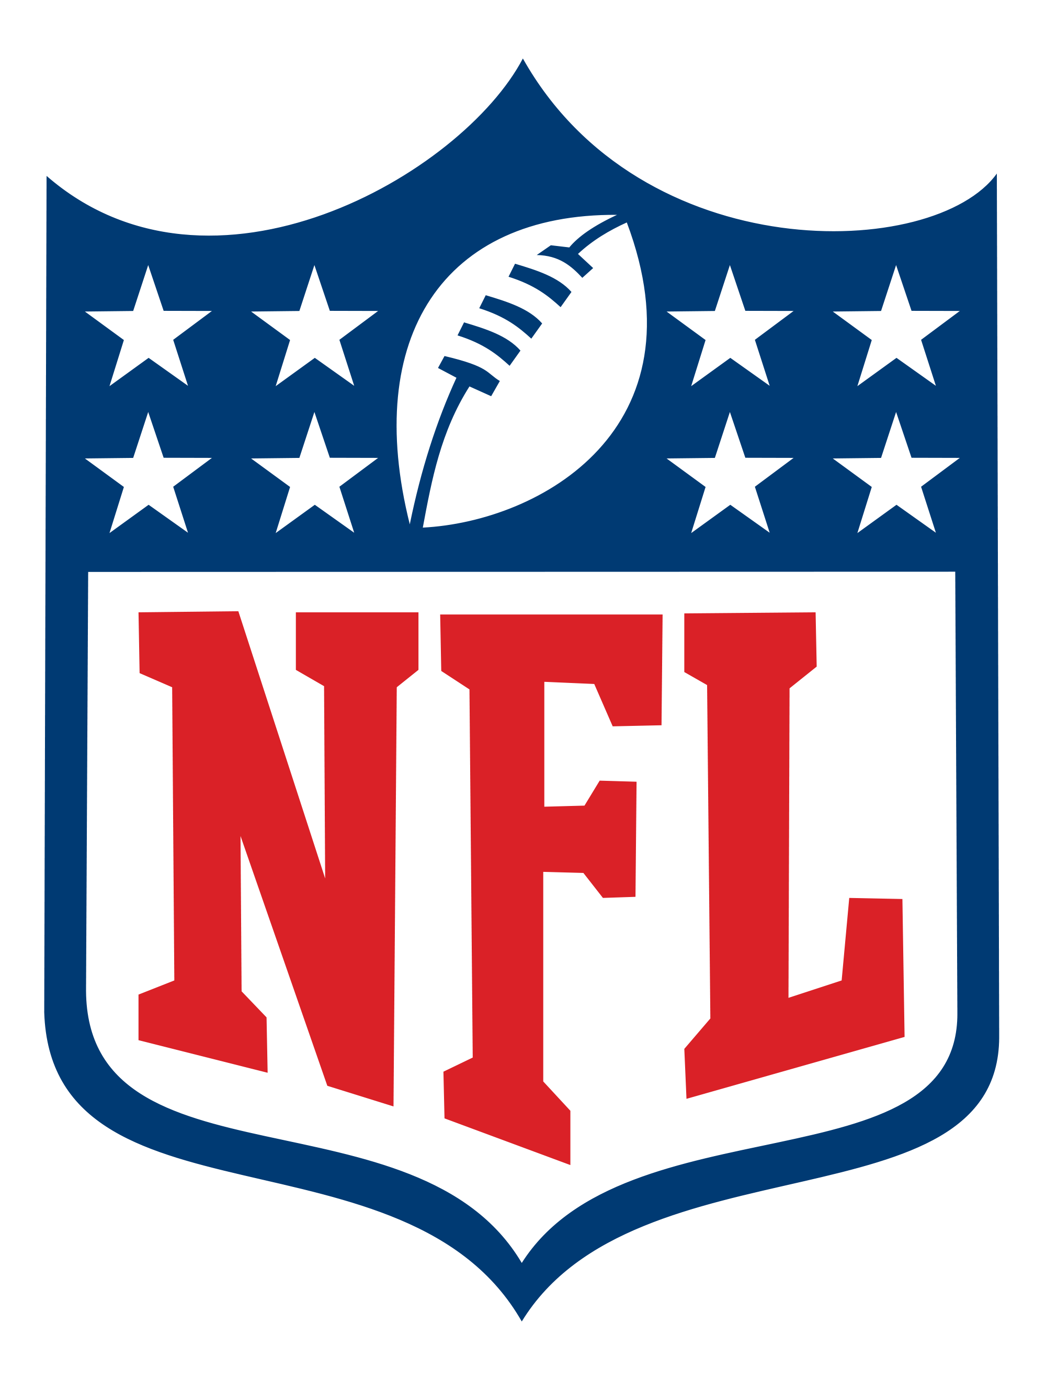
180
Super Bowl LV was broadcast in 180 different countries around the world and in 25 different languages.

Slide 36
1.5 million
On average, 1.5 million people call in sick to work the day after the Super Bowl. Three years ago, in a creative marketing stunt, Heinz (makers of the popular ketchup brand) created a petition to convert the Monday following last year’s Super Bowl to a National Holiday.

Slide 38
1988
In honor the Bengals’ first trip to the Super Bowl since 1988, Cincinnati Public Schools announced that they would be cancelling classes for Monday, February 14th (the day after the Big Game).

Slide 39
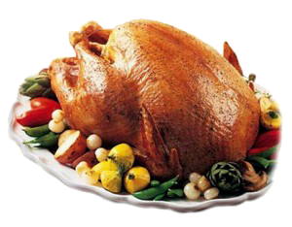
2
The Super Bowl is the second highest day of food consumption in the United States next to the Thanksgiving holiday.

Slide 40
62%
Super Bowl Sunday is the most popular grilling day of winter with 62% of BBQ owners firing up their grills for the Big Game!

Slide 41
#1
Vegetables at a Super Bowl party? That's right! In fact, the healthy treat is the top food eaten in homes during Super Bowl. However, various forms of dips are also a favorite among Super Bowl snackers with 32% saying they plan on eating some form of the snack.

Slide 42
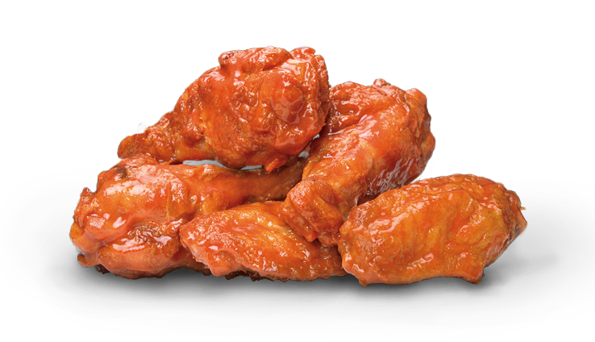
1.42 billion
The National Chicken Council predicts Americans will eat 1.42 billion chicken wings during Super Bowl LVI weekend.

Slide 43
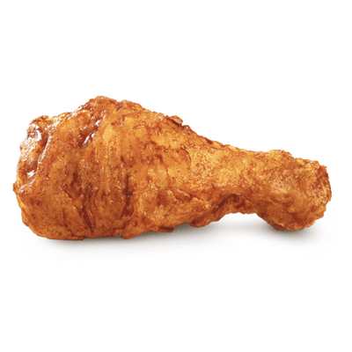
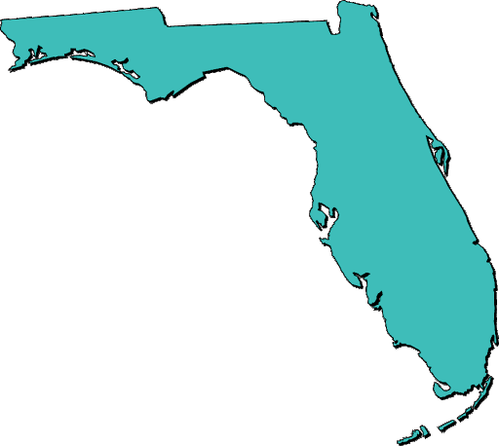
9
If that many wings were laid end to end, they would stretch the entire Florida coastline more than nine times.

Slide 44
17,108
If that many wings were laid end to end, they would stretch the entire Florida coastline more than nine times

Slide 45
162
Assuming Molly Schuyler, the world record holder for eating 501 wings in 30 minutes, could keep that pace – it would take her 162 years to eat 1.42 billion wings.

Slide 46
3x
42 billion wings could circle the circumference of the Earth 3 times.

Slide 47
37.3%
Wing sales in Cincinnati have seen a 27.6 percent growth during the NFL playoffs and Los Angeles a 37.3 percent increase compared to the same period last year.

Slide 48
30%
The Super Bowl is one of the biggest day of the year for pizza sales. According to Domino’s website, the popular chain typically sells around 2 million pizzas on Super Bowl Sunday – about 30% more than on a normal Sunday.

Slide 49
17
In a non-pandemic year, the number of people, on average, at a typical Super Bowl party is 17.

Slide 50
90 million
This year, 90 million people are planning to throw or attend a party, up from 62.8 million last year, and another 13.7 million adults plan to watch the game at a bar or restaurant.

Slide 51
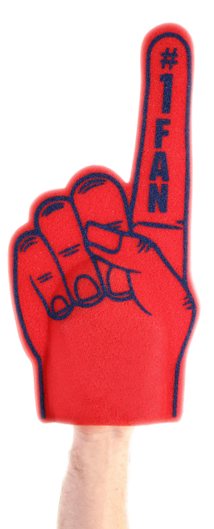
$78.92
American adults plan to spend an average of $78.92 per person and a total of $14.6 billion nationwide as they watch Super Bowl LVI, according to the National Retail Federation.

Slide 52
78%
78% of fans would rather watch the Super Bowl with commercials. 70% will pay attention to ads before the game and 45% will seek out ads before kickoff (A 350% increase since 2010).

Slide 53
52%
Post-game, viewers are as likely to talk about Super Bowl ads as they are plays. More than half (52%) will re-watch ads after the game.

Slide 54
24
24 different stadiums have played host to the Super Bowl over the years. Miami has been the site of the Big Game 11 different times, more than any other city.

Slide 55
$50,000
The Vince Lombardi Trophy, awarded to the Super Bowl winner, costs $50,000 to and its iconic design is featured in the Super Bowl logo. Tiffany’s has been producing the trophy since the first Super Bowl way back in 1967.

Slide 56
Discussion Questions, Fun Facts & Trivia

Slide 57
Trivia Question
Only three state capital cities have played host to a Super Bowl.
Who are they?

Slide 58
Trivia Answer
Indianapolis, Atlanta and Minneapolis-St. Paul (last year) are the only U.S. capital cities to host a NFL Super Bowl

Slide 59
Trivia Question
Why does each Super Bowl contain a unique set of roman numerals in the game’s name?

Slide 60
Trivia Answer
The Super Bowl is measured in Roman numerals because a football season runs over two calendar years

Slide 61
Trivia Question
Only four NFL teams have NEVER played in a Super Bowl.
Who are they?

Slide 62
Trivia Answer
The Detroit Lions, Cleveland Browns, Jacksonville Jaguars and Houston Texans have never appeared in the Super Bowl.

Slide 63
Fun Facts!
According to msn.com, today’s Super Bowl rings cost an estimated $6,000 to make on average (and are worth far more on the open market as collectors' items).
Compare that to the average NFL salary in 1958 which was $10,000.

Slide 64
Show of Hands:
* How many plan to watch the game?
* How many will watch on a mobile device?
* How many will watch with friends?
* How many will attend a party or gathering?
* How many will buy food or snacks?

Slide 65
Questions for Class Discussion
Why does the NFL bring in “big name” performers (like Dr. Dre, Snoop, Eminem, Kendrick Lamar & Mary J. Blige) for the Super Bowl halftime show?
Can you name five other performers who have played the halftime show in the past?

Slide 66
Questions for Class Discussion
What are naming rights? Why do companies invest in naming rights?
Who owns the naming rights to the stadium playing host to this year’s Super Bowl? What type of business is it?

Slide 67
Questions for Class Discussion
How do you think hosting the Super Bowl in a stadium bearing the name “SoFi Stadium” might benefit the company and their brand?
What are the different ways stadium projects are usually financed? Who paid for the construction of SoFi Stadium?

Slide 68
Questions for Class Discussion
Hosting a mega-event like the Super Bowl is a massive undertaking for a host city like Los Angeles. Create a list of factors the city must consider when planning an event like this to insure a successful event (security, staffing, lodging, safety etc). Why might volunteers be important to the event?

Slide 69
Questions for Class Discussion
Based on the figures you saw in this presentation; the Super Bowl is obviously big business. What types of companies stand to gain the most during the Super Bowl from a sales perspective?

Slide 70
Questions for Class Discussion
What is supply and demand?
How do you think supply and demand impacts the ticket prices for the Super Bowl?
Why do you think this year’s Super Bowl tickets are setting record high prices?

Slide 71
Questions for Class Discussion
What are ratings? Why is viewership an important figure to consider?
Who are those numbers important to?
What are broadcast rights?

Slide 72
Questions for Class Discussion
Why do you think CBS is charging so much for a 30 second advertisement during the game?
Why would a company spend that much (in some cases purchasing more than one ad slot)?

Slide 73
Questions for Class Discussion
The concept of “ambush marketing” was not addressed in the previous slides.
What is ambush marketing and why is it relevant when it comes to discussing the business of the Super Bowl?

Slide 74
Questions for Class Discussion
Do you think Super Bowl advertisers invest only in the cost of the advertisement during the game or do they spend more money on tying other promotions to the Big Game as well? Can you think of an examples?

Slide 75
Questions for Class Discussion
Who do you think will win Super Bowl LIV???

Slide 76
SOURCES

Slide 77
SOURCES
https://nrf.com/media-center/press-releases/consumers-say-theyll-spend-average-81-super-bowl
https://autos.yahoo.com/nfl-sells-first-million-dollar-105538355.html
https://huddleup.substack.com/p/the-financials-behind-the-super-bowl
https://www.nationalchickencouncil.org/americans-projected-to-eat-1-42-billion-chicken-wings-for-super-bowl-lvi/
https://www.cincyjungle.com/2022/2/1/22911919/cincinnati-schools-closed-monday-after-super-bowl-56-bengals-news
https://www.foxbusiness.com/sports/super-bowl-2022-ticket-prices-nfl
https://thesource.com/2021/02/09/the-weeknd-sees-over-200-increase-in-spotify-streaming-numbers-following-super-bowl-performance/
https://www.cnbc.com/2021/02/09/super-bowl-ratings-game-fails-to-attract-more-than-100-million-viewers.html
https://www.forbes.com/sites/timnewcomb/2022/02/01/sofi-stadium-6-things-you-didnt-know-that-make-this-super-bowl-stadium-different/
https://www.spotrac.com/nfl/rankings/cash/quarterback/
https://www.stubhub.com/super-bowl-tickets/grouping/542/

