Slide 1
beijing 2022
by the numbers
The Business of Sports & Entertainment
www.sportscareerconsulting.com

Slide 2
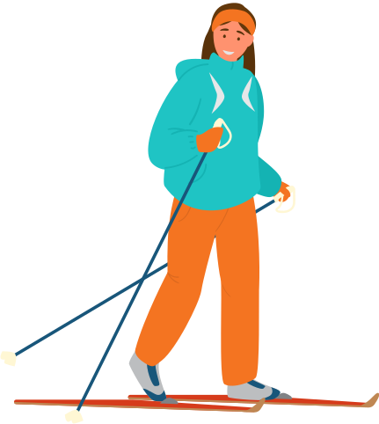
WHAT CAN THE 2022 WINTER GAMES TEACH US ABOUT SPORTS AND ENTERTAINMENT MARKETING?
www.sportscareerconsulting.com

Slide 3
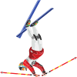
DURING THE BEIJING GAMES, YOU WILL SEE HUNDREDS OF EXAMPLES OF TOPICS discussed in class!
www.sportscareerconsulting.com

Slide 4
THE BUSINESS OF SPORTS & ENTERTAINMENT
SPORTS
ENTERTAINMENT
BUSINESS
ECONOMICS
GLOBAL PRODUCT CONSUMERS
FANDOM
BROADCASTS
TICKETS
SALES
PRICING
MARKETING
MANAGEMENT
CAREERS
SOCIAL ISSUES
ATHLETES
ENTERTAINERS
VIEWERSHIP
STADIUMS
VENUES
DIGITAL
APPS
SOCIAL MEDIA
STREAMING
SPONSORSHIP
BRANDING
LICENSING
MERCHANDISE
EVENTS
PUBLICITY
PR
SUSTAINABILITY
www.sportscareerconsulting.com

Slide 5
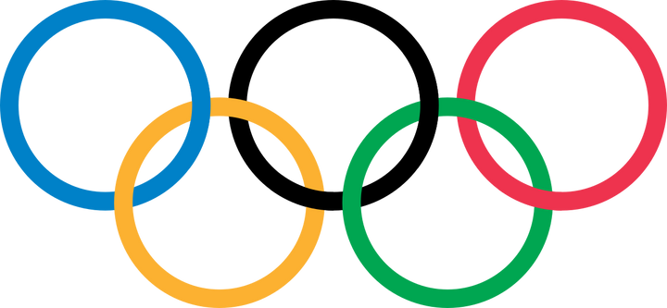
BEIJING
2022

Slide 6
20M
2,303
Beijing is the capital of China, and its population is over 20 million. It is one of the largest cities in the world.
Beijing is the biggest city ever to host the Winter Olympic Games. The next closest is Vancouver, British Columbia, with 2.5 million residents. The smallest city is the village of Lake Placid, NY, who hosted the 1980 Winter Games with a population of just 2,303.
www.sportscareerconsulting.com

Slide 7
3,000
Nearly 3,000 athletes will compete at the Beijing Winter Games
1ST
Beijing will become the first city to have hosted both the Winter and Summer Olympics
www.sportscareerconsulting.com

Slide 8
12
Twelve countries have sent athletes to every Winter Olympic Games: Austria, Canada, Finland, France, Great Britain, Hungary, Italy, Norway, Poland, Sweden, Switzerland and the United States.
1
Only one Country, the United States, has earned gold at each of the Winter Olympic Games.
www.sportscareerconsulting.com

Slide 9
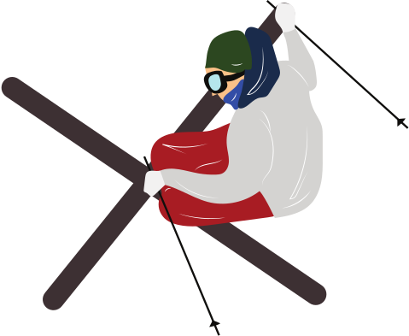
7
The 2022 Winter Games will feature 7 new events: Women's monobob, men and women's big air skiing, mixed team relay in short track speedskating, mixed team ski jumping, mixed team snowboard cross and freestyle skiing mixed team aerials
15
Athletes will compete in 15 disciplines at the Beijing Games
www.sportscareerconsulting.com

Slide 10
0
17
The U.S., U.K., Canada and Australia have joined together for a “diplomatic boycott”—meaning no government officials will attend the 2022 Beijing Winter Olympics, though athletes from the countries will still compete.
The event will span a period of 17 days
www.sportscareerconsulting.com

Slide 11
1ST
45%
This still represents the most gender equality the Olympic Games, both Summer in Tokyo and Winter in Beijing, have seen in the event's history...progress, but still work to be done
Of the participating athletes in Tokyo for the 2020 Games, 51% were male and 49% were female. By contrast, 45% of the athletes competing at the Winter Games will be female.
www.sportscareerconsulting.com

Slide 12
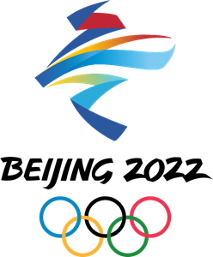
EVENT MANAGEMENT
THE BUSINESS OF SPORTS & ENTERTAINMENT

Slide 13
13
In total, 13 venues, split between the zones of Beijing, Zhangjiakou and Yanqing, will be used the Games. One new venue, the National Speed Skating Oval, was built in Beijing, and existing venues are being renovated for the Games.
109
109 sets of medals will be awarded, seven more than there were at PyeongChang 2018.
www.sportscareerconsulting.com

Slide 14
71
750K
Beijing 2022 organizers reported 71 new cases of COVID-19 over the weekend leading up to the Winter Games, bringing the total to almost 250 cases linked to the Beijing Olympics as just days ahead of the Opening Ceremonies
According to data provided by the local organizing committee, nearly 750,000 tests had been administered with the Games' goal of zero cases inside the "closed loop" (the Beijing Games version of a "bubble")
www.sportscareerconsulting.com

Slide 15
1M
19,000
Over 1 million people submitted applications for volunteer positions at the Beijing 2022 Olympic and Paralympic Winter Games. Among the successful candidates, the youngest volunteer is 19 years old and the eldest 63.
About 19,000 volunteers will help out in various roles during the 2022 Beijing Olympic Winter Games, each required to complete a four-stage training program in preparation
www.sportscareerconsulting.com

Slide 16
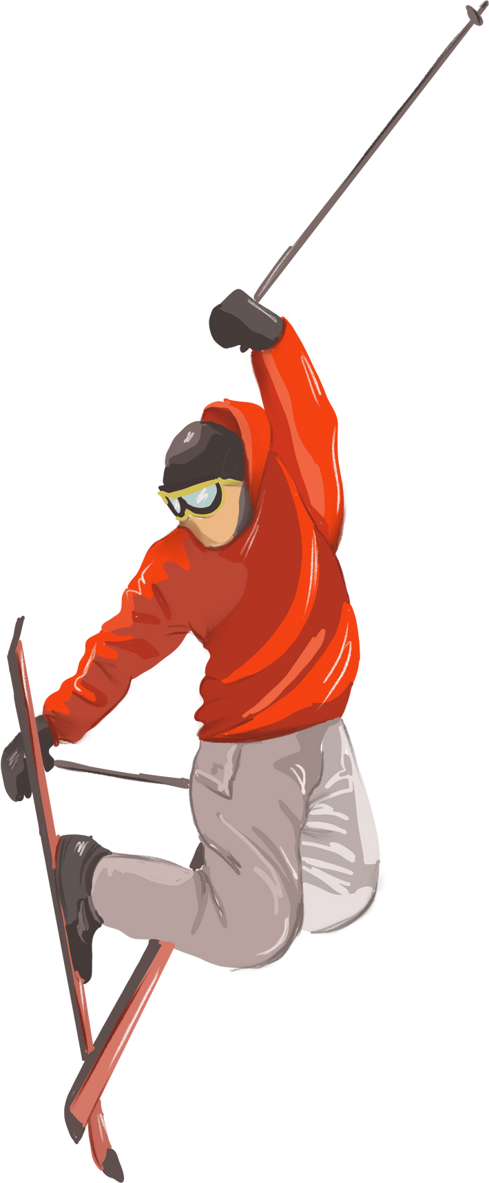
1.2M
It will require an estimated 49 million gallons of water, 130 fan-operated snow generators and 300 snowmaking guns to create the 1.2 million cubic meters of snow
100%
This year’s games in Beijing will be the first Olympic Games where 100% of the snow will be made artificially
www.sportscareerconsulting.com

Slide 17
SUSTAINABILITY
THE BUSINESS OF SPORTS & ENTERTAINMENT

Slide 18
100%
3
All Olympic venues at the 2022 Games in Beijing will be powered by 100 percent renewable energy
The top 3 finishers in each event will stand on podiums constructed from recyclable and environmentally friendly materials
www.sportscareerconsulting.com

Slide 19
1,807
600
The Beijing Games aim will use clean energy vehicles for transportation, including 370 pure electric vehicles, nearly 500 natural gas-fueled vehicles, and 1,807 hybrid vehicles
Beijing 2022 is also prioritizing plant and wildlife conservation. Nighttime construction was controlled to decrease light pollution, over 600 artificial nests were set up for birds, and tree removal was limited.
www.sportscareerconsulting.com

Slide 20
SPONSORSHIP
THE BUSINESS OF SPORTS & ENTERTAINMENT

Slide 21
13
The Beijing Games will feature 13 official "Worldwide" Olympic corporate partners, the most expensive sponsorship tier (the Tokyo Summer Games held last summer boasted a record 14 worldwide corporate partners)
2032
Many Beijing 2022 sponsors have contracts that run through the 2028 and 2032 Olympic Games
www.sportscareerconsulting.com

Slide 22
$835M
One report suggested that Toyota committed $835 million for an Olympic Games sponsorship deal from 2017 through ‘24
$200M
Basic, four-year sponsorship packages begin at around $200 million, but that price point is expected to increase for the 2024 and 2028 Summer Games
www.sportscareerconsulting.com

Slide 23
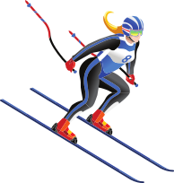
$400M
$1B
Skims, the underwear brand founded by Kim Kardashian, is the official official underwear, loungewear and pajamas for female members of Team USA. Last year, the company reported an increase in sales of 90% to $275 million. This year it projects sales to reach $400 million.
Collectively, the top 13 Olympic sponsors have contracts with the International Olympic Committee that add up to more than $1 billion.
www.sportscareerconsulting.com

Slide 24
BROADCASTING
THE BUSINESS OF SPORTS & ENTERTAINMENT

Slide 25
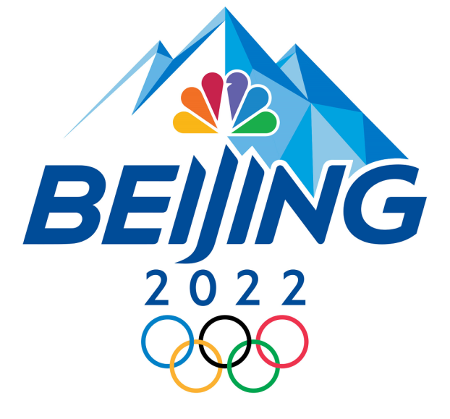
$7.65B
100
NBCUniversal paid $7.75 for the broadcast rights to the Summer and Winter Olympic Games through 2032.
NBC has about 100 advertisers signed up for the games. Returning advertisers are reportedly spending slightly more than they did four years ago during the PyeongChang Winter Games.
www.sportscareerconsulting.com

Slide 26
10%+
40
According to NBCUniversal, digital advertising revenue is up double digits for the Beijing Winter Games
Of the brands scheduled to air commercials during Beijing 2022 broadcasts, nearly 40 of them will be advertising during the Winter Games for the first time
www.sportscareerconsulting.com

Slide 27
740M
An Olympic record 739.4 million viewers in China saw at least one minute of the Opening Ceremony coverage in 2008. Beijing 2008 was the first truly digital Games with at least some events being broadcast on internet and mobile platforms for the first time.
$1.3M
The average cost for a 30-second primetime TV advertisement for the Tokyo Olympics last summer was an estimated $1.3 million.
www.sportscareerconsulting.com

Slide 28
46%
2,800
A recent poll found that 46% of Americans support the diplomatic boycott of the Beijing Winter Olympics, potentially impacting viewership numbers
NBCUniversal will present a Winter Olympics-record 2,800+ hours of coverage across its platforms at the Beijing Games
www.sportscareerconsulting.com

Slide 29
ECONOMICS
THE BUSINESS OF SPORTS & ENTERTAINMENT

Slide 30
$3.9B
$38.5B
It was reported by Chinese officials that the Winter Games would be the least expensive Olympics event to host in the last two decades with a price tag of $3.9 billion (compare that to the $42 billion Beijing spent on the 2008 Summer Games)
However, several independent reports suggest the Games would cost significantly more than that, with Business Insider suggesting the actual sum is in excess of $38.5 billion, 10 times the official budget.
www.sportscareerconsulting.com

Slide 31
$423M
2.5M
Beijing National Stadium (known as the "Bird's Nest"), the 80,000 seat stadium that will host the Opening and Closing Ceremonies, was constructed when the city hosted the 2008 Summer Games at a cost of $423 million
An economic impact study prior to the 2008 Summer Games suggested 600,000 foreign visitors and 2.5 million domestic Chinese tourists would visit Beijing for the event
www.sportscareerconsulting.com

Slide 32
TICKETS & HOSPITALITY
THE BUSINESS OF SPORTS & ENTERTAINMENT

Slide 33
0
30%
No tickets will be sold due to COVID-19. Chinese organizers have indicated that some invited fans will be permitted to attend, as long as they follow COVID-19 protocols.
However, Beijing Games organizers reportedly still hoped to reach 30% capacity in Olympic venues, despite banning ticket sales to the general public
www.sportscareerconsulting.com

Slide 34
ATHLETE COMPENSATION
THE BUSINESS OF SPORTS & ENTERTAINMENT

Slide 35
$37,500
$737K
A gold winner for Team USA earns $37,500 for the achievement, paid by the United States Olympic & Paralympic Committee (USOPC)
A gold medal winner from Singapore would receive an Olympic medal bonus of $737,000 — nearly 20 times more, driven by the government.
www.sportscareerconsulting.com

Slide 36
SOURCES
https://en.wikipedia.org/wiki/2022_Winter_Olympics
https://www.cnn.com/2022/01/17/sport/winter-olympics-explainer-beijing-2022-spt-intl/index.html
https://brightly.eco/winter-olympics-sustainability
https://www.nexttv.com/news/nbcu-still-has-some-spots-for-sale-in-super-bowl
https://www.newsweek.com/beijing-winter-olympics-games-2022-ticket-sales-public-omicron-fears-1670060
https://sports.yahoo.com/climate-change-could-limit-number-143602619.html
https://www.washingtonpost.com/outlook/2022/01/19/winter-olympics-face-an-existential-crisis-half-century-making
https://www.usatoday.com/story/sports/olympics/2022/01/19/winter-olympics-2022-nbc-tv-beijing-covid-19/6585943001
https://www.cnn.com/2021/05/26/world/2022-beijing-winter-olympics-fast-facts/index.html
https://www.usatoday.com/story/sports/olympics/2022/01/31/2022-beijing-olympics-covid-19-cases-continue-rise-games/9281805002
https://www.insider.com/real-cost-of-beijing-games-10-times-chinas-reported-figure-2022-1

