Slide 1
2022 March Madness
By the Numbers…

Slide 2
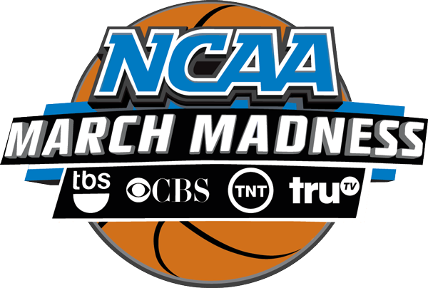
$10.8 billion
In 2011, the NCAA inked a 14-year, $10.8 billion TV deal with CBS and Turner Sports (home to TNT, TBS and truTV)

Slide 3
$8.8 billion
In 2016, the NCAA announced an eight year extension of that deal — for a combined total rights fee of $8.8 billion — that will keep the big game at Turner and CBS until 2032

Slide 4
4,535%
The value of the tournament’s television rights since 1986 have increased by an average of 4,535% per year

Slide 5
$2.1 million
Mark Emmert, NCAA President, earns $2.1 million in annual salary with a contract that runs through 2023

Slide 6
$48.6 million
The University of Louisville boasts the most valuable basketball program in all of college sports, with the Cardinals’ men’s program generating $42.8 million in revenue and the women’s program hauling in $5.8 million

Slide 7
$39.31 million
Duke is the next most valuable program, generating $39.3 million in revenue, followed by Kentucky ($39.3M), Syracuse ($37M) and North Carolina ($27.9M)

Slide 8
$10.2 million
Kansas’s Head Coach, Bill Self, is college basketball’s highest paid coach. His 2022 salary will pay him over $10 million, making him the first college basketball coach to make more than $10 million in a season.

Slide 9
46
Last season, Duke coach Mike Krzyzewski (Coach K) was the highest-paid coach in college basketball. This is his 42nd, and final, season coaching the Blue Devils, and his 46th total year as a head coach. He is the winningest coach ever.

Slide 10
$0
Amount players earned playing for Duke (or any other team) this season (although many have tuition covered as scholarship athletes)

Slide 11
$77,000
Estimated cost to attend Duke University for the 2020/21 academic year is more than $77,000 (Duke is one of the 100 most expensive U.S. institutions)

Slide 12
$10 million
Oklahoma State’s Cade Cunningham, last year’s top NBA draft pick, earned over $10 million this season in his rookie year with the Detroit Pistons

Slide 13
$944
The annual NCAA Division 1 Men’s Basketball Championship tournament generated more than $900 million in national TV ad spending in 2022 for CBS, TBS, TNT and truTV, making it one of the most valuable franchises in televised sports (according to TV ad measurement company iSpot.tv)

Slide 14
155
In 2019, advertisements came from 155 brands, appearing throughout the entire NCAA Tournament. Those brands accounted for 363 unique ads, 5,252 airings and 8,688 minutes of ad time.

Slide 15
282
AT&T, one of the NCAA’s corporate champions, was the event’s biggest advertiser by a significant amount — airing 16 different spots a total of 282 times.

Slide 16
391
All told, iSpot estimates that 142 brands ran 391 ads during March Madness, for a grand total of 6,761 airings. This barrage of commercial messaging generated 20.8 billion impressions.

Slide 17
$1.5 million
The average price of a 30 second commercial during the 2017 championship game was $1.5 million (by comparison, a 30 second ad during one of CW’s popular super hero shows like ‘Arrow’, ‘Supergirl’, or ‘The Flash” cost between $40,000 and $60,000 per spot)

Slide 18
$2 million
This year, it is estimated that a 30-second spot during the championship game will cost around $2 million

Slide 19
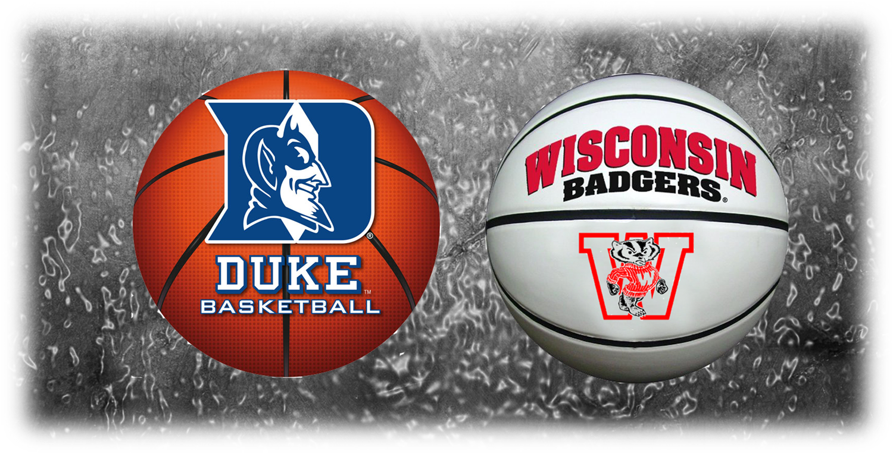
28.3 million
The 2014 championship game between the Duke Blue Devils and Wisconsin Badgers drew an audience of 28.3 million viewers, making it the highest-rated NCAA final in nearly 20 years

Slide 20
16.9 million
Last year, just 16.5 million fans tuned in to see Baylor’s win over Gonzaga in the NCAA men’s basketball championship game, a 14% decrease from 2019

Slide 21
85%
More fans tuned in on Roku devices than ever last year, marking an 85% increase in streaming audience for the first rounds of March Madness (a total of 1 billion minutes were streamed in the first two days of the tournament alone!)

Slide 22
180
March Madness was broadcast in 180 different countries last year

Slide 23
10%
What impact does a tournament birth have on participating smaller basketball schools? According to Bloomberg, the excitement surrounding a big upset can result in a 10% increase in enrollment applications…one more reason to root for the "cinderella" teams!

Slide 24
$1.09
When the tournament was canceled in 2020 because of the pandemic, the price of chicken wings plummeted. At the Super Bowl, just over one month prior to when March Madness was scheduled to begin, wings were selling for nearly $2 per pound. After the tournament was canceled, supply outstripped demand and the average price dropped to just $1.09 per pound.

Slide 25
$376
The average price of a single game ticket for this year’s NCAA championship game is currently at $376, up from $258 at the same time last year

Slide 26
70,000
An estimated 70,000 visitors are expected in the New Orleans area for the 2022 NCAA Men’s Basketball Tournament

Slide 27
$200 million
Previous Final Fours have generated tens of millions of dollars in economic impact for host cities; New Orleans reported $135 million in economic impact in 2012 while Atlanta reported $70 million in 2013. This year, analysts project a $200 million boost to the New Orleans economy.

Slide 28
14
Fourteen different cities will host games during the 2022 NCAA Basketball Tournament

Slide 29
$95 million
The NCAA tournament has created an $95 million economic impact for the Dayton, Ohio area since 2001 by hosting March Madness regional games

Slide 30
73,432
Caesars Superdome Stadium, home to this year’s Final Four in New Orleans, can seat over 73,000 fans for a basketball game

Slide 31
$138 million
According to reports, Caesars paid $138 million over 20 years for the naming rights to the stadium

Slide 32
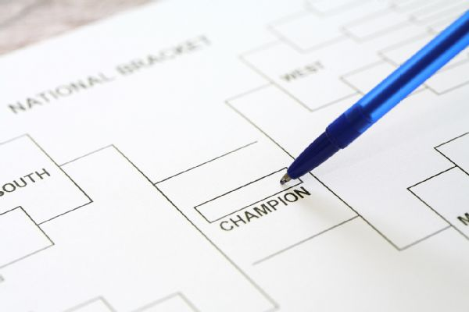
149 million
149 million tournament brackets were filled out in 2019 and $10 billion is expected to be wagered on the 2022 tournament (only $6 billion will be wagered legally)

Slide 33
2x
The amount of money wagered on March Madness is nearly double the amount of money wagered on the Super Bowl

Slide 34
$100 million
Over $100 million annually is registered annually in profits for casinos in Las Vegas during March Madness

Slide 35
NOTE:
To change images on this slide, select a picture and delete it. Then click the Insert Picture icon
in the placeholder to insert your own image.
$13.8 billion
This year’s tournament could cost employers roughly $13.8 billion in lost productivity this year with time spent filling out brackets and watching games, according to WalletHub.

Slide 36
6
On average, American workers will spend 6 hours watching March Madness at the workplace, according to WalletHub

Slide 37
81%
81% of HR professionals say their organizations do not have policies in place addressing regulating office pools

Slide 38
9.2 quintillion
The chances of filling out a perfect bracket in picking the winners of the tournament are 1 in 9.2 quintillion. In other words, it is nearly impossible. However, if you do correctly pick every game, it is likely that some company will give you a lot of cash. That publicity stunt has been in play for about three years now, although nobody has announced that promotion yet!

Slide 39
2 x
It is TWO TIMES easier to win BACK-TO-BACK Mega Millions lotteries than it is to fill out a perfect bracket.

Slide 40
Questions for Class Discussion

Slide 41
How do you think March Madness contributes to a drop in worker productivity in the American workplace?
Only 3% of collegiate basketball programs generate a revenue surplus according to cbsnews.com. Why do you think they continue playing if that is the case?
Why is social media important to the tournament?
Why do you think tracking the number of consumers who follow the tournament via some form of social media is important to the NCAA? To a broadcast company like CBS or Turner Sports? What about for advertisers/marketing professionals?

Slide 42
What are broadcast rights? Why do you think CBS and Turner invested so much in the rights to the NCAA Tournament?
What types of companies sponsor the NCAA Tournament? What demographic are they targeting?
What is economic impact? Why is it an important concept when it relates to mega events like the Super Bowl, Olympic Games and NCAA Tournament?
Why do you think college athletes don’t get paid? How might new NIL rules change the landscape of the sport?
Who do you think will win this year’s championship?

Slide 43
Sources

Slide 44
http://www.nysportsjournalism.com/record-spend-for-march-madness/tag/ncaa
https://wallethub.com/blog/march-madness-statistics/11016
https://www.cnn.com/2015/07/08/us/gallery/ncaa-by-the-numbers/index.html
https://www.collegesimply.com/colleges/north-carolina/duke-university/price/
https://www.kantarmedia.com/us/newsroom/press-releases/march-madness-release
https://www.kantarmedia.com/us/thinking-and-resources/blog/whos-on-top-32017-32617
https://www.ncaa.com/news/basketball-men/article/2017-04-07/2017-final-four-viewership-attendance-numbers
https://money.yahoo.com/richest-college-basketball-programs-america-210045624.html
https://www.bizjournals.com/sanantonio/news/2018/02/16/ncaa-final-fours-local-economic-impact-expected-to.html
https://www.usatoday.com/story/sports/ncaab/2022/03/11/college-basketball-bill-self-first-10-million-season/9425924002/?gnt-cfr=1

