Slide 1
MARKETING
STUNTS 2022
www.sportscareerconsulting.com - Marketing Insights from SCC

Slide 2
MARKETING
STUNTS 2022
Every year on April Fools’ Day, brands launch creative product innovations and collaborations online and through social media channels. We call this practice a publicity or marketing "stunt."
In this presentation, we will review several examples. See if you can guess if the product launch is an actual product or brand collaboration or if it is just an April Fools' Day prank.
www.sportscareerconsulting.com - Marketing Insights from SCC

Slide 3
Hellmann’s Mayo Teams up with Butterfinger
MARKETING
STUNTS 2022
Hellman's Mayo, in collaboration with Butterfinger, created a "more crispety, crunchety and peanut buttery spread."
The website featured a cake recipe as a way to encourage consumers to try to the new product.
www.sportscareerconsulting.com - Marketing Insights from SCC

Slide 4
APRIL FOOLS!
www.sportscareerconsulting.com - Marketing Insights from SCC

Slide 5
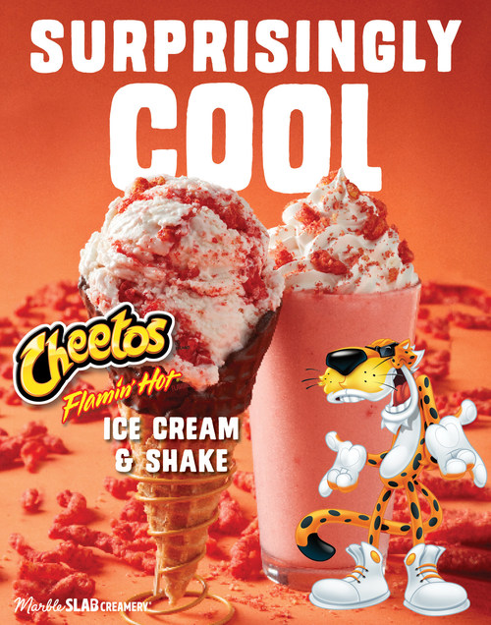
Flamin' Hot Cheetos Ice Cream
MARKETING
STUNTS 2022
Marble Slab Creamery launched a limited-edition ice cream flavor that featured a sweet cream ice cream mixed with crushed Flamin' Hot Cheetos.
www.sportscareerconsulting.com - Marketing Insights from SCC

Slide 6
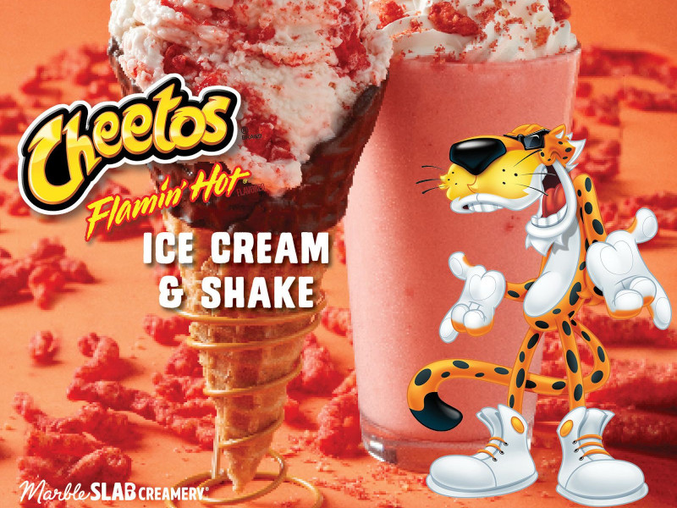
REAL PRODUCT!
www.sportscareerconsulting.com - Marketing Insights from SCC

Slide 7
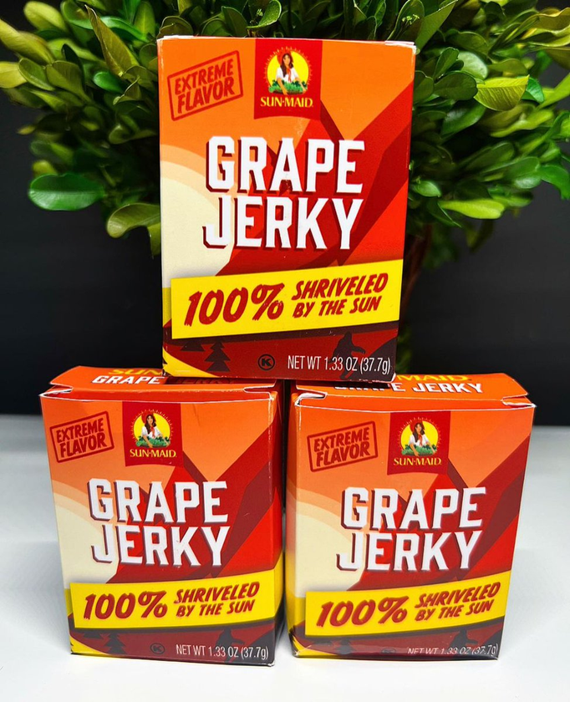
Sun-Maid Introduces Grape Jerky
MARKETING
STUNTS 2022
Sun-Maid, the iconic raisin brand, launched a grape jerky product, "100% shriveled by the sun", and only available for purchase for one day only (April 1st) on its online store.
www.sportscareerconsulting.com - Marketing Insights from SCC

Slide 8
APRIL FOOLS!
www.sportscareerconsulting.com - Marketing Insights from SCC

Slide 9
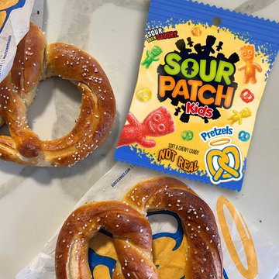
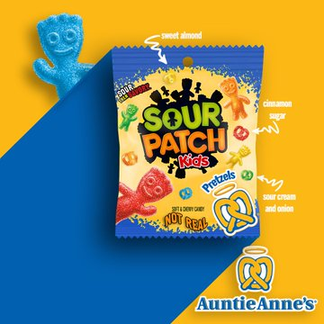
MARKETING
STUNTS 2022
Sour Patch
Kids Pretzels
This year on April Fool's Day, Sour Patch Kids introduced a new product in partnership with Auntie Anne's: Sour Patch Kids pretzels.
www.sportscareerconsulting.com - Marketing Insights from SCC

Slide 10
APRIL FOOLS!
www.sportscareerconsulting.com - Marketing Insights from SCC

Slide 11
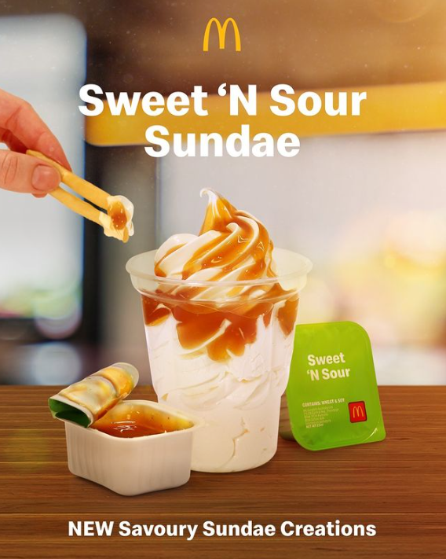
McDonald's Introduces Sweet 'N Sour Sundaes
MARKETING
STUNTS 2022
In Australia, McDonald's offered a unique twist on its popular Sundae, the "Sweet 'N Sour" Sundae. As promoted on its McDonald's Australia Instagram page, the product is “available until yesterday.”
www.sportscareerconsulting.com - Marketing Insights from SCC

Slide 12
APRIL FOOLS!
www.sportscareerconsulting.com - Marketing Insights from SCC

Slide 13
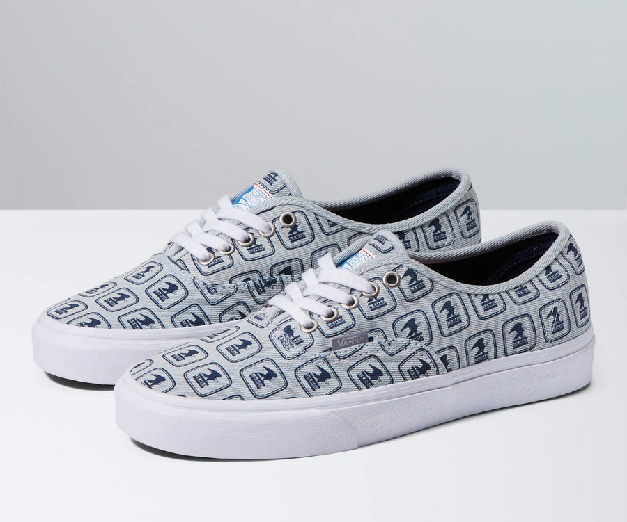
Vans and USPS Apparel Collaboration
MARKETING
STUNTS 2022
Vans teamed up with the United States Postal Service to create a limited-edition line of apparel, including hoodies, sneakers, t-shirts and beanies.
www.sportscareerconsulting.com - Marketing Insights from SCC

Slide 14
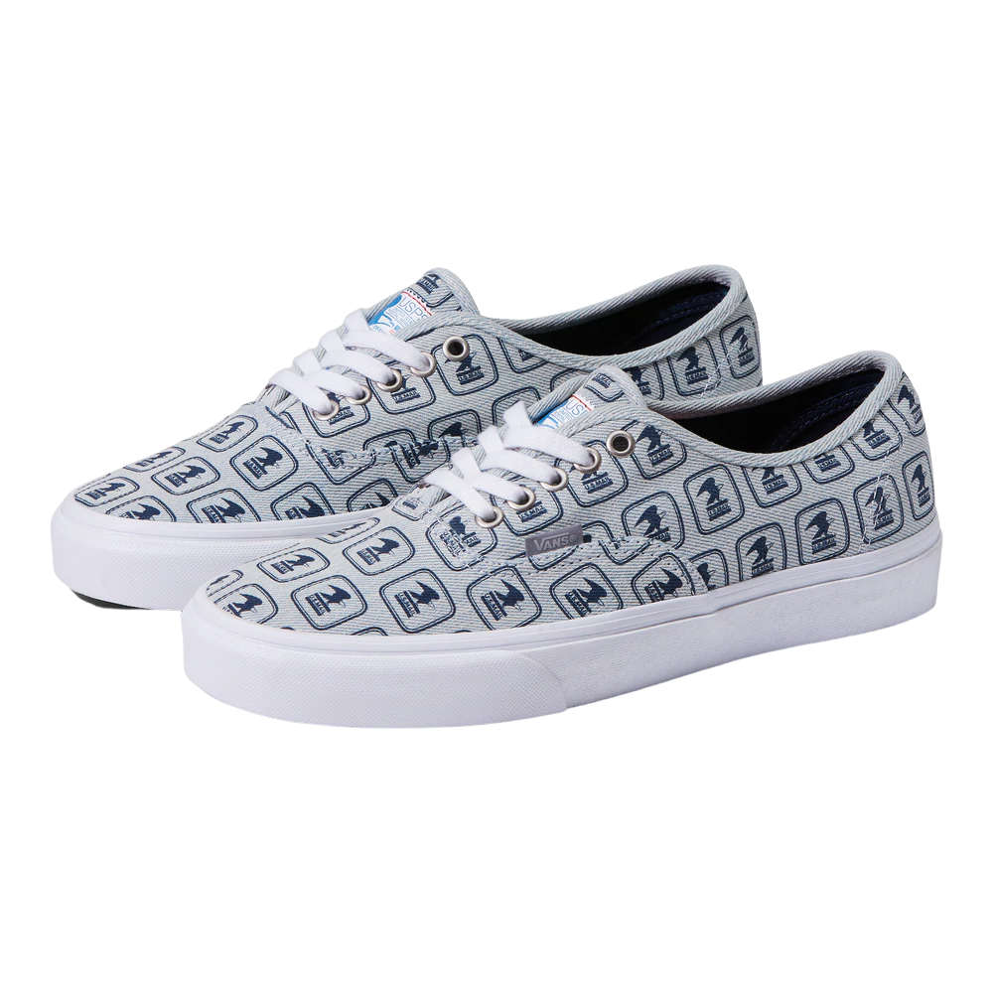
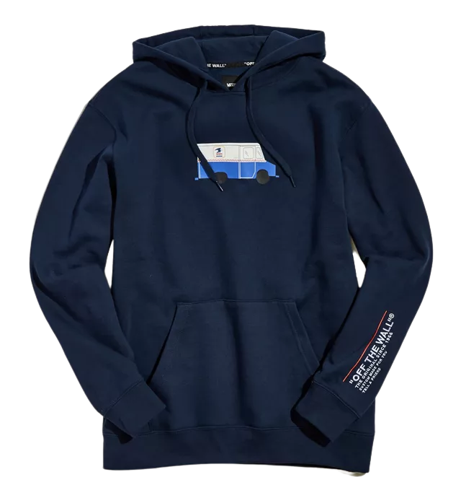
REAL PRODUCT!
www.sportscareerconsulting.com - Marketing Insights from SCC

Slide 15
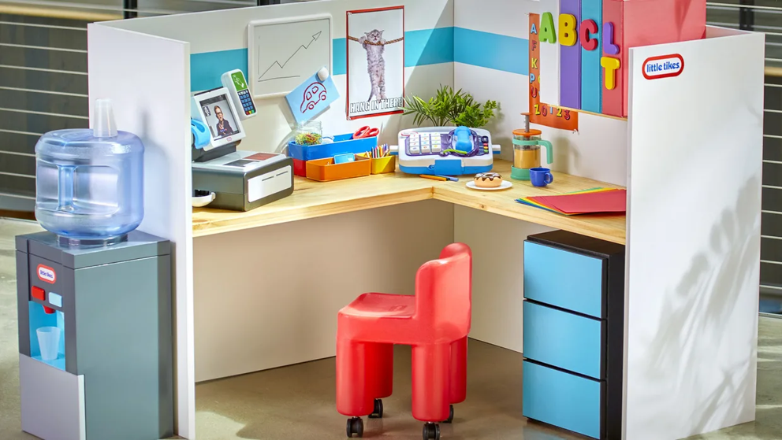
Little Tikes Launches Toy "My First Cubicle"
MARKETING
STUNTS 2022
It's never too soon to introduce children into the workforce, apparently, as the toy company Little Tikes introduced "My First Cubicle", a play set which comes with a "toy laptop, phone, coffee cup, filing cabinet and functional water cooler."
www.sportscareerconsulting.com - Marketing Insights from SCC

Slide 16
APRIL FOOLS!
www.sportscareerconsulting.com - Marketing Insights from SCC

Slide 17
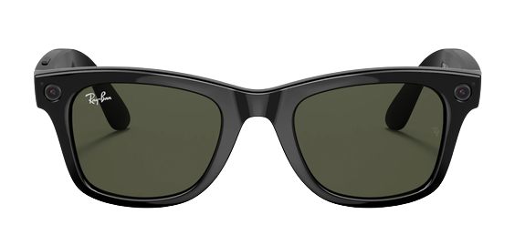
Facebook & Ray-Ban "Smart" Sunglasses
MARKETING
STUNTS 2022
Facebook and Ray-Ban collaborated to build a "smart" product that enables those wearing the sunglasses to record video, take pictures, make calls, and play music, all by tapping the glasses.
www.sportscareerconsulting.com - Marketing Insights from SCC

Slide 18
REAL PRODUCT!
www.sportscareerconsulting.com - Marketing Insights from SCC

Slide 19
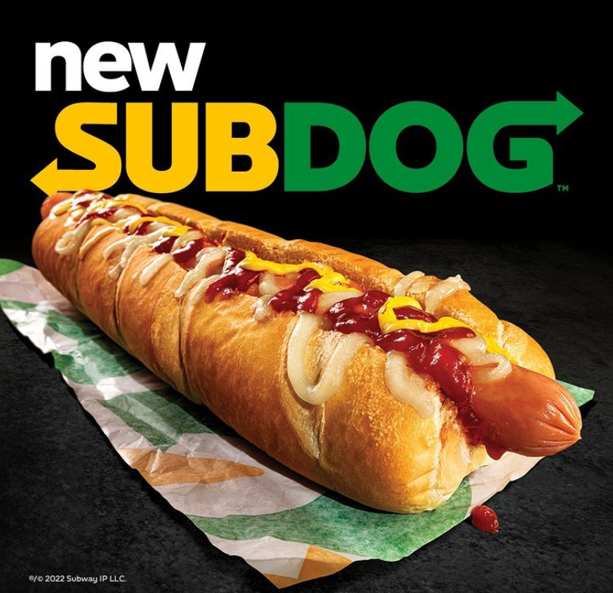
Subway Footlong Hotdog
MARKETING
STUNTS 2022
In Australia, Subway has added a new product to its "Famous Footlong" menu, the "SUBDOG." The SUBDOG is a footlong hot dog made with only fresh ingredients.
www.sportscareerconsulting.com - Marketing Insights from SCC

Slide 20
APRIL FOOLS!
www.sportscareerconsulting.com - Marketing Insights from SCC

Slide 21
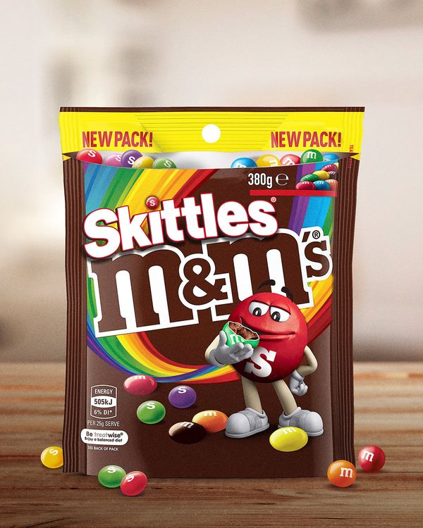
MARKETING
STUNTS 2022
Skittles Teams Up with M&Ms
Skittles announced via Instgram: We’re excited to introduce this delicious new treat, with M&M’S and Skittles pre-mixed so you can enjoy a chocolate and fruity flavour in one bite. 🌈🍇🍫🍏
www.sportscareerconsulting.com - Marketing Insights from SCC

Slide 22
APRIL FOOLS!
www.sportscareerconsulting.com - Marketing Insights from SCC

Slide 23
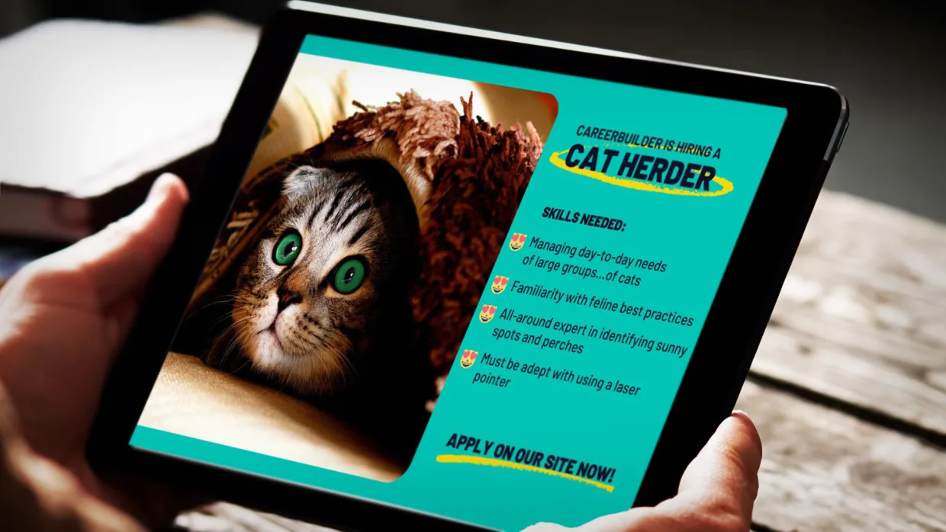
MARKETING
STUNTS 2022
CareerBuilder
is Hiring
Job search website CareerBuilder recently posted an advertisement for a Cat Herder position, requiring candidates to manage the day-to-day needs of pet cats.
www.sportscareerconsulting.com - Marketing Insights from SCC

Slide 24
APRIL FOOLS!
www.sportscareerconsulting.com - Marketing Insights from SCC

Slide 25
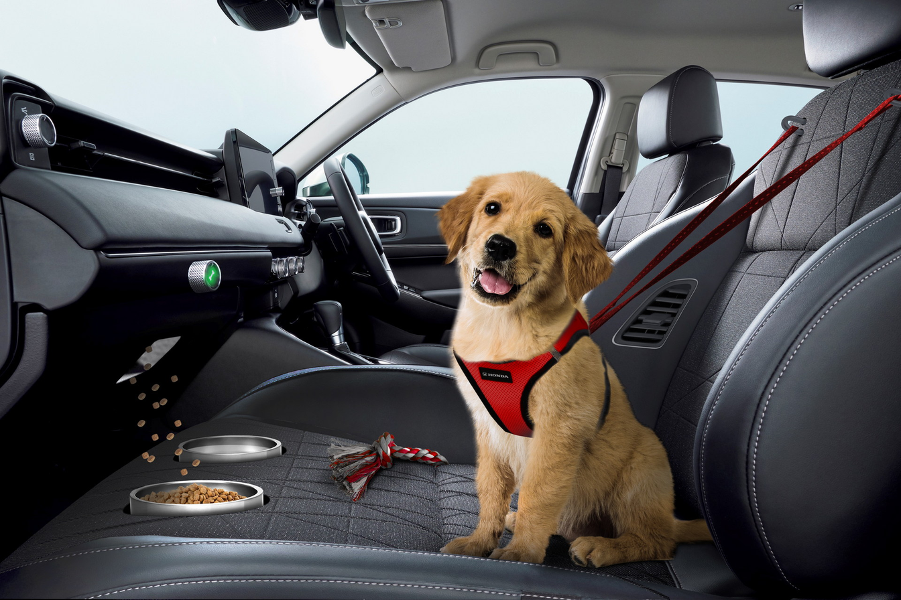
Honda's New Line of Pet-Friendly Vehicles
MARKETING
STUNTS 2022
Honda's new series of pet friendly vehicles allow for furry friends to ride as co-pilots in the front seat. The cabin features built in cannisters for dog dishes and sqeaker toys attached to the seats.
www.sportscareerconsulting.com - Marketing Insights from SCC

Slide 26
APRIL FOOLS!
www.sportscareerconsulting.com - Marketing Insights from SCC

Slide 27
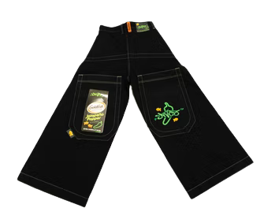
JNCO & GOLDFISH BLUE JEANS
MARKETING
STUNTS 2022
To promote Pepperidge Farms' new Jalapeño Popper flavored Goldfish, the brand partnered with JNCO to sell limited-edition Goldfish JNCO pants. The cost? $200.
www.sportscareerconsulting.com - Marketing Insights from SCC

Slide 28
REAL PRODUCT!
www.sportscareerconsulting.com - Marketing Insights from SCC

Slide 29
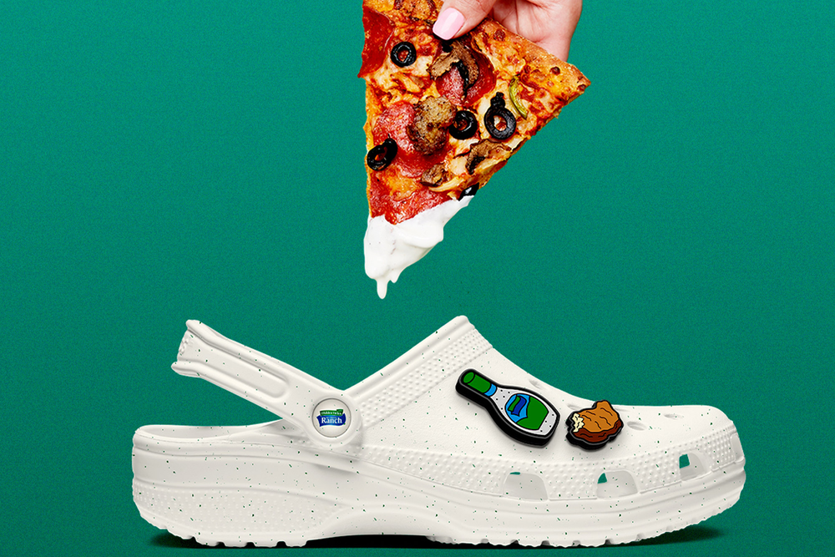
MARKETING
STUNTS 2022
Hidden Valley Ranch Crocs
Hidden Valley Ranch launched a salad dressing themed collaboration with streetwear brand Crocs.
The classic clogs cost $69.99.
www.sportscareerconsulting.com - Marketing Insights from SCC

Slide 30
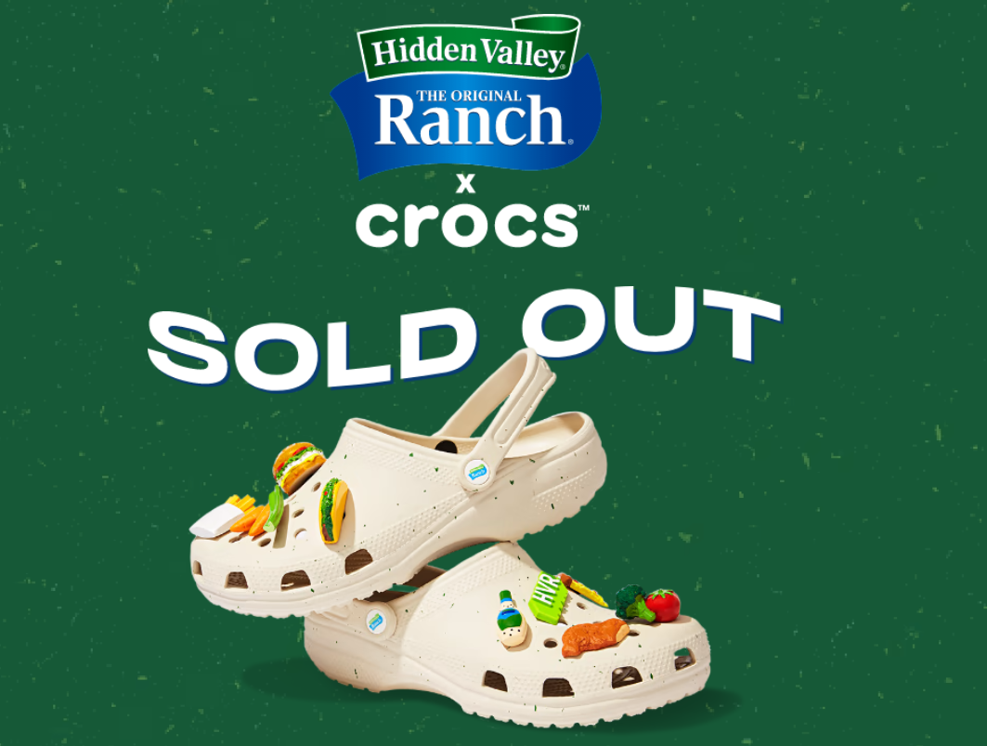
REAL PRODUCT!
www.sportscareerconsulting.com - Marketing Insights from SCC

Slide 31
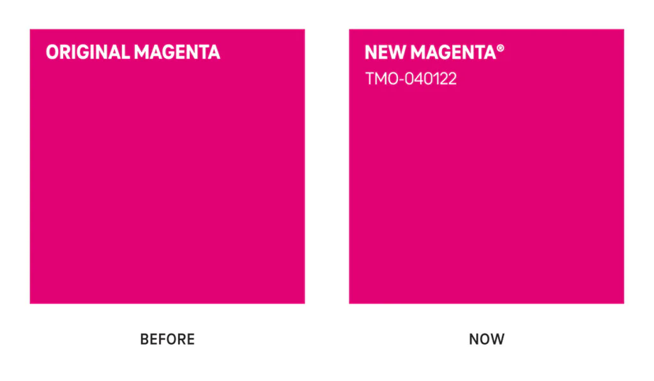
MARKETING
STUNTS 2022
T-Mobile's Makeover
T-Mobile is introducing a rebrand of its iconic magenta color scheme. The company announced a new color, “New Magenta,” and the rollout features a dedicated website, gear and more.
www.sportscareerconsulting.com - Marketing Insights from SCC

Slide 32
APRIL FOOLS!
(It is the same color as the original magenta)
www.sportscareerconsulting.com - Marketing Insights from SCC

Slide 33
MARKETING
STUNTS DISCUSSION QUESTIONS
www.sportscareerconsulting.com - Marketing Insights from SCC

Slide 34
MARKETING
STUNTS 2022
1) What is a "stunt" from a marketing perspective?
2) What is a collaboration?
3) Why do brands collaborate?
4) What is publicity?
5) Why do you think brands engage in "stunts" as a marketing strategy?
6) Do you think there is any risk associated with this strategy? Why or why not?
www.sportscareerconsulting.com - Marketing Insights from SCC

Slide 35
SOURCES:
thestreet.com/investing/papa-johns-reyka-vodka-get-in-on-the-aprils-fools-day-fun
blog.cheapism.com/weird-brand-mashups
www.nosh.com/news/2022/ben-jerrys-scratchn-snfts-sun-maid-grape-jerky-fluoride-free-kale-toothpaste-and-more-new-product-prankery
adweek.com/commerce/funniest-weirdest-wildest-brand-stunts-april-fools-day-2022
thedrum.com/news/2022/04/01/bold-brand-collabs-and-weird-product-launches-april-fools-day-stunts-2022
carscoops.com/2022/04/april-fools-day-2022-roundup-cater-ham-snacks-hondas-pet-co-pilot-and-other-pranks
https://twitter.com/SourPatchKids/status/1509900580667506692
MARKETING
STUNTS 2022
www.sportscareerconsulting.com - Marketing Insights from SCC

