Slide 1



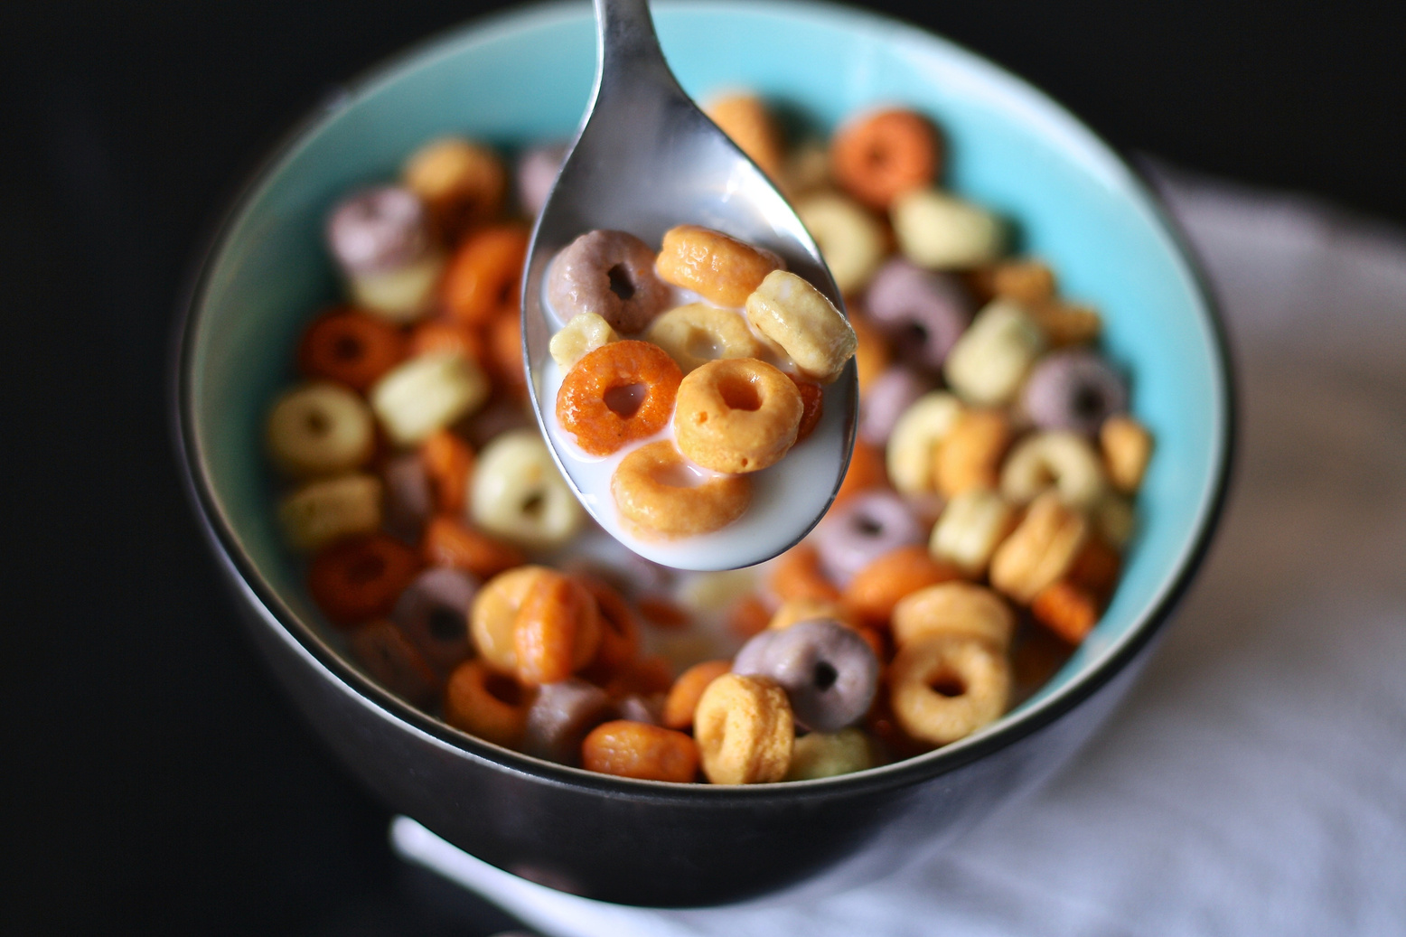


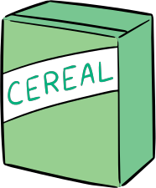

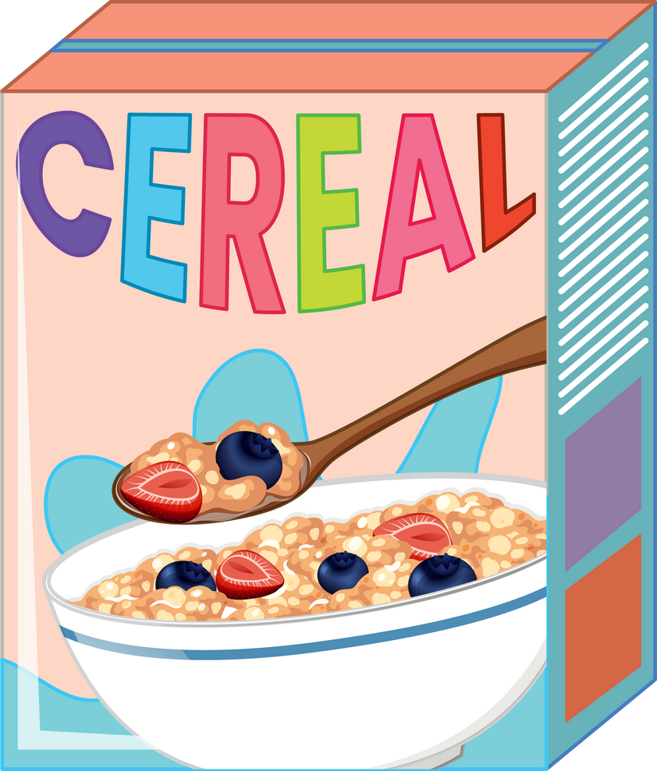
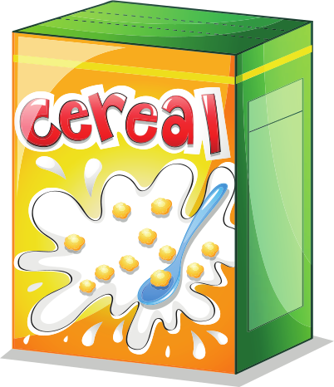
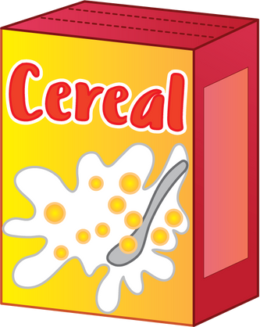
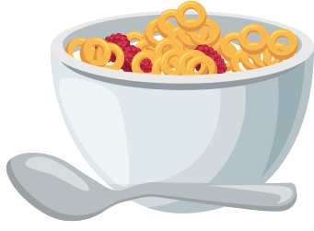
"HEALTHY" CEREALS?
The U.S. FDA has proposed new criteria for labeling cereals as "healthy"....which cereal brands would be impacted by the new guidelines?

Slide 2


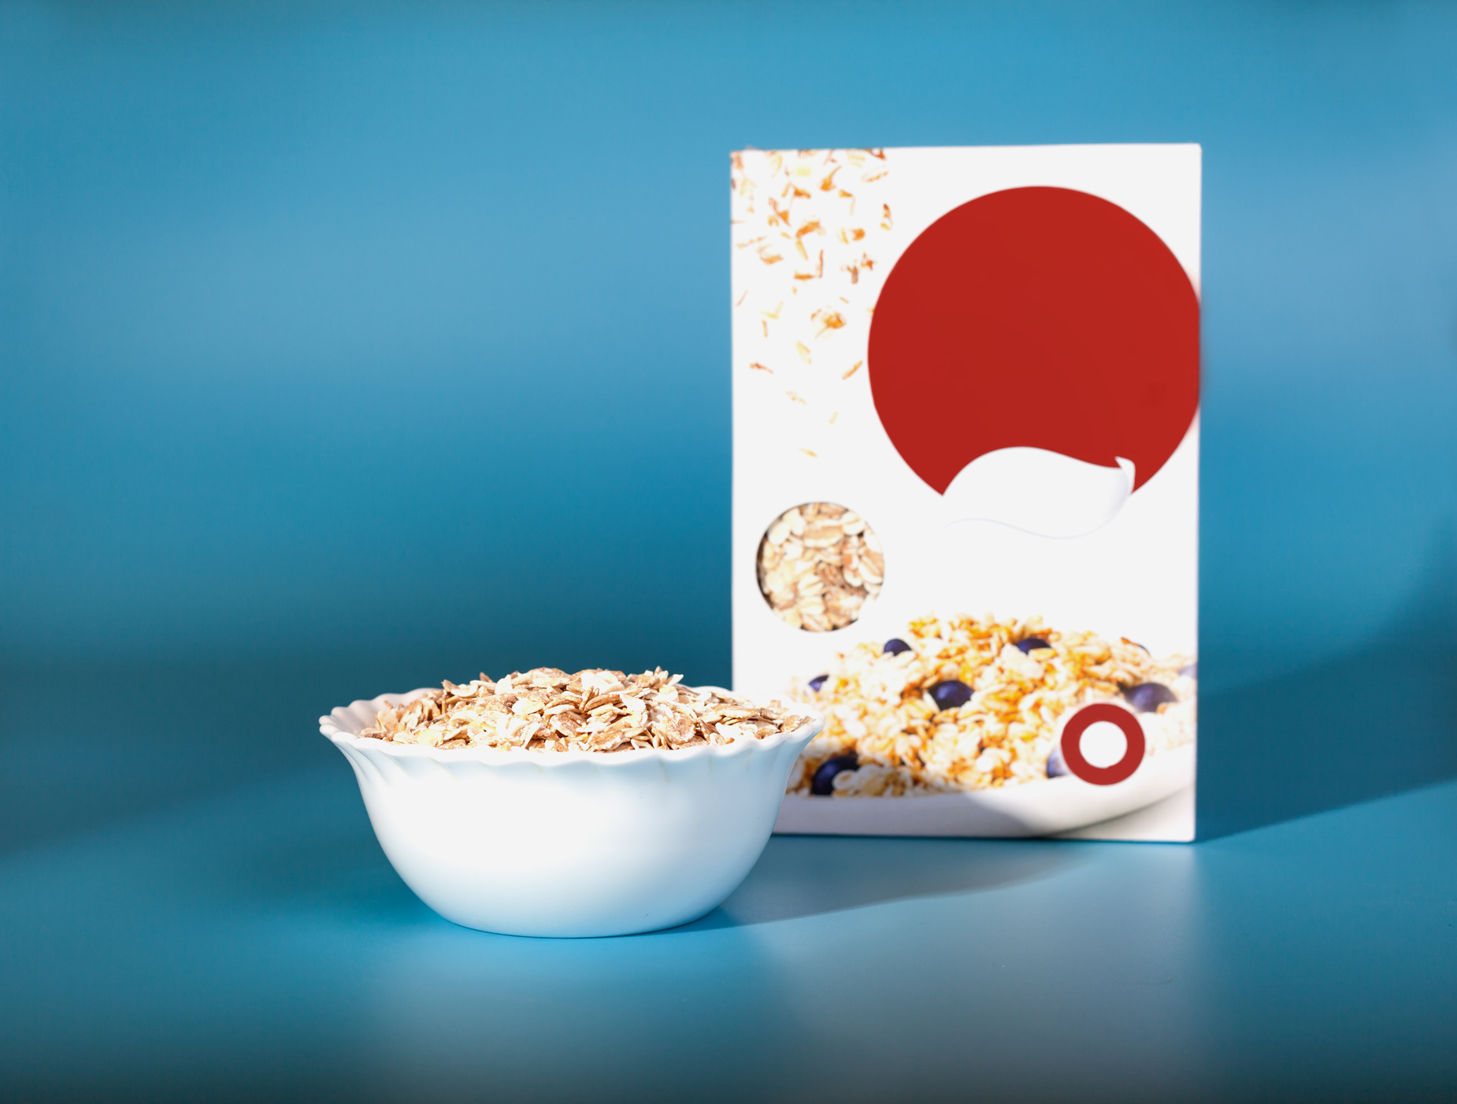



packaging
In marketing, packaging refers to the process of designing and producing the container for a product. The container could be anything from a candy bar wrapper to the packaging surrounding a new Android device.
Packaging can serve two basic purposes, it offers both functional benefits as well as branding and marketing opportunities for a company.
Am I
Really
Healthy?

Slide 3
functional benefits
  Protection of the product itself during shipping and delivery
  Proper storage to prevent breakage or spoilage
  Consumer safety
  Product guarantees
Am I
Really
Healthy?

Slide 4
marketing benefits
  Differentiation
  Positioning
  Rebranding
  Attract the attention of consumers
  Communicate important information about the product
  Innovation
  Marketing and promotions
Am I
Really
Healthy?

Slide 5
labeling
In marketing, labeling is the attaching of messaging to packaging that communicates key product information to consumers. Its main function is to inform customers about the product’s contents and give directions for its use.
Like packaging, when used properly, labeling provides a business with a variety of branding benefits.
Am I
Really
Healthy?

Slide 6
consumer protection
Consumers are protected from false, misleading, or deceptive claims from brands by a variety of government agencies.
  The Fair Packaging and Labeling Act (FPLA)
  U.S. Food and Drug Administration (FDA)
  The Federal Trade Commission (FTC)
  The U.S. Department of Agriculture (USDA)
Am I
Really
Healthy?

Slide 7
"Healthy" cereals
According to reports, The U.S. Food and Drug Administration (FDA) is proposing new criteria for manufactured foods to be labeled as “healthy,” using some popular brand-name cereals as an example of how things could change under the new guidelines.
Which popular brands would be impacted by the new guidelines? Click through this presentation to find out!
Am I
Really
Healthy?

Slide 8
labeling
In marketing, labeling is the attaching of messaging to packaging that communicates key product information to consumers. Its main function is to inform customers about the product’s contents and give directions for its use.
Like packaging, when used properly, labeling provides a business with a variety of branding benefits.
Am I
Really
Healthy?

Slide 9
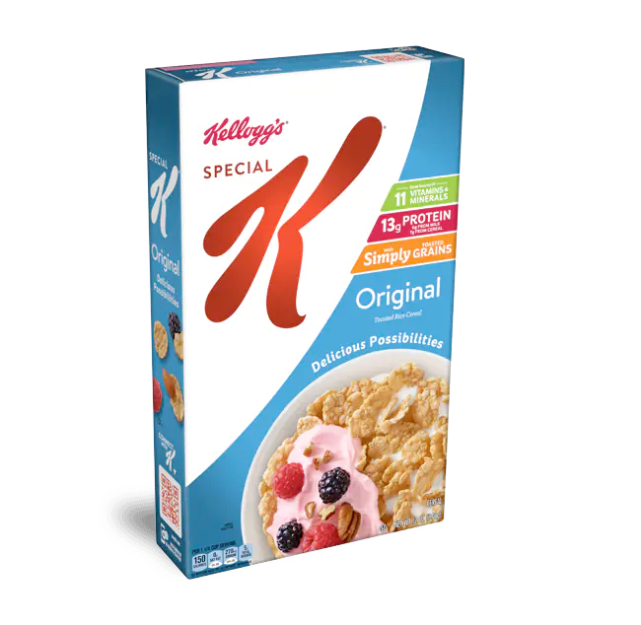

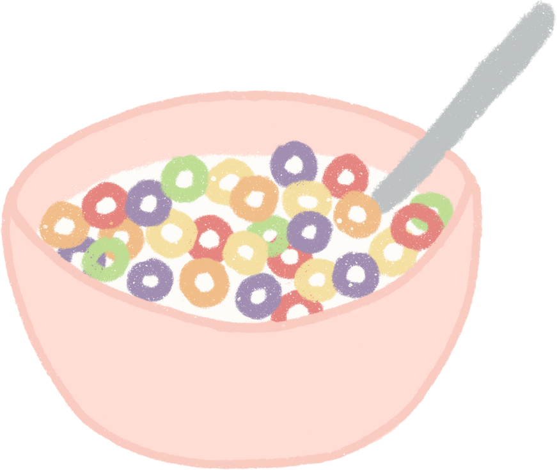
special k
Special K has grams of added sugars which means it would no longer be considered “healthy” under the FDA’s proposed criteria, despite the packaging that has used terms like "11 vitamins and minerals" and "With Simply Toasted Grains"

Slide 10
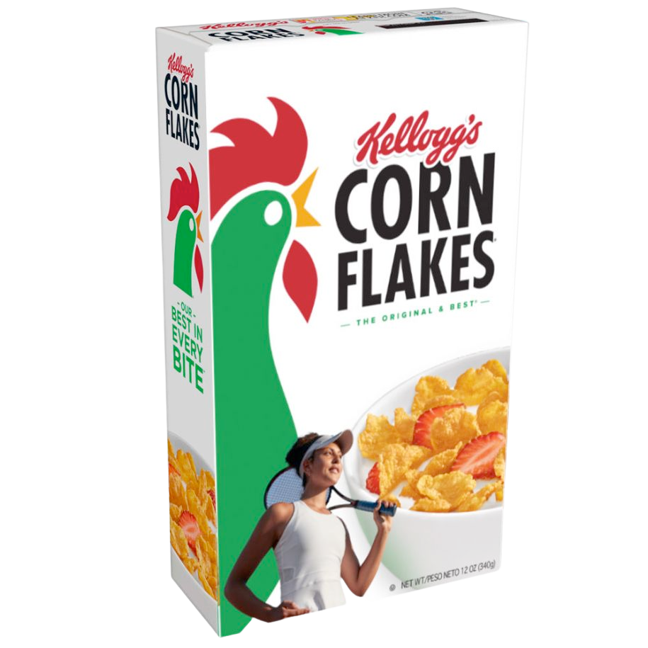
corn flakes
Corn Flakes has 4 grams of added sugars which means it would no longer be considered “healthy” under the FDA’s proposed criteria.

Slide 11
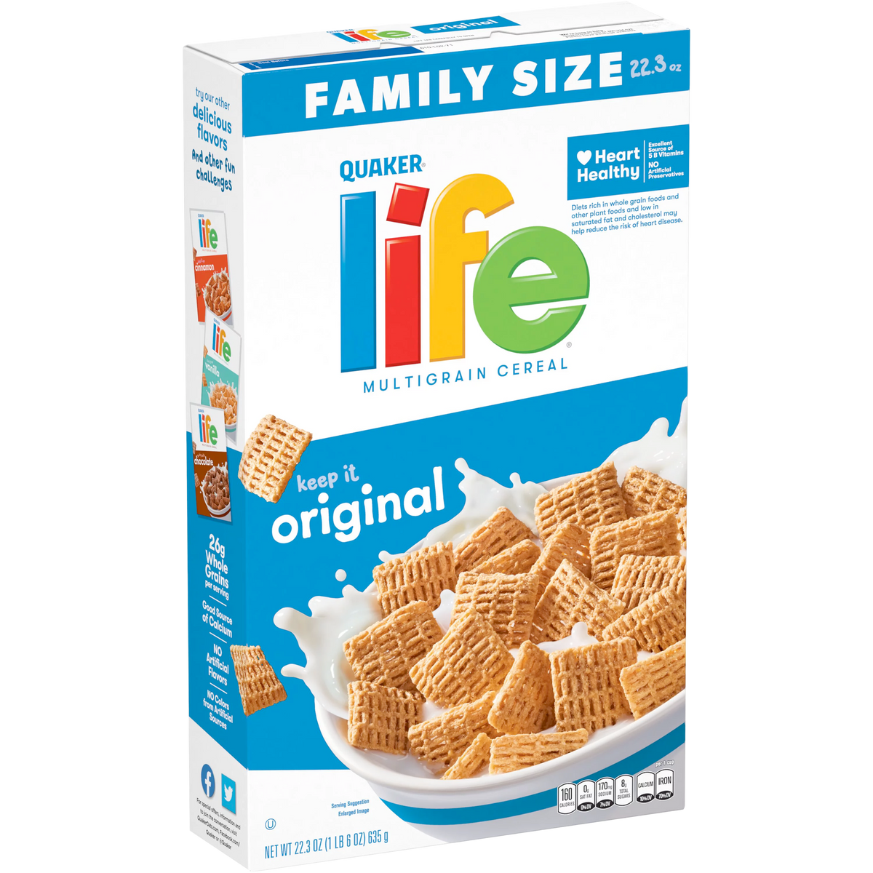
life
Life has 8 grams of added sugars which means it would no longer be considered “healthy” under the FDA’s proposed criteria, despite the packaging that uses terms like "Heart Healthy" and "NO Artificial Preservatives"

Slide 12
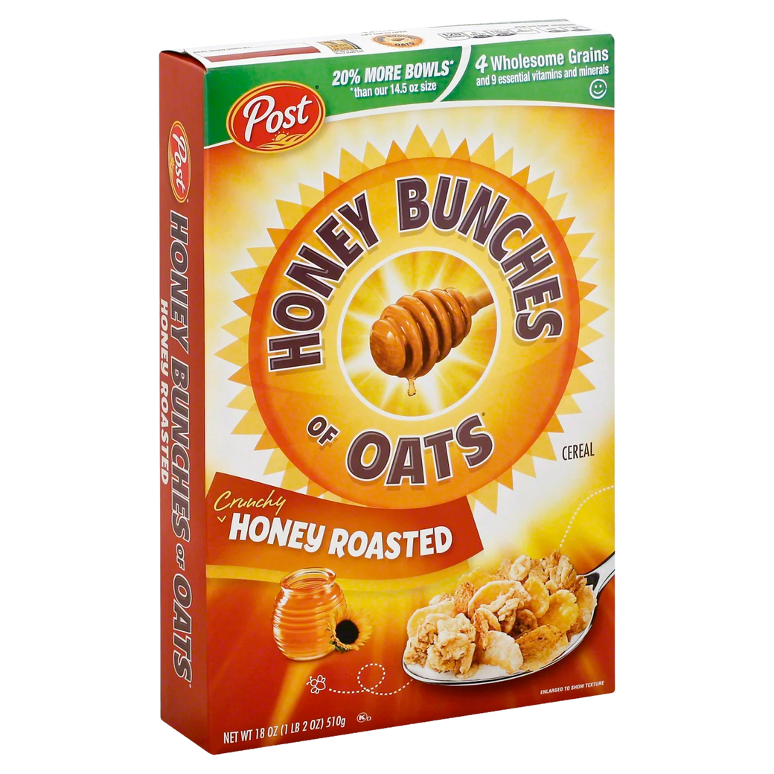
honey bunches of oats, honey roasted
Honey Bunches of Oats, Honey Roasted has 8 grams of added sugars which means it would no longer be considered “healthy” under the FDA’s proposed criteria, despite the packaging that uses terms like "4 Wholesome Grains."

Slide 13
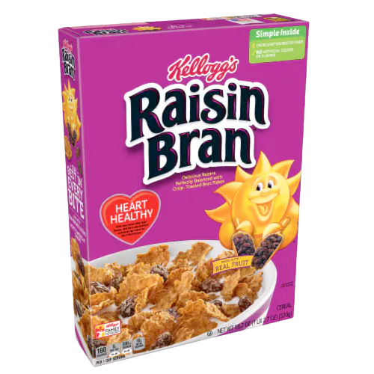
Raisin Bran
Raisin Bran has 9 grams of added sugars which means it would no longer be considered “healthy” under the FDA’s proposed criteria, despite the packaging that uses terms like "Heart Healthy" and "Made with Real Fruit."

Slide 14
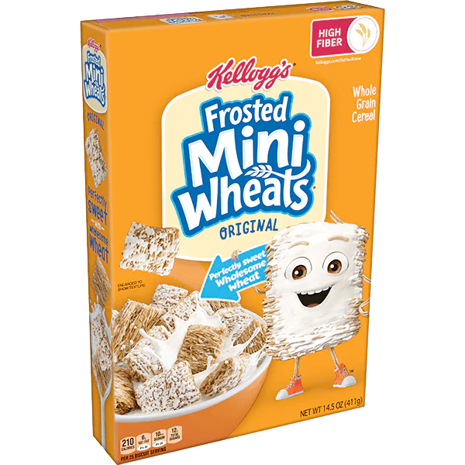
frosted mini wheats
Frosted mini wheats has 12 grams of added sugars which means it would no longer be considered “healthy” under the FDA’s proposed criteria, despite the packaging that uses terms like "Perfectly Sweet Wholesome Wheat."

Slide 15
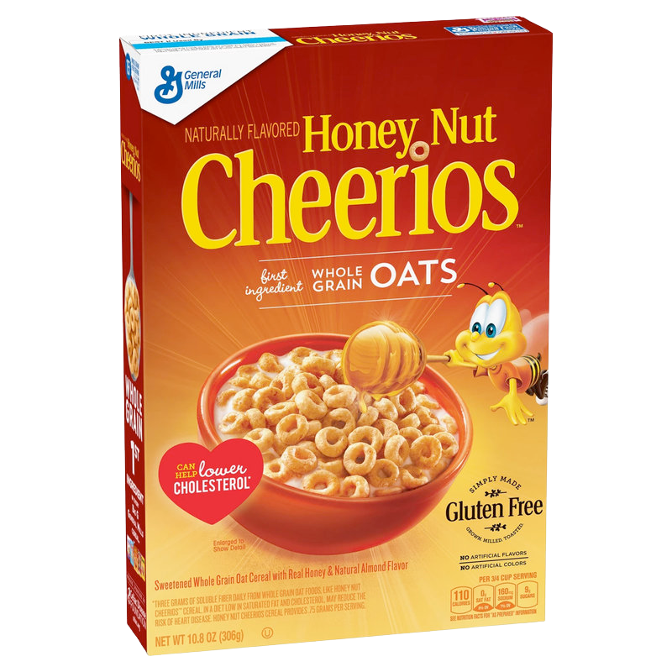
Honey Nut Cheerios
Honey Nut Cheerios has 12 grams of added sugars which means it would no longer be considered “healthy” under the FDA’s proposed criteria, despite the packaging that uses terms like "Can help lower cholesterol."

Slide 16

DISCUSSION QUESTIONS
1) Who is the U.S. FDA?
2) What does the U.S. FDA do?
3) Why does the organization exist?
4) How does marketing influence packaging decisions?
5) How does marketing influence the labels that appear on product packaging?
6) What is product positioning?
7) How might labeling explain a brand's positioning strategy?

Slide 17
DISCUSSION QUESTIONS
8) How do you think brands are positioning their product with "healthy" claims on packaging and labels?
9) Why is the FDA proposing new guidelines on what constitutes healthy packaging and labeling?
10) How will the new guidelines, if instituted, impact some food products?
11) What are three examples of cereal brands that would be impacted by the new proposed guidelines?
12) How might a shift in packaging and labeling impact product sales for those affected by the new proposed guidelines?
13) How might that impact the way those brands market the product?

Slide 18
DISCUSSION QUESTIONS
14) According to this news story, what are some additional future planned actions from the FDA as it relates to packaging and labeling food products?
15) Do you think the proposed guidelines might force some brands to actually change the product so that it fits the new proposed guidelines? Why or why not?
16) If you were responsible for marketing a cereal product that no longer qualified as "healthy" under the proposed new guidelines, what would you recommend? Be prepared to discuss your ideas in class.

Slide 19
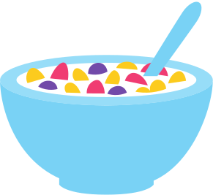
SOURCES
https://www.silive.com/news/2022/10/under-new-fda-proposed-guidelines-these-10-cereals-would-no-longer-be-labeled-healthy.html

