Slide 1


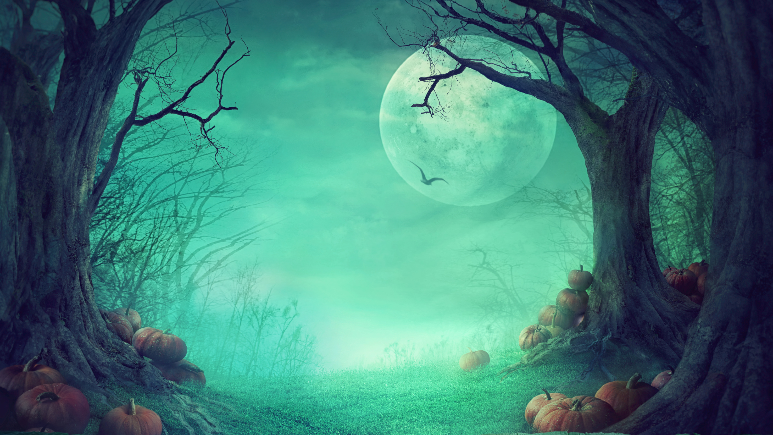



Marketing Insights from SCC
Module 9: Seasonal Marketing
SPOOKY
MARKETING
How do businesses and brands leverage Halloween to reach, connect with, and engage consumers? Let's take a look at some of this year's notable Halloween brand marketing campaigns.

Slide 2
Marketing Insights from SCC
Module 9: Seasonal Marketing
WHAT IS
MARKETING?
As you review this year's Halloween marketing campaigns, you will see a specific business or marketing concept identified on each slide. For each example, take a moment to discuss how each campaign provides an example of the business and marketing concepts discussed in class and in your Marketing Insights from SCC modules and lessons.

Slide 3
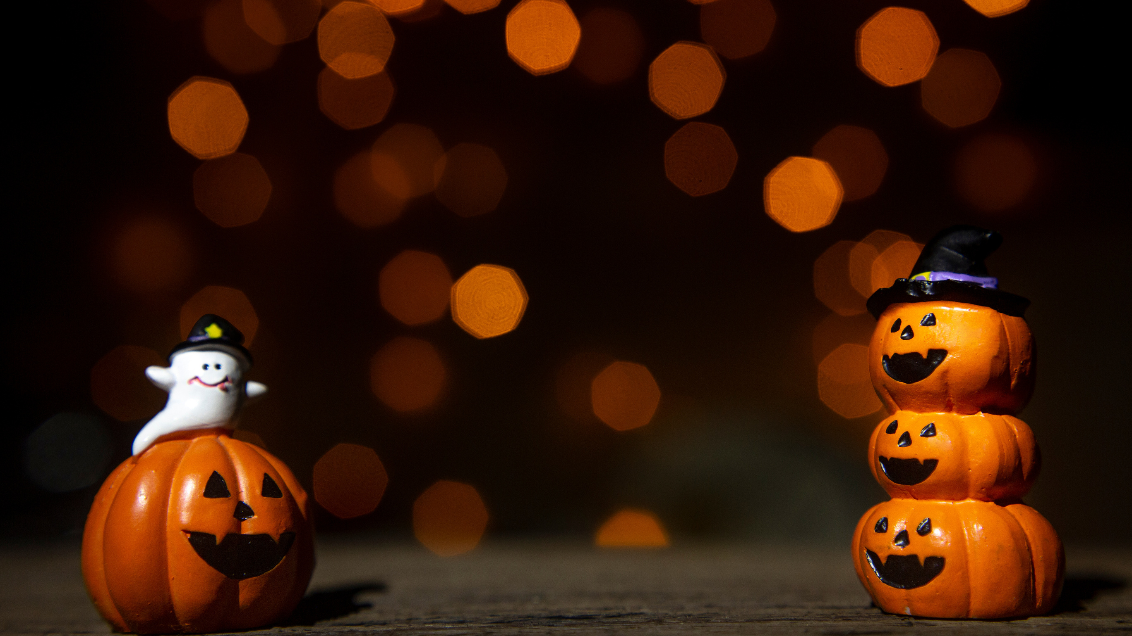
Marketing Insights from SCC
Module 9: Seasonal Marketing
BUSINESS OF
HALLOWEEN
The infographics on the following pages reveal some interesting information about the 2022 Halloween season. How might this information benefit businesses and brands who are considering a Halloween-themed marketing campaign?

Slide 4
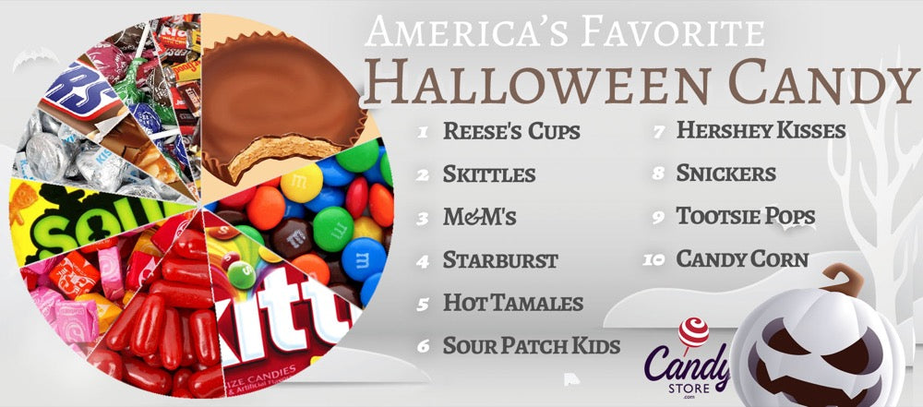
Here is America's favorite Halloween Candy nationally in 2022, according to data from Candystore.com.

Slide 5
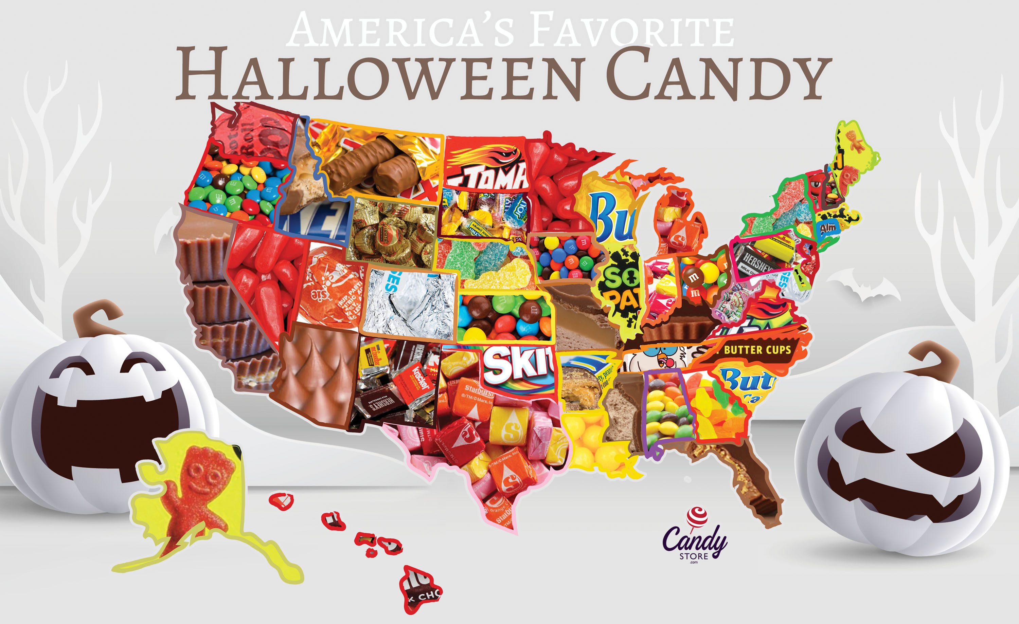
Here is America's favorite Halloween Candy by state in 2022, according to data from Candystore.com.

Slide 6
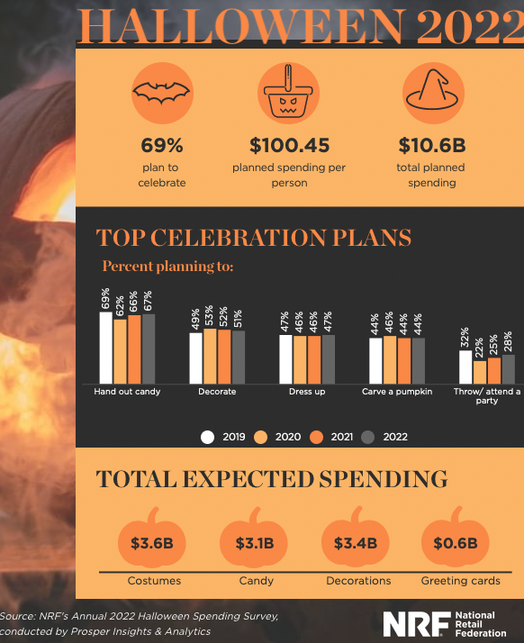
According to data from National Retail Federation, consumers will spend $3.6 billion on Halloween costumes this year.

Slide 7
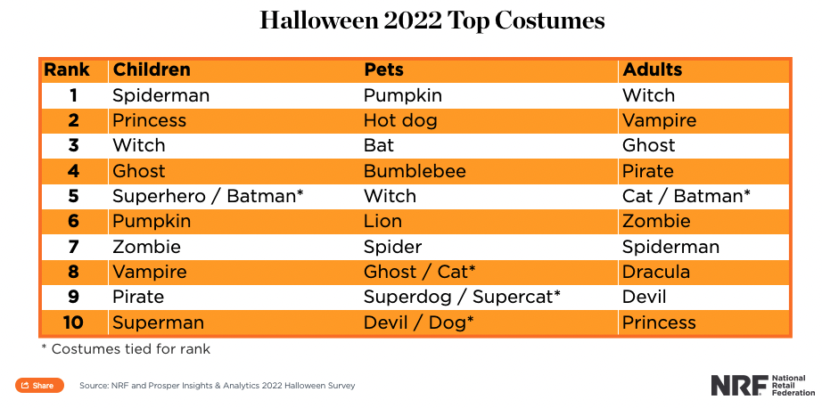
According to data from National Retail Federation, Spiderman is the most popular Halloween costume among children this year, while witches will be a common sight among adults celebrating Halloween.

Slide 8
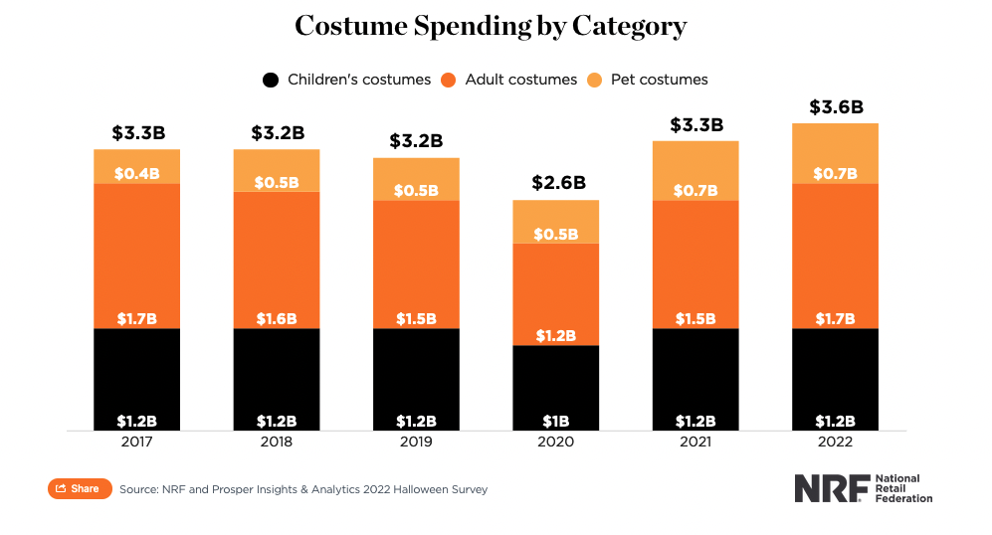
According to data from National Retail Federation, adult consumers will spend $1.7 billion on Halloween costumes this year, up from $1.5 billion last year and $1.2 billion in 2020 when the pandemic impacted the season.

Slide 9
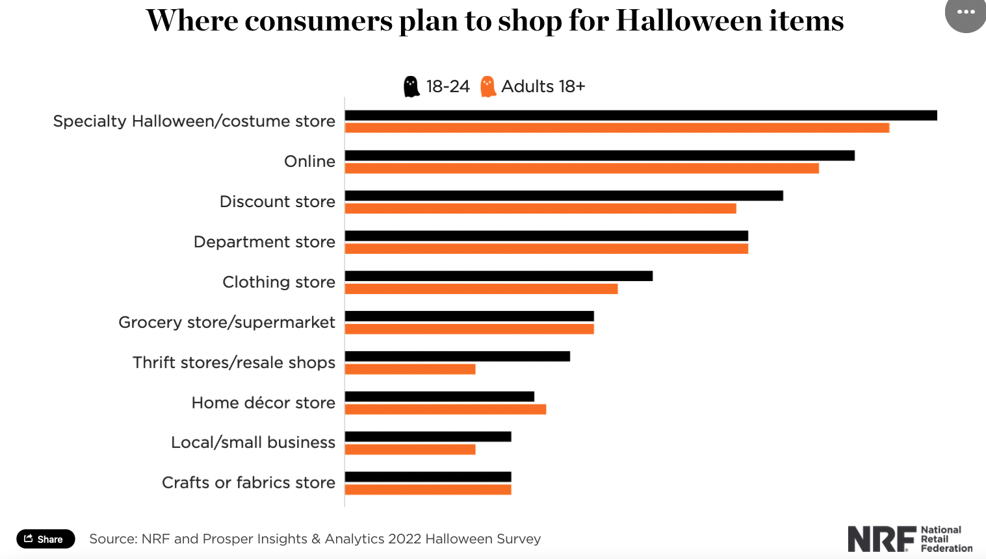
According to data from National Retail Federation, costume stores will be the most popular place for Halloween shoppers to find holiday items.

Slide 10
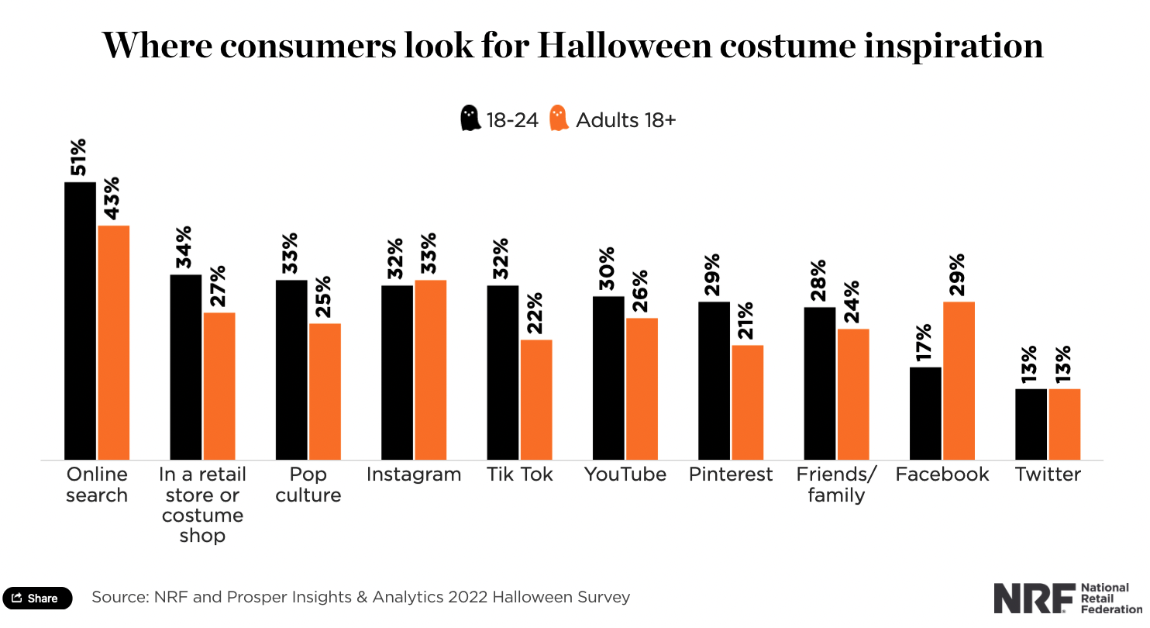
According to data from National Retail Federation, 51% of consumers will search online for inspiration for this year’s Halloween costumes.

Slide 11
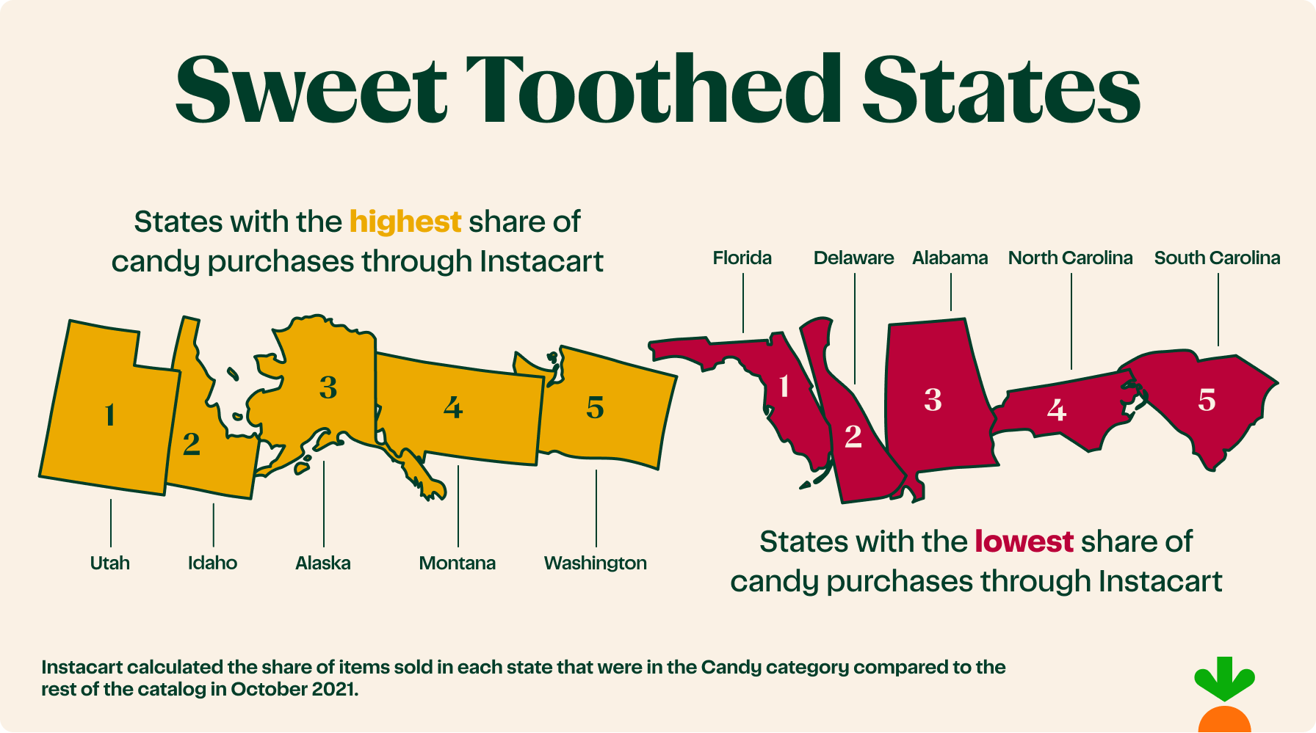
According to data from Instacart, here are the states who buy the most candy.

Slide 12
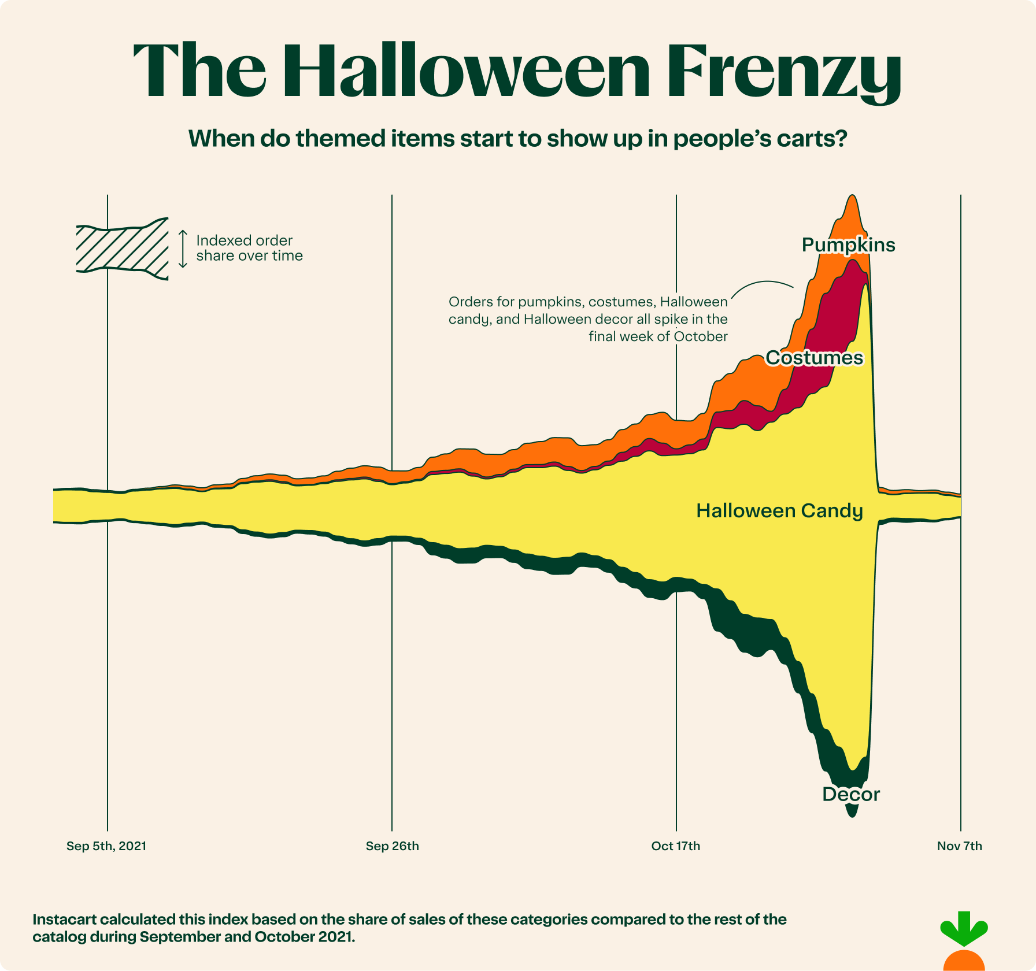
This Instacart infographic provides a glimpse into consumer shopping habits when making Halloween-related purchases.

Slide 13
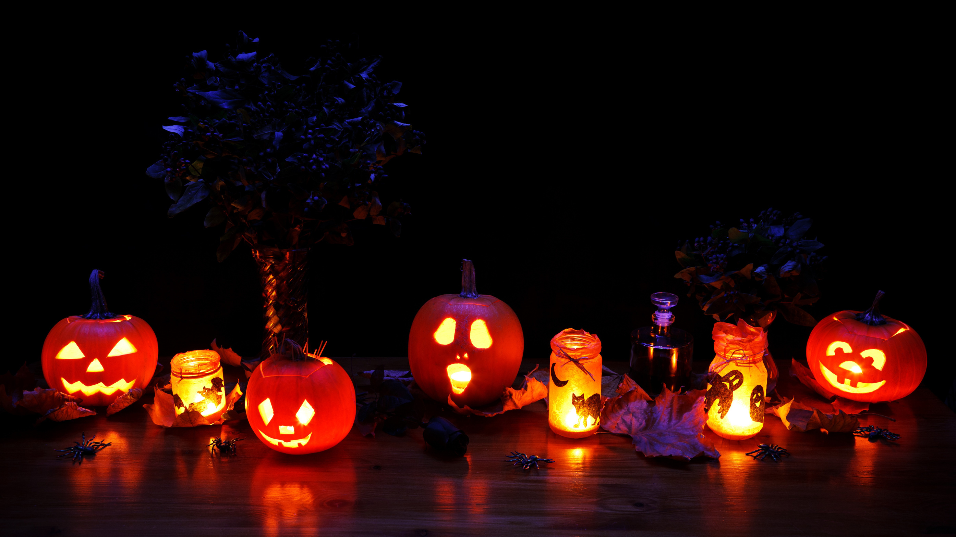
Marketing Insights from SCC
Module 9: Seasonal Marketing
2022 HALLOWEEN
MARKETING CAMPAIGNS

Slide 14


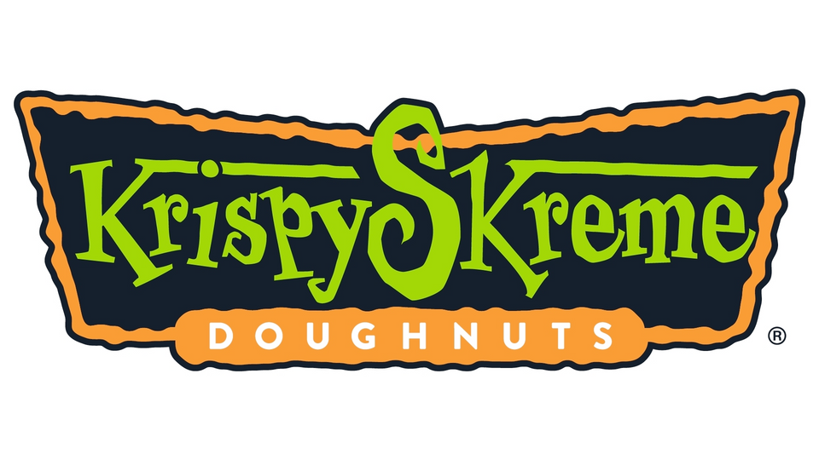
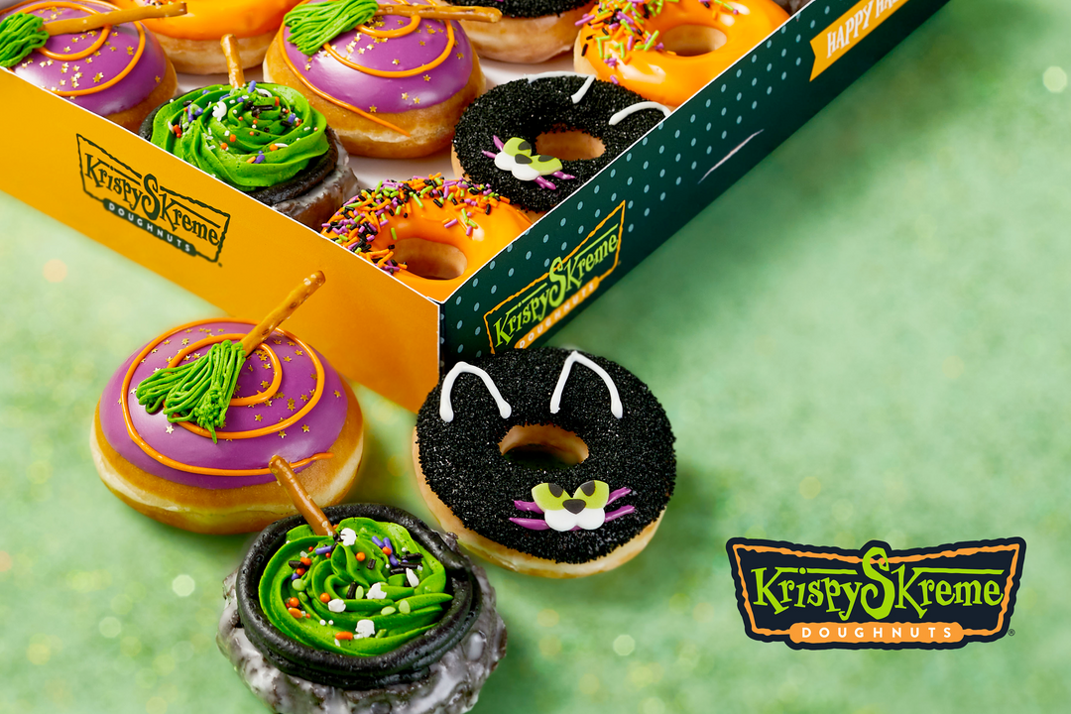

Marketing Insights from SCC
Module 9: Seasonal Marketing
KRISPY KREME
"KRISPY SKREME"
REBRAND
Krispy Kreme has rebranded as "Krispy Skreme" during this Halloween season. In addition to a name and logo change, the chain also introduced several new Halloween-themed doughnuts:
  Spooky Spider Doughnut
  Scaredy Cat Doughnut
  Boo Batter Doughnut
  Neon Orange Sprinkle Doughnut
M7L1: Publicity Stunt

Slide 15
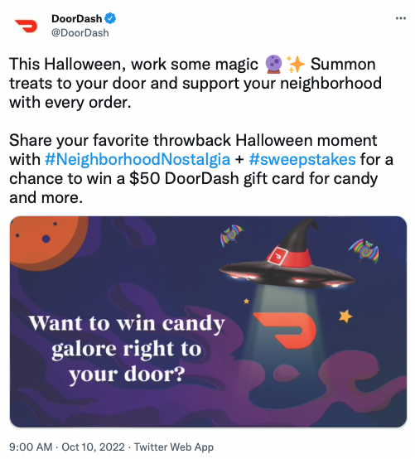
Marketing Insights from SCC
Module 9: Seasonal Marketing
DOORDASH
FREE CANDY!
For a limited time, DoorDash customers were offered the chance to win prizes delivered directly to their door, including Halloween candy, pet costumes, decor, and other prizes.
For the chance to win, consumers were instructed to head to DoorDash's Facebook, Twitter, or Instagram feeds and respond to the Nostalgia social post that DoorDash made while using the hashtags #neighborhoodNostalgia and #sweepstakes in the comments.
M6L3: Social Media Marketing

Slide 16
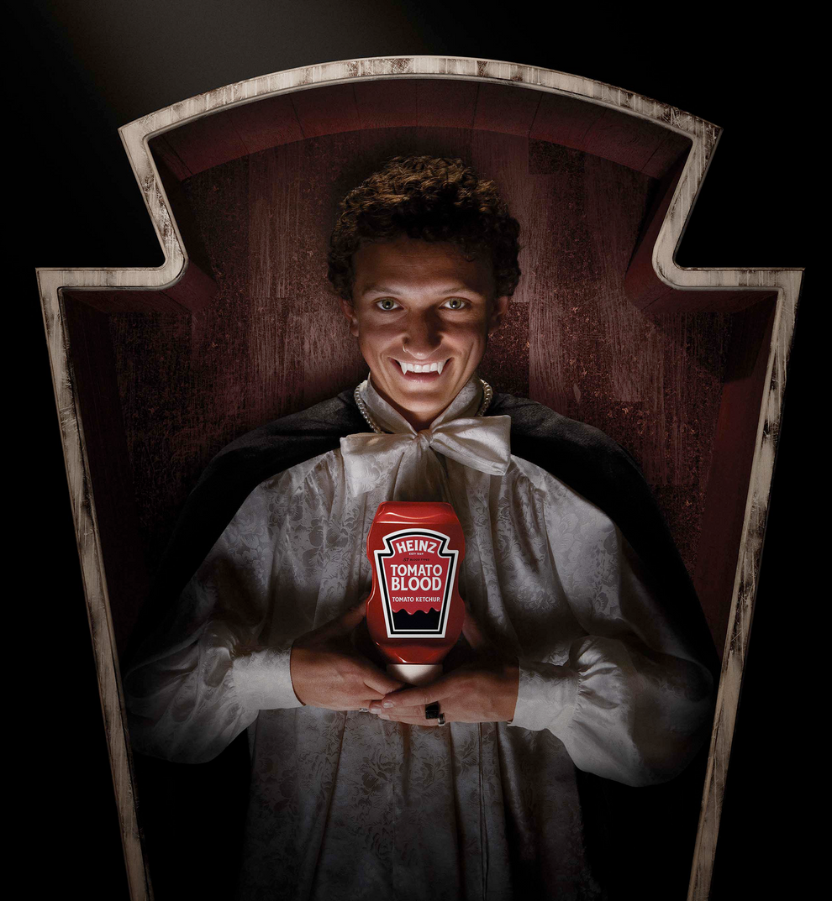
Marketing Insights from SCC
Module 9: Seasonal Marketing
HEINZ KETCHUP
TOMATO BLOOD
Heinz announced the return of a popular promotion from last year with Heinz Tomato Blood Ketchup.
According to a press release from the company, the tomato-gore-filled limited edition bottle featured "the delicious, thick & rich Heinz Ketchup fans know and love and return just in time for Halloween."
M1L1: Promotion

Slide 17
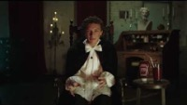

Slide 18
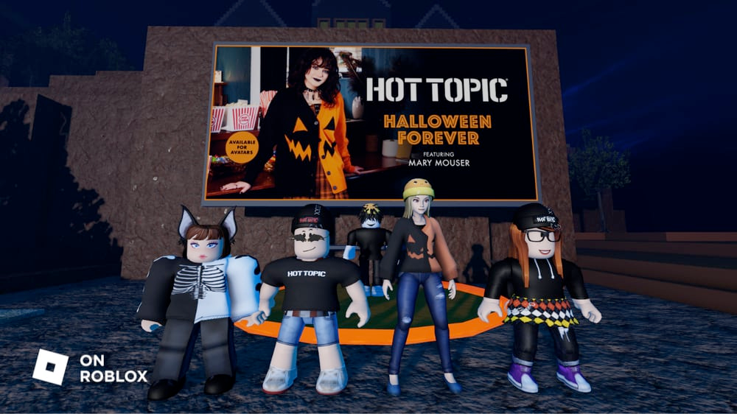
Marketing Insights from SCC
Module 9: Seasonal Marketing
HOT TOPIC
VIRTUAL CLOTHING DROP
To celebrate Halloween, Hot Topic launched a series of 10 branded, Halloween-themed virtual clothing items.
The line, called the ‘Halloween Forever Collection,’ was available in the Roblox Avatar Marketplace – a virtual store in Roblox where users can shop for avatar customizations, clothing and accessories. The brand has also built three virtual pop-up shops that are accessible via a number of popular Roblox experiences.
M6L2: Digital Marketing

Slide 19
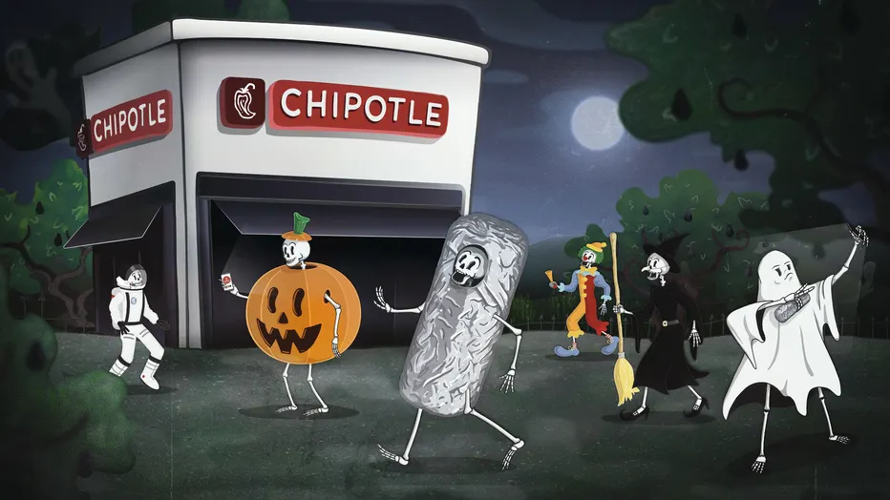
Marketing Insights from SCC
Module 9: Seasonal Marketing
CHIPOTLE
"BOORITO" PROMO
After a two-year hiatus because of the pandemic, Chipotle brought back their popular "Boorito" promotion.
Consumers were eligible for a free $6 entree by signing up for the brand's loyalty program (Chipotle Rewards) and visiting a Chipotle restaurant on Halloween dressed up in a costume.
M1L1: Promotion

Slide 20
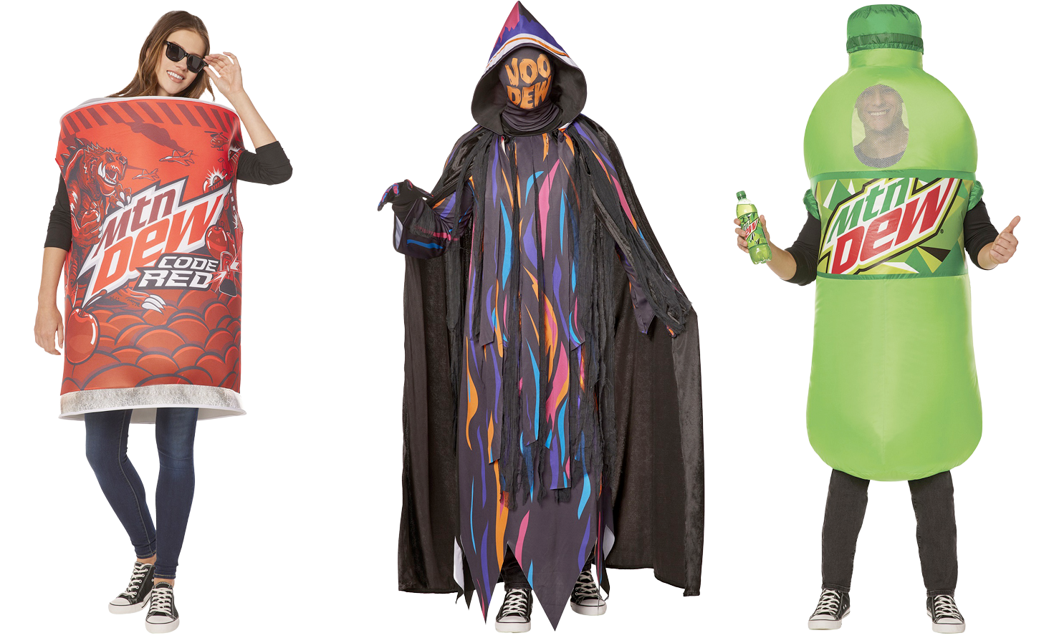
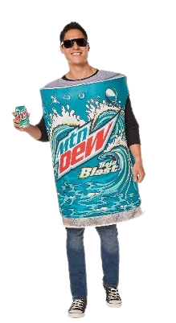
Marketing Insights from SCC
Module 9: Seasonal Marketing
MTN DEW X SPIRIT HALLOWEEN
COSTUME FLAVORS
According to a press release, Spirit Halloween and MTN DEW collaborated to create a new collection of limited-edition Halloween "flavor" costumes inspired by three fan-favorite MTN DEW flavors (Original, Baja Blast, and Code Red) and the VOO-DEW Grim, the embodiment of the iconic Halloween mystery flavor, MTN DEW VOO-DEW.
M3L2: Brand Collaboration

Slide 21
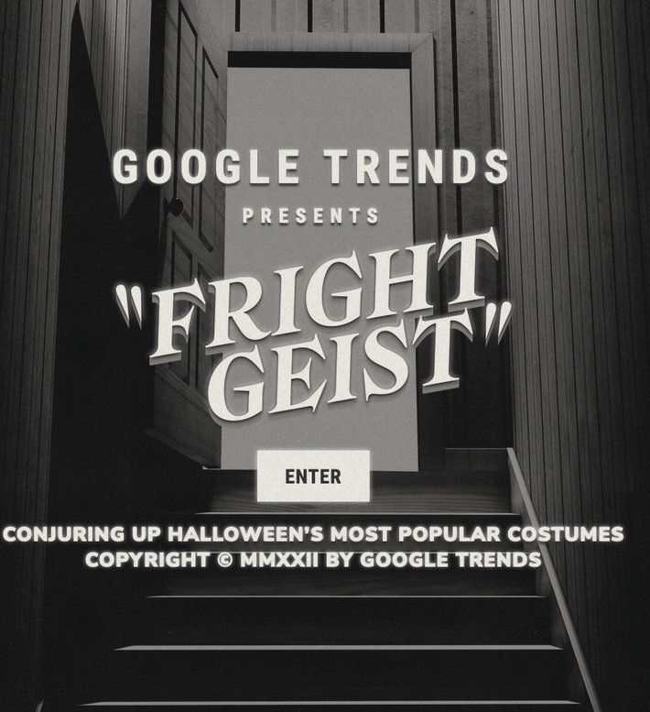
Marketing Insights from SCC
Module 9: Seasonal Marketing
GOOGLE
POPULAR SEARCH TOPICS
According to the 2022 Google Frightgeist, there are common topics and keywords that spike during searches this time of year. Some of the most popular terms this year include spiderweb, skeleton, witchcraft, and vampire. How might that information be used by businesses and brands with Halloween marketing campaigns?
M4L2: Advertising

Slide 22
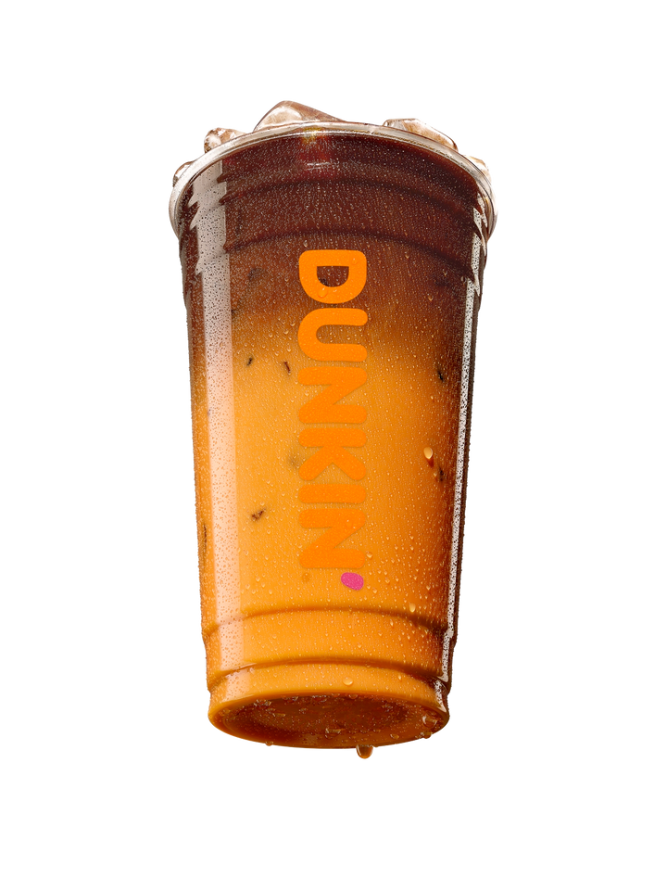
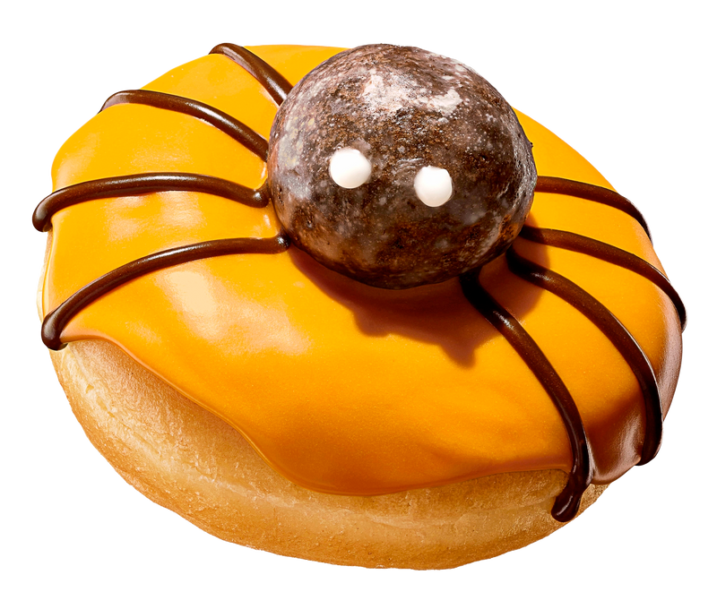
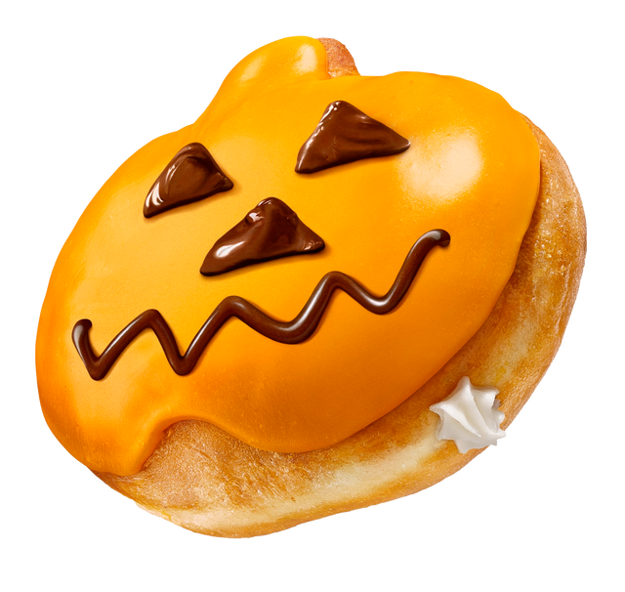
Marketing Insights from SCC
Module 9: Seasonal Marketing
DUNKIN'
SEASONAL PRODUCTS
Dunkin’ fans look forward to its seasonal Halloween products every year. In 2022, Dunkin' is treating them to a variety of new offerings, including:
  Peanut Butter Cup Macchiato
  Dunk-o-Lantern Donut
  Spider Donut
The new menu items were introduced in mid-October and only available to customers through October 31st.
M2L3: Product Life Cycle

Slide 23
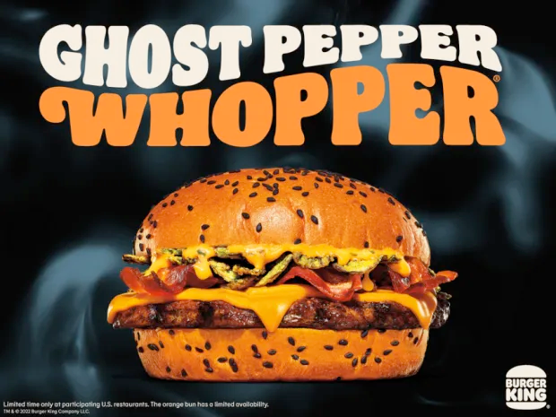
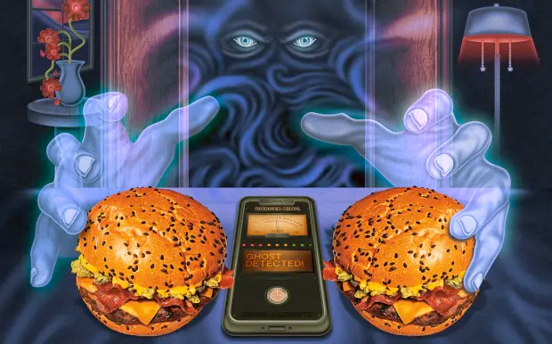
Marketing Insights from SCC
Module 9: Seasonal Marketing
BURGER KING
GHOST PEPPER WHOPPER & PARANORMAL ACTIVITY CHECK
Burger King introduced a Ghost Pepper Whopper on a Halloween-themed orange and black bun (for a limited time only), and launched a new feature for rewards members (BK's Royal Perks program) that provides access to a "ghost detector" through the brand's app that allows customers to check for paranormal activity in their homes.
Loyal customers who use the app's "Home of the Ghosts" feature could earn a meal for two that included the burger chain's new Ghost Pepper Whopper.
M6L3: Brand Loyalty

Slide 24
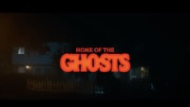

Slide 25
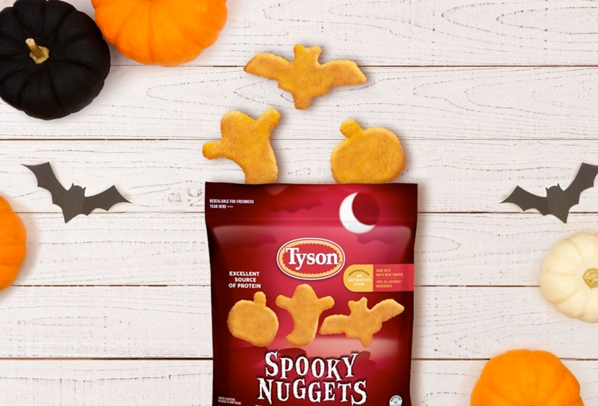
Marketing Insights from SCC
Module 9: Seasonal Marketing
TYSON FOODS
SPOOKY NUGGETS
Tyson Foods introduced a limited-edition Halloween-themed version of their popular chicken nuggets in three shapes: pumpkins, bats, and ghosts.
Nugget fans were encouraged to enter for a chance to win a bag of Tyson Spooky Nuggets by commenting on the Instagram announcement post with the emoji of the shape they are most excited to try (🎃 🦇 👻) and tag a friend they’d like to share them with, using hashtags #TysonSpookyNuggets and #Sweepstakes.
M6L1: Consumer Engagement

Slide 26
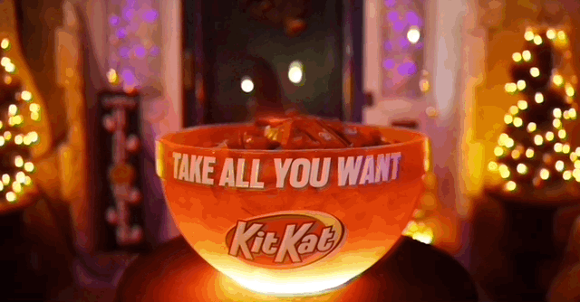
Marketing Insights from SCC
Module 9: Seasonal Marketing
KIT KAT
BOTTOMLESS CANDY BOWL
KIT KAT created a solution for those trick-or-treaters who encounter a home with a bowl of candy and a sign that says "take one."
With its enchanted bottomless trick-or-treat bowl, the supply of KIT KAT never runs out with more candy bars magically appearing when the supply is depleted. According to a press release from the brand, "You've heard of bubbling cauldrons, well now you have a trick-or-treat bowl that has a mesmerizing red light that will flash when the bowl magically refills for the next group of trick-or-treaters."
M7L1: Publicity Stunt

Slide 27
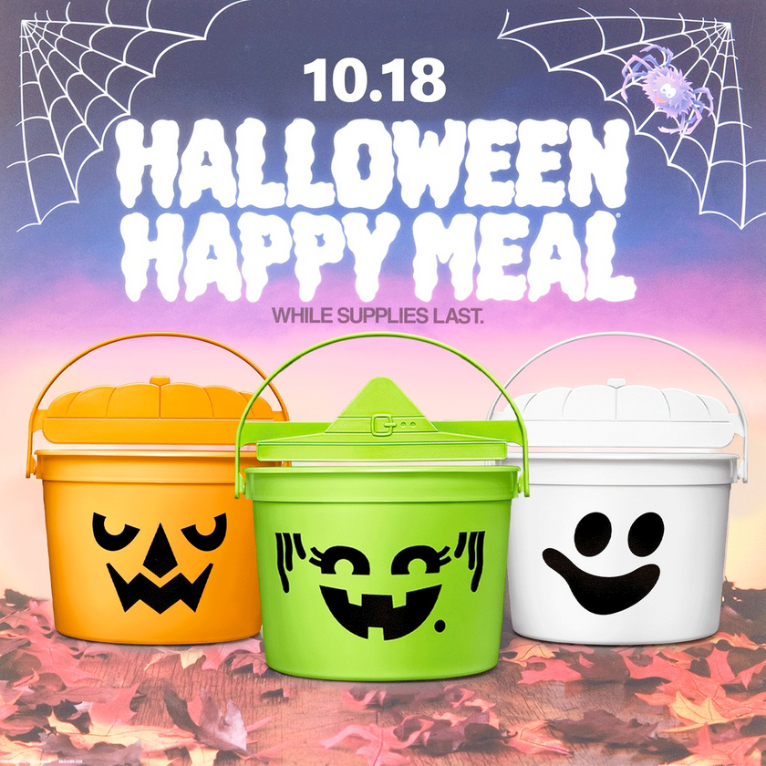
Marketing Insights from SCC
Module 9: Seasonal Marketing
MCDONALD'S
HALLOWEEN PAILS
According to a McDonald's corporate press release, they are bringing back the most iconic Halloween Happy Meal trio – McBoo, McPunk’n and McGoblin – that first came on the scene back in 1986, for Halloween this year.
For a limited time only (and while supplies last), McDonald's fans can purchase the Happy Meals, served in a Halloween-themed pails.
M9L1: Nostalgia Marketing

Slide 28

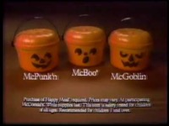
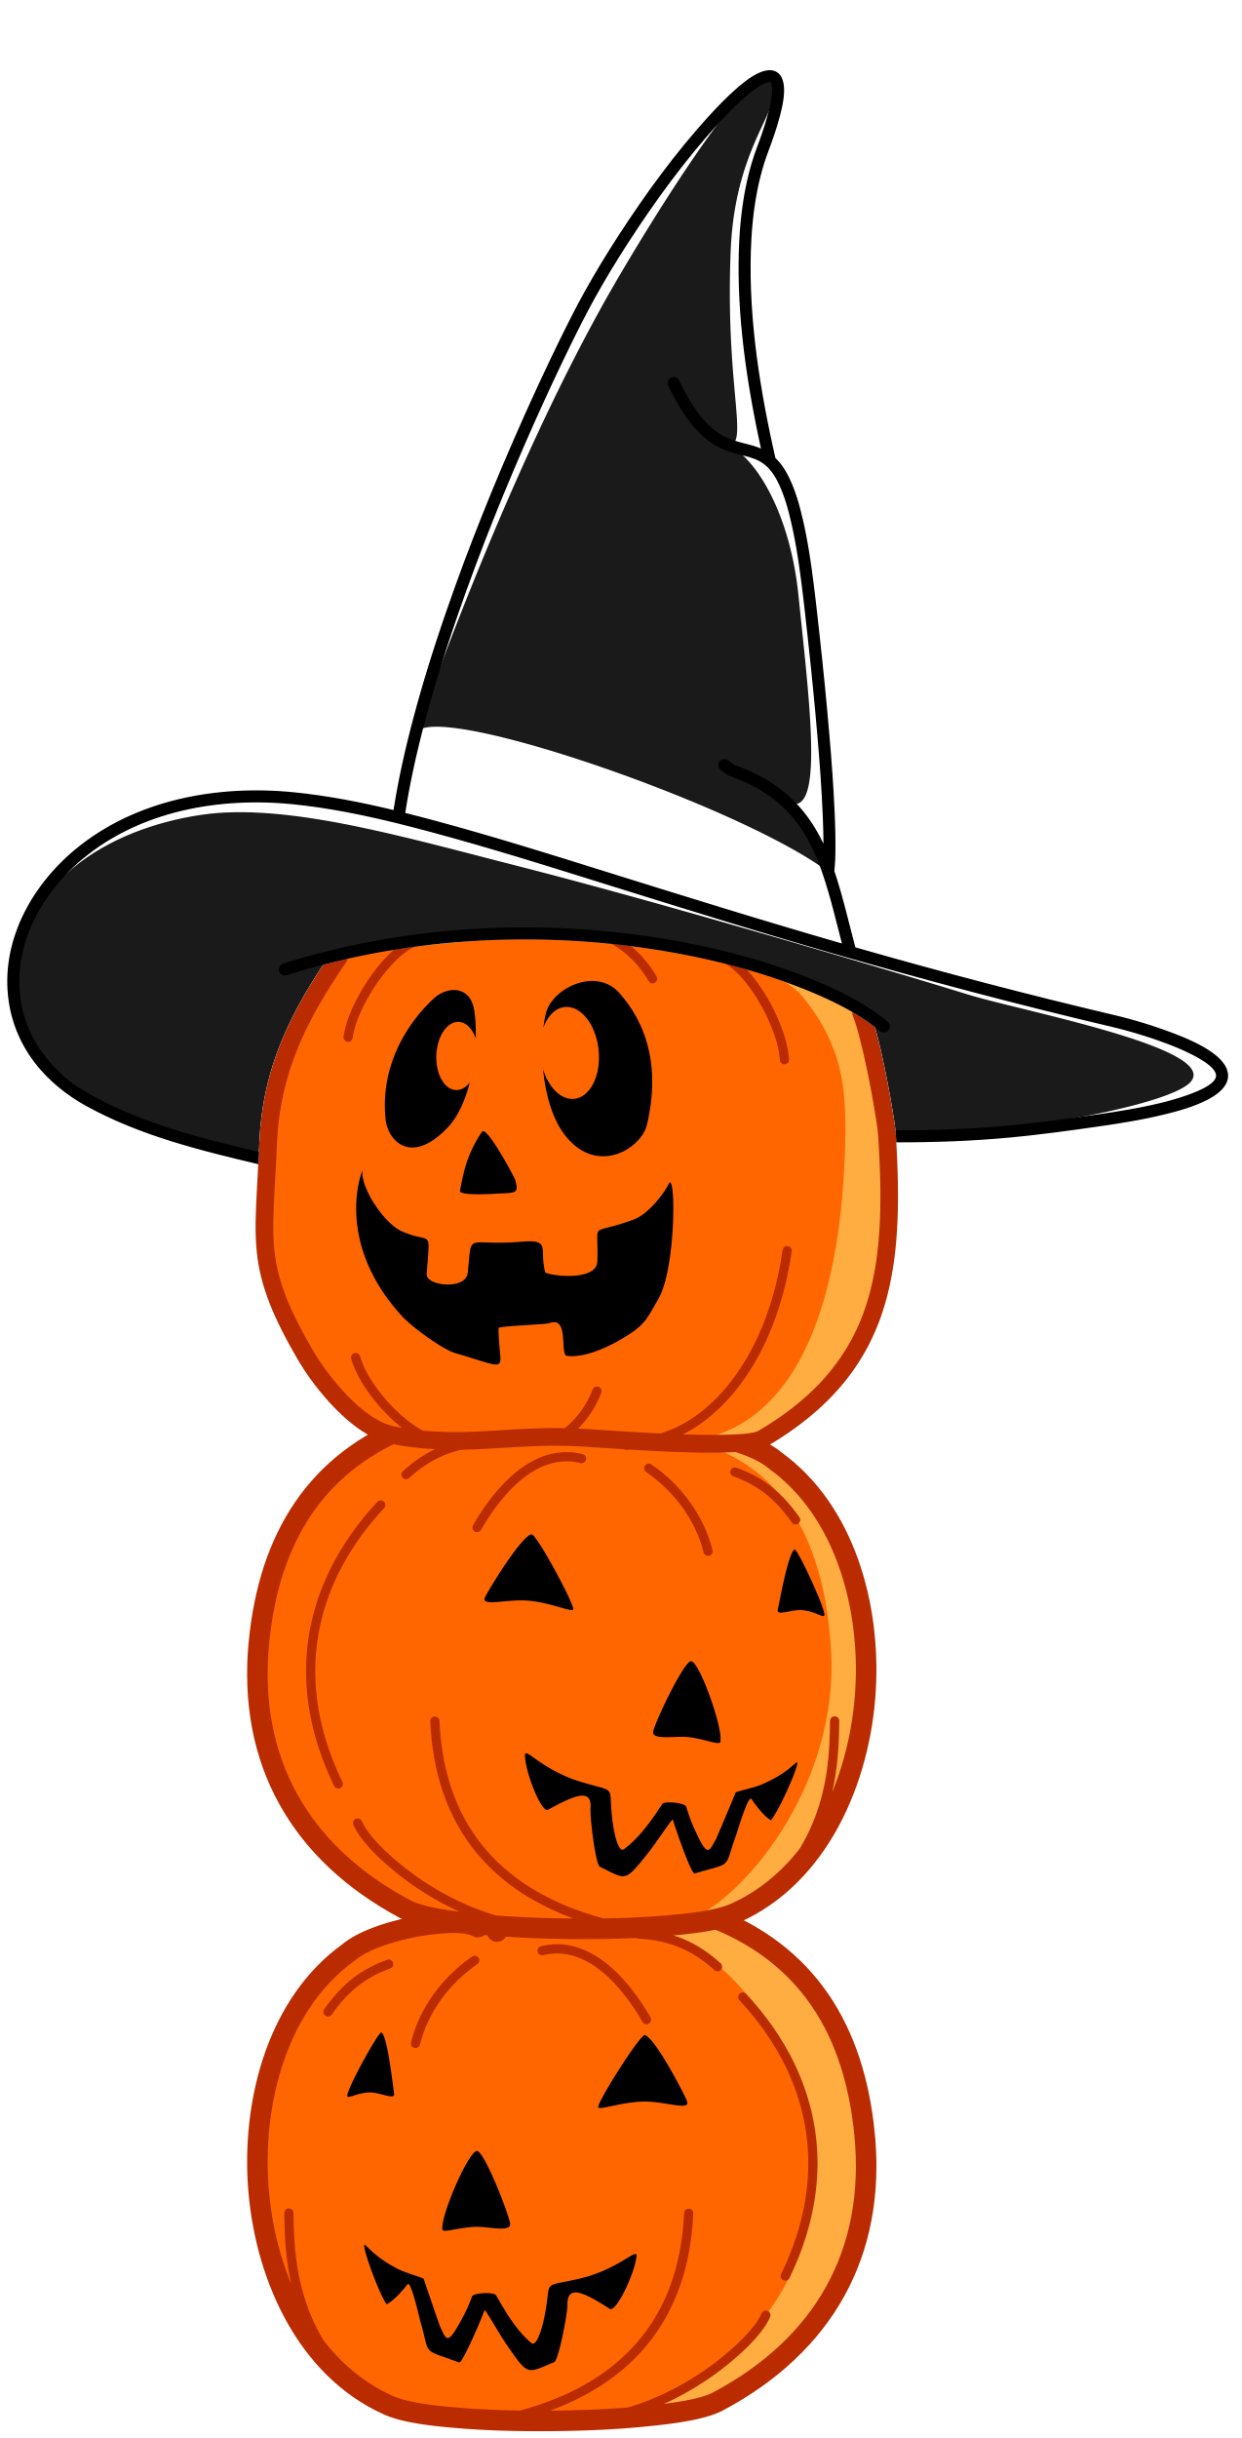

Slide 29
Marketing Insights from SCC
Module 9: Seasonal Marketing
DISCUSSION
QUESTIONS
1) What is seasonal marketing?
2) What are seasonal products?
3) What are industry trends?
4) Is Halloween more important to some businesses and brands than others?
5) What types of businesses and brands might benefit most from Halloween marketing?
6) Have you seen other examples of Halloween marketing
other than what was featured in this presentation?

Slide 30
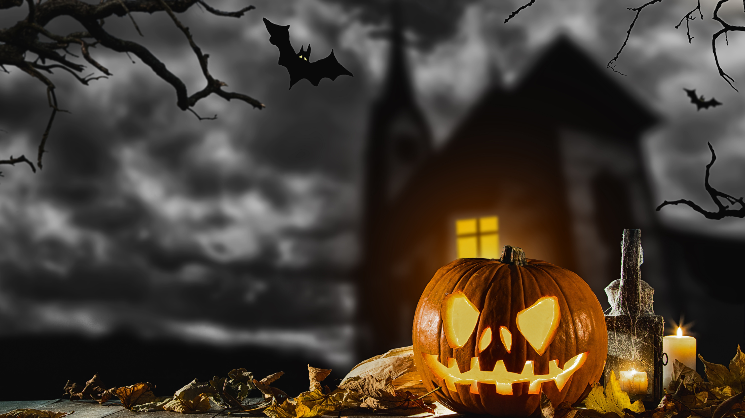
Marketing Insights from SCC
Module 9: Seasonal Marketing
STUDENT
ACTIVITY
The next slide features a list of several brands. Select one and create a Halloween-themed marketing campaign. Consider all the marketing tactics and strategies that you just reviewed in this presentation and apply some of those concepts to your campaign.
Be sure to incorporate a digital and social media
component to your marketing campaign, and you
will want to clearly communicate the goals of the
campaign. Explain how the brand will benefit from
the marketing campaign and be prepared to
present your ideas in class.

Slide 31
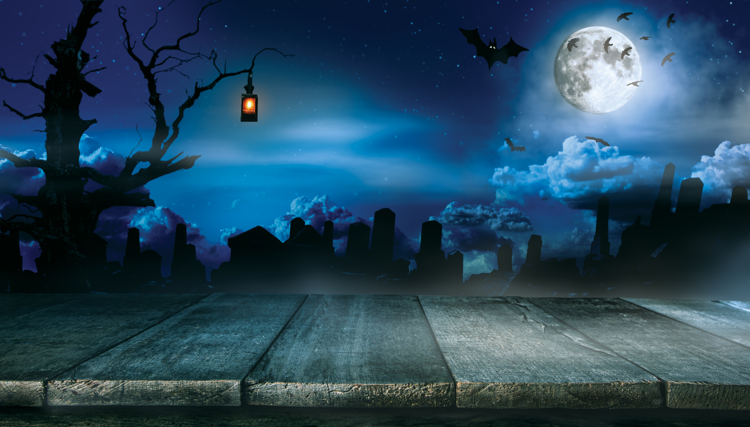
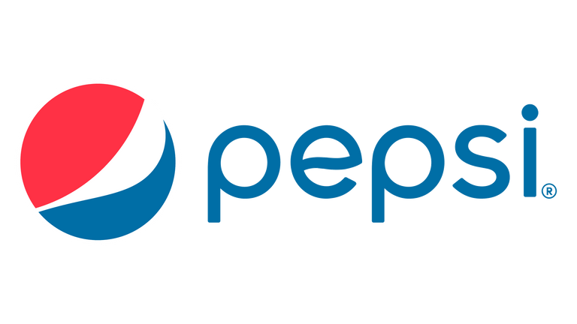
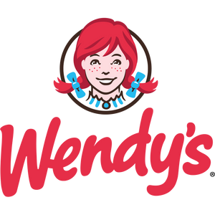
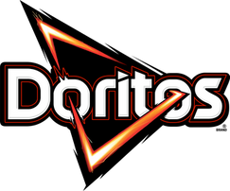
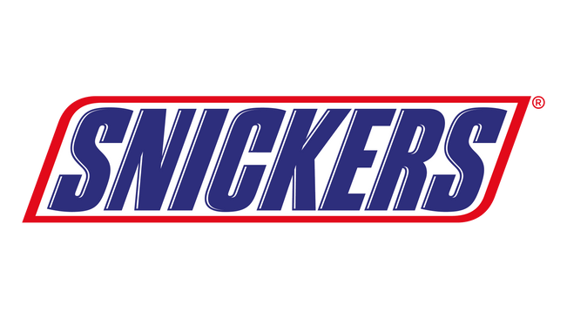
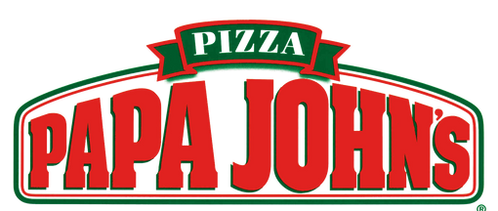


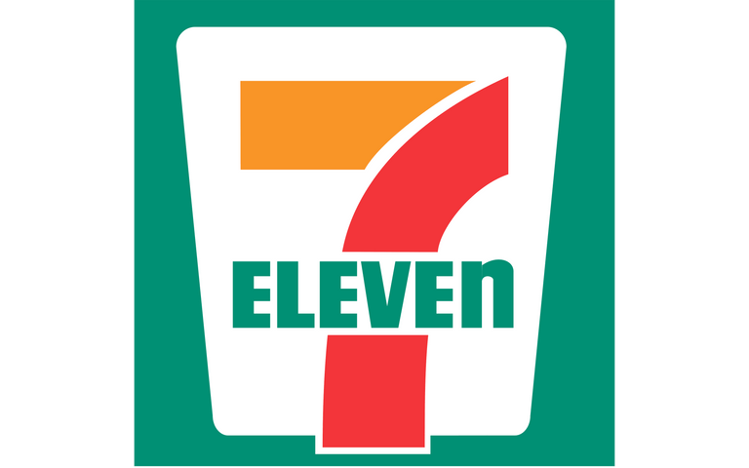
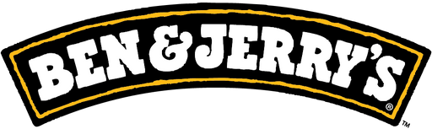
Marketing Insights from SCC
Module 9: Seasonal Marketing
STUDENT
ACTIVITY
SELECT FROM THE FOLLOWING BRANDS:

Slide 32
SOURCES
NRF.COM/TOPICS/HOLIDAY-AND-SEASONAL-TRENDS/HALLOWEEN
INSTACART.COM/COMPANY/UPDATES/HALLOWEENS-ULTIMATE-CANDY-CONTENDERS
CANDYSTORE.COM/BLOGS/FACTS-TRIVIA/HALLOWEEN-CANDY-MAP-POPULAR
THRILLIST.COM/NEWS/NATION/DOORDASH-FREE-HALLOWEEN-CANDY-CONTEST
IR.KRAFTHEINZCOMPANY.COM/NEWS-RELEASES/NEWS-RELEASE-DETAILS/MAKING-MEALS-SCARY-GOOD-TIME-HEINZR-TOMATO-BLOOD-KETCHUP-RETURNS
THEDRUM.COM/NEWS/2022/10/06/HOT-TOPIC-CELEBRATES-HALLOWEEN-WITH-ITS-FIRST-VIRTUAL-CLOTHING-DROP-ROBLOX
FRIGHTGEIST.WITHGOOGLE.COM
RNEWSWIRE.COM/NEWS-RELEASES/SPIRIT-HALLOWEEN-AND-MTN-DEW-SUMMON-FOUR-NEW-COSTUME-FLAVORS-FOR-HALLOWEEN-INCLUDING-HALLOWEEN-MYSTERY-FLAVOR-ICON-THE-VOO-DEW-GRIM-301612116.HTML
COMICBOOK.COM/IRL/NEWS/KRISPY-KREME-CHANGES-NAME-LOGO-HALLOWEEN-NEW-DOUGHNUTS
NEWS.DUNKINDONUTS.COM/NEWS/HALLOWEEN-2022
PRNEWSWIRE.COM/NEWS-RELEASES/NO-NEED-TO-FEAR-THIS-HALLOWEENTHE-NEVER-ENDING-KIT-KAT-TRICK-OR-TREAT-BOWL-IS-HERE-301647468.HTML
MARKETINGDIVE.COM/NEWS/CHIPOTLE-BOORITO-BEREAL-CASH-APP-IN-PERSON/633727
BUSINESSWIRE.COM/NEWS/HOME/20221011005574/EN/THE-HOME-OF-THE-WHOPPER%C2%AE-TURNS-INTO-THE-HOME-OF-THE-GHOSTS-THIS-HALLOWEEN
YAHOO.COM/LIFESTYLE/SUN-MAID-KNOWS-VILLAIN-HALLOWEEN-140000800.HTML
TYSONFOODS.COM/NEWS/NEWS-RELEASES/2022/10/TYSON-BRAND-LAUNCHES-EERIE-SISTABLE-LIMITED-EDITION-HALLOWEEN-SHAPED
CORPORATE.MCDONALDS.COM/CORPMCD/EN-US/OUR-STORIES/ARTICLE/OURSTORIES.MCD-HALLOWEEN-PAILS.HTML

