Slide 1


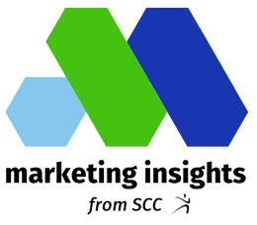
How are businesses and brands promoting their products and services this holiday season?
Holiday
Marketing
Marketing Insights from SCC

Slide 2



Seasonal Marketing
Seasonality in marketing refers to periods of the calendar year where certain products and services generate higher levels of consumer demand. These “seasons” influence sales and revenue for some companies and impact how those brands create business and marketing plans.
During the winter holiday season, businesses and brands introduce seasonal products and packaging designed to boost brand awareness and increase sales. Holiday marketing often features a popular strategy of adding limited-edition flavors and menu items for food, beverage, snack, and restaurant brands.

Slide 3
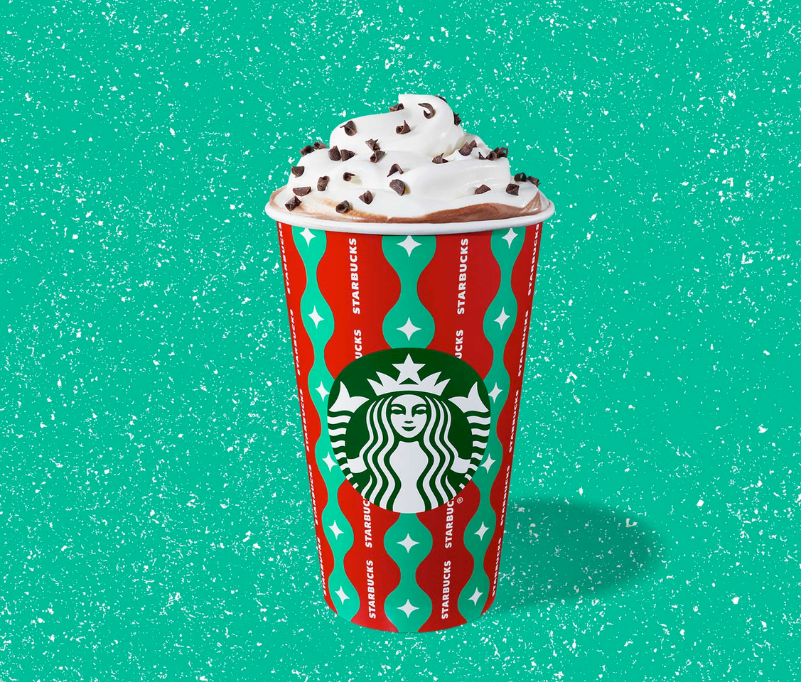

Starbucks
Seasonal Holiday-Themed Cups and Drinks

Slide 4

Starbucks Holiday-Themed Menu Items & Cups
This year, Starbucks announced the return of its popular holiday beverage, the Peppermint Mocha, for the 20th year. The Peppermint Mocha will be joined by its newer cohorts, the Caramel Brulee Latte, Chestnut Praline Latte, and Toasted White Chocolate Mocha.
Along with holiday drinks, Starbucks has unveiled new holiday cups, tumblers, and ornaments that are sold for a limited time. The first batch of cups rolled out in October and the second batch was released in early November. The third batch was offered in late November. Starbucks does not sell the cups online, they are only available for purchase in-store at a local Starbucks.

Slide 5
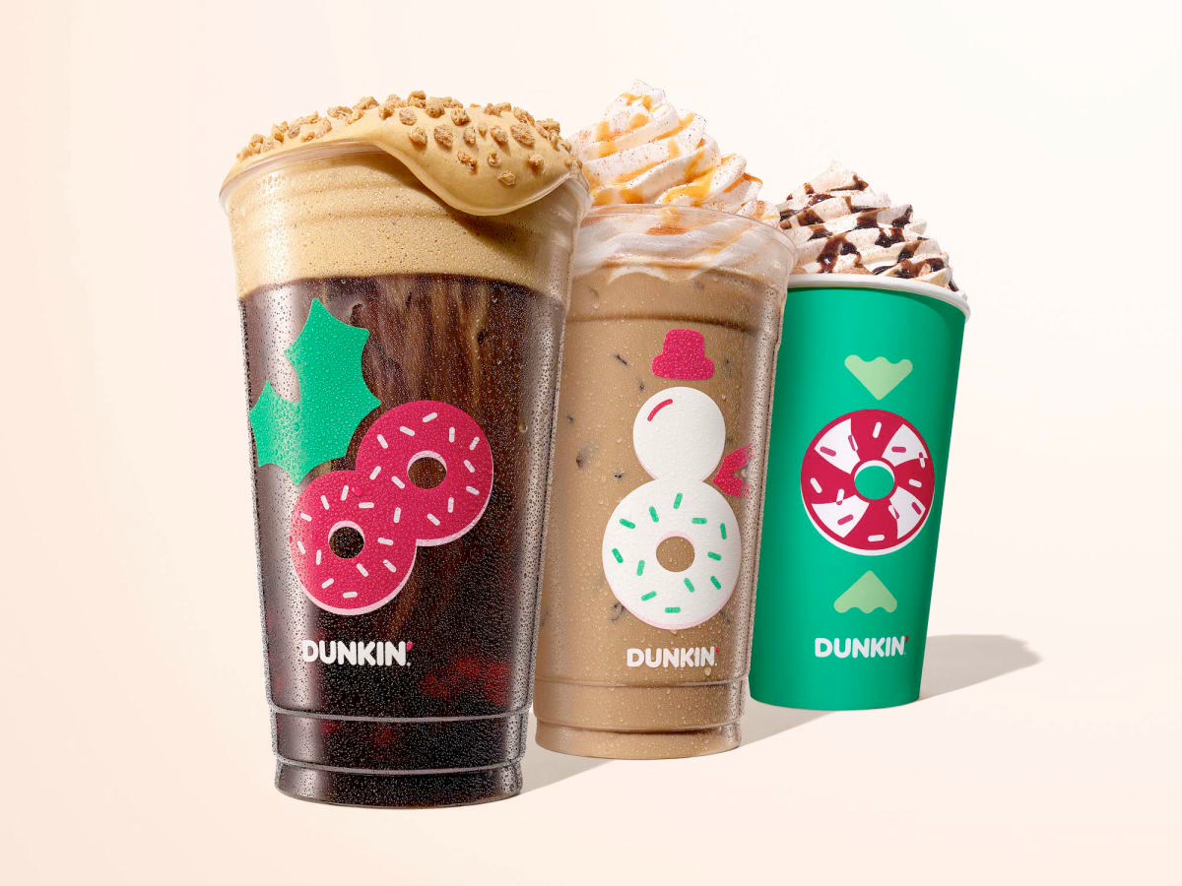

Dunkin'
Seasonal Food and Drinks Menu

Slide 6
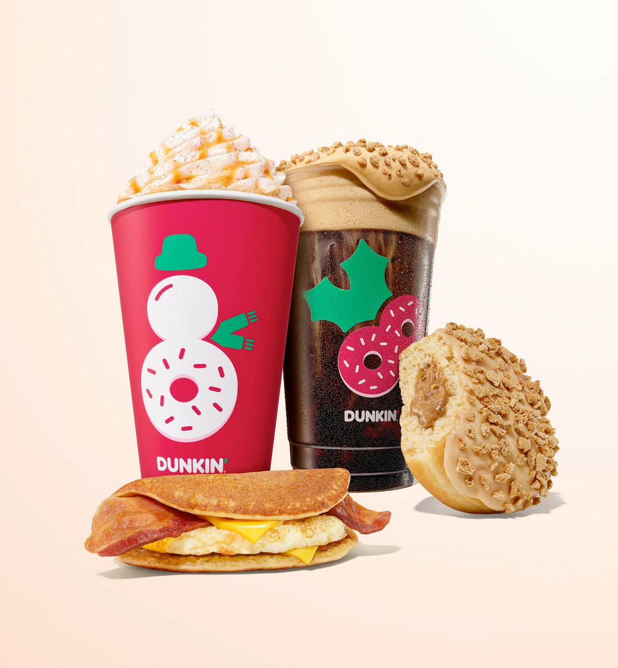
Dunkin'
Dunkin' traditionally rolls out new holiday-themed menu items and packaging at the beginning of November. This year, the menu featured holiday-themed food items along with winter drinks, including a new "Pancake Wake-Up Wrap" item, described by Dunkin' as "wrapped and ready to sleigh."

Slide 7
Promotion
Promotion is any form of communication used to inform, persuade, or remind people about a company’s products or services. Promotion plays a significant role in creating and maintaining the levels of commitment and emotional involvement consumers have with the brand.
In addition to Black Friday deals and Cyber Monday promotions, businesses and brands reach consumers during the holidays with a variety of limited-edition offerings, holiday-themed branded merchandise collections, collabs, direct marketing campaigns, and more.

Slide 8
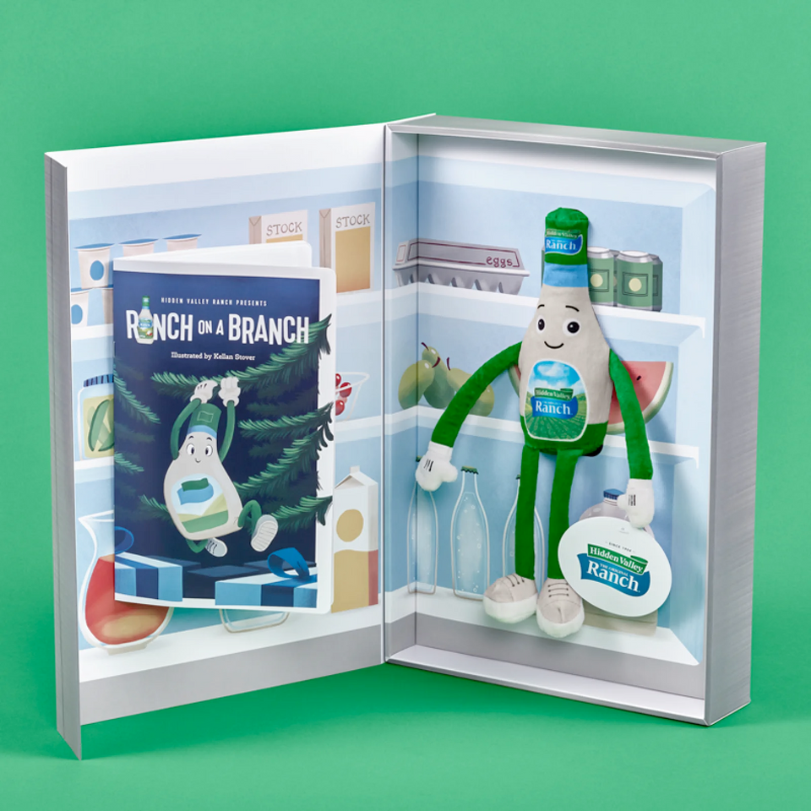
Hidden Valley
"Ranch on a Branch" Campaign

Slide 9
Hidden Valley
Priced at $30, Hidden Valley (maker of ranch dressing and other condiments) take on the popular "Elf on a Shelf" holiday tradition quickly sold out. The limited-edition merchandise package included a plush doll of the brand's mascot "Ranchie" and an accompanying storybook.
The campaign also supported a cause, with Hidden Valley Ranch donating $30,000 to Feeding America to provide 300,000 meals to people in need this holiday season and beyond.

Slide 10
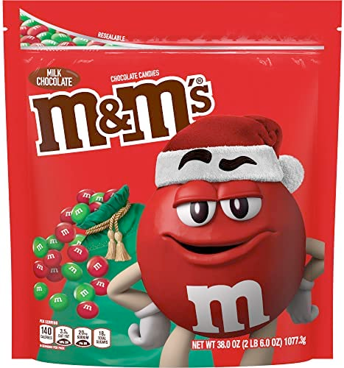
M&Ms
Customizable M&Ms Candies &
Holiday Gift Collection

Slide 11
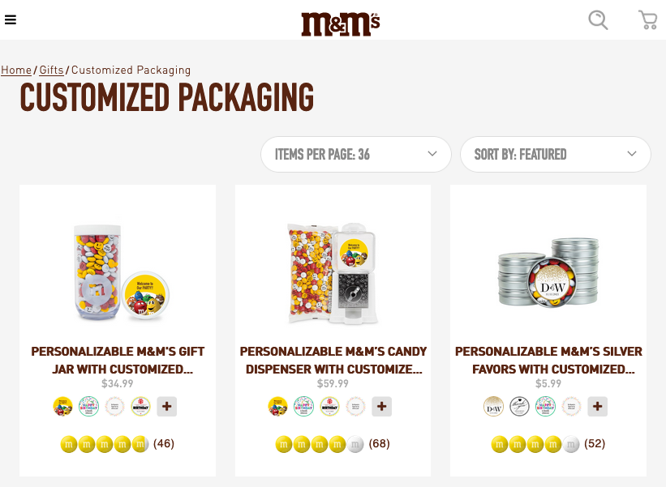
M&Ms Holiday Promotions
In addition to holiday-themed packaging, M&Ms offers a variety of holiday gift options:
  Customizable personalized candies
  Customizable personalized packaging
  Branded merchandise
  Holiday recipes
  Corporate gifts
  Party favors

Slide 12
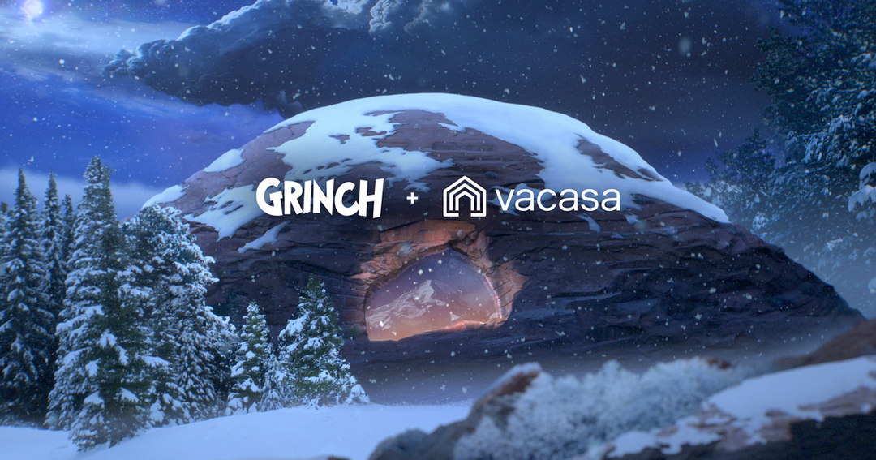
Vacasa
Grinch Cave Vacation Property

Slide 13
Vacasa
Last year, vacation rental management company Vacasa teamed up with Dr. Seuss Enterprises for a promotion that offered the ultimate holiday getaway "three thousand feet up, up the side of Mt. Crumpit."
A recreation of the lair belonging to Dr. Seuss's fan-favorite character — The Grinch, from "How the Grinch Stole Christmas"— opened its doors to visitors for a limited time. Located on a remote property outside of Boulder, Utah, the lair was a massive 5,700 square feet (no need to grow three sizes) spread across several levels. Accommodations included a main bedroom, guest bedroom, study, bathrooms, and music room — complete with the Grinch's organ and Max's drum set.

Slide 14
Publicity Stunts
Publicity stunts are a marketing tactic where specific events or activities are planned with the sole purpose of achieving a high level of media coverage and public awareness. Publicity stunts (also referred to as PR stunts or marketing stunts) can serve as an effective vehicle in generating public “buzz” surrounding a brand, often promoting the release of a new product or around a major event.
Publicity stunts are popular marketing tactics during the holiday season.

Slide 15
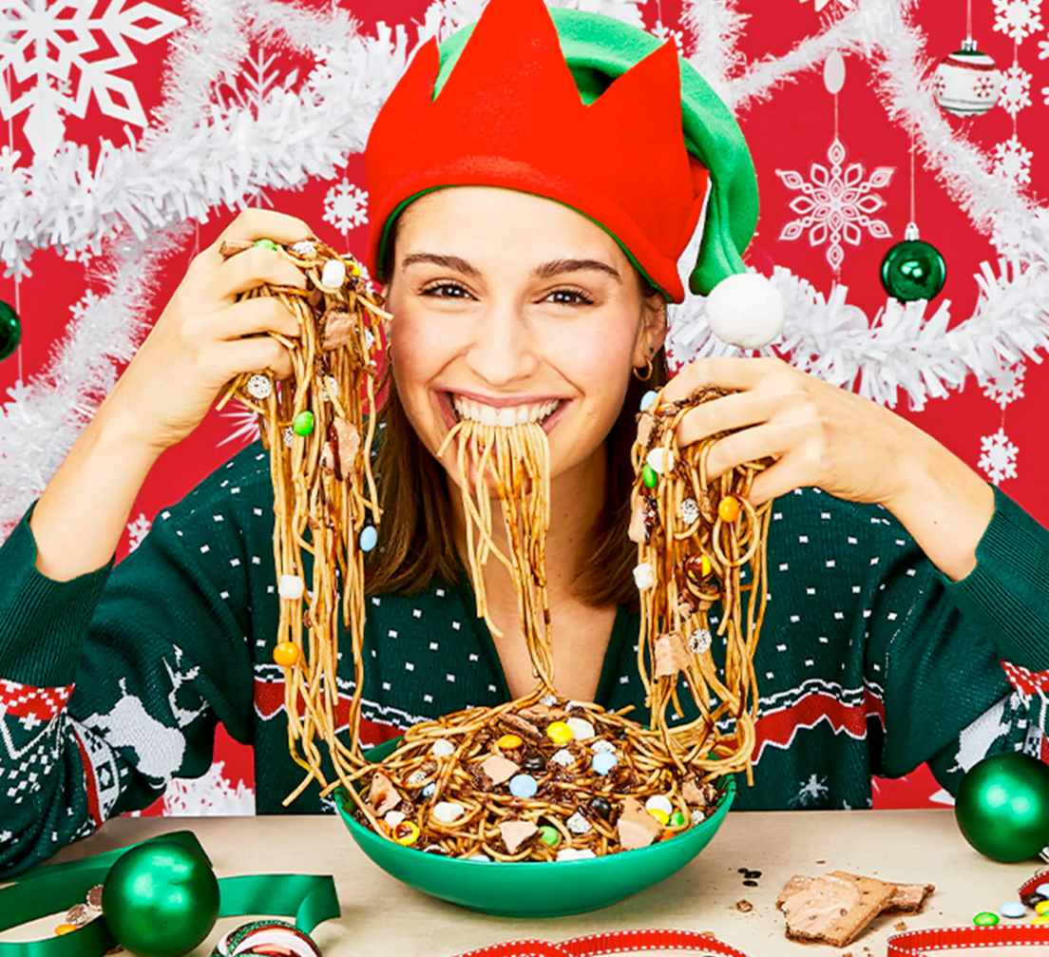
HelloFresh
Buddy the Elf Spaghetti Meal Kit

Slide 16
HelloFresh
For those who think Buddy the Elf’s rather specific concoction featuring spaghetti and syrup sounds appetizing, then Hello Fresh has something for you this holiday season. The meal-kit company HelloFresh teamed with Warner Bros. to launch limited-edition Buddy the Elf Spaghetti meal kits this holiday season.
Based on the spaghetti "dish" featured in the classic 2003 movie, 'Elf', the HelloFresh version features all the notable ingredients: Colavita spaghetti, maple syrup, chocolate syrup, marshmallows, chocolate nonpareil candies, crumbled chocolate frosted pastries, and more. The suggested pairing for the optional hands-free dish is a bottle of cola (not included).

Slide 17
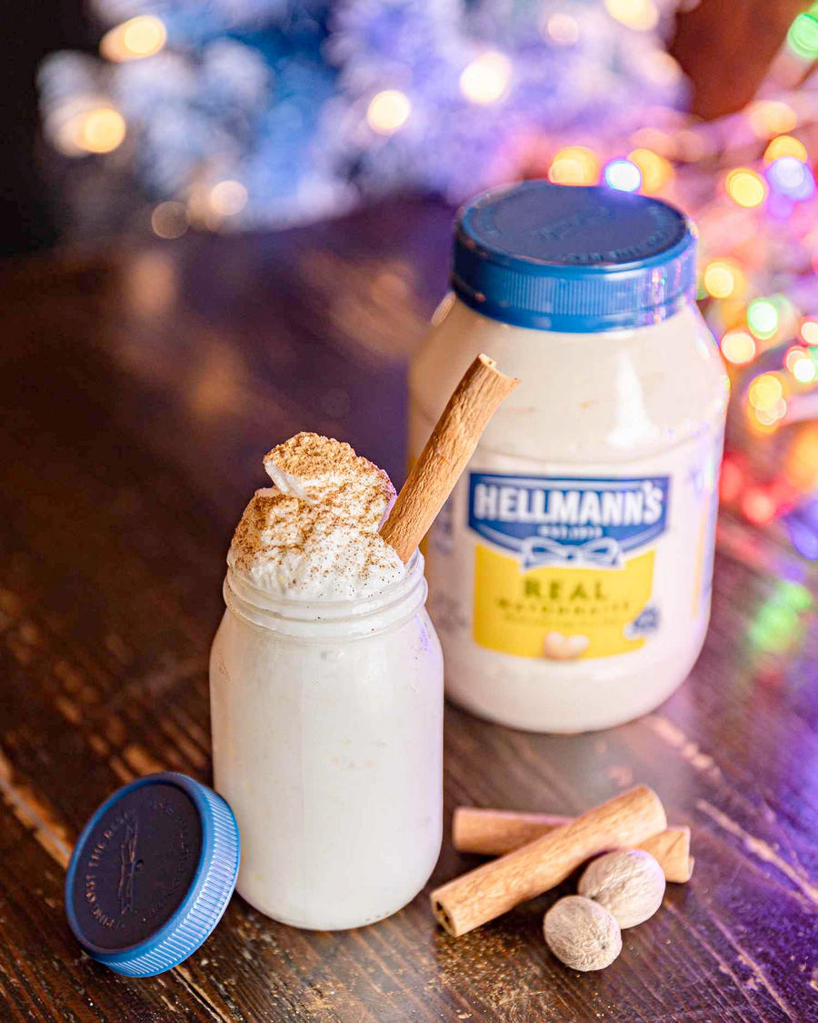
Hellmann's
Snickerdoodle Mayo Cookie & an Eggnog Mayo Adaptation: Frozen Mayo-nog

Slide 18
Hellmann's Mayo
It’s Eggnog, but not as we know it. Condiment producer Hellmann’s teamed up with hospitality experience company Muddling Memories to create the most eclectic dessert and cocktail pairing of the holiday season with Snickerdoodle Mayo Cookie and a Mayo-Nog drink.
While the items are only available for sale at a bar in New York City (Amy Fontaines) through December 15, where a single glass (which can also be made in a non-alcoholic version) cost $16, paired with Snickerdoodle Mayo Cookies (including a mayo glaze) for $24, Muddling Memories also posted the recipe to Instagram.

Slide 19
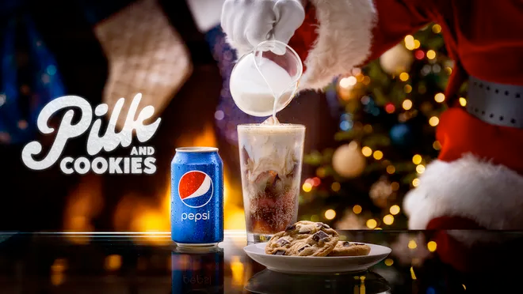
Pepsi
Pepsi’s “Pilk and Cookies” Holiday Campaign

Slide 20
Pepsi "Pilk and Cookies"
There's nothing like celebrating the holiday season by leaving Santa Claus with his favorite snack: milk and cookies – with soda. With its 2022 holiday campaign, Pepsi introduced "a surprising and naughty new twist." It's Pilk, Pepsi mixed with milk, and cookies. According to the brand, the combination has "long been a secret hack among Pepsi fans."
To help launch the promotion, Pepsi got the help of Lindsay Lohan, who recently starred in Netflix's "Falling for Christmas" and has been associated with Christmas since her "Jingle Bell Rock" performance in the 2004 film "Mean Girls." Pepsi offered some recipes for people to try, like "The Naughty & Ice," which involves mixing whole milk, heavy cream and vanilla creamer into a cup of Pepsi and enjoying it with a chocolate chip cookie. Another recipe, "The Cherry on Top," uses 2% milk, heavy cream and caramel creamer into a cup of Pepsi Wild Cherry, pairing it with a gingerbread cookie.

Slide 21
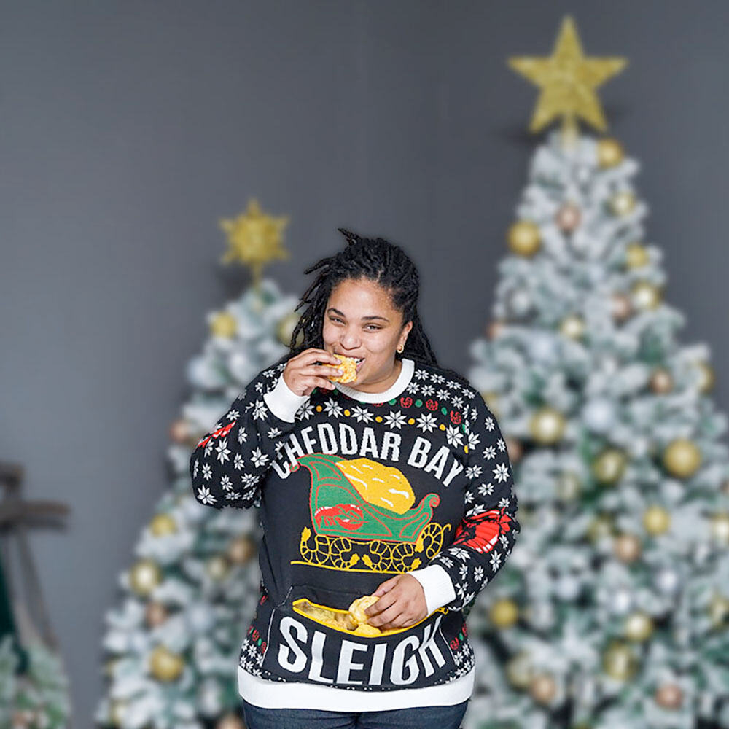
Red Lobster
Limited Edition Holiday Collection

Slide 22
Red Lobster
As part of a new merchandise collection in 2022 available in the Red Lobster Shop, the brand is offering a limited-edition Cheddar Bay Sleigh Ugly Sweater, outfitted with an insulated pocket to keep Cheddar Bay Biscuits® warm and safe.
Other offerings in the Red Lobster Shop include:
  Cheddar Bay Sleigh Ugly Sweater
  Red Lobster Restaurant Snow Globe
  Red Lobster Ornament
  Red Lobster Claw Hoodie
  What’s Crackin’ T-Shirt
  Red Lobster Critter Beanie

Slide 23
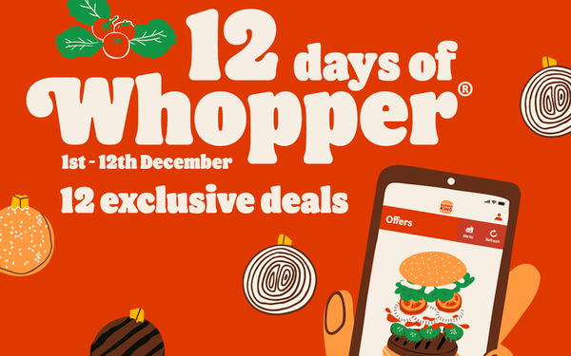
Burger King
Burger King "12 Days of Christmas"

Slide 24
Burger King
To boost brand loyalty and encourage more consumers to use the brand's app, Burger King's "12 Days of Christmas" promotion Burger King promises 12 days of free food and special offers to celebrate the festive season.
Beginning December 1st and running through the 12th of the month, all customers need to do to be eligible for the promotional offers is download the Burger King app on their mobile devices.

Slide 25
Public Relations
Public relations (PR) refers to a business or brand’s efforts to build and maintain a favorable image with consumers through mass communication. Unlike advertising, which can also influence consumer perceptions, public relations is not a paid form of media, and does not always have a direct impact on sales. Instead, a brand or business will lean on a public relations strategy to build its image and communicate key information to consumers without spending money through any advertising channels.
Throughout the holidays, businesses and brands engage in a variety of activities designed to make a positive impact on communities around the world.

Slide 26
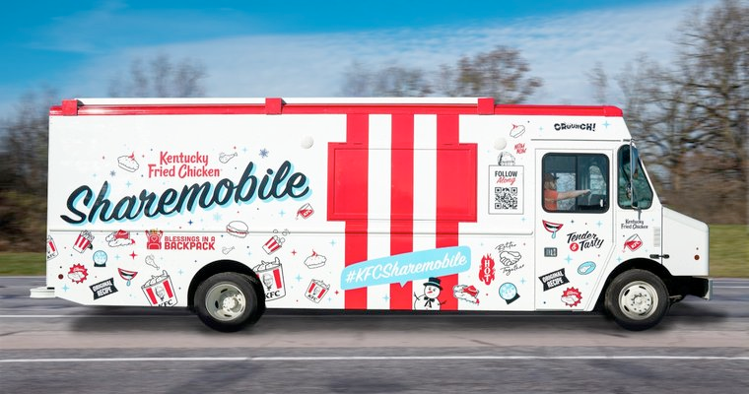
KFC
"Sharemobile" Meal Sharing

Slide 27
KFC
KFC, in conjunction with Blessings in a Backpack, is hitting the road to feed families in need with the KFC Sharemobile, a holiday-edition charitable food truck. KFC and its franchisees are expected to provide nearly 70,000 meals to kids and families in need this holiday season, according to a press release.
KFC has partnered with Blessings in a Backpack since 2017, donating nearly $1 million to the nonprofit in recent years. KFC employees at its Louisville, Kentucky headquarters volunteer weekly to provide and physically package more than 300 meals for local students to take home for the weekend.

Slide 28
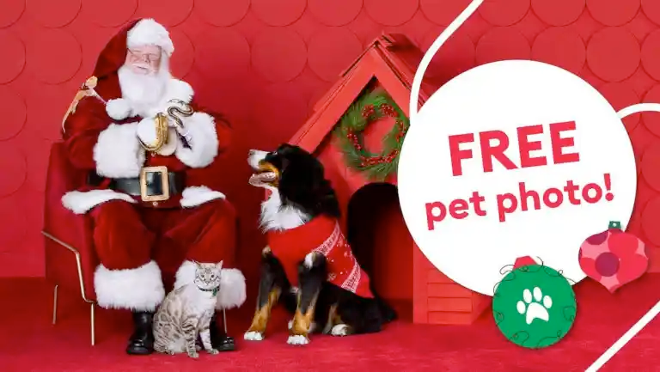
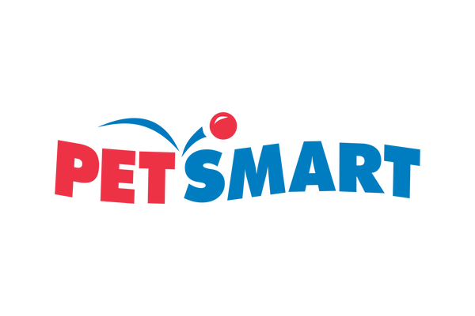
PetSmart
PetSmart's "Chance & Friends"
Holiday Collection

Slide 29
PetSmart
In addition to promotional activities like free pet photos with Santa at some PetSmart locations, the brand also launched a cause marketing campaign that allows shoppers to purchase pet toys from PetSmart's philanthropic Chance & Friends collection. For each Chance & Friends purchase, $1 is donated to the nonprofit PetSmart Charities, the leading funder of animal welfare in the country that also celebrated its 10 millionth pet adoption this year.

Slide 30
Content Marketing
Content marketing is a strategic marketing approach focused on creating and distributing valuable, relevant, and consistent content to attract and retain a clearly defined audience—and, ultimately, drive profitable customer action.
A content marketing strategy provides businesses and brands with an effective tool for capturing the attention of consumers during the holidays while boosting levels of engagement.

Slide 31
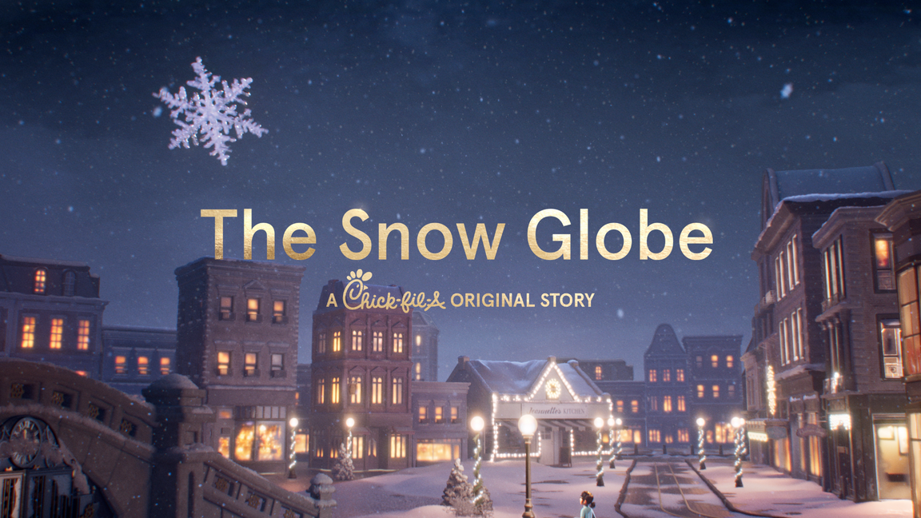
Chick-fil-A
"The Snow Globe", Chick-fil-A's 2022 edition of its annual animated film series

Slide 32
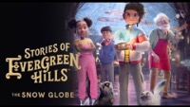

Slide 33
Digital & Social Media Marketing
Digital marketing is when businesses promote their products and services using digital distribution channels.
Social media is a group of online technologies and practices that people use to share content, opinions, insights, experiences, perspectives, media, and otherwise interact online. Harnessing the power of social media and using it as a marketing tool has become a top priority for businesses and brands across the globe because it offers an effective means for connecting with and engaging consumers.

Slide 34
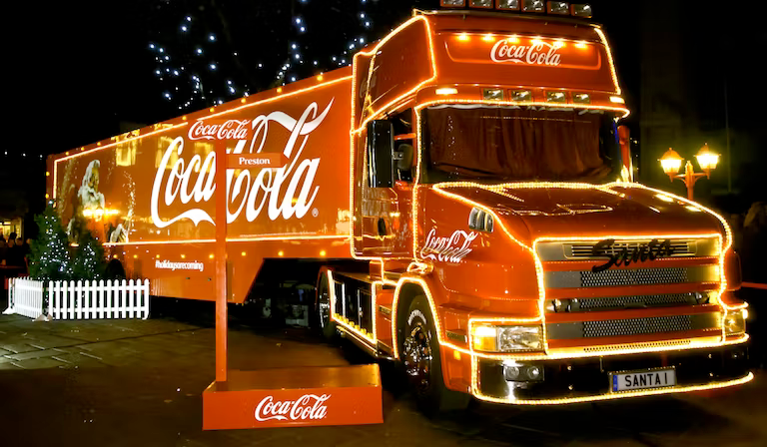
Coca-Cola
Coca-Cola's "Holidays are Coming"
Annual Holiday Marketing Campaign

Slide 35
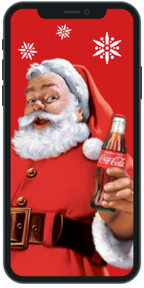
Coca-Cola
Coca-Cola will be promoting its long-running annual holiday campaign, ‘Holidays are Coming’. This year's campaign will include:
  Advertising
  Holiday caravan distributing meals and cheer to families around the world
  A digital marketing component allowing consumers to get a photo with Santa on the Coca-Cola app or by scanning a QR code on the brand's website
  Social media element using #CokeCaravan hashtag
  Personalized gifts in the Coca-Cola online store
  Holiday packaging
  Recipes on the Coca-Cola website

Slide 36
Advertising
Advertising refers to any paid, non-personal form of communication by an identified company promoting goods and services.
Advertising channels could include:
  Print
  Outdoor / OOH (Out of home) advertising
  Traditional broadcast (television, radio, satellite)
  Online/digital media
  Social media
  Search
  Cinema
  Promotional products

Slide 37
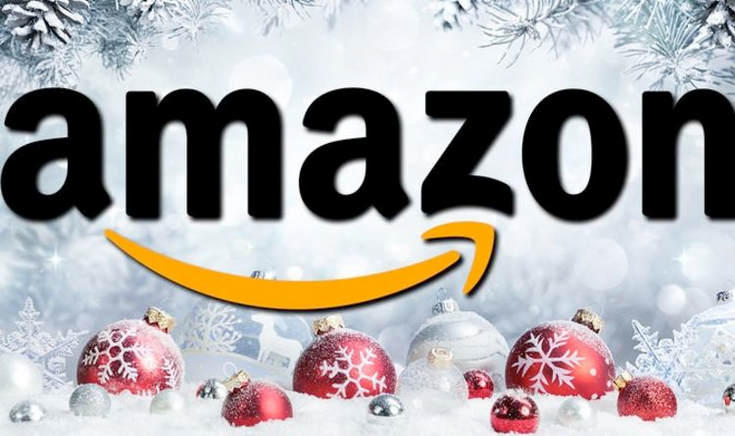
Amazon
"Joy is Made" Advertising Campaign

Slide 38
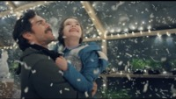

Slide 39
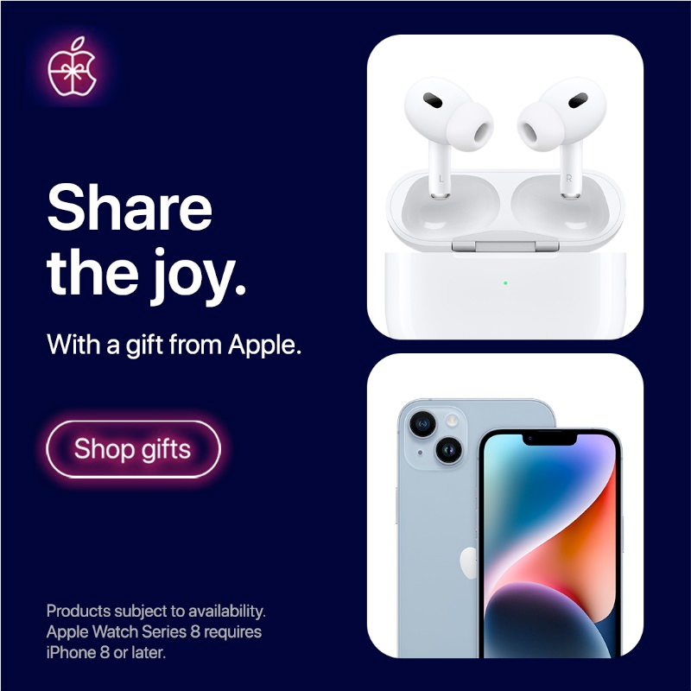
Apple
Apple "Share the Joy"
2022 Holiday Advertising Campaign

Slide 40
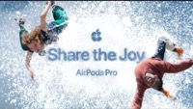

Slide 41
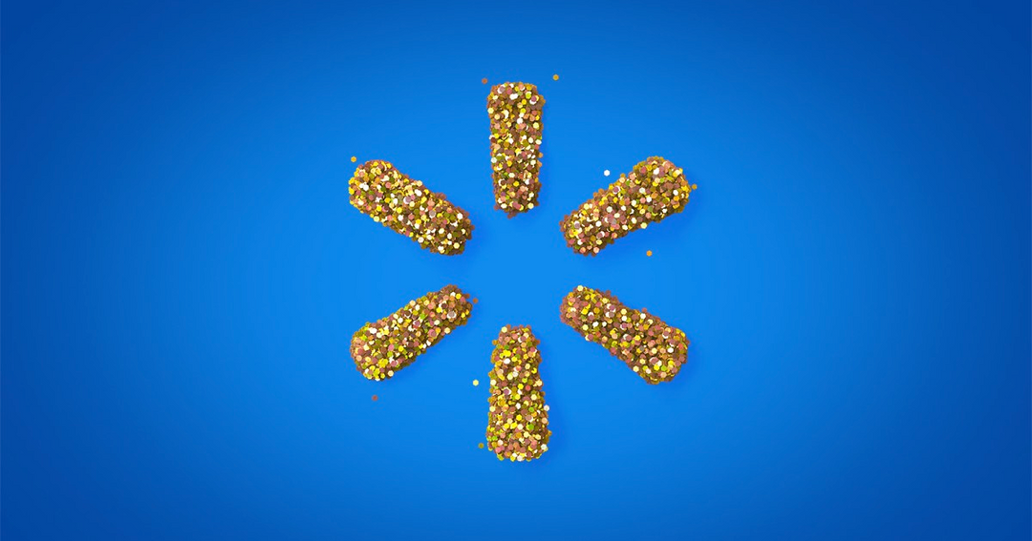
Walmart
Walmart's "All the Ways We Holiday"
2022 Holiday Advertising Campaign

Slide 42
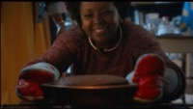

Slide 43
Dunkin'
Dunkin' "It's Here" 2022
Holiday Advertising Campaign

Slide 44
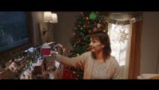

Slide 45
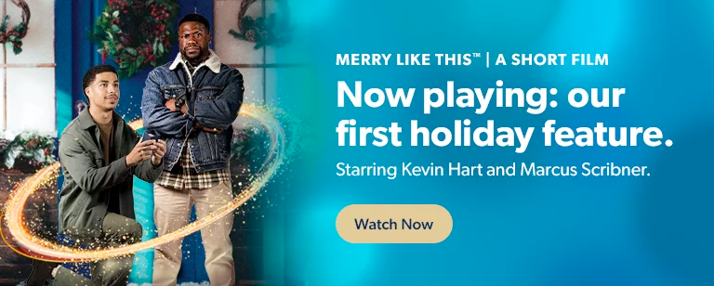
Sam's Club
"Merry Like This: A Short Film"
Starring Kevin Hart and Marcus Scribner, a two-minute film that will run in 1,700 theaters across the country

Slide 46
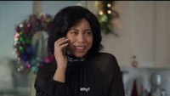

Slide 47
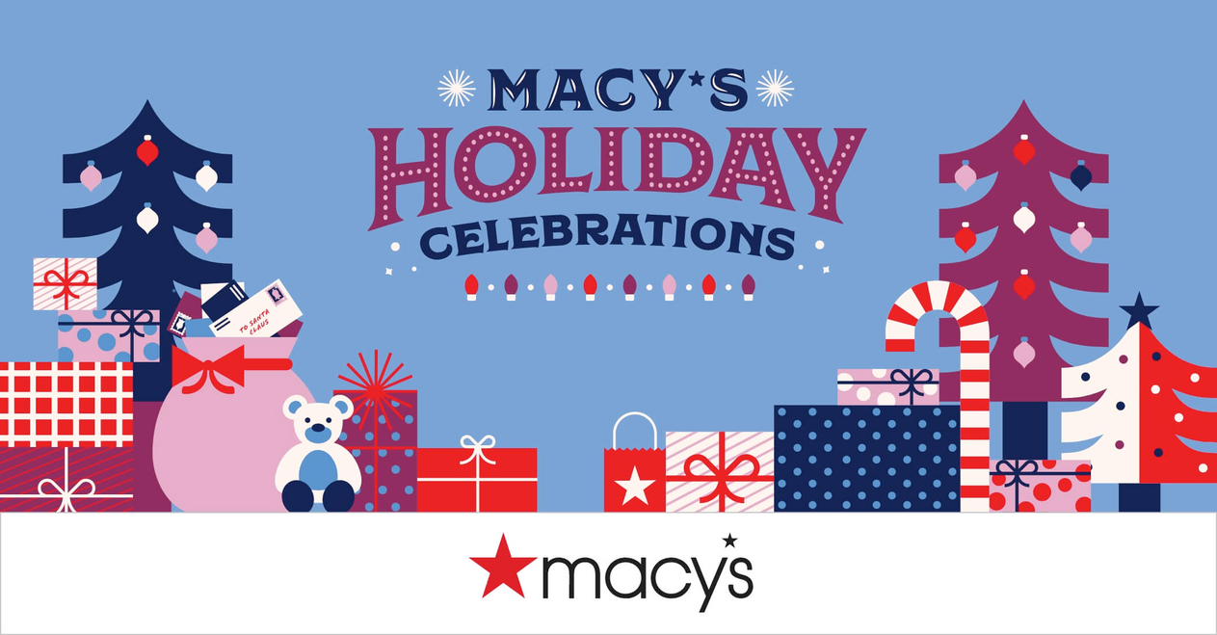
Macy's
Macy's "Speechlees" 2022
Holiday Advertising Campaign

Slide 48
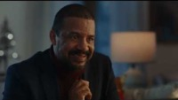

Slide 49
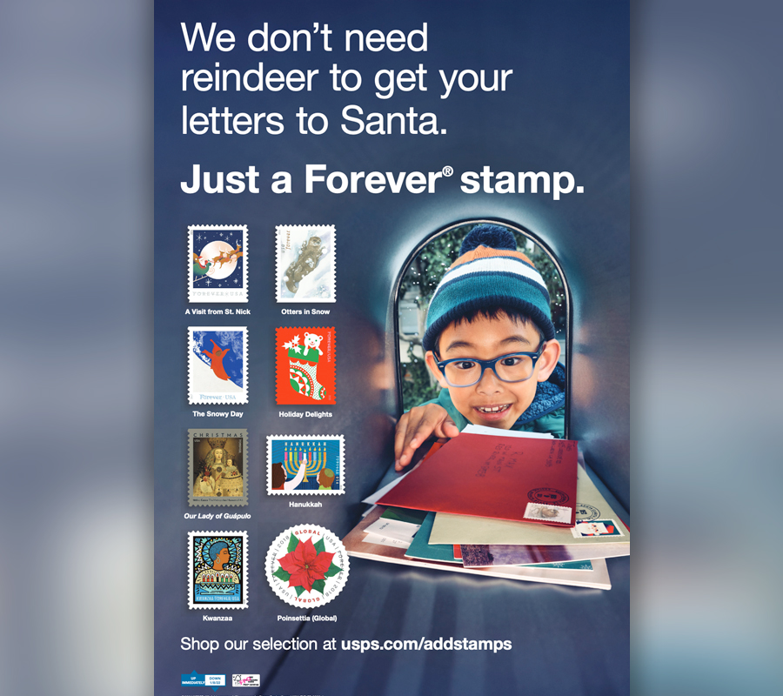
USPS
United States Postal Service "Holiday Ready"
2022 Holiday Advertising Campaign

Slide 50
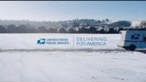

Slide 51
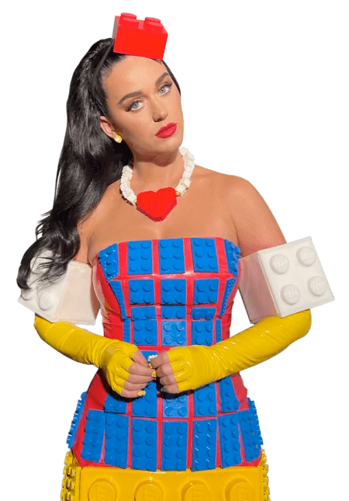
LEGO
LEGO "Build to Give" 2022
Holiday Advertising Campaign

Slide 52
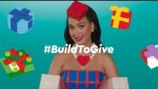

Slide 53
Discussion
Questions

Slide 54

Discussion Questions
What is seasonal marketing?
What is one example of seasonal marketing?
Is seasonal marketing equally important to all businesses and brands? Why or why not?
What is advertising?
Why do businesses and brands advertise?
Do you think some businesses and brands spend more on advertising during the holidays? Why or why not?
What is promotion?
What are the different types of promotion?
What type of promotion is Black Friday and Cyber Monday?
Why is promotion important around the holidays?
When do you think a holiday-themed promotion should launch? Why?
What is a marketing stunt?
Why do you think businesses and brands launch marketing stunts?

Slide 55
Discussion Questions
What is cause marketing?
What is the difference between cause marketing and pure philanthropy?
Why might cause marketing be effective during the holidays?
What are some examples of holiday marketing that you have seen in your area?
Which of these campaigns do you think was the best?
Would you eat the HelloFresh Buddy the Elf spaghetti meal kit?
Why is Red Lobster selling ugly sweaters in their online store?
Why do you think Burger King wants consumers to use the app?
What is social media marketing?
Which of these holiday campaigns utilized a social media component?
Which brand is using cinema advertising? Why do you think they are using that advertising channel?
What do you think Chic—fil-A hopes to accomplish with a video-short like the one featured in this presentation?
How might packaging provide brands with a marketing opportunity? Why do you think this is popular during the holidays?

Slide 56
Activity
Suggestions

Slide 57
Activity Suggestions
Review each campaign from this presentation and identify what the business or brand might hope to accomplish. Are they hoping to bolster the brand’s image? Raise awareness about a product or service? Increase sales?
Choose the campaign you liked the best. Then, identify a direct competitor of the business or brand featured in the campaign. Then, develop a holiday campaign for the competitor brand.
Select one of your favorite businesses or brands and create a holiday-themed cause marketing campaign.
Think of a local business that would benefit from a holiday-themed marketing campaign. Create a strategy incorporating elements like advertising, social media marketing, and public relations but do so in a way that would be budget-friendly and affordable.
Develop a marketing stunt for a charity that would help raise awareness (and potentially funds) for the cause.

Slide 58
Sources

Slide 59
Sources
news.dunkindonuts.com/news/holiday-menu-2022
mms.com/customized-packaging
qsrweb.com/news/kfcs-sharemobile-to-provide-meals-for-families-in-need
hellofreshelfspaghetti.com/products/buddy-the-elf-spaghetti
yahoo.com/lifestyle/hellmann-wants-put-mayo-eggnog-191432315.html
usatoday.com/story/money/food/2022/12/01/pepsi-soda-milk-cookies-pilk/10810260002
redlobster.com/news-press/press/article/2022/11/16/sleigh-the-holidays-with-the-red-lobster-limited-edition-holiday-collection
hiddenvalley.com/ranch-shop-products/hidden-valley-ranch-on-a-branch-collectible-boxed-set
delish.com/uk/food-news/a30101213/burger-king-free-food-12-days-of-whopper/

Slide 60
Sources
corporate.samsclub.com/newsroom/2022/11/17/sams-club-releases-merry-like-this-movie-trailer-starring-kevin-hart-and-holiday-single-with-singer-songwriter-kirby
businesswire.com/news/home/20221018005518/en
www.youtube.com/@usps
link.usps.com/2021/11/01/holiday-magic
prnewswire.com/news-releases/petsmart-provides-holiday-shoppers-with-full-season-of-deals-including-unique-gifts-ways-to-give-back-301642427.html
travelandleisure.com/holiday-travel/vacasa-grinch-cave-utah
us.coca-cola.com/holiday
multivu.com/players/English/9113851-chick-fil-a-evergreen-hills-the-snow-globe-a-short-film

