Slide 1
Top 10
Marvel
Films
Highest-Grossing Marvel films
at the box office of all-time
(as of August,, 2023)
www.sportscareerconsulting.com

Slide 2
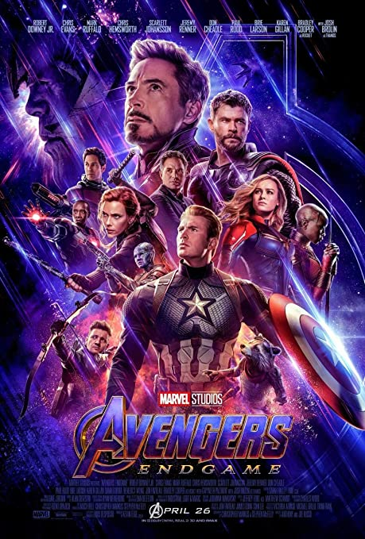
#1
Avengers:
Endgame
(2019)
Total worldwide gross:
$858,373,000
SOURCE: Box Office Mojo

Slide 3
#2
Spider-Man: No Way Home
(2021)
Total worldwide gross:
$804,793,477
SOURCE: Box Office Mojo

Slide 4
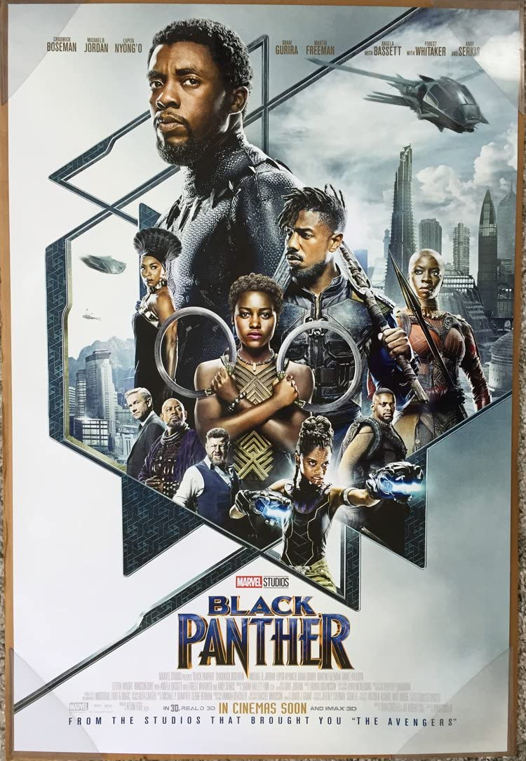
#3
Black Panther
(2018)
Total worldwide gross:
$700,059,566
SOURCE: Box Office Mojo

Slide 5
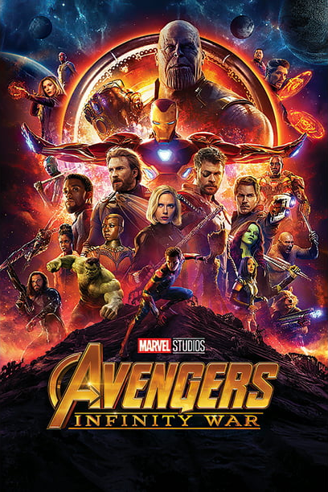
#4
Avengers:
Infinity War
(2018)
Total worldwide gross:
$678,815,482
SOURCE: Box Office Mojo

Slide 6
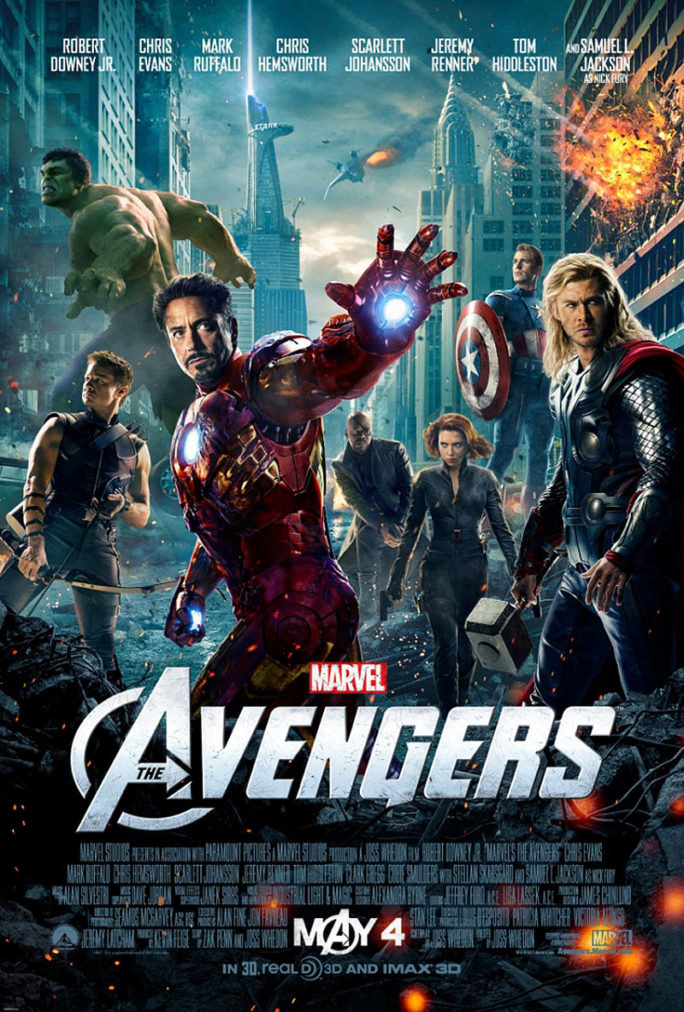
#5
The Avengers
(2012)
Total worldwide gross:
$623,357,910
SOURCE: Box Office Mojo

Slide 7
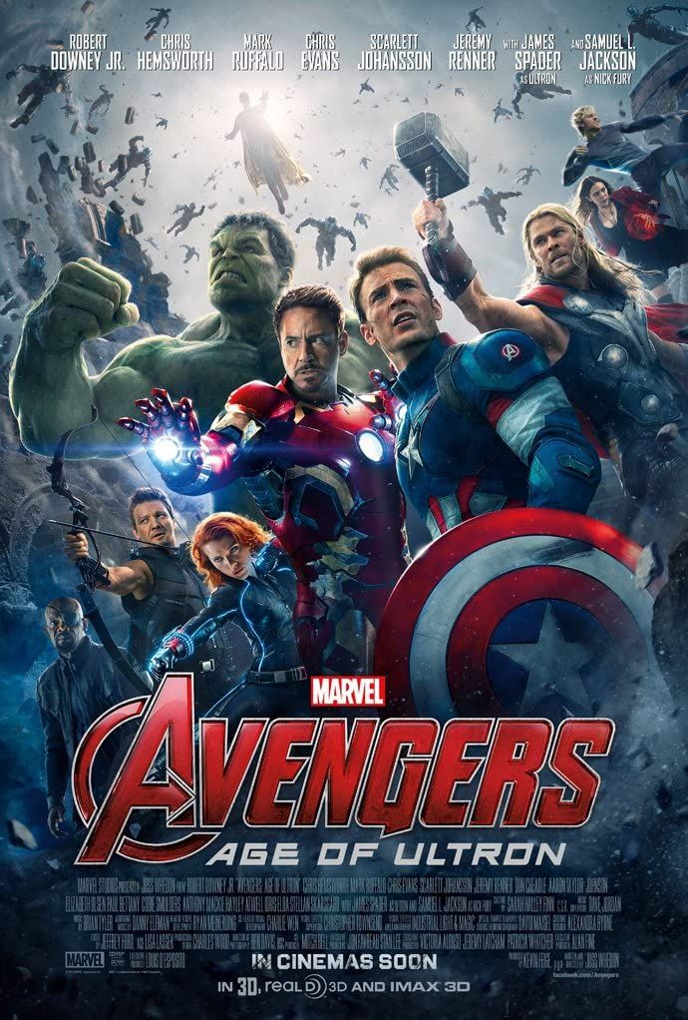
#6
Avengers:
Age of Ultron
(2015)
Total worldwide gross:
$459,005,868
SOURCE: Box Office Mojo

Slide 8
#7
Black Panther: Wakanda Forever
(2022)
Total worldwide gross:
$453,829,060
SOURCE: Box Office Mojo

Slide 9
#8
Captain Marvel (2019)
Total worldwide gross:
$426,829,839
SOURCE: Box Office Mojo

Slide 10
#9
Doctor Strange in the Multiverse of Madness (2022)
Total worldwide gross:
$411,331,607
SOURCE: Box Office Mojo

Slide 11
#10
Iron Man 3
(2013)
Total worldwide gross:
$409,013,994
SOURCE: Box Office Mojo

Slide 12
Student Activity
Select a film from one of the previous slides and imagine the franchise will soon release another movie
Create a list of five potential tie-ins with the film
Explain how those tie-ins might benefit the brand as well as boost box office sales
Identify two different brands that might benefit from product placement in the film
Explain how the brand will benefit from the placement
Define ”brand”
Describe how branding helps to establish a successful film franchise and how it leads to increase in box office sales and merchandising opportunities
www.sportscareerconsulting.com

