Slide 1
SPORTS CAREER CONSULTING
UNIQUE VENUES
UNIT 2: LESSON 2.9
EVENT MANAGEMENT & MARKETING

Slide 2
UNIQUE VENUES
Event Management & Marketing
WHAT IS A VENUE? AS IT RELATES TO SPORTS AND ENTERTAINMENT, AN EVENT VENUE DESCRIBES THE SPACE USED FOR THE HOSTING OF THE EVENT.
VENUES CAN BE INDOOR OR OUTDOOR AND CAN BE FOUND ALMOST ANYWHERE.
TRADITIONALLY IN SPORTS AND ENTERTAINMENT, EVENTS ARE HELD IN STADIUMS, ARENAS, RACETRACKS, BALLPARKS, AND CONFERENCE CENTERS, OR OUTDOOR VENUES FOR CONCERTS AND FESTIVALS.

Slide 3
UNIQUE VENUES
Event Management & Marketing
WHAT IS A VENUE?
WITH SO MANY EVENTS BEING OFFERED, EVENT ORGANIZERS OFTEN FIND CREATIVE NEW VENUES TO HOST EVENTS IN AN EFFORT TO GENERATE PUBLIC INTEREST.
IN THIS PRESENTATION, WE WILL REVIEW SOME OF THE MOST UNIQUE SPORTS VENUES IN THE WORLD.

Slide 4
UNIQUE VENUES
Henningsvaer Stadium
A soccer field located in a tiny fishing village on an island in Norway, Henningsvaer Stadium is world-famous for its picturesque views and unique setting. Despite no seating for spectators, the "stadium" has become an incredibly popular tourist attraction.
UNIT 2 - LESSON 2.9: EVENT MANAGEMENT & MARKETING

Slide 6
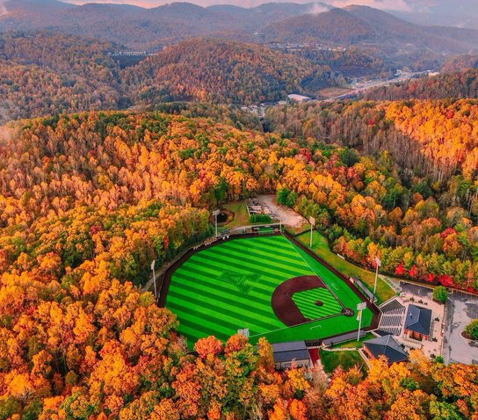
UNIQUE VENUES
Beaver Field
Home to the Appalachian State baseball program, Beaver Field at Jim and Bettie Smith Stadium in North Carolina seats 1,000 fans. The venue features Adirondack chairs with accompanying fire pits down the first-base line as a new viewing area for fans.
UNIT 2 - LESSON 2.9: EVENT MANAGEMENT & MARKETING

Slide 8
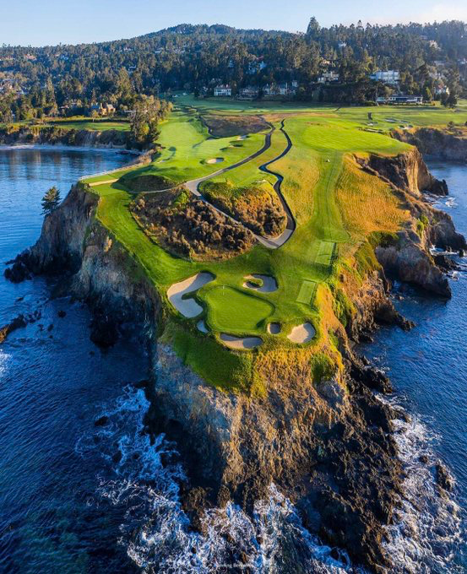
UNIQUE VENUES
Pebble Beach
Pebble Beach golf course in California is one of the most iconic venues in sports, and the 7th hole, a challenging par 3, offers one of the most breathtaking views of any golf course in the world.
UNIT 2 - LESSON 2.9: EVENT MANAGEMENT & MARKETING

Slide 10
UNIQUE VENUES
Alcatraz
Red Bull hosted a "King of the Rock" one-on-one basketball tournament at "The Yard" of Alcatraz, the infamous prison just off the shores of San Francisco (known as "The Rock").
UNIT 2 - LESSON 2.9: EVENT MANAGEMENT & MARKETING

Slide 12
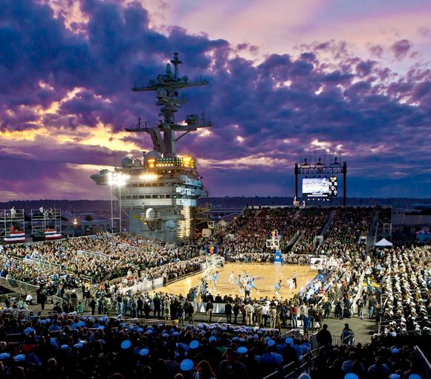
UNIQUE VENUES
U.S.S. Abraham Lincoln
In 2022, Michigan State will play a basketball game vs. Gonzaga on the deck of the U.S.S. Abraham Lincoln aircraft carrier. MSU also played in the first-ever game on an aircraft carrier in 2011, the U.S.S. Carl Vinson.
UNIT 2 - LESSON 2.9: EVENT MANAGEMENT & MARKETING

Slide 14
UNIQUE VENUES
Uummannaq Golf Course
The Uummannaq ice golf course in Greenland is a far cry from the oceanside links at Pebble Beach, or the iconic St. Andrews course in Scotland. This course is made of snow and ice and playing requires playing a golf ball that is any color other than white.
UNIT 2 - LESSON 2.9: EVENT MANAGEMENT & MARKETING

Slide 15
UNIQUE VENUES
Underground Cricket
A cricket match between two English teams took place 2,000 feet underground in a mine in the North of England. The match was a fundraiser to provide relief for flood victims.
UNIT 2 - LESSON 2.9: EVENT MANAGEMENT & MARKETING

Slide 17
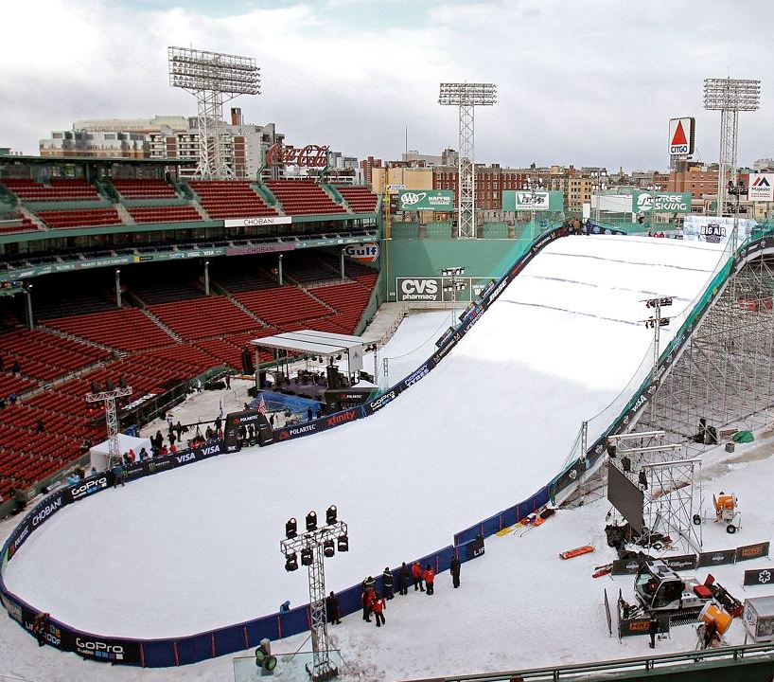
UNIQUE VENUES
Fenway Park Ski Jump
One of the most historic, iconic baseball stadiums once played host to a unique ski jump event
UNIT 2 - LESSON 2.9: EVENT MANAGEMENT & MARKETING

Slide 19
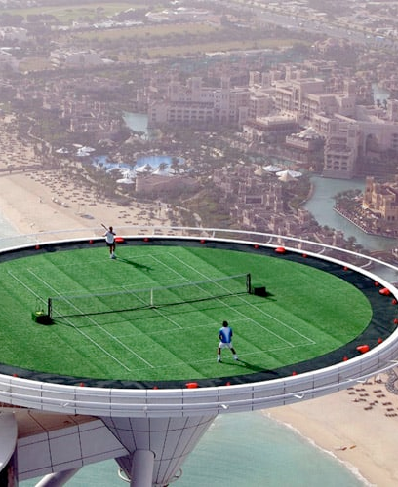
UNIQUE VENUES
Tennis Court at Burj al Arab Hotel
The Burj al Arab is the fourth tallest hotel in the world and stands out in the water on its own artificial island. The hotel once hosted two legendary tennis stars, Andre Agassi and Roger Federer, for a match on their helipad tennis court.
UNIT 2 - LESSON 2.9: EVENT MANAGEMENT & MARKETING

Slide 21
UNIQUE VENUES
NHL at Lake Tahoe
The NHL Outdoors Series took place in 2020 at Lake Tahoe, with two regular-season games situated on the south shore of North America's largest alpine lake against the backdrop of the Sierra Nevada.
UNIT 2 - LESSON 2.9: EVENT MANAGEMENT & MARKETING

Slide 24
UNIQUE VENUES
NASCAR Chicago Street Race
The Grant Park 220 was a NASCAR Cup Series race held on a street circuit in Chicago, Illinois in 2023. The event represented the first ever street race contested in the NASCAR Cup Series.
UNIT 2 - LESSON 2.9: EVENT MANAGEMENT & MARKETING

Slide 26
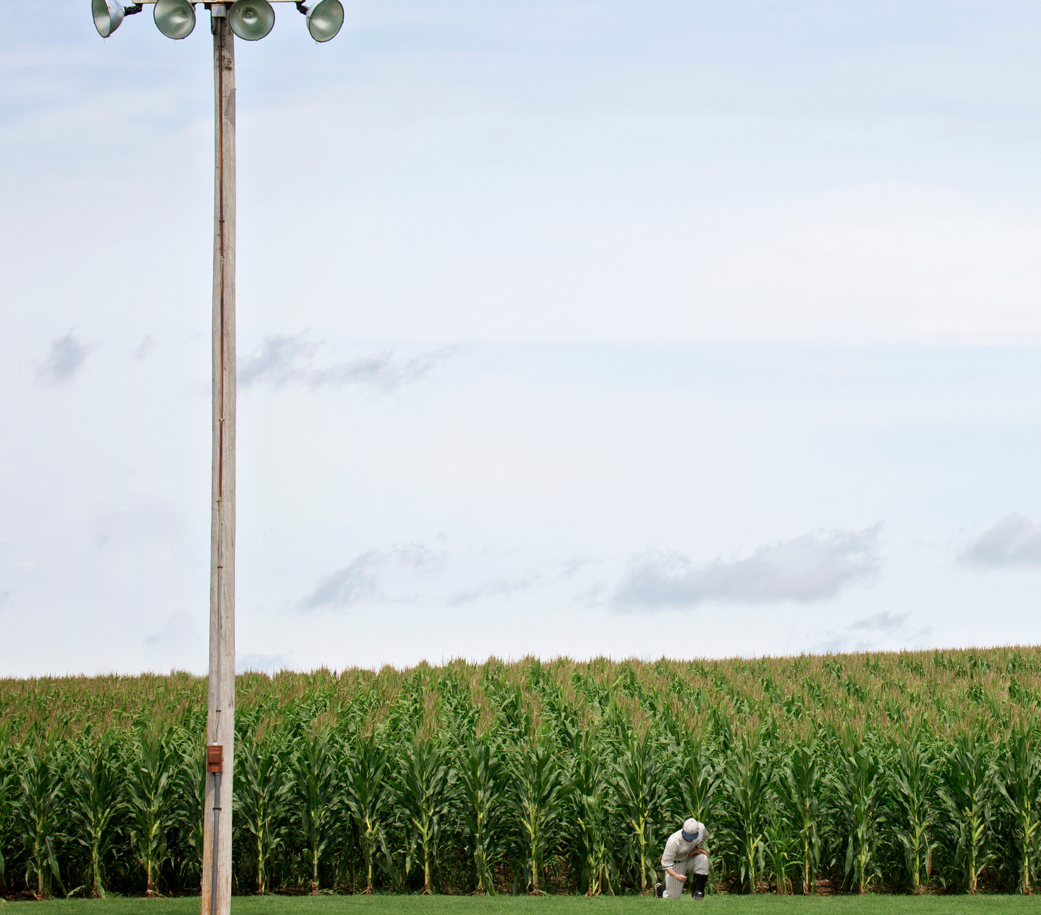
UNIQUE VENUES
MLB "Field of Dreams" Game
The "MLB at Field of Dreams games", played in 2021 and 2022, were held at a field in an Iowa cornfield near the site of the original location of the "Field of Dreams" ball diamond from the iconic movie of the same name.
UNIT 2 - LESSON 2.9: EVENT MANAGEMENT & MARKETING

Slide 28
UNIQUE VENUES
The Sphere at The Venetian Resort
The sphere, a $2.3 billion futuristic entertainment venue that seats nearly 18,000, is the world’s largest spherical structure. It features a one-of-a-kind sound system and its 1.2 million exterior LEDs can light up the Las Vegas skyline with any number of customized images (including an eyeball).
UNIT 2 - LESSON 2.9: EVENT MANAGEMENT & MARKETING

Slide 30
DISCUSSION QUESTIONS
UNIQUE VENUES
WHAT IS A VENUE?
WHY ARE VENUES IMPORTANT IN SPORTS AND ENTERTAINMENT?
WHAT IS EVENT MARKETING?
WHAT DO YOU THINK EACH OF THESE ORGANIZATIONS (LIKE RED BULL OR THE NHL) FROM THIS PRESENTATION HOPED TO ACCOMPLISH BY HOSTING THE EVENT AT A UNIQUE VENUE?
WHAT IS EVENT MANAGEMENT?
WHAT CHALLENGES MIGHT EACH OF THESE EVENTS HAVE FACED FROM AN EVENT MANAGEMENT PERSPECTIVE?
WHICH EVENT DID YOU THINK WAS THE MOST INTERESTING?
IF YOU WERE TASKED WITH FINDING A UNIQUE VENUE FOR YOUR FAVORITE SPORTS TEAM OR LEAGUE, WHAT WOULD IT BE? HOW MIGHT HOSTING AN EVENT AT THAT UNIQUE VENUE BENEFIT THE TEAM, LEAGUE, SPONSORS, CAUSES BEING SUPPORTED, OR ANY OTHER ORGANIZATION INVOLVED WITH THE EVENT?
WHAT ARE THE 5 P’S OF EVENT MARKETING AND HOW MIGHT THEY APPLY TO YOUR EVENT?

Slide 31
SOURCES
UNIQUE VENUES
FIFA.COM/NEWS/HEAVENLY-HENNINGSV%C3%A6R-AND-ITS-PICTURE-PERFECT-PITCH
APPSTATESPORTS.COM/FACILITIES/BEAVER-FIELD-AT-JIM-AND-BETTIE-SMITH-STADIUM/6
PEBBLEBEACH.COM/INSIDEPEBBLEBEACH/A-HISTORY-OF-THE-7TH-HOLE-AT-PEBBLE-BEACH-IN-PHOTOS
ESPN.COM/MENS-COLLEGE-BASKETBALL/STORY/_/ID/34239444/GONZAGA-MICHIGAN-STATE-PLAY-USS-ABRAHAM-LINCOLN-NOV-11
REDBULL.COM/US-EN/RED-BULL-KING-OF-THE-ROCK-HISTORY-OF-THE-TOURNAMENT
CNN.COM/2013/09/24/GOLF/GALLERY/EXTREME-GOLF-GALLERY
THEGUARDIAN.COM/SPORT/GALLERY/2013/DEC/05/UNDERGROUND-CRICKET-WORLD-FIRST-SUBTERRANEAN-MATCH-PICTURES
BOSTONGLOBE.COM/SPORTS/2016/02/09/ORGANIZERS-HOPE-BIG-AIR-FENWAY-LAUNCHING-POINT/W5RJY5G9PWGKQJMEFPXHDL/STORY.HTML
INHABITAT.COM/WORLD%E2%80%99S-HIGHEST-TENNIS-COURT-WAS-A-GREEN-ROOF-ATOP-THE-BURJ-AL-ARAB-IN-DUBAI
NHL.COM/NEWS/NHL-LAKE-TAHOE-OUTDOOR-GAMES-NEW-TWIST/C-320186268
MLB.COM/FANS/FIELD-OF-DREAMS
THESPHEREVEGAS.COM
NASCARCHICAGO.COM

Slide 32
YouTube Links
UNIQUE VENUES
Henningsvaer Stadium: www.youtube.com/watch?v=Fe81iAUyM7c&t=65s
Beaver Field: https://youtu.be/XJ9GqfUwBGA
Pebble Beach: https://youtu.be/7Qj73Mf9WFc
Alcatraz: https://youtu.be/aiFtJb6xt2g
U.S.S. Abraham Lincoln: https://youtu.be/Pt3lLHwxWzc
Underground Cricket: https://youtu.be/4P9J7tXBbhE
Fenway Park Ski Jump: https://youtu.be/XpuZ3dqeLBA
Tennis Court on the heli pad at Burj al Arab Hotel: https://youtu.be/InV_pOvRORU
NHL outdoors at Lake Tahoe: https://youtu.be/b9eMxBKpt0s
https://youtu.be/-cjDKYAeIUE
NASCAR Chicago Street Race: https://youtu.be/c5kr5B75b2g
MLB Field of Dreams: https://youtu.be/Ug4bsd4LqqM
The Sphere: https://youtu.be/ywbA28K-7Ak

