Slide 1



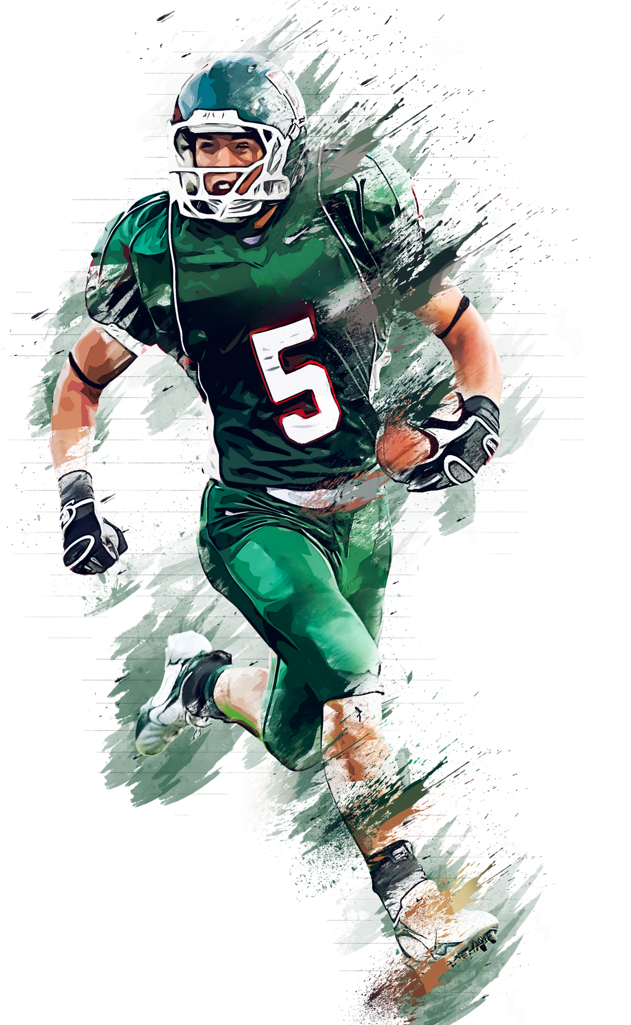


2023 SEASON RECAP
THE XFL REBOOT
BY THE NUMBERS
Sports Career Consulting
The Business of Sports and Entertainment

Slide 2





THE HISTORY OF THE XFL
20O1
2020
2023
Vince McMahon, founder of WWE, initially launched the XFL in 2001 using a strategy that had been successful for pro wrestling, featuring storylines, skits, and characters. It folded after one season, with losses of a reported $50 million.
McMahon spent $200 million to relaunch the league in 2020, dubbed XFL 2.0, but filed for bankruptcy just five weeks into the season.
Dwayne "The Rock" Johnson and his business partner Dany Garcia purchased the league for $15 million in 2021 with the promise of an improved product, officially launching the reboot in 2023.

Slide 3




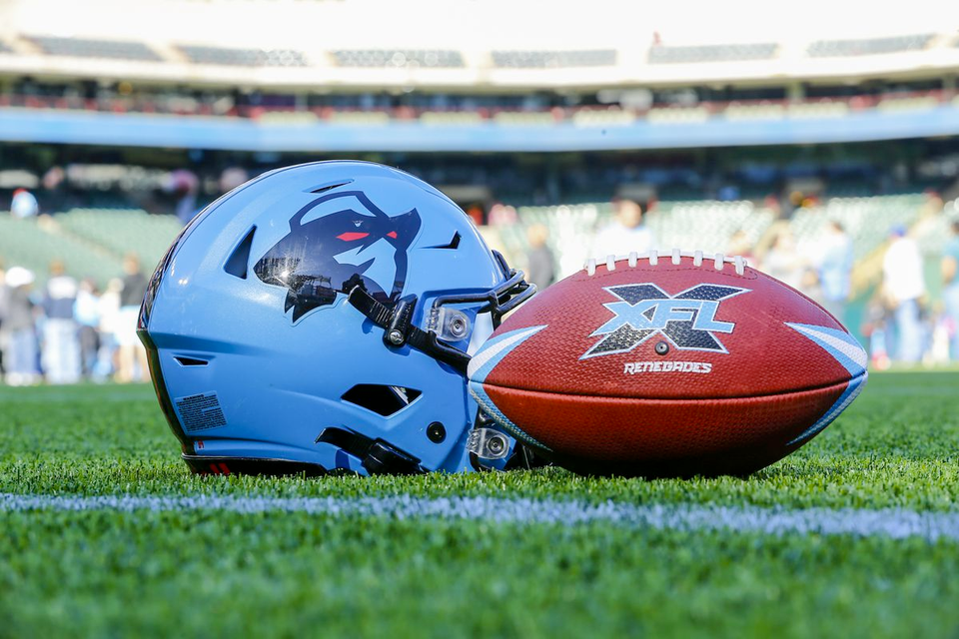

2023
GAME PLAN FOR SUCCESS
“We want to do great work and we want this league to be sustainable. That requires a tremendous amount of meetings, strategy, review, infrastructure, all of that is happening.”
Dany Garcia, co-owner of XFL, upon acquiring the rights to the league in 2020

Slide 4
2023 SEASON RECAP
WHAT CITIES?
WHERE ARE XFL
TEAMS LOCATED?
Sports Career Consulting
The Business of Sports and Entertainment

Slide 5









2023
seattle
sea dragons
st. louis
battlehawks
d.c. defenders
Vegas
vipers
arlington renegades
san antonio
brahmas
Orlando Guardians
houston roughnecks
Sports Career Consulting
The Business of Sports and Entertainment

Slide 6
2023 SEASON RECAP
SEASON RESULTS
HOW DID THE LEAGUE FARE IN 2023?
Sports Career Consulting
The Business of Sports and Entertainment

Slide 7
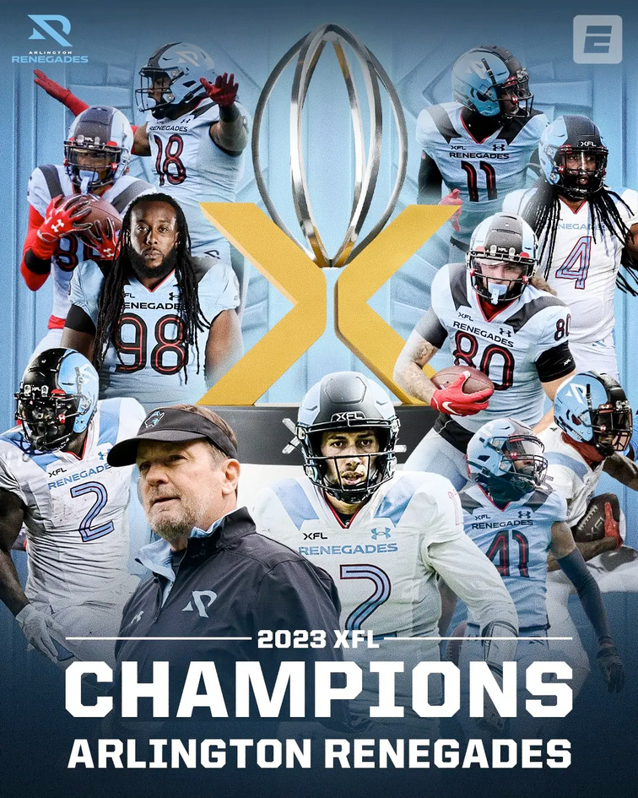
REBOOT
2023 SEASON RECAP
The 2023 edition (and third iteration) of the XFL featured a variety of rules changes and increased fan access, like allowing fans to listen in on coach-to-player communications and internal discussions on replay challenges.
8
$40
$60M
There were 8 teams competing in the 2023 XFL reboot
60% of tickets were priced at $40 or less
The league lost a reported $60M in 2023
Sports Career Consulting
The Business of Sports and Entertainment

Slide 8
REBOOT
2023 SEASON RECAP
The league has several high-profile partners, including the NFL, ESPN, and Under Armour. One of the XFL's goals is to serve as a hub for innovation by testing new rules, equipment, and broadcast technologies. Each of its partners has a vested interest in seeing the league succeed.
$100M
2027
26
The XFL is projecting $100M in revenue next year
League ownership expects to be "cash positive" by 2027
The NFL signed 26 XFL players after the season concluded
Sports Career Consulting
The Business of Sports and Entertainment

Slide 9

2023
LEAGUE
ATTENDANCE
23%
577K
35,000
Total gameday attendance in the regular season was 577K, representing an average of 14.4K per game; Average weekly attendance grew 18% from week 1 to week 10
Despite the moderate success at the gate, attendance did not meet league expectations as the XFL saw a 23% decline in attendance when compared to the 2020 season
However, St. Louis was a standout market that represented the league's full potential, drawing an average attendance of more than 35,000 fans per home game
Sports Career Consulting
The Business of Sports and Entertainment

Slide 10


2023
TELEVISION
VIEWERSHIP
28M
5
1.43M
The XFL signed a five-year exclusive broadcast rights deal with ESPN & Disney starting in 2023 through the 2027 season, worth a reported $20M per year
According to a league report, more a total of 28 million fans tuned in to watch an XFL game in 2023, and the audience grew by 2 million new viewers per week
The season ended on a high note, with the XFL Championship Game averaging 1.43 million viewers on ABC, the league's best TV audience since opening weekend
Sports Career Consulting
The Business of Sports and Entertainment

Slide 11

2023
DIGITAL & SOCIAL MEDIA
3.5M
59%
135K
According to a release from the league, the XFL email database increased by 192K to more than 520K, representing 59% growth
The total number of fans following the XFL and its teams on social media platforms reached 3.5 million followers, representing a growth rate of 28.5% (770K fans were added during the year)
The XFL app was downloaded 135,000 times during the year
Sports Career Consulting
The Business of Sports and Entertainment

Slide 12

2023
MORE DATA
1/3
$55K
3M
In 2023, the base annual salary for XFL players was $55,000, and total compensation was expected to be around $60,000 per player.
Nearly one-third of all XFL television viewers are age 18-49, an important demographic for the league
Throughout the regular season, there was an average of 3 million weekly page views of XFL content consumed on the ESPN app and at ESPN.com.
Sports Career Consulting
The Business of Sports and Entertainment

Slide 13


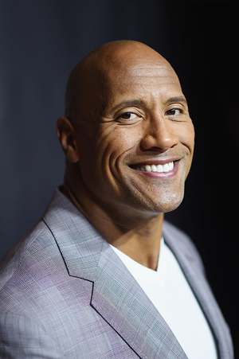
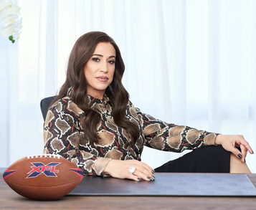
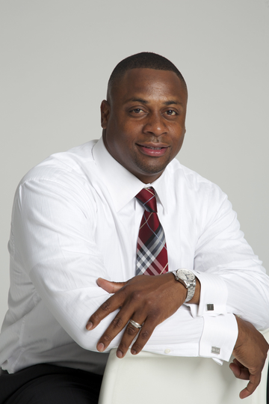
2023
WHAT ARE THEY SAYING?
"We are bringing forward an XFL that is progressive and forward-thinking when it comes to innovation, leveraging the newest technology to enhance game-day experience."
"The XFL has shown us that innovation is one of its core principles."
NFL executive VP of football operations Troy Vincent
- Dany Garcia
On the XFL after year number one its latest reboot: “It's not a flip the switch and all of a sudden you're successful."
- Dwayne Johnson
Sports Career Consulting
The Business of Sports and Entertainment

Slide 14
2023
GAME PLAN FOR SUCCESS
“We want to do great work and we want this league to be sustainable. That requires a tremendous amount of meetings, strategy, review, infrastructure, all of that is happening.”
Dany Garcia, co-owner of XFL, upon acquiring the rights to the league in 2020

Slide 15
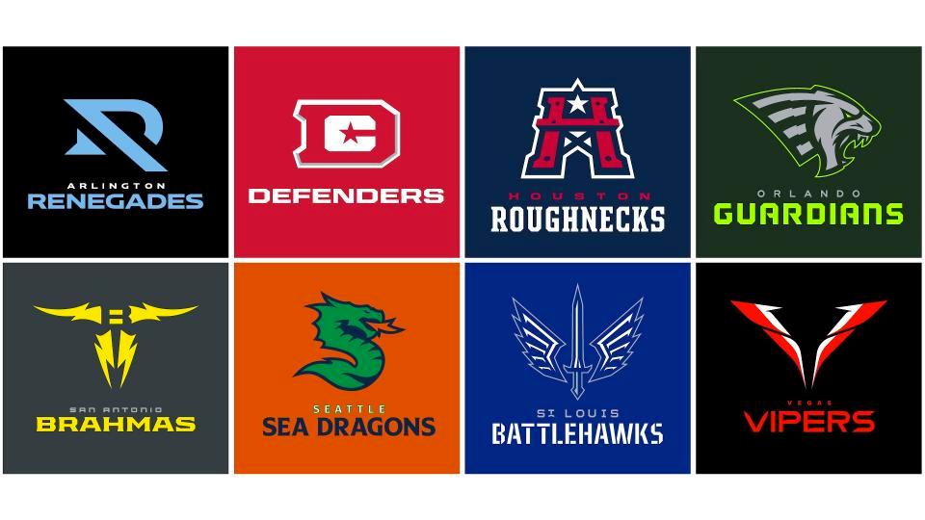
DISCUSSION
1) What Is a product?
2) Is the XFL a product? Why or why not?
3) Why is the quality of the product important in sports and entertainment?
4) How would you describe the quality of the XFL product?
5) What is innovation?
6) Why is innovation important to the quality of a product?

Slide 16
DISCUSSION
7) Who are the high-profile partners of the league identified in this presentation deck?
8) Why might it be important to them to see the league succeed?
9) Do you think the XFL's 2023 reboot was a success? Why or why not?
10) What do you think the future holds for the XFL?
11) What would you do to improve the XFL product and/or innovate and how might that impact the league's future?

Slide 17
DISCUSSION
12) What is a brand?
13) What is brand identity?
14) Why do you think the XFL reboot featured a new logo?
15) How do you think the location of each franchise impacted individual team names and logos?
16) What does that have to do with branding?
17) How would you describe the XFL’s overall branding strategy?

Slide 18
DISCUSSION
18) What is a marketing plan?
19) Why is a marketing plan important to any new venture?
20) How would you describe the XFL’s marketing strategy for the reboot in 2023? How might it adjust after its inaugural season?

Slide 19
ACTIVITY
As partners or small groups, discuss how well you think the XFL fared in its “reboot” season. As part of the discussion, define what it means to be a “quality product”, and determine whether the XFL currently meets that criteria.
Explain the concept of “innovation”, and based on what you learned in this presentation, list the ways the XFL has innovated and can innovate in the future. Be sure to consider how innovations might impact the XFL’s partners like the NFL and ESPN.
Describe at least three different ways the XFL can improve the product for next season and how the league will benefit from those improvements.

Slide 20
SOURCES
www.si.com/nfl/2020/10/21/dany-garcia-xfl-owner-the-unrelenting
www.espn.com/xfl/story/_/id/29593665/the-xfl-rock-dany-garcia-15-million-know-league-sale-2021-season
www.xflnewshub.com/xfl-history/the-complete-history-of-the-xfl
www.xflnewshub.com/xfl-news/xfl-co-owners-dwayne-the-rock-johnson-and-dany-garcia-talk-successful-xfl-season-teams-staying-in-hub-in-2024
www.forbes.com/sites/jabariyoung/2023/06/10/dwayne-johnson-says-xfl-succeed-nfl-usfl-dany-garcia/?sh=e537ff57fe1b
www.profootballnetwork.com/what-is-the-xfl
www.espnpressroom.com/us/press-releases/2023/05/xfl-season-highlights

