Slide 1
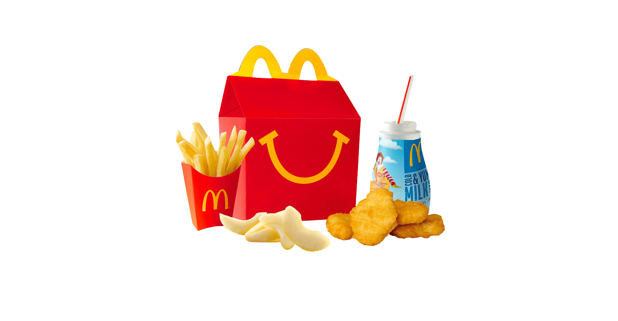


History of the
Happy Meal

Slide 2
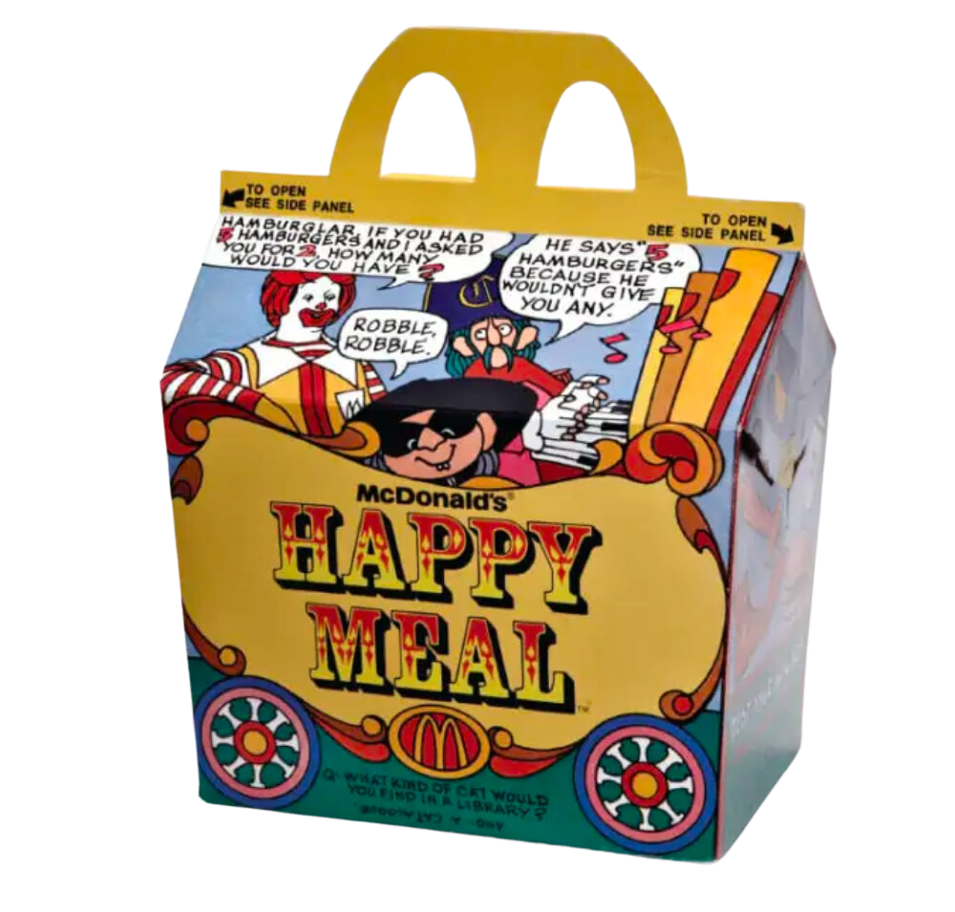
The concept of the Happy Meal was developed by a McDonald's advertising executive named Bob Bernstein. He came up with the idea in the early 1970s as a way to make the McDonald's dining experience more enjoyable for children and their families.

Slide 3
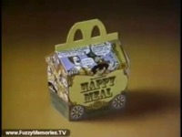
The Happy Meal was officially introduced by McDonald's in 1979, featuring a meal specifically designed for children that included a burger or chicken nuggets, french fries, a drink, and a toy.
Over the years, the Happy Meal has become an iconic part of McDonald's branding and a popular choice for kids' meals at fast-food restaurants worldwide.
Vintage McDonald's commercial, "Introducing the Happy Meal" (c. 1979)

Slide 4

What is a
Target Market?
A target market is a particular group of consumers at which a product or service is aimed.

Slide 5
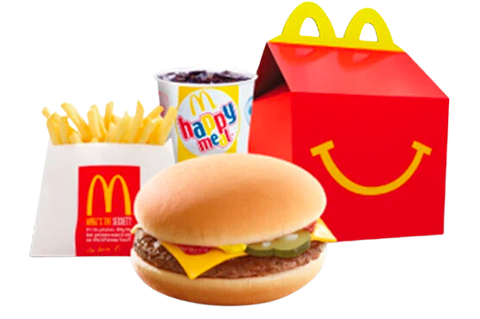
McDonald's
Target Market
McDonald's targets a broad age range of customers, from children as young as two years old to seniors over the age of 60. The company's Happy Meals, with their colorful packaging and toy promotions, are specifically designed to attract the attention of kids.

Slide 6
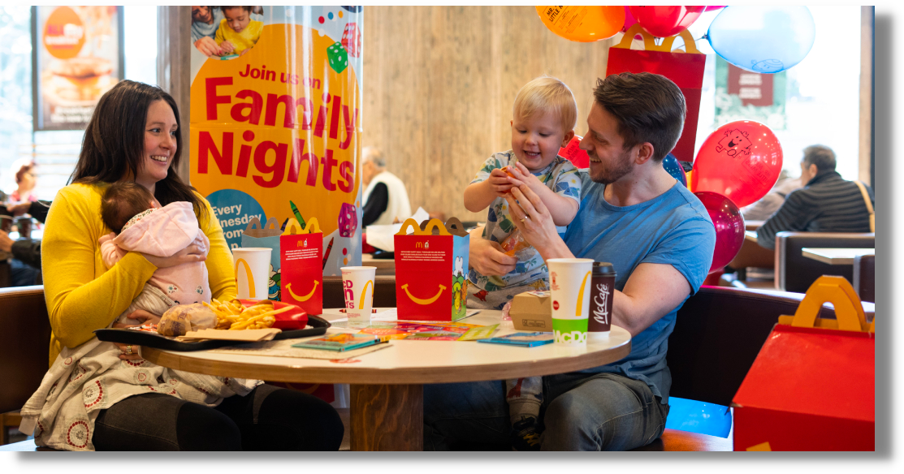
TARGET MARKET: FAMILIES
McDonald's aims to attract families by offering a convenient and affordable dining option. They provide a variety of menu choices to cater to different tastes and preferences within a family, ensuring there's something for everyone.

Slide 7
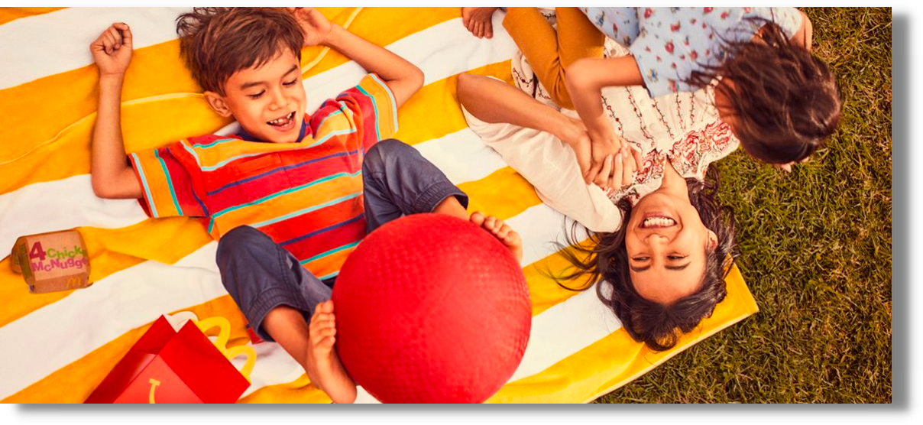
TARGET MARKET: CHILDREN
McDonald's has long been recognized as a popular destination for children due to its Happy Meal and the inclusion of toys or promotional items. The company strategically designs its marketing and menus to appeal to kids with colorful branding, playful advertisements, and a fun dining experience.

Slide 8
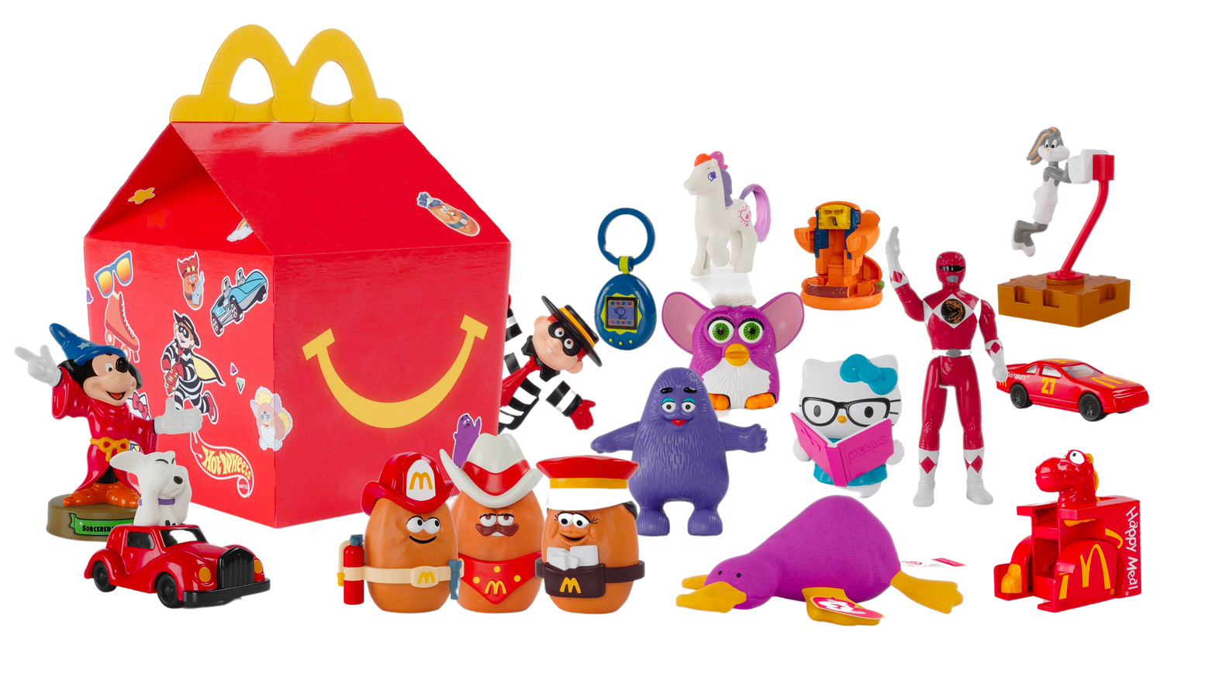
How Did McDonald's Happy Meal Toys Get Their Start?
It may seem like Happy Meals have been around since the time McDonald's first went into business back in 1940, but that's not the case. The Happy Meal wasn't introduced until 1979, almost 40 years later.
The first Happy Meal featured a circus theme on its box and included fries, cookies, a soft drink, and a toy (not much nutrition there!). At that time, the toys were little stencils, bracelets, erasers, wrist wallets, spinning tops, and puzzles.

Slide 9
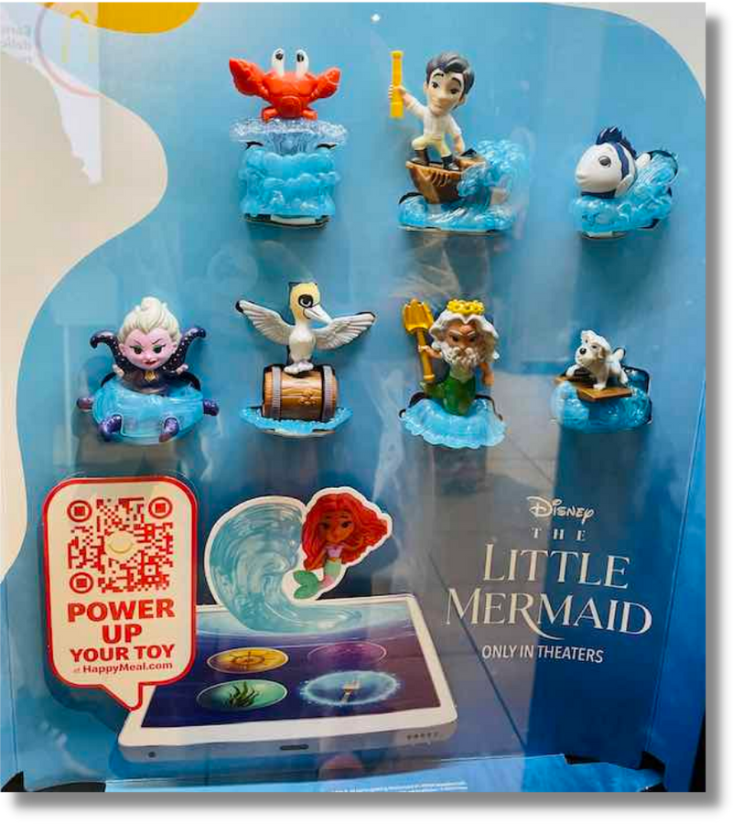
DISNEY HAPPY MEAL TOYS
In May 2023 McDonald's introduced a line of Happy Meals toys to celebrate and promote the premiere of Disney's live-action remake of The Little Mermaid.
The Disney toys are cartoon-ified versions of the new versions of iconic The Little Mermaid characters, like Triton, Ursula, Prince Eric, Sebastian, and of course, Ariel.

Slide 10
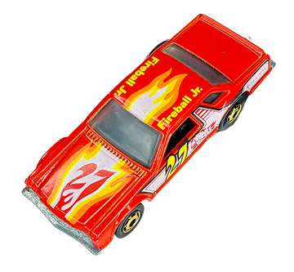
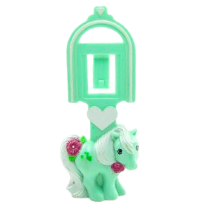
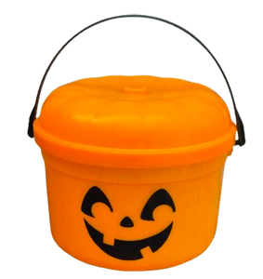
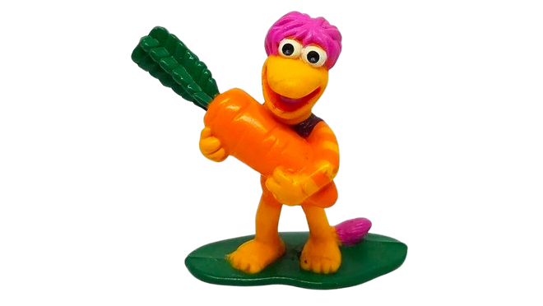
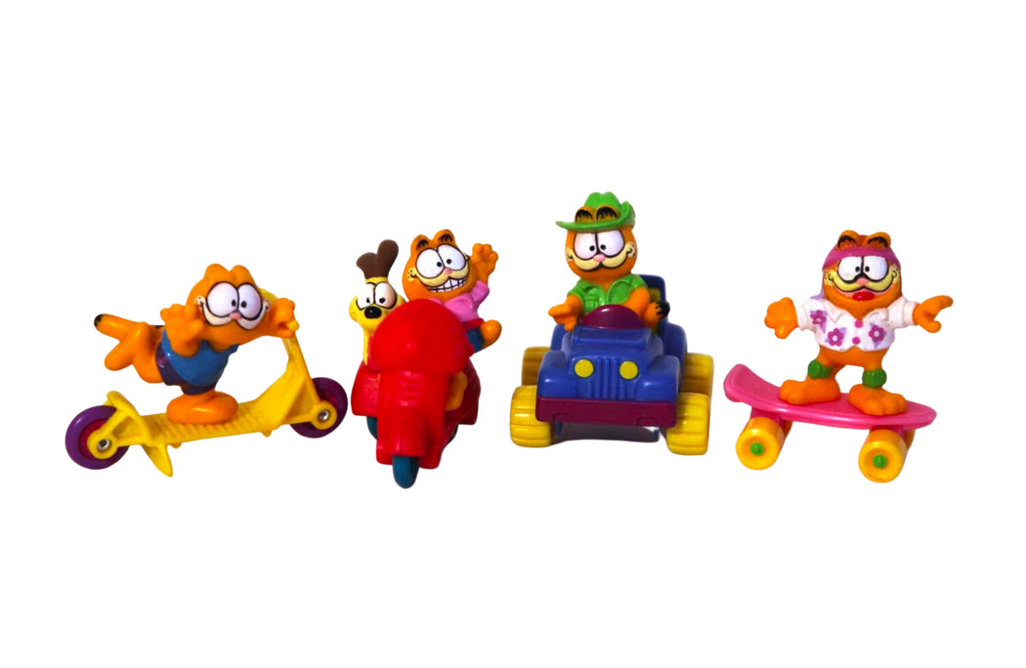
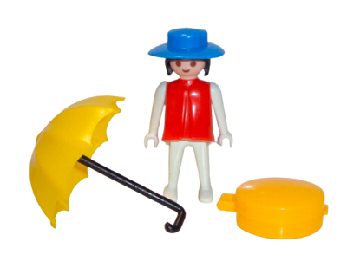
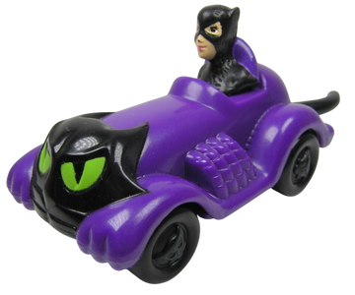
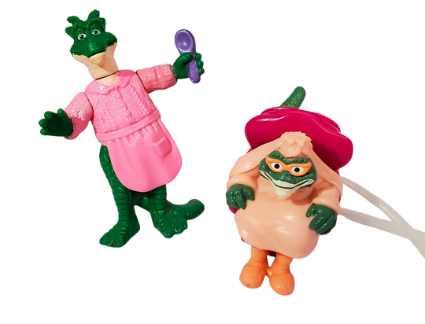
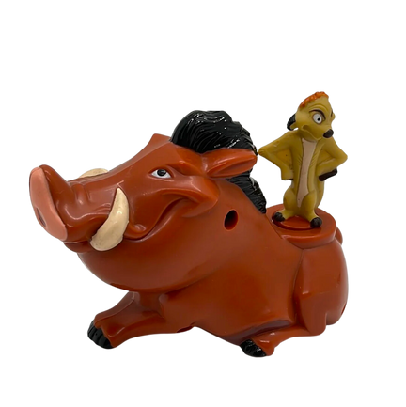
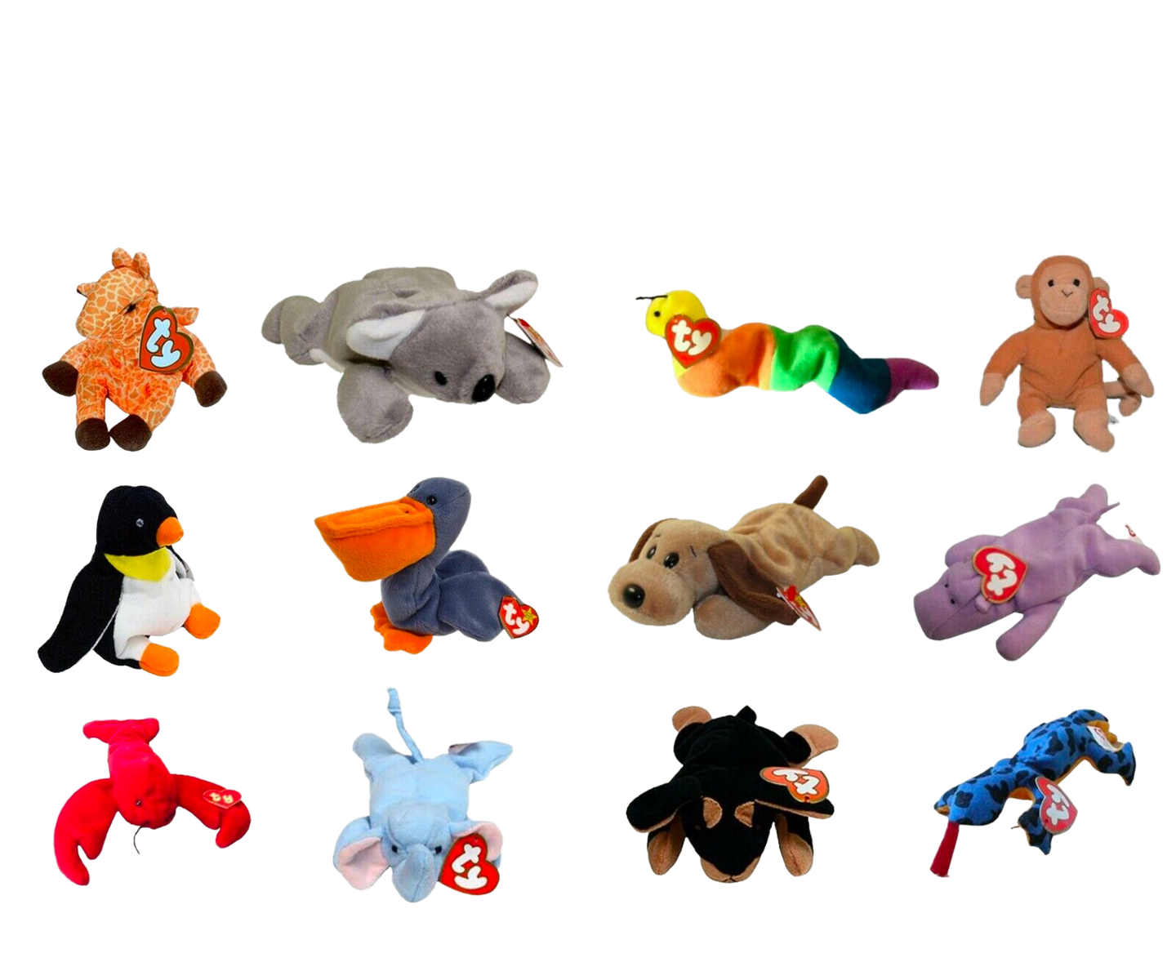
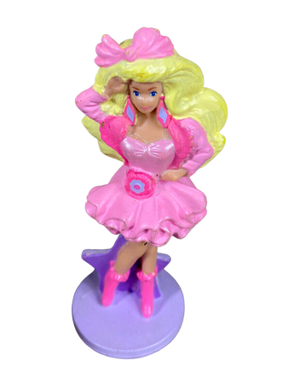
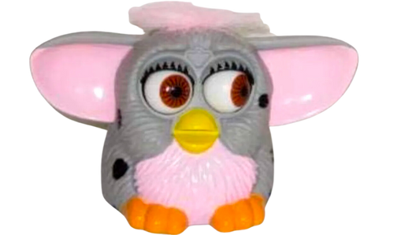
Vintage Happy Meal Toys
1982
Playmobil
1983
Hotwheels
1985
My LIttle Pony
1986
Halloween Pail
1988
Fraggle Rock
1989
Garfield
1991
Barbie
1992
Batman
1993
Dinosaurs
1995
Lion King
1998
Beanie Babies
1999
Furby

Slide 11
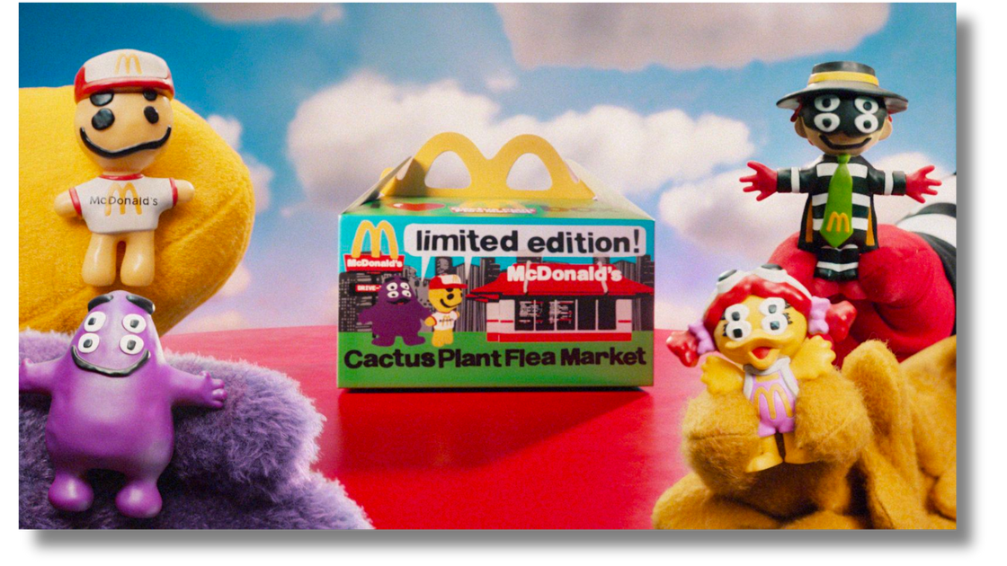
Shifting
ADULT HAPPY MEALS
Last year, McDonald’s collaborated with streetwear brand Cactus Plant Flea Market to create a happy meal targeted toward its adult customers.
McDonald' wanted their customers to feel like kids again by being able to score merchandise created with a cult brand known for its secretiveness and scarcity.
“We’re taking one of the most nostalgic McDonald’s experiences and literally repackaging it in a new way that’s hyper-relevant for our adult fans,” said Tariq Hassan, McDonald’s USA chief marketing and customer experience officer, in a press statement.
Target Market

Slide 12
Limited
Edition
What is limited edition?
Limited edition products are only available for a short amount of time, and are produced in limited quantities.
Why are these promotions effective?
Limited edition promotions are effective because they create market scarcity, which often drives customer demand.

Slide 13
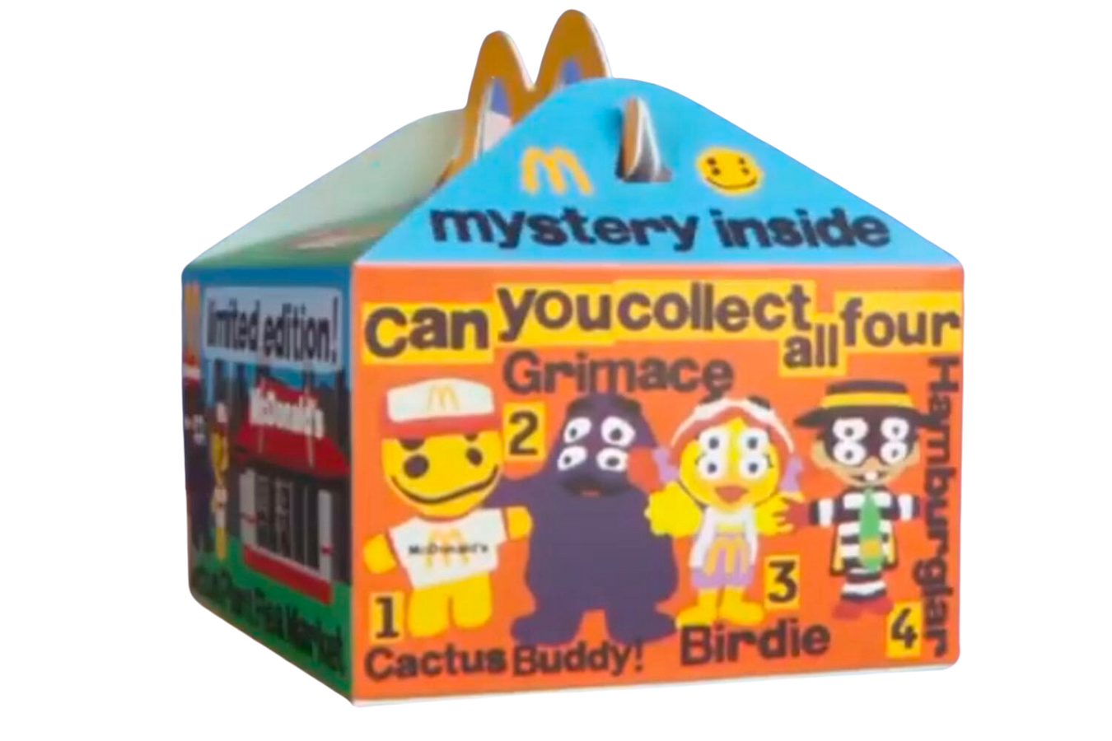
$300,000
Happy Meal Toys
McDonald's limited-edition adult Happy Meal toys produced in collaboration with Cactus Plant Flea Marketare listed for as much as $300,000 on eBay.
Opportunistic resellers are taking advantage of McDonald’s limited-time collaboration with streetwear company Cactus Plant Flea Market to try to make a quick buck.

Slide 14
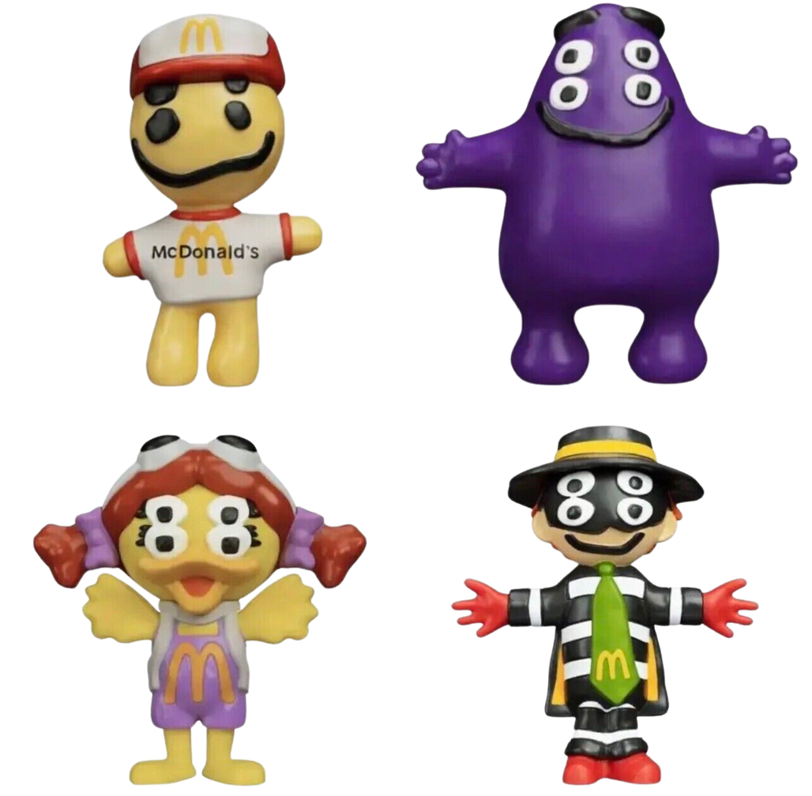
Cactus Plant Flea Market
ADULT HAPPY MEAL TOYS
Birdie
Grimace
Cactus Buddy Avatar
Hamburgler

Slide 15
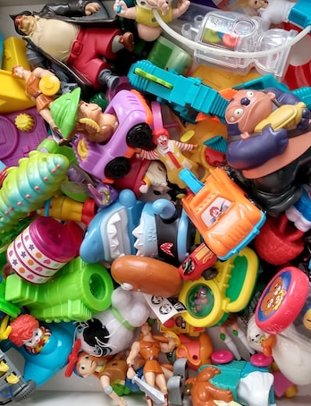
Sustainable
Marketing
Happy Meals are also providing opportunities to show consumers that they are prioritizing sustainability.
Cutting down on plastics used to make its Happy Meals toys allows the brand to showcase its commitment to the environment, and it has reportedly promised to reduce fossil fuel-based plastic in Happy Meals toys by 90% by 2025.

Slide 16
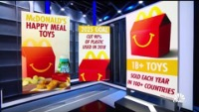
McDonald’s promises to make its Happy Meals toys more sustainable in the future.

Slide 17
DISCUSSION
What is a target market?
Why is it important for businesses and brands to define a target market?
Who did McDonald’s originally target with the creation of the Happy Meal?
Why do you think they focused on marketing to that consumer group?
Was the strategy a success? Why or why not?
How have Happy Meals evolved over the years?
How have consumer preferences and behaviors influenced that evolution?
If you were a marketing professional at McDonald’s, what would you recommend as the next Happy Meal toy? Why?

Slide 18
STUDENT ACTIVITY
Consider what you have learned about market segmentation and target markets.
After reviewing the information in the “Happy Marketing: History of the Happy Meal” presentation, you will create your own Happy Meal promotion. You will then present your ideas in class.
Working in pairs or small groups, be sure your presentation addresses the following:
Your target market
WHY you will be targeting that specific consumer group
Description of the Happy Meal promotion
  Will it include a toy?
  What will the toy be?
  Will you partner with a film studio? Sports team or event? Athlete? Celebrity?
  Explanation of how this promotion, and target market, will deliver an increase in Happy Meals sales for McDonald’s

Slide 19
SOURCES
https://www.poconorecord.com/story/entertainment/2019/07/08/who-created-mcdonald-x2019-s/4739524007/
https://www.adweek.com/brand-marketing/the-happy-meal-ranks-among-the-most-successful-and-copied-ideas/
https://www.enterpriseappstoday.com/stats/mcdonalds-statistics.html
https://en.wikipedia.org/wiki/Happy_Meal
https://www.usatoday.com/story/money/2020/10/22/40-happy-meal-toys-well-never-forget/42853509/
https://www.marketingdive.com/news/mcdonalds-happy-meal-streetwear-millennials-Gen-Z/632742/
https://www.cnbc.com/2022/10/19/mcdonalds-collectible-adult-happy-meal-toys-are-selling-for-thousands.html
https://gobraithwaite.com/thinking/happy-meal-marketing
https://www.treasureadvertising.com/post/the-story-of-bob-bernstein-and-the-happy-meal
https://www.mashed.com/1294520/most-popular-happy-meal-toy-year-you-were-born/
https://www.mentalfloss.com/posts/mcdonalds-happy-meal-food-history
https://parade.com/living/mcdonalds-happy-meal-toys
https://www.cnbc.com/2022/10/19/mcdonalds-collectible-adult-happy-meal-toys-are-selling-for-thousands.html
https://www.usatoday.com/story/money/2020/10/22/40-happy-meal-toys-well-never-forget/42853509

