Slide 1
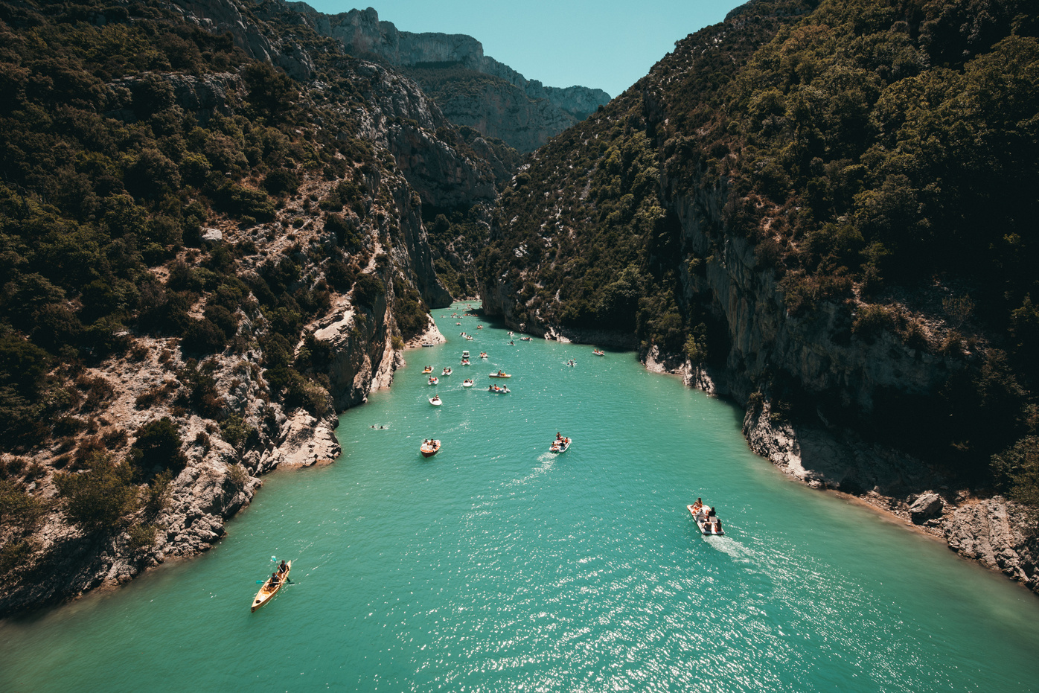

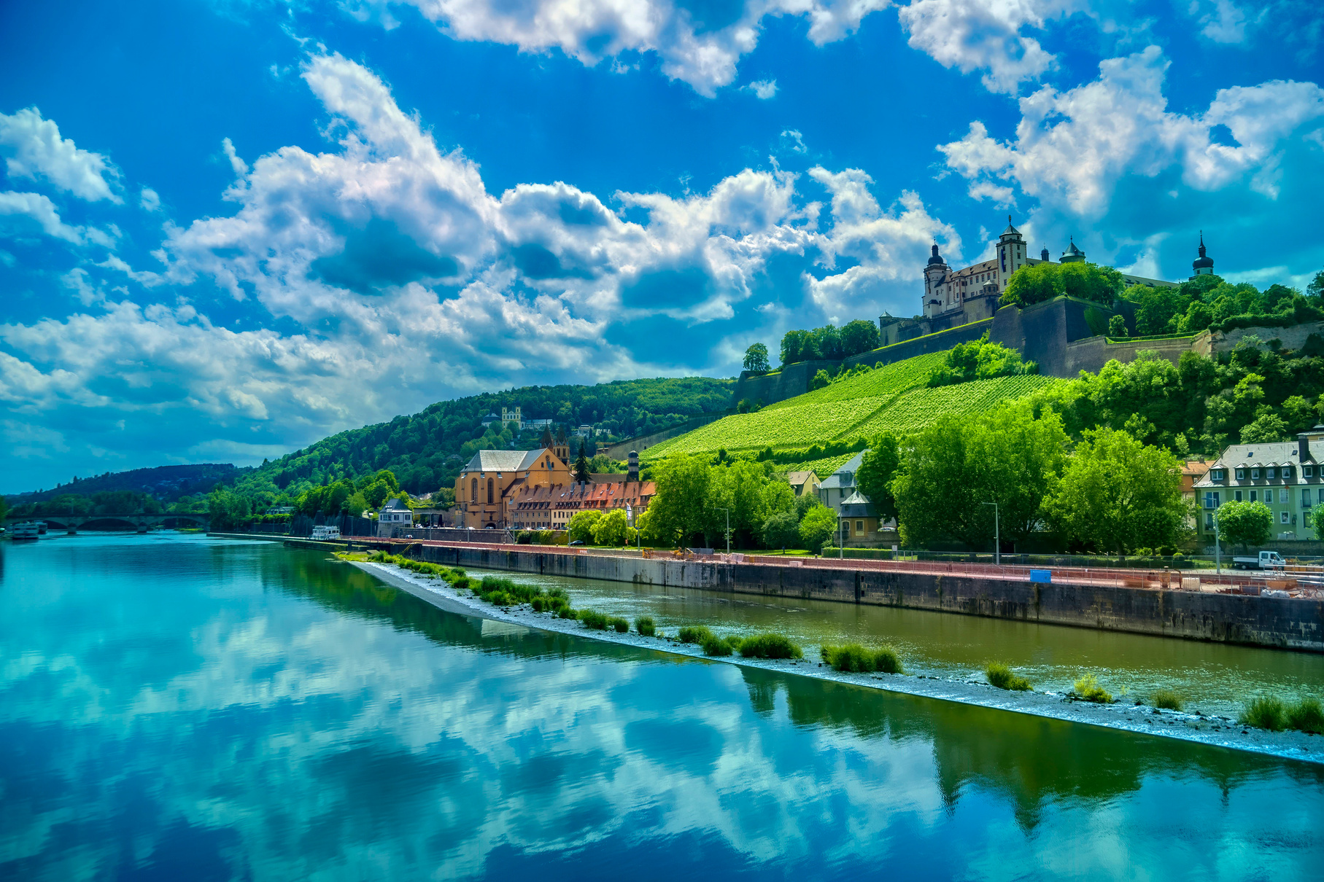


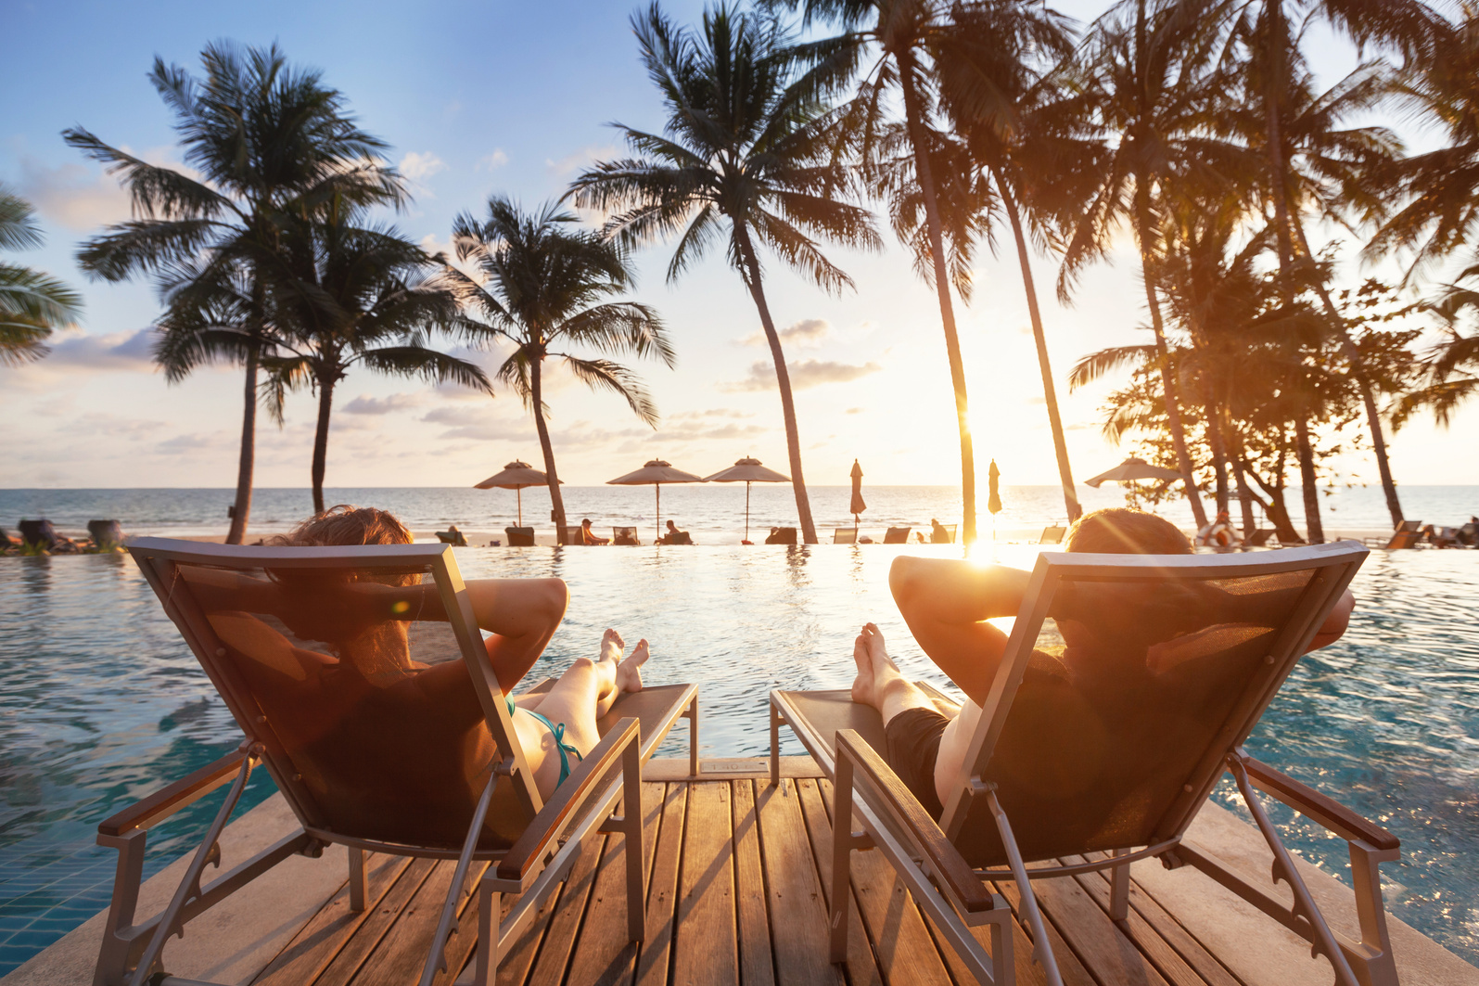
Marketing Insights from SCC
Slogans & Taglines
Tourism is extremely important to many areas around the world.
From smaller cities like Walla Walla, Washington (population 34,000) and counties like Door County in Wisconsin (population 30,000) to entire countries, like France where tourism brings 90 million visitors to the country each year, tourists represent big business.

Slide 2
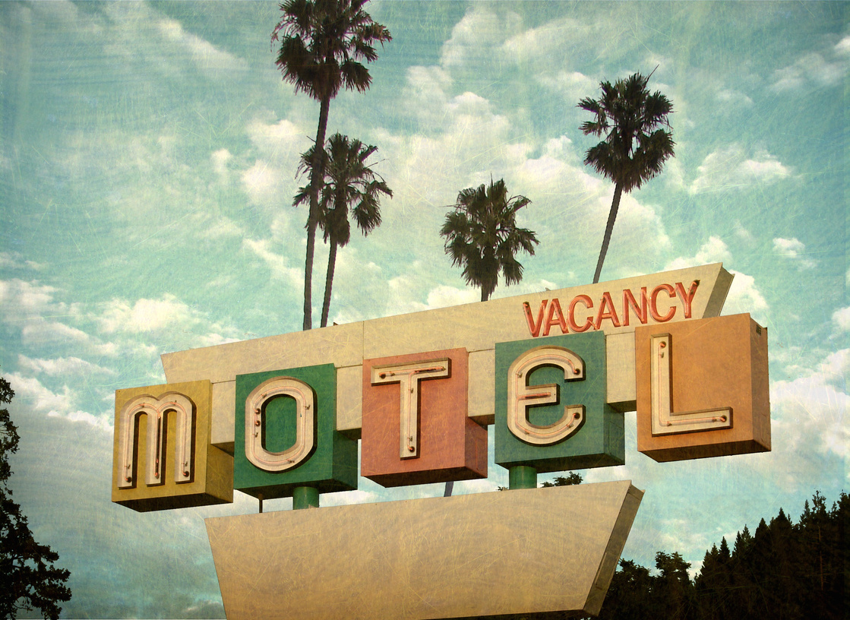


Marketing Insights from SCC
Slogans & Taglines
Travelers will stay in resorts, hotels, and bed and breakfasts, visit local businesses, and dine at area restaurants. They visit area attractions, buy souvenirs and pay for experiences, all contributing to the destination's economy.

Slide 3
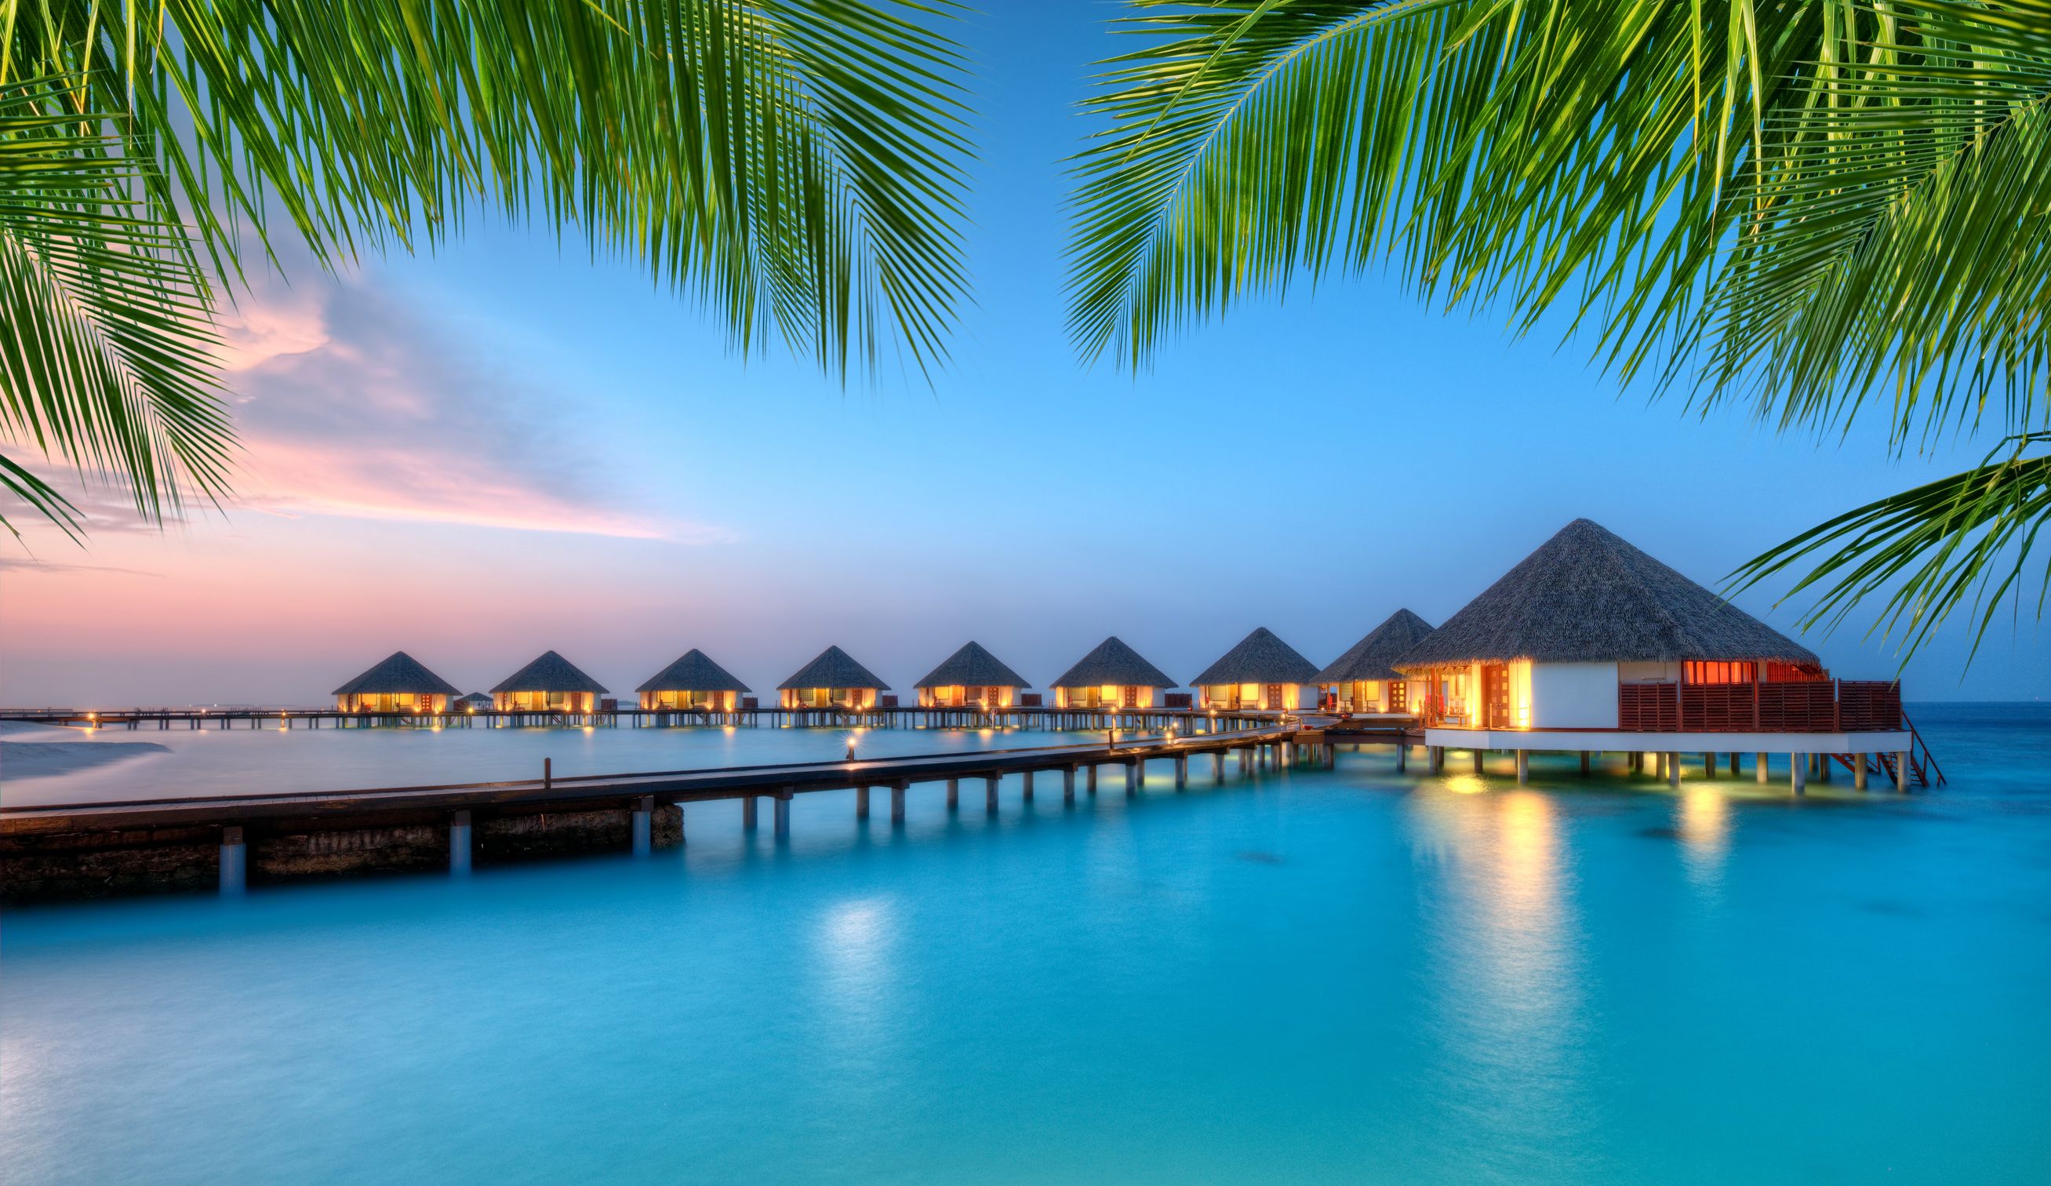
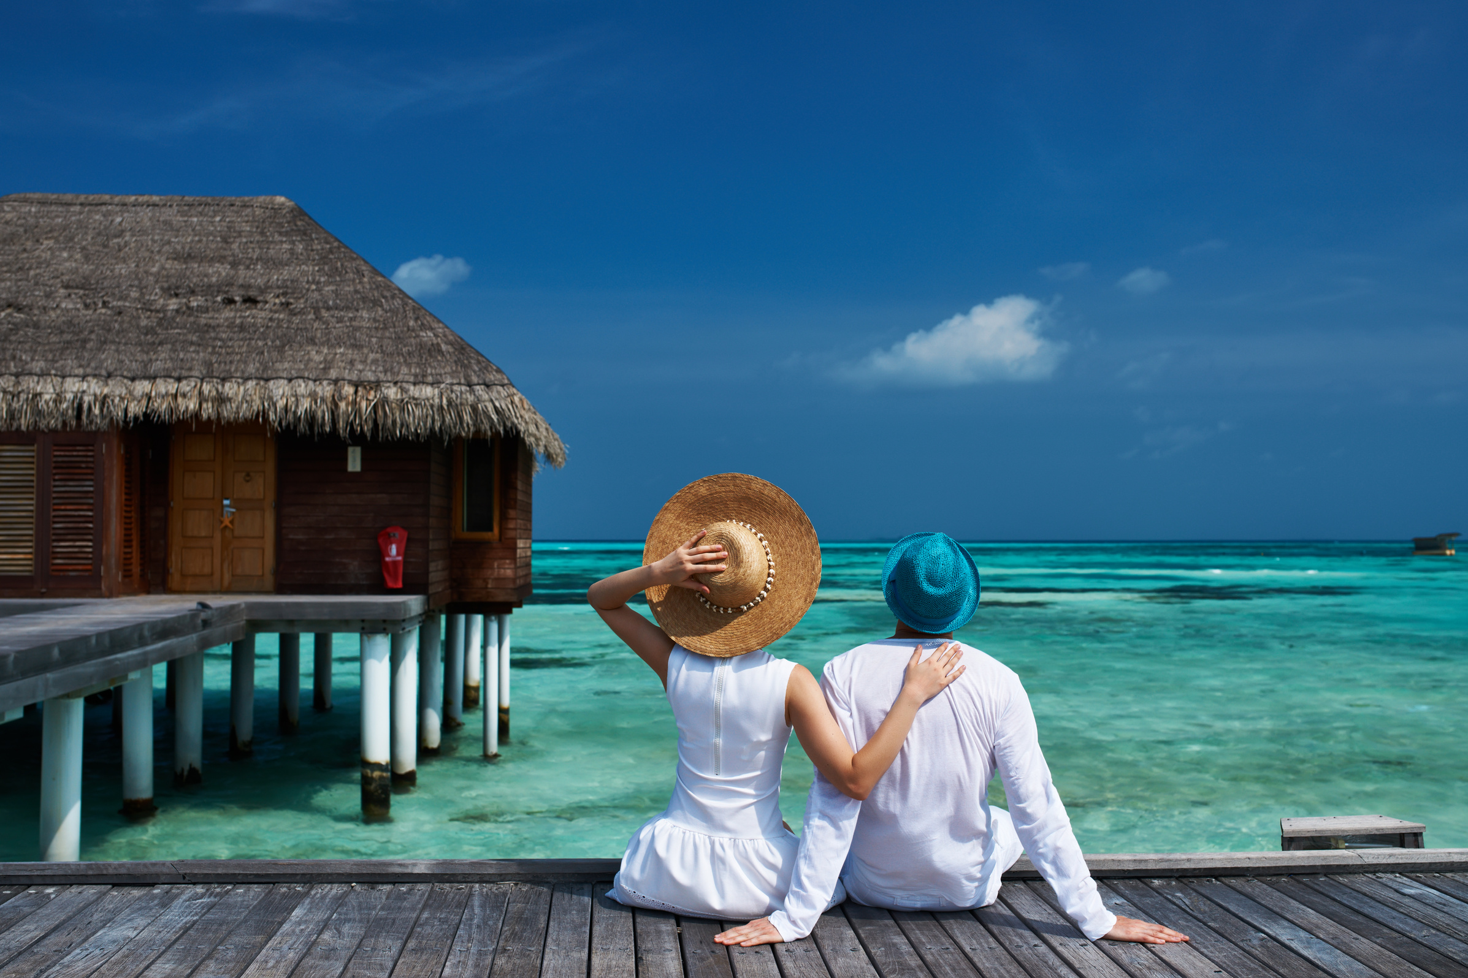
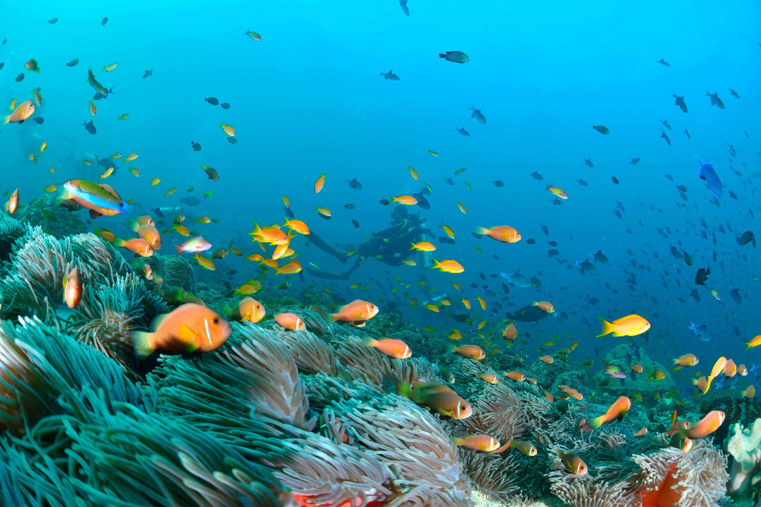
Marketing Insights from SCC
Slogans & Taglines
Some destinations rely on tourism as a significant means for powering the economy. For example, tourism brings more than $1 billion per year to the Maldives, accounting for nearly 40% of the country’s entire GDP.

Slide 4

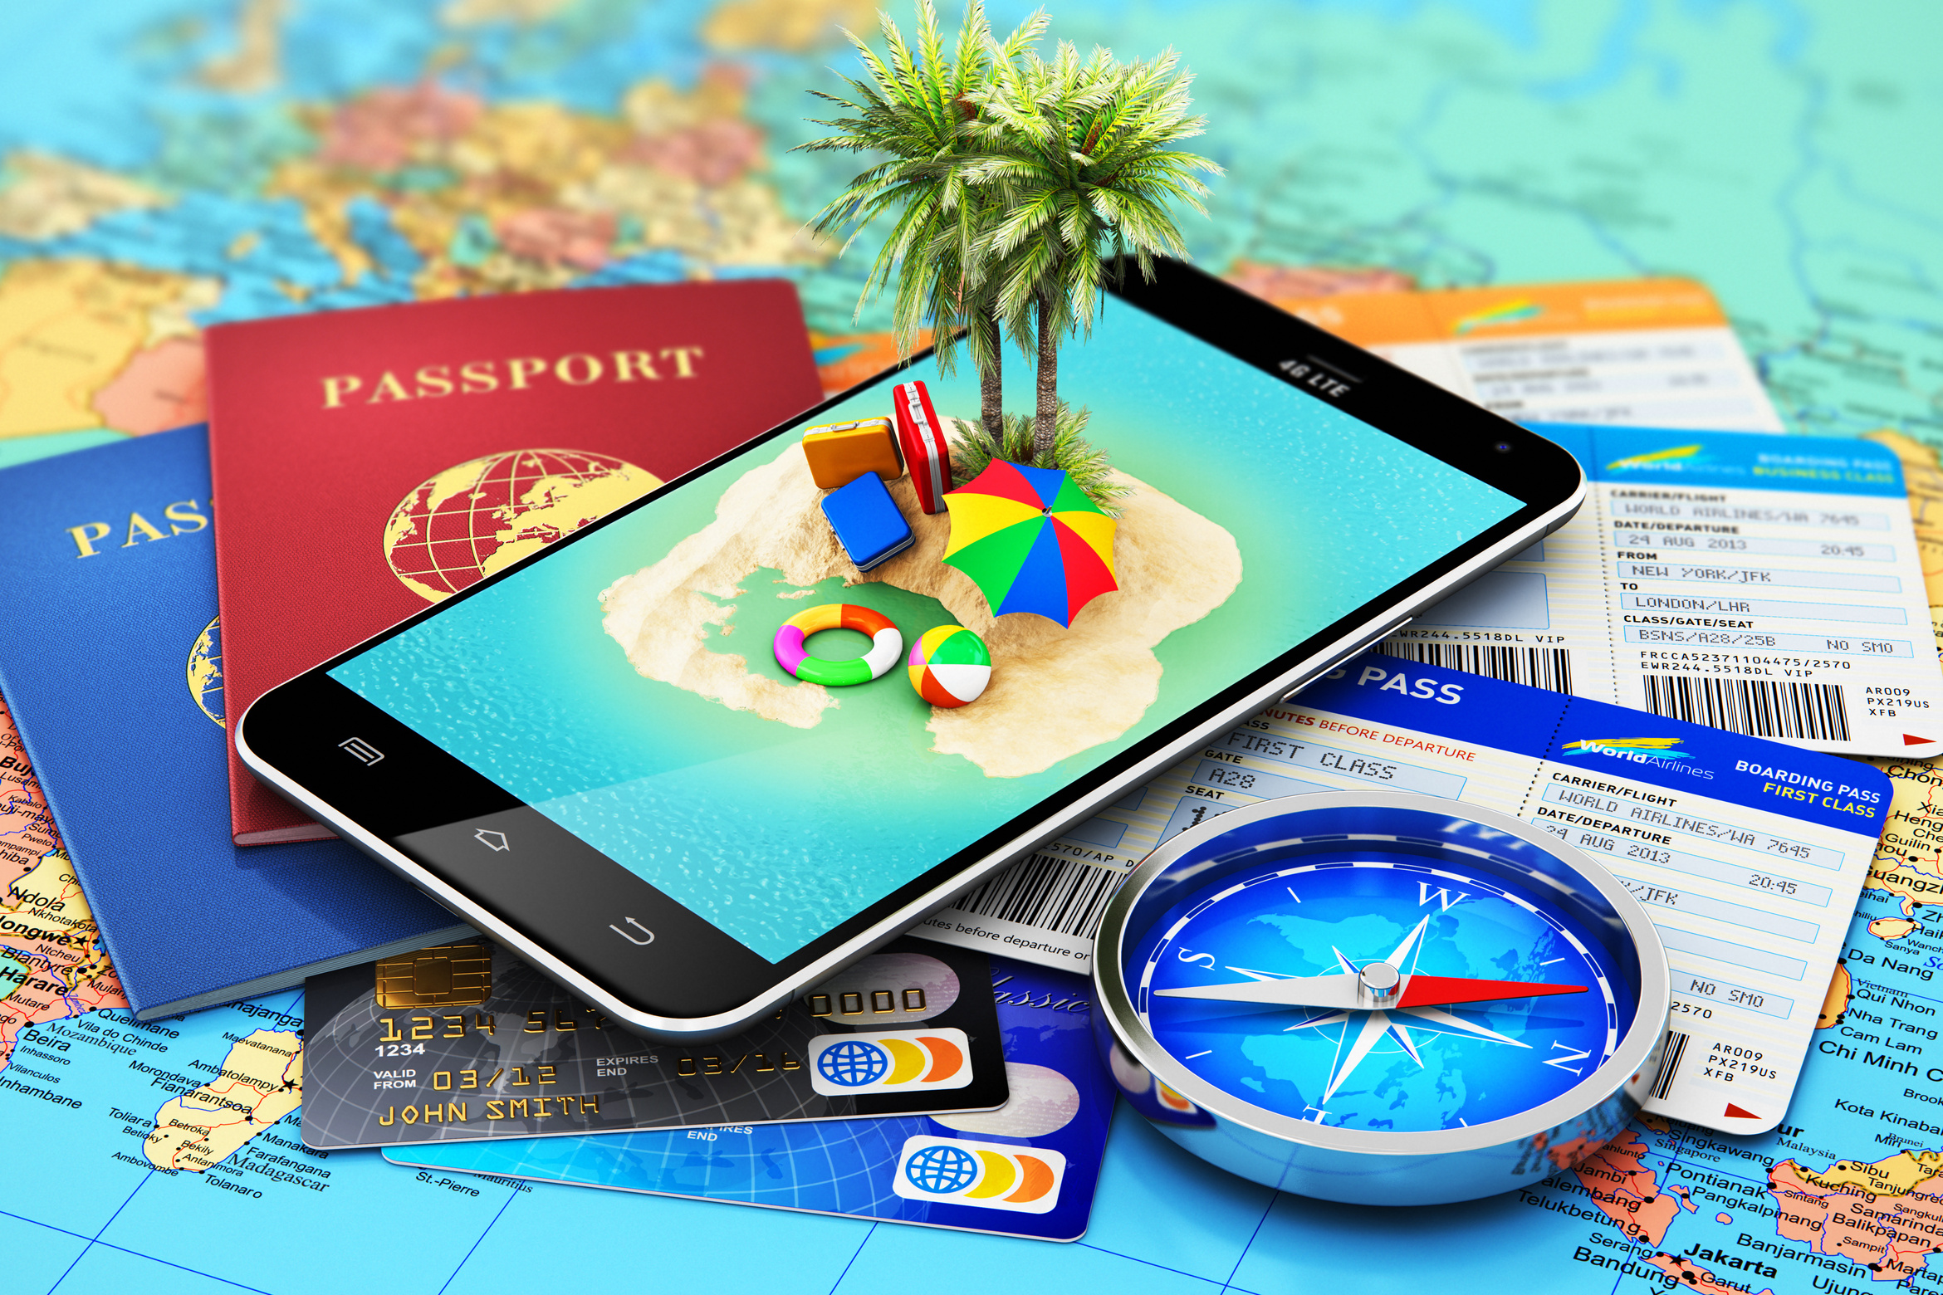
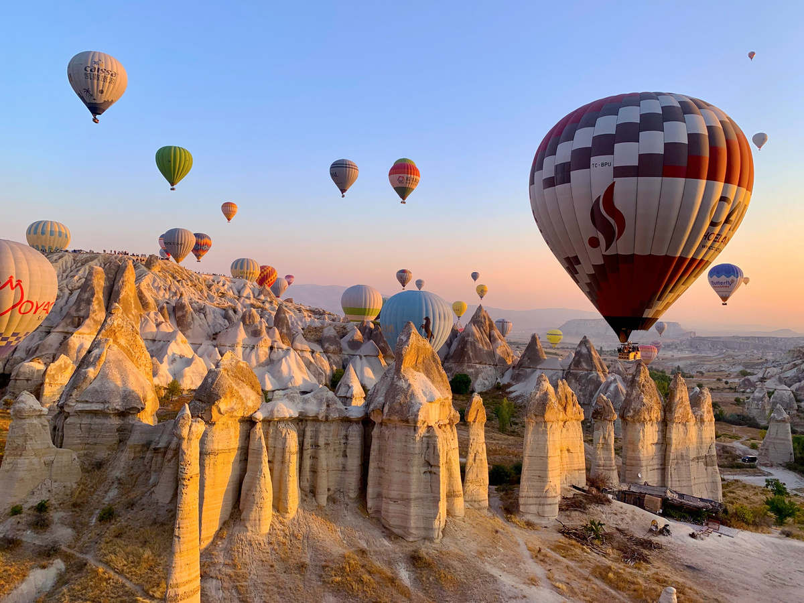
Marketing Insights from SCC
Slogans & Taglines
Because attracting visitors is vital to the economy in some of these areas, destination marketing professionals are employed specifically to develop tourism marketing campaigns. Typically, these campaigns will feature a slogan or tagline. We will review several examples in this presentation.

Slide 5
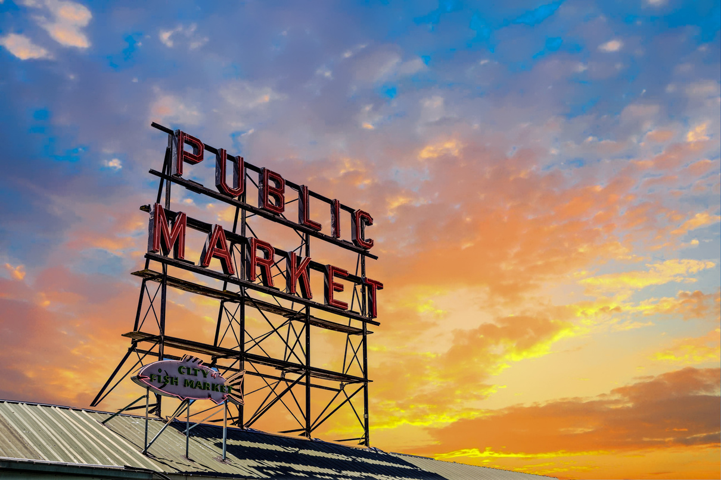
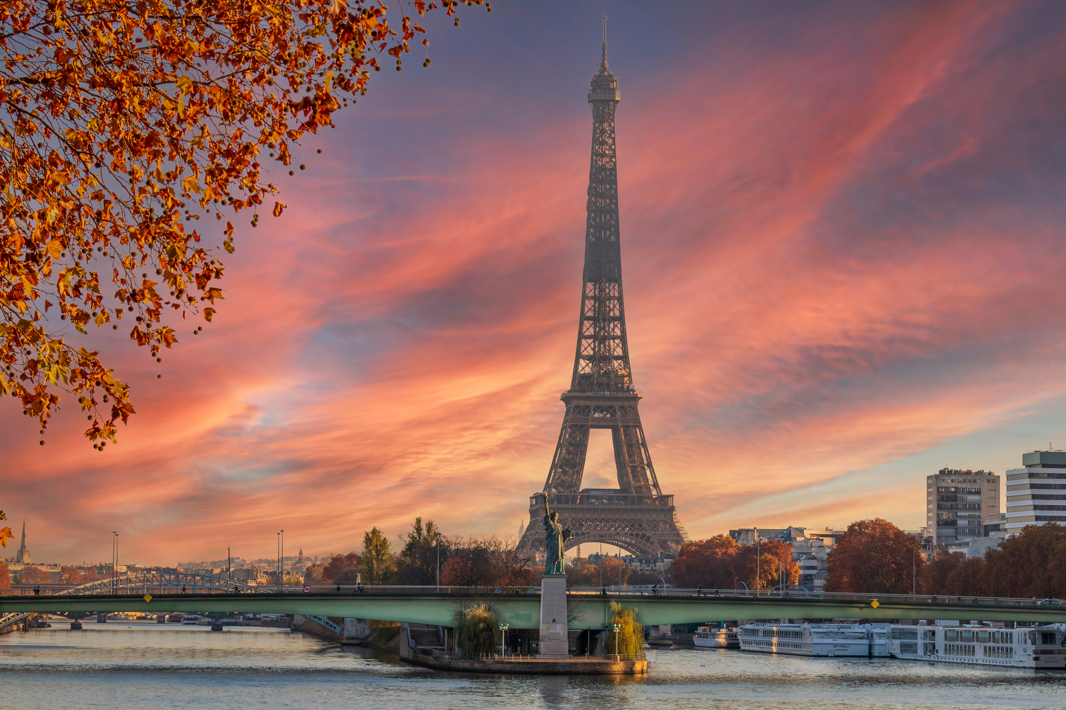
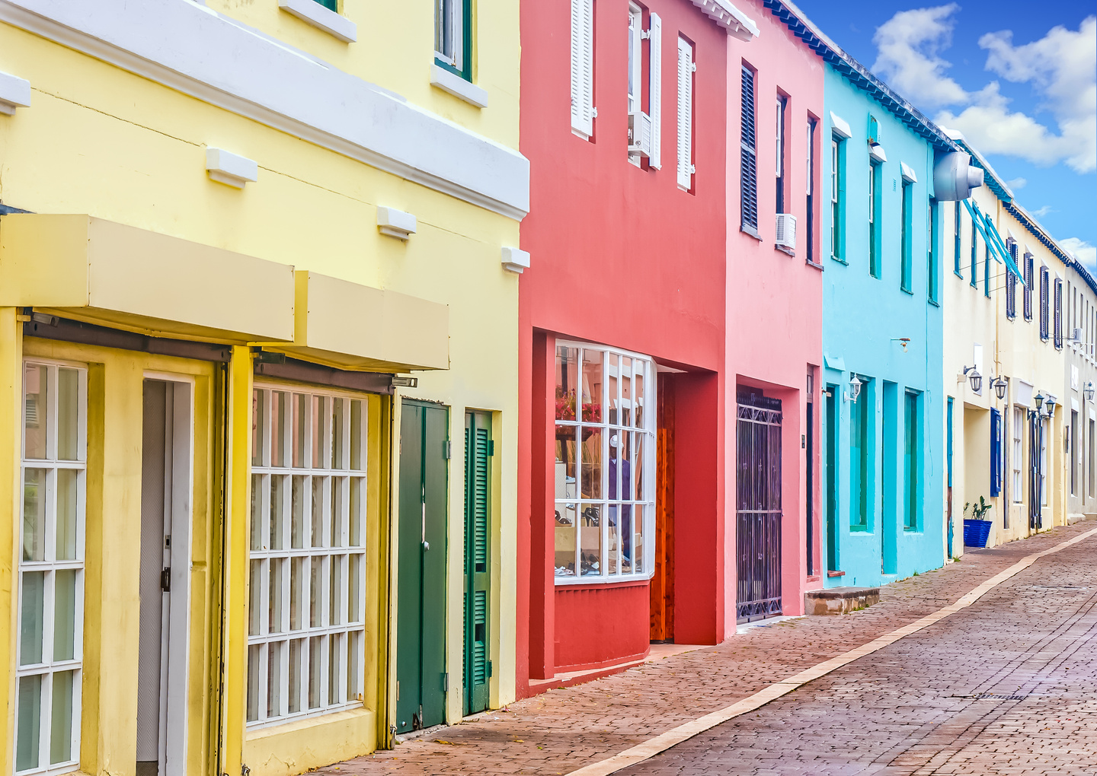
Marketing Insights from SCC
Slogans & Taglines
As you review the presentation, consider the following questions:
  What is the value proposition of the destination?
  What makes them unique? How might that illustrate the concepts of positioning and differentiation?
  What is the message the destination is hoping to communicate to potential travelers with the slogan or tagline and why?
  Does the slogan or tagline make you want to visit?

Slide 6

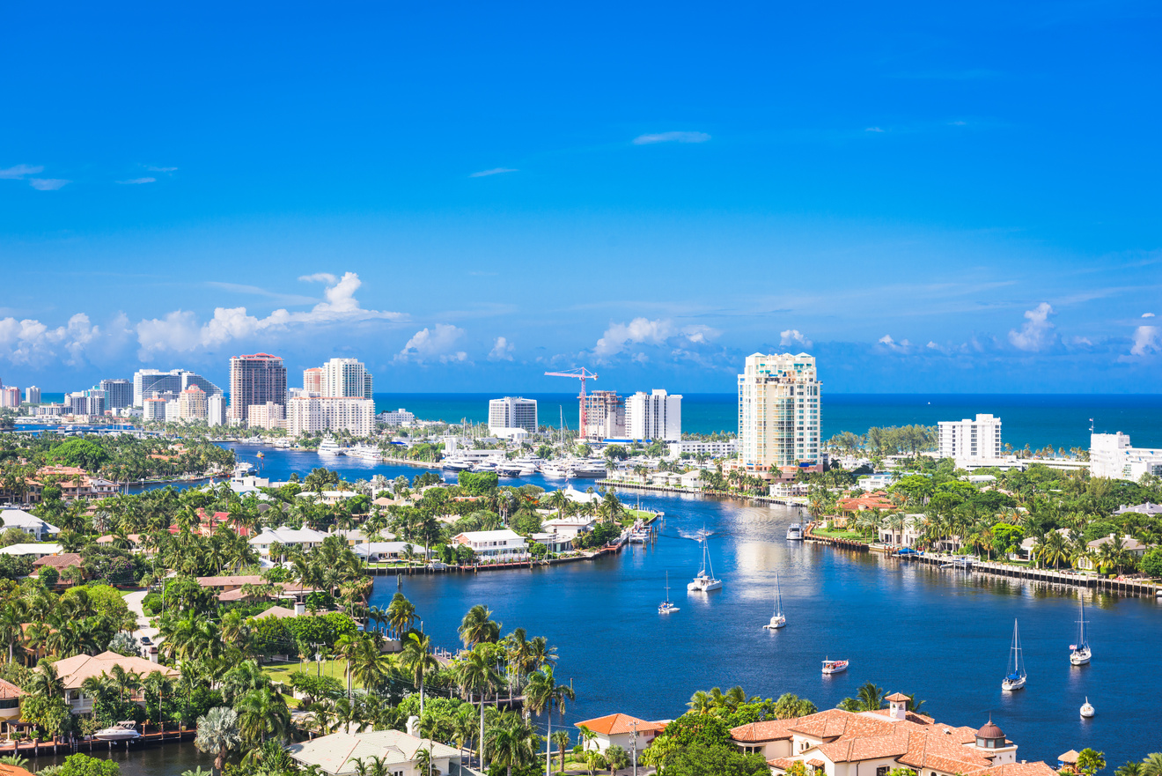
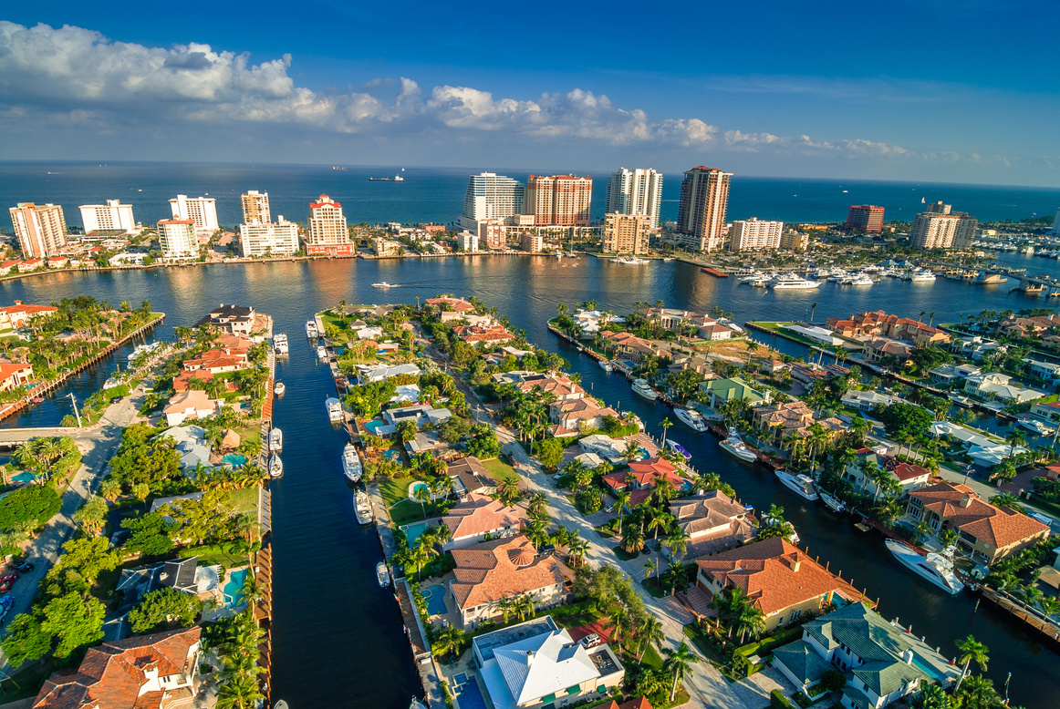
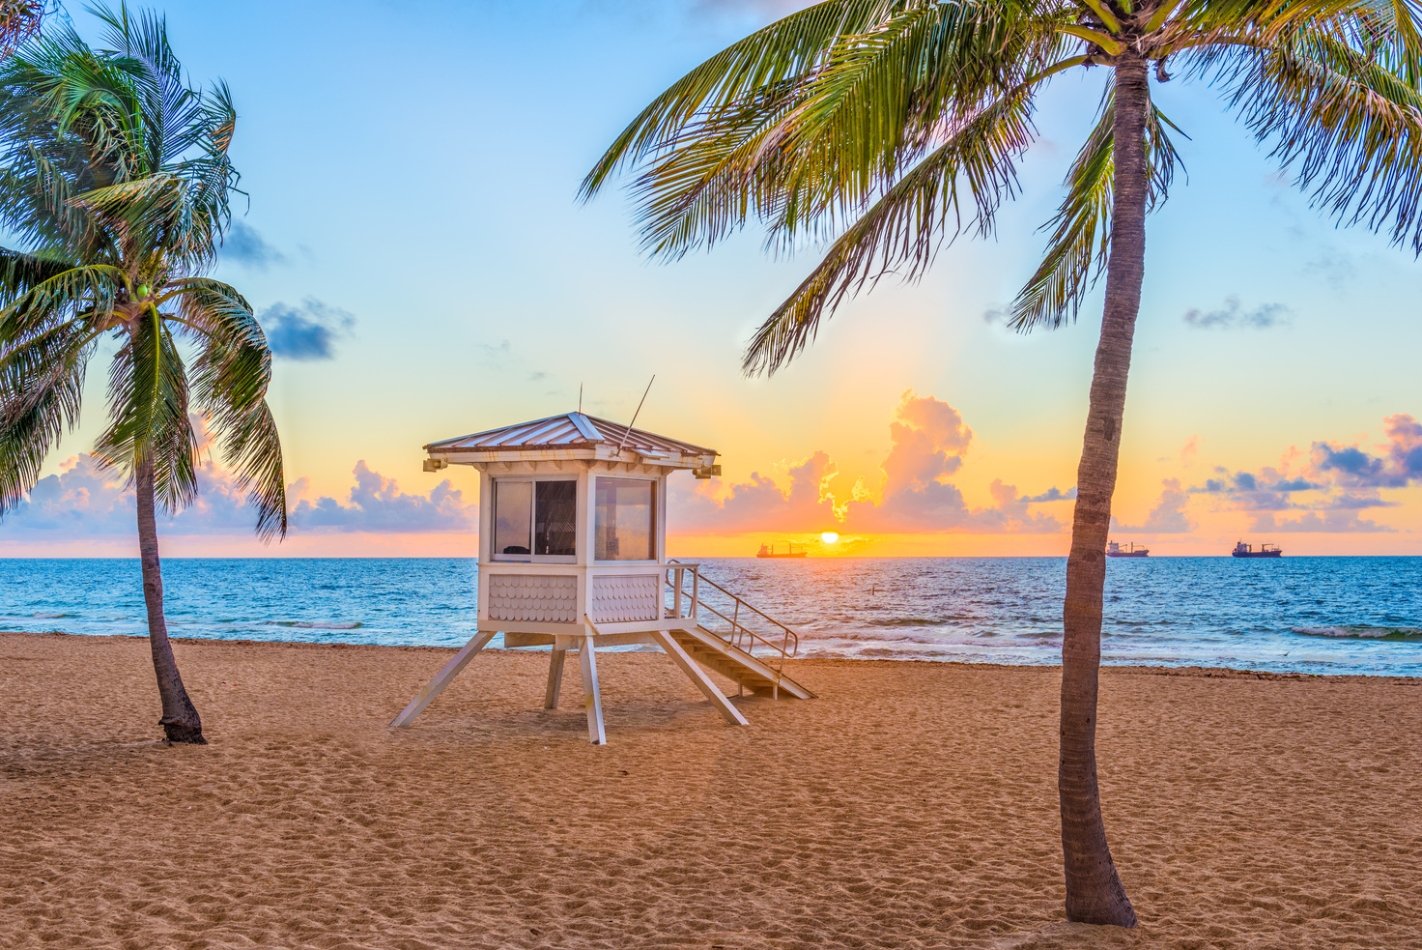
"Everyone Under the Sun"
FT LAUDERDALE, FL
SOURCE: VISIT LAUDERDALE

Slide 7

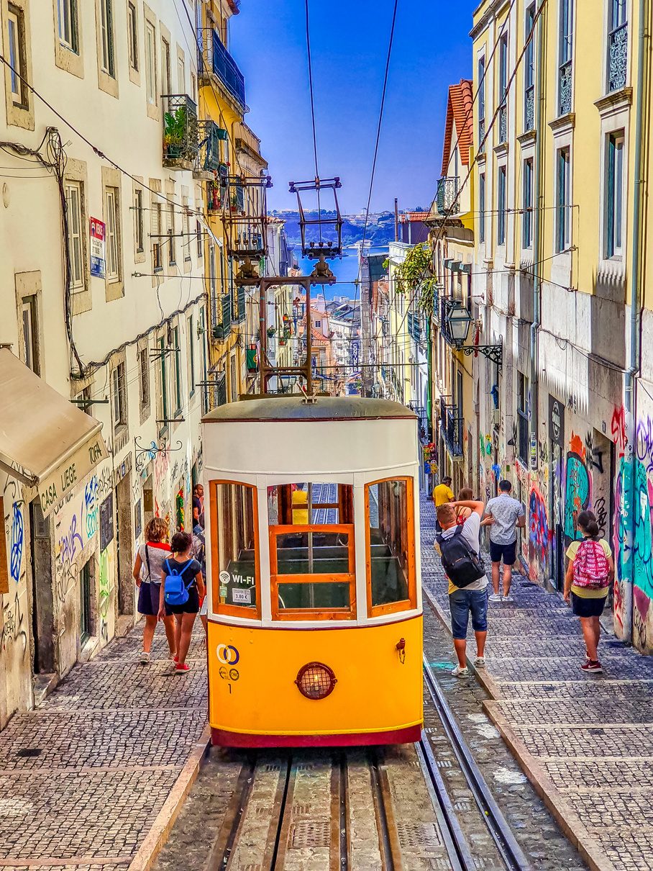
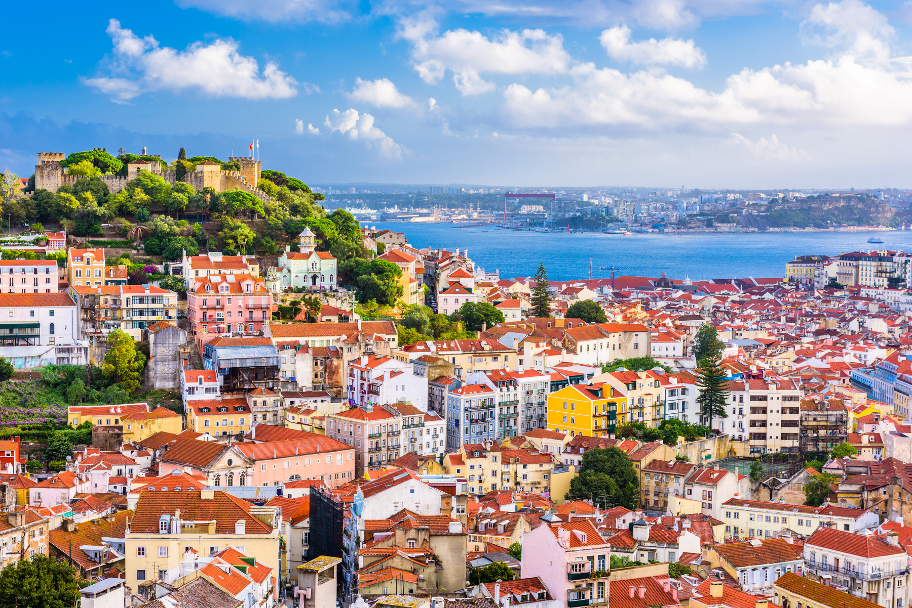
"Can’t Skip Tomorrow"
PORTUGAL
This tourism campaign was launched exclusively in digital media and in a totally organic way (without investment in advertising).
SOURCE: TOURISMO DE PORTUGAL

Slide 8
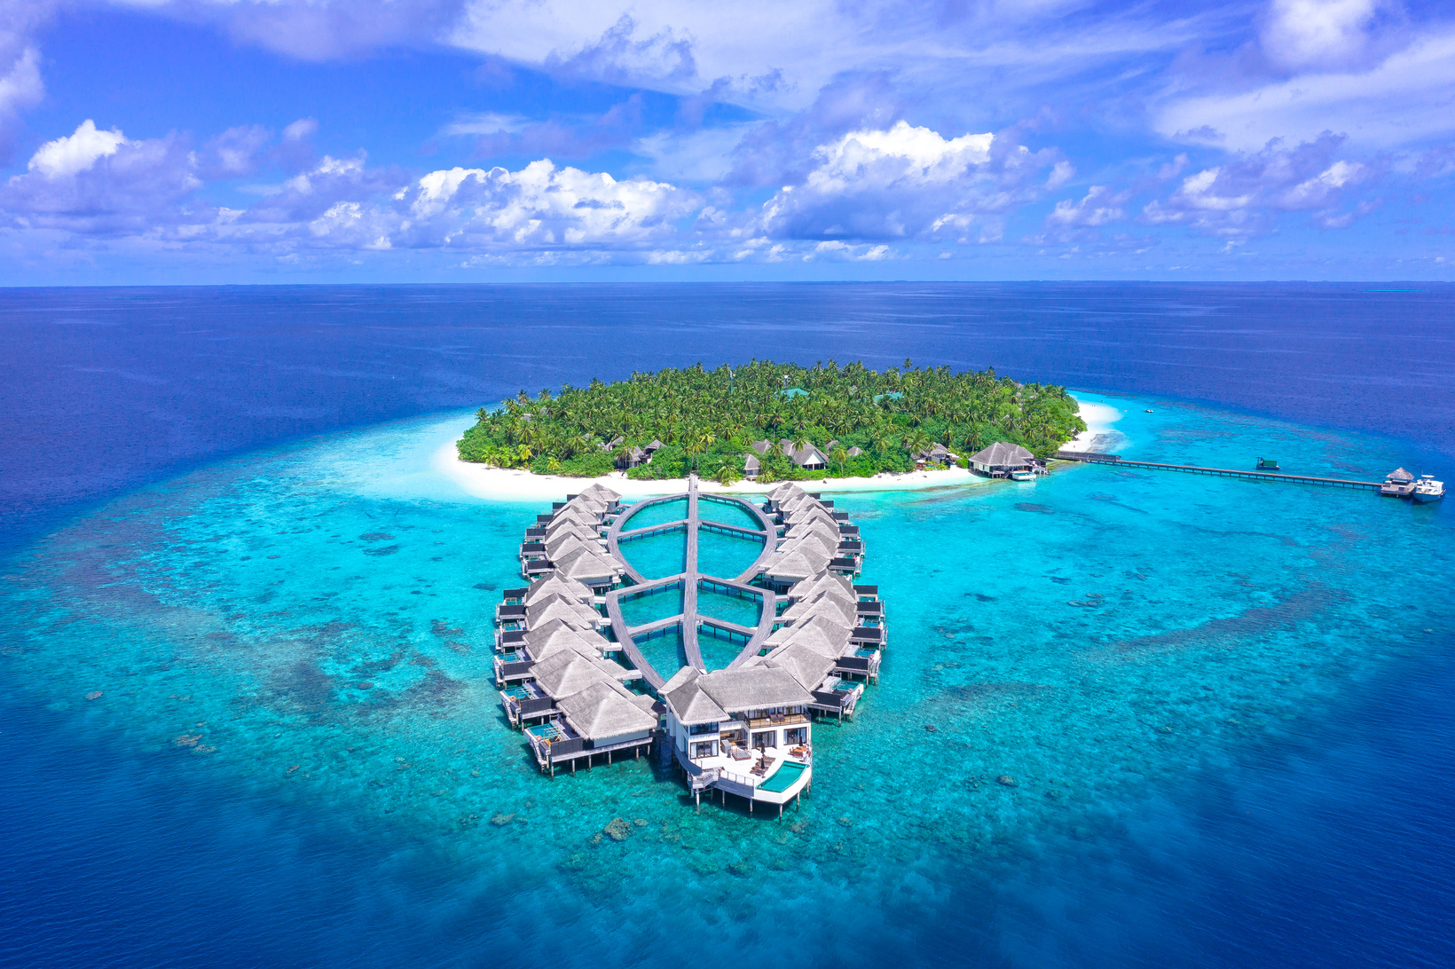
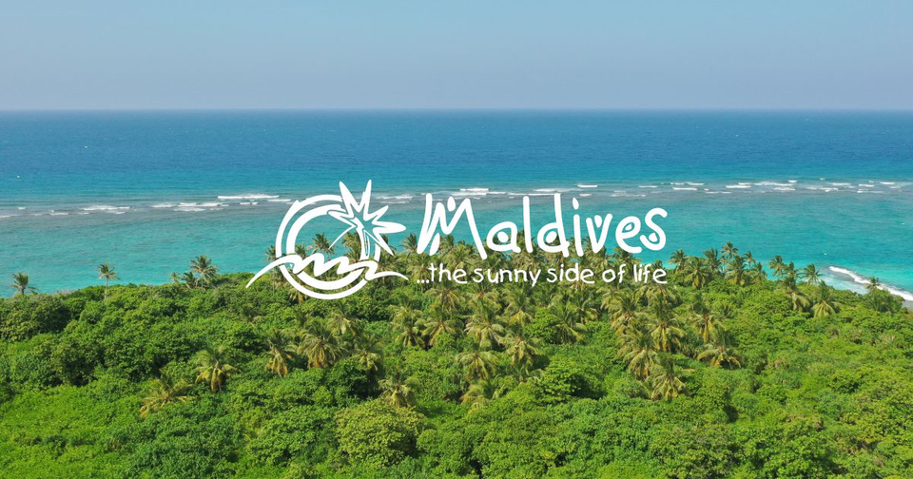
"The sunny side of life"
THE MALDIVES
SOURCE: VISIT MALDIVES

Slide 9

"All Dreams Welcome"
ANAHEIM, CALIFORNIA
SOURCE: TRAVEL MATTERS CA

Slide 10
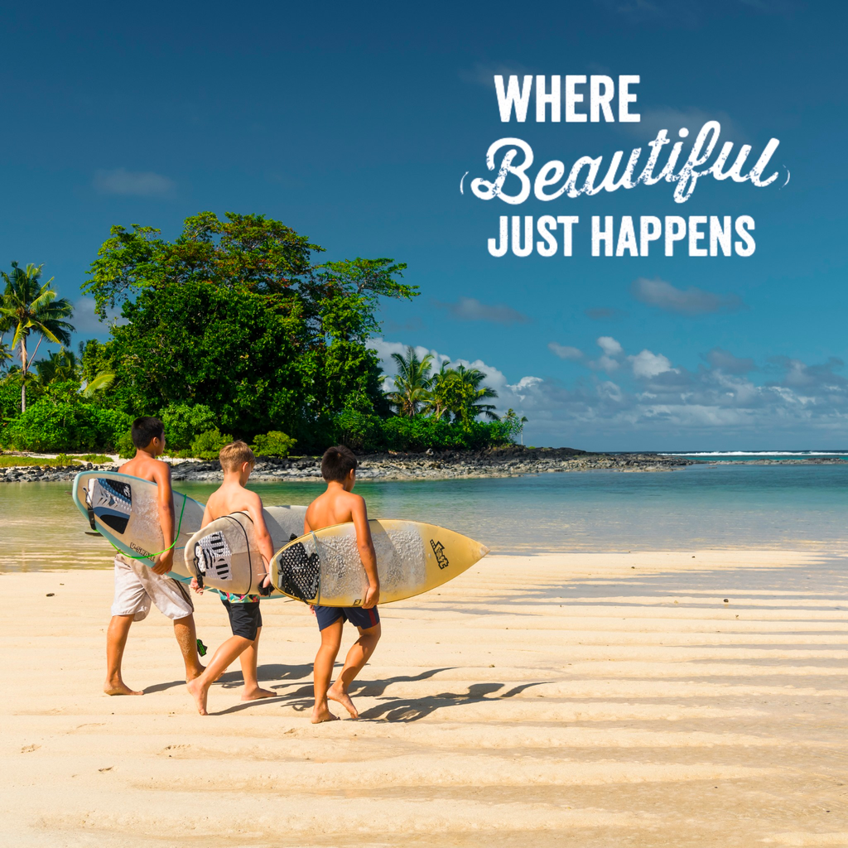
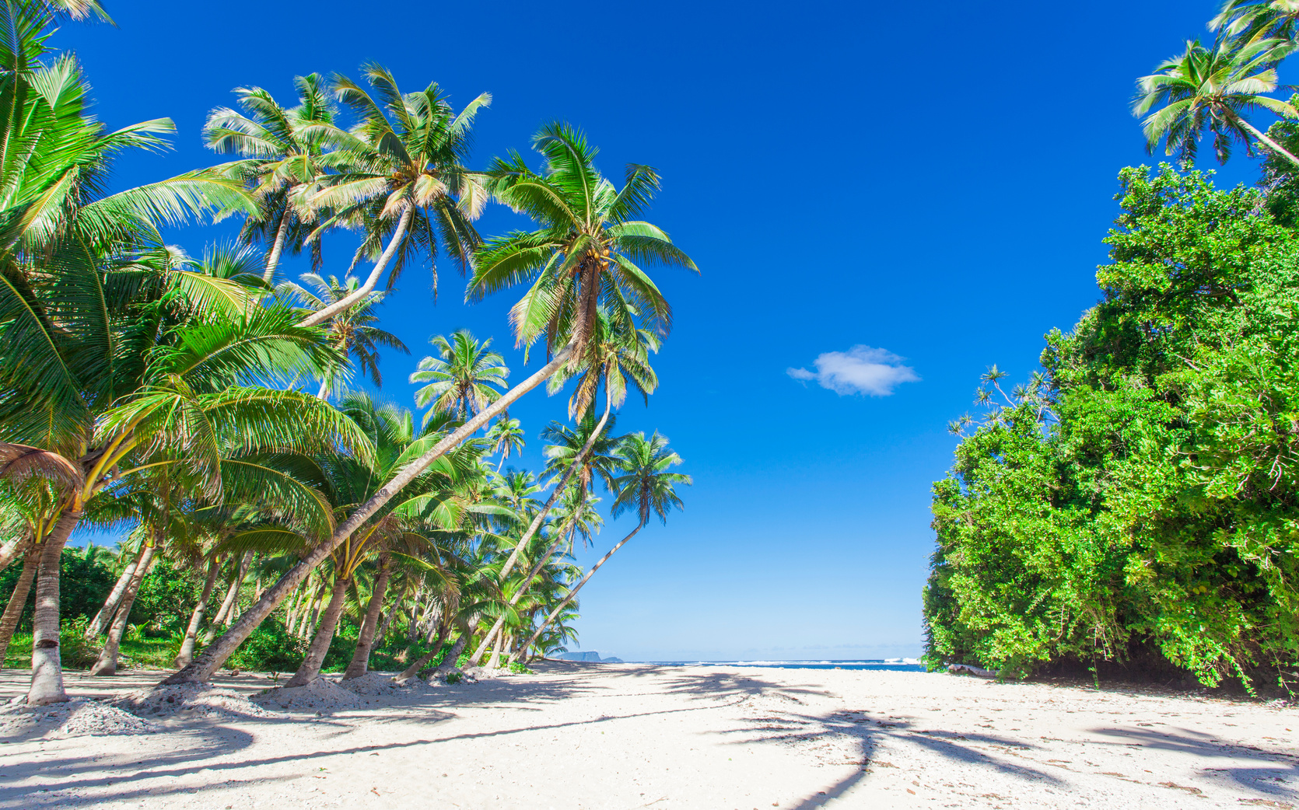
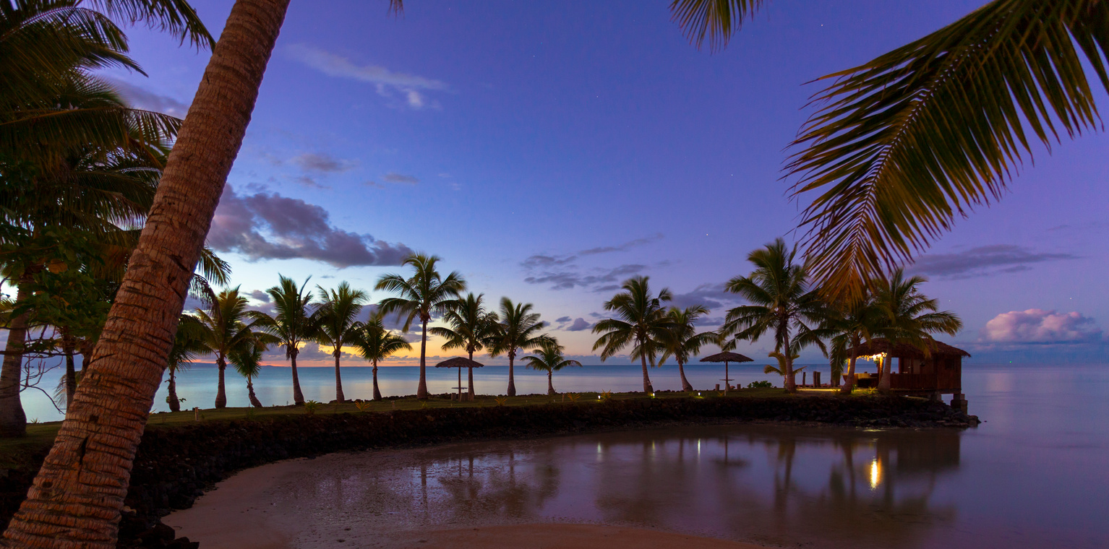
"Where beautiful just happens"
SAMOA
SOURCE: SAMOA TRAVEL

Slide 11
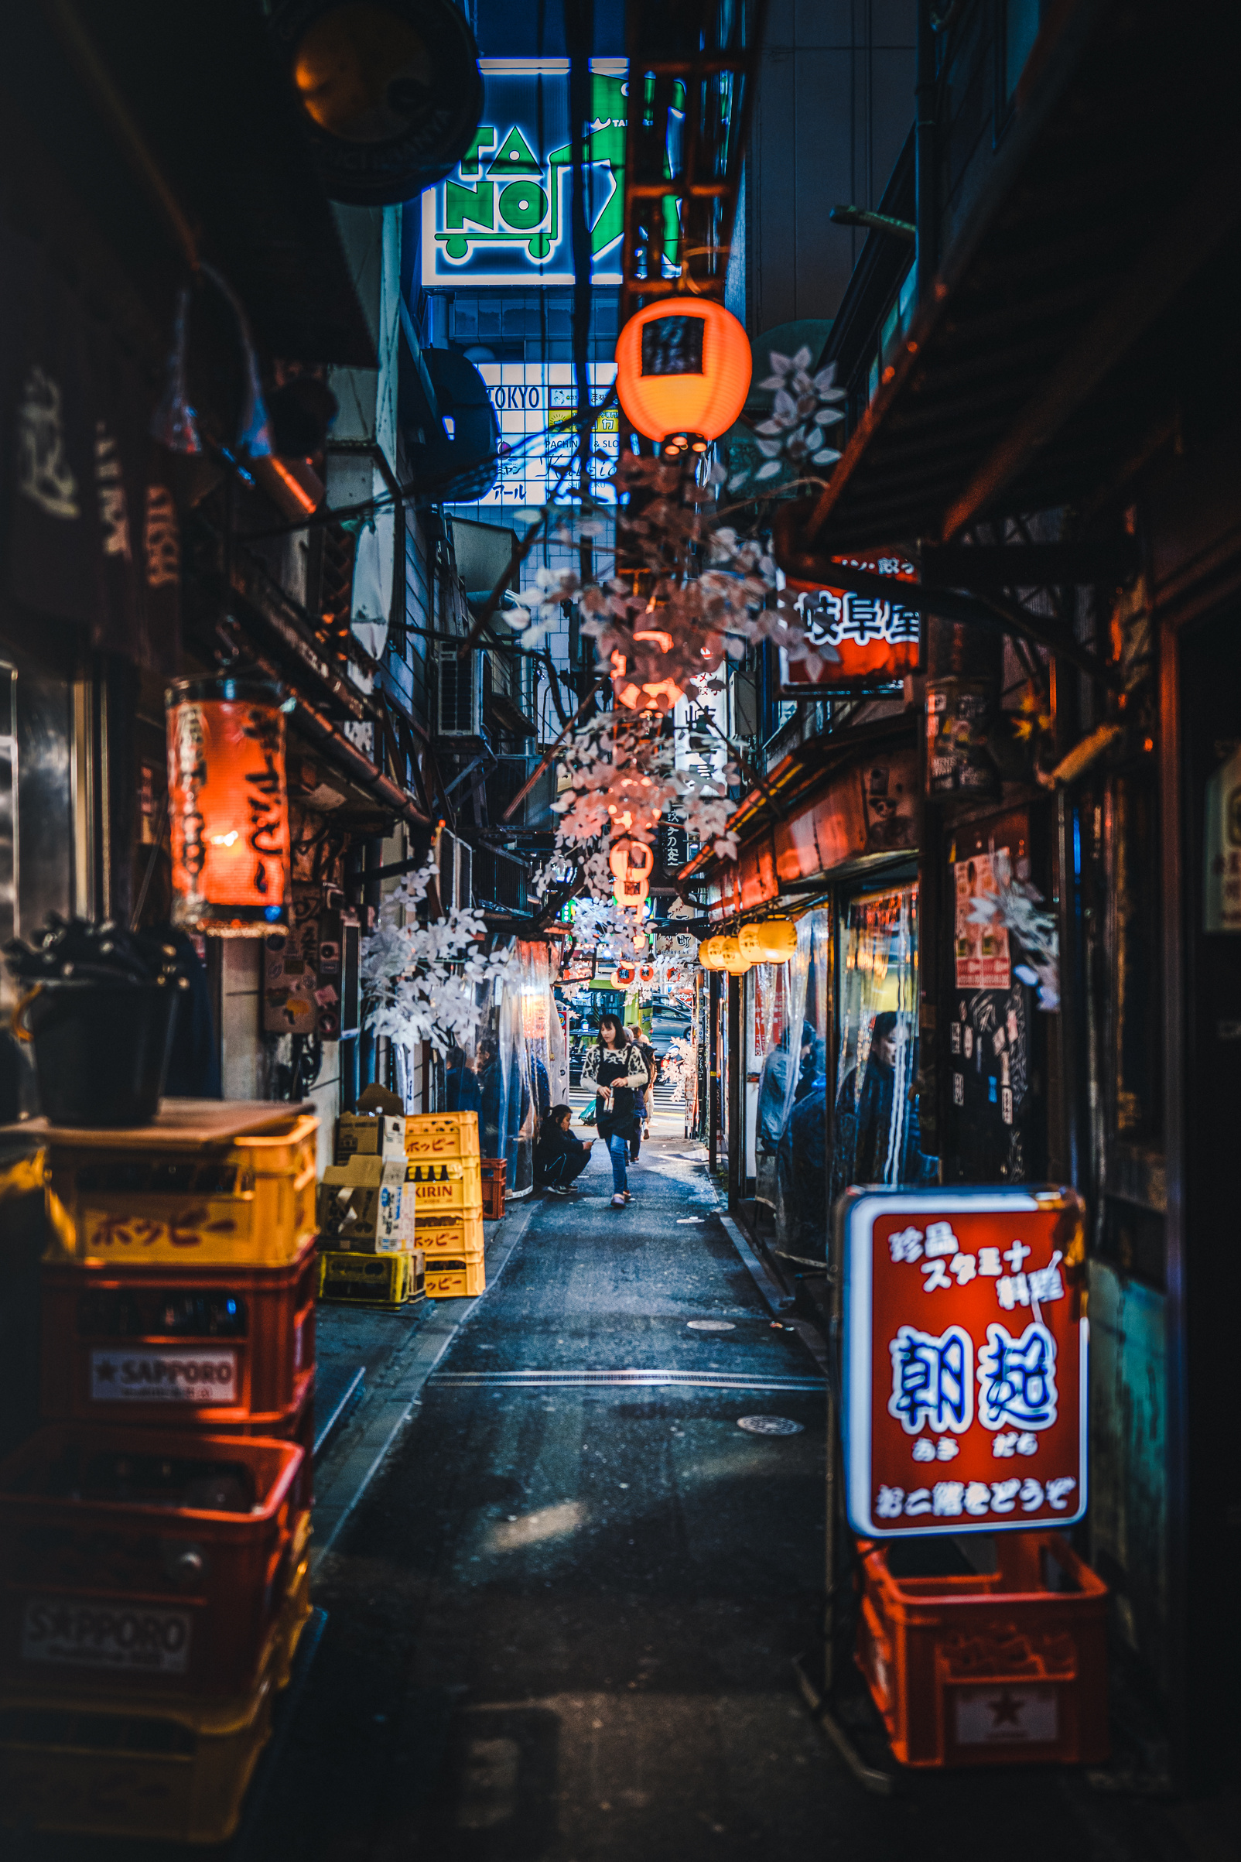


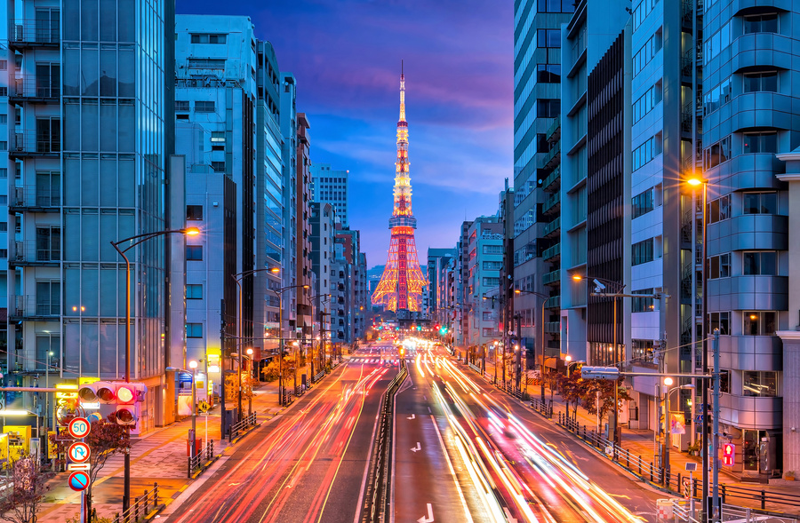
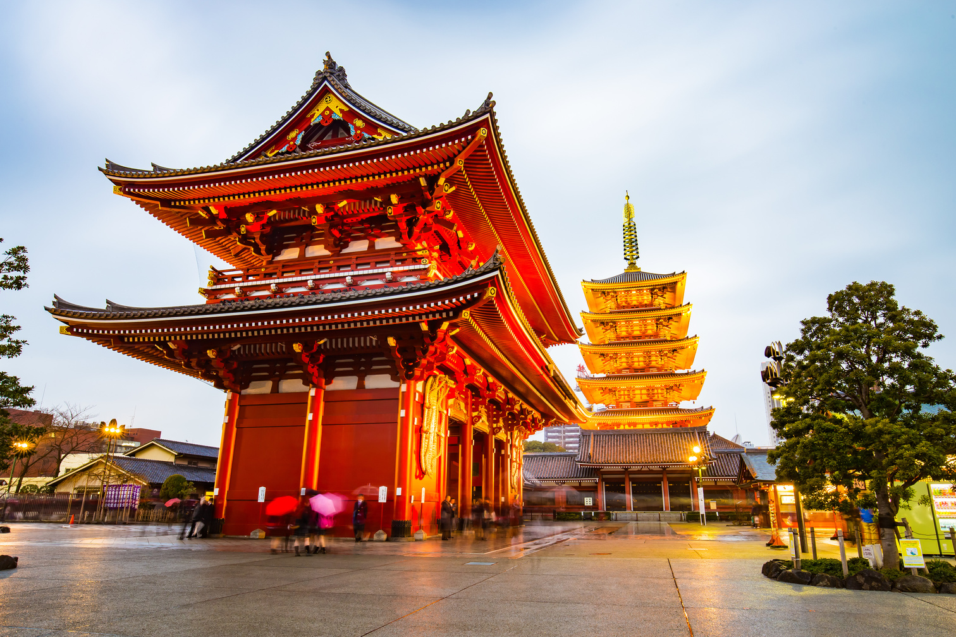
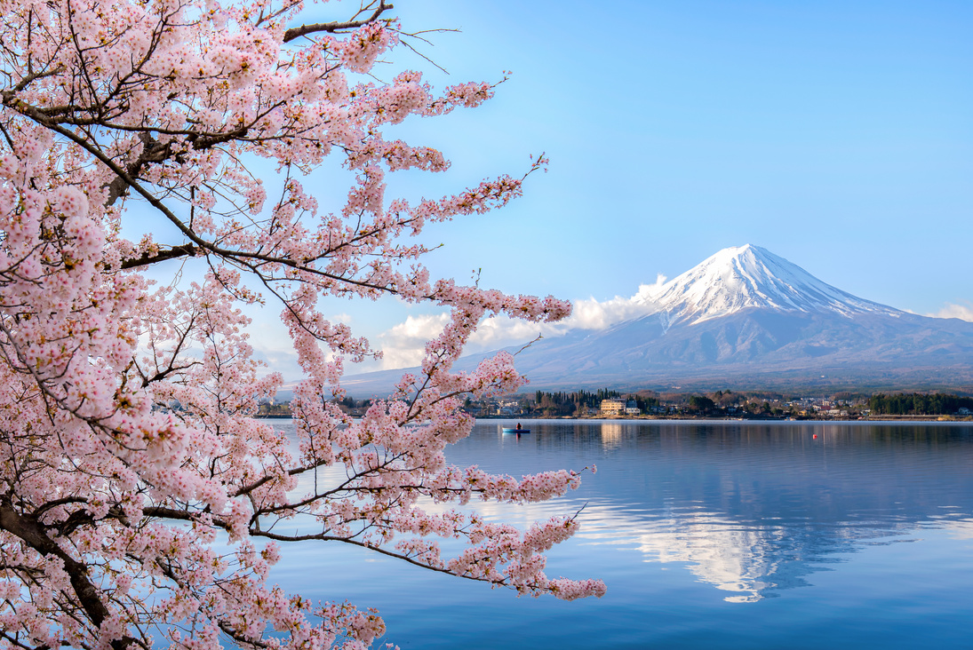
"Tokyo: Old Meets New"
TOKYO
SOURCE: TOKYO METROPOLITAN GOVERNMENT

Slide 12

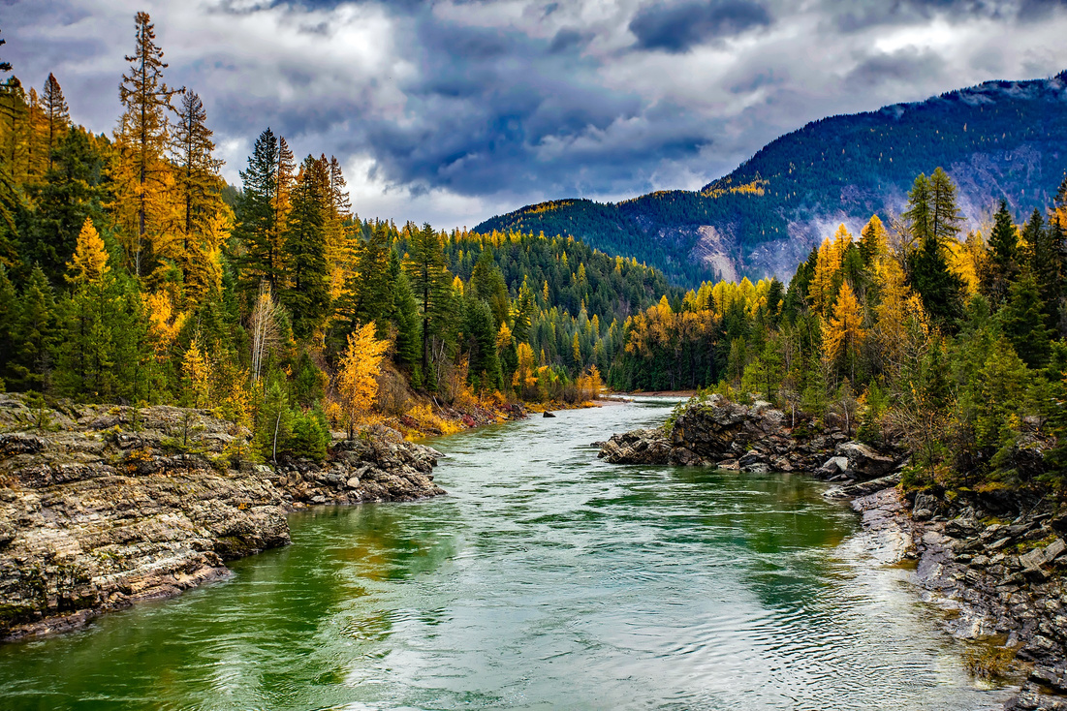
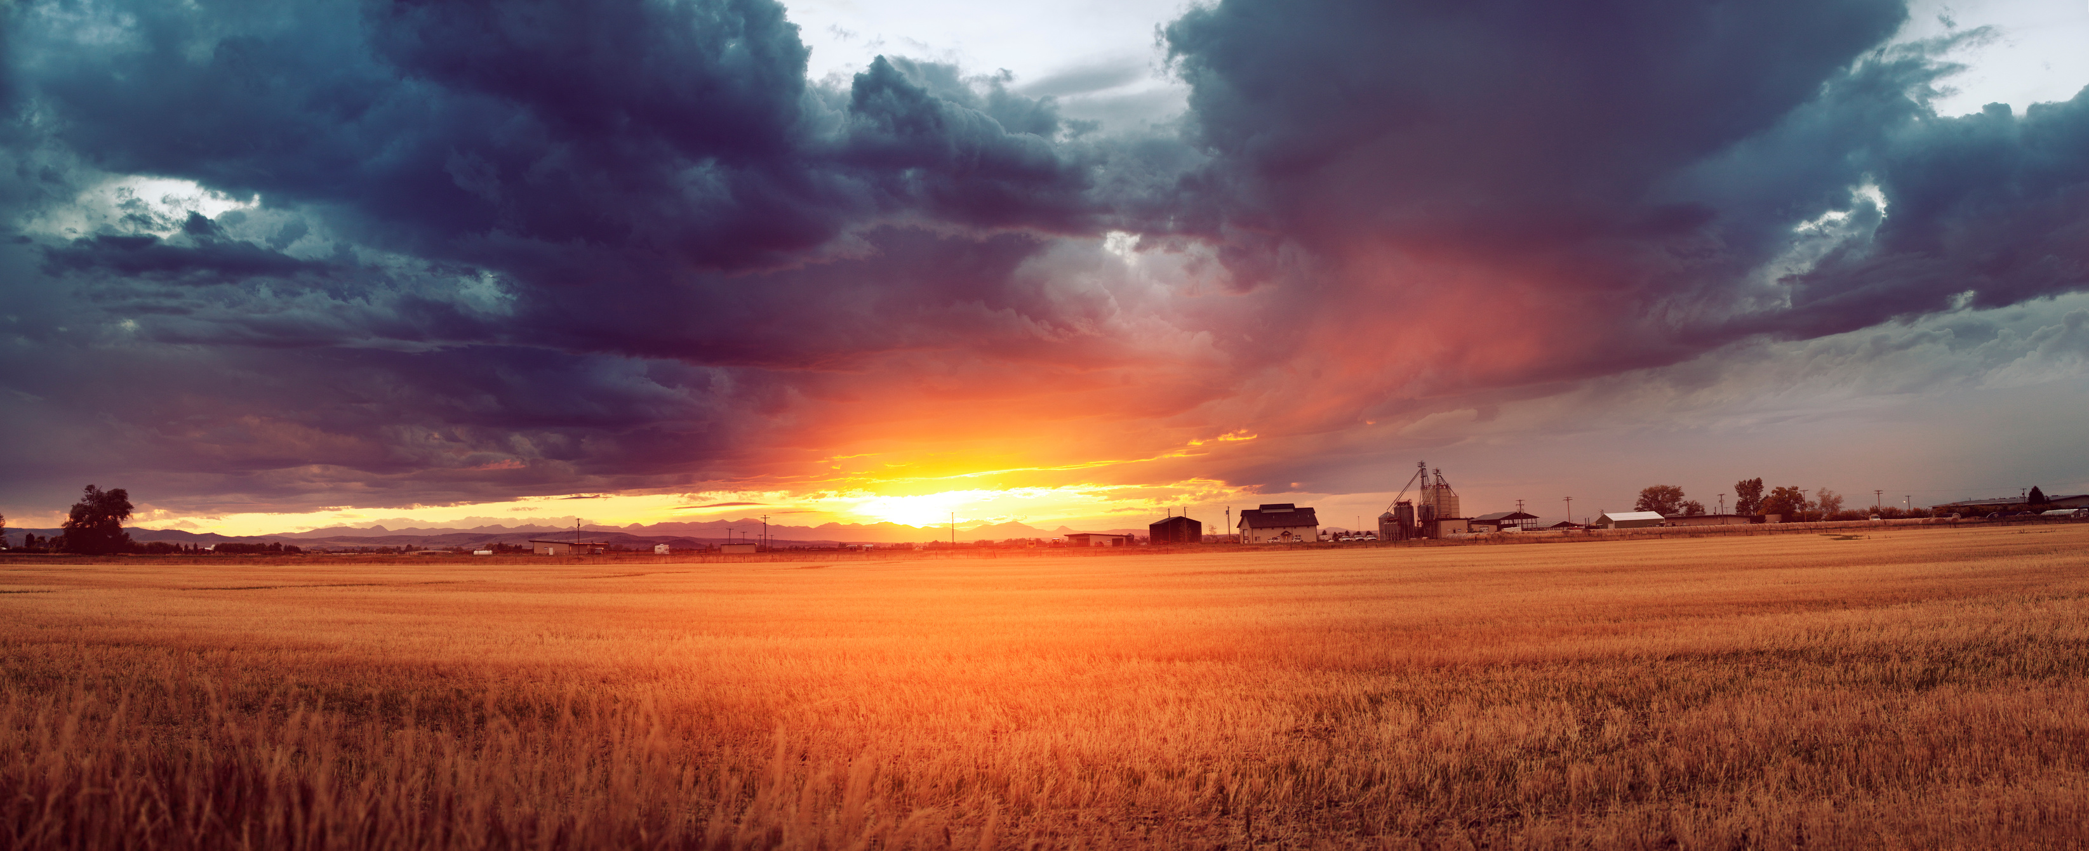
"Get Lost (In Montana)"
MONTANA
SOURCE: MT.GOV
"Get Lost (in Montana)" is the tagline of a popular tourism marketing campaign the Montana Department of Commerce introduced in 2012 to inspire Montana residents to explore their state. Since its retirement, the logo has continued to live on in the form of officially licenced merchandise."

Slide 13

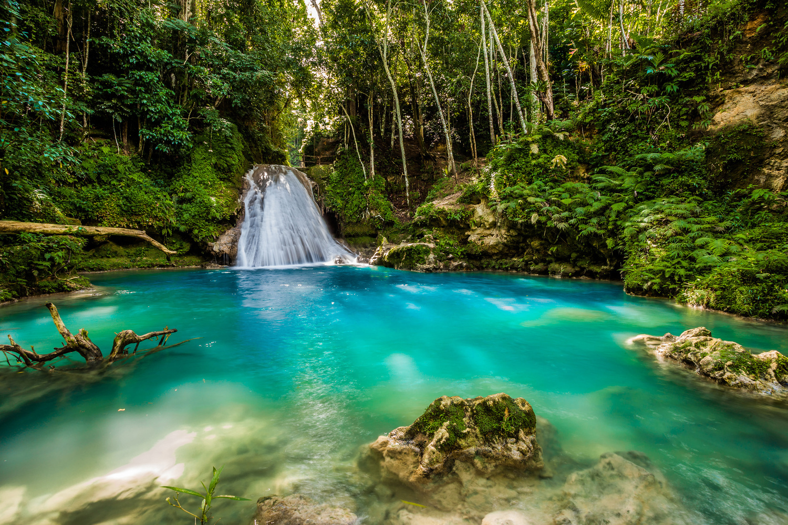
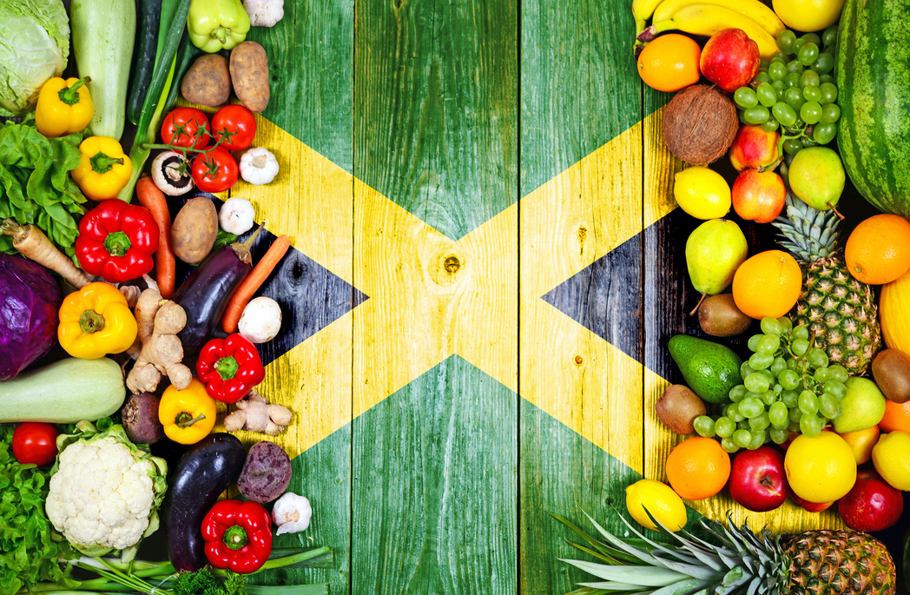
"Heartbeat of the World"
JAMAICA (2021 - PRE-PANDEMIC)
SOURCE: JAMAICA TOURIST BOARD

Slide 14
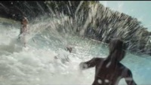
"Come Back"
JAMAICA (2022-CURRENT)
SOURCE: VISIT JAMAICA'S YOUTUBE CHANNEL

Slide 15
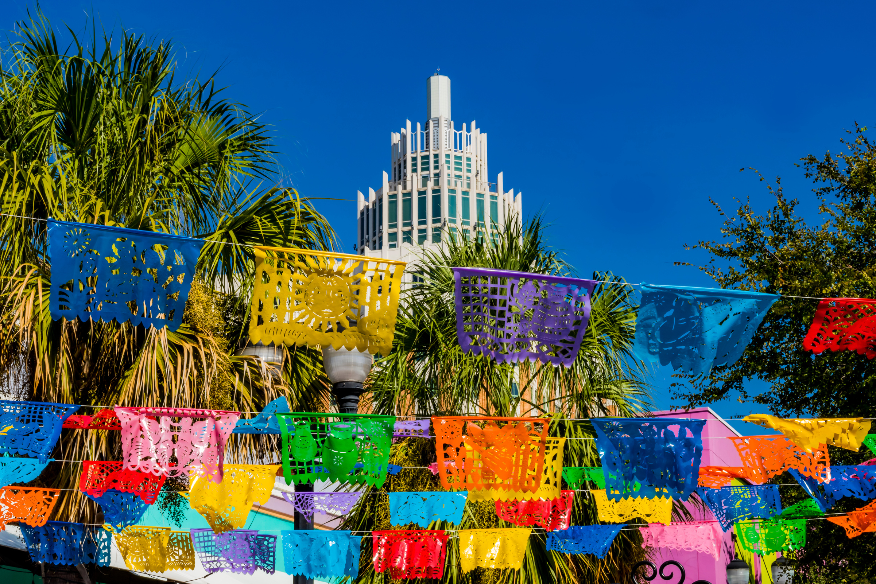

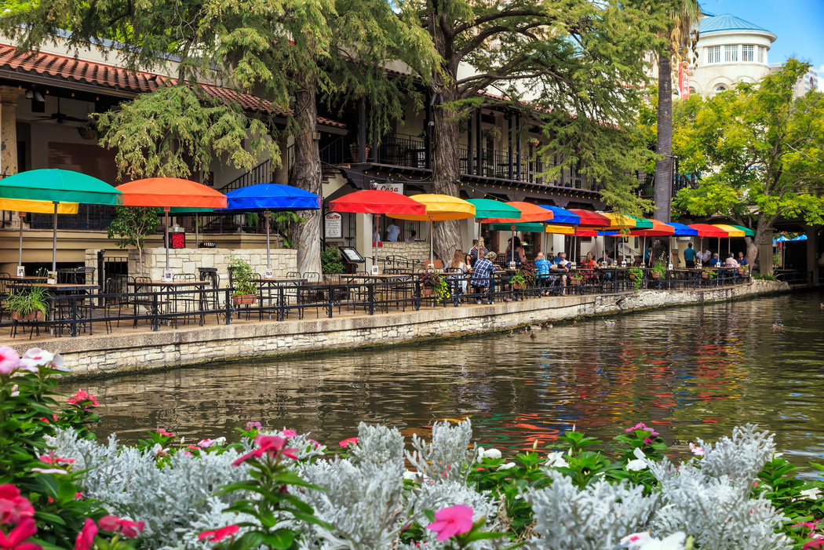
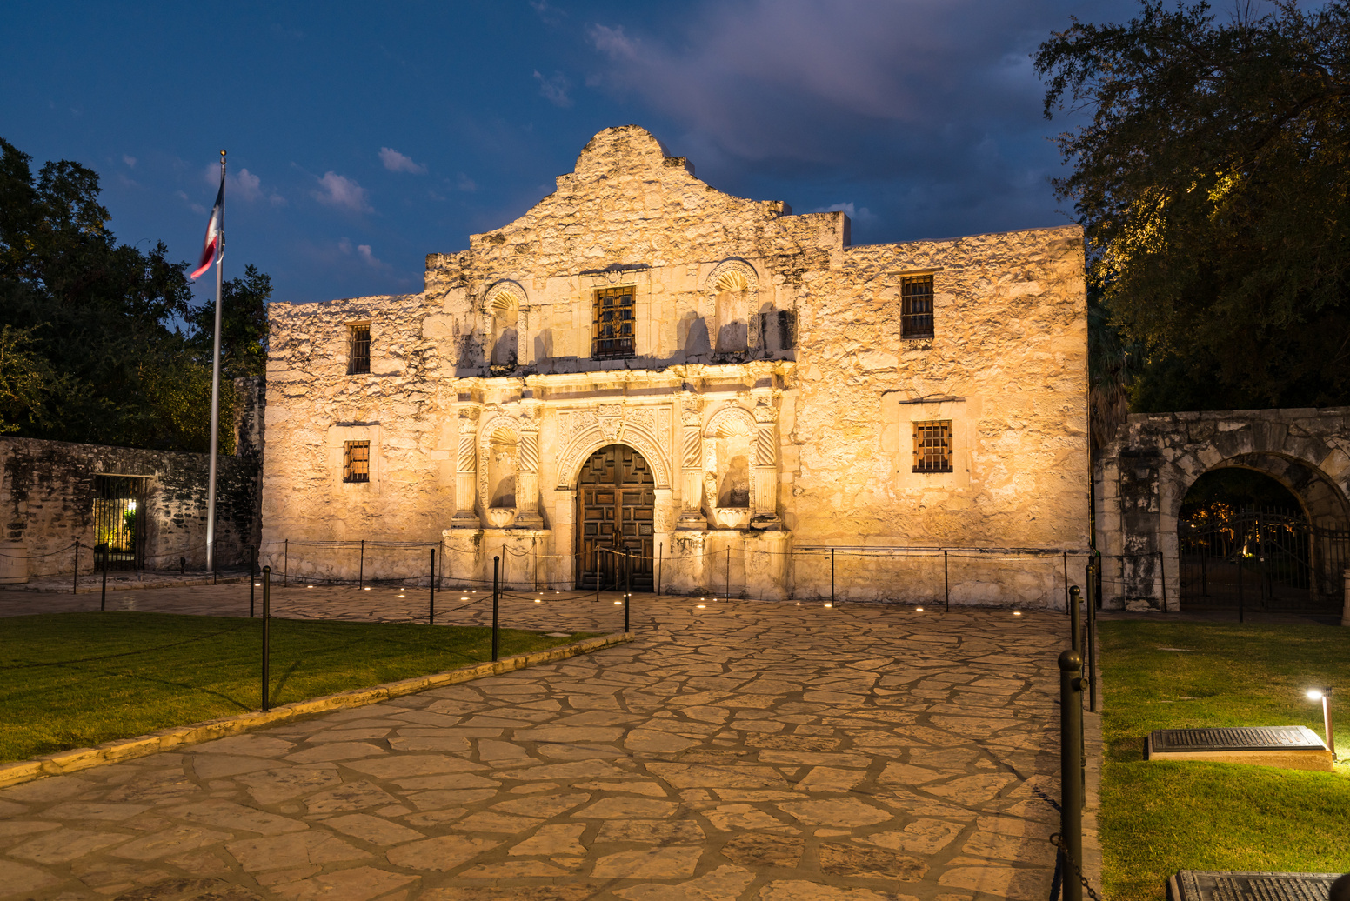
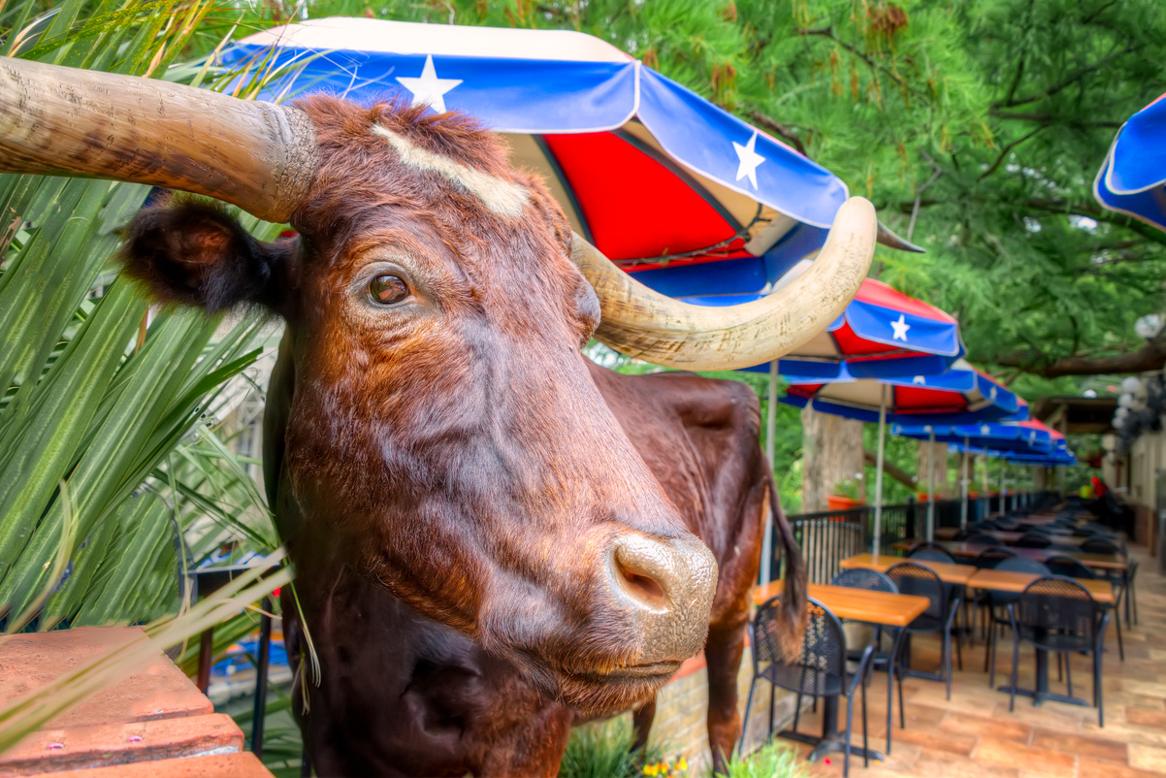
"Real and True"
SAN ANTONIO, TEXAS
SOURCE: VISIT SAN ANTONIO

Slide 16

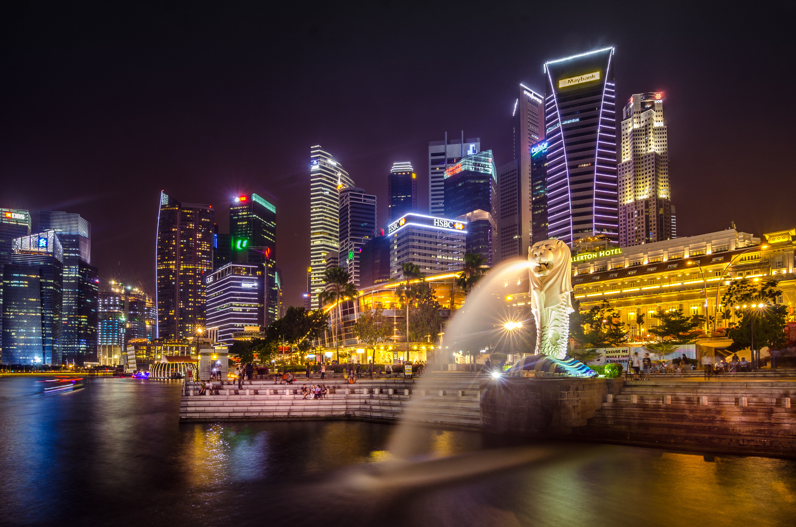
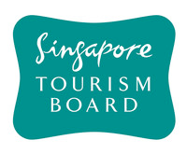
"Passion Made Possible"
SINGAPORE TOURISM TAGLINE
SOURCE: PR NEWSWIRE

Slide 17
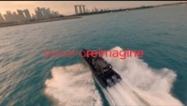
"Reimagine"
SINGAPORE TOURISM SLOGAN (2022 - PRESENT)
SOURCE: SINGAPORE TOURISM BOARD

Slide 18

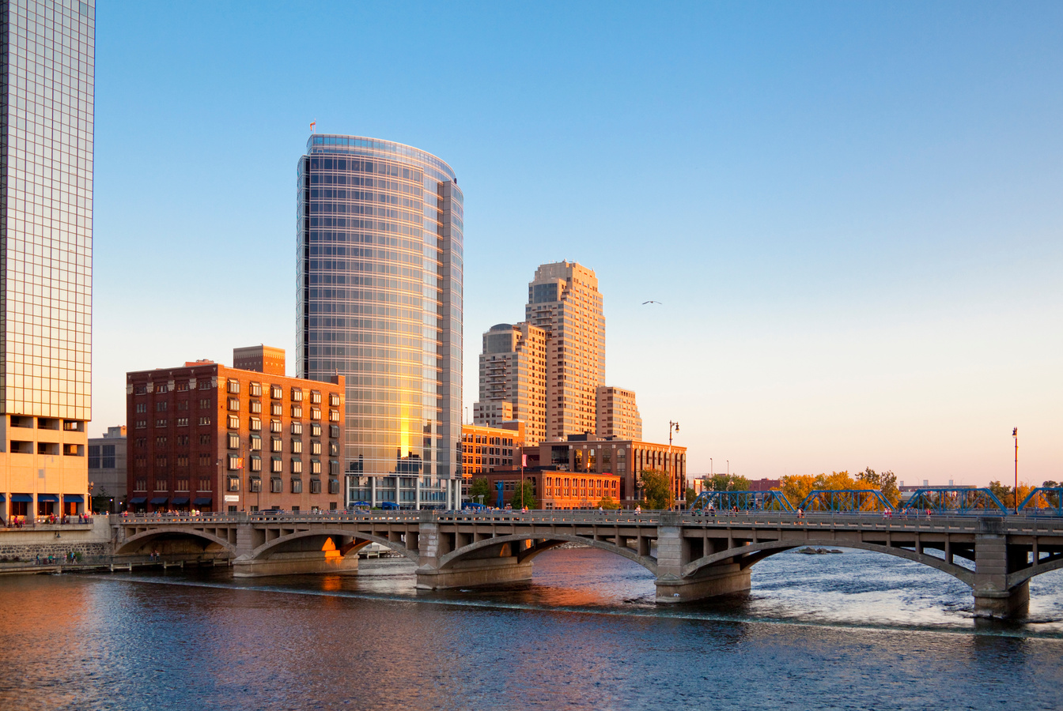

"Keep it Fresh"
MICHIGAN
SOURCE: PURE MICHIGAN
Travel Michigan, the state’s official tourism promotion office, launched a "Keep it Fresh" marketing campaign, designed to attract visitors through fresh travel perspectives. The campaign included three television commercials - “Fresh Voices”, “Fresh Air”, and “Fresh Path.”

Slide 19
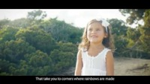
"Discover Our Way of Life"
IBIZA, SPAIN
SOURCES: TRAVEL PURSUIT,

Slide 20
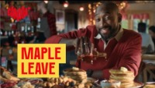

"Maple Leave"
CANADA
SOURCE: DESTINATION CANADA
Destination Canada launched a tourism campaign presenting Canada as a remedy for Americans who needed a break: Instead of taking “Sick Leave,” they encouraged them to take "Maple Leave."

Slide 21
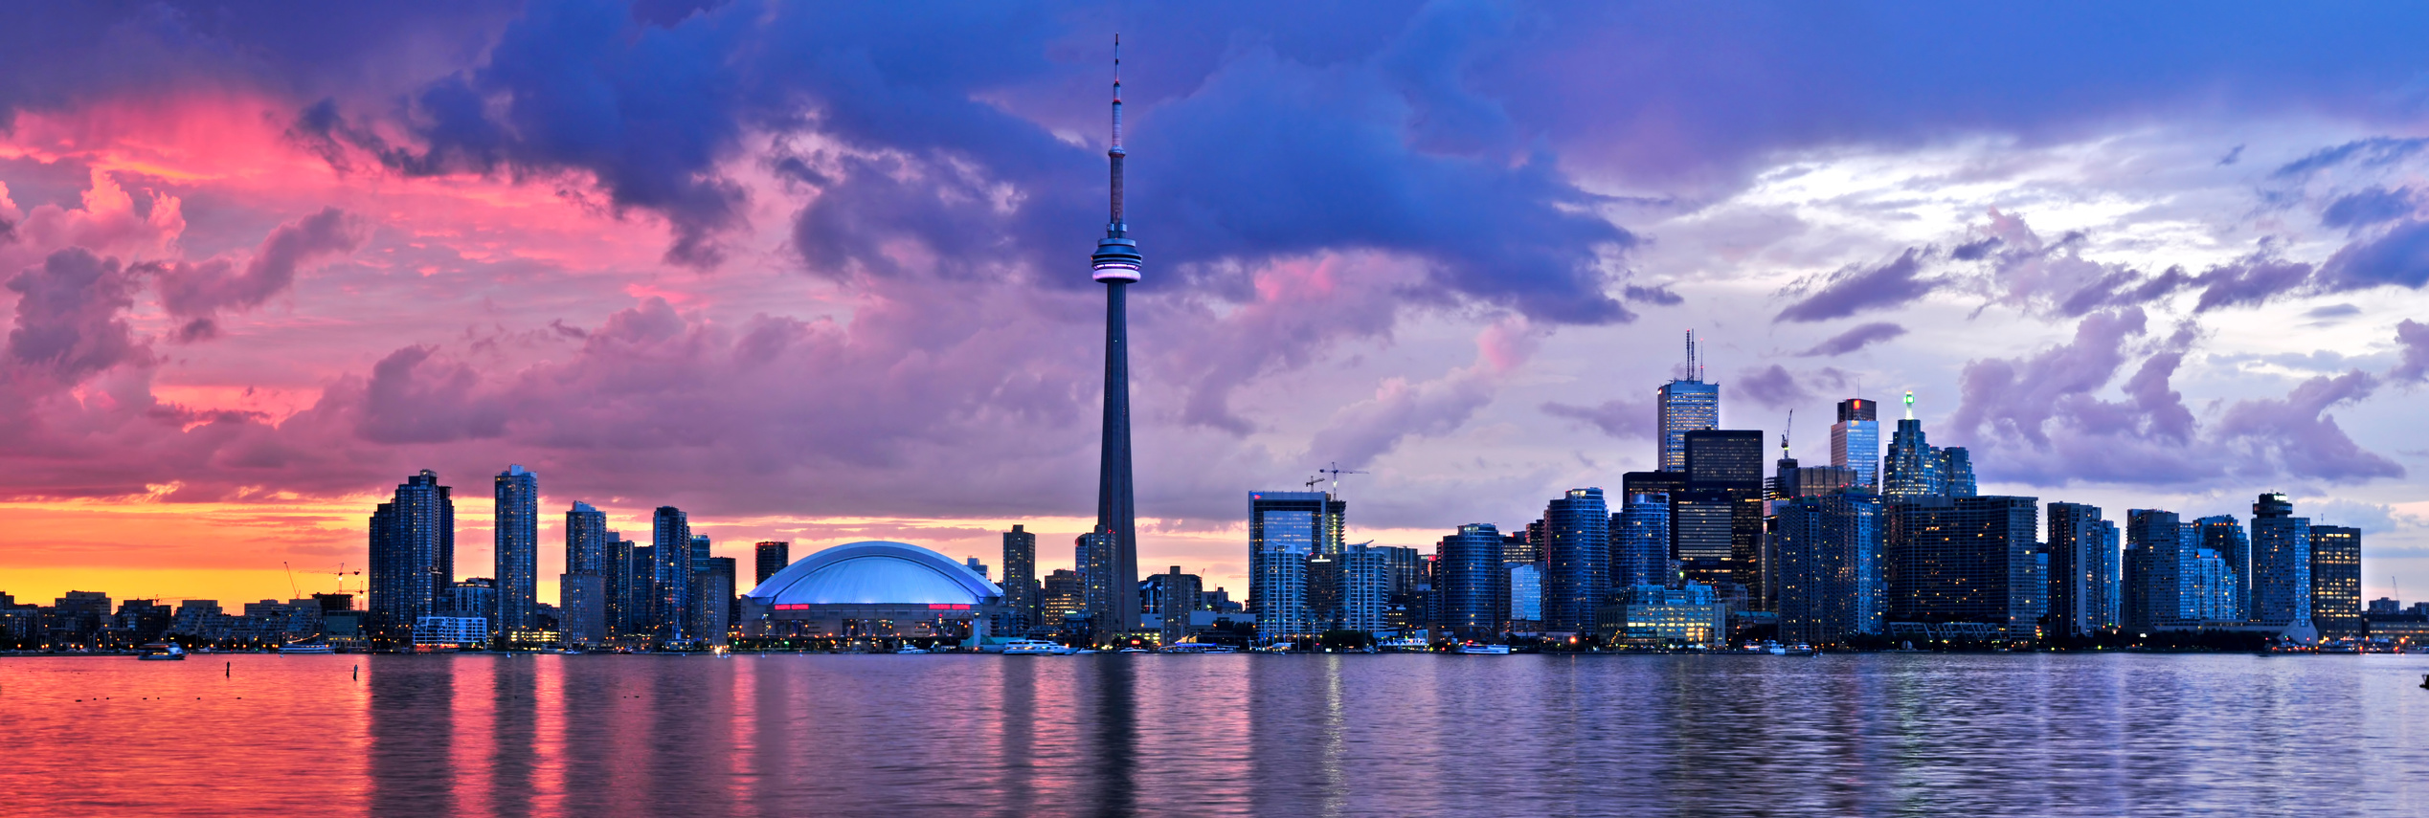

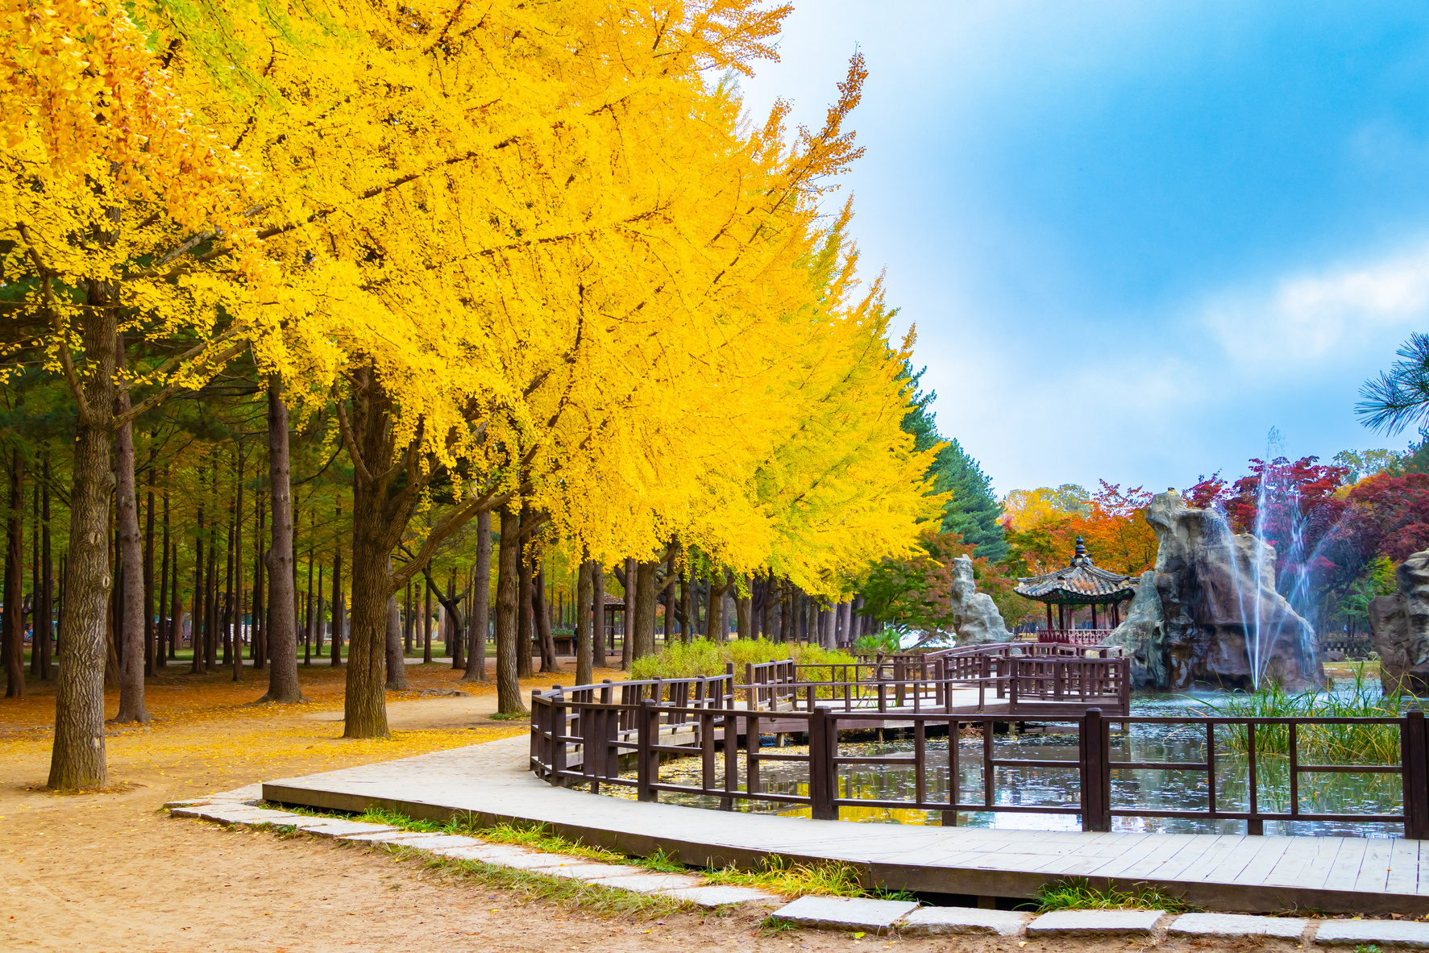
Marketing Insights from SCC
Discussion
  What is branding?
  What is a slogan?
  What is the difference between a slogan and a tagline?
  Why are slogans and taglines an important branding mechanism?
  Why are they important in marketing?
  What is positioning? Differentiation?
  How might a slogan or tagline reflect a business or brand's positioning or differentiation strategy?

Slide 22
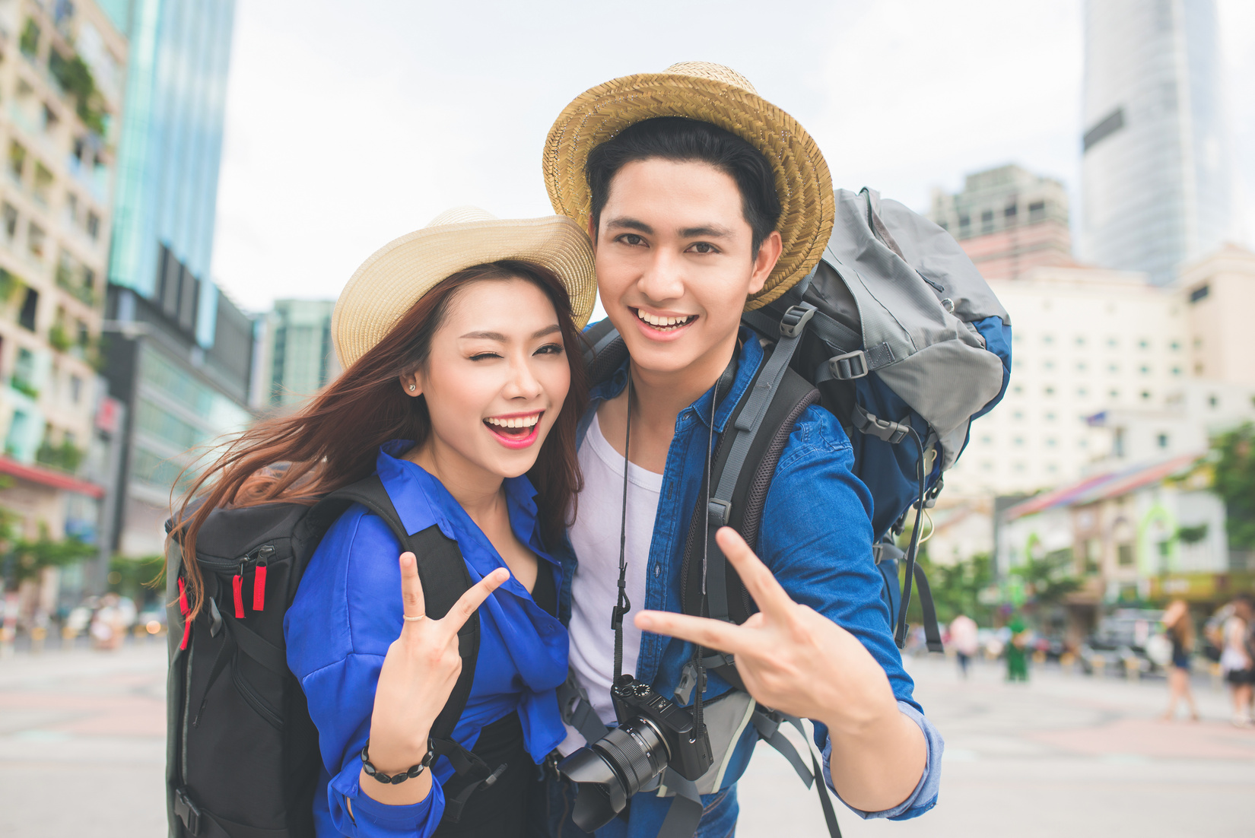



Marketing Insights from SCC
Activity Suggestion
Working in pairs or small groups, create a destination marketing campaign of your own, and be prepared to present your ideas in class. Be sure to include the following:
  Destination
  Segmentation strategy
  Slogan and/or tagline
  Positioning strategy
  Value proposition (why should travelers visit your destination and not somewhere else)
  Imagery highlighted as part of the campaign
  Explanation of how the area will benefit from an influx of tourists
  Description of campaign execution elements: Advertising? Social media? Paid search? Etc.

