Slide 1


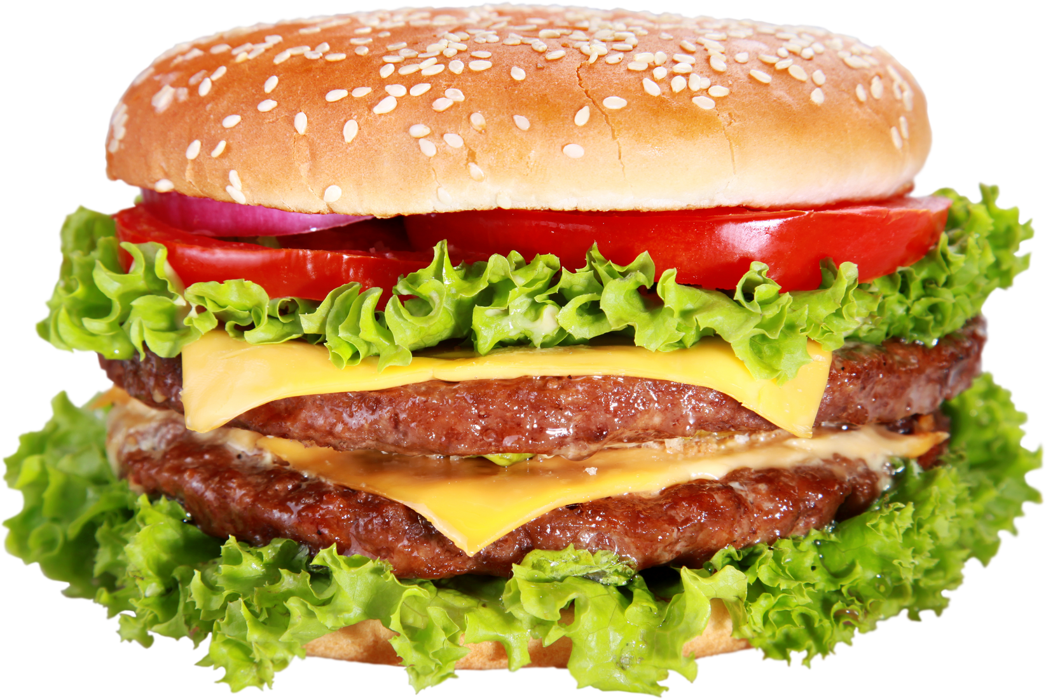

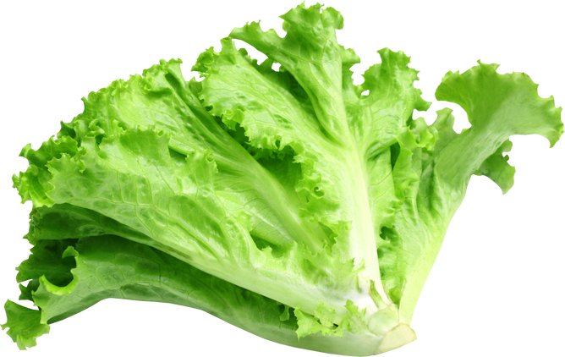

NATIONAL
CHEESEBURGER DAY
PROMOTIONS - SEPTEMBER 18

Slide 2
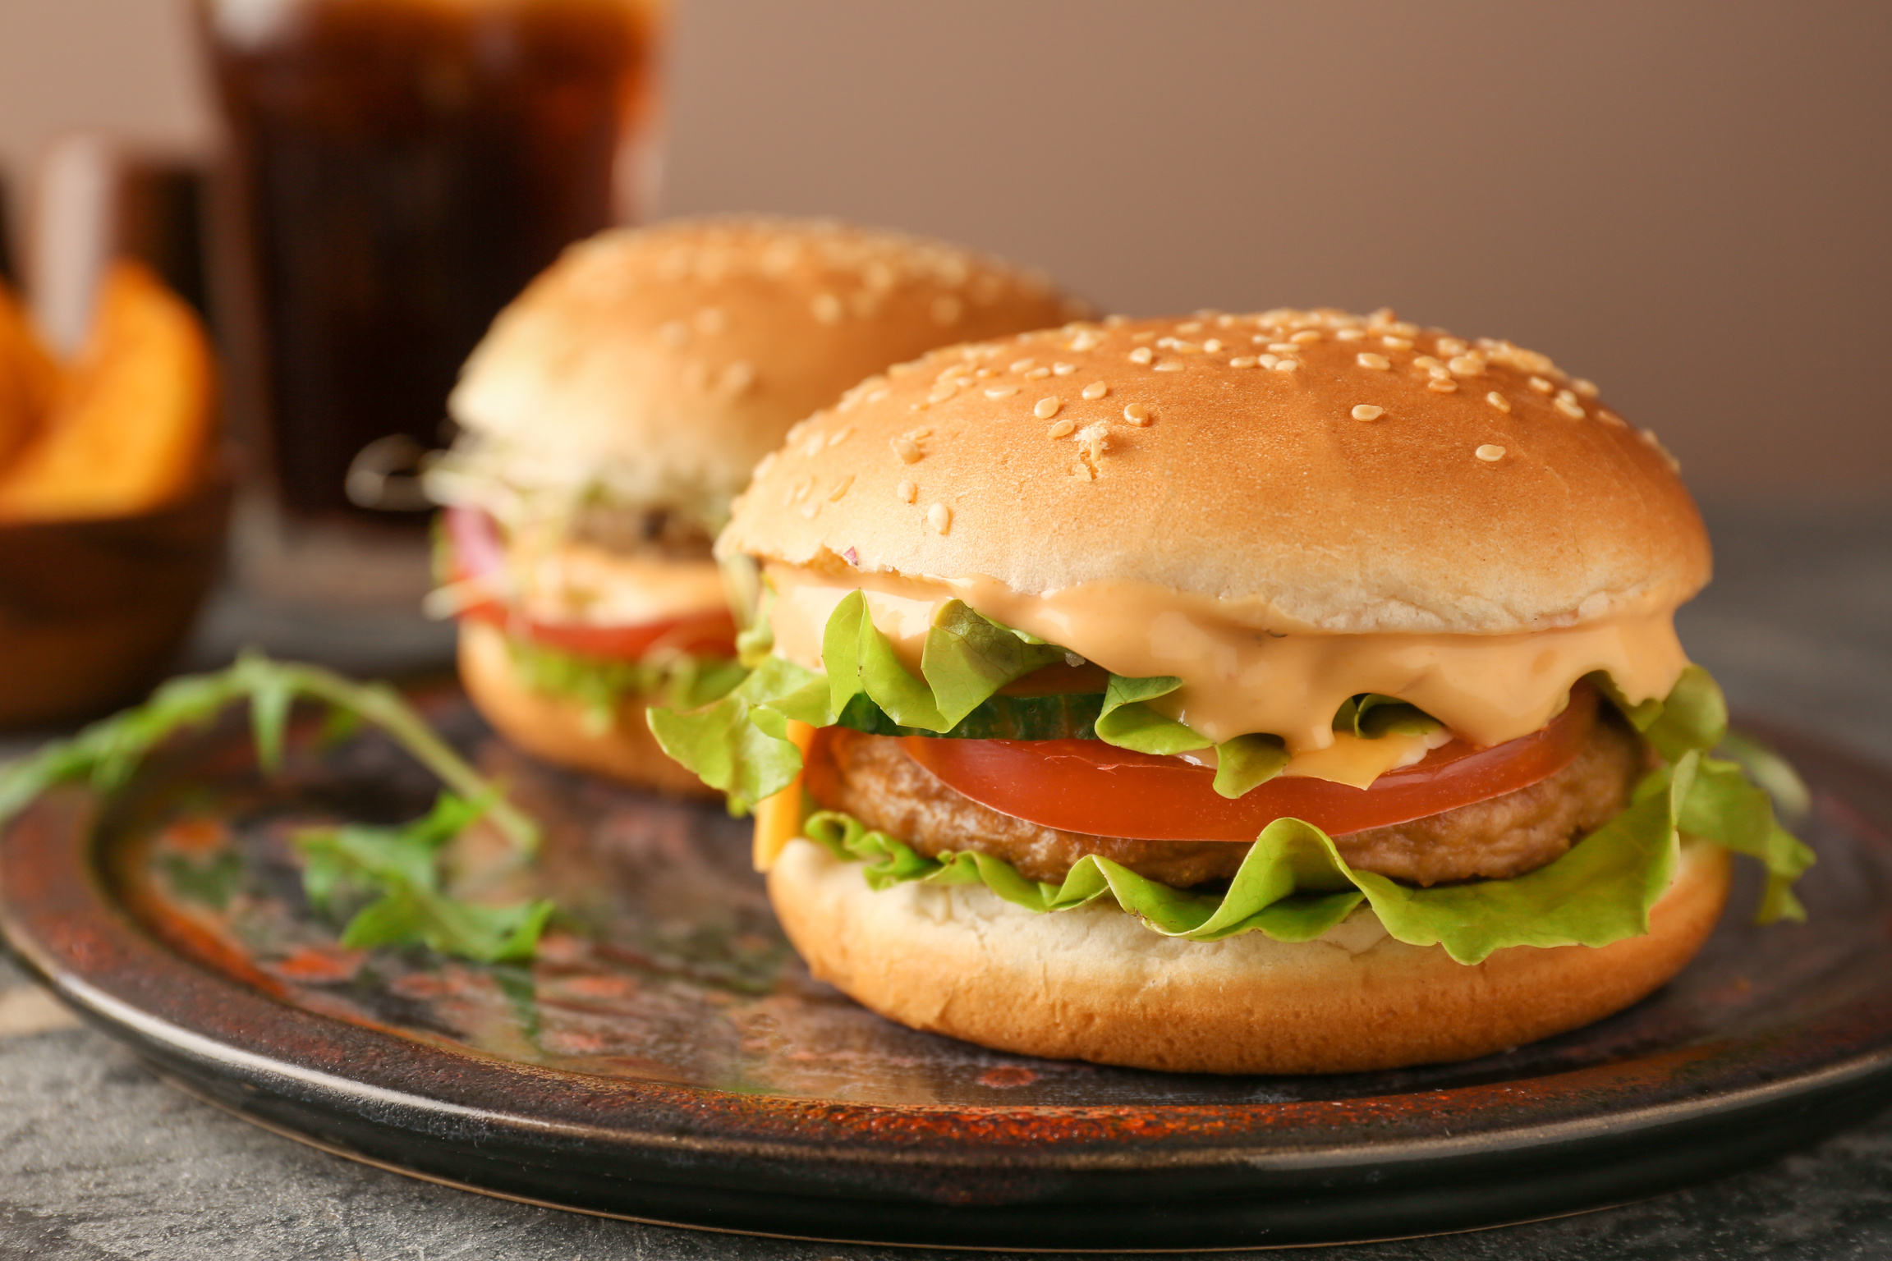

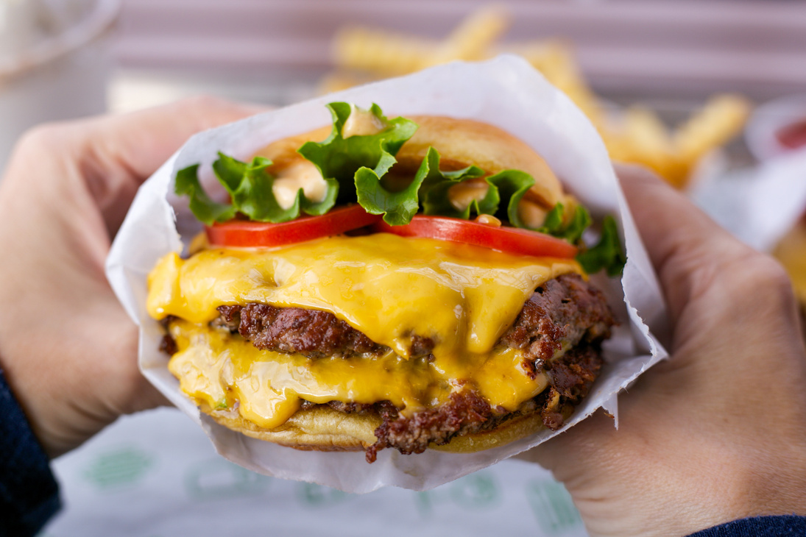
National Cheeseburger Day
National Cheeseburger Day
Promotions
Which Restaurant Chains offered National Cheeseburger Day deals in 2023?

Slide 3

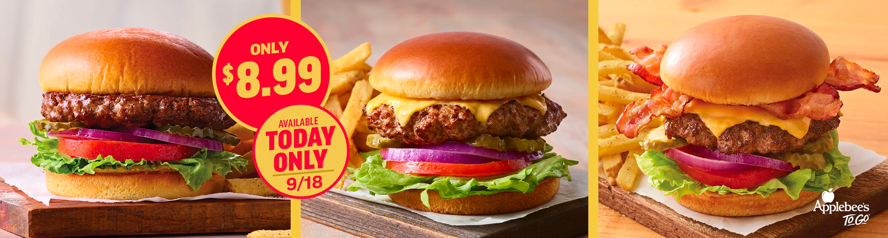
National Cheeseburger Day
2023 National Cheeseburger Day Deals
Applebees offered their Classic Burger, Classic Cheeseburger or the Classic Bacon Cheeseburger, paired with fries, for $8.99. The deal was available in-store, online and through the Applebee’s app.
Applebees

Slide 4
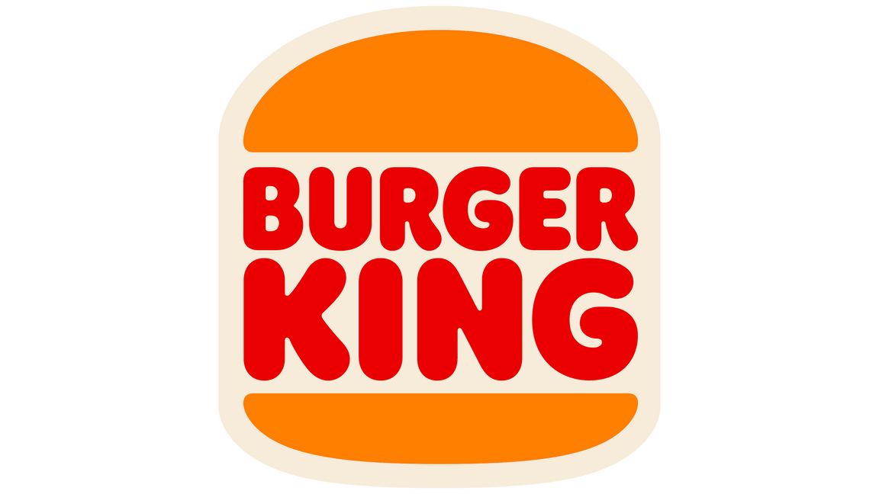
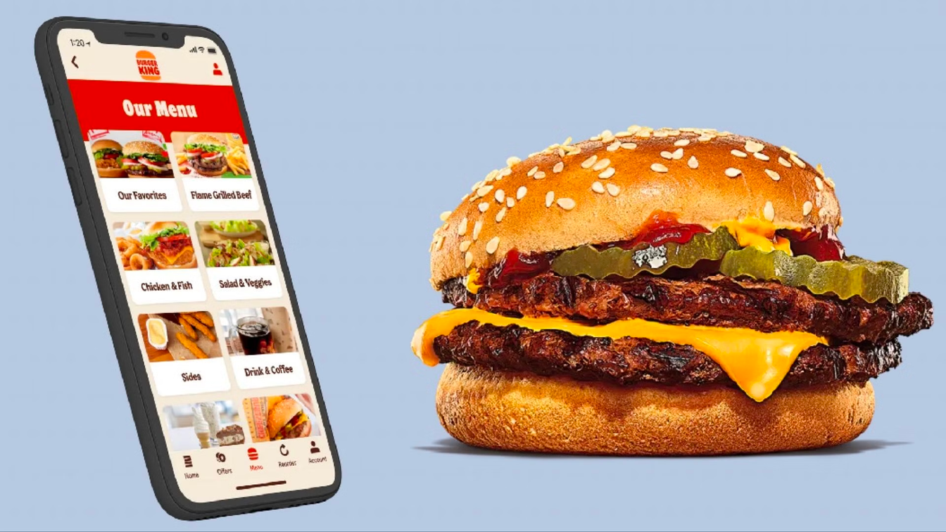
National Cheeseburger Day
2023 National Cheeseburger Day Deals
Burger King unveiled a week of deals and discounts for customers using their app and website, starting on National Cheeseburger Day, September 18, 2023.
September 18 - Free Cheeseburger*
September 19 - Free Whopper Jr.*
September 20 - Whopper Sandwich only for $3
September 21 - Whopper BOGO
September 22 - Free Onion Rings*
September 23 - Family Bundle for as low as $22.
September 24 - Double Crowns (customer loyalty rewards) on all online orders
*with minimum purchase of $1
Burger King

Slide 5

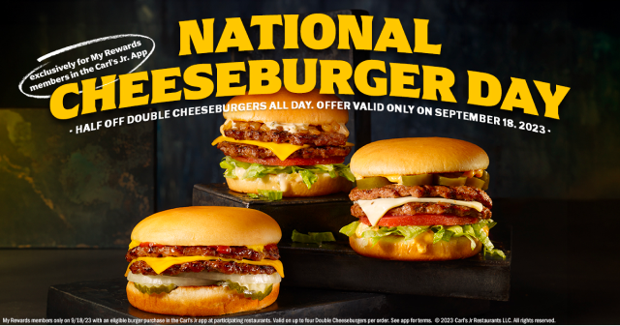
National Cheeseburger Day
2023 National Cheeseburger Day Deals
Carl’s Jr. offered half priced Double Cheeseburgers all day to customers who ordered through the restaurant’s app.
Carl’s Jr.

Slide 6
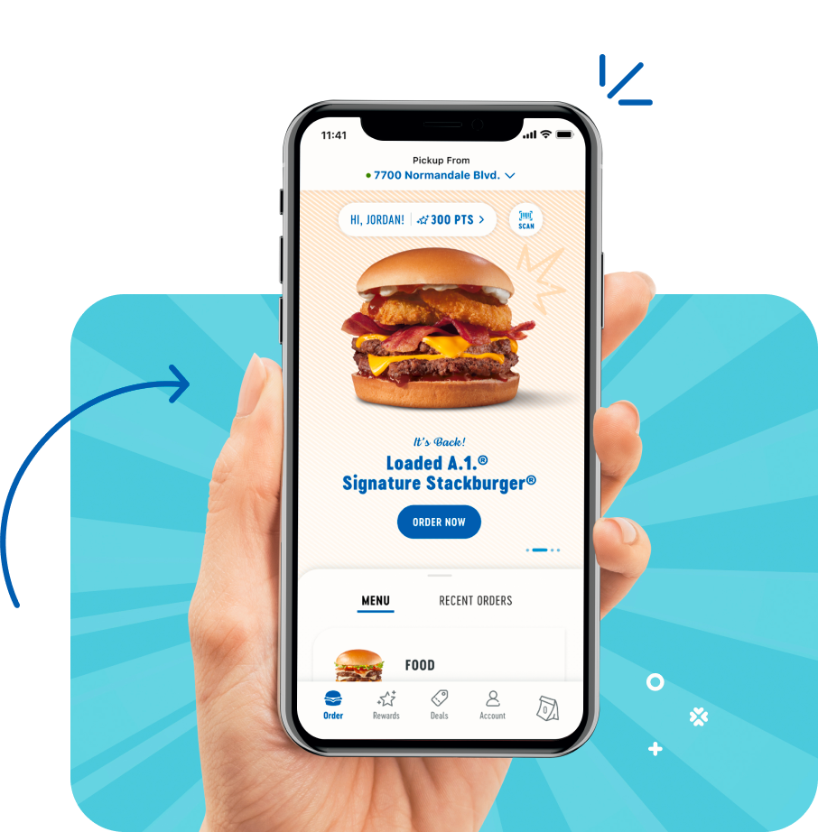
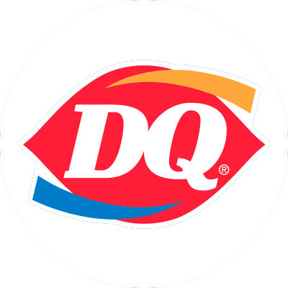
National Cheeseburger Day
Dairy Queen’s National Cheeseburger Day promotion — which was available in the restaurant’s app — included a free cheeseburger with an order of $1 or more, excluding tax. Free cheeseburgers were limited to one per customer.
Dairy Queen

Slide 7
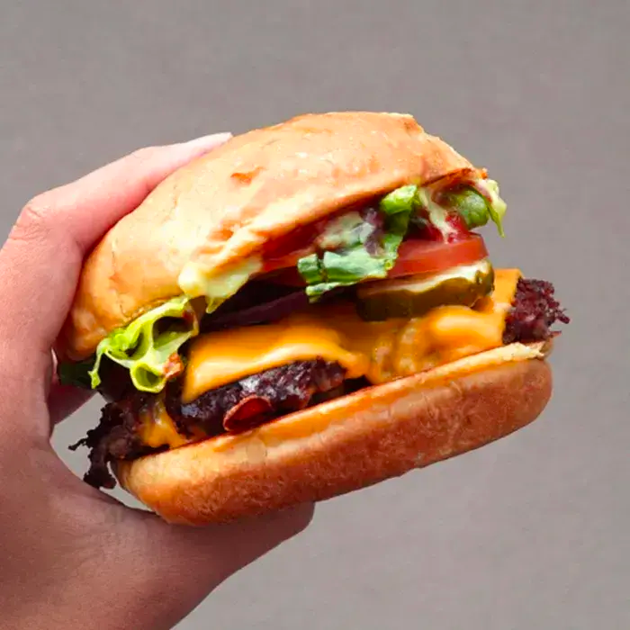

National Cheeseburger Day
2023 National Cheeseburger Day Deals
From Sept 18 - 20, Smashburger offered their Single Classic cheeseburger for just $5. Customers could redeem thie promotion with a checkout code.
Smashburger

Slide 8
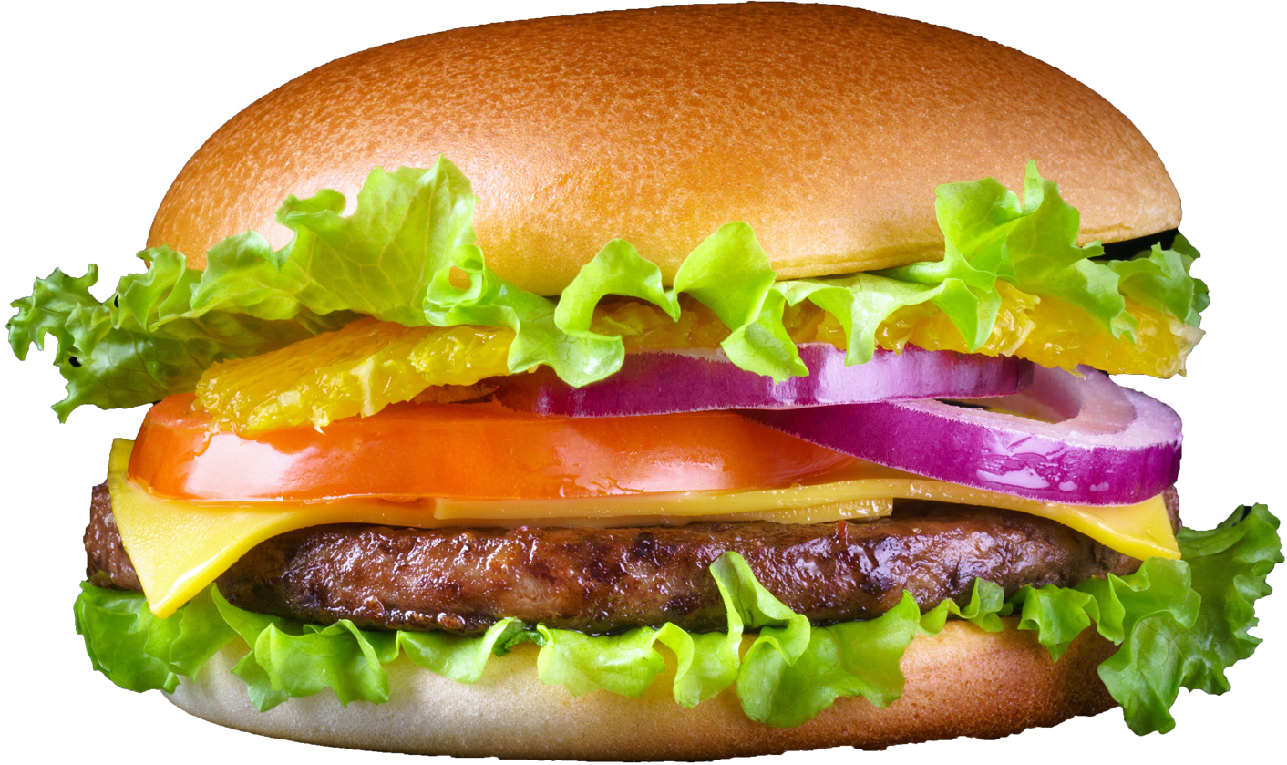

National Cheeseburger Day
2023 National Cheeseburger Day
When Technology Fails
Sometimes relying on technology to execute a promotion can result in unforeseen problems.
Two of the largest restaurant chains had their mobile apps crash due to the high volume of customers seeking National Cheeseburger Day deals.

Slide 9

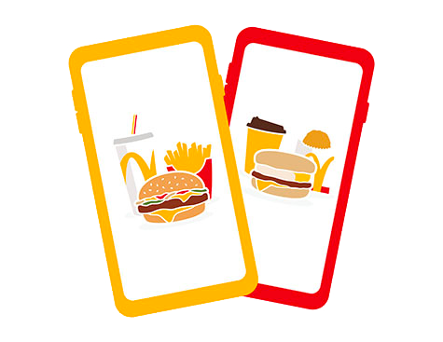
National Cheeseburger Day
2023 National Cheeseburger Day
When Technology Fails
McDonald’s ran a National Cheeseburger Day promotion that lowered the price of their Double Cheeseburger to just 50 cents. A high volume of deal-seeking customers crashed the McDonald’s app trying to access the promotion.

Slide 10
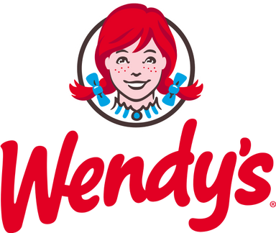
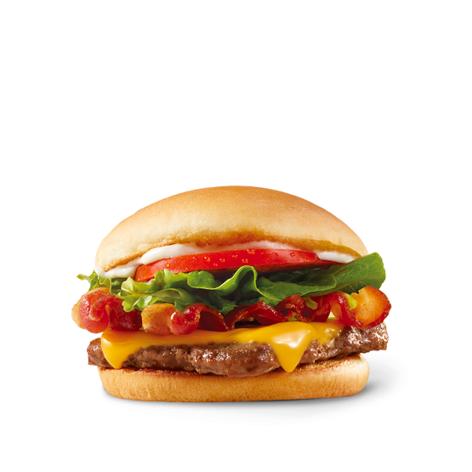
National Cheeseburger Day
2023 National Cheeseburger Day
When Technology Fails
For National Cheeseburger Day, Wendy’s ran a promotion that lowered the price of their Jr. Bacon Cheeseburgers to just 1 cent. The promotion was only available on the fast-food chain’s rewards app and on their website. Customers crashed the Wendy’s app trying to access the deal.

Slide 11
National Cheeseburger Day
DISCUSSION QUESTIONS
  What is promotion?
  Why do businesses and brands engage in promotion?
  What are the different types of promotion?
  What is a “BOGO” promotion?
  What is the goal of a sales promotion?
  What is digital marketing?
  Why do you think several burger chains featured in this presentation tied their National Cheeseburger Day promotions to their app?
  Do you think Wendy’s or McDonald’s considered their National Cheeseburger Day promotions to be a failure when the app crashed? Why or why not?
  Why do you think “holidays” National Cheeseburger Day exist?
  Did you see any other examples of National Cheeseburger Day promotions that weren’t discussed in this presentation deck?

Slide 12
National Cheeseburger Day
ACTIVITY SUGGESTION
  Break classroom into pairs or groups.
  Have each group select from the following burger or casual dining chains: Shake Shack, Five Guys, Culver’s, White Castle, Whataburger, Sonic, Jack in the Box, Hardee’s, Checkers, Chili’s, TGI Friday’s, Red Robin, Fuddruckers, or Buffalo Wild Wings. If possible, have each group choose a different chain.
  After choosing a chain, each group will create a National Cheeseburger Day promotion.
  Each group will present their promotion ideas in class, making sure to address the following:
    Description of the ways the promotion will be communicated to customers (online, advertisements, social media, digital, etc.)
    Explanation of how customers will redeem the offer (coupon, redemption code, app, etc.)``
    Details of how the chain will benefit from the promotion
    Explanation of how (or if) the chain can expect to see an increase in brand loyalty as a result of the promotion and why that might be important
    Inclusion of a sketch or other graphic illustrating a sample of the promotion

Slide 13
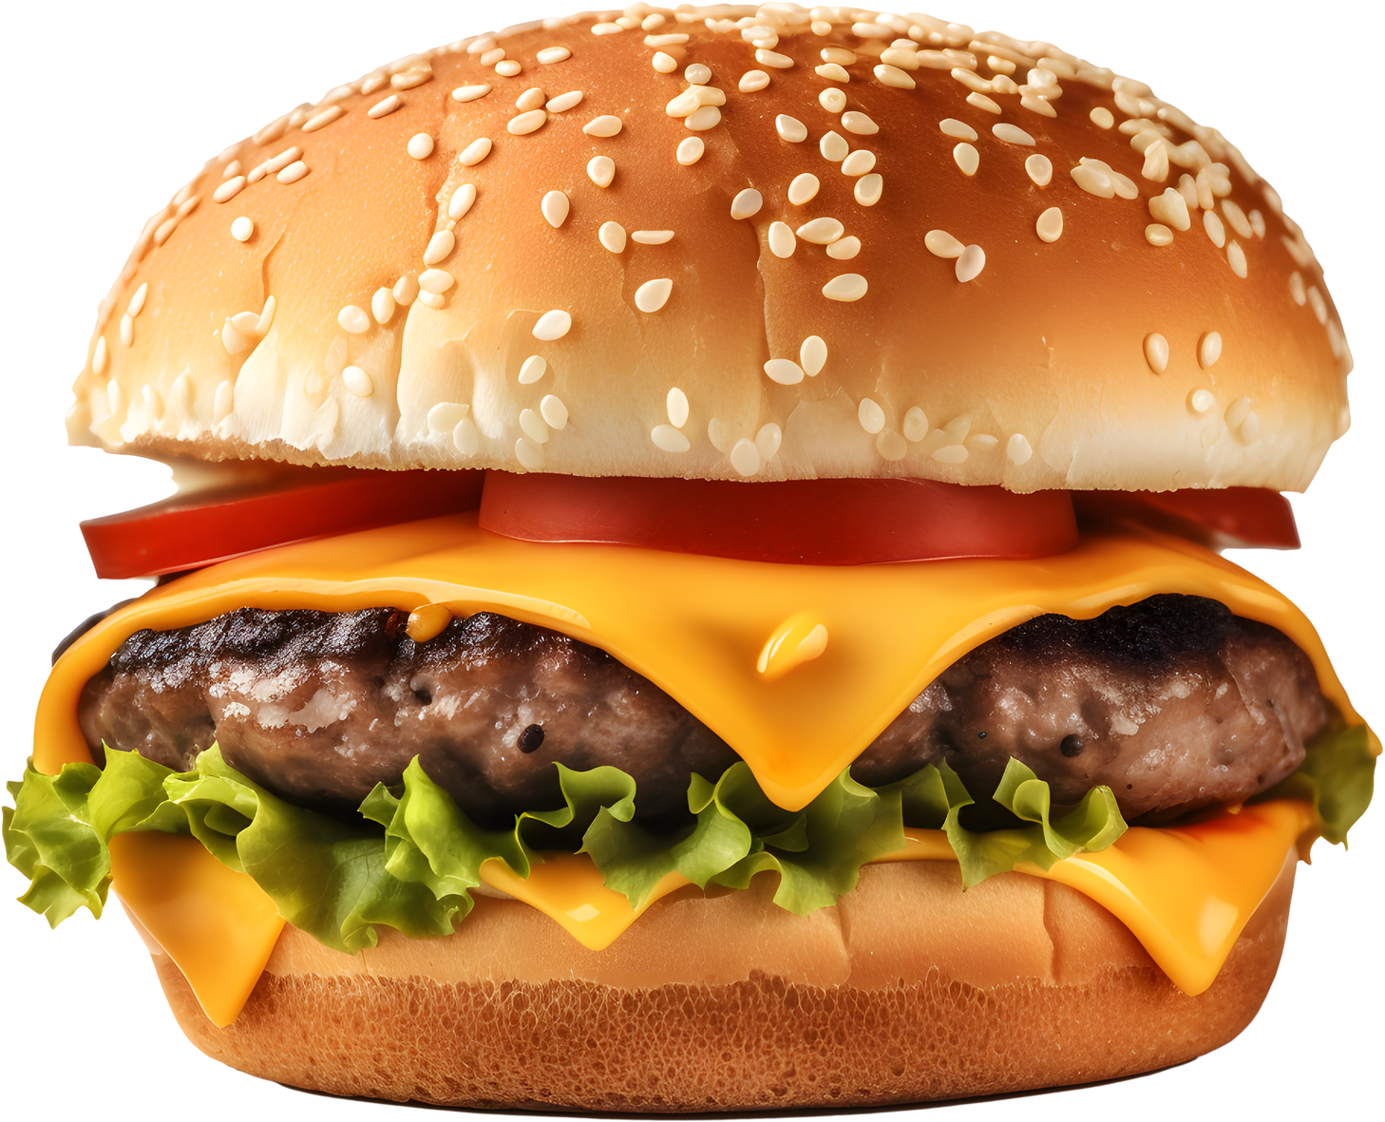
National Cheeseburger Day
SOURCES
https://deseret.com/2023/9/18/23878898/national-cheeseburger-day-2023-best-deals-free-cheeseburgers
https://today.com/food/restaurants/burger-king-free-cheeseburgers-national-cheeseburger-day-rcna105360
https://yahoo.com/lifestyle/mcdonald-wendy-botched-national-cheeseburger-172818673.html
https://applebees.com
https://burgerking.com
https://carlsjr.com
https://dairyqueen.com
https://smashburger.com
https://mcdonalds.com
https://wendys.com

