Slide 1
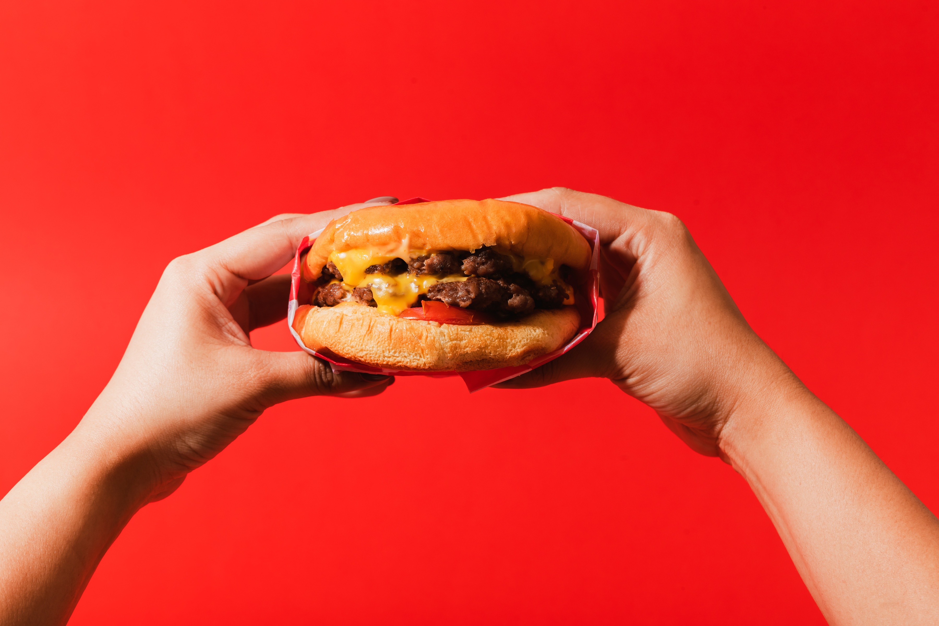


NFL CONCESSIONS
2023-24 MENUS

Slide 2
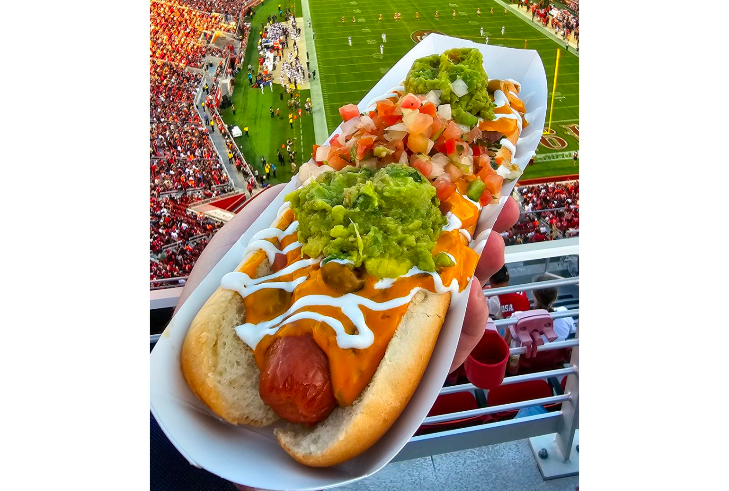
New NFL Concession Items
2023-24
Concessionaires (the companies that manage food and beverage services inside NFL stadiums) update food and drink menus each year with unique items to help attract customers. The three largest concessionaires are Delaware North, Levy, and Legends Hospitality. These types of companies also represent opportunities to work in the sports industry!
Here is a look at some of the new concessions items for the 2023-24 NFL season.

Slide 3
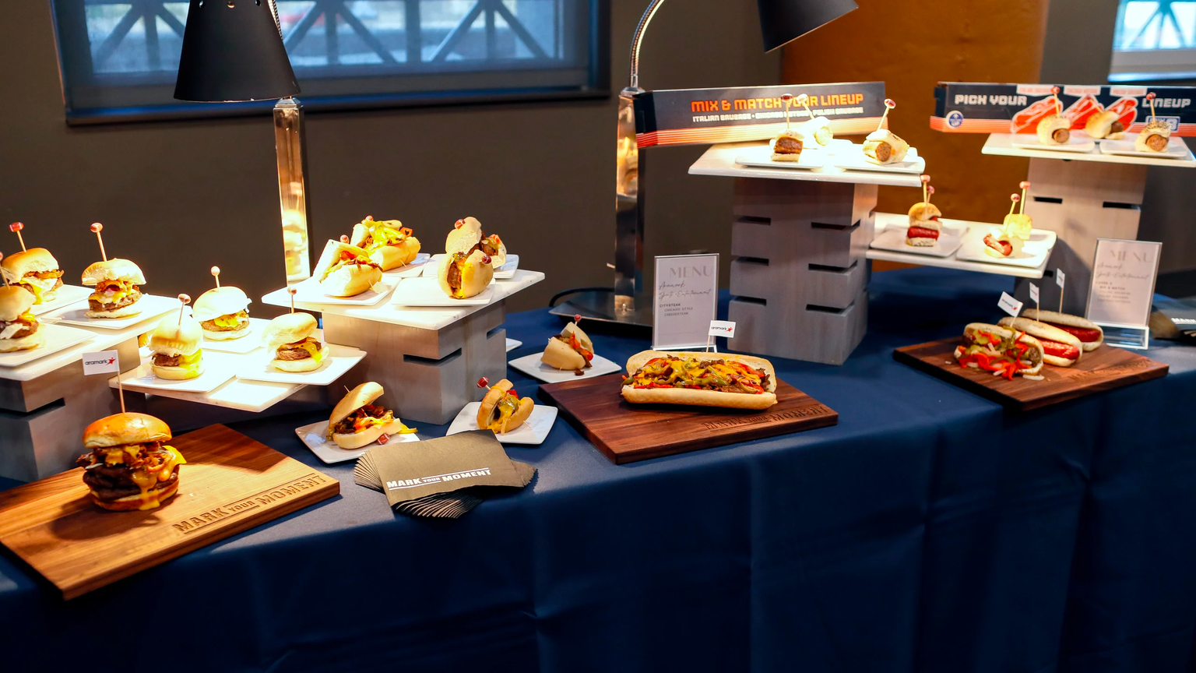
Chicago Bears
Tasting Event
"Today is a great event for a lot of different reasons—not only about highlighting and showcasing what Aramark is doing on the food and beverage side, but also being able to talk about the overall gameday experiences for fans."
Lee Twarling
Bears Senior Vice President of Sales and Customer Relations
The Chicago Bears partnered with concessionaire Aramark Sports + Entertainment to host a tasting event at Soldier Field in Chicago the week prior to the 2023 home season opener.
The tasting event, which returned for the first time since 2019, introduced the stadium's new food and beverage items.
Chicago Bears / Aramark

Slide 4
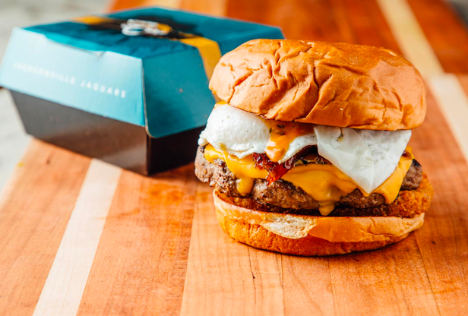
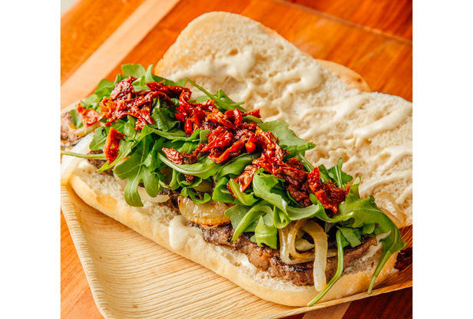
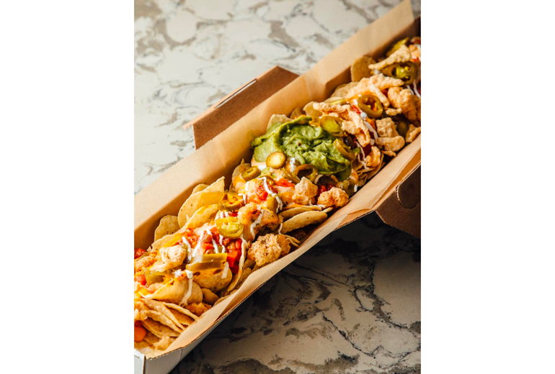
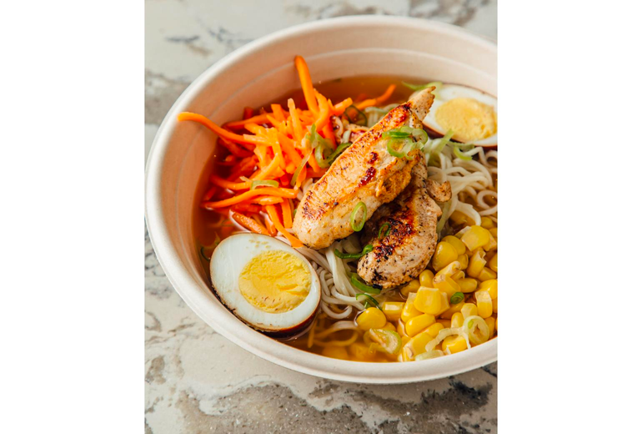
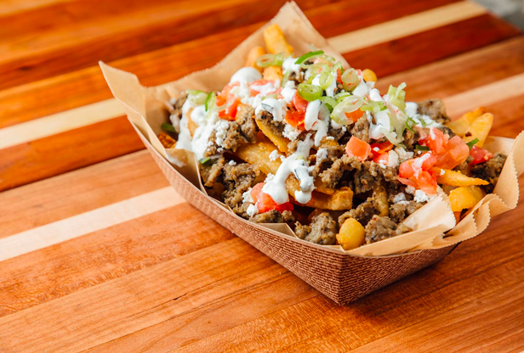
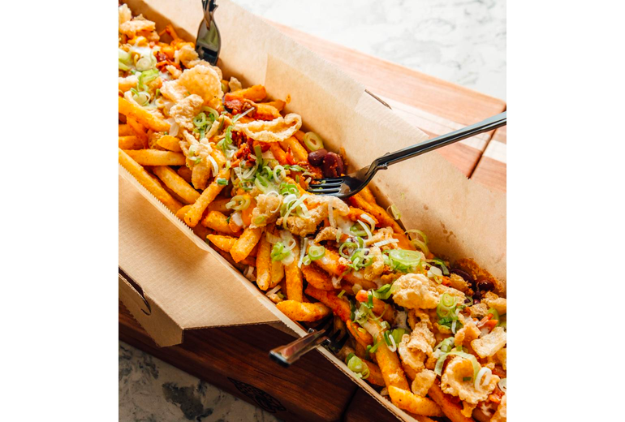
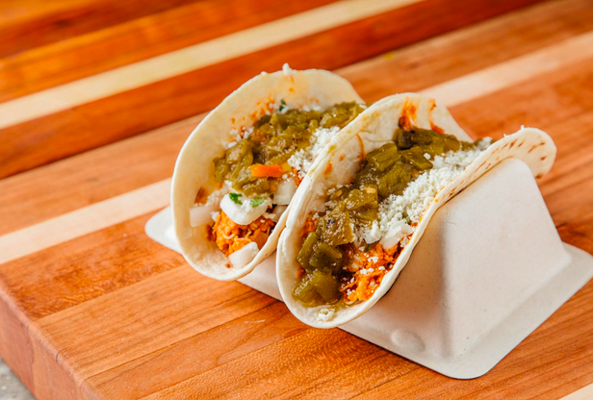

Breakfast Burger
Burger topped with a hash brown, cheese, fried egg, bacon jam and burger sauce, served on a brioche bun.
Ribeye Sandwich
Served with fresh arugula, house-made sun-dried tomato confit and a horseradish drizzle on a ciabatta bun.
2nd & Long Fries
Fries topped with zesty Cajun seasoning, chili, cheese, bacon bits, pork rind crumble, and a drizzle of cilantro ranch, garnished with scallions.
Jacksonville Jaguars
Everbank Stadium
Jacksonville, FL
Chicken Ramen Bowl
Includes two grilled chicken breast skewers, noodles, sliced mushrooms, roasted corn and shredded carrots in a savory miso broth.
Concessionaire: Delaware North
2nd & Long Nachos
Tortilla chips topped with shredded spicy chicken tinga and barbacoa beef, shredded cheese, roasted green chile, tomato salsa, jalapeños, sour cream, guacamole and a pork rind crumble.
Mediterrean Fries
Crispy French fries topped with diced gyro meat, feta cheese crumble, sliced black olives and a drizzle of Tzatziki sauce.
Chicken Tinga Tacos
Spicy shredded chicken, onion, cilantro, cotija cheese and a drizzle of roasted green chile.

Slide 5
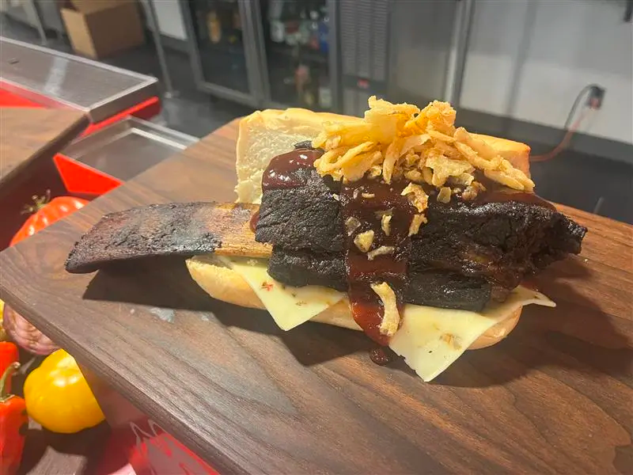
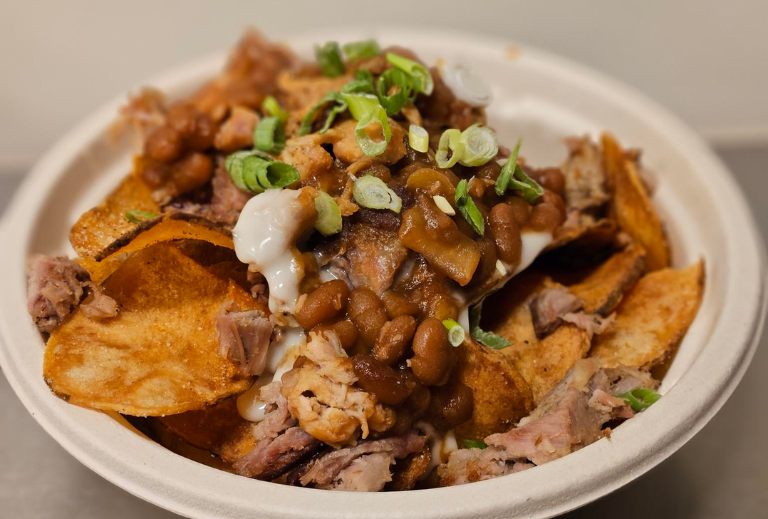
Bone-In Beef Short Rib Sandwich
Tender short rib sandwich paired with pepper jack cheese, crispy onion straws and spicy BBQ sauce. This sandwich is an experience: Fans pull out the short rib bone causing the tender meat to fall into the roll.
Kansas City Chiefs
GEHA Field at Arrowhead Stadium
Kansas City, MO
Concessionaire: Levy
Loaded BBQ Nachos
House-made kettle chips are topped with BBQ pulled pork, baked beans, melted white cheddar cheese and scallions.

Slide 6
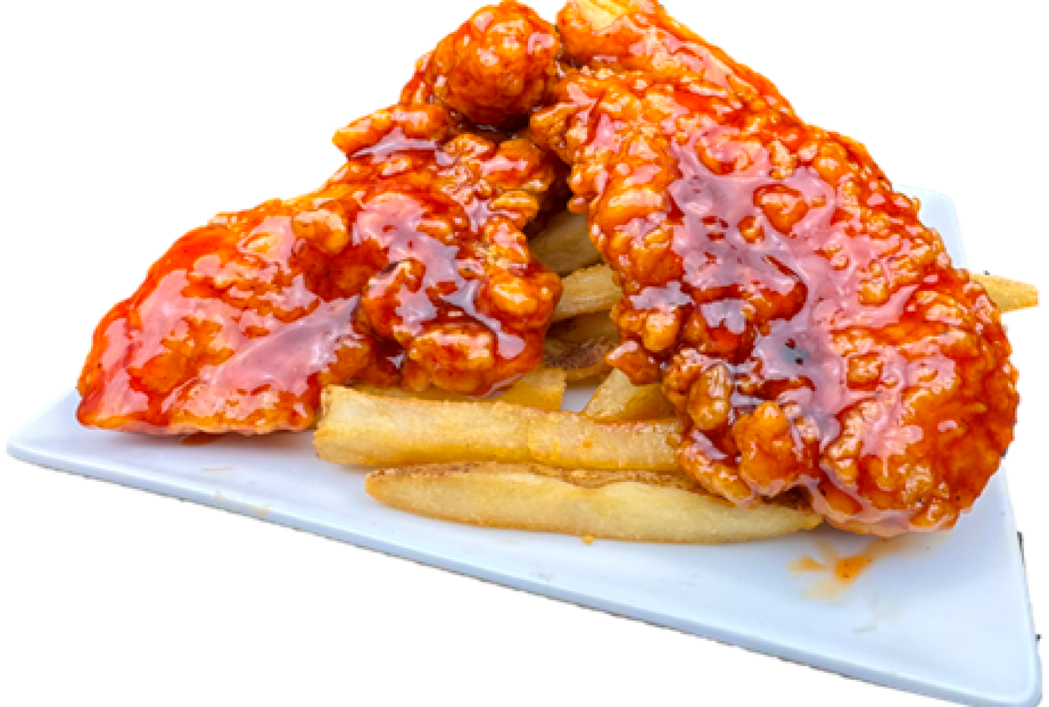
Tossed Tenders
Chicken tenders tossed in choice of sauce including Buffalo, Parmesan garlic or bourbon BBQ (pictured).
Houston Texans
NRG Stadium
Houston, TX
Concessionaire: Aramark

Slide 7
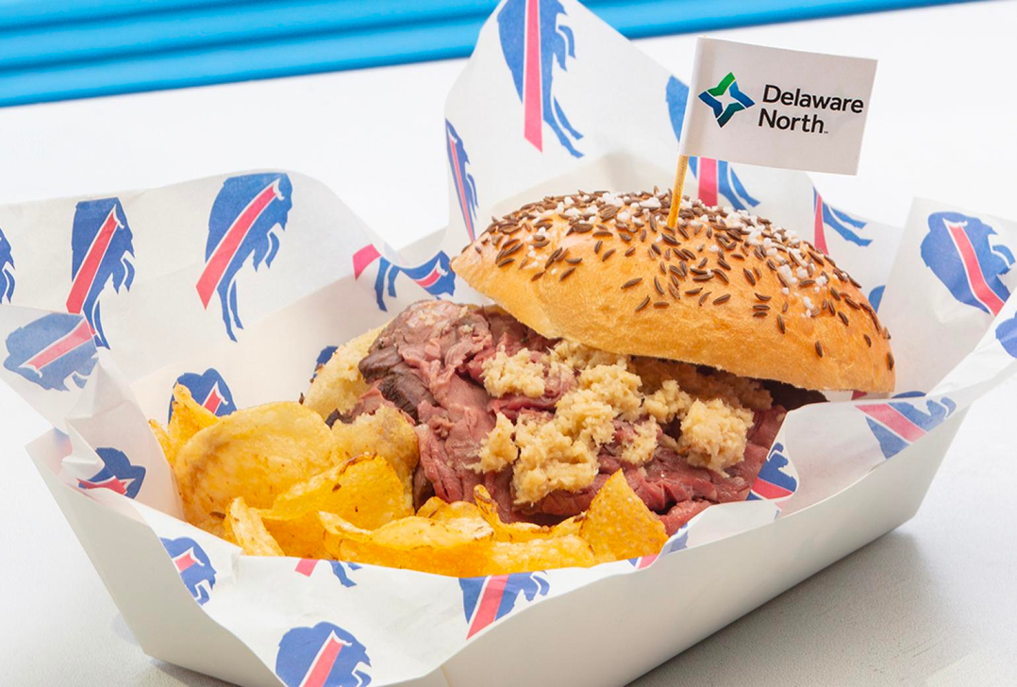
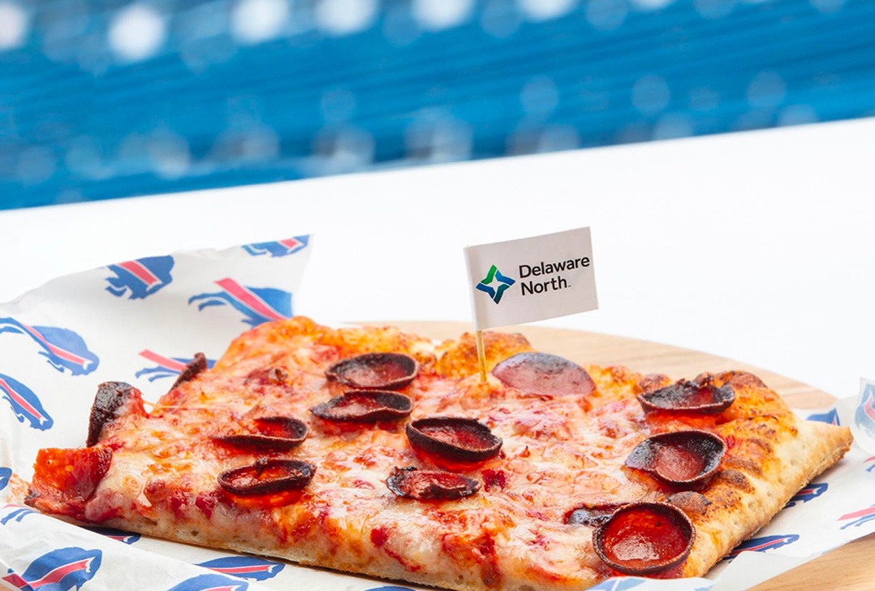
Beef on Weck
The quintessential Buffalo Beef on Weck sandwich features hand-carved, house-roasted top round beef served on a Wegman’s fresh-baked weck roll with complemented by horseradish and a pickle spear. For an even more indulgent option, the Queen City Weck features double-sized, hand-carved top round topped with horseradish fondue, crispy onions and jus.
Buffalo Bills
Highmark Stadium
Buffalo, NY
Concessionaire: Delaware North
Joey T’s Pizza
Traditional Buffalo-style Joey T’s Pizza is loaded with shredded mozzarella and cup-and-char pepperoni.

Slide 8
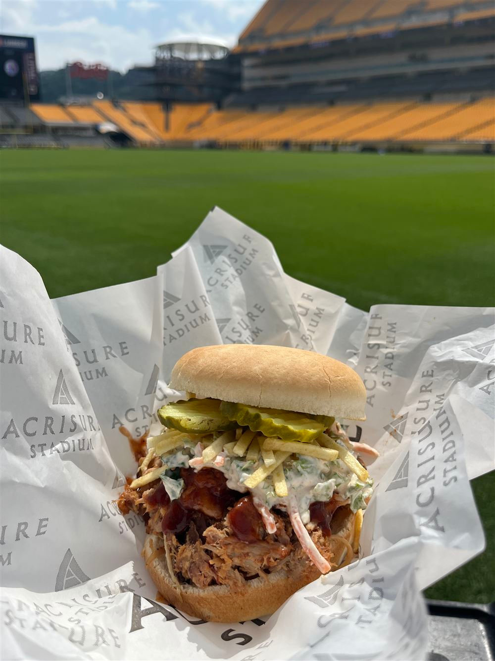
Barbeque Pulled Pork Sandwich
Piled high pulled pork is topped with coleslaw and crunchy potato sticks.
Pittsburgh Steelers
Acrisure Stadium
Pittsburgh, PA
Concessionaire: Aramark

Slide 9
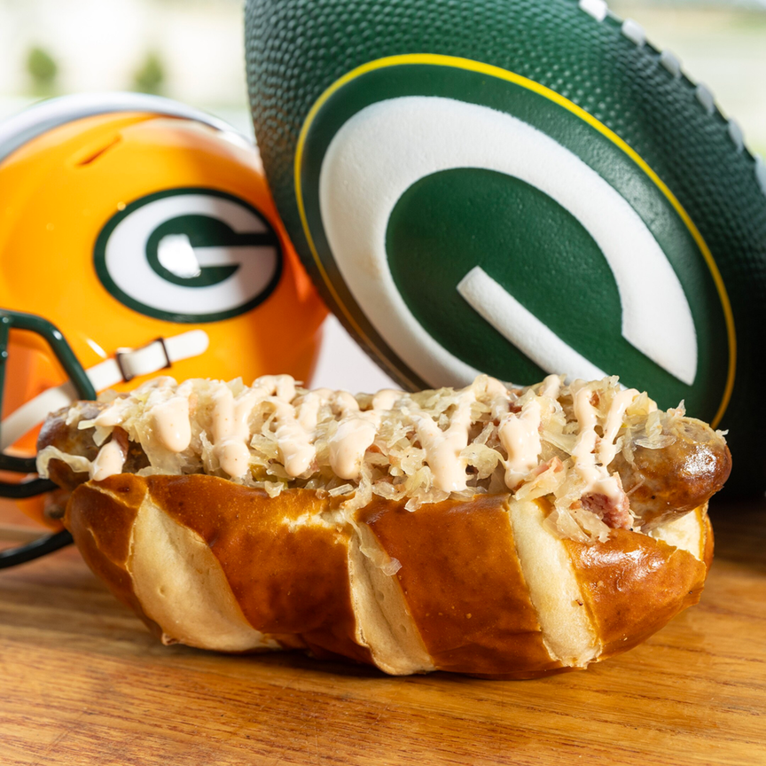
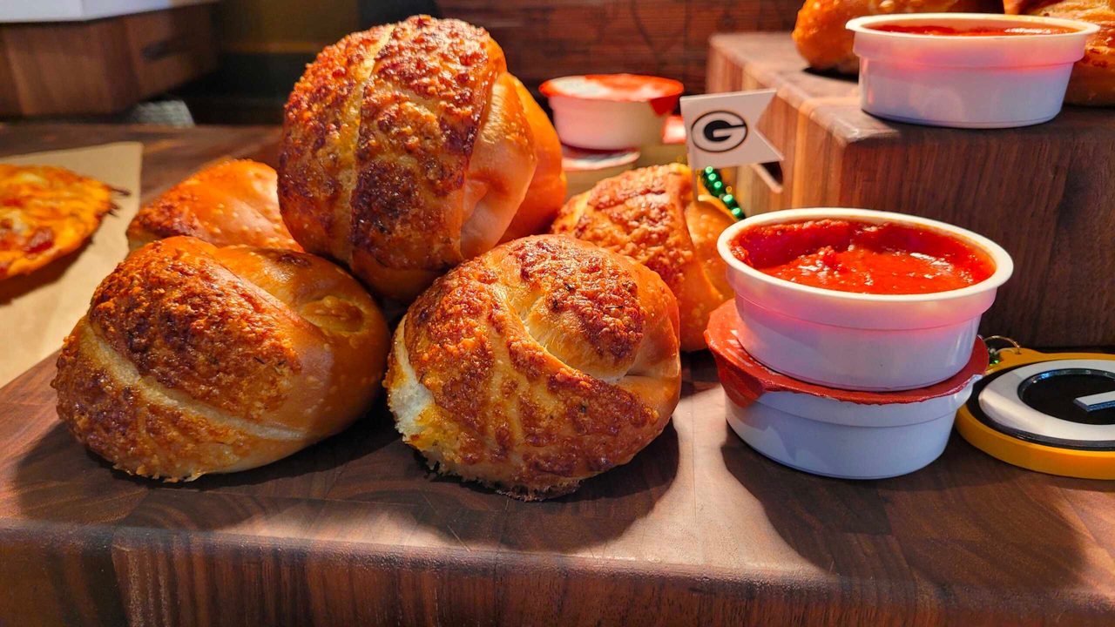




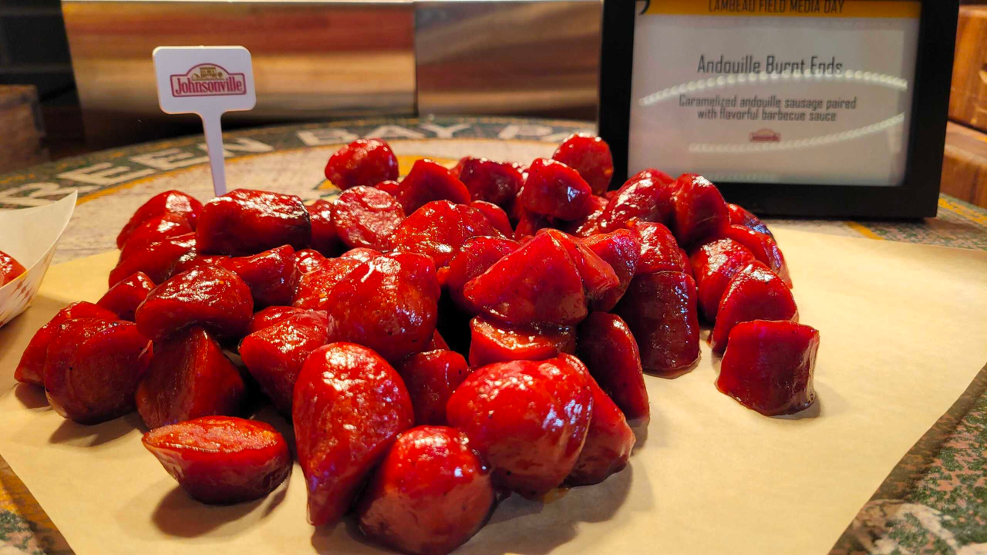
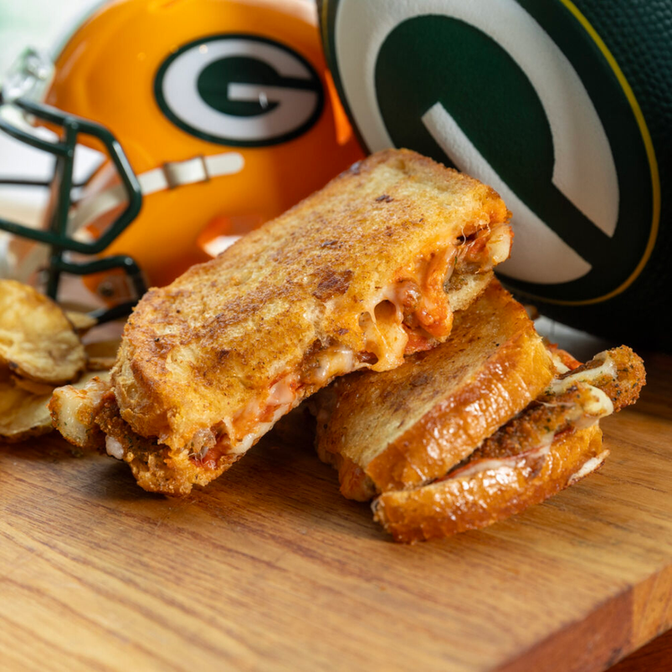




Green Bay Packers
Lambeau Field
Green Bay, WI
Concessionaire: Delaware North
Special Teams Brat
Johnsonville brat topped with Coca-Cola-caramelized onions, sauerkraut, bacon and BBQ aioli, all served on a pretzel bun.
Garlic Knots
Breadstick dough knotted with garlic and parmesan, served with marinara sauce.
Burnt Ends
Caramelized Andouille Johnsonville sausage paired with flavorful BBQ sauce.
Mozzarella Stick Sandwich
Topped with marinara, pepperoni and shredded mozzarella on sourdough bread.
Delaware North

Slide 10
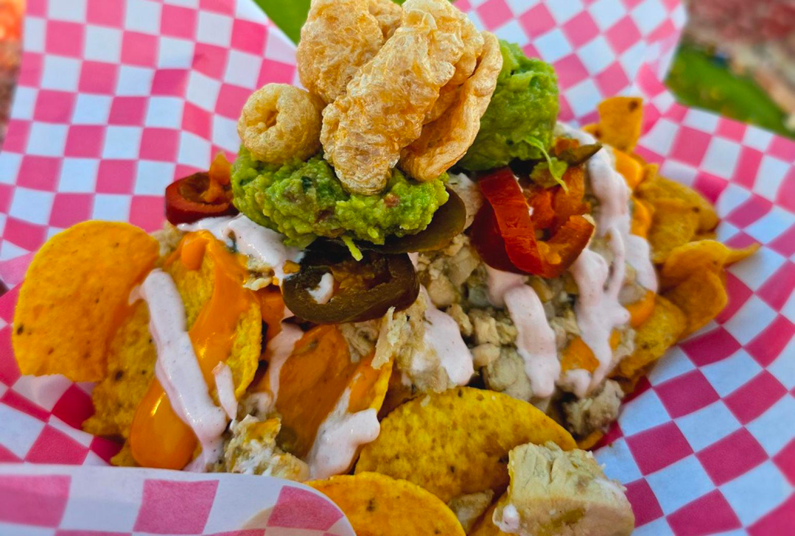
Fiesta Dog
A 10-inch all-beef hot dog layered with warm chili con queso, lime-infused crema, guacamole and pico de gallo.
San Francisco 49ers
Levi’s Stadium
San Francisco, CA
Concessionaire: Levy
Green Chili Chicken Nachos
Green chili chicken, nacho cheese and spicy crema layered on tortilla chips and topped with chili lime chicharrones.

Slide 11
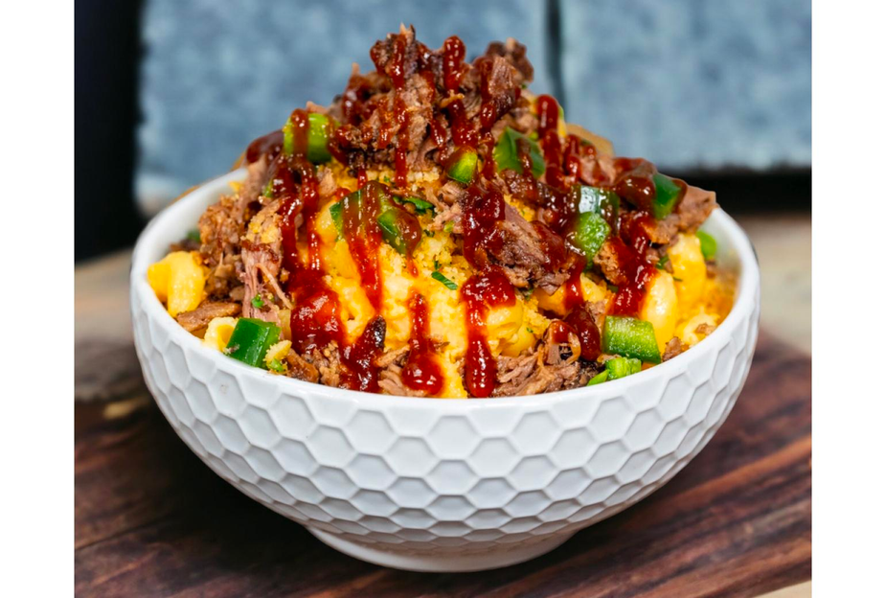
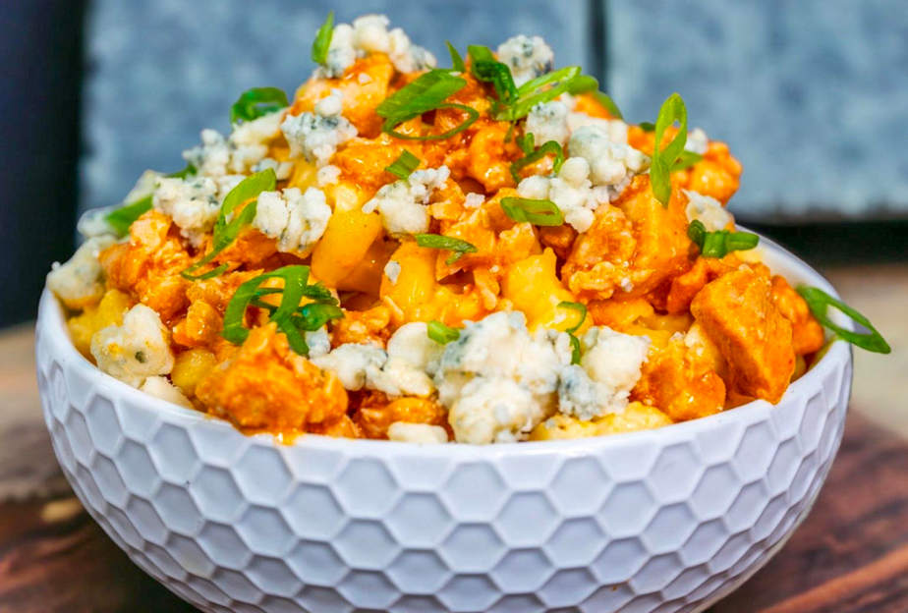
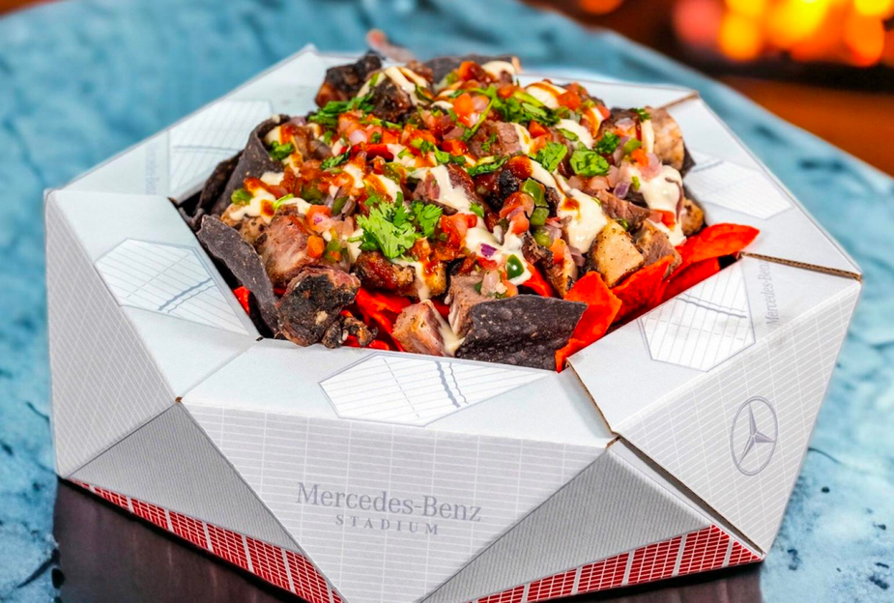
Atlanta Falcons
Mercedes-Benz Stadium
Atlanta, GA
Concessionaire: Levy
ATL Mac
Dirty Bird Mac
Stadium Nacho
Mac and cheese topped with chopped brisket, diced jalapeños, BBQ sauce and scallions.
Mac and cheese topped with Buffalo chicken, blue cheese crumbles and scallions.
Falcons-themed red and black tortilla chips topped with smoked burnt ends, pico de gallo, white cheddar cheese sauce and cilantro.

Slide 12
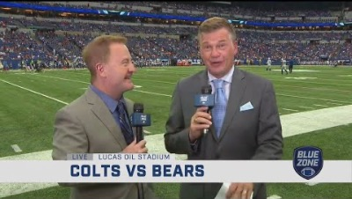
Indianapolis Colts
Tasting Event
WATCH NOW: Colts Culinary Showcase
The Indianapolis Colts partnered with concessionaire Sodexo to host a tasting event at Lucas Oil Stadium in Indianapolis prior to the 2023 home season opener.
The tasting event introduced the stadium's new food and beverage items tp fans and media invitees.

Slide 13

Teaming Up
Barbeque Pulled Pork Sandwich
Some concessionaires partner with local restaurants to provide unique food offerings.
WATCH: Lumen Field has the Home Taste Advantage
Piled high pulled pork is topped with coleslaw and crunchy potato sticks.
Seattle Seahawks
Lumen Field
Seattle, WA
Concessionaire: Levy

Slide 14
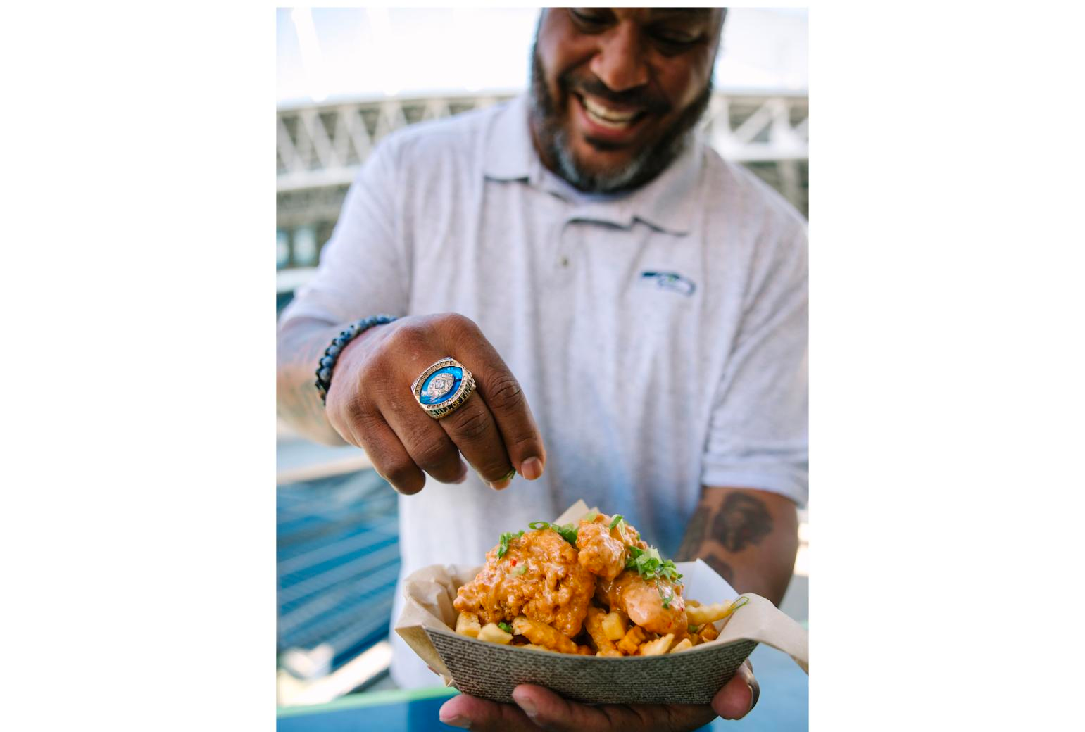
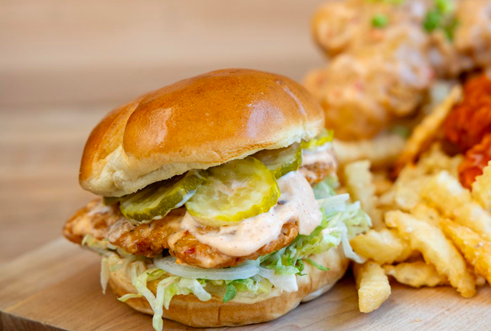
Leveraging Legendary Talent
Concessionaires also partner with local sports legends to create exciting new restaurant brands with instant name recognition.
Seattle Seahawks
Lumen Field
Seattle, WA
Concessionaire Levy partnered with Seahawks Hall of Famer Walter Jones to launch “Big Walt’s Kitchen” at Lumen Field prior to the 2023 season. The restaurant specializes in chicken dishes created by Jones himself.
Hall of Fame Nashville Hot Chicken Sandwich from Big Walt’s Kitchen (left)
Bang Bang Chicken Tenders (right)

Slide 15
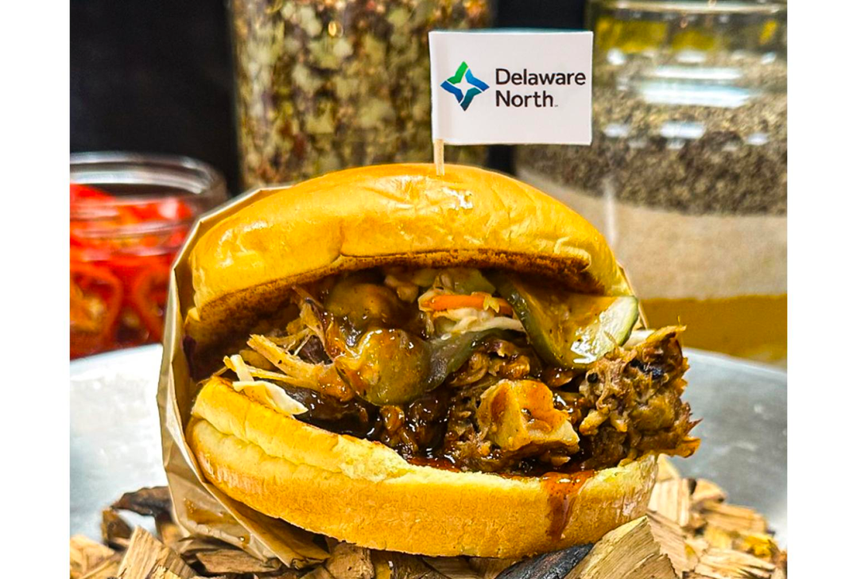
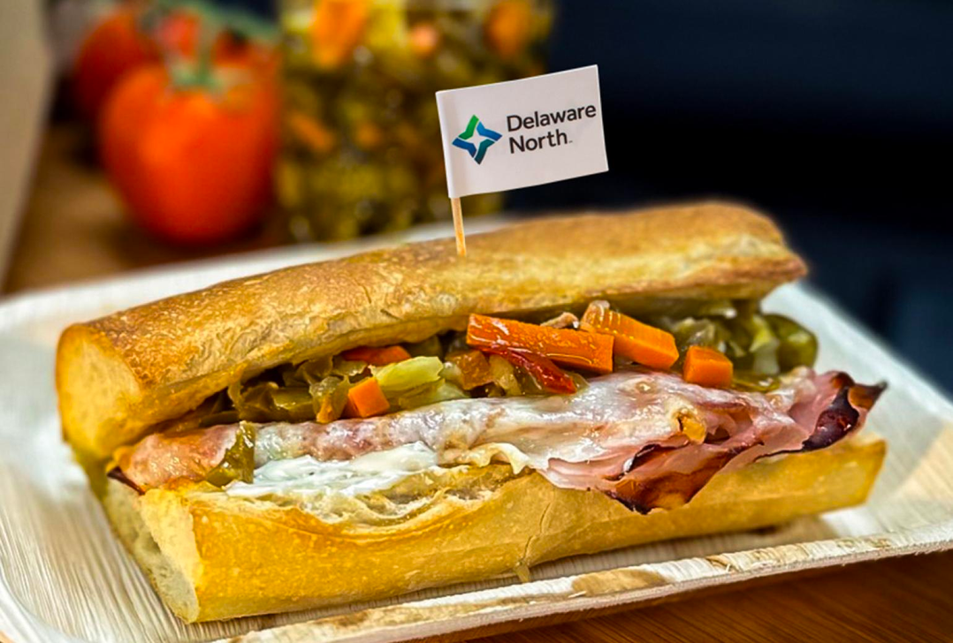
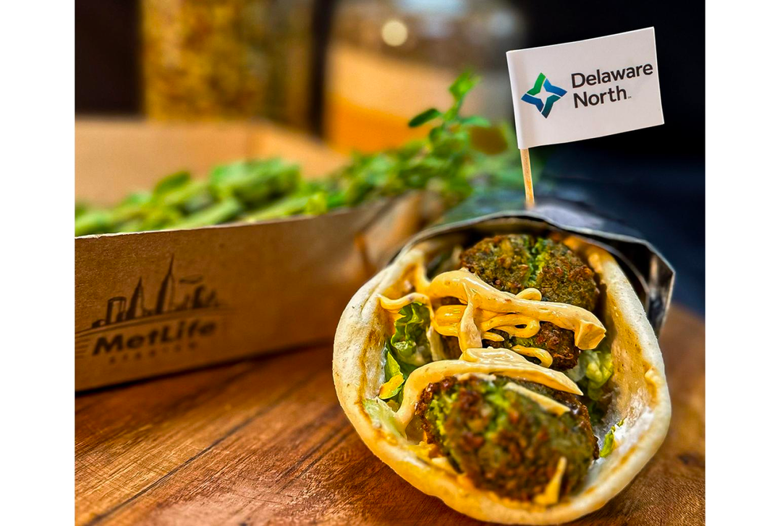
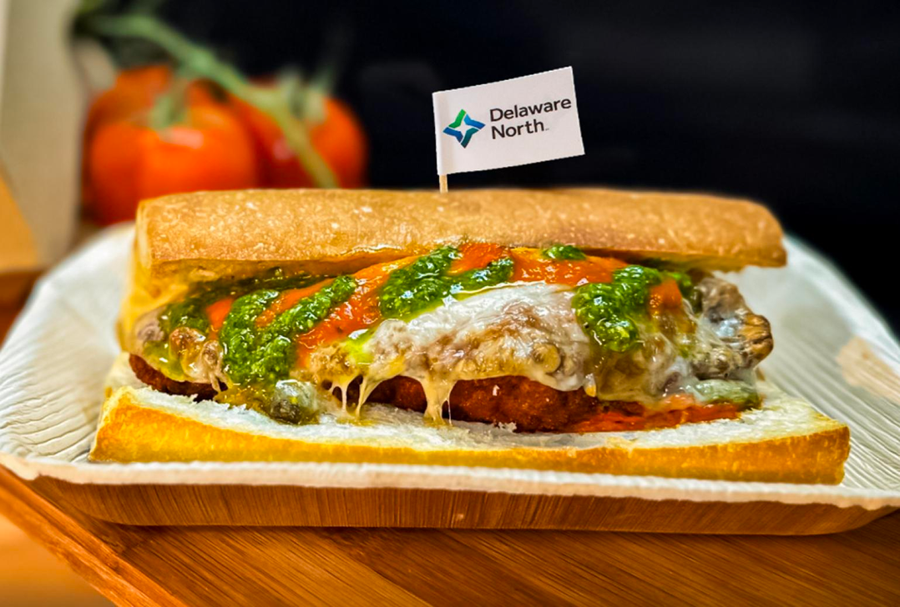
New York Giants
MetLife Stadium
East Rutherford, NJ
Concessionaire: Delaware North
BBQ Pulled Pork Sandwich
Tender pulled pork and pork belly, smothered in MG BBQ sauce and creamy BBQ slaw, served on a toasted Martin’s bun and topped with house-made pickles.
The Gridiron Sandwich
Cotto ham, Genoa salami and pepperoni are topped with provolone cheese, hot pepper aioli and spicy giardiniera. A drizzle of Italian vinaigrette ties the flavors together.
Falafel Gyro
A vegan falafel gyro, topped with tzatziki sauce, cucumber and dill salad, harissa aioli, lettuce and feta cheese, served on warm pita bread.
Chicken Vodka Sandwich
Buttermilk and Parmesan chicken cutlet, vodka sauce and provolone cheese, served on a baguette.
Delaware North

Slide 16
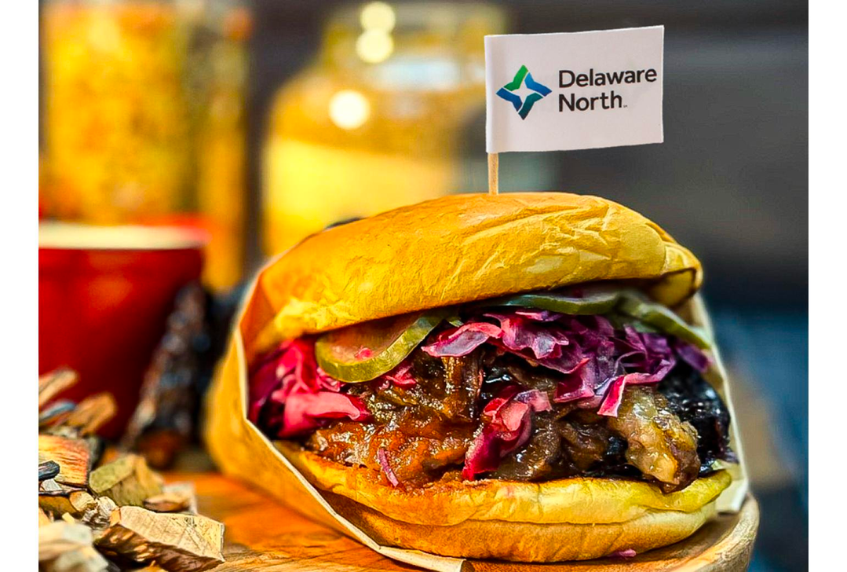
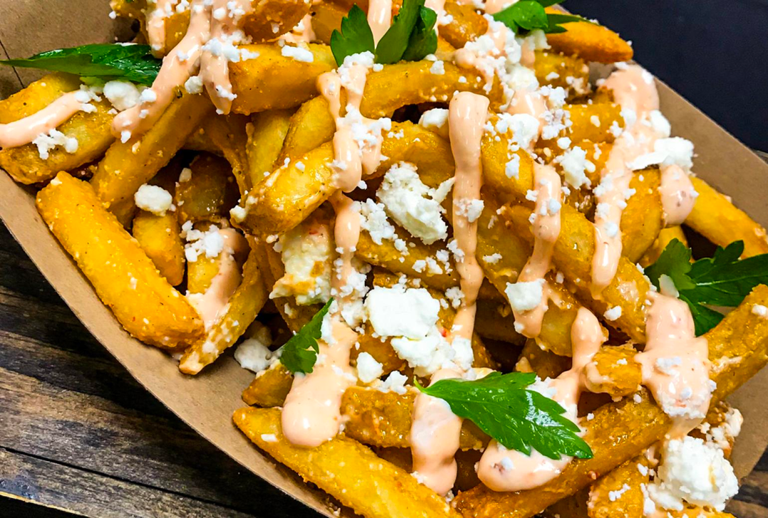




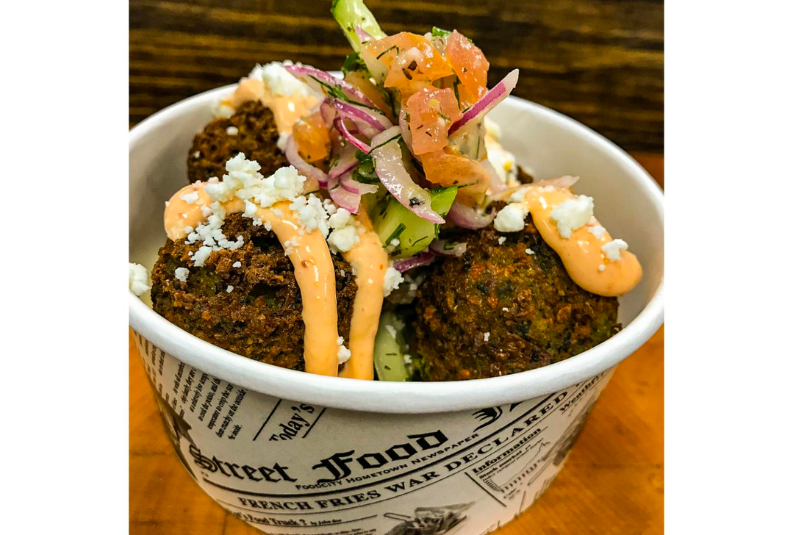
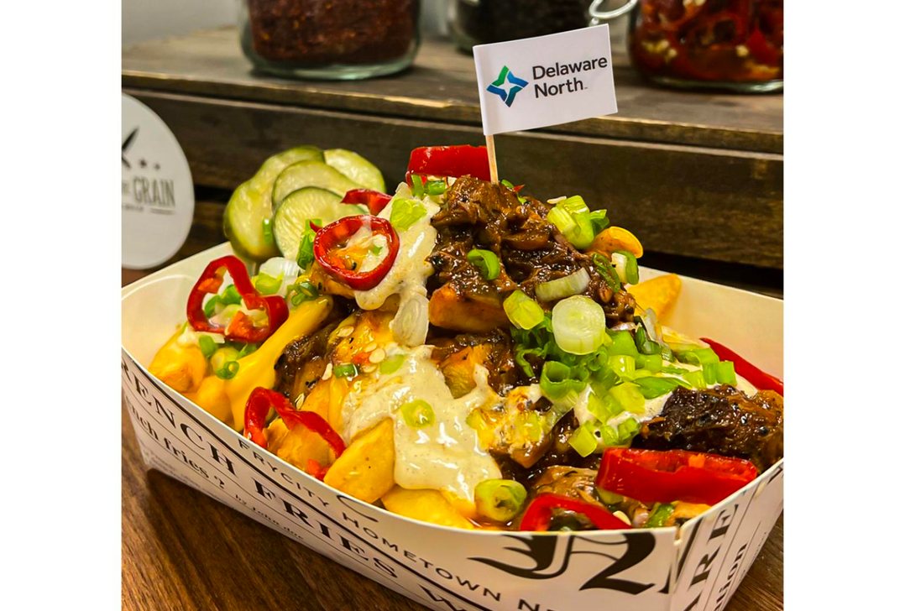




New York Giants
MetLife Stadium
East Rutherford, NJ
Concessionaire: Delaware North
Smoked Beef Brisket Sandwich
Smoked beef brisket with zesty citrus red cabbage slaw, drizzled with chipotle BBQ sauce, house-made pickles and served on a toasted bun.
Loaded Greek Fries
Greek fries are loaded with house-made lemon pepper and oregano salt, harissa aioli, feta cheese and parsley. Customers can add protein if they choose.
Falafel Appetizer
Vegan falafel fritters are accompanied by feta cheese, harissa aioli, cucumber and dill salad.
Burnt Ends Chili Loaded Tots
BTater tots topped with brisket chili, beer cheese sauce, pickled Fresno peppers, house-made pickles, BBQ crema and scallions.
Delaware North

Slide 17
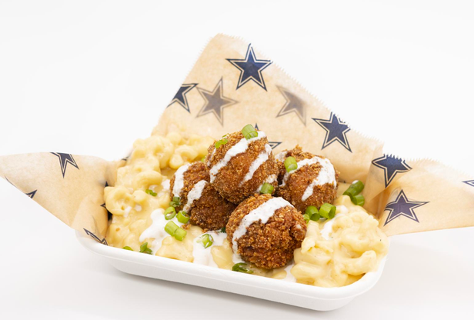
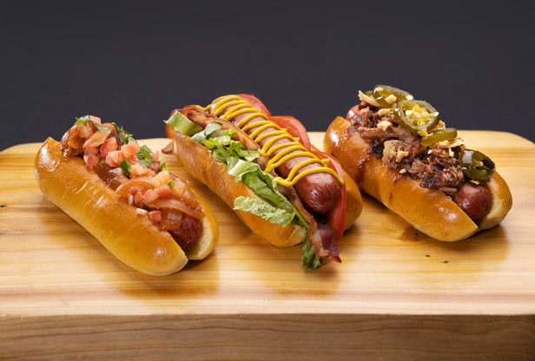
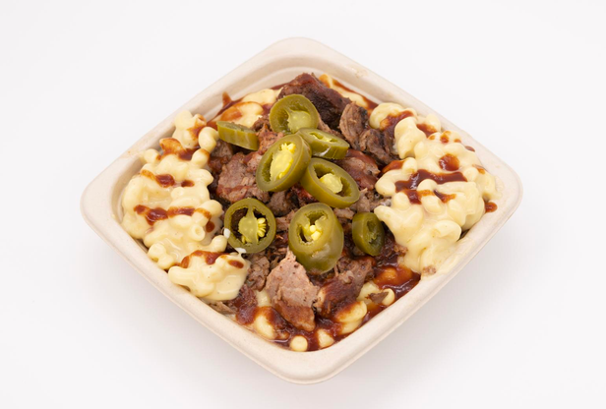
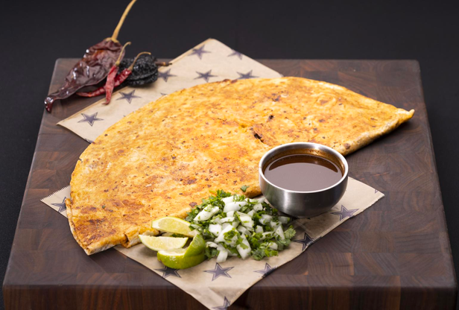
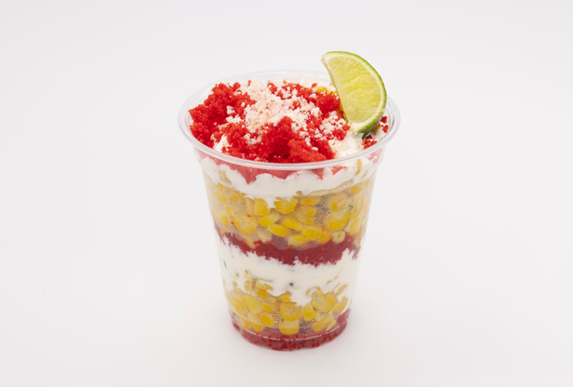
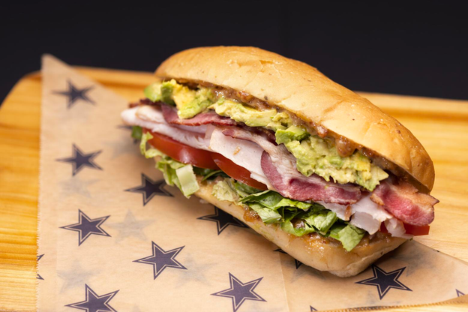
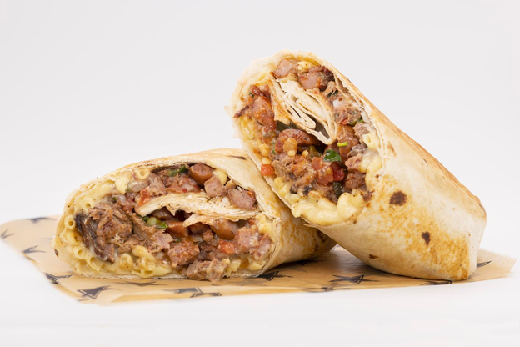
Fritos Brisket Mac n Cheese Balls
House-smoked Bent Buckle brisket and famous Cowboy’s Mac n Cheese breaded with BBQ Fritos and fried, served on a bed of Mac, drizzled with sour cream and topped with green onions.
New York Hot Dog Trio
Nathans’s All Beef hot dogs: Onion Dog, BLT Dog and BBQ Dog.
Brisket Mac n Cheese Bowl
Based on one of the most popular fan requests, this bowl of the famous Cowboy’s Mac n Cheese is loaded with house smoked brisket and topped with jalapenos and BBQ sauce.
Dallas Cowboys
The Birria Quesadilla
AT&T Stadium
Dallas, TX
Slow-cooked beef marinated in Mexican spices, creamy pepperjack and Oaxaca cheeses, grilled inside of a 17-inch flour tortilla, served with savory Birria consommé.
Concessionaire: Legends Hospitality Management
Flamin’ Hot Cheetos Elote
A twist on a classic street food favorite with sweet corn topped with crema, cotija cheese and Flamin’ Hot Cheetos.
Turkey Bacon Hoagie
classic turkey sandwich loaded with bacon, avocado, lettuce and tomato, with house-made bacon jam aioli served on an Italian herb hoagie baked exclusively for the Dallas Cowboys by a local bakery.
Lineman Burrito
17-inch flour tortilla filled with famous Cowboys Mac n Cheese, in-house smoked brisket, jalapeño pepper jack sausage, pico de gallo and candied jalapeños.

Slide 18
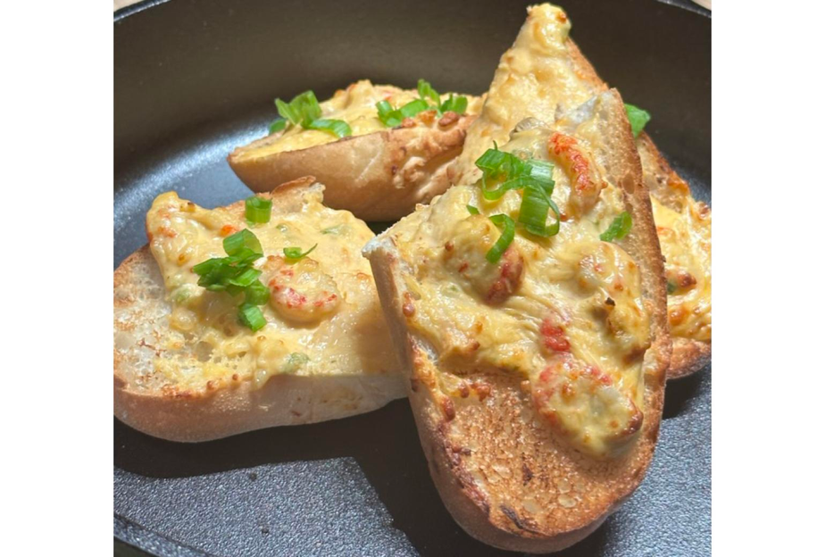
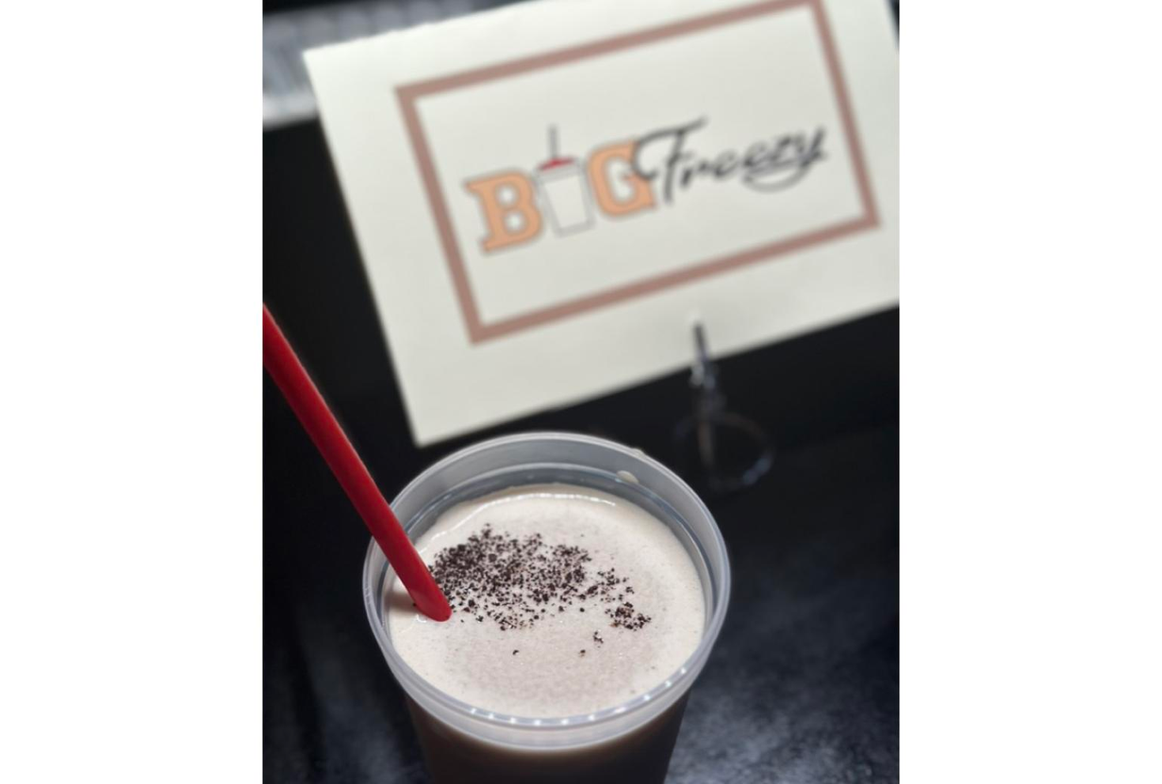
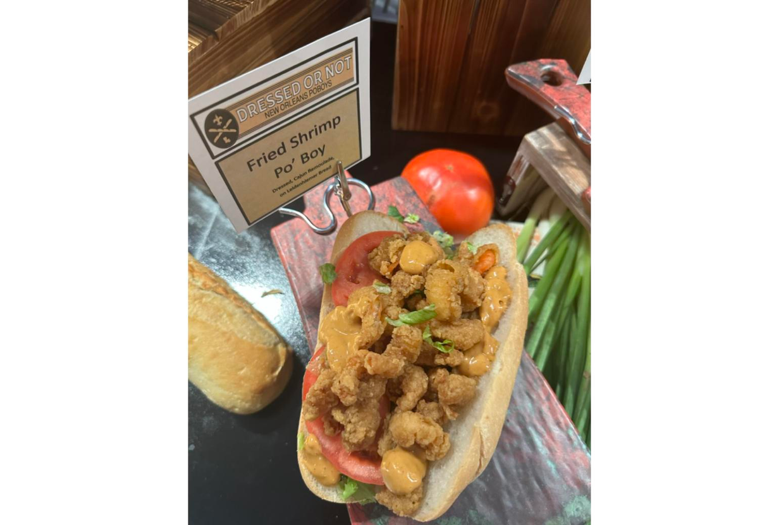
New Orleans Saints
Caesars Superdome
New Orleans, LA
Concessionaire: Sodexo Live!
Crawfish Bread
Big Freezy
Dressed Or Not New Orleans Po’ Boy
Toasted french bread topped with crawfish, cheese and scallions.
A NOLA classic brand offers the Frozen Daiquiri (pictured), plus frozen Irish Coffee and soft serve ice cream in cups and cones.
NOLA-style Po’ Boy sandwiches include Cochon du Lait, fried shrimp, and vegetarian wild mushroom styles.

Slide 19
DISCUSSION QUESTIONS
  What is fan experience?
  Why is the fan experience important?
  What does the fan experience have to do with the business of sports?
  What factors influence the fan experience at NFL stadiums?
  How important do you think food and beverage options are to the overall fan experience?
  How might those offerings represent the community?
  How can that help to connect with fans while building fan support and loyalty?
  What are ticket sales?
  Why are they important to a NFL franchise?
  How might the food and beverage options available at the stadium impact ticket sales for an NFL franchise?

Slide 20
DISCUSSION QUESTIONS
  What is publicity?
  How might the introduction of new menu items each season help to provide a team with valuable publicity?
  What is promotion?
  How can a team turn food and beverage items into a promotion opportunity?
  What is price and why is it an important component of the marketing mix?
  How do you think concessionaires determine price points for stadium food and beverage options?
  Why do some teams offer a “low cost” menu?
  Which of the menu items from this presentation looks the tastiest?
  Which is the least appealing food or beverage item?
  Which is the most creative?
  Which stadiums do you think did the best job creating an item (or items) that reflect local tastes or cuisines? Why is that important?

Slide 21
ACTIVITY SUGGESTION
  After reviewing this discussion deck, divide the classroom into small groups or pairs
  Each group will select an NFL stadium
  The group will then research to see if they can find what items are currently offered or available (or any promotions) at that stadium
  After identifying current options, each group will create new stadium food and beverage offerings for this season
  Groups will present their food and beverage menus in class, and should address the following:
    Highlights of any new or creative food or beverage offerings
    Price points for each option and explanation of how that price was determined
    Description of any items that reflect local cuisine and/or represent the community
    Explanation of how the new menu will be communicated to fans
    Explanation of how the new menu will generate publicity and how it will impact the overall fan experience for the team’s fans on game days

Slide 22
SOURCES
https://www.food-management.com/food-beverage/what-s-new-2023-nfl-season-part-1
https://www.chicagobears.com/news/bears-aramark-host-tasting-event-at-soldier-field-ahead-of-season-opener
https://www.aramark.com/newsroom/news/aramark-sports---entertainment-kicks-off-2023-nfl-season-with-fr
https://fox4kc.com/sports/chiefs/arrowhead-features-new-menu-big-tech-upgrades-this-chiefs-season/
https://www.post-gazette.com/life/food/2023/09/07/acrisure-stadium-steelers-food-walk-thru-bru/stories/202309070095
https://www.nbc26.com/sports/nfl/green-bay-packers/taste-bud-touchdowns-packers-unveil-new-concession-items-at-lambeau-field
https://sports-teller.com/top-10-browns-2023-new-foods-cleveland-stadium/
https://us.sodexo.com/media/news-releases/new-food-for-40th-season-colts-s.html
https://www.wishtv.com/lifestylelive/indianapolis-colts-unveil-new-menu-items-in-time-for-40th-season/

