Slide 1
Marketing Insights from SCC
Module 9: Seasonal Marketing
SPOOKY
MARKETING
How do businesses and brands leverage Halloween to reach, connect with, and engage consumers?
Let's look at some of this year's notable Halloween brand marketing campaigns.

Slide 2
Marketing Insights from SCC
Module 9: Seasonal Marketing
WHAT IS
MARKETING?
As you review this year's Halloween marketing campaigns, you will see a specific business or marketing concept identified on each slide. For each example, take a moment to discuss how each campaign provides an example of the business and marketing concepts discussed in class and in your Marketing Insights from SCC modules and lessons.

Slide 3
Marketing Insights from SCC
Module 9: Seasonal Marketing
BUSINESS OF
HALLOWEEN
This presentation reveals some interesting marketing data and statistics about the 2023 Halloween season.
How does this information benefit businesses and brands that are considering a Halloween-themed marketing campaign?

Slide 4
America's favorite Halloween Candy by state in 2023, according to data from Candystore.com.

Slide 5
Total Halloween Spending 2013-2023
Calculated as per-person spending multiplied by the percentage of the population participating in the holiday.
SOURCE: NRF
15B
12.2 billion
10.1
10B
9.1
9
8.8
8.4
8
10.6
7
7.4
6.9
5B
0B
2013
2014
2015
2016
2017
2018
2019
2020
2021
2022
2023

Slide 6
"Consumers will be shopping early for festive décor and other related items and retailers are prepared with the inventory to help customers and their families take part in this popular and fun tradition."
NRF President and CEO Matthew Shay

Slide 7
Instacart Scare Score
“For the first time ever, we’re introducing a tool that lets you enter your zip code to discover your area’s Scare Score. This score, determined by analyzing candy, costume, and decor purchases via Instacart, rates your community’s Halloween spirit — and shows the top candies in your zip code, so you know which treats your neighbors are most likely going to be handing out! You can also use it to pinpoint the places in your city with the highest Scare Scores — aka the ultimate trick-or-treating destinations. With this unique metric, we’ve also identified Halloween’s Best Haunts, a list of the top 10 zip codes boasting the highest Scare Scores — guaranteeing top-notch trick-or-treating experiences.”
Laurentia Romaniuk
Instacart Trends Expert
SOURCE: Instacart

Slide 8
Marketing Insights from SCC
Module 9: Seasonal Marketing
2023 HALLOWEEN
MARKETING CAMPAIGNS

Slide 9
Marketing Insights from SCC
Module 9: Seasonal Marketing
KRISPY KREME
SCOOBY DOO HALLOWEEN DOZEN
Just in time for Halloween, Krispy Kreme is partnering with Warner Bros. Discovery Global Consumer Products to create a special Scooby-Doo Halloween Dozen, which features new doughnuts and comes in a limited-edition custom box.
M3L2: Brand Building
SOURCE: Krispy Kreme
M3L4: Packaging & Labeling

Slide 10
Marketing Insights from SCC
Module 9: Seasonal Marketing
Doordash x
Spirit Halloween
DoorDash and Spirit Halloween, the world’s No. 1 Halloween retailer, are partnering to provide on-demand access to thousands of Halloween items, from costumes to decorations, just in time for the holiday.
For the first time ever, over 1,500 Spirit Halloween locations will be available on the DoorDash marketplace nationwide.
M3L2: Brand Building
SOURCE: Doordash

Slide 11
Marketing Insights from SCC
Module 9: Seasonal Marketing
Hot Topic x Disney
Nightmare Before Christmas 30th Anniversary
In honor of the 30th anniversary of Tim Burton’s The Nightmare Before Christmas (NBX, for those in the know), Hot Topic is offering new, limited edition NBX licensed apparel, just in time for Halloween.
M3L2: Brand Collaboration

Slide 12
Marketing Insights from SCC
Module 9: Seasonal Marketing
Chipotle
“BooRito” Promotion
Chipotle’s annual “Boorito” promotion will be returning in 2023.
Since 2000 (except for 2020 and 2021), Chipotle has held their annual Boorito promotion wherein Chipotle Rewards Members can get a FREE burrito by dressing up in a Halloween costume and visiting a participating Chipotle restaurant after 3 p.m.
SOURCE: Chipotle
M3L1: Promotion

Slide 13
Marketing Insights from SCC
Module 9: Seasonal Marketing
Spirit Halloween x
Mountain Dew
Spirit Halloween’s costume collaboration with MTN DEW returns for 2023. Spirit Halloween will offer Halloween "flavor" costumes inspired by three fan-favorite MTN DEW flavors (Original, Baja Blast, and Code Red) and the VOO-DEW Grim, the embodiment of the iconic Halloween mystery flavor, MTN DEW VOO-DEW.
M3L2: Brand Collaboration

Slide 14
Marketing Insights from SCC
Module 9: Seasonal Marketing
Google “Frightgeist”
Google Frightgeist is an interactive web app that uses Google’s search frequency data and user location to show which costumes are the most popular based on geography.
The app features tools including “Top Costumes”, “Costume Map” and a “Costume Generator.”
How can businesses leverage Google Search information to improve a Halloween marketing campaign?
M4L2: Advertising

Slide 15
Marketing Insights from SCC
Module 9: Seasonal Marketing
Dunkin Spider Donut
Each year, Dunkin’ fans look forward to its seasonal Halloween products, including the beloved Spider Donut—an orange-frosted doughnut with a chocolate-glazed Munchkin decorated like a spider nestled in the middle.
In 2023, Dunkin unveiled a giant inflatable Spider Donut yard decoration, available for sale on the company’s website, shopdunkin.com.
"Every October, we watch our guests celebrate the spooky season with Spider Donuts in hand. This year, we wanted to create a new and out-of-the-donut-box way for Spider Donut superfans to showcase their love for the season with this inflatable masterpiece."
Kemma Kefalas
Dunkin Director of Brand Engagement
Dunkin’s inflatable spider doughnut,
on sale for Halloween 2023.
M2L3: Product Life Cycle

Slide 16
Marketing Insights from SCC
Module 9: Seasonal Marketing
McDonalds
Boo Buckets
In 2023, McDonalds will be bringing back their iconic Boo Buckets, a reboot of a popular Happy Meal that was introduced in 1986.
For a limited time only (and while supplies last), McDonald's fans can purchase the Happy Meals, served in three Halloween-themed pails: McBoo, McPunk’n and McGoblin.
SOURCE: McDonalds
M9L1: Nostalgia Marketing

Slide 17
Vintage McDonalds Happy Meal Commercial
WATCH NOW: McDonalds Happy Meal Commercial (1986)

Slide 18
Marketing Insights from SCC
Module 9: Seasonal Marketing
Burger King
Ghost Pepper Menu Items &
“Trick-Or-Heat” Bucket
For Halloween 2023, Burger King is bringing back their limited edition, Ghost Pepper Whopper—an extra spicy Whopper served on a Halloween-themed, orange and black bun. And this year, they are introducing a Ghost Pepper version of their iconic Chicken Fries.
Also new for 2023, Burger King is offering a limited edition, “Trick-or-Heat” bucket. Designed to compete with McDonalds’ Boo Bucket, Burger King’s “Trick-or-Heat” buckets will be available in only a few metro areas.
SOURCE: Burger King
M6L3: Brand Loyalty

Slide 19
Marketing Insights from SCC
Module 9: Seasonal Marketing
Tyson Foods
Spooky Nuggets
In 2023, Tyson Foods will be bringing back Spooky Nuggets, a limited edition, Halloween-themed version of their popular chicken nuggets in three shapes: pumpkins, bats, and ghosts.
In previous years, Spooky Nuggets were in limited supply and only available via an Instagram sweepstakes, meaning only a lucky few were able to get their hands on them before they vanished. This year Spooky Nuggets will be available to nugget fans nationwide, in their local grocery store.
SOURCE: Tyson
M6L1: Consumer Engagement

Slide 20
Marketing Insights from SCC
Module 9: Seasonal Marketing
Fanta
Halloween Mystery Flavor
In 2023, Coca-Cola released a new, limited edition mystery flavor of their popular soft drink, Fanta with a special surprise—a few sips will turn your tongue black!
Fanta is keeping the flavor a mystery on purpose. Customers will have to sample it for themselves to figure it out. As long as the special soda is available, the brand is inviting fans to guess the flavor on social media through weekly events.
The promotion is part of Fanta’s “What the Fanta” campaign, which debuted last year.
M6L1: Consumer Engagement

Slide 21
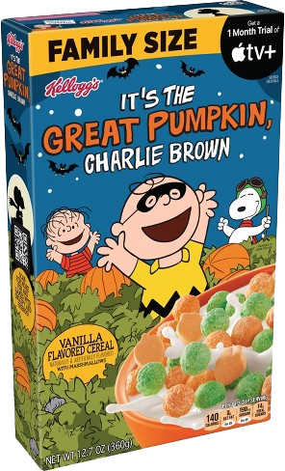
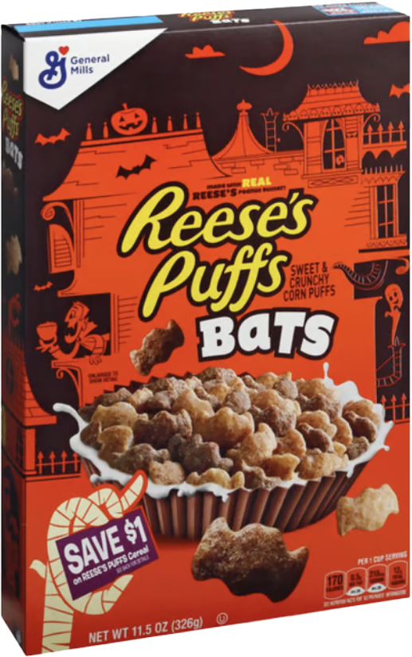
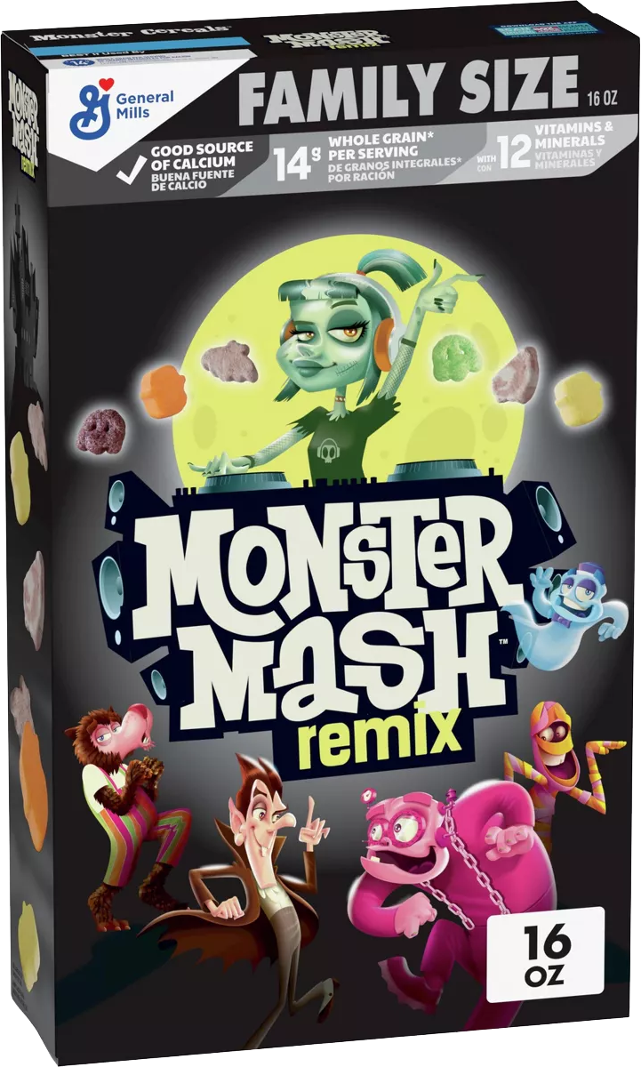
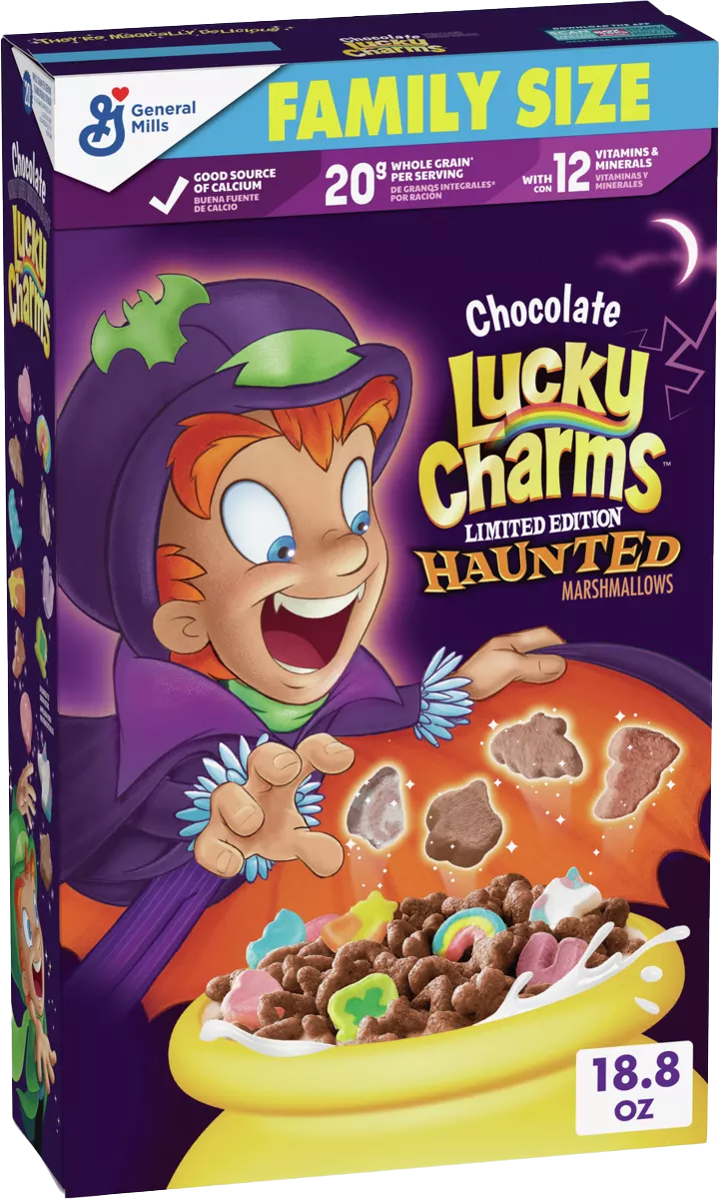
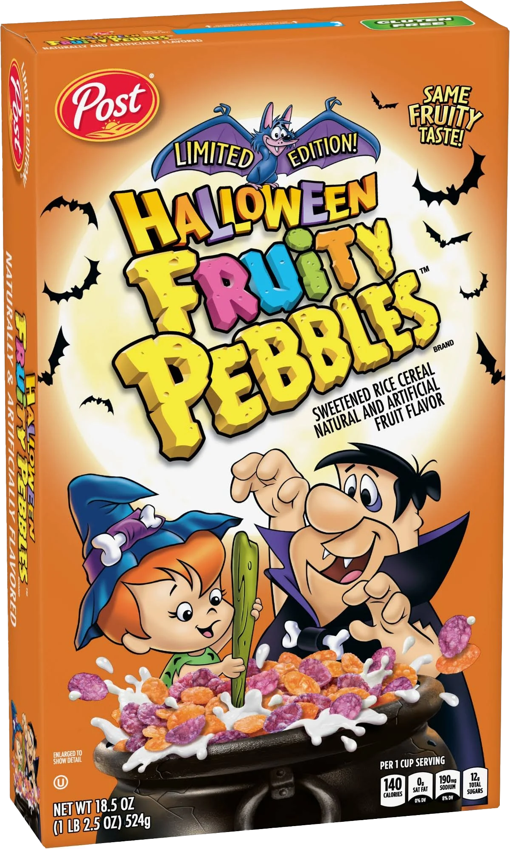
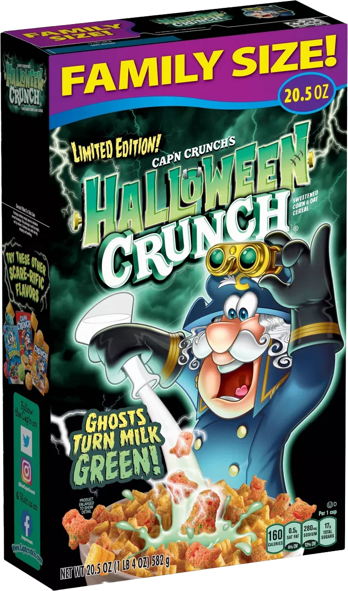
Marketing Insights from SCC
Module 9: Seasonal Marketing
Halloween
Cereals
Several companies, including Kellogg’s, Post and Quaker are offering limited-edition Halloween flavors of their classic cereals.
M6L1: Consumer Engagement

Slide 22
Marketing Insights from SCC
Module 9: Seasonal Marketing
DISCUSSION
QUESTIONS
What is seasonal marketing?
What are seasonal products?
What are industry trends?
Is Halloween more important to some businesses and brands than others?
What types of businesses and brands might benefit most from Halloween marketing?
Have you seen other examples of Halloween marketing besides what was featured in this presentation?

Slide 23
Marketing Insights from SCC
Module 9: Seasonal Marketing
DISCUSSION
QUESTIONS
What is promotion?
Why do brands engage in promotion around Halloween?
What is a brand collaboration?
Why do you think brands collaborate?
What is one example of a brand collaboration for Halloween this year from this presentation?
Can you think of two brands that could launch a successful Halloween collaboration promotion?
What is engagement? How might Fanta’s promotion boost levels of engagement with the brand?

Slide 24
Marketing Insights from SCC
Module 9: Seasonal Marketing
DISCUSSION
QUESTIONS
What is social media marketing?
Why do you think social media is a valuable tool when it comes to Halloween-themed marketing campaigns and promotions?
How might packaging provide brands with marketing opportunities?
What is one example of how a brand is using Halloween-themed packaging as a marketing tool this year, based on the promotions you reviewed in this presentation?
What types of companies might benefit most from Halloween-themed promotions?

Slide 25
Marketing Insights from SCC
Module 9: Seasonal Marketing
STUDENT
ACTIVITY
The next slide features a list of several brands. Select one and create a Halloween-themed marketing campaign. Consider all the marketing tactics and strategies that you just reviewed in this presentation and apply some of those concepts to your campaign.
Be sure to incorporate a digital and social media
component to your marketing campaign, and you
will want to clearly communicate the goals of the
campaign. Explain how the brand will benefit from
the marketing campaign and be prepared to
present your ideas in class.

Slide 26
Marketing Insights from SCC
Module 9: Seasonal Marketing
STUDENT
ACTIVITY
SELECT FROM THE FOLLOWING BRANDS:

Slide 27
SOURCES
CANDYSTORE.COM/BLOGS/FACTS-TRIVIA/HALLOWEEN-CANDY-MAP-POPULAR
NRF.COM/TOPICS/HOLIDAY-AND-SEASONAL-TRENDS/HALLOWEEN
INSTACART.COM/COMPANY/UPDATES/TRICK-OR-TREAT-TRENDS-MAPPING-OUT-HALLOWEENS-BEST-HAUNTS/
USATODAY.COM/STORY/MONEY/FOOD/2023/10/09/SCOOBY-DOO-KRISPY-KREME-DOUGHNUT-HALLOWEEN-DOZEN/71116427007/
ABOUT.DOORDASH.COM/EN-US/NEWS/DOORDASH-PARTNERS-WITH-SPIRIT-HALLOWEEN
COMICBOOK.COM/MOVIES/NEWS/THE-NIGHTMARE-BEFORE-CHRISTMAS-30TH-ANNIVERSARY-FASHION-COLLECTION-HOT-TOPIC-HALLOWEEN/
THEFOODXP.COM/CHIPOTLE-HALLOWEEN-MENU/
NBCBOSTON.COM/NEWS/LOCAL/DUNKIN-UNVEILS-100-INFLATABLE-HALLOWEEN-DONUT-AS-TALL-AS-A-PERSON/3150731/
TODAY.COM/FOOD/RESTAURANTS/BURGER-KING-HALLOWEEN-BUCKET-GHOST-PEPPER-WHOPPER-RCNA118472
PARADE.COM/FOOD/MCDONALDS-BOO-BUCKETS-RETURN-HOW-GET-2023
FOODNETWORK.COM/FN-DISH/NEWS/WHERE-TO-BUY-TYSON-SPOOKY-HALLOWEEN-CHICKEN-NUGGETS-2023
MENTALFLOSS.COM/POSTS/FANTA-MYSTERY-FLAVOR-TURNS-TONGUE-BLACK
COMICBOOK.COM/IRL/NEWS/HALLOWEEN-CEREALS-2023-MONSTER-CEREALS-HALLOWEEN-FLAVORS/

