Slide 1
Holiday
Marketing
How are businesses and brands promoting their products and services this holiday season?

Slide 2
Seasonal
Marketing
Seasonality refers to periods of the calendar year where certain products and services generate higher levels of consumer demand. These marketing “seasons” influence sales and revenue for some companies and impact how those brands create business and marketing plans.

Slide 3
During the holiday season, businesses engage in different marketing strategies designed to boost brand awareness and increase sales:
Sharing season-related marketing content
Rolling out seasonal product packaging
Offering limited edition products
Holding themed contests
Offering promotional discounts
Running time-limited sales
Creating gift guides
Offering freebies
Running referral discounts
Creating virtual reality content
Seasonal Marketing Strategies

Slide 4
SEASONAL PRODUCT
Starbucks
Holiday-Themed Menu Items & Cups
In addition to the new Starbucks holiday cups, in 2023 Starbucks released new holiday seasonal beverages such as the new Iced Gingerbread Oat milk Chai, in addition to returning seasonal favorites including Peppermint Mocha, Caramel Brulé Latte, Chestnut Praline Latte and Iced Sugar Cookie Almond milk Latte.
Along with holiday drinks, Starbucks released new holiday cups, tumblers, and ornaments that are sold for a limited time.
Images via Starbucks

Slide 5
SEASONAL PRODUCT
Dunkin'
Holiday Menu Items
The 2023 Dunkin’ holiday menu features Cookie Butter Cold Brew, which debuted last year, in addition to the Toasted White Chocolate Cold Brew, Toasted White Chocolate Signature Latte, and Peppermint Mocha Signature Latte. The new drink for 2023 is Spiced Cookie Coffee, a play on cookies and milk, and is available hot or iced.
This year’s holiday food menu features a Triple Chocolate Muffin and Loaded Hash Browns (topped with queso, jalapeño and bacon).
Dunkin Seasonal Food and Drinks Menu
Image via Dunkin’

Slide 6
SEASONAL PRODUCT
M&Ms
Limited Edition Holiday Flavors
For the 2023 holiday season Mars released a new limited-edition M&M flavor, Toasty Vanilla in addition to its perennial favorite flavor, Mint.
Images via M&Ms

Slide 7
Promotion
Promotion is any form of communication used to inform, persuade, or remind people about a company’s products or services.
Promotion helps create and maintain a consumer’s commitment and emotional involvement with a brand.

Slide 8
Holiday Promotional Strategies
Examples of Holiday promotional strategies:
Black Friday/Cyber Monday promotions and sales
Limited-edition product offerings
Holiday-themed branded merchandise collections
Limited edition product collaborations
Direct marketing campaigns

Slide 9
HOLIDAY PROMOTION
Starbucks
Red Cup Day
To celebrate the start of the holiday season, held their annual Red Cup Day on November 16, 2023. On Red Cup Day, Starbucks gifted a free 2023 reusable red holiday cup to customers who ordered a handcrafted holiday beverage.
Image via Starbucks

Slide 10
HOLIDAY PROMOTION
Starbucks
Festive Thur-Yays
During the month of December, on Thursday afternoons from 12-6 PM, Starbucks Rewards members can get half off any hand-crafted Starbucks beverage.
Image via Starbucks

Slide 11
HOLIDAY PROMOTION
Dunkin'
Free Donut Wednesdays
Dunkin’ Free Donut Wednesdays returned in 2023 with the debut of the Dunkin’ holiday menu. Dunkin’ is offering rewards club members to a free donut with the purchase of any drink through December 31.
Image Via Dunkin Donuts

Slide 12
HOLIDAY PROMOTION
Burger King
“T’is the Cheeson”
Burger King "Tis the Cheeson"
Available from Dec. 1 – 31 in the BK App, Burger King rewards club members can access daily deals, which include free food with purchase on select days and $3 Whopper sandwiches every Wednesday.
Image via Burger King

Slide 13
HOLIDAY ﻿PROMOTION
M&Ms
Promotional Products
In addition to holiday-themed packaging, and seasonal flavors M&Ms offers a variety of themed holiday gift options including:
Customizable personalized candies
Customizable personalized packaging
Branded merchandise
Holiday recipes
Corporate gifts
Party favors
Images Via M&Ms

Slide 14
HOLIDAY PROMOTION
Olive Garden
Holiday Merchandise
Just in time for the Holiday Season, Olive Garden released their “Never Ending First Course” collection which includes their signature cheese grater, and a “Seasons Gratings” sweatshirt. The product line also features other themed apparel, including pajama pants and shirts, as well as a breadstick plush for pets.
Image Via Olive Garden

Slide 15
HOLIDAY ﻿PROMOTION
Chipotle
Limited Edition Products
Just in time for the 2023 holiday gifting season, Chipotle released a series of limited-edition t-shirts, featuring Chipotle-themed artwork created by emerging artists. The company also released a limited-edition car napkin holder that sold out in hours of it’s release!
Images Via Chipotle

Slide 16
Publicity Stunts
Publicity stunts are a marketing strategy where specific events or activities are planned with the sole purpose of achieving a high level of media coverage and public awareness. Publicity stunts (also referred to as PR stunts or marketing stunts) can serve as an effective vehicle in generating public “buzz” surrounding a brand, often promoting the release of a new product or around a major event.

Slide 17
PUBLICITY STUNT
Turo x Warner Bros.
“Elf” 20th Anniversary Promotion
In 2023 Car sharing company, Turo partnered with Warner Brothers Discovery to promote the 20th anniversary of the iconic holiday movie "Elf.”
Turo created five limited-edition "Elf"-themed cars for guests to book in NYC from Dec. 6 to 12 on a first-come, first-served basis. The Elf experience includes car rental, four tickets to a theater showing of Elf, Buddy the Elf hats, and car snacks from the four Elf food groups — candy, candy canes, candy corns, and syrup!
Images via Turo

Slide 18
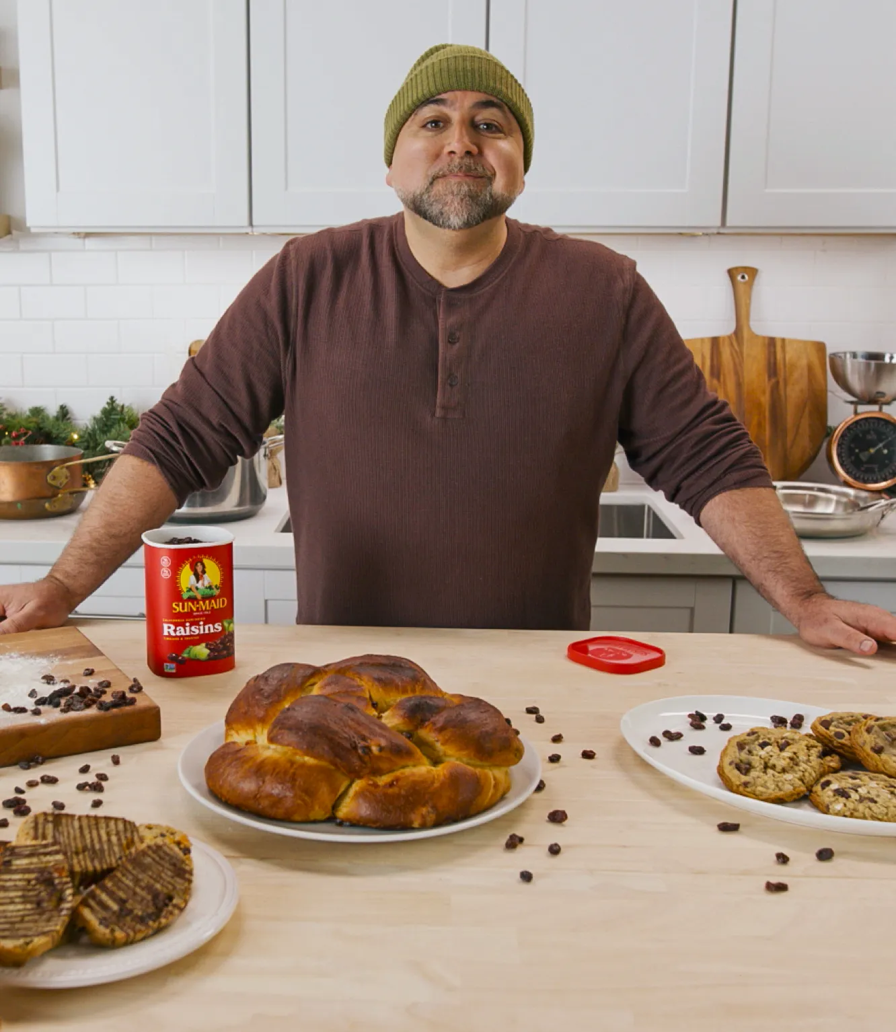
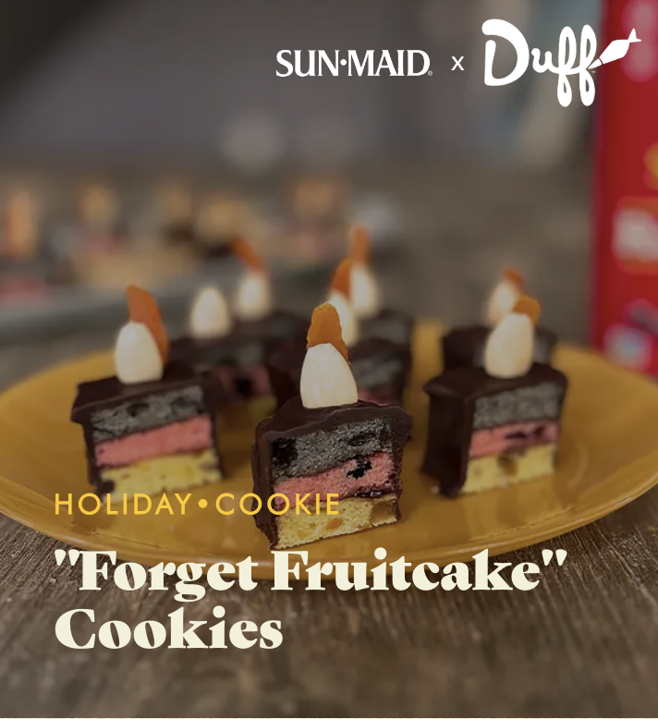
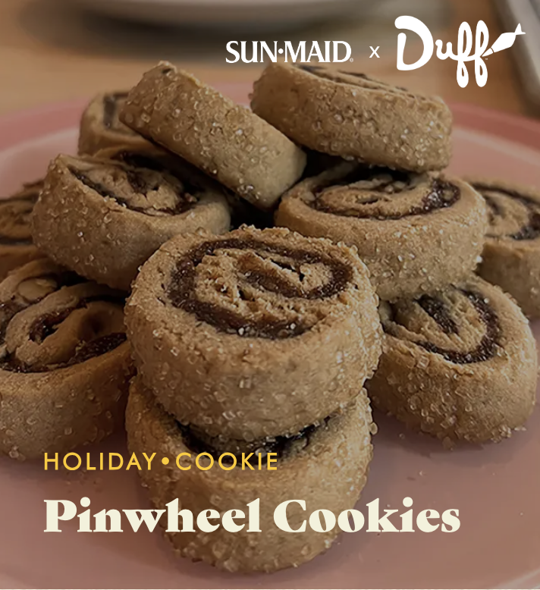
PUBLICITY STUNT
Sun Maid
Dried Fruit Breaks Up
With Fruit Cake
In a social media stunt, Sun-Maid Growers of California, “formally” announced an “amicable” breakup with fruitcake, the classic but polarizing holiday dessert.
This gives Sun-Maid dried fruits a chance to pair up with others baked goods at the holidays.
Sun-Maid even hired celebrity pastry chef, TV host Duff Goldman to create new custom recipes.
Images via Sun Maid

Slide 19
PUBLICITY STUNT
Bath & Body Works
Giant Candle Street Display
In early December 2023, Bath & Body Works installed a huge scented candle outside of the Herald Square Macy’s in New York City. The campaign, themed “Come Back to your Senses,” also includes a 15-second television spot.
Image Via Bath & Body Works

Slide 20
Public Relations
Public relations (PR) refers to a business or brand’s efforts to build and maintain a favorable image with consumers through mass communication. Unlike advertising, which can also influence consumer perceptions, public relations is not a paid form of media, and does not always have a direct impact on sales. Instead, a brand or business will lean on a public relations strategy to build its image and communicate key information to consumers without spending money through any advertising channels.
Throughout the holidays, businesses and brands engage in a variety of activities designed to make a positive impact on communities around the world.

Slide 21
PUBLIC RELATIONS
Domino’s
“Plowing for Pizza”
Domino’s is awarding half a million dollars in grants for snow plowing, “so that carryout customers can have access to hot pizza, even on the coldest, snowiest days.” Customers can nominate their hometown on the company’s website. Dominos will award up to 20 cities, $25,000 in snow plowing grants.
Image Via Domino’s

Slide 22
PUBLIC RELATIONS: CAUSE MARKETING
KFC
Sharemobile
KFC has partnered with the non-profit organization, Blessings in a Backpack since 2017 to provide food to families in need. KFC’s Sharemobile, a holiday-edition charitable food truck, provides food to families in Houston, Orlando and Chicago. KFC and its franchisees are expected to provide nearly 70,000 meals this holiday season.
The Sharemobile is an example of cause marketing, a type of public relations marketing that ties an organization with a charitable cause and features a mutually beneficial relationship between a for-profit business (sponsor) and a non-profit organization.
Image Via KFC

Slide 23
Content
Marketing
Content marketing is a strategic marketing approach focused on creating and distributing valuable, relevant, and consistent content to attract and retain a clearly defined audience—and, ultimately, drive profitable customer action.
A content marketing strategy provides businesses and brands with an effective tool for capturing the attention of consumers during the holidays while boosting levels of engagement.

Slide 24
CONTENT MARKETING
Chick-fil-A
“Stories of Evergreen Hills:
The Spark Tree”
Stories of Evergreen Hills is a series of short films, with a new installment released each holiday season. The 2023 film, “The Spark Tree” celebrates kindness, compassion, and the joy that comes from serving others.
WATCH: The Spark Tree

Slide 25
DIGITAL MARKETING: SHOPPABLE CONTENT
Home Depot x Vizio
“Merry and Bright”
Home Depot collaborated with Vizio to offer shoppable content on the home screen of their connected television (CTV) platform through the use of an on-screen QR code.
The “Merry & Bright” content consists of 10-minute episodes highlighting holiday tips and tricks from host and “American Idol” winner Jordin Sparks.
Each episode introduces a new family to viewers and shows off the ways they transform their houses with holiday decorations from The Home Depot.
Image Via Vizio

Slide 26
DIGITAL MARKETING: SHOPPABLE CONTENT
Home Depot x Vizio
“This partnership exemplifies how shoppable technology is expanding the role of brand storytelling.”
Brandon Helrich
Group Director
The Content Collective

Slide 27
DIGITAL MARKETING: SHOPPABLE CONTENT
Home Depot x Vizio
“The shift to streaming is accompanied by a corresponding shift beyond traditional 15- and 30-second ads into branded content that is closer to entertainment.”
Katelyn Wilson
Director of Branded Content Sales & Strategy
Vizio

Slide 28
Digital & Social Media Marketing
Digital marketing is when businesses promote their products and services using digital distribution channels, such as social media, online and mobile advertising.
Harnessing the power of social media and using it as a marketing tool has become a top priority for businesses and brands across the globe because it offers an effective means for connecting with and engaging consumers.

Slide 29
DIGITAL MARKETING CAMPAIGN
Coca-Cola
“The World Needs More Santas”
Coca-Cola’s 2023 “The World Needs More Santas” holiday campaign extends their almost 100-year advertising tradition of using Santa Claus as a marketing tool to generate consumer feelings of kindness and joy associated with their product.
This year's campaign includes:
Commercials
Interactive online components
Social media element using #CokeCaravan hashtag
Personalized gifts in the Coca-Cola online store
Holiday packaging
Recipes on the Coca-Cola website
Image Via Coca-Cola

Slide 30
DIGITAL MARKETING: APP
Coca-Cola
“The World Needs More Santas”
In 2023 Coca-Cola released an app that determines a user’s “inner Santa” type, generating an illustration that can be shared on social media. Users can also use this app to enter a sweepstakes, where the grand prize is a trip to Rovaniemi, Finland — the “official” hometown of Santa Claus.
Image Via Coca-Cola

Slide 31
MARKETING: GENERATIVE ARTIFICIAL INTELLIGENCE
Coca-Cola
Create Real Magic Application
In 2023, Coca-Cola unveiled a web application called Create Real Magic that allows users to create customized holiday greeting cards using iconic Coca-Cola holiday artwork from the company’s art and advertising archive.
The application leverages Generative Artificial intelligence to generate the artwork based on the user’s input and Coca-Cola’s original holiday artwork.
Generative artificial intelligence (AI) is a programming algorithm that can generate text, images, or other media. The program is trained on existing patterns and structures, called generative models, with the purpose of creating output that has similar characteristics to the model.
Image Via Coca-Cola

Slide 32
DIGITAL MARKETING X OOH ADVERTISING
Coca-Cola Caravan
In 2023, the Coca-Cola Caravan will return for it’s 26th year. The fleet of 60 lit-up Coca-Cola semi-trucks crisscross the United States on a promotional tour, stopping at Coke retailers all over the country.
Consumers are encouraged to take photos with the trucks, and post to social media using the hashtag #cokecaravan.
The Coca-Cola Caravan is an example of a company leveraging both Out of Home (OOH) advertising and digital marketing in one marketing effort.
Image Via Coca-Cola

Slide 33
Advertising
Advertising is any paid, non-personal form of communication by an identified company promoting goods and services.
Advertising channels include:
Print
Outdoor / OOH (Out of home) advertising
Traditional broadcast commercials
Online/digital media
Social media
Search
Cinema
Promotional products

Slide 34
ADVERTISING
Apple
“Fuzzy Feelings”
This ad begins as a stop-motion animation, modern-day Scrooge story. Midway through the story, the camera pans out to reveal that the film is being made by a woman using an iPhone 15 Pro Max and edited with a MacBook Air.
WATCH: “Fuzzy Feelings”
WATCH: Behind the Scenes: “Fuzzy Feelings”

Slide 35
ADVERTISING
Amazon
“Joy Ride”
A part of the company’s “The Joy is Shared” ad campaign, Amazon’s in-house creative team created the centerpiece ad “Joy Ride” with the purpose of conveying the company’s mission of making people’s lives a little easier.
The 60-second spot sees three older women who, as lifelong friends, revive the joy they felt as children at the top of a sledding hill, thanks to a moment of inspiration and Amazon’s website.
WATCH: “Joy Ride”

Slide 36
ADVERTISING
Coca-Cola
“The World Needs More Santas”
Coca-Cola’s 2023 advertising spot, “The World Needs More Santas” imagines a world where every person is Santa Claus.
WATCH: “The World Needs More Santas”

Slide 37
ADVERTISING
DoorDash
“Holiday Workers’ Lament”
DoorDash released a musical spot targeting delivery workers who gig with DoorDash. It’s a musical titled “Holiday Workers’ Lament,” all about how rough it can be working retail and food-service jobs at this time of year. Be a Dasher instead, says the spot.
WATCH: Holiday Workers Lament

Slide 38
SOCIAL MEDIA ADVERTISING / OOH ADVERTISING
Spotify
Wrapped
Spotify Wrapped is a viral marketing campaign created by Spotify with the purpose of increasing subscribers and user engagement. Released annually since 2016, every December, Spotify Wrapped breaks down a user’s listening preferences and produces a list of their most-streamed artists over the past year.
Spotify also encourages users to share their results on social media.
OOH: Billboard for Spotify Wrapped

Slide 39
OOH ADVERTISING
Hulu
Wrapping Paper Billboards
Hulu's 2023 holiday billboards feature show-themed wrapping paper that can be pulled off and used! The billboards are refreshed daily, and each ad has 25 sheets of wrapping paper. Hulu anticipated creating about 15,000 sheets of paper in total.
OOH: Billboard for Hulu
Image Via Hulu

Slide 40
Discussion
Questions

Slide 41
Discussion Questions
What is seasonal marketing?
What is one example of seasonal marketing?
Is seasonal marketing equally important to all businesses and brands? Why or why not?
What is advertising?
Why do businesses and brands advertise?

Slide 42
Discussion Questions
Do you think some businesses and brands spend more on advertising during the holidays? Why or why not?
What is promotion?
What are the different types of promotion?
What type of promotion is Black Friday and Cyber Monday?
Why is promotion important around the holidays?

Slide 43
Discussion Questions
When do you think a holiday-themed promotion should launch? Why?
What is a marketing stunt?
Why do you think businesses and brands launch marketing stunts?
What are some examples of holiday marketing that you have seen in your area?
Which of these campaigns do you think was the best?

Slide 44
Discussion Questions
Why is Olive Garden selling a “Seasons Gratings” sweatshirt in their online store?
Why do you think Burger King wants consumers to use the app?
What is social media marketing?
Which of these holiday campaigns utilized a social media component?
Which brand is using shoppable content marketing? Why do you think they are using that advertising channel?

Slide 45
Discussion Questions
What is cause marketing and what does KFC hope to accomplish from their cause marketing effort?
What do you think Chic-fil-A hopes to accomplish with a video-short like the one featured in this presentation?
How might packaging provide brands with a marketing opportunity? Why do you think this is popular during the holidays?

Slide 46
Activity Suggestions

Slide 47
Activity Suggestions
Review each campaign from this presentation and identify what the business or brand might hope to accomplish. Are they hoping to bolster the brand’s image? Raise awareness about a product or service? Increase sales?
Choose the campaign you liked the best and identify a direct competitor of the business or brand featured in the campaign. Then, develop a holiday campaign for the competitor brand.

Slide 48
Activity Suggestions
Select one of your favorite businesses or brands and create a holiday-themed cause marketing campaign.
Think of a local business that would benefit from a holiday-themed marketing campaign. Create a strategy incorporating elements like advertising, social media marketing, and public relations but do so in a way that would be budget-friendly and affordable.
Develop a marketing stunt for a charity that would help raise awareness (and potentially funds) for the cause.

Slide 49
Sources

Slide 50
Sources
stories.starbucks.com/stories/2023/starbucks-holiday-highlights-2023/
news.dunkindonuts.com/news/holiday-menu-2023 https://www.brit.co/dunkin-holiday-menu/
people.com/m-and-ms-drops-new-vanilla-white-chocolate-flavor-holiday-season-8386784
mms.com/customized-packaging https://www.restaurantbusinessonline.com/marketing/olive-garden-launches-holiday-merchandise-collection-starring-its-iconic-cheese
news.bk.com/blog-posts/tis-the-cheeson-burger-king-r-celebrates-the-holidays-with-31-days-of-deals-and-the-return-of-two-fan-favorites https://www.prnewswire.com/news-releases/dominos-is-plowing-for-pizza-snowy-roads-shouldnt-get-in-the-way-of-hot-pizza-302003913.html
newsroom.chipotle.com/2023-11-29-CHIPOTLE-DRIVES-HOLIDAY-GIFTING-TO-NEXT-LEVEL-WITH-FAN-INSPIRED-CAR-NAPKIN-HOLDER-AND-MYSTERY-TEES
www.mediapost.com/publications/article/391595/chipotle-launches-holiday-merch-celebrating-napkin.html
www.mediapost.com/publications/article/391647/turo-warner-brothers-partner-for-elf-promotion.html?edition=132553
www.kfc.com/kfcsharemobile

Slide 51
Sources
qsrweb.com/news/kfc-foundation-donates-1m-for-community-projects/
adweek.com/brand-marketing/amazon-holiday-campaign-growing-creative-power/
adweek.com/brand-marketing/apples-holiday-ad-is-a-modern-day-scrooge-tale-in-stop-motion/
marketingdive.com/news/coke-coca-cola-holiday-campaign-2023-santa-AI/698731/
adage.com/creativity/work/hulus-holiday-billboards-come-show-themed-wrapping-paper-passersby/2532266
marketingdive.com/news/best-holiday-marketing-campaigns-2023/699044/
marketingdive.com/news/home-depot-vizio-holiday-shoppable-content-qr-codes/698450/

