Slide 1

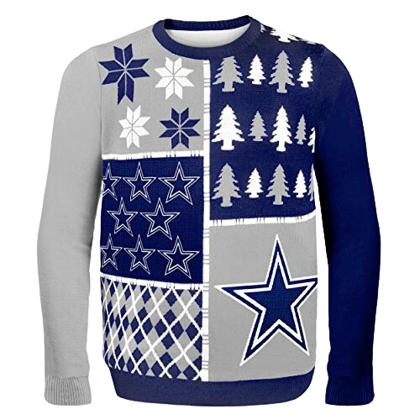

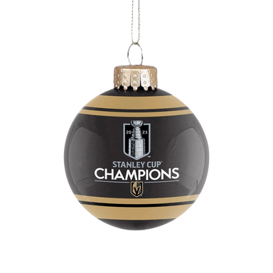
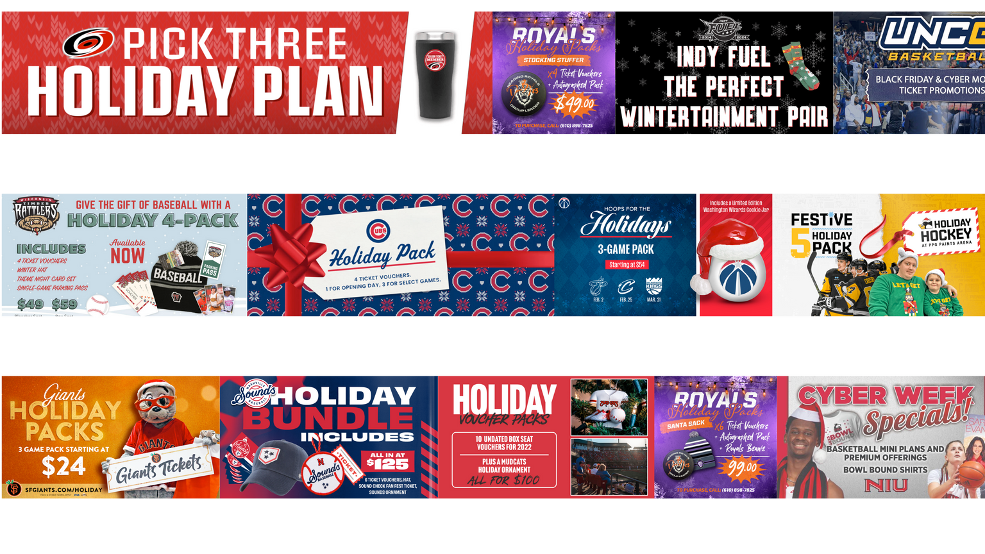
HOLIDAY SPORTS
MARKETING
THE BUSINESS OF SPORTS & ENTERTAINMENT

Slide 2

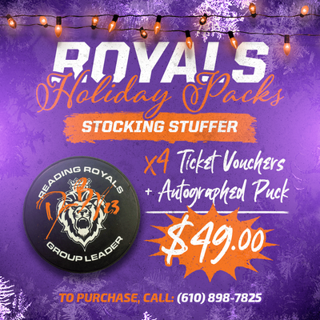

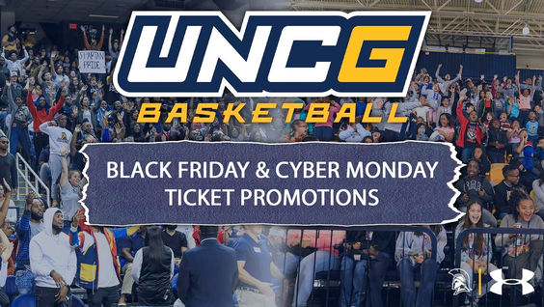
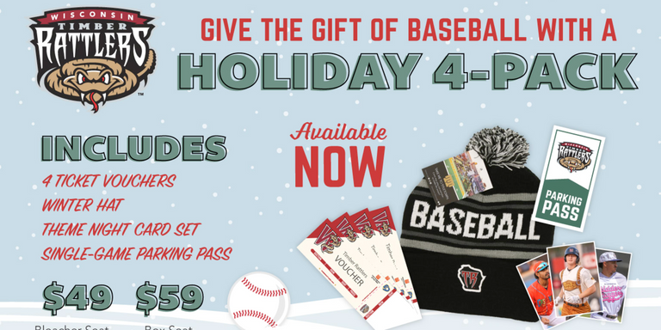
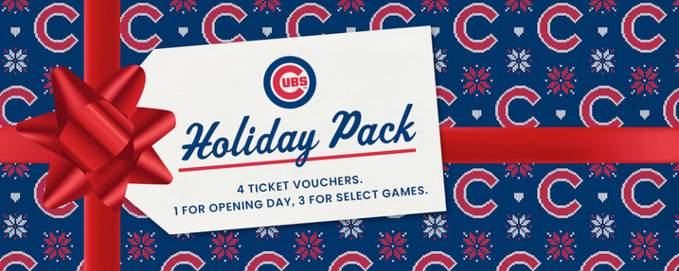
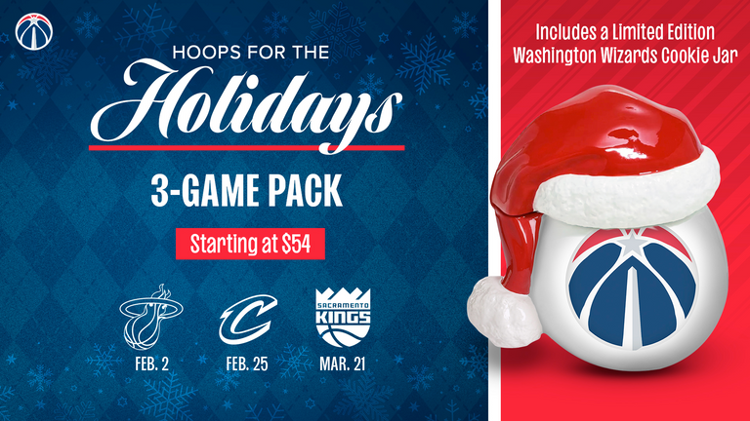
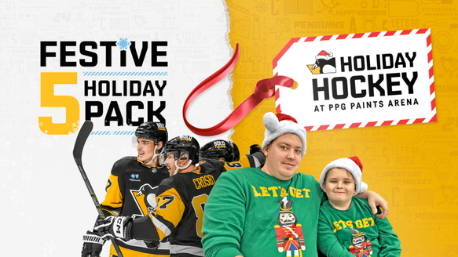
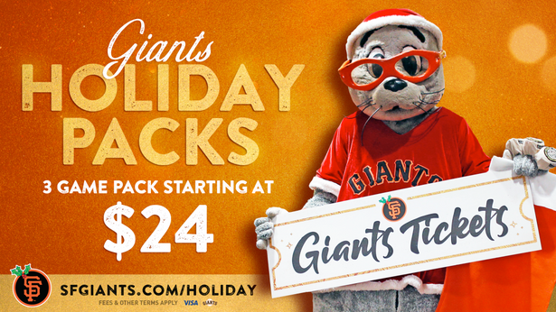
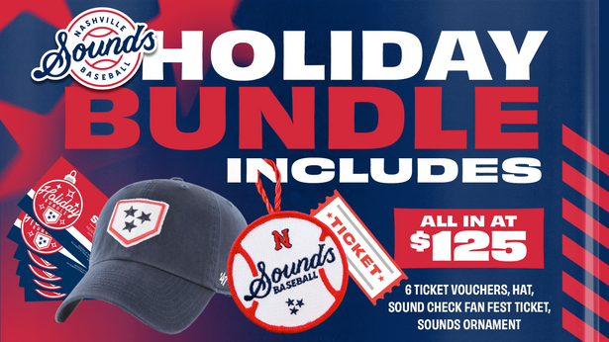
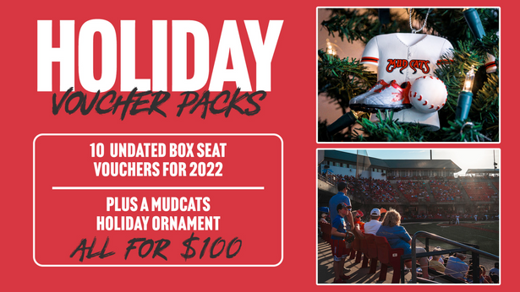
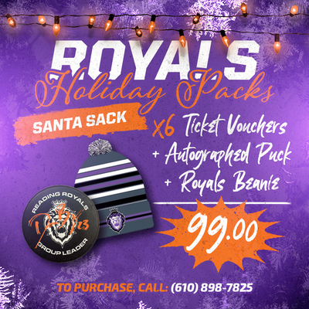
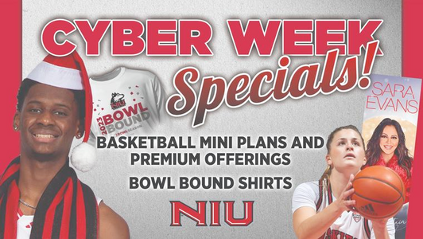

Slide 3




PROMOTION
Promotion is any form of communication used to inform, persuade, or remind people about company products or services.

Slide 4


WHY DO SPORTS TEAMS OFFER PROMOTIONS?
Effective promotions can help generate sales while creating opportunities to engage and connect with consumers. They can also help to create or maintain a positive image for a sports organization or brand.

Slide 5


WHAT ARE SOME EXAMPLES?
During the holidays, sports teams will launch promotions ranging from ticket sales and merchandise to community relations. In this presentation, we will review several holiday-themed sports marketing and promotions campaigns offered by sports teams this year.

Slide 6


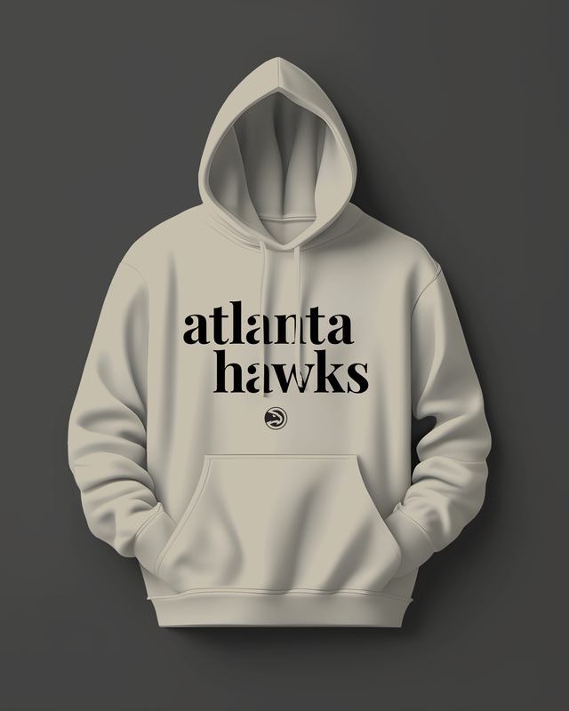
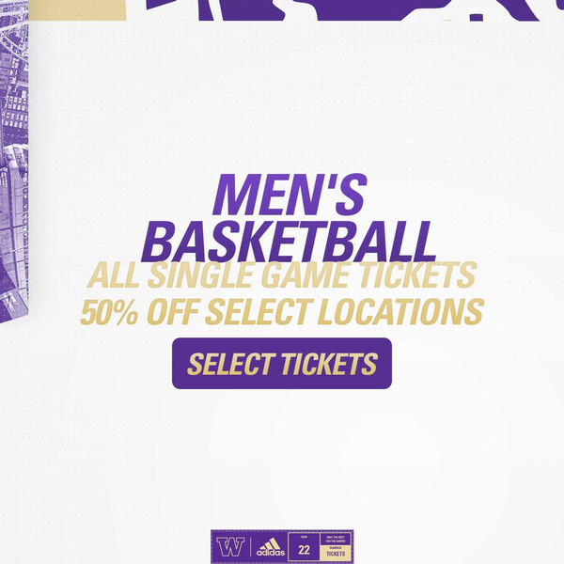


Sports Career Consulting
The Business of Sports and Entertainment
UNIVERSITY OF WASHINGTON
ATLANTA HAWKS
The Atlanta Hawks offered a “Holiday Bundle” package that included two game tickets at nearly 50% off along with a city-edition hoodie that wasn’t available for purchase anywhere else other than as part of the holiday bundle.
In a twist, the Huskies launched a “Purple Friday” promotion (instead of Black Friday), offering discounts on tickets to men’s basketball, women’s basketball, and the home opener to next year’s football game.
source: fevo-enterprise.com/group/Hawksholidaybundle // https://gohuskies.com/sports/2022/11/24/black-friday-x-purple-friday-ticket-deals

Slide 7

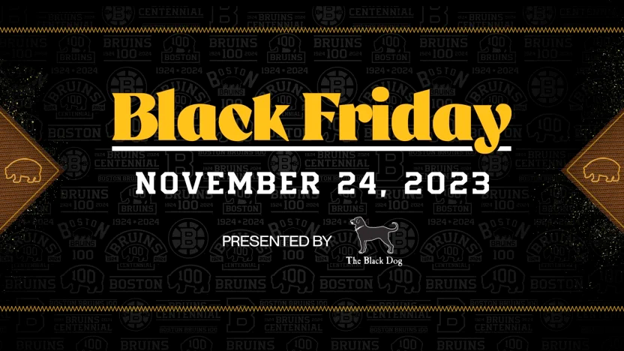
Sports Career Consulting
The Business of Sports and Entertainment
BOSTON BRUINS
The Boston Bruins introduced several promotions tied to their Black Friday game. The arena ProShop held a special “early bird” shopping event from 8-10 a.m. on Black Friday. For one hour beginning at 8 a.m., purchases were discounted by 30 percent, followed by a 20 percent discount from 9 a.m. to 10 a.m. Also, the team’s charitable arm, the Bruins Foundation, sold ornaments made with Plexiglass from the 2023 Winter Classic at Fenway Park to raise money for charity.
source: https://www.nhl.com/bruins/news/bruins-announce-promotions-for-black-friday-game-presented-by-the-black-dog

Slide 8

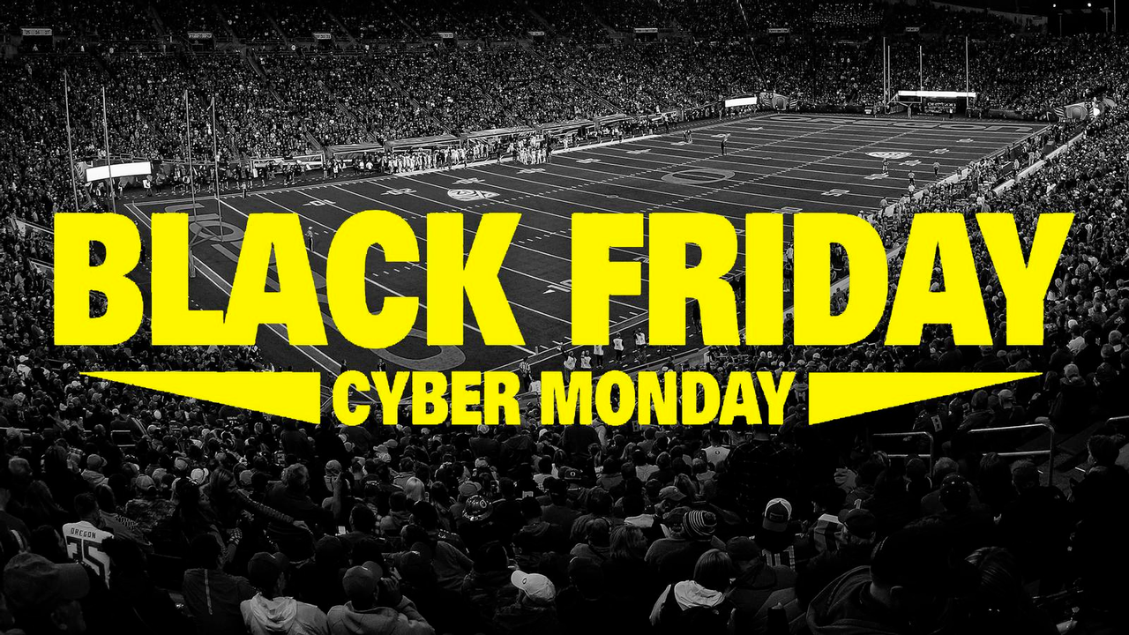

Sports Career Consulting
The Business of Sports and Entertainment
INDIVIDUAL GAME TICKET SALES PROMOTION
50% OFF
UNIVERSITY OF OREGON DUCKS HOLIDAY FLASH SALE
OREGON WOMEN'S BASKETBALL
UCLA $5 Ticket (52% Savings)
Purchase: Black Friday | Cyber Monday
ONLY 500 AVAILABLE
Limited 100 Level $5 tickets available
UCLA | February 18
OREGON MEN'S BASKETBALL
Michigan $5 Ticket (50% Savings)
Purchase: Black Friday | Cyber Monday
200 Level $5 tickets available
Michigan | December 2
source: https://goducks.com/sports/2016/11/22/black-friday

Slide 9

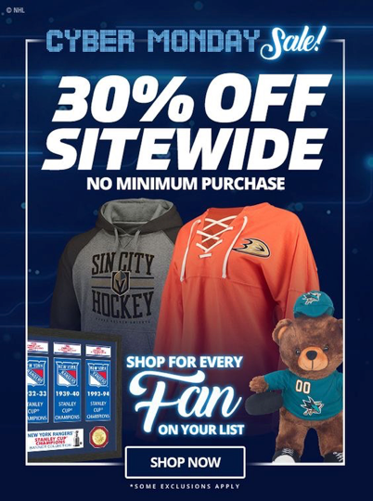
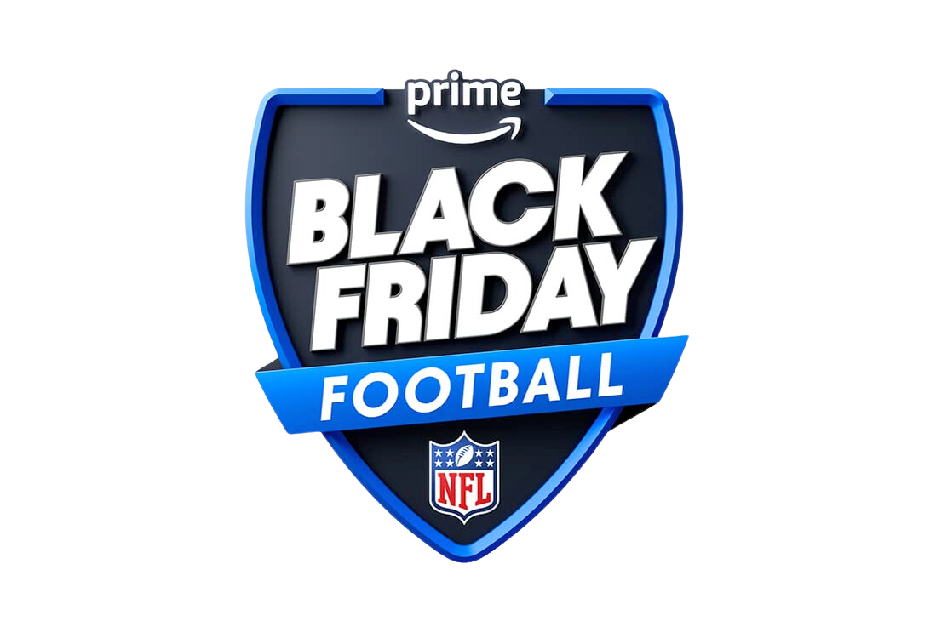
NHL CYBER MONDAY
The NHL offered 30% off everything on the league’s website for Cyber Monday, with no minimum purchase, which can be a deterrent for some consumers.
Meanwhile, Amazon leveraged its position as official broadcast rightsholder to Thursday Night Football to move its traditional Thursday game to Friday, creating the first-ever “Black Friday” NFL football game.
NFL / AMAZON “BLACK FRIDAY” FOOTBALL

Slide 10
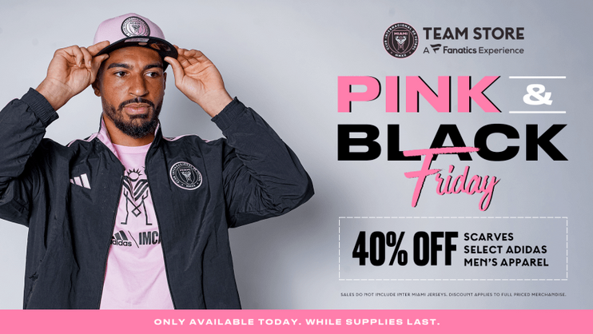

Sports Career Consulting
The Business of Sports and Entertainment
INTER MIAMI CF
LOS ANGELES ANGELS
Major League Soccer’s Inter Miami CF launched a special “Pink and Black Friday” offering 40% off select adidas apparel while focusing on a promotion to help them sell a specific product, its Inter Miami CF scarves.
The Angels offered two options for fans to purchase a single game suite, which included 12 tickets with $480 in food and beverage credits and parking passes at nearly half-off the regular price.
source: intermiamicf.com/news/inter-miami-cf-team-store-at-drv-pnk-stadium-announces-pink-black-friday-sale-de

Slide 11

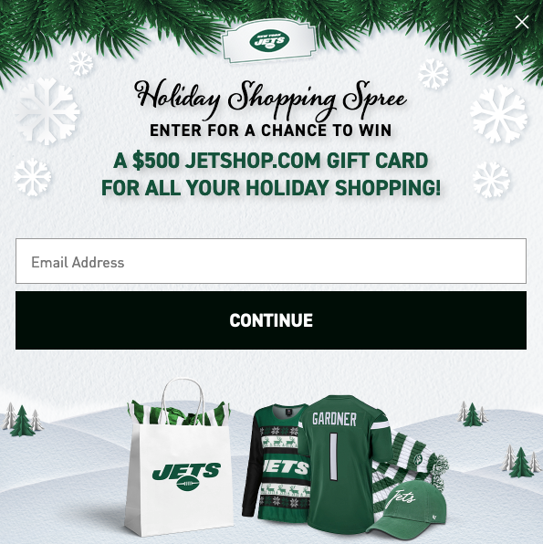
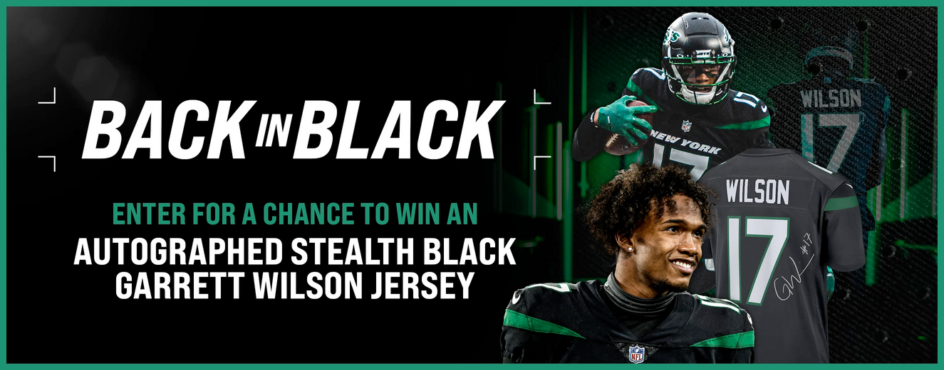

Sports Career Consulting
The Business of Sports and Entertainment
NEW YORK JETS SWEEPSTAKES PROMO
The Jets introduced a Sweepstakes promotion for the Holiday Season, giving away a $500 gift card to the Team Shop and an autographed jersey of one of the team’s most popular players. The promotion helped the team to capture fan email addresses to use in future marketing efforts.
source: https://www.newyorkjets.com/fans/sweepstakes/black-friday-sweeps

Slide 12


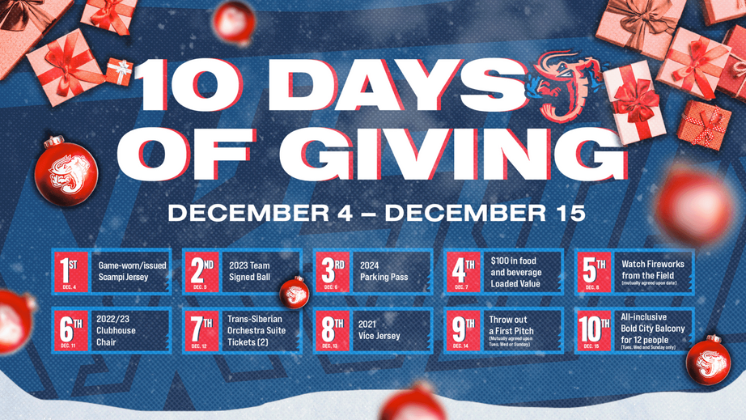
Sports Career Consulting
The Business of Sports and Entertainment
JACKSONVILLE JUMBO SHRIMP
Each year, Minor League Baseball’s Jacksonville Shrimp launches “10 Days of Giving” where the team gives away everything from tickets and merchandise to unique experiences, like the opportunity to throw a ceremonial first pitch at a home game.
The team also invites fans to a holiday-themed event at the ballpark, charging just $1 for admission. Fans can take pictures with Santa, buy holiday crafts, and meet the team’s mascot while holiday movies play on the videoboard.
source: https://www.milb.com/news/very-shrimpy-christmas-presented-by-the-law-offices-of-ron-sholes-and-fun-4-firs h

Slide 13
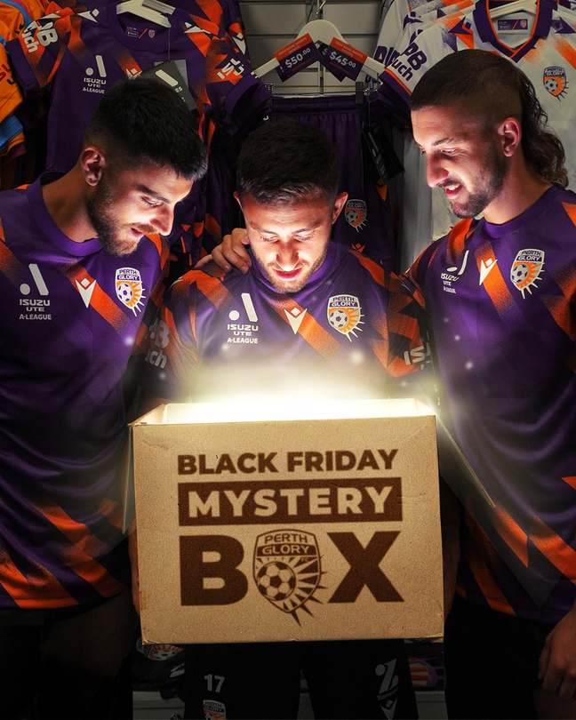
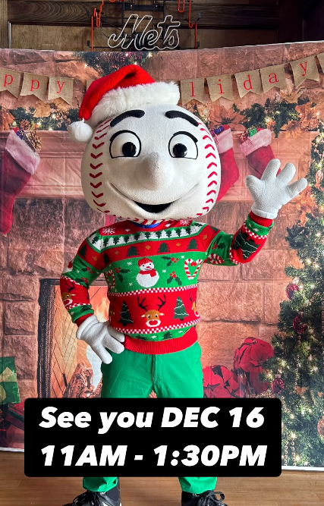
PERTH FC BLACK FRIDAY
NEW YORK METS PHOTO OPS
Australia’s Perth FC sold Black Friday “Mystery Boxes” on the team’s websites. Fans purchasing the box could receive a wide variety of merchandise, including jerseys, hats, accessories, and other gear.
The NY Mets, wanting to draw more fans to the team store to shop during the holidays, promoted things like photo opportunities with the team’s mascots on Instagram.
source: twitter.com/PerthGloryFC/status/1727169262383767611 // https://gohuskies.com/sports/2022/11/24/black-friday-x-purple-friday-ticket-deals

Slide 14
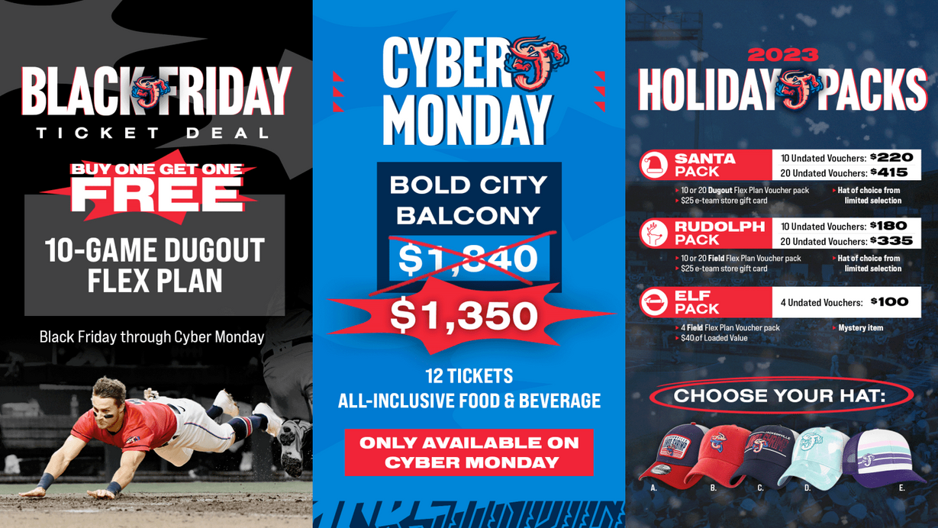
Sports Career Consulting
The Business of Sports and Entertainment
JACKSONVILLE JUMBO SHRIMP
Of course, the team also takes advantage of the holidays to offer a variety of ticket promotions. The Jumbo Shrimp offered a BOGO Black Friday ticket deal, an “all-inclusive” package on Cyber Monday that included food and beverage with a ticket purchase, and three different Holiday Packs offering mini-plans bundled with team-branded merchandise.
source: https://www.milb.com/news/very-shrimpy-christmas-presented-by-the-law-offices-of-ron-sholes-and-fun-4-firs h

Slide 15



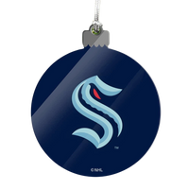
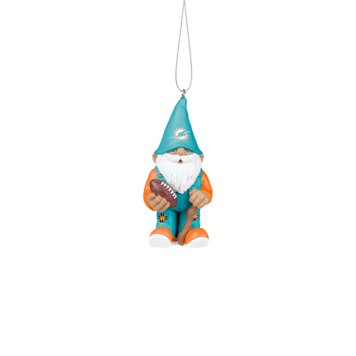
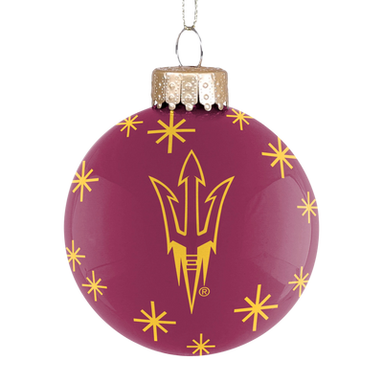
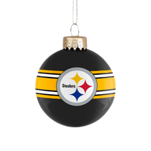
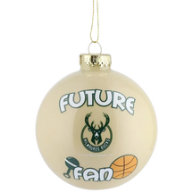
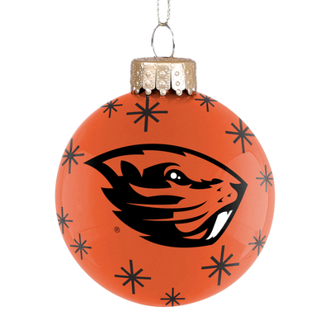
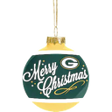
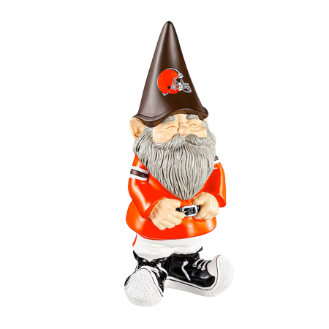
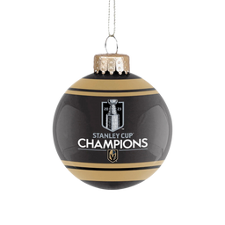
Sports Career Consulting
The Business of Sports and Entertainment
SEASONAL
PRODUCT
OFFERS!
ALL SPORTS TEAMS, COLLEGE, MINOR-LEAGUE, AND MAJOR LEAGUE
Nearly all sports teams offer unique holiday-themed products during the holiday season. Popular sellers include figurines, ornaments, “Ugly Christmas Sweaters”, light-up sweaters, gift wrap, “stocking stuffer” suggestions, holiday decor including stockings and Santa hats, and of course, special holiday ticket packages.

Slide 16


Sports Career Consulting
The Business of Sports and Entertainment
ROCKET CITY TRASH PANDAS
The Rocket City Trash Pandas, a Minor-League Baseball franchise, provide opportunities for fans to visit the ballpark for a drive-thru holiday-themed light show. The show is a mile-and-a-half maze lit up with more than 1 million lights and admission is $30 per car.
The team also created a unique fundraising opportunity as part of its Rocket City Christmas Light Show program. Fans can grab trees ranging from 2 feet to 9 feet with a donation of $20-$120. Proceeds benefit several local charities in partnership with the Trash Pandas.
source: https://www.milb.com/rocket-city/events/christmas

Slide 17
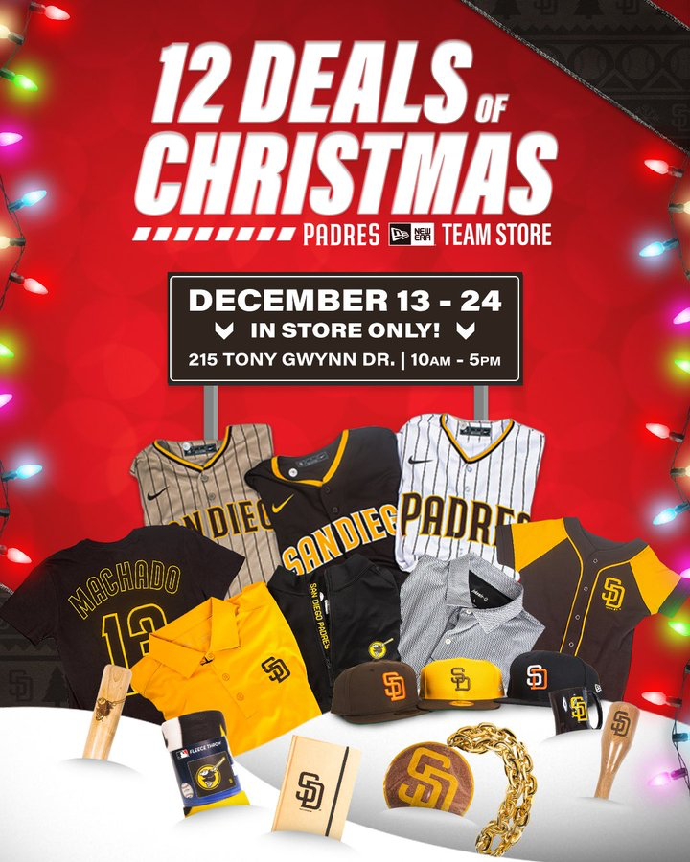
Sports Career Consulting
The Business of Sports and Entertainment
SAN DIEGO PADRES
The San Diego Padres used Instagram to promote its “12 Deals of Christmas” holiday marketing campaign in which the team offered different special promotions every day from December 13th to December 24th. The deals were only available on-site at the Team Store at Petco Park (the team’s home stadium).
source: https://twitter.com/Padres/status/1470127349798617090

Slide 18
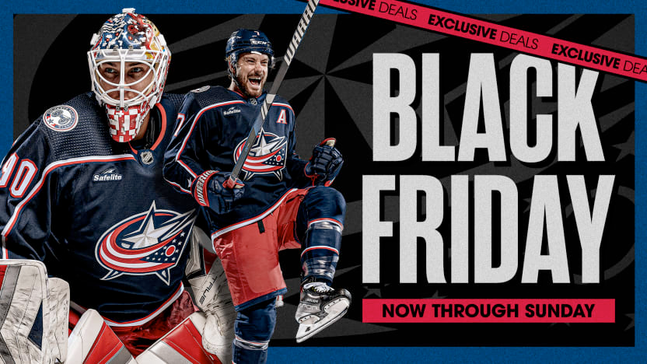
Sports Career Consulting
The Business of Sports and Entertainment
Exclusive!
COLUMBUS BLUE JACKETS
The NHL’s Columbus Blue Jackets offered a holiday package featuring “Loaded Tickets”, which are single-game tickets that include a value meal and a pass to ice skate at a local rink. The team also sold “Mystery Ornaments”, each autographed by different players on the team or the team’s mascot, Stinger, and sold them for $30 each to raise money for charity.
source: https://www.milb.com/news/very-shrimpy-christmas-presented-by-the-law-offices-of-ron-sholes-and-fun-4-firs h
source: https://www.nhl.com/bluejackets/news/blue-jackets-launch-black-friday-promotions-and-offers

Slide 19
SPORTS MARKETING
DISCUSSION
THE BUSINESS OF SPORTS & ENTERTAINMENT

Slide 20
50% OFF
DISCUSSION QUESTIONS
1) What is promotion?
2) What are the different types of promotion?
3) Why do sports teams offer promotions?
4) Why might the holidays be an important time of year for promotion?
5) What is Black Friday and Cyber Monday?
6) Why do sports teams offer promotions for Black Friday and Cyber Monday?
7) Based on what you saw in this presentation, what types of promotions do they offer?
Sports Career Consulting
The Business of Sports and Entertainment

Slide 21
50% OFF
DISCUSSION QUESTIONS
8) Why do you think Amazon wanted to broadcast a “Black Friday” NFL game, one of the busiest times when shoppers are visiting retail stores?
9) What is inventory? Why do you think some holiday-themed merchandise items are only offered in limited quantities?
10) Not all promotions are sales promotions. How else might a sports team benefit from a holiday promotion if it isn’t specifically designed to help sell tickets or merchandise?
11) If your class was responsible for building a holiday-themed marketing campaign for your high school athletics, what types of promotions would you offer?
ACTIVITY IDEA: Create a holiday marketing campaign for your high school sports program.
Sports Career Consulting
The Business of Sports and Entertainment

