Slide 1



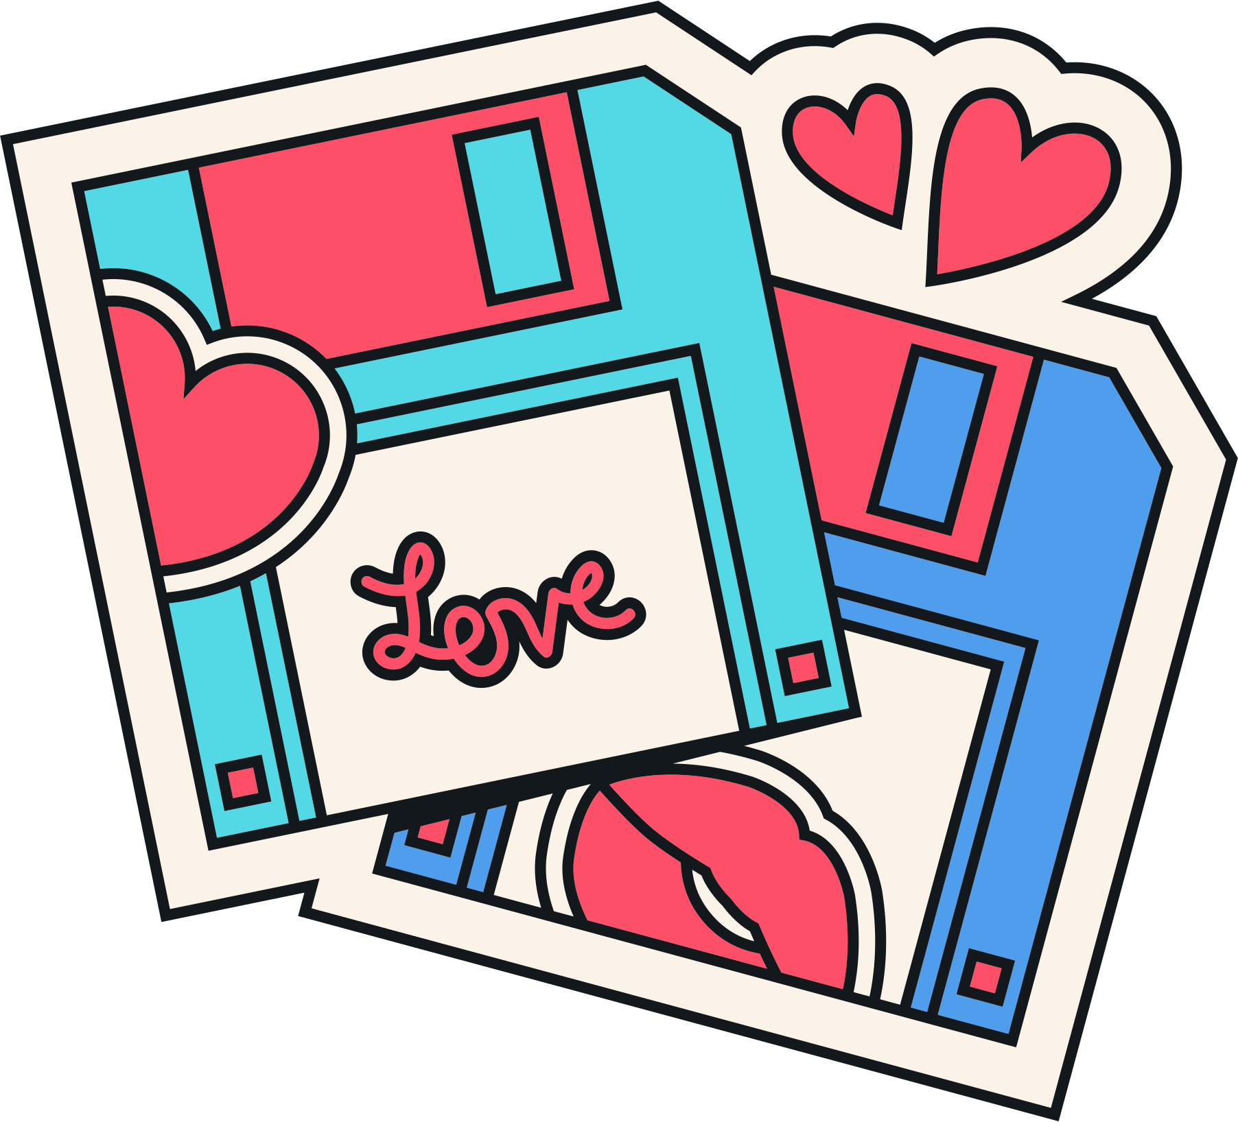





BRANDS
VALENTINE’S DAY

Slide 2

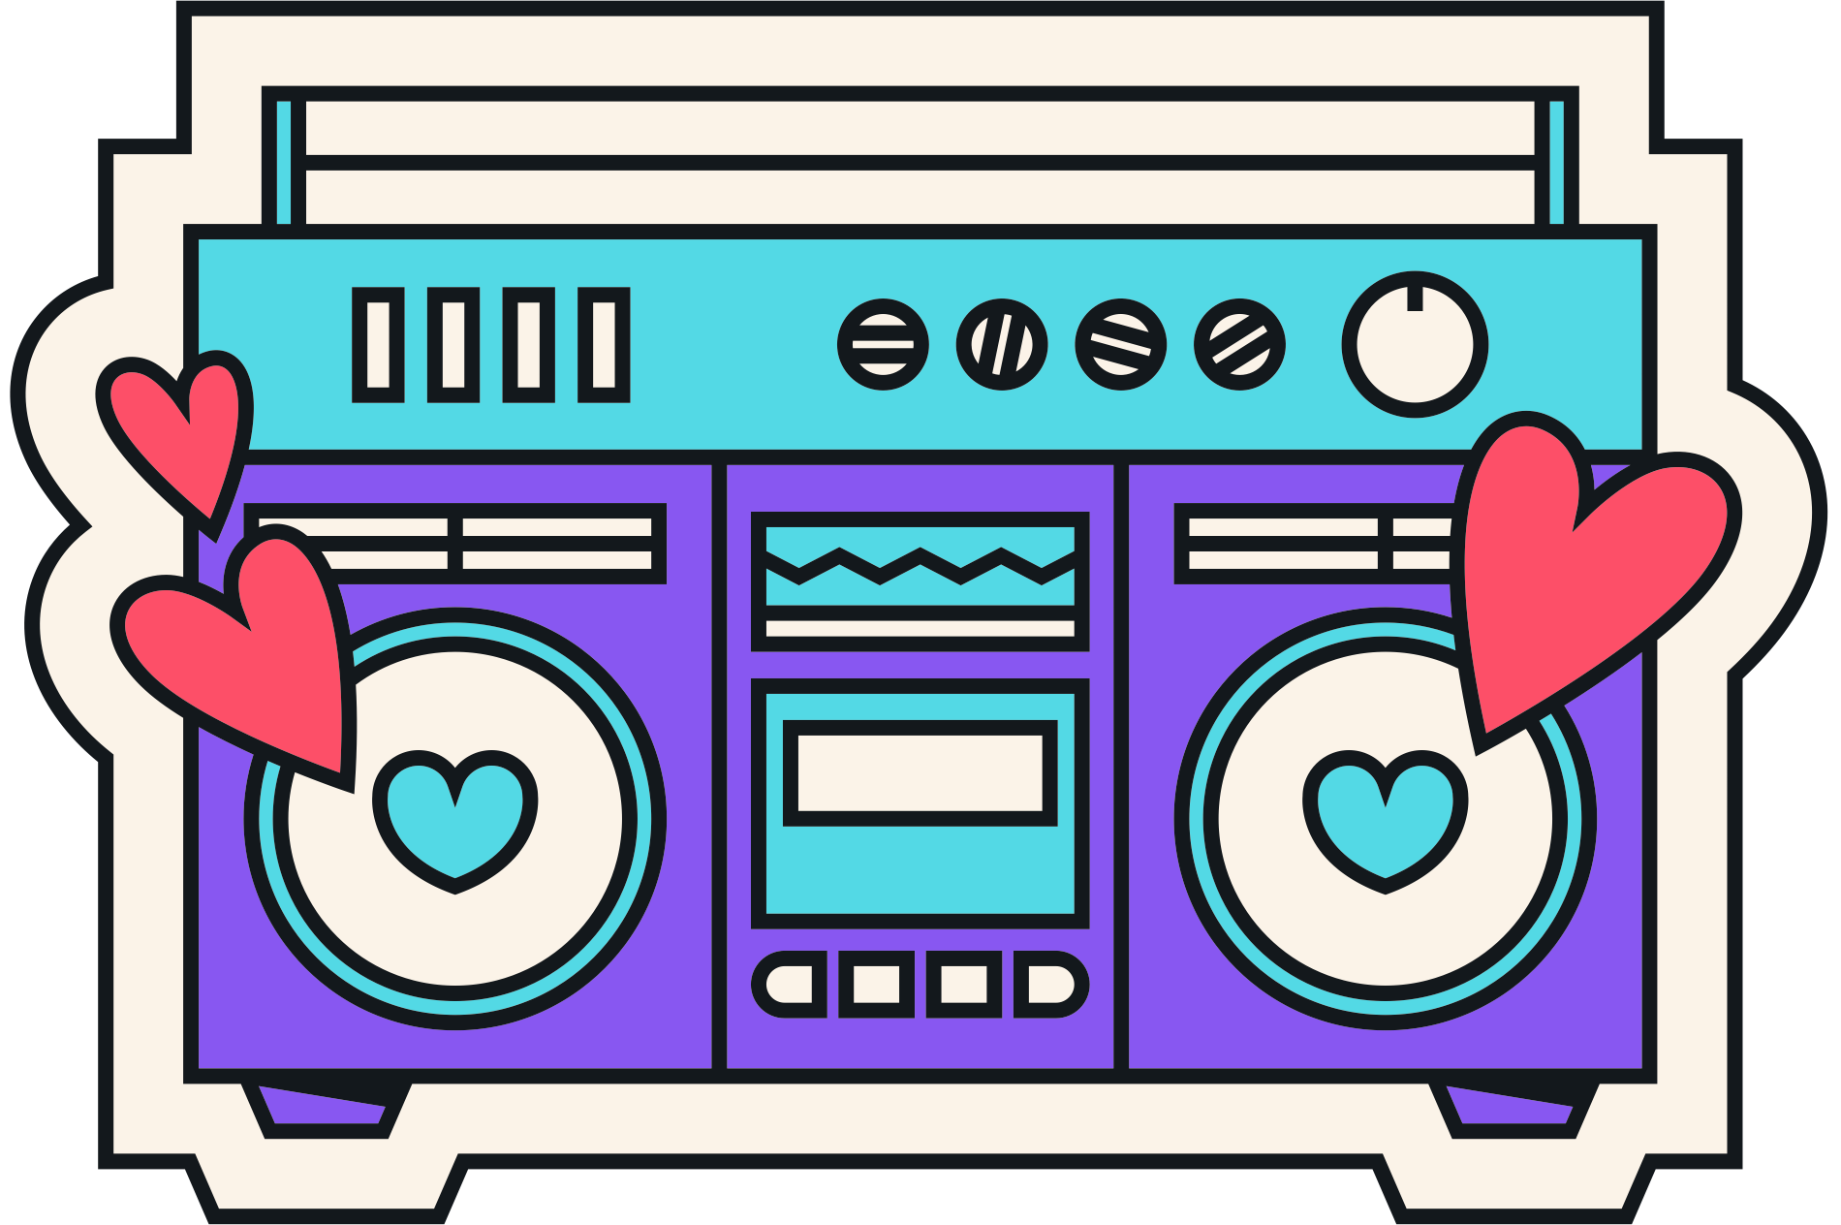
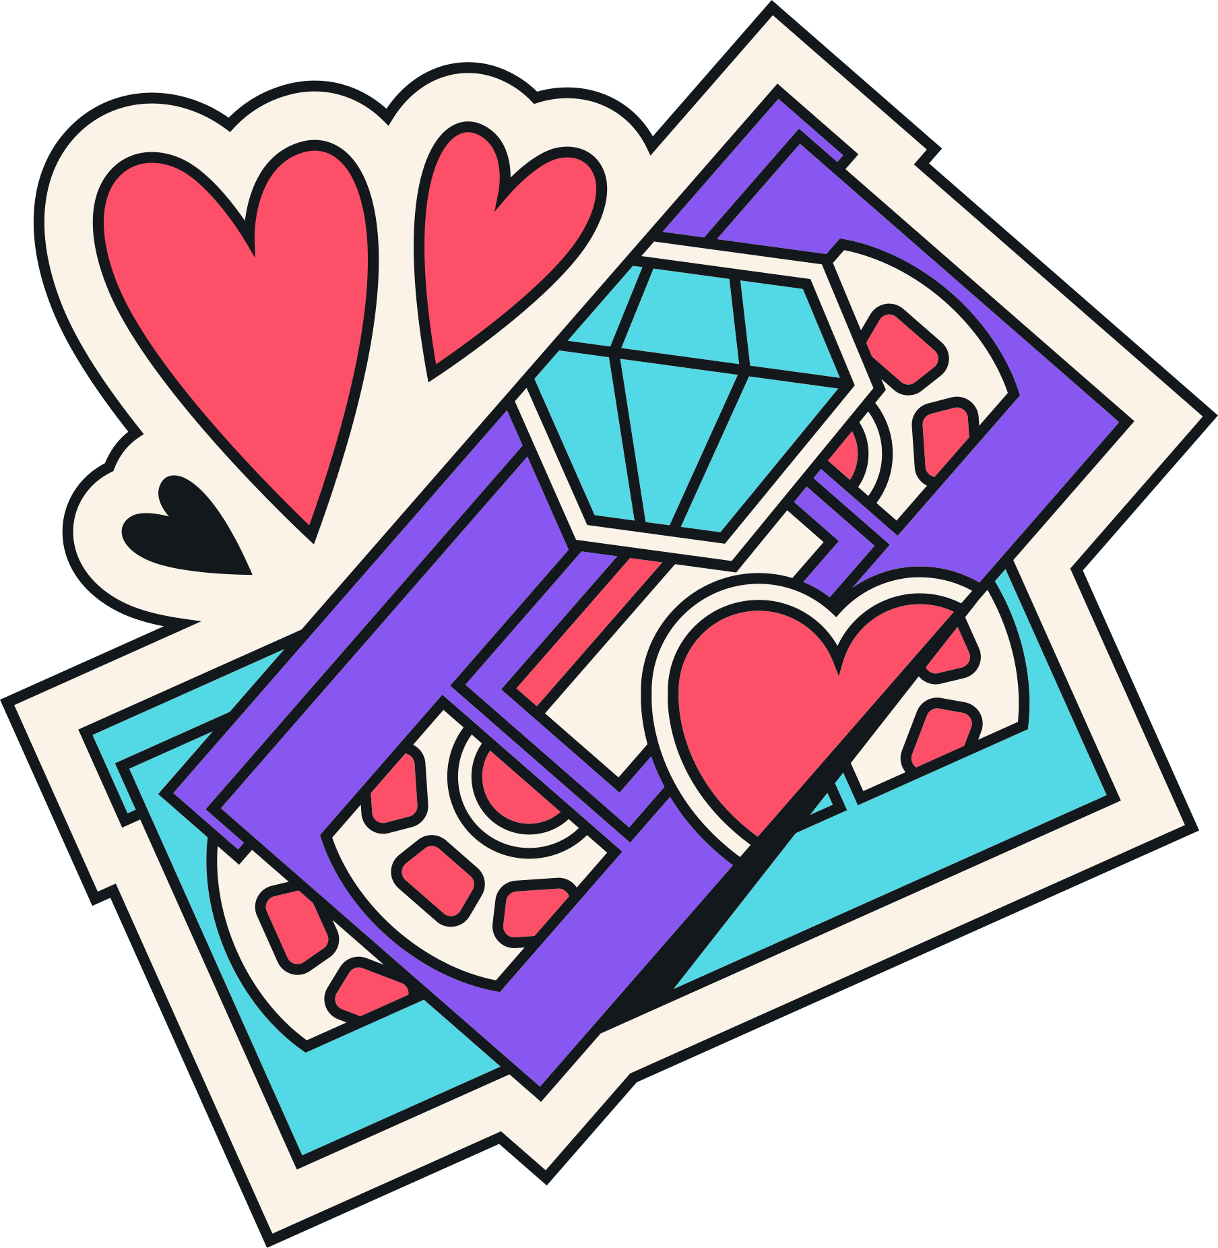
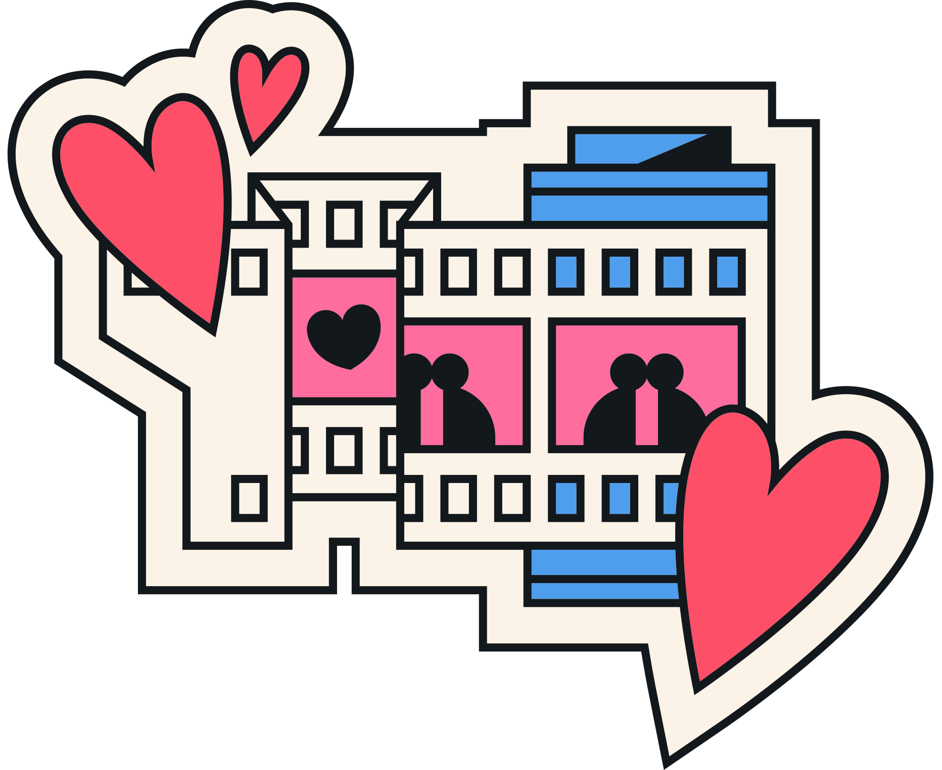
PROMOTION
Promotion is any form of communication used to inform, persuade, or remind people about a company’s products or services.
Promotion plays a significant role in creating and maintaining the levels of commitment and emotional involvement consumers have with the brand.

Slide 3

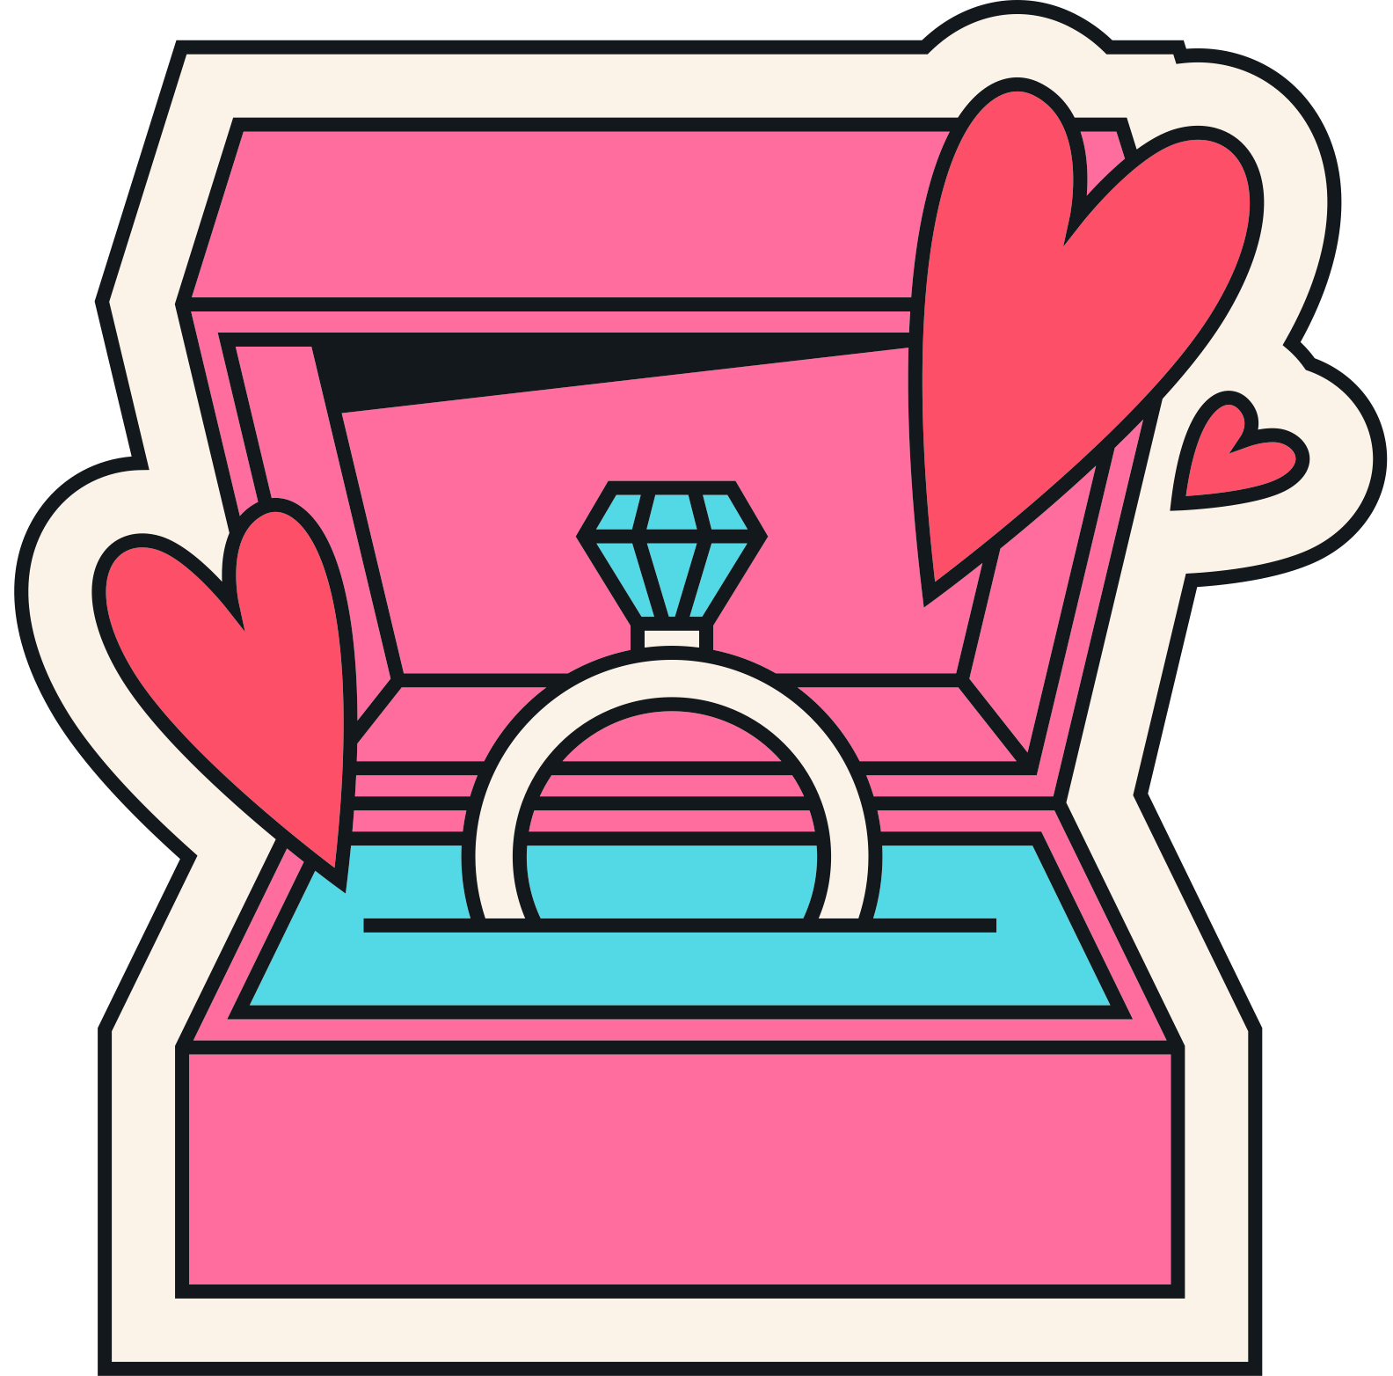
PACKAGING
Packaging is the process of designing and producing the container for a product. The container could be anything from a candy bar wrapper to the packaging surrounding a new Android device.
HOW IMPORTANT IS PACKAGING AS IT RELATES TO MARKETING?
Some industry professionals consider packaging as a fifth “P” in an expanded variation of the marketing mix.

Slide 4
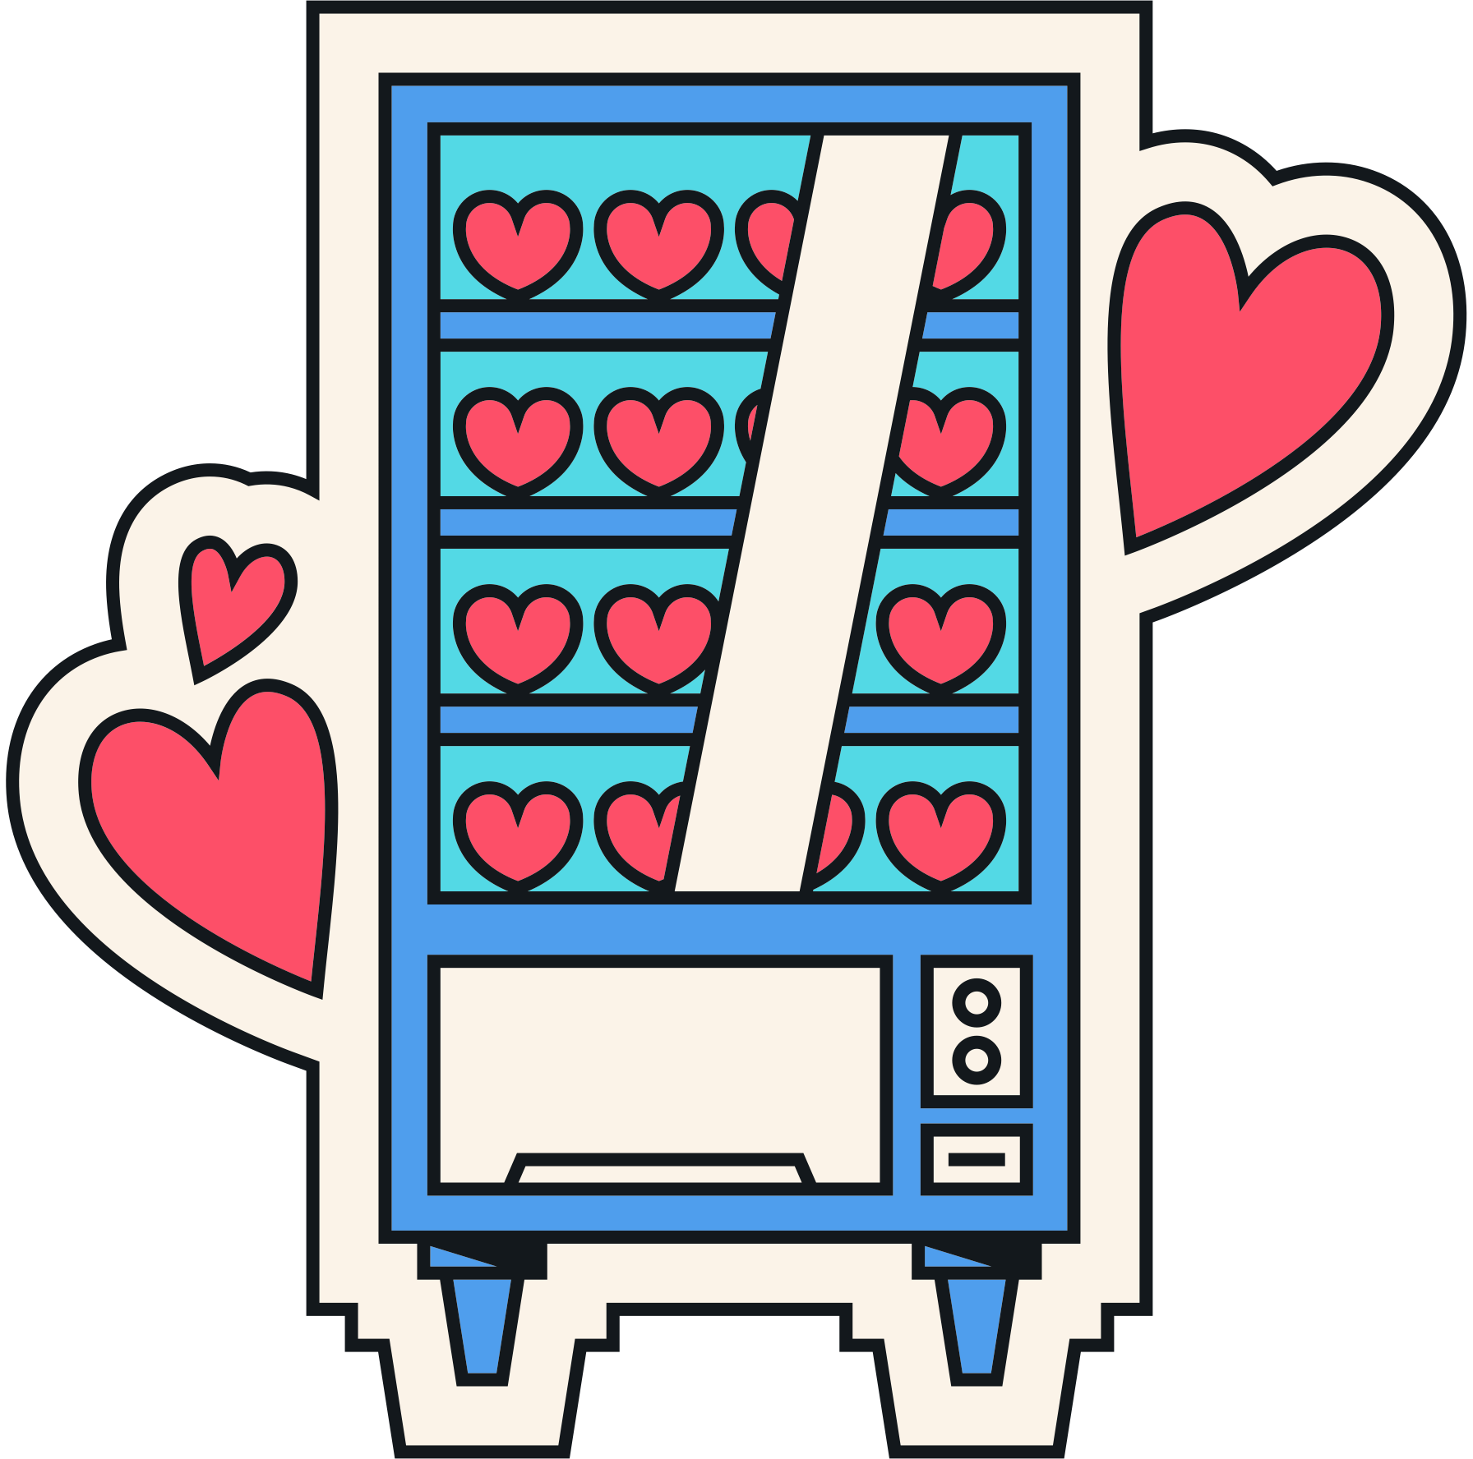


PACKAGING &
PROMOTION
How do businesses and brands develop packaging & promotion strategies to help grab consumer attention?
Let's look at some of this year's notable Valentine's Day brand packaging and promotions strategies.

Slide 5
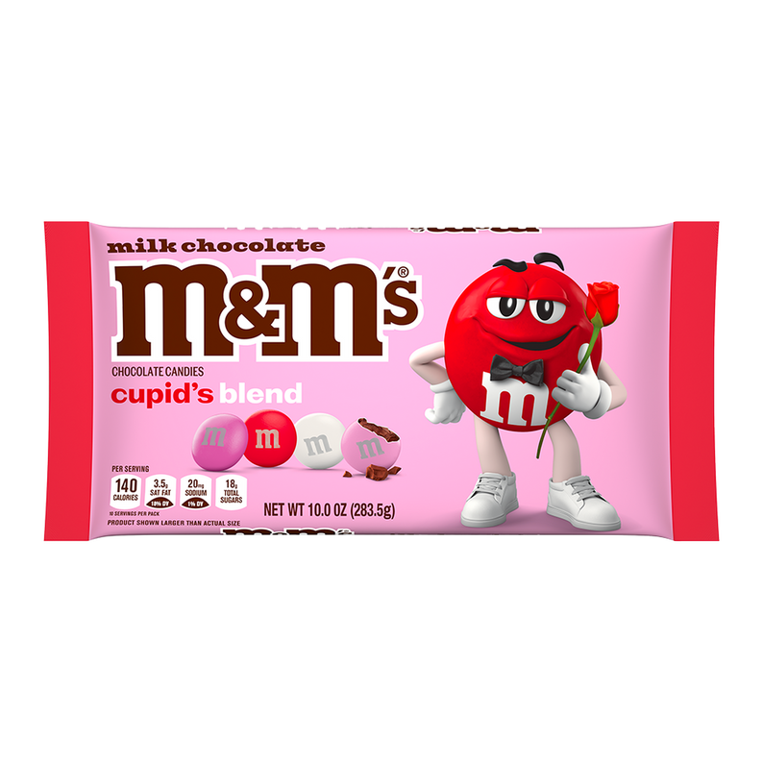
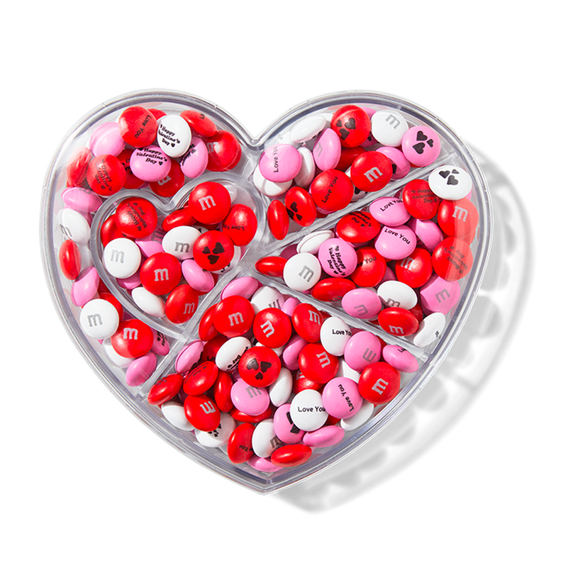
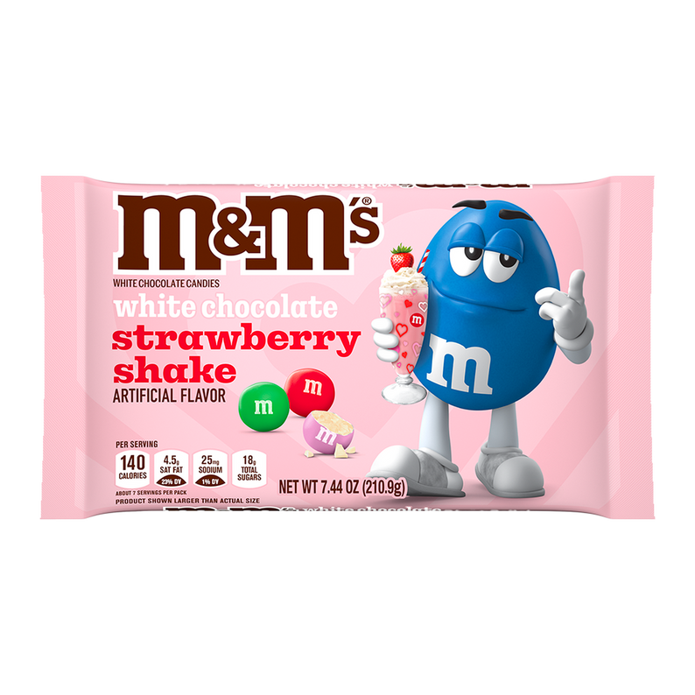
M&Ms
Each year, M&M's releases a Valentine’s Day Gift Guide (a subsection of their online store), that offers customizable gifts, party favors and limited-time seasonal flavored candy.
This year, M&Ms is bringing back their popular limited-edition seasonal flavor, White Chocolate Strawberry Shake.
M&Ms also offers heart-shaped candy boxes, themed gift bottles and gift jars.

Slide 6
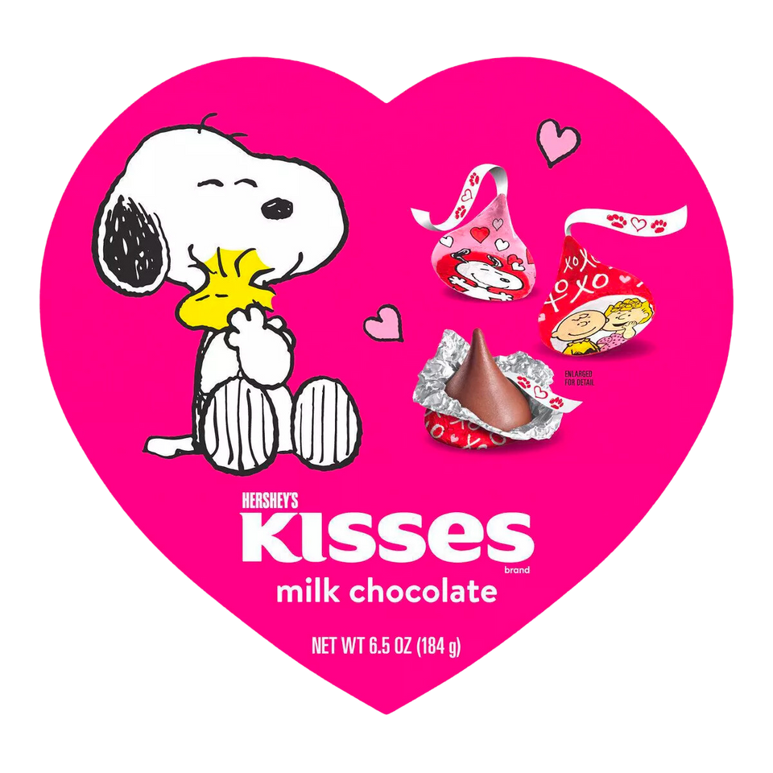
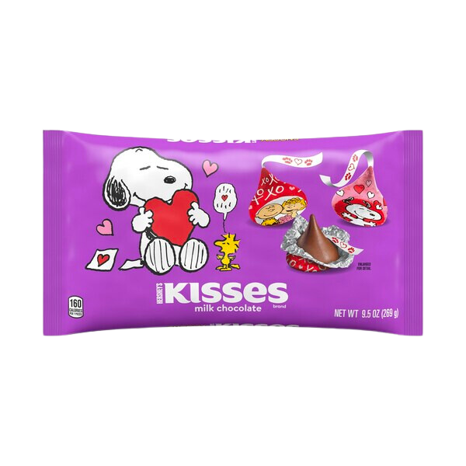
HERSHEY’S
New for 2024, Hershey’s introduced a special line of their famous Hershey’s Kisses candy that feature characters from the Peanuts cartoon series on special holiday product packaging.
This partnership is an example of character licensing, a marketing strategy wherein a brand gives permission to use their images or logos in another brand’s consumer products or promotions.

Slide 7
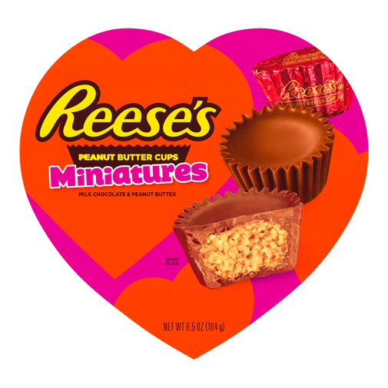
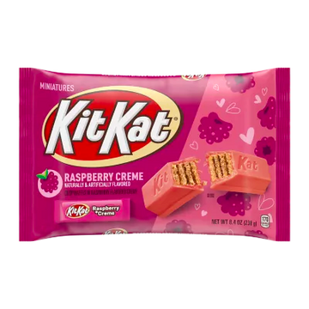
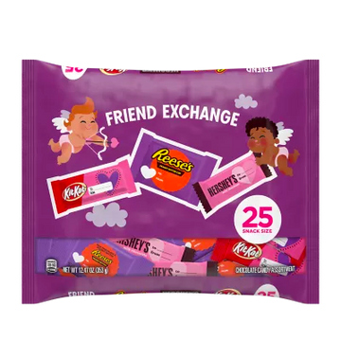
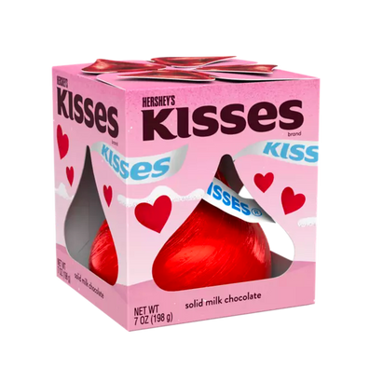
HERSHEY’S
In 2024, Hershey’s is also offering a complete range of Valentines branded candies, special valentines packaging and limited-edition product flavors.
Hershey’s Valentine’s Day product sales account for a significant portion of the company’s first quarter (January - April) sales each year.

Slide 8
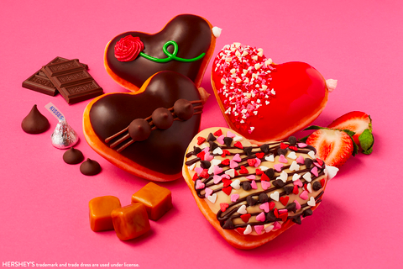

KRISPY KREME X HERSHEY’S
Beginning January 30 Krispy Kreme will offer a new Valentine’s Day Dozen featuring HERSHEY’S milk chocolate and KISSES, strawberry and caramel syrup.
Krispy Kreme’s Valentine’s Day Dozen comes in a custom red and pink “Choc-Full-of-Love” box with a heart-shaped cutout showcasing the chocolate sweet treats inside.

Slide 9

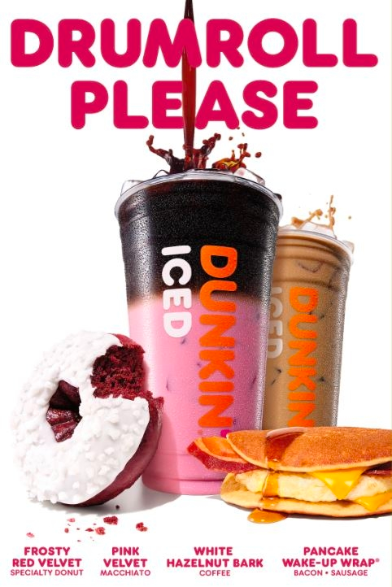
DUNKIN
At the end of December, Dunkin launched it’s Winter menu that includes a Pink Velvet Macchiato, a frosted Red Velvet specialty doughnut, White Hazelnut Bark coffee and a Pancake Wake-Up Wrap.

Slide 10
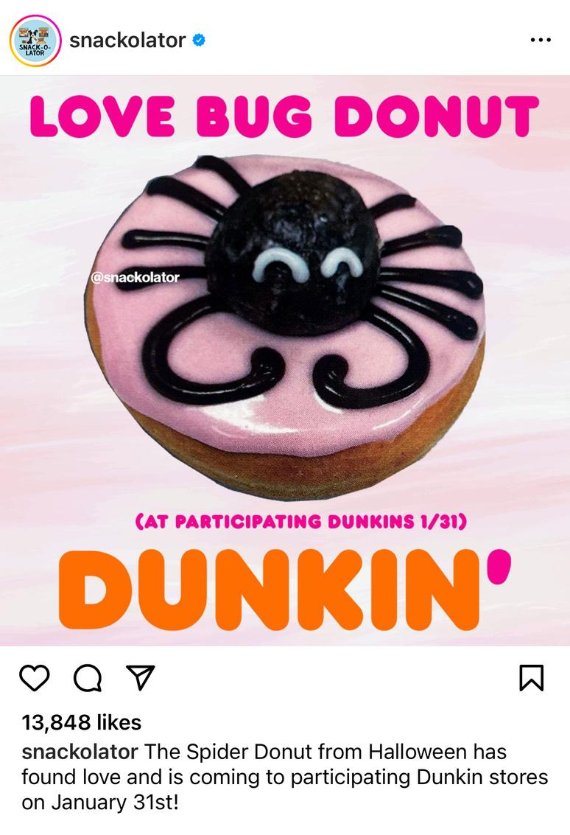
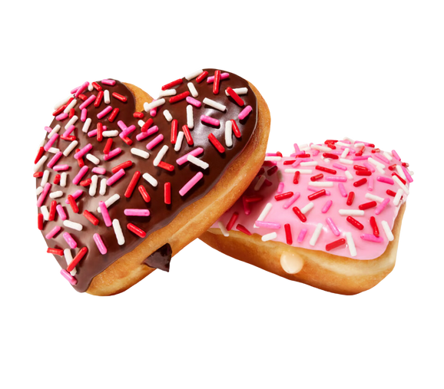
DUNKIN
Starting January 31, 2024 Dunkin will roll out its Valentines menu that includes a redesigned Valentine’s version of their popular Halloween Spider Donut, aptly called the “Love Bug.”
Dunkin will also offer a heart-shaped Brownie Batter Donut, and a heart-shaped bavarian cream donut called “Cupid’s Choice.”

Slide 11
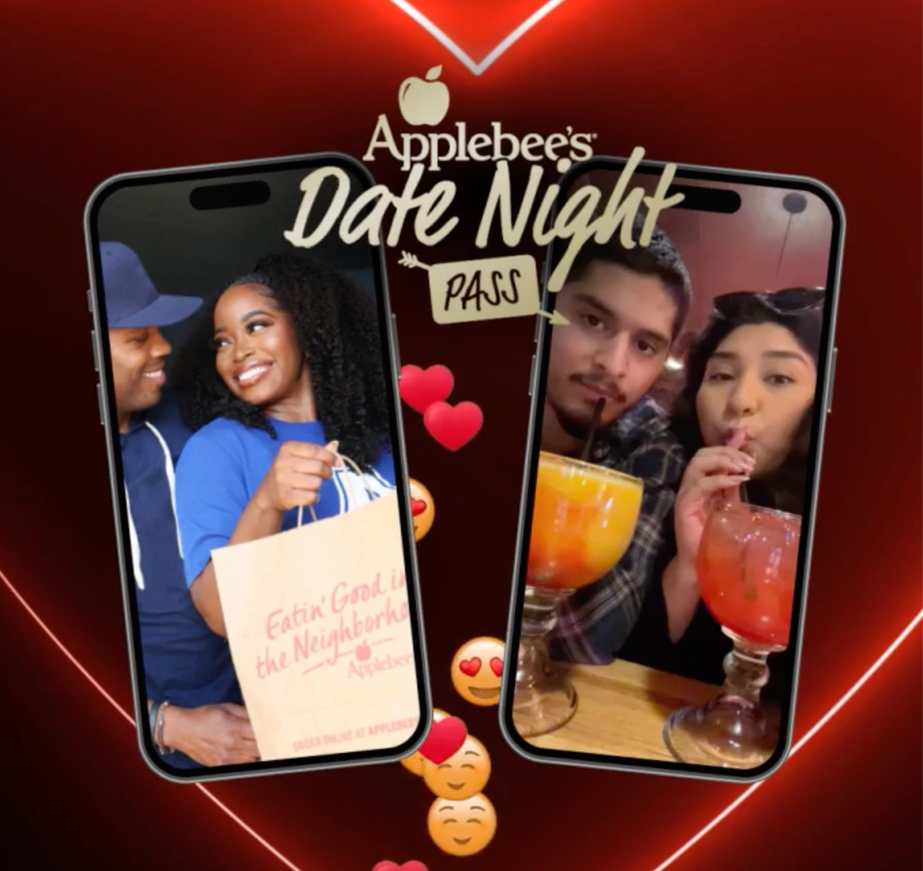
APPLEBEE’S
For Valentines Day 2024, Applebee's offered a promotion wherein they sold a limited number of weekly date night passes that includes up to $30 in food per week for a year (a $1560 value).
Applebees sold these passes for only $200. The promotion was extremely popular and sold out within an hour.

Slide 12
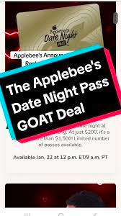
APPLEBEE’S
Why would Applebees sell $1560 worth of food for only $200?
This promotion is an example of a loss leader—a pricing strategy where a product or service is sold below market value to attract customers, who will hopefully purchase more profitable items when using the promotion.
In the case of the Applebees promotion, customers using the pass could purchase alcohol (which isn‘t included in the promotion, and is more profitable than food), or they could purchase additional food that exceeds the $30 included with the pass.

Slide 13
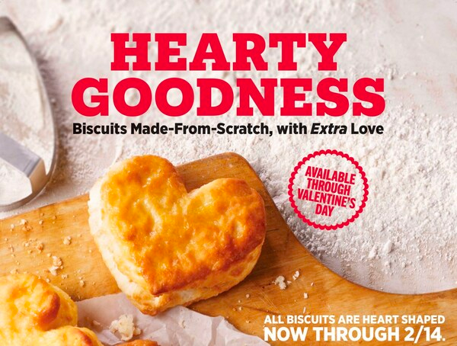
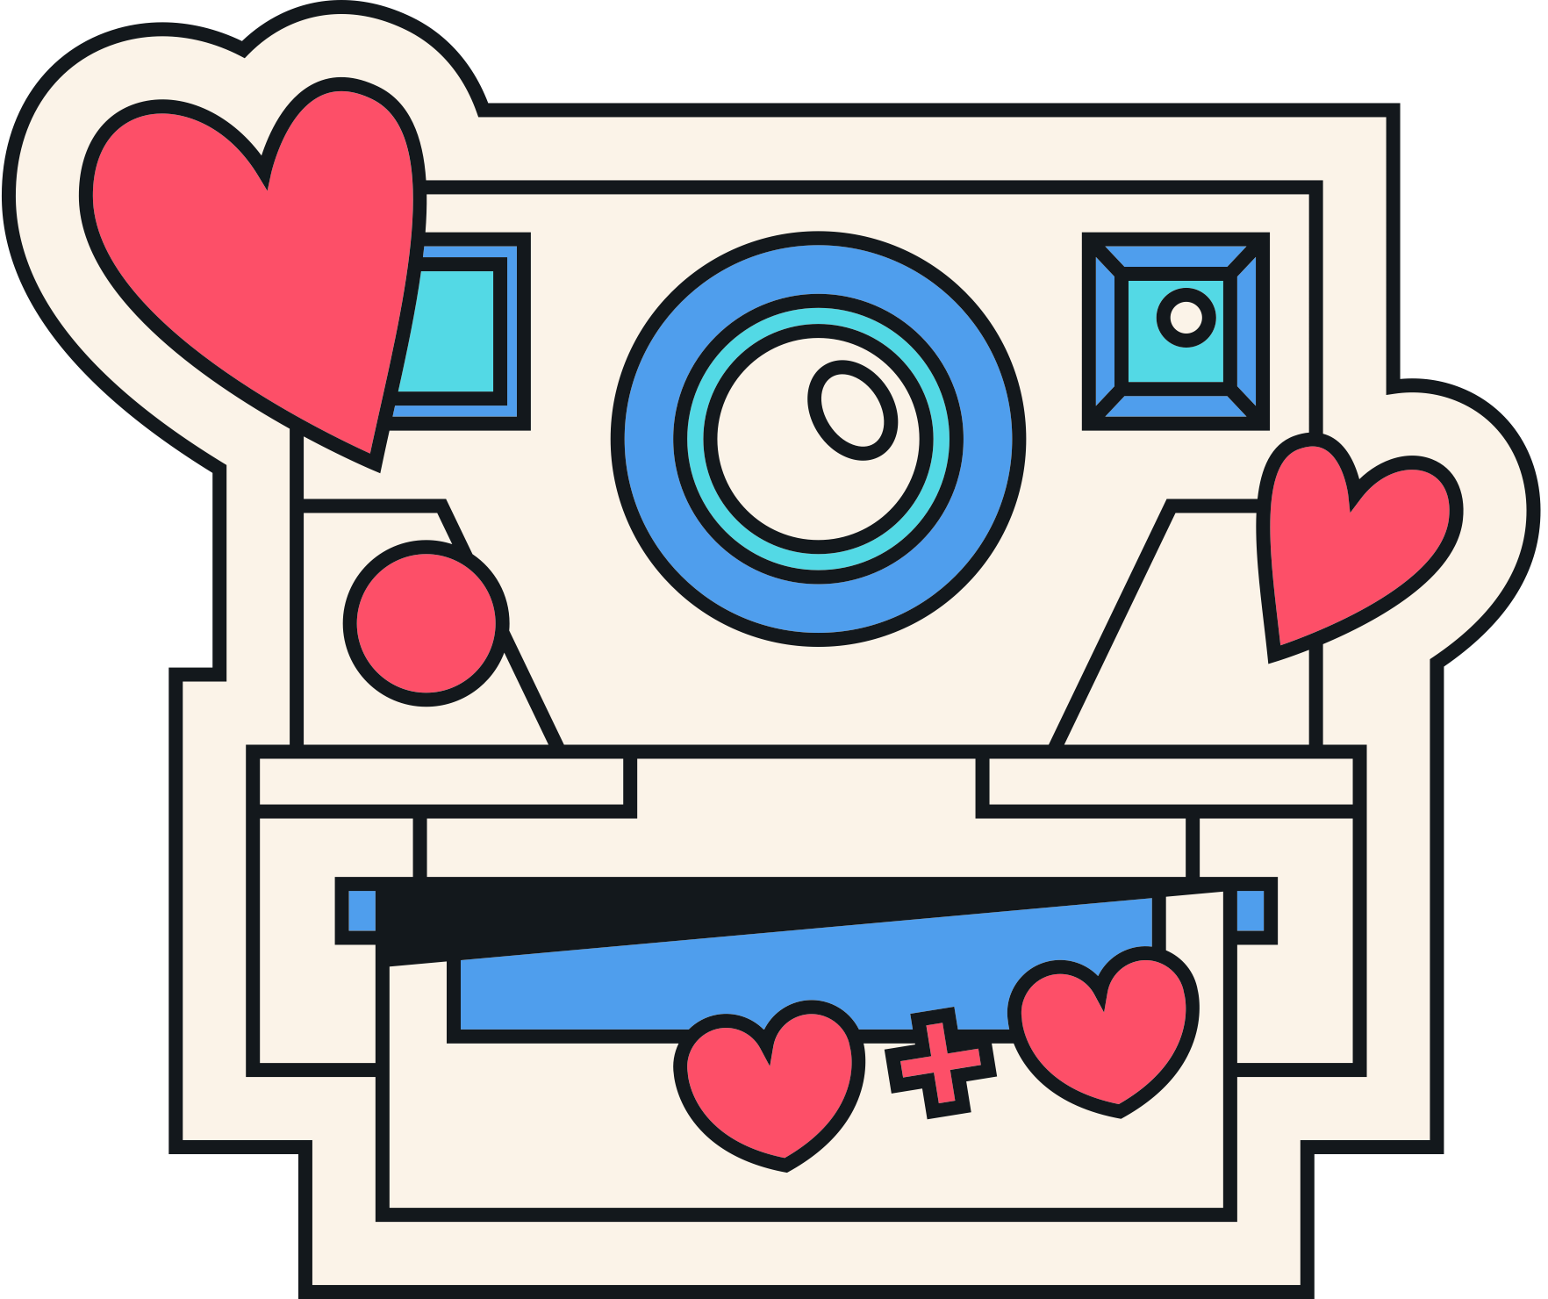
HARDEE’S
Hardee's is bringing back their Made from Scratch™ Buttermilk Biscuits in the shape of a heart on all breakfast sandwiches Feb. 1-14.
"There's no better articulation of love than our heart-shaped biscuits to celebrate Valentine's Day – a seasonal twist on our iconic breakfast items. We love seeing how this returning favorite brightens our guests' days and encourages them to spread the love with family and friends."
Regina Schneider
Senior Vice President of Marketing
Hardee's

Slide 14
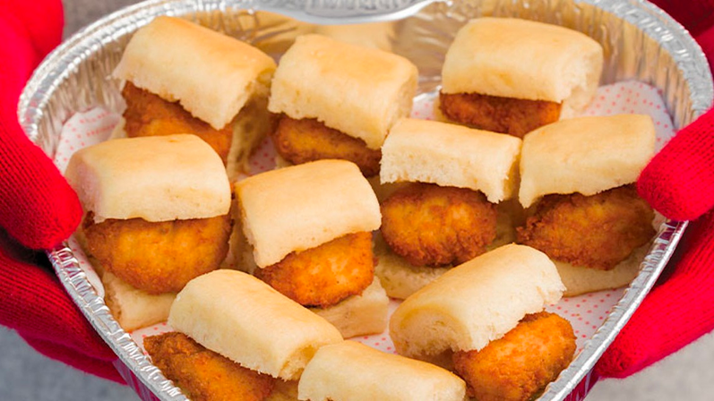
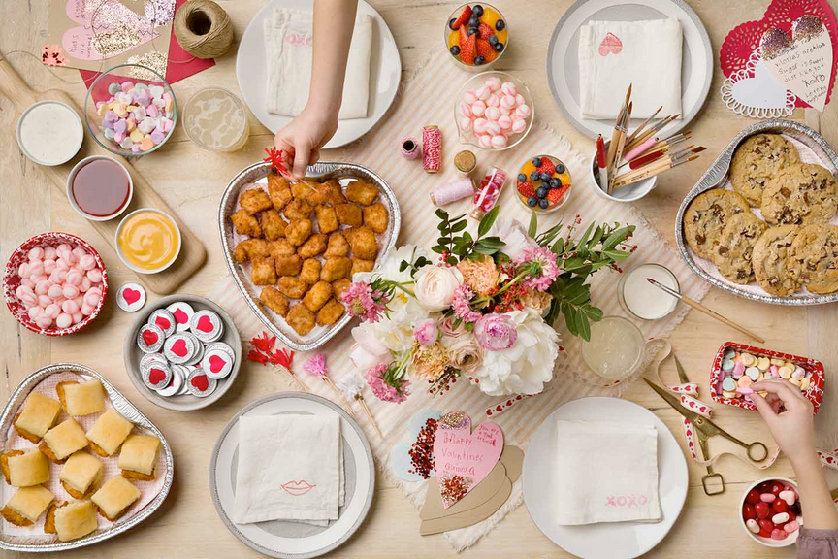
CHICK-FIL-A
For Valentine’s Day, Chick-fil-A's will again offer heart-shaped trays for a limited time, filled with select menu items, such as 30-count Chick-fil-A® Nuggets, 10-count Chick-n-Minis®, 6-count Chocolate Chunk Cookies or 12 Chocolate Fudge Brownie halves.

Slide 15

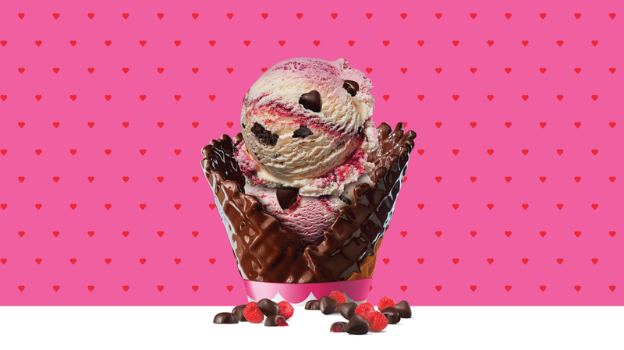
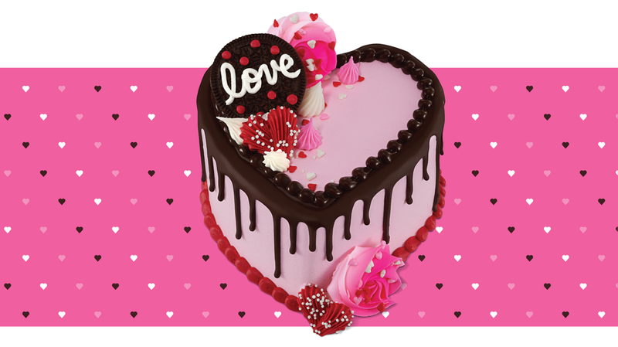
BASKIN ROBBINS
Starting Feb. 1, Baskin Robbins will bring back a fan-favorite Flavor of the Month, Love Potion #31®, along with a sweet new surprise, the Crazy for You Cake.

Slide 16
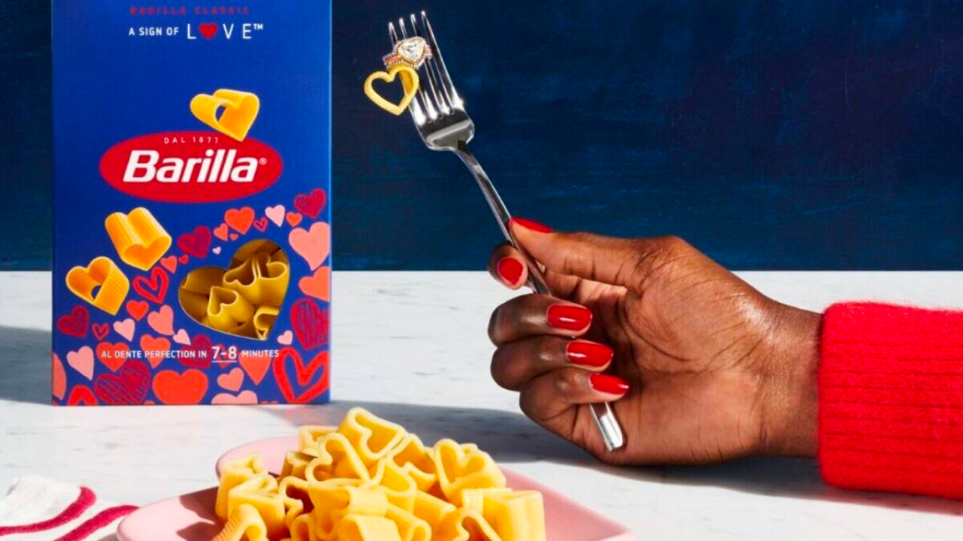
BARILLA
For the second year in a row, but the first time in stores, Barilla is offering Valentine-themed heart-shaped pasta. The pasta comes specialty packaging adorned with hearts, and a heart-shaped cutout window.
Barilla is also holding a sweepstakes, the Pasta Promise Giveaway, where customers can enter to win a set of two diamond-and-ruby rings, dubbed “Ring-a-toni” by the brand.

Slide 17
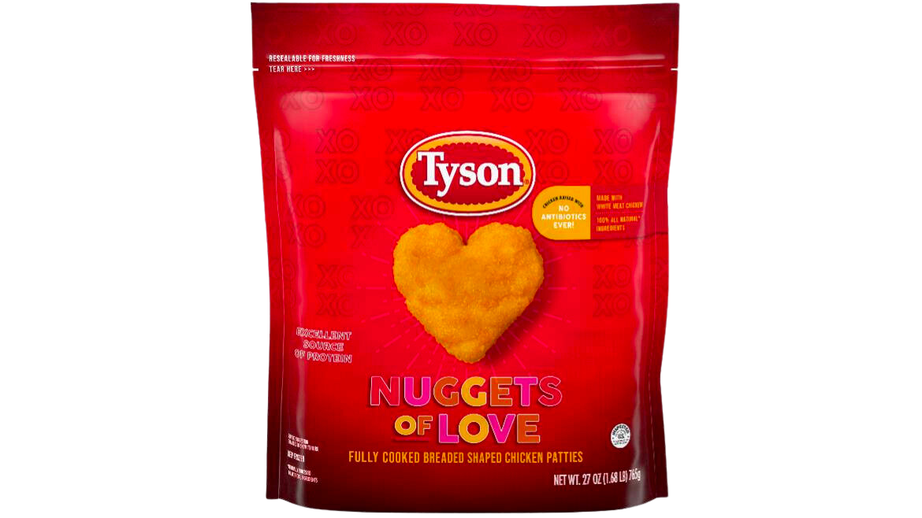
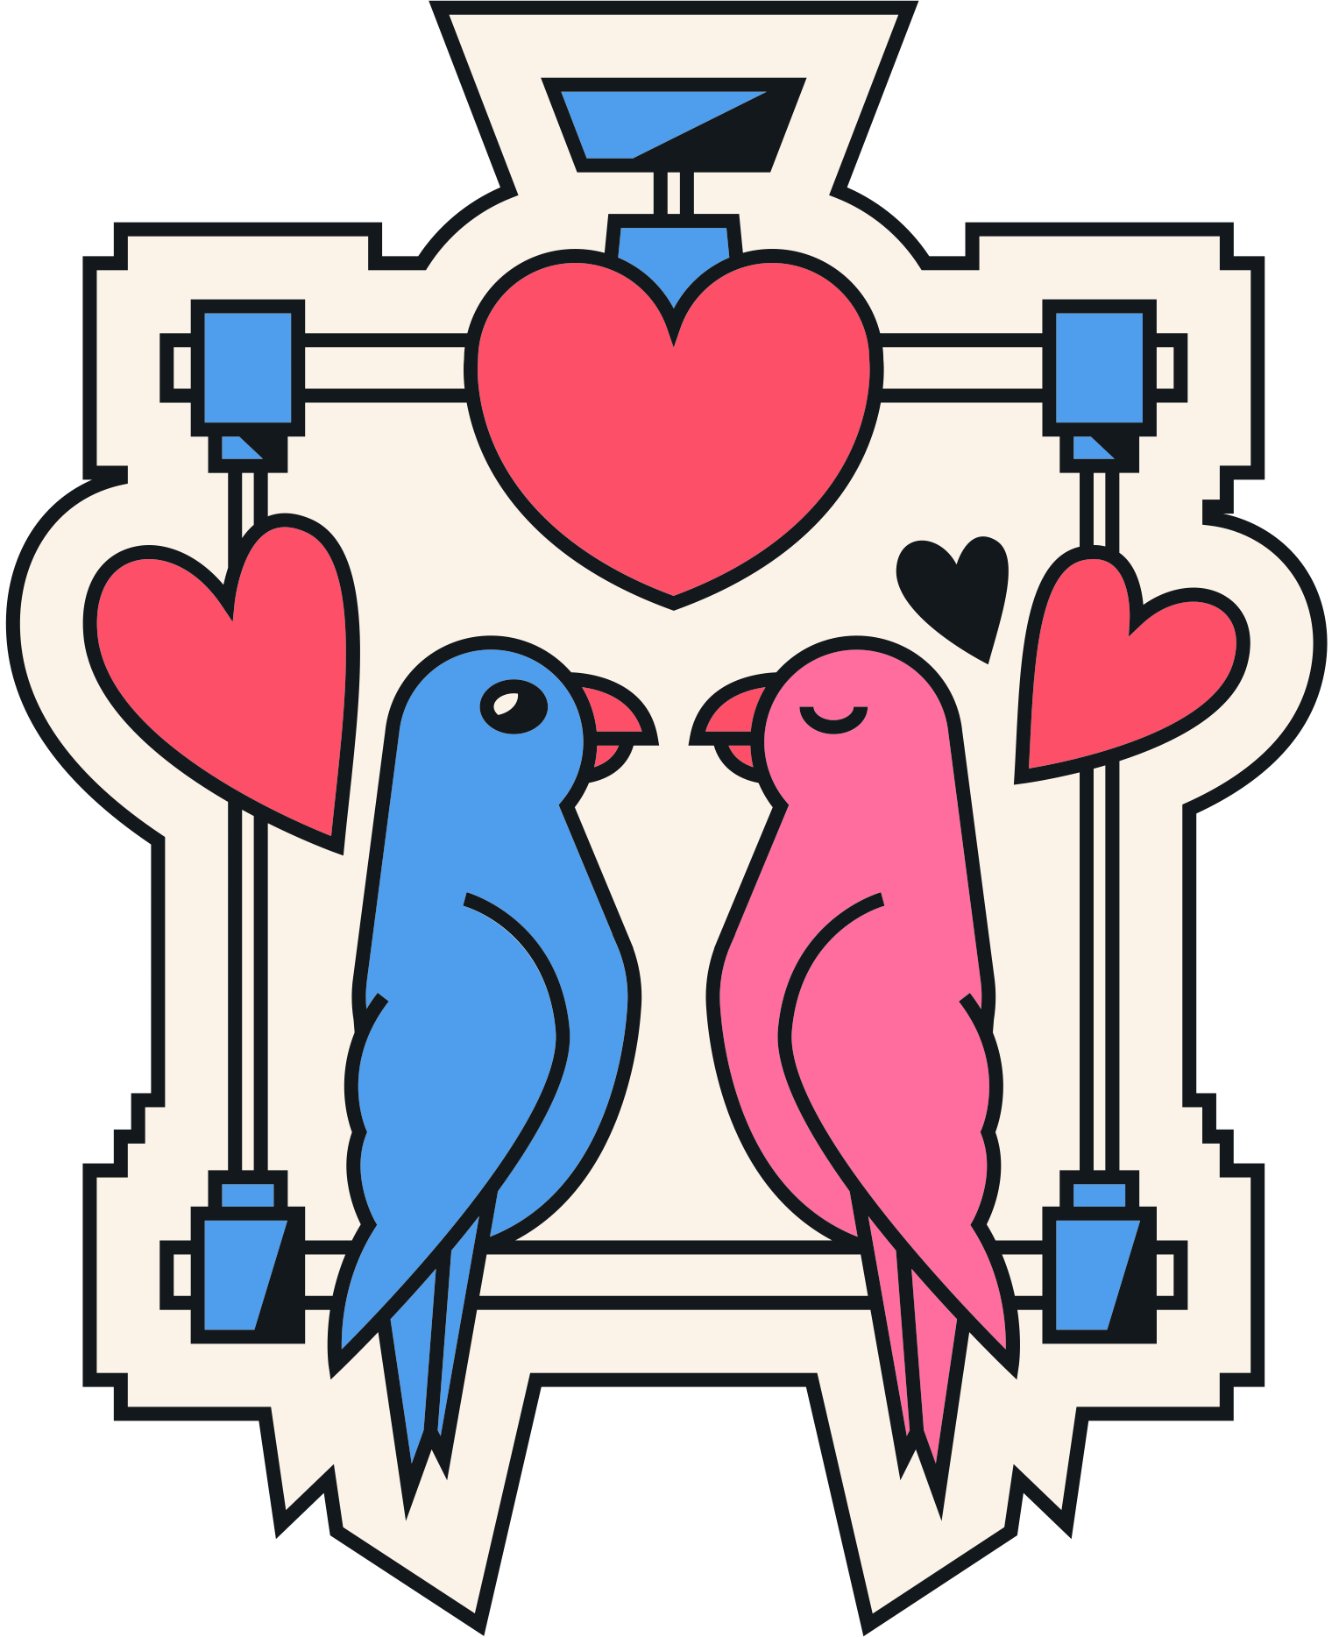
TYSON
For the 5th year in a row, Tyson is bringing back Nuggets of Love, their popular Valentine-themed, heart-shaped chicken nuggets.

Slide 18
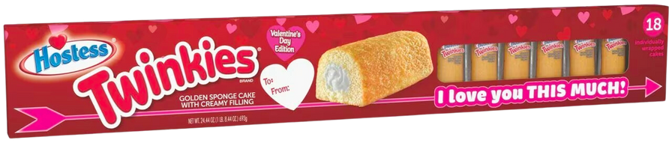
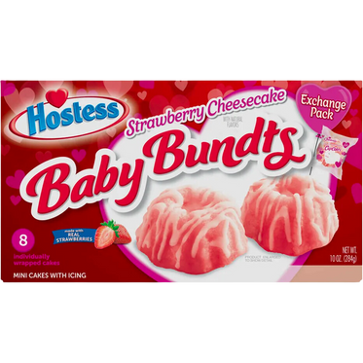
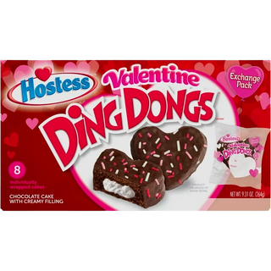
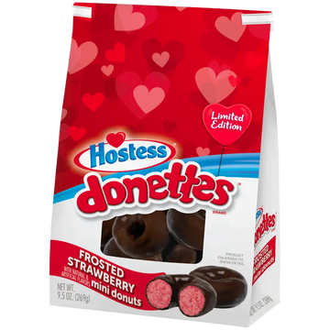
HOSTESS
New from Hostess for 2024 is the Walmart-exclusive Twinkies Valentine’s Day Gift Box. The 3-foot-long box includes 18 individually wrapped Twinkies and a place to personalize your message on the box.
In addition to Twinkies, Hostess is offering other limited-edition Valentine treats including heart-shaped Ding Dongs, strawberry cheesecake flavored Baby Bundts and frosted strawberry-flavored Donettes.

Slide 19
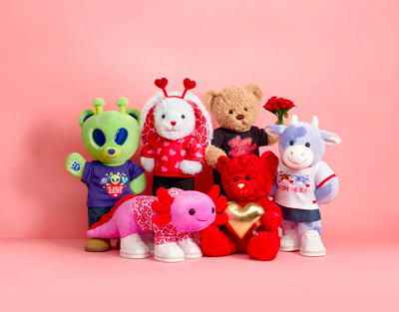
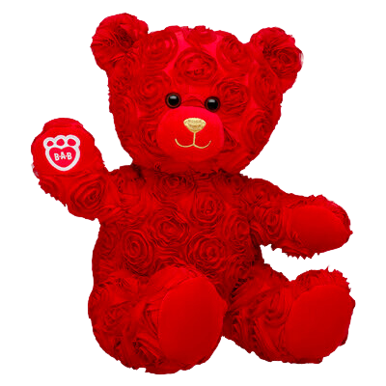

BUILD-A-BEAR
For Valentine’s Day this year, Build-A-Bear Workshop is offering a lineup of limited-edition customizable stuffed plush animals including Red Roses Teddy Bear, Love You Alotl Axolotl and Groovy Hearts Pawlette Bunny, in addition to a variety of limited Valentine’s clothing, accessories and gift sets.

Slide 20
DISCUSSION QUESTIONS
1) WHAT DO THE BRANDS FEATURED IN THIS PRESENTATION HAVE IN COMMON?
2) WHAT IS PROMOTION?
3) WHAT IS PACKAGING AS IT RELATES TO MARKETING?
4) HAVE YOU SEEN ANY OTHER EXAMPLES OF VALENTINE'S DAY PACKAGING OR PROMOTIONS?
5) WHAT IS CROSS PROMOTION?
6) WHAT IS ONE EXAMPLE OF CROSS PROMOTION FROM THIS PRESENTATION?

Slide 21
DISCUSSION QUESTIONS
7) WHAT OTHER BUSINESSES OR BRANDS MIGHT BENEFIT FROM VALENTINE'S DAY PACKAGING OR PROMOTION?
8) WHY MIGHT RESTAURANTS AND/OR HOSPITALITY & TRAVEL BRANDS BE INTERESTED IN MARKETING AROUND VALENTINE'S DAY?
9) WHY DO YOU THINK SOME BRANDS ARE TAKING AN ANTI-VALENTINE'S DAY MARKETING APPROACH?
10) IN YOUR OPINION, IS THAT A RISKY STRATEGY? WHY OR WHY NOT?

Slide 22
STUDENT ACTIVITY
The next slide features a list of several brands. Select one and create a Valentines-themed promotion or special packaging. Consider all the examples that you just reviewed in this presentation and apply some of those concepts to your promotion or packaging.
Be prepared to present your ideas in class.

Slide 23


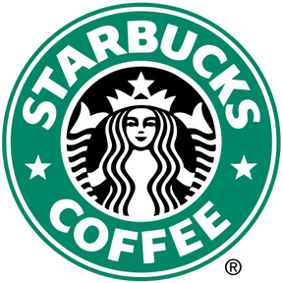
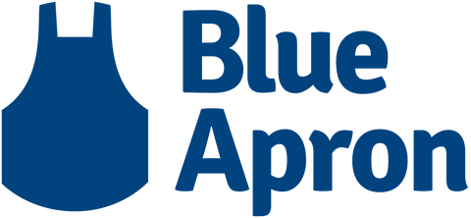
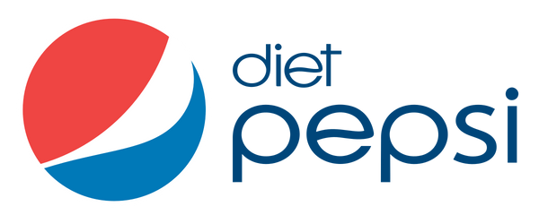
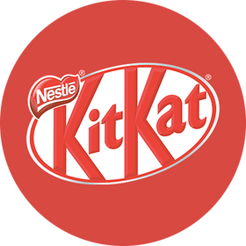
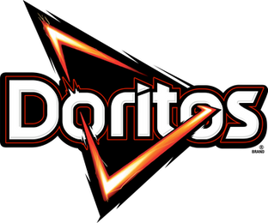
STUDENT ACTIVITY

Slide 24
SOURCES
applebees.com/en/specials/date-night-pass
foxbusiness.com/lifestyle/applebees-launches-one-year-weekly-date-night-passes-200
prnewswire.com/news-releases/new-hersheys-kisses-milk-chocolates-with-snoopy--friends-foils-inspire-sweet-connections-this-valentines-day-302021145.html
brandeating.com/2024/01/hersheys-2024-valentines-day-product-line-up.html
news.baskinrobbins.com/news/february-menu-2023
kxxv.com/barillas-heart-shaped-pasta-is-returning-along-with-a-diamond-ring-giveaway
foxbusiness.com/lifestyle/barillas-reintroduces-valentines-day-themed-pasta-offers-33k-ring-lucky-customer

Slide 25
SOURCES
pennlive.com/life/2024/01/say-i-love-you-this-much-with-a-3-foot-long-box-of-twinkies.html
prnewswire.com/news-releases/mars-celebrates-valentines-day-with-mms-offering-personalized-gifts-perfect-for-spreading-love-and-inspiring-sweet-moments-302030882.html
mms.com/en-us/mms-candy-flavors/milk-chocolate-cupids-blend-valentines-day-candy-10oz/ct2222-p.html
convenience.org/Media/Daily/2024/Jan/11/5-Mars-Seasonal-MMs-Flavor-Valentines_CatMan
prnewswire.com/news-releases/share-the-hardees-love-language-this-valentines-day-heart-shaped-biscuits-are-back-feb-1-14-302040237.html
prnewswire.com/news-releases/build-a-bear-celebrates-valentines-day-with-paw-some-selection-of-gifts-stuffed-with-love-302038818.html

