Slide 1
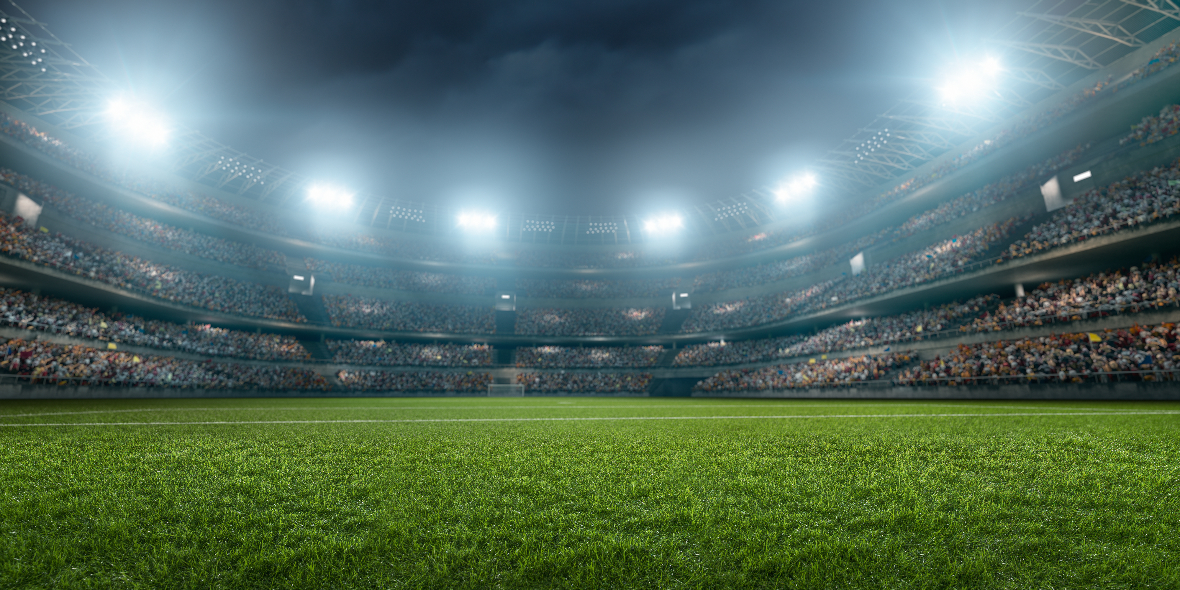
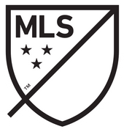
Major League Soccer
TRIVIA GAME
The Business of Sports
Copyright 2024 Sports Career Consulting

Slide 2
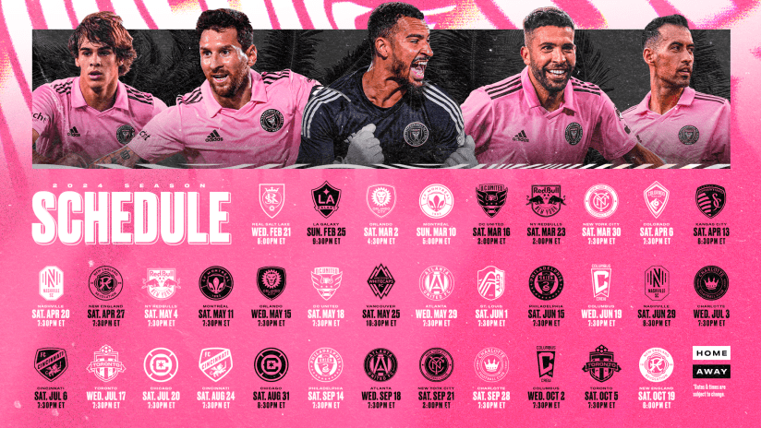
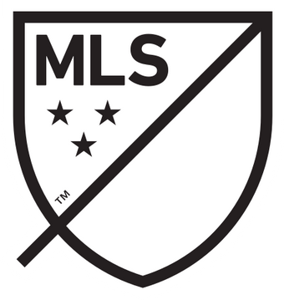
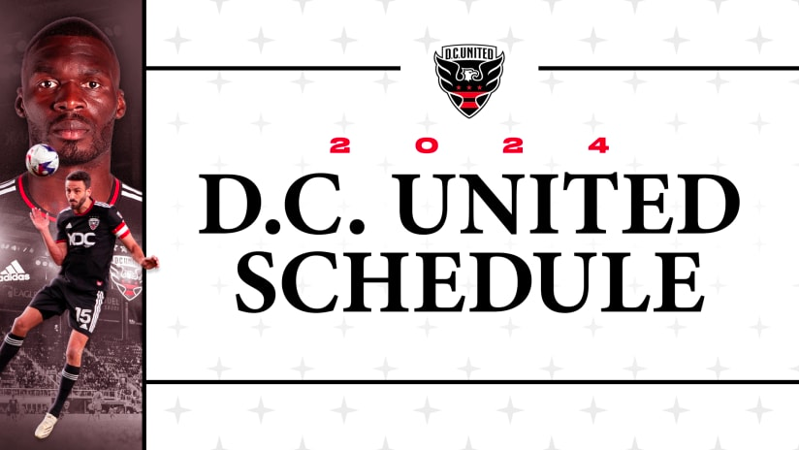
2024 Season
Major League Soccer opening day has arrived, and the league is bigger, and growing faster, than ever before.
Copyright 2024 Sports Career Consulting

Slide 3
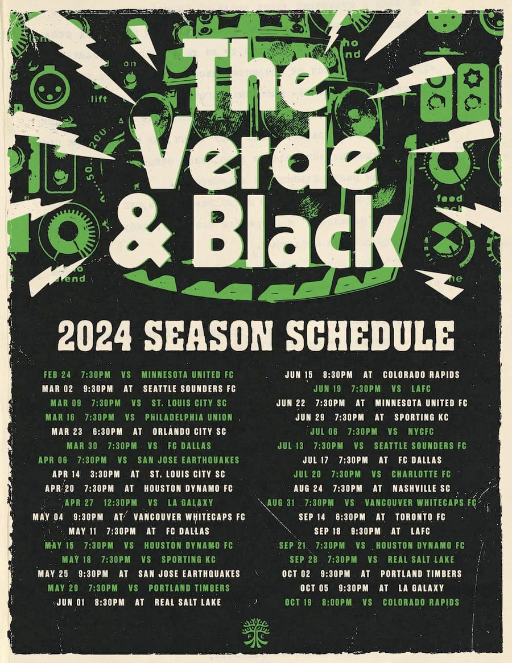
Major League Soccer
In this trivia game, we will explore several key sports business concepts.
But first, let’s take a quick look at the history and current state of MLS.
Copyright 2024 Sports Career Consulting

Slide 4

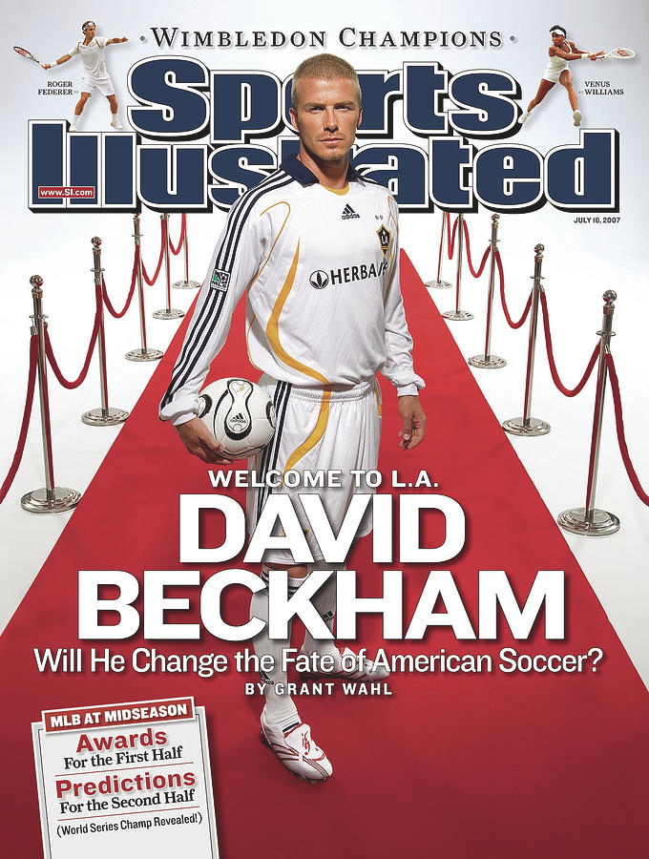
In 2007, there were just 12 teams in Major League Soccer. The average MLS franchise was worth $37 million, and not profitable. The most valuable franchise was worth less than $100 million.
But the league’s fortunes would shift after bringing one of the sport's biggest stars, David Beckham, to the United States. Beckham’s international star power brought awareness and interest to Major League Soccer and, perhaps more importantly, credibility.
Copyright 2024 Sports Career Consulting

Slide 5
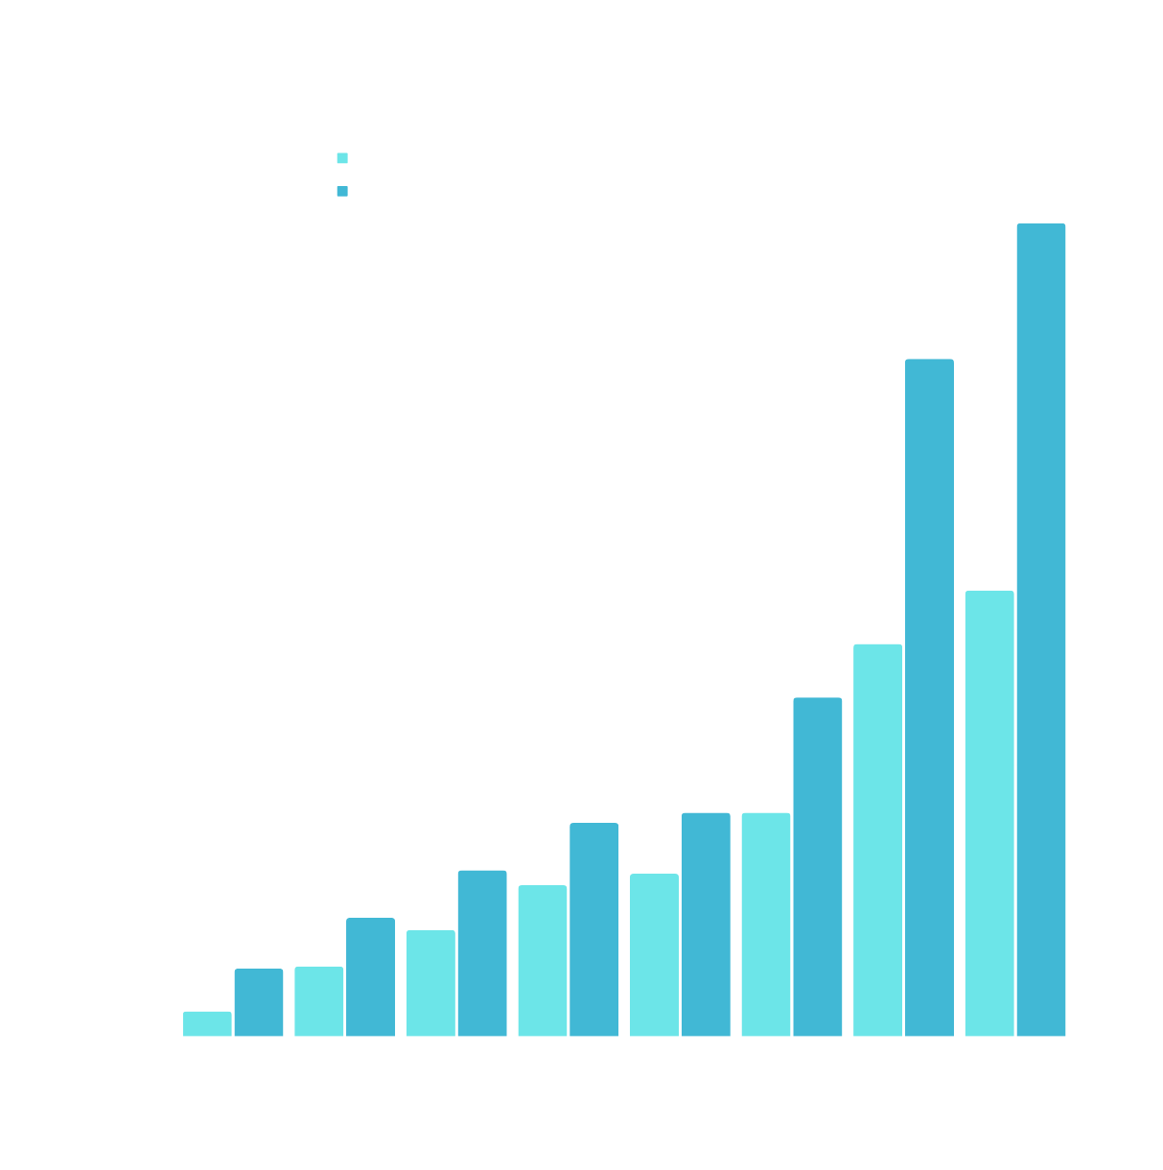
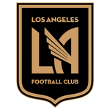
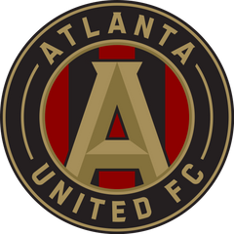
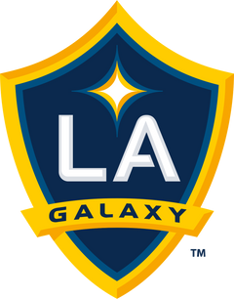
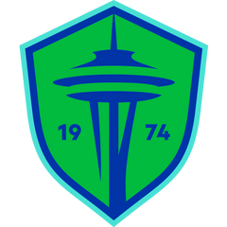
Ten years ago, Major League Soccer started seeing significant growth, with the average franchise valued at $157 million (according to Forbes). That was up an astonishing 52% from the previous year.
Fast forward to today, and the average franchise is now worth $658 million, according to Forbes, up 14% from last year. LAFC is the most valuable at $1.2B.
Copyright 2024 Sports Career Consulting

Slide 6
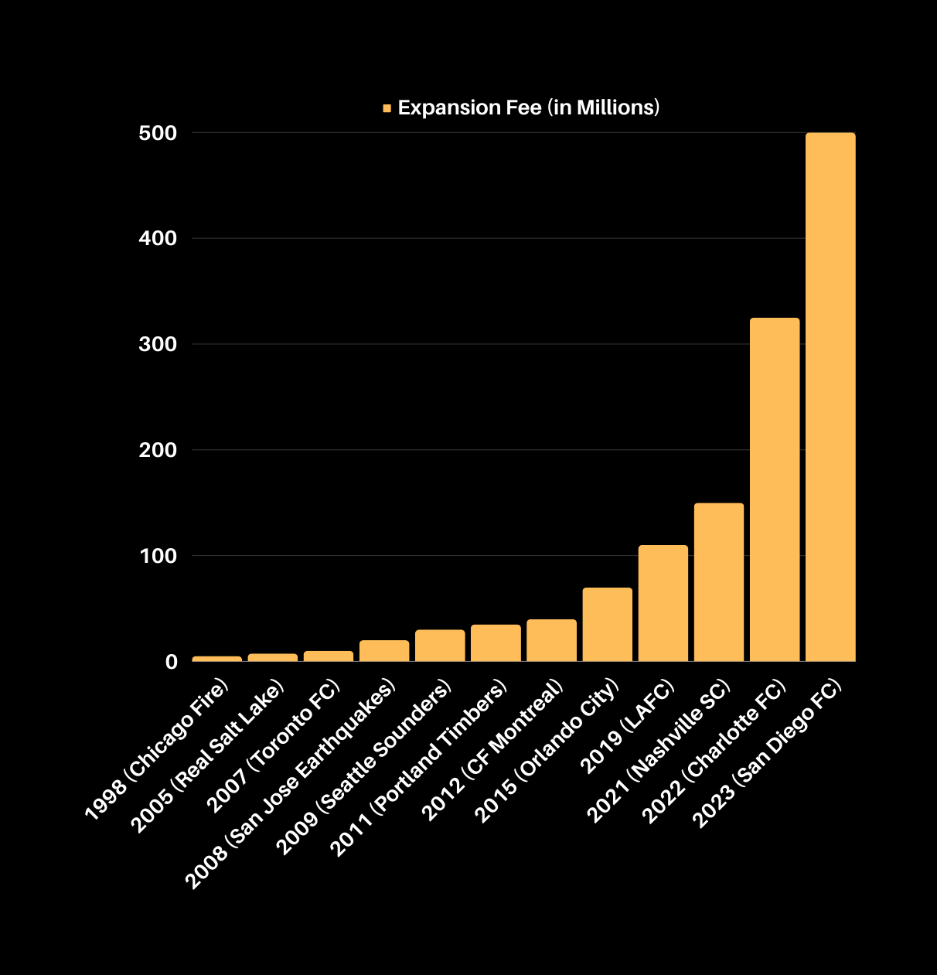
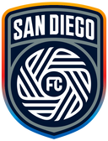
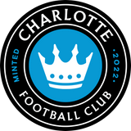
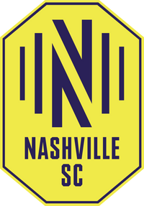
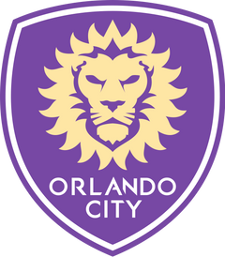

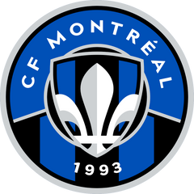


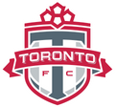

In 1998, Chicago paid a $5 million expansion fee to join Major League Soccer. By 2008, that fee had reached $30 million when the city of Seattle was awarded a franchise. The price tag for the latest expansion team? $500 million, paid by an ownership group in San Diego (San Diego FC will begin play in 2025).
Copyright 2024 Sports Career Consulting

Slide 7
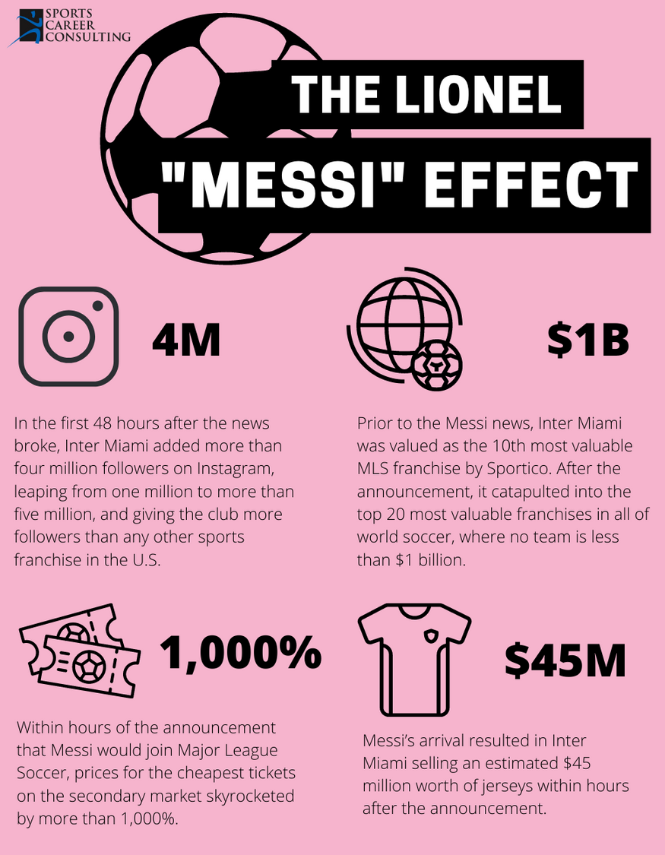
The “Superstar Effect” in the U.S.
Much like the influence of superstars in other sports, signing Messi (one of the greatest players of all time) had a massive impact on Major League Soccer. From viewership, ticket sales, social media following, and local economies, Lionel Messi’s arrival has launched Major League Soccer’s popularity into the stratosphere.
Copyright 2024 Sports Career Consulting

Slide 8

https://www.youtube.com/watch?v=T5Vs5vRymtk

Slide 9
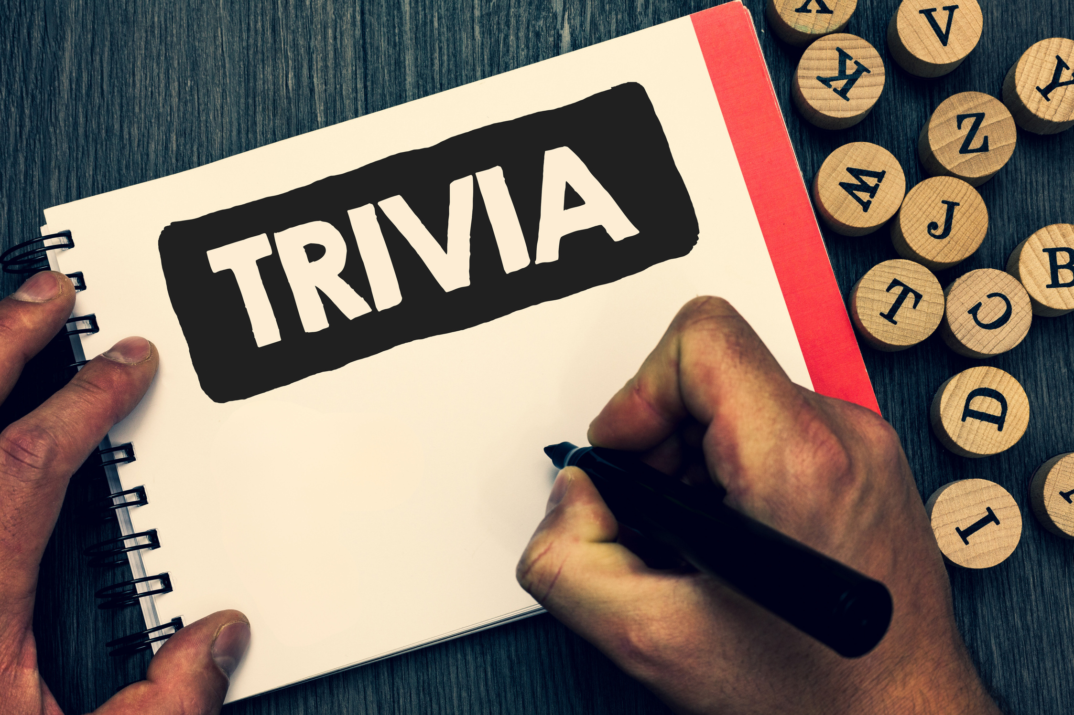
Game Rules
01
This trivia game can be played in groups or individually.
Your teacher will read a trivia question about a fundamental sports business concept. The answer will be displayed after every student or group has submitted a response.
02
Sports Business
03
Each question is worth one point. The student or group with the highest score at the end of the game wins.
Copyright 2024 Sports Career Consulting

Slide 10
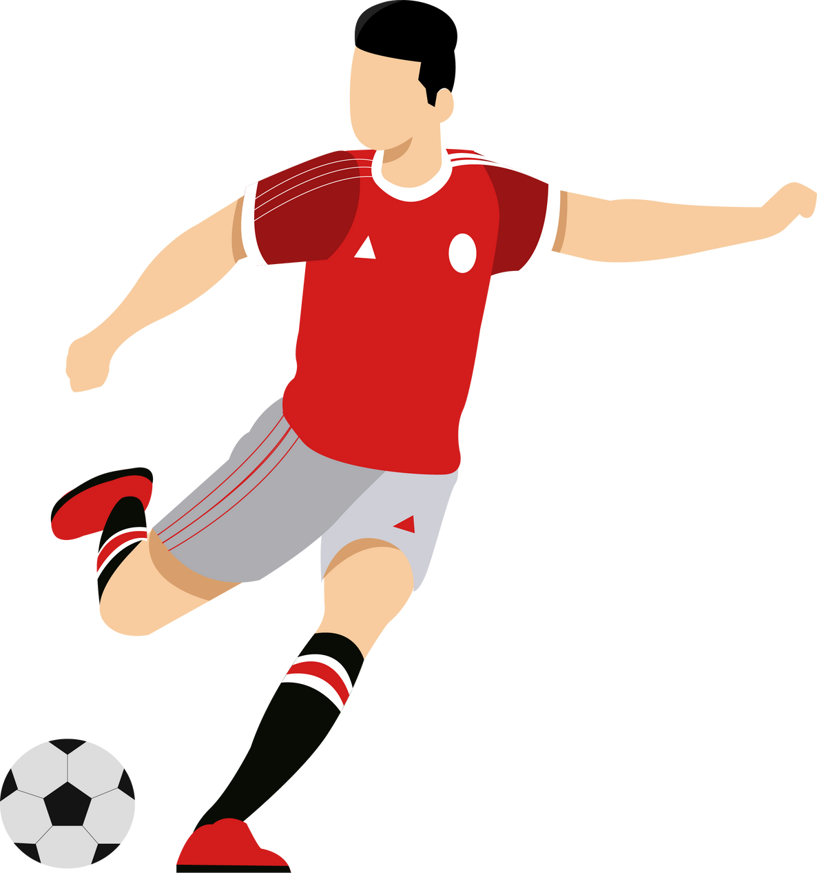
QUESTION #1
The tagline for Major League Soccer’s marketing campaign in 2024 is “Our Soccer is Calling.” This is an example of what?
A.
The marketing of sports
B.
Marketing through sports
C.
Sponsorship

Slide 11
ANSWER #1
The tagline for Major League Soccer’s marketing campaign in 2024 is “Our Soccer is Calling.” This is an example of what?
A.
The marketing of sports
B.
Marketing through sports
C.
Sponsorship

Slide 12
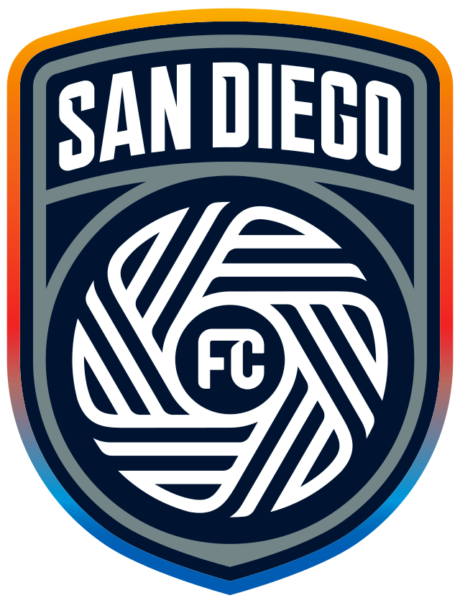
QUESTION #2
San Diego, an expansion franchise, introduced its team colors and logo last year. This is an example of what?
A.
Merchandising
B.
Licensing
C.
Branding

Slide 13
ANSWER #2
San Diego, an expansion franchise, introduced its team colors and logo last year. This is an example of what?
A.
Merchandising
B.
Licensing
C.
Branding

Slide 14

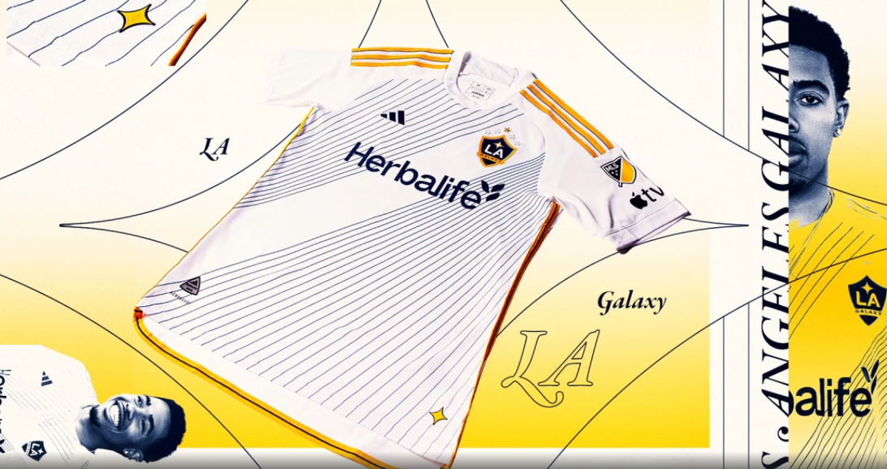
QUESTION #3
In MLB, the NFL, and the NBA, players are outfitted in uniforms or jerseys. What are they often called in soccer?
A.
Kits
B.
Licensed merchandise
C.
Sponsorship

Slide 15
ANSWER #3
In MLB, the NFL, and the NBA, players are outfitted in uniforms or jerseys. What are they often called in soccer?
A.
Kits
B.
Licensed merchandise
C.
Sponsorship

Slide 16
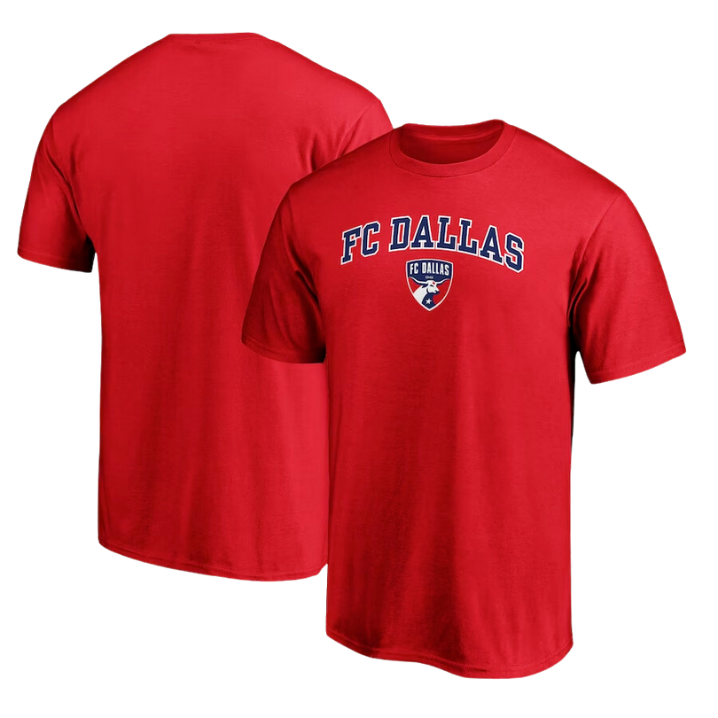
QUESTION #4
If you wanted to legally sell a t-shirt that you created using your favorite soccer team’s logo, you would need what?
A.
A vendor contract
B.
A license
C.
A screen printer

Slide 17
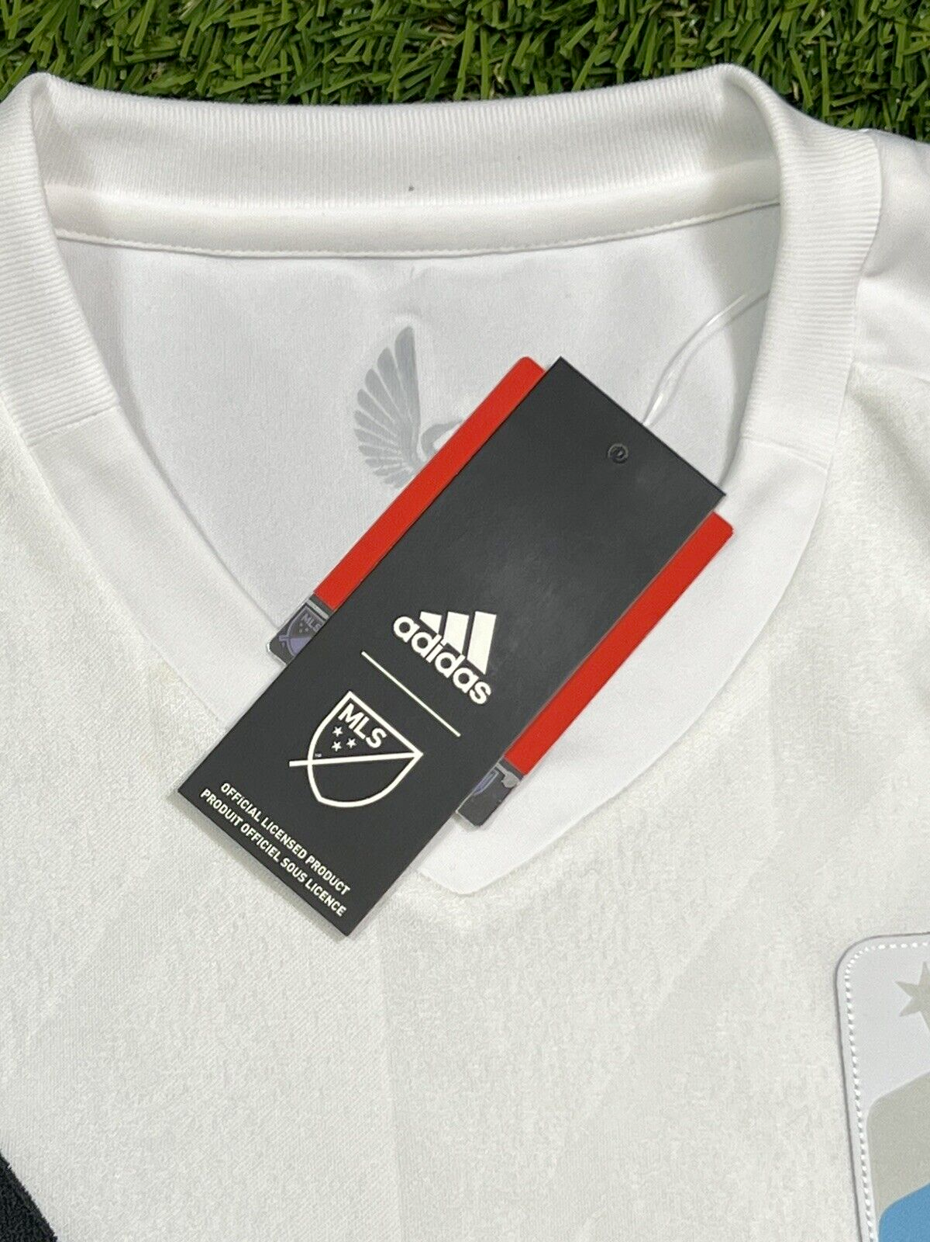


ANSWER #4
If you wanted to legally sell a t-shirt that you created using your favorite soccer team’s logo, you would need what?
A.
A vendor contract
B.
A license
C.
A screen printer

Slide 18
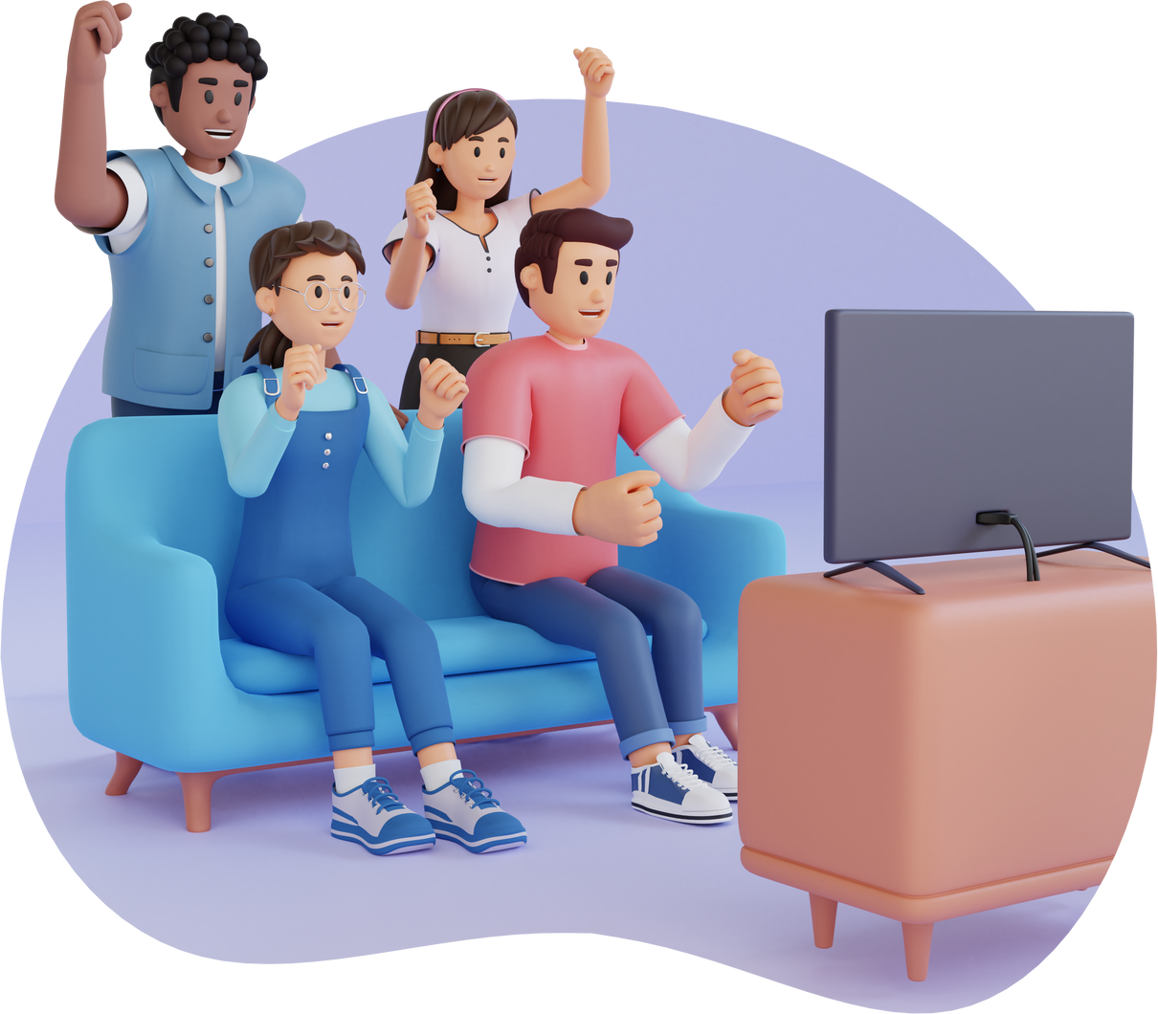
QUESTION #5
One company streams every MLS regular season and playoff match. What arrangement does that company have with Major League Soccer so they can show the matches?
A.
Broadcast rights
B.
Advertising
C.
Sponsorship

Slide 19
ANSWER #5
One company streams every MLS regular season and playoff match. What arrangement does that company have with Major League Soccer so they can show the matches?
A.
Broadcast rights
B.
Advertising
C.
Sponsorship

Slide 20
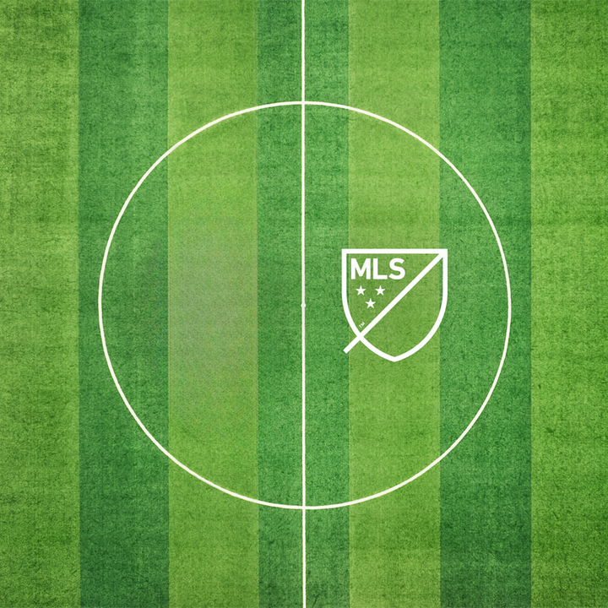
QUESTION #6
Which company currently has the broadcast rights to MLS games?
A.
ESPN
B.
YouTube
C.
Apple

Slide 21
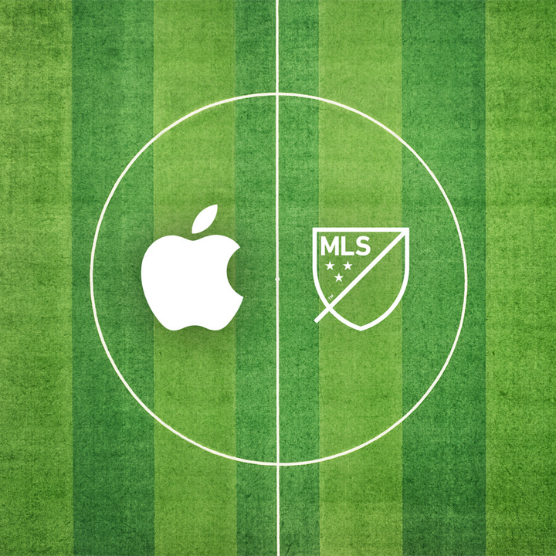
ANSWER #6
Which company currently has the broadcast rights to MLS games?
A.
ESPN
B.
YouTube
C.
Apple

Slide 22
QUESTION #7
What tool do broadcasters use to measure the total size of an audience viewing a Major League Soccer match?
A.
Broadcast rights
B.
Ratings
C.
Advertising time

Slide 23
ANSWER #7
What tool do broadcasters use to measure the total size of an audience viewing a Major League Soccer match?
A.
Broadcast rights
B.
Ratings
C.
Advertising time

Slide 24
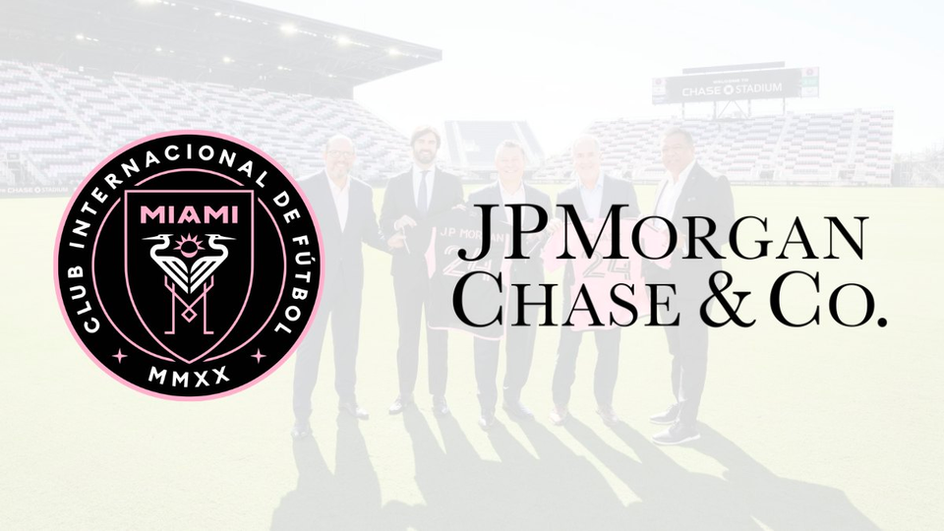
QUESTION #8
Inter Miami’s home field will be known as Chase Stadium after recently signing a deal with JPMorgan Chase. What is this type of arrangement called?
A.
Signage
B.
Stadium sponsorship
C.
Naming rights

Slide 25
ANSWER #8
Inter Miami’s home field will be known as Chase Stadium after recently signing a deal with JPMorgan Chase. What is this type of arrangement called?
A.
Signage
B.
Stadium sponsorship
C.
Naming rights

Slide 26
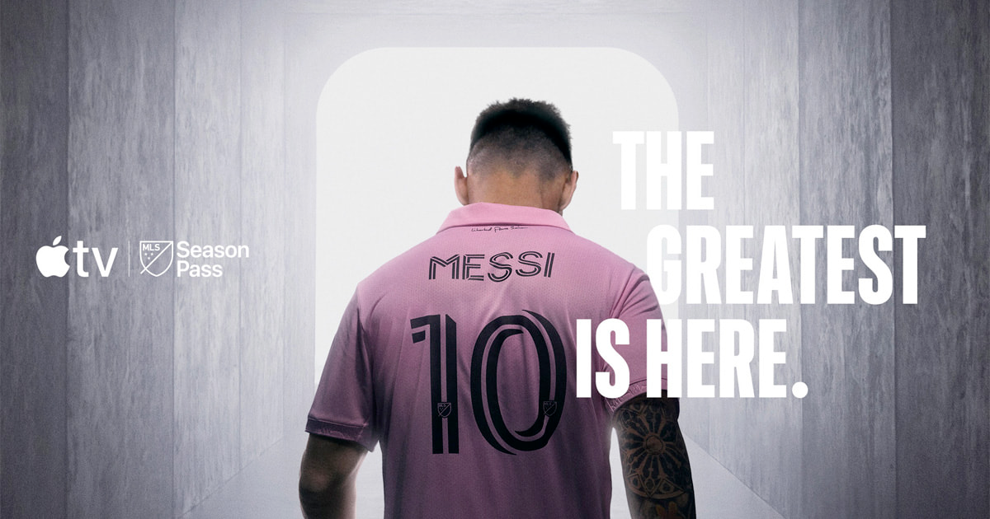
QUESTION #9
The arrival of Lionel Messi has impacted the league in many ways, including viewership, ticket sales, merchandise sales, sponsorship, and social media following. Your textbook refers to this phenomenon as what?
A.
“Superstar Effect”
B.
“Messi Mania”
C.
Ticket sales amplifier

Slide 27
ANSWER #9
The arrival of Lionel Messi has impacted the league in many ways, including viewership, ticket sales, merchandise sales, sponsorship, and social media following. Your textbook refers to this phenomenon as what?
A.
“Superstar Effect”
B.
“Messi Mania”
C.
Ticket Sales Amplifier

Slide 28
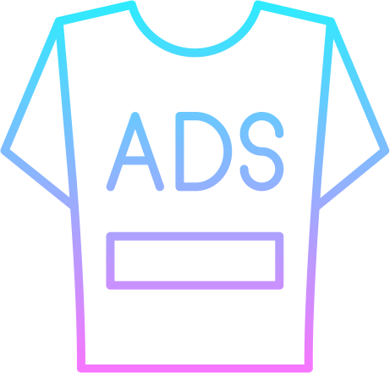
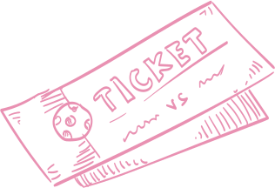
QUESTION #10
MLS teams generate this through the sale of tickets, sponsorship, merchandise, and more. If the team hopes to make a profit, what do they need?
A.
Branding
B.
Revenue
C.
Marketing

Slide 29
ANSWER #10
MLS teams generate this through the sale of tickets, sponsorship, merchandise, and more. If the team hopes to make a profit, what do they need?
A.
Branding
B.
Revenue
C.
Marketing

Slide 30
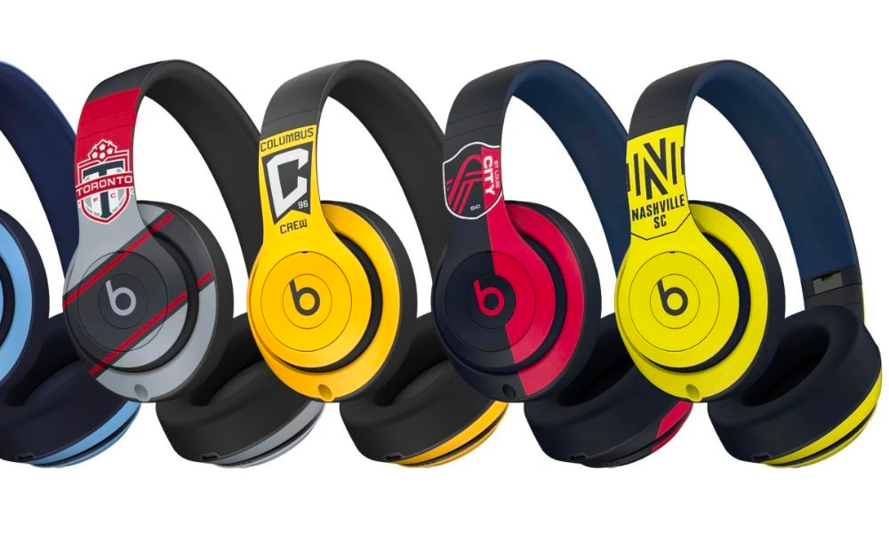
QUESTION #11
Major League Soccer named Beats as its official consumer audio products partner ahead of the 2024 season. This is an example of what?
A.
Bad marketing
B.
Sponsorship
C.
Branding

Slide 31
ANSWER #11
Major League Soccer named Beats as its official consumer audio products partner ahead of the 2024 season. This is an example of what?
A.
Bad marketing
B.
Sponsorship
C.
Branding

Slide 32

QUESTION #12
Stadiums were sold out in every stadium where Messi played last season, and ticket prices skyrocketed. This illustrates which economic concept?
A.
Economic impact
B.
Ticket sales
C.
Supply and demand

Slide 33

ANSWER #12
Stadiums were sold out in every stadium where Messi played last season, and ticket prices skyrocketed. This illustrates which economic concept?
A.
Economic impact
B.
Ticket sales
C.
Supply and demand

Slide 34
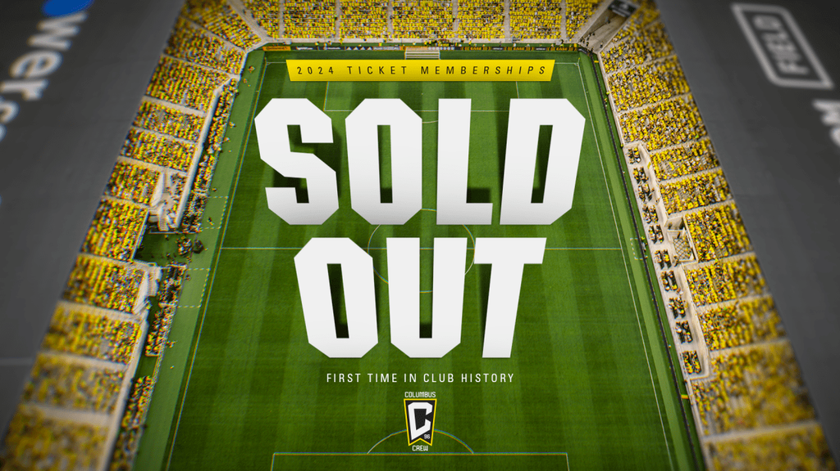
QUESTION #13
The Columbus Crew sold out of season ticket memberships this year and has started a waitlist. Which function of sports marketing does this represent?
A.
Ticket sales
B.
Customer Service
C.
Fandom

Slide 35
ANSWER #13
The Columbus Crew sold out of season ticket memberships this year and has started a waitlist. Which function of sports marketing does this represent?
A.
Ticket sales
B.
Customer Service
C.
Fandom

Slide 36
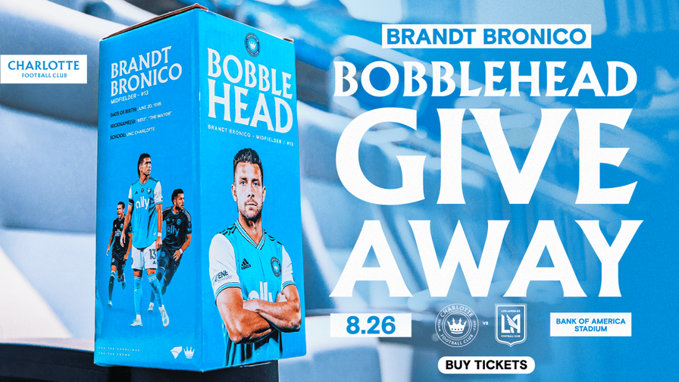
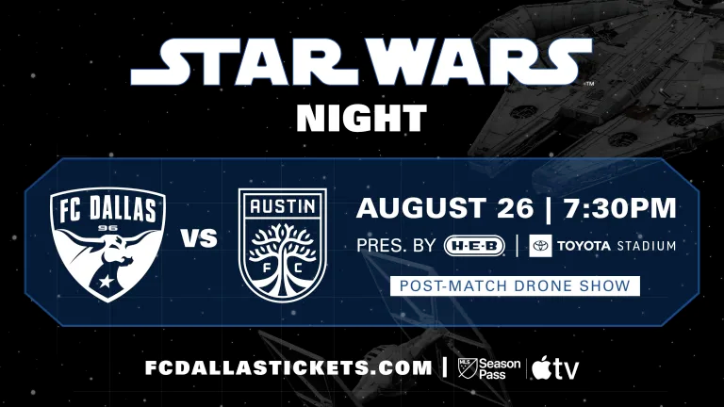
QUESTION #14
Some MLS teams will give away things like bobbleheads or scarves on game days and host themed events, like “Star Wars Night.” This is an example of what?
A.
Sponsorship
B.
Endorsement
C.
Promotion

Slide 37
ANSWER #14
Some MLS teams will give away things like bobbleheads or scarves on game days and host themed events, like “Star Wars Night.” This is an example of what?
A.
Sponsorship
B.
Endorsement
C.
Promotion

Slide 38
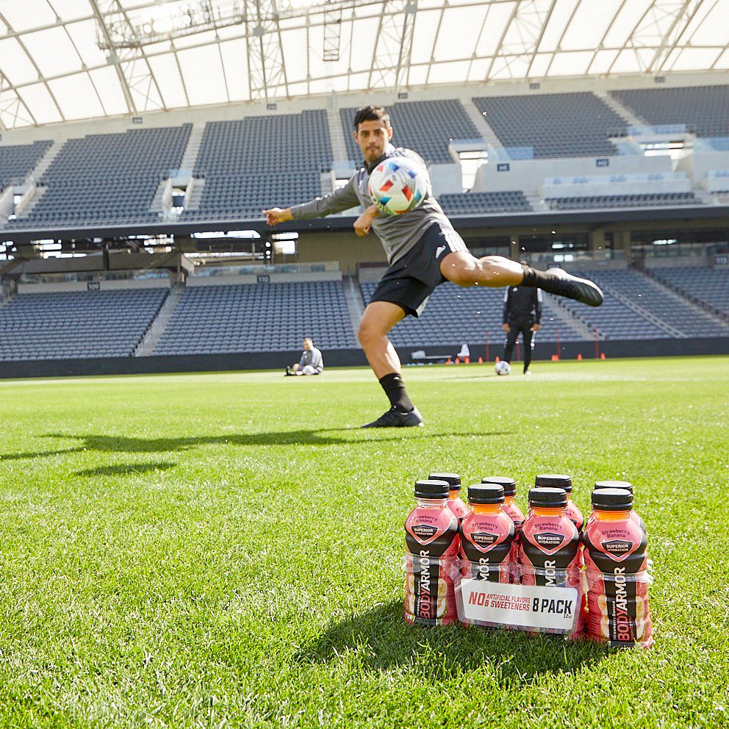
QUESTION #15
LAFC’s Carlos Vela promotes Body Armor sports drink and has been featured in the brand’s advertising. This is an example of what?
A.
Endorsement
B.
NIL
C.
Marketing of sports

Slide 39
ANSWER #15
LAFC’s Carlos Vela promotes Body Armor sports drink and has been featured in the brand’s advertising. This is an example of what?
A.
Endorsement
B.
NIL
C.
Marketing of sports

Slide 40
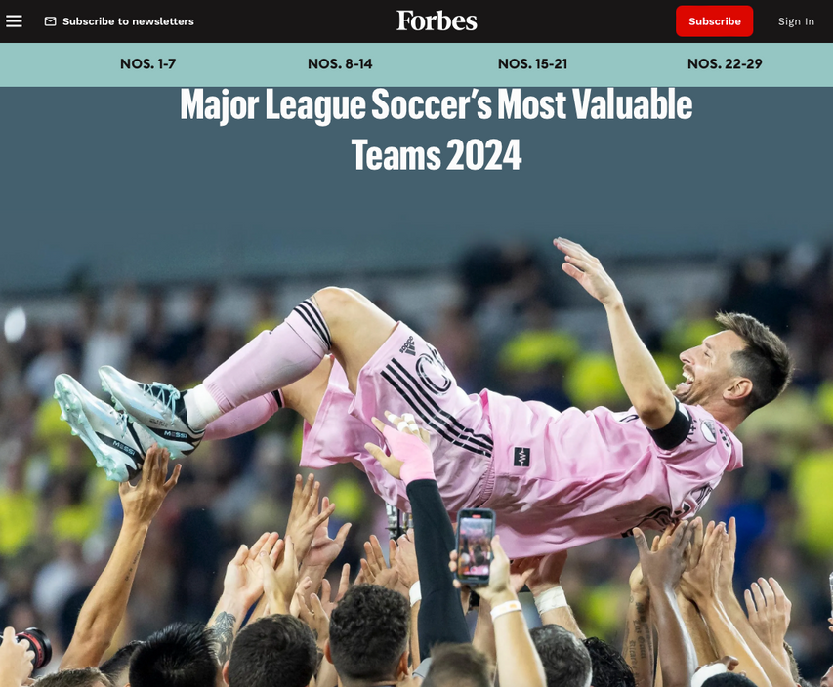
QUESTION #16
According to Forbes, valued at $1.2 billion, this is the most valuable franchise in Major League Soccer.
A.
Seattle Sounders
B.
LAFC
C.
Atlanta United FC

Slide 41
ANSWER #16
According to Forbes, valued at $1.2 billion, this is the most valuable franchise in Major League Soccer.
A.
Seattle Sounders
B.
LAFC
C.
Atlanta United FC

Slide 42
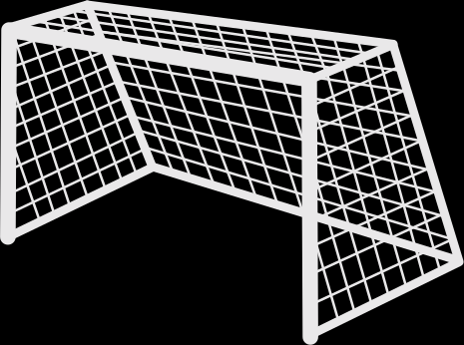

QUESTION #17
Lionel Messi is currently the highest-paid player in Major League Soccer. Who is the second-highest-paid player?
A.
Carlos Vela
B.
Sergio Busquets
C.
Lorenzo Insigne

Slide 43
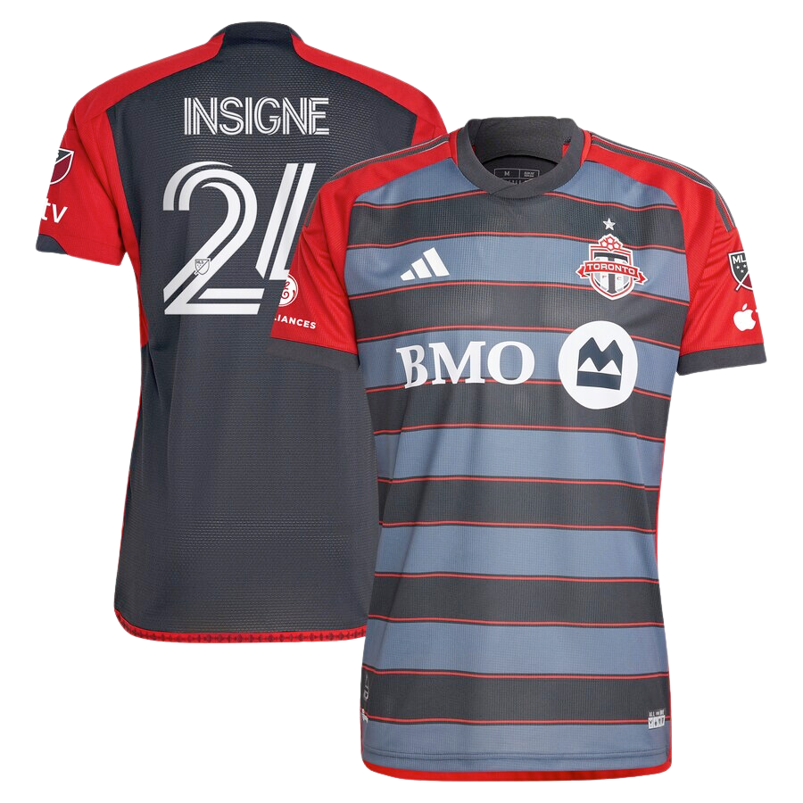
ANSWER #17
Lionel Messi is currently the highest-paid player in Major League Soccer. Who is the second-highest-paid player?
A.
Carlos Vela
B.
Sergio Busquets
C.
Lorenzo Insigne

Slide 44
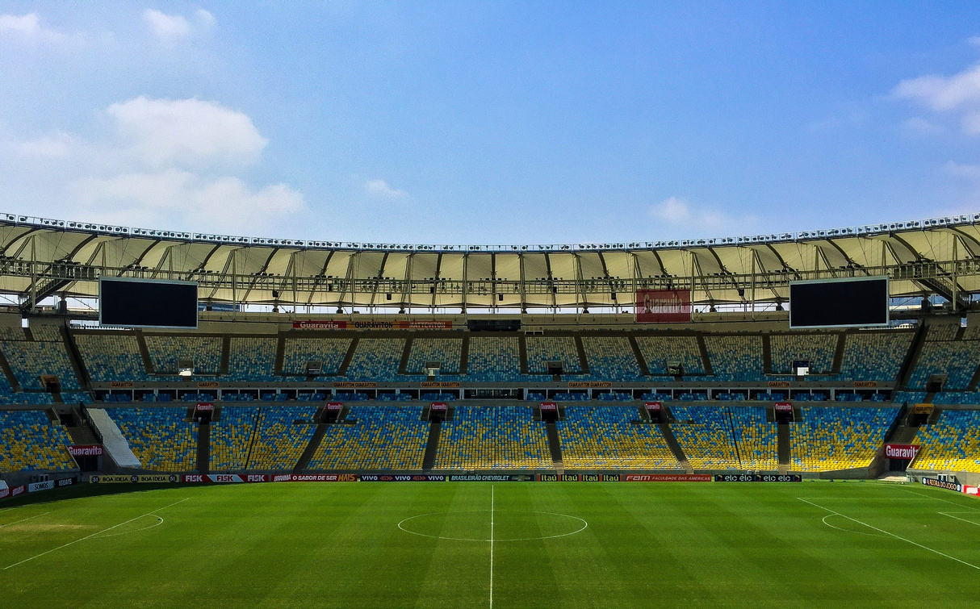
QUESTION #18
GEODIS Park, home to Nashville, SC, is the largest soccer-specific stadium in Major League Soccer. What is its capacity?
A.
55,000
B.
30,000
C.
17,500

Slide 45
ANSWER #18
GEODIS Park, home to Nashville, SC, is the largest soccer-specific stadium in Major League Soccer. What is its capacity?
A.
55,000
B.
30,000
C.
17,500

Slide 46
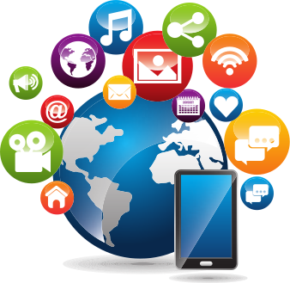
QUESTION #19
Other than Lionel Messi, which MLS player has the most followers on social media?
A.
Carlos Vela
B.
Jordi Alba
C.
Thiago Almada

Slide 47
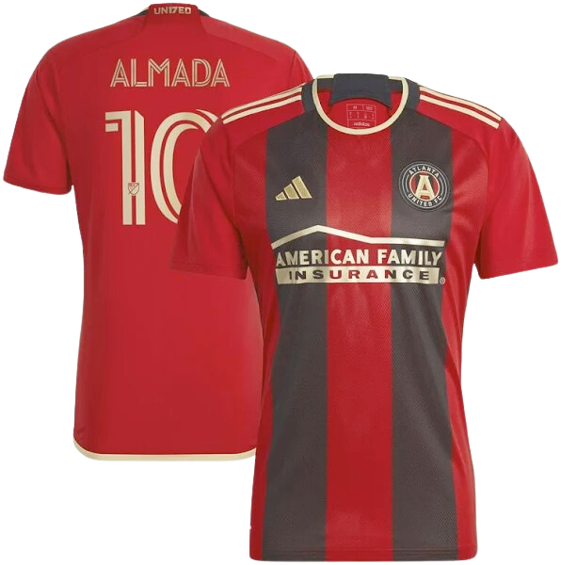
ANSWER #19
Other than Lionel Messi, which MLS player has the most followers on social media?
A.
Carlos Vela
B.
Jordi Alba
C.
Thiago Almada

Slide 48

QUESTION #20
According to a report from Sponsorwise, this team has more sponsorship deals (125) than any other MLS franchise.
A.
Sporting Kansas City
B.
Inter Miami
C.
Austin FC

Slide 49
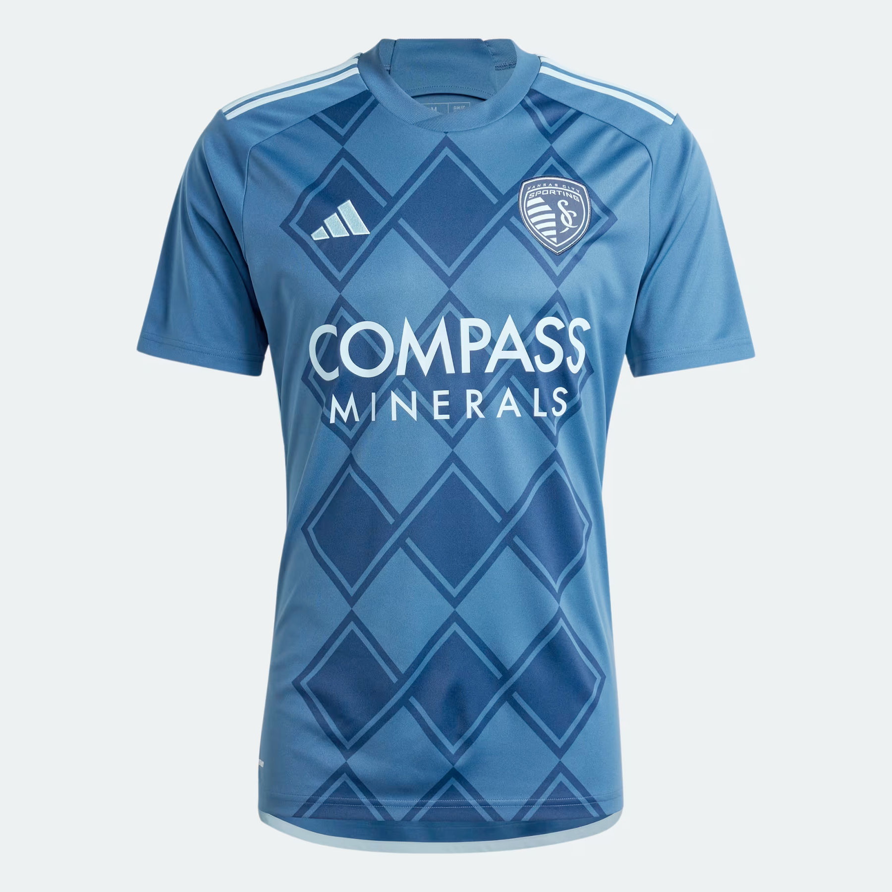
ANSWER #20
According to a report from Sponsorwise, this team has more sponsorship deals (125) than any other MLS franchise.
A.
Sporting Kansas City
B.
Inter Miami
C.
Austin FC

Slide 50

TIME TO ADD UP YOUR SCORES AND SEE WHO WON!

Slide 51
SOURCES:
https://www.columbuscrew.com/tickets/memberships
https://www.chicagofirefc.com/tickets/packsandpromotions
https://www.usatoday.com/story/sports/soccer/2024/02/21/lionel-messi-apple-tv-mls-season-pass/72691951007
https://www.sportsbusinessjournal.com/Articles/2024/02/19/major-league-soccer
https://www.forbes.com/sites/justinbirnbaum/2024/02/02/major-league-soccers-most-valuable-teams-2024
https://www.forbes.com/sites/justinbirnbaum/2023/02/02/major-league-soccers-most-valuable-clubs-2023-lafc-is-the-first-billion-dollar-franchise
https://www.forbes.com/sites/chrissmith/2019/11/04/major-league-soccers-most-valuable-teams-2019-atlanta-stays-on-top-as-expansion-fees-sale-prices-surge
https://www.forbes.com/sites/chrissmith/2017/08/16/major-league-soccers-most-valuable-teams-2
https://www.forbes.com/sites/chrissmith/2013/11/20/major-league-soccers-most-valuable-teams
https://en.wikipedia.org/wiki/Expansion_of_Major_League_Soccer
https://theathletic.com/4674349/2023/07/10/messi-miami-beckham-money
https://www.intermiamicf.com/news/inter-miami-cf-and-jpmorgan-chase-announce-naming-rights-partnership-introduce-c
https://www.capology.com/us/mls/salaries
https://en.wikipedia.org/wiki/Soccer-specific_stadium
https://www.sportsbusinessjournal.com/Daily/Issues/2020/02/18/Marketing-and-Sponsorship/BodyArmor-Vela.aspx
https://www.prnewswire.com/news-releases/mls-team-sponsorship-revenue-nears-600-million-302009011.html#:~:text=Lionel%20Messi%2C%20Inter%20Miami%20FC's,Dynamo's%20Hector%20Herrera%20(7).
MLS Marketing Partnerships Report. Sponsorwise. 2023.

