Slide 1
2024
MARCH
MADNESS
BY THE NUMBERS

Slide 2
THE BIG DANCE = BIG BUSINESS
The NCAA Division I Basketball Tournament, also known as “The Big Dance” or March Madness, is one of America’s premier sporting events.
Many parties profit from national event including:
The NCAA (National Collegiate Athletic Association)—a non-profit organization that regulates collegiate athletics in the U.S.
Athletic conferences (SEC, Big 10, etc.) that are NCAA members
Participating colleges and universities
Broadcast networks
Advertisers
The cities that host tournament games

Slide 3
MARCH MADNESS MONEY ﻿TRAIL
THE NCAA

Slide 4
MARCH MADNESS REVENUE
March Madness is the NCAA’s biggest money-maker. In a typical year, the NCAA men’s basketball tournament pulls in over $1 billion dollars in revenue.
$1.29 BILLION
1.12 billion
1.16 billion
1.14 billion
Revenue sources include:
Broadcast rights earnings
Tournament revenue (ticket sales)
Product licensing fees
519 million
(pandemic year, no tournament held)
SOURCE: SPORTICO
2019
2020
2021
2022
2023

Slide 5
$10.8 BILLION
In 2011, the NCAA inked a 14-year, $10.8 billion TV deal with CBS and Turner Sports (home to TNT, TBS and truTV) for broadcast rights to the NCAA Men’s Basketball Tournament.
The NCAA earns roughly $770 million/year from this deal.

Slide 6
$8.8 BILLION
In 2016, the NCAA announced an $8.8 billion, eight-year extension, to their existing broadcast rights deal that would keep the tournament on Turner and CBS through 2032.
The NCAA will earn roughly $1.1 billion/year between 2026 and 2032 from this deal.

Slide 7
4535%
The value of the tournament’s television rights have increased by an average of 4,535% per year since 1986.

Slide 8
69%
According to U.S. News & World Report, broadcast rights to the Men’s basketball tournament account for roughly 69% of the NCAA’s total revenue.
PHOTO: NCAA

Slide 9
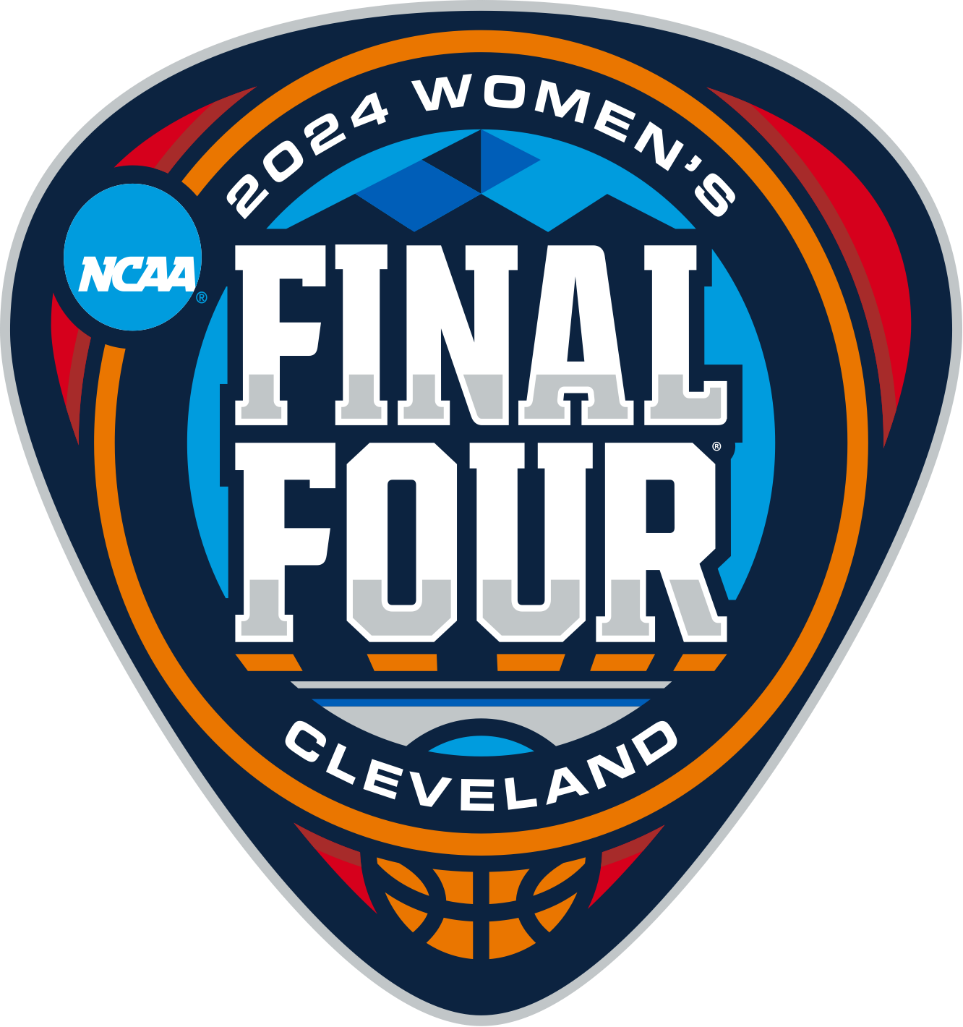
$920 MILLION
Early in 2024, the NCAA signed an 8-year, $920 million media deal that bundled broadcast rights to 40 different college sports championships, including the NCAA Division I Women’s Basketball Tournament.
Through this deal, the NCAA and ESPN aim to capitalize on the increasing popularity of women’s sports, including basketball.
The new deal did not come without criticism.
According to The Athletic, advocates for women’s college basketball believe that the women’s tournament could have garnered a more lucrative media rights deal if it had been sold separately from the bundled championships.

Slide 10
$2.5 MILLION
Mark Emmert, NCAA President, earned $2.5 million in annual base salary prior to his retirement in 2023. Emmert held the position for twelve years.
PHOTO: NCAA

Slide 11
$3 MILLION
In March 2023, Charlie Baker, former governor of Massachusetts, became the 6th NCAA president.
Baker’s annual salary as NCAA president is estimated to be close to $3 million per year, far exceeding his $185,000 annual salary as governor.
PHOTO: NCAA

Slide 12
MARCH MADNESS MONEY ﻿TRAIL
NCAA CONFERENCES

Slide 13
NCAA BASKETBALL
TOURNAMENT PAYOUTS
After each March Madness tournament, the NCAA distributes a percentage of their $1B+ in tournament revenue to its member conferences through the NCAA Basketball Fund.

Slide 14
HOW IS THE MONEY DISTRIBUTED?
The NCAA distributes money from the NCAA Basketball Fund to individual conferences after the tournament is complete.
Participating teams earn money for their conference for each game they play in the tournament (except for the final).
Conferences usually distribute earnings equally to each member school (this is not a NCAA rule, but a guideline most conferences follow).
The result is that winning teams don’t always reap the fruits of their labor.

Slide 15
$10 MILLION
San Diego State’s run to the 2023 NCAA Finals was worth approximately $10 million to the Mountain West Conference (paid out over six years), however SDSU will see less than $1 million of that money come back to their school and basketball program.
PHOTO: NCAA

Slide 16
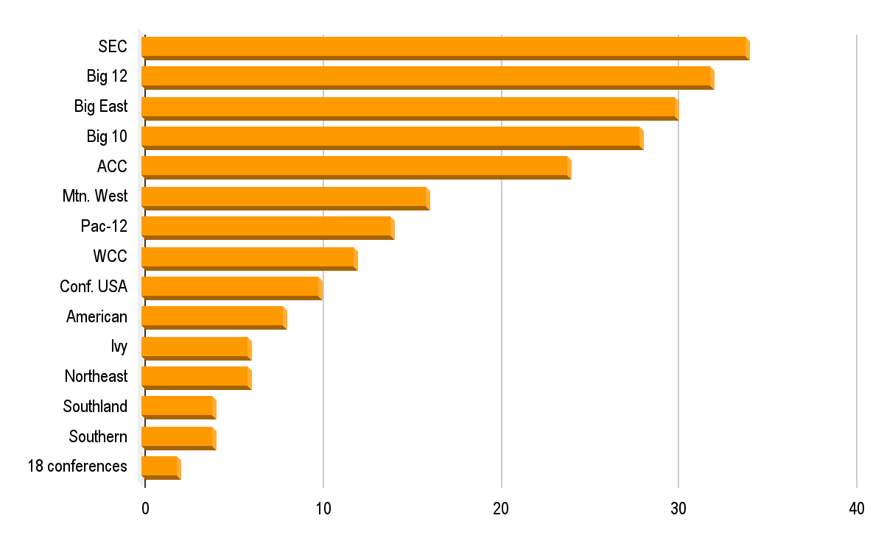
2023 Men’s NCAA Tournament Payouts
Payouts are based on tournament games played by teams within each conference.
$34M
$32M
$30M
$28M
$24M
$16M
$14M
$12M
$10M
$8M
$6M
$6M
$4M
$4M
$2M
SOURCE: SPORTICO
PAYOUT AMOUNT (MILLIONS OF DOLLARS)

Slide 17
MARCH MADNESS MONEY ﻿TRAIL
COLLEGES & UNIVERSITIES

Slide 18
$13.7 MILLION
In November 2023, University of Kansas coach Bill Self became the highest paid coach in the history of Division I NCAA basketball.
According to BetMGM, Self will earn more than $13.7 million for the 2023-24 season, which includes a $1 million signing bonus.
Self’s new annual salary is $4 million more than the second highest paid coach (and former top earner), John Calipari (Kentucky), whose salary is $8.5 million/year.
PHOTO: NCAA

Slide 19
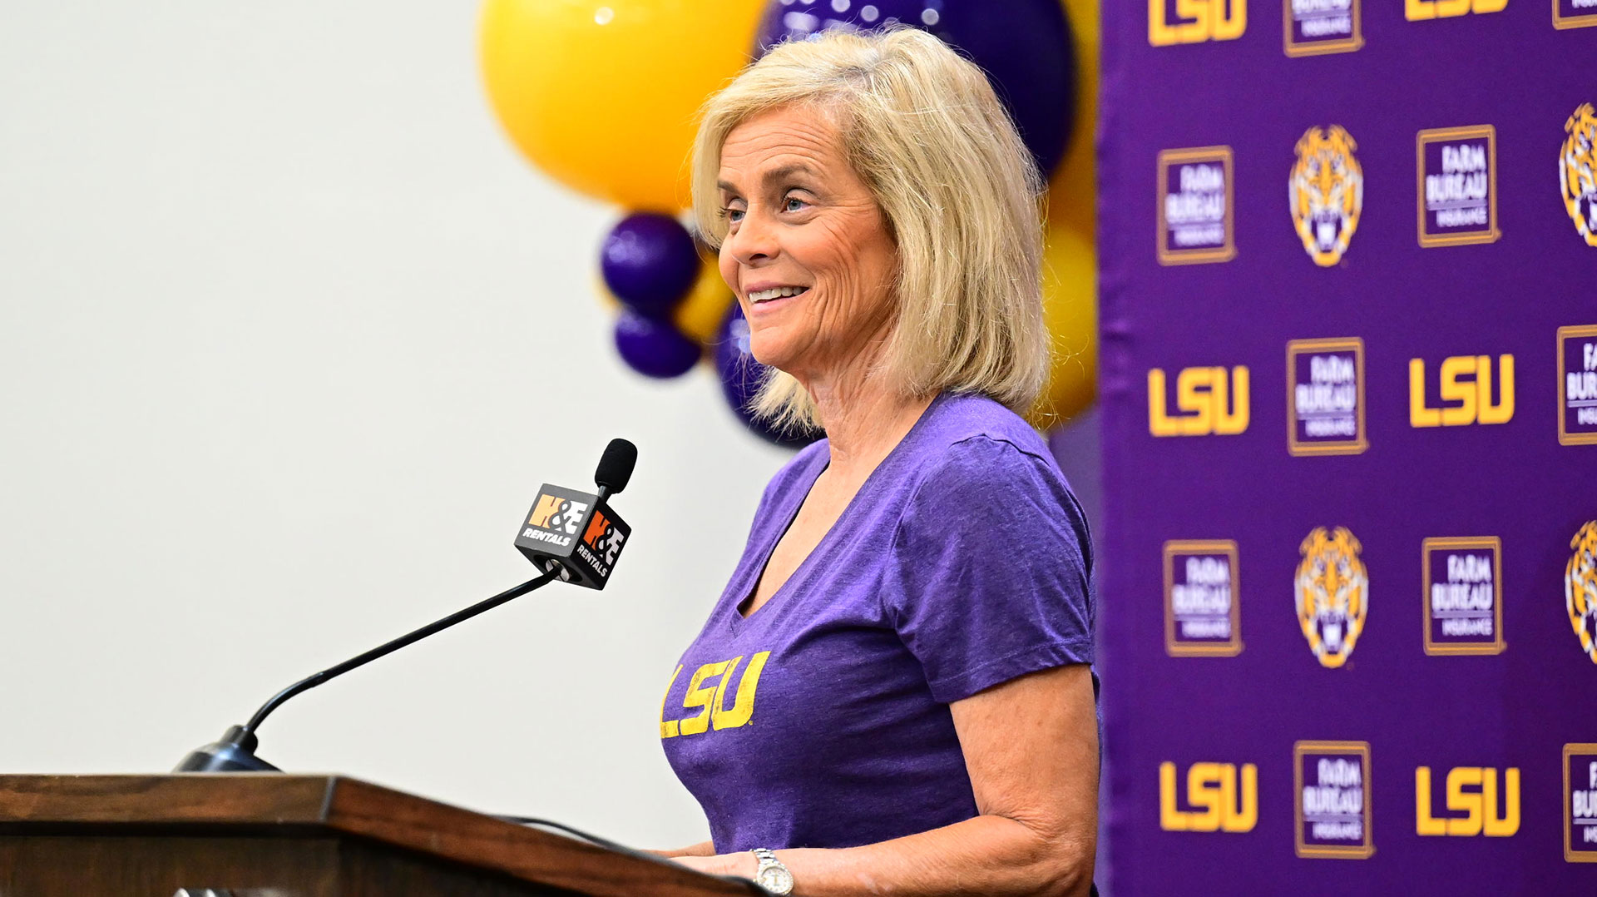
$3.2 MILLION
After winning her 4th National Championship in 2023, LSU Women’s Basketball coach Kim Mulkey signed a 10-year, $32 million contract extension with the school, making her the highest paid Women’s coach in the NCAA earning $3.2 million/year.
PHOTO: LSU

Slide 20
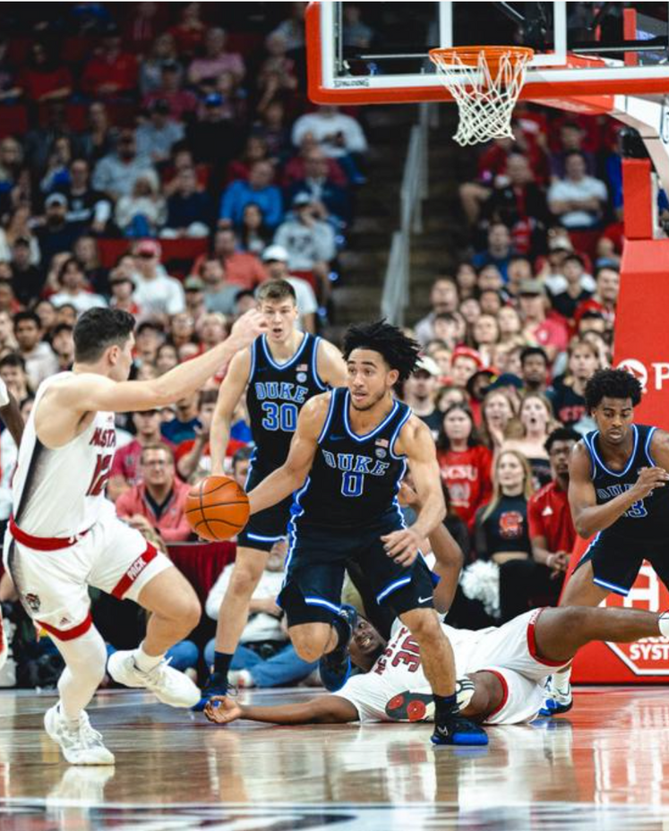
$45 MILLION
According to the latest data in a news story published by NASDAQ, Duke University is home to the most valuable collegiate basketball team, with the men’s program generating over $45 million in revenue.
PHOTO: DUKE UNIVERSITY BASKETBALL

Slide 21
$8 MILLION
On the women’s side, in 2023 Stanford University brought in more revenue than any other women's basketball program, with total earnings of over $8 million.
PHOTO: STANFORD UNIVERSITY WOMEN'S BASKETBALL

Slide 22
$0
College athletes earn exactly zero dollars from the schools they play for. Due to NCAA rules, college athletes are considered “amateurs” and cannot be paid. Many athletes, however, are awarded scholarships or partial scholarships by their schools to cover tuition, room and board.
PHOTO: DUKE ATHLETICS

Slide 23
$86,886
The total cost of tuition plus room and board at Duke University for the 2024-2025 academic year is $86,886, making it one of the most expensive schools to attend in the country.
Athletes who receive an athletic scholarship to play at Duke (and other schools) may have a portion, or all of their fees paid for by the university.
PHOTO: DUKE UNIVERSITY

Slide 24
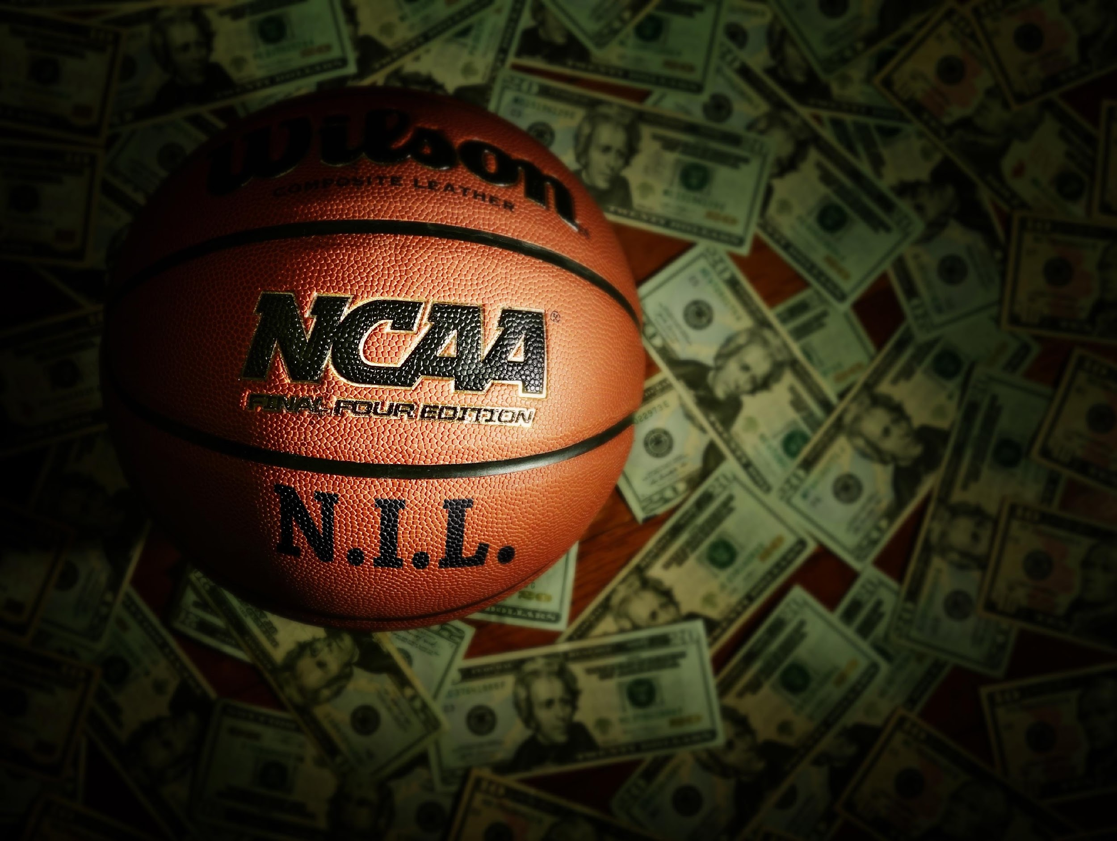
NIL
Players can, however, earn income through NIL (Name, Image & Likeness) deals with corporate sponsors.
Earning money through NIL is not a given, and for some, requires social media and marketing savvy.
There are several factors that make college athletes appealing to sponsors including athletic success, social media following, positive online presence, and previous fame (coming from a famous family helps!)

Slide 25
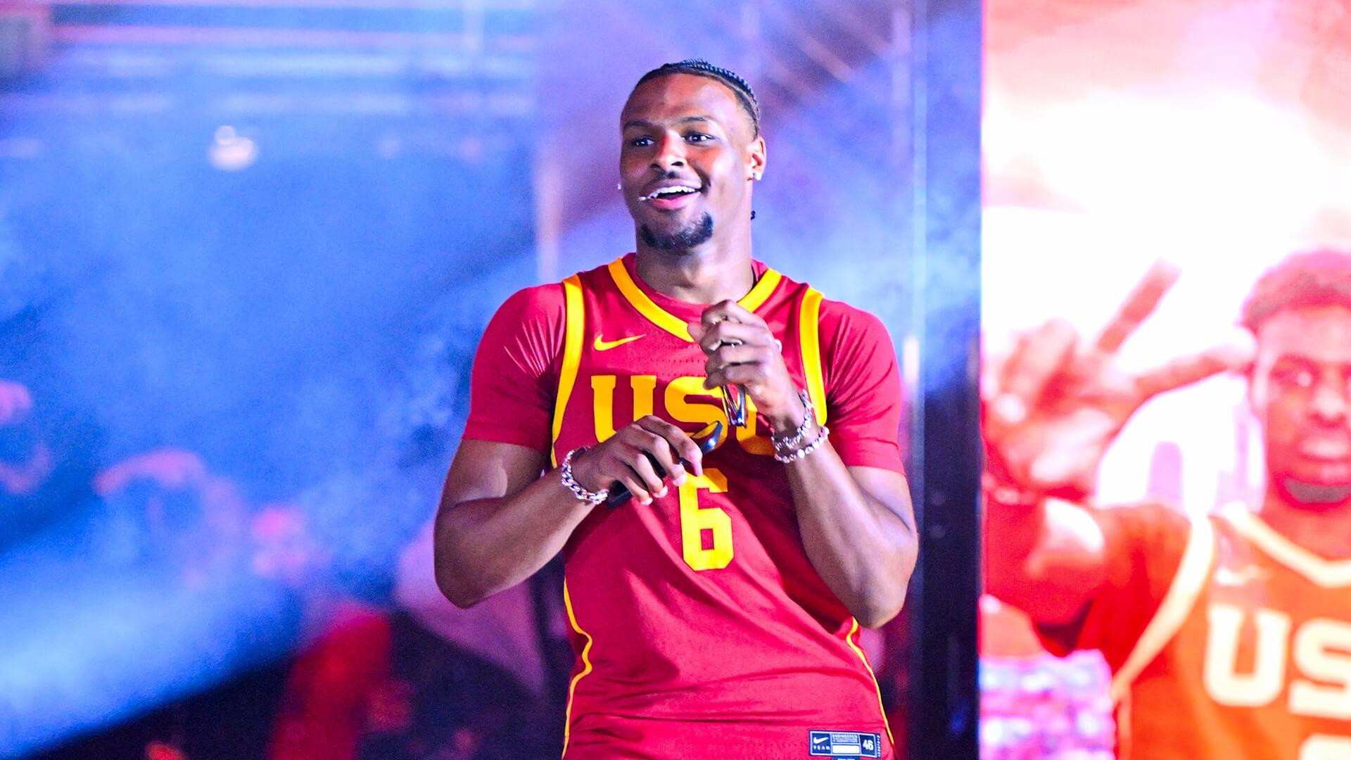
$5.9 MILLION
Bronny James (Lebron James’ son) secured $5.9 million in NIL sponsorships before playing a single game at USC.
He even signed a deal with Nike before graduating high school!
PHOTO: USC

Slide 26
TOP 10 NIL VALUATIONS: NCAA MEN’S BASKETBALL
ENTERING 2023-24 SEASON
ATHLETE
PROGRAM
SOCIAL MEDIA FOLLOWERS
NIL VALUE
1
BRONNY JAMES
USC
13.5M
$5.9M
2
HANSEL ENMANUEL
AUSTIN PEAY
4.3M
$1.2M
3
JARED MCCAIN
DUKE
2.6M
$1M
4
ARMANDO BACOT
UNC
251K
$930K
5
HUNTER DICKINSON
KANSAS
112K
$844K
RANK
6
SHAQIR O’NEAL
TEXAS SOUTHERN
4.4M
$822K
7
ZACH EDEY
PURDUE
60K
$810K
8
DONOVAN CLINGAN
UCONN
52K
$800K
9
KYLE FILIPOWSKI
DUKE
48K
$795K
10
ROBERT DILLINGHAM
KENTUCKY
723K
$710K
SOURCE: ON3NIL

Slide 27
TOP 10 NIL VALUATIONS: NCAA WOMEN’S BASKETBALL
ENTERING 2023-24 SEASON
ATHLETE
PROGRAM
SOCIAL MEDIA FOLLOWERS
NIL VALUE
1
CAITLIN CLARK
IOWA
1.4M
$3.5M
2
ANGEL REESE
LSU
5.2M
$1.7M
3
FLAU'JAE JOHNSON
LSU
3.1M
$1.1M
4
HALEY CAVINDER
TCU
5.3M
$868K
5
PAIGE BUECKERS
UCONN
1.6M
$652K
RANK
6
HAILEY VAN LITH
LSU
1.1M
$563K
7
MIA MASTROV
CAL
1.2M
$363K
8
SEDONA PRINCE
TCU
3M
$358K
9
DEJA KELLY
UNC
861K
$262K
10
CAMERON BRINK
STANFORD
534K
$232K
SOURCE: ON3NIL

Slide 28
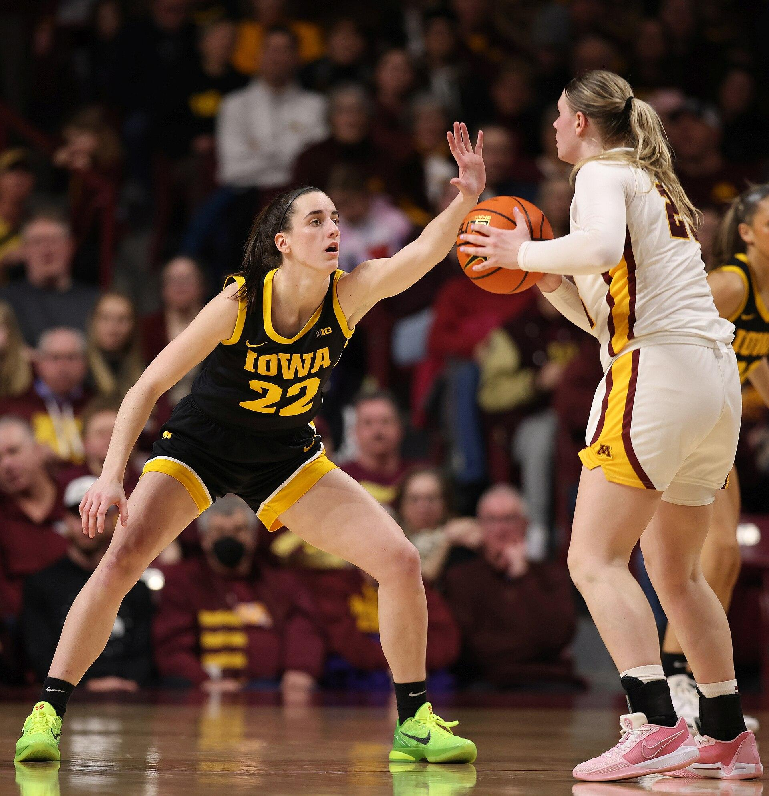
$76K
Caitlin Clark, the NCAA’s all-time leading scorer, and likely the #1 overall pick in the 2024 WNBA draft, will earn about $76,000/year for her rookie contract. For context, the highest paid WNBA player earns $242,000/year.
$3.5 MILLION
As of March 2024, Caitlin Clark has $3.5 million in NIL sponsorships from major brands including Nike, Gatorade, State Farm, Buick, H&R Block and the regional grocery store chain Hy-Vee.
According to Yahoo Sports, Clark believes she will be able to retain her major sponsors when she turns pro.
PHOTO: IOWA BASKETBALL

Slide 29
$4.7 MILLION
Duke’s Dereck Lively II, picked 12th in the 2023 NBA draft, will earn more than $4.7 million/year in his rookie year with the Dallas Mavericks.
By comparison, the top twenty WNBA players, including stars like Arike Ogunbowale, Breanna Stewart, Jewell Lloyd, Jackie Young, Diana Taurasi, Sabrina Ionescu, and A’ja Wilson, will earn roughly $4.4 million this year COMBINED.
PHOTO: DUKE UNIVERSITY BASKETBALL

Slide 30
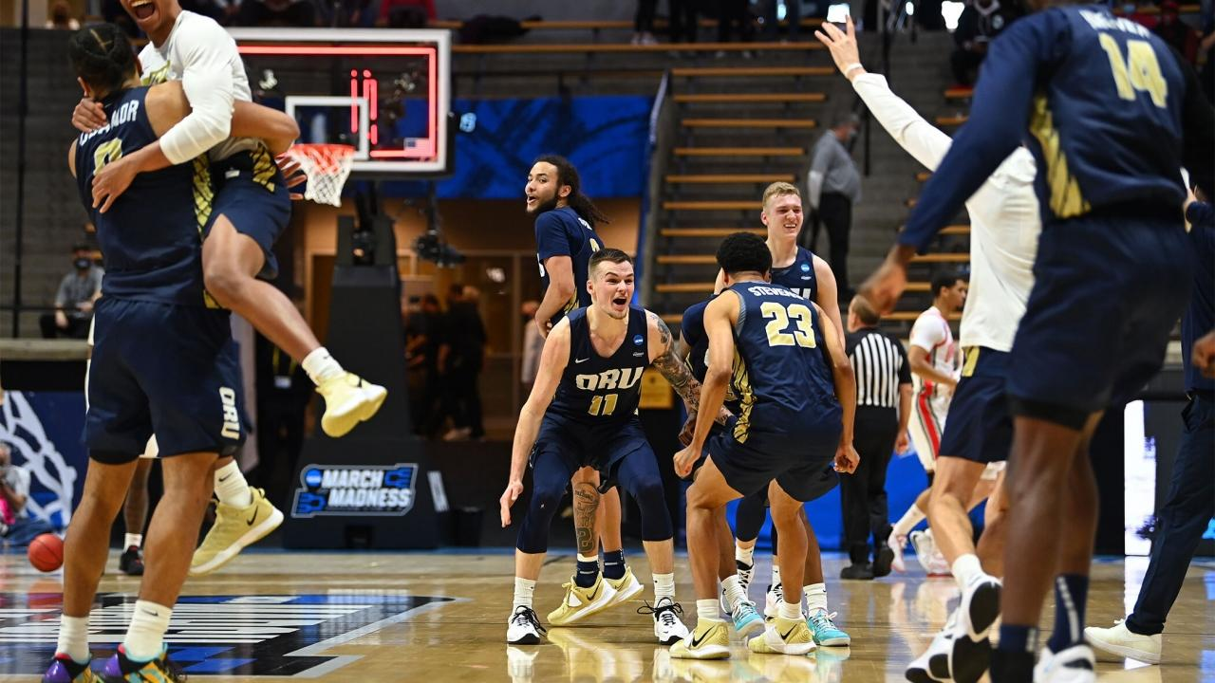
WHAT IMPACT DOES EARNING A TOURNAMENT BERTH
HAVE ON SMALLER SCHOOLS?
Participating in March Madness can be an effective marketing tool for lesser-known colleges and universities.
20.75%
In 2021, the Oral Roberts Golden Eagles went on a March Madness “Cinderella run” when they upset perennial basketball powerhouse, Ohio State in the first round of the tournament.
Oral Roberts then became the second No. 15 seed EVER to earn a spot in the Sweet 16 by beating No. 7 seed Florida in the second round of the tournament.
Forbes attributed Oral Roberts University 2021 Cinderella run to a 20.75% increase in applications to the school in 2022.
PHOTO: NCAA

Slide 31
100,000
San Diego State University (SDSU) reported that undergraduate applications increased from 60,000 in 2011 to nearly 100,000 in 2023, a period that coincides with their men’s basketball team’s two Sweet 16 appearances.
With an appearance in the 2023 NCAA Men’s Basketball Finals, the school is expecting an even greater increase in 2024 applications.
PHOTO: SDSU

Slide 32
MARCH MADNESS
VIEWERSHIP NUMBERS

Slide 33
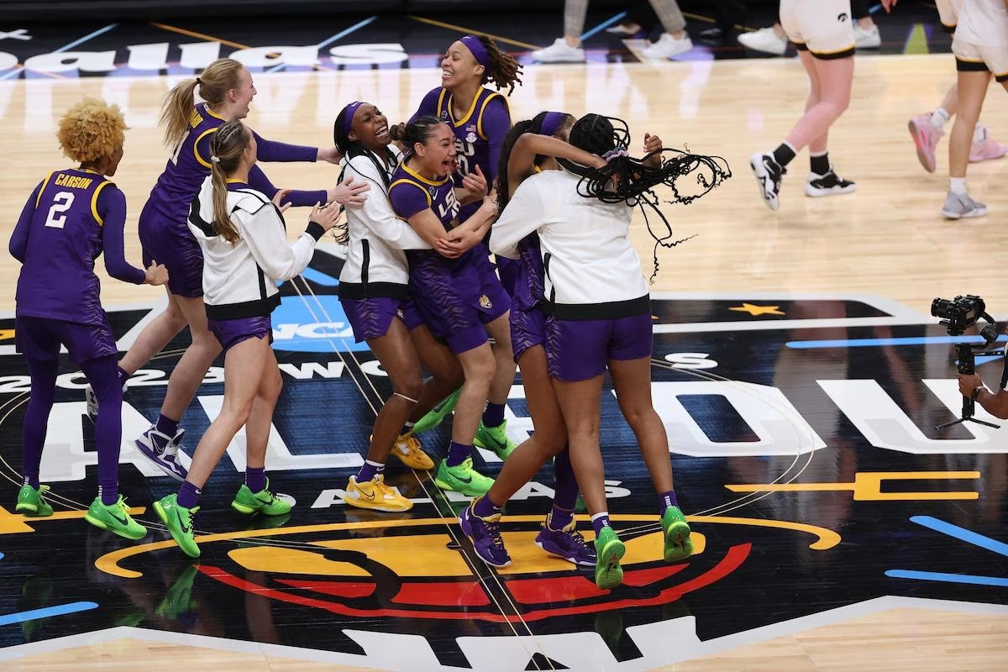
12.6 MILLION
The 2023 NCAA Women’s Basketball Tournament had a record number of viewers. Viewership peaked at 12.6 million people tuning in to watch the final quarter of the championship game between LSU, led by superstar Angel Reese and Iowa led by the (now) all-time NCAA leading scorer, Caitlin Clark.
This game marked the first time since 1995 that the women’s championship game was aired on a broadcast network (ABC).
The 2023 women’s championship game also holds the record for the most streamed sporting event on ESPN+ to date.
PHOTO: NCAA

Slide 34
DOUBLED
With 9.92 million average viewers throughout the game, the 2023 NCAA Women’s Basketball Championship between LSU and Iowa, more than DOUBLED the number of viewers from the previous year’s contest between South Carolina and UConn, which averaged 4.85 million viewers on ESPN/ESPN2.
PHOTO: NCAA

Slide 35
357,542
The 2023 NCAA Women’s Basketball tournament also broke their all-time attendance record, with 357,542 fans attending games throughout the tourney.

Slide 36
15% DROP
Despite drawing 14.69 million viewers, 2023's Men’s championship game between UConn and SDSU (CBS) that number represented a 15% viewership drop from the previous year’s championship game between Kansas and UNC.
The 2022 championship game averaged 17.05 million viewers across TBS, TNT and TruTV.
PHOTO: NCAA

Slide 37
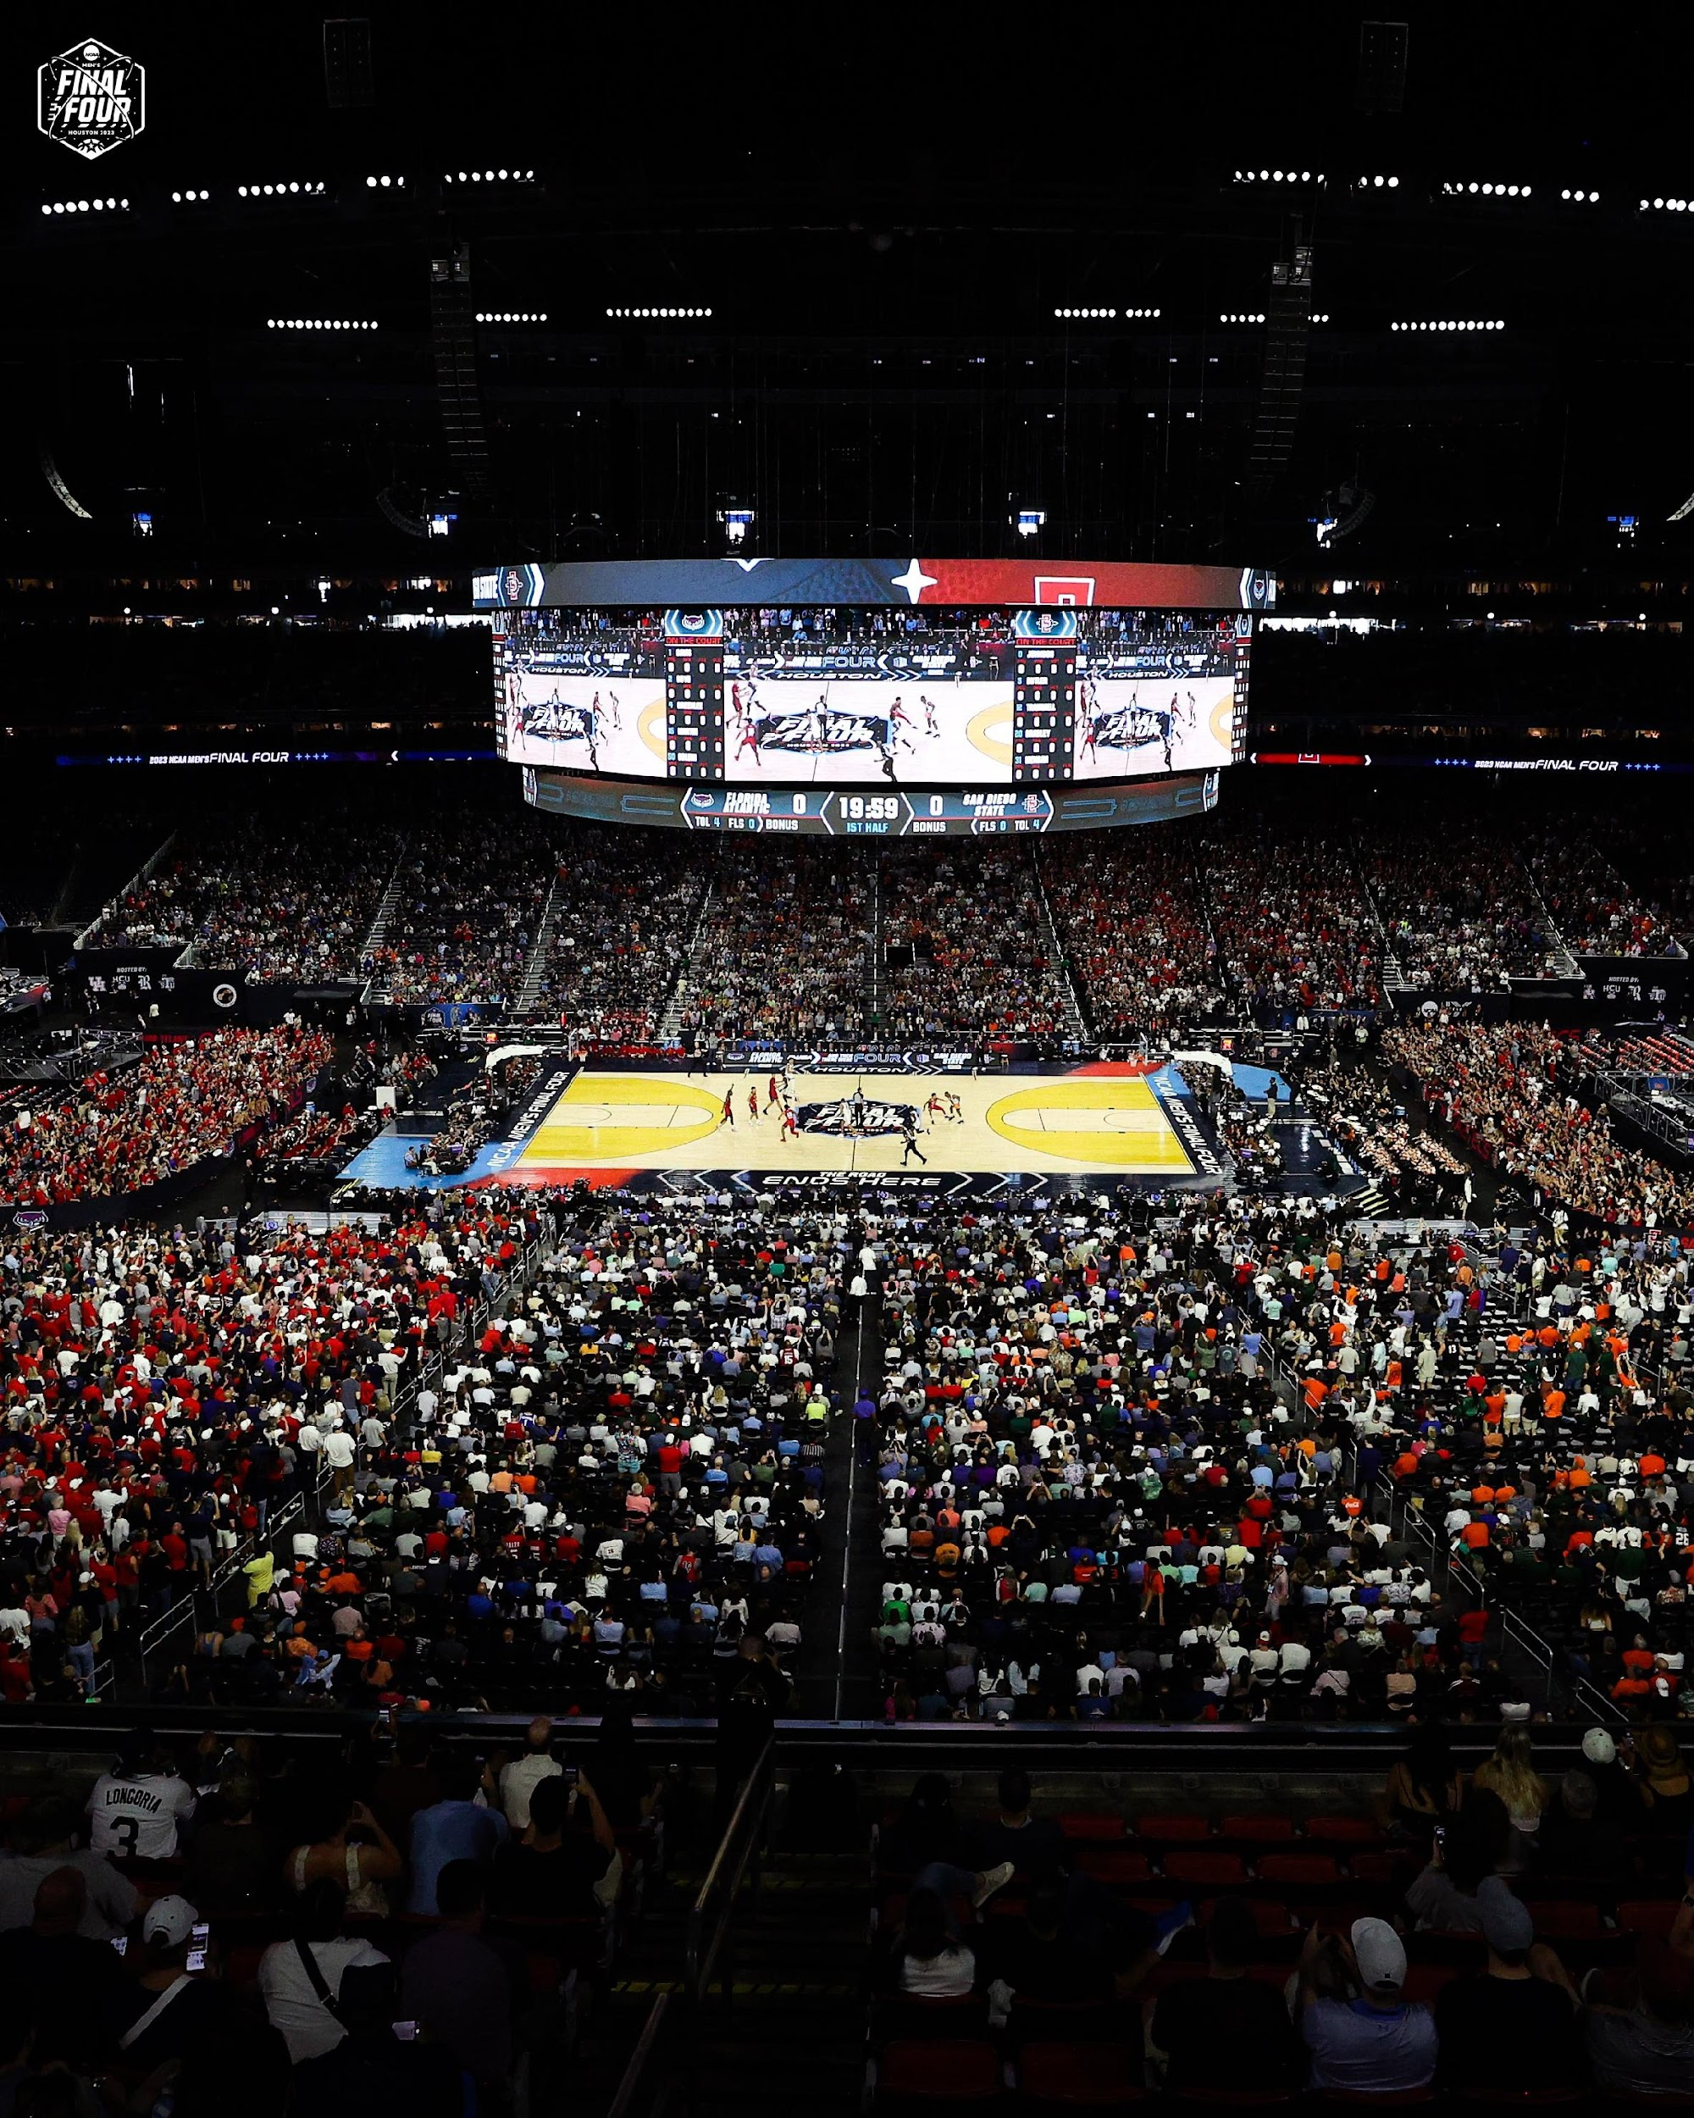
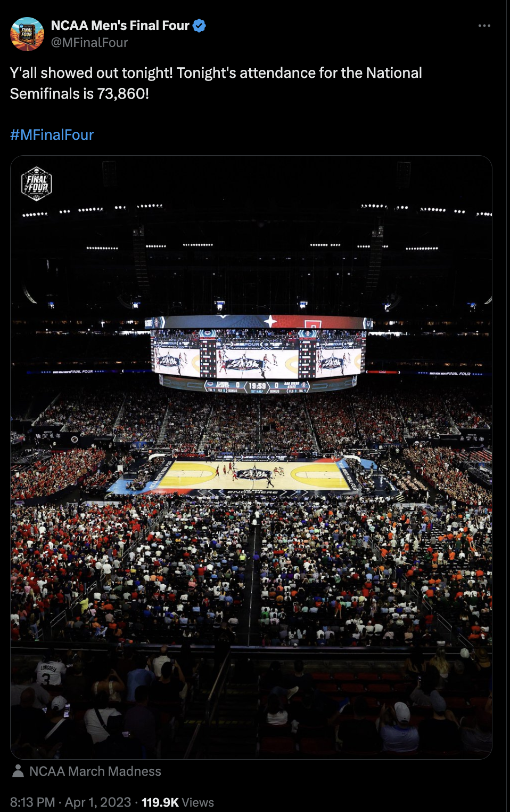
722,121
The total attendance for the 2023 NCAA Men’s Basketball tournament was 722,121 fans.
73,860
On April 1, 2023, a total of 73,860 fans attended the NCAA men’s semifinals in Houston. Attendance for the Final Four exceeded the number of fans that attended the championship game two days later (72,423).
To maximize ticket sales, the NCAA requires potential stadium locations for the men’s Final Four to hold at least 70,000 spectators.

Slide 38
MARCH MADNESS MONEY ﻿TRAIL
SPONSORSHIP & ADVERTISING

Slide 39
30.53 BILLION
According to a report by ispot, the 2023 NCAA Men’s Basketball Tournament games delivered 30.53 billion TV ad impressions, while the NCAA Women’s Basketball Tournament games delivered 3.85 billion impressions.
These numbers represent an impressive year-over-year increase of 85%.

Slide 40
$1.2 BILLION
According to The Sports Business Journal the 2023 NCAA Men's Basketball Tournament brought in close to $1.2 billion in advertising revenue for broadcast partners Warner Bros. Discovery and Paramount, an 8% increase from the previous year.
Believe it or not, ad revenue for March Madness exceeds the ad revenue for the NBA playoffs, MLB postseason and the College Football Playoffs!

Slide 41
$2.3 MILLION
According to Sportico, the estimated price of a 30-second advertising spot during the 2023 NCAA finals was between $2.2 and $2.3 million.
During earlier tournament rounds, 30-second spots fetched a few hundred-thousand dollars, with the prices escalating throughout the tournament.

Slide 42
2024 Sponsors
60%
60 percent of all in-game advertising time during the men’s tournament is reserved for the NCAA’s 17 official sponsors.
The three heaviest spenders, the NCAA’s so-called “Corporate Champions” (Capital One, Coca-Cola and AT&T) account for the bulk of advertising dollars spent.

Slide 43
SOLD OUT
According to an ESPN press release, advertising spots for the entire 2023 women’s tournament were sold out by March 14, 2023.
Most notably, in 2023, longtime NCAA sponsor Aflac, moved 100% of its sponsorship funds from the men’s tournament to the women’s tournament according to a report by Dow Jones.
The number of advertisers for the women’s tournament also increased to almost 100, up from 22 in the previous year.

Slide 44
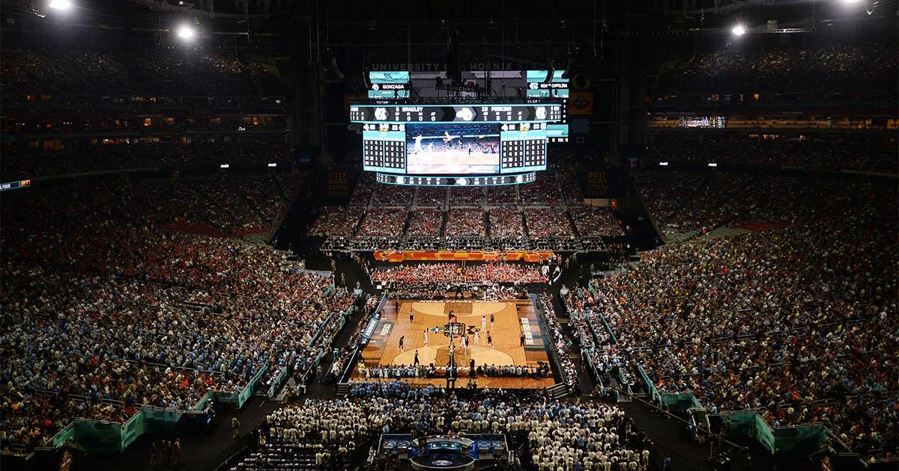
187 HOURS
According to Ministry of Sport, through the tournament’s 134 games (combined men’s and women’s), brands earn more than 187 hours of cumulative brand exposure.
The NCAA’s corporate champion brands, AT&T, Coca-Cola and Capital One, along with equipment and apparel brands Nike and Spalding earned 50% of total screen time throughout both tournaments.

Slide 45
ADVERTISER
AD SPEND
$52.3M
$27.1M
$247 MILLION
$26.5M
$25.2M
$24.7M
In 2023, the Top 10 biggest ad spenders alone accounted for $247 million in March Madness ad revenue, according to iSpot data.
$23.8M
$18.4M
$16.8M
$15.8M

Slide 46
MARCH MADNESS MONEY ﻿TRAIL
ECONOMIC IMPACT

Slide 47
MEN’S NCAA TOURNAMENT HOST CITIES
14
ROUND
HOST CITY
HOST CITY
HOST CITY
HOST CITY
HOST CITY
HOST CITY
FIRST FOUR
DAYTON, OH
14 cities will play host to the 2024 NCAA Men’s Basketball tournament, with the Final Four and National Championship being played in Phoenix, AZ.
While Phoenix will likely reap the greatest benefit, each of these cities stands to earn money from tourism and visitor spending related to the tournament.
FIRST & SECOND ROUND
BROOKLYN, NY
CHARLOTTE, NC
INDIANAPOLIS, IN
OMAHA, NE
FIRST & SECOND ROUND
PITTSBURGH, PA
SALT LAKE CITY, UT
SPOKANE, WA
MEMPHIS, TN
REGIONALS
(ELITE 8)
BOSTON, MA
DALLAS, TX
DETROIT, MI
LOS ANGELES, CA
FINAL FOUR & FINALS
PHOENIX, AZ

Slide 48
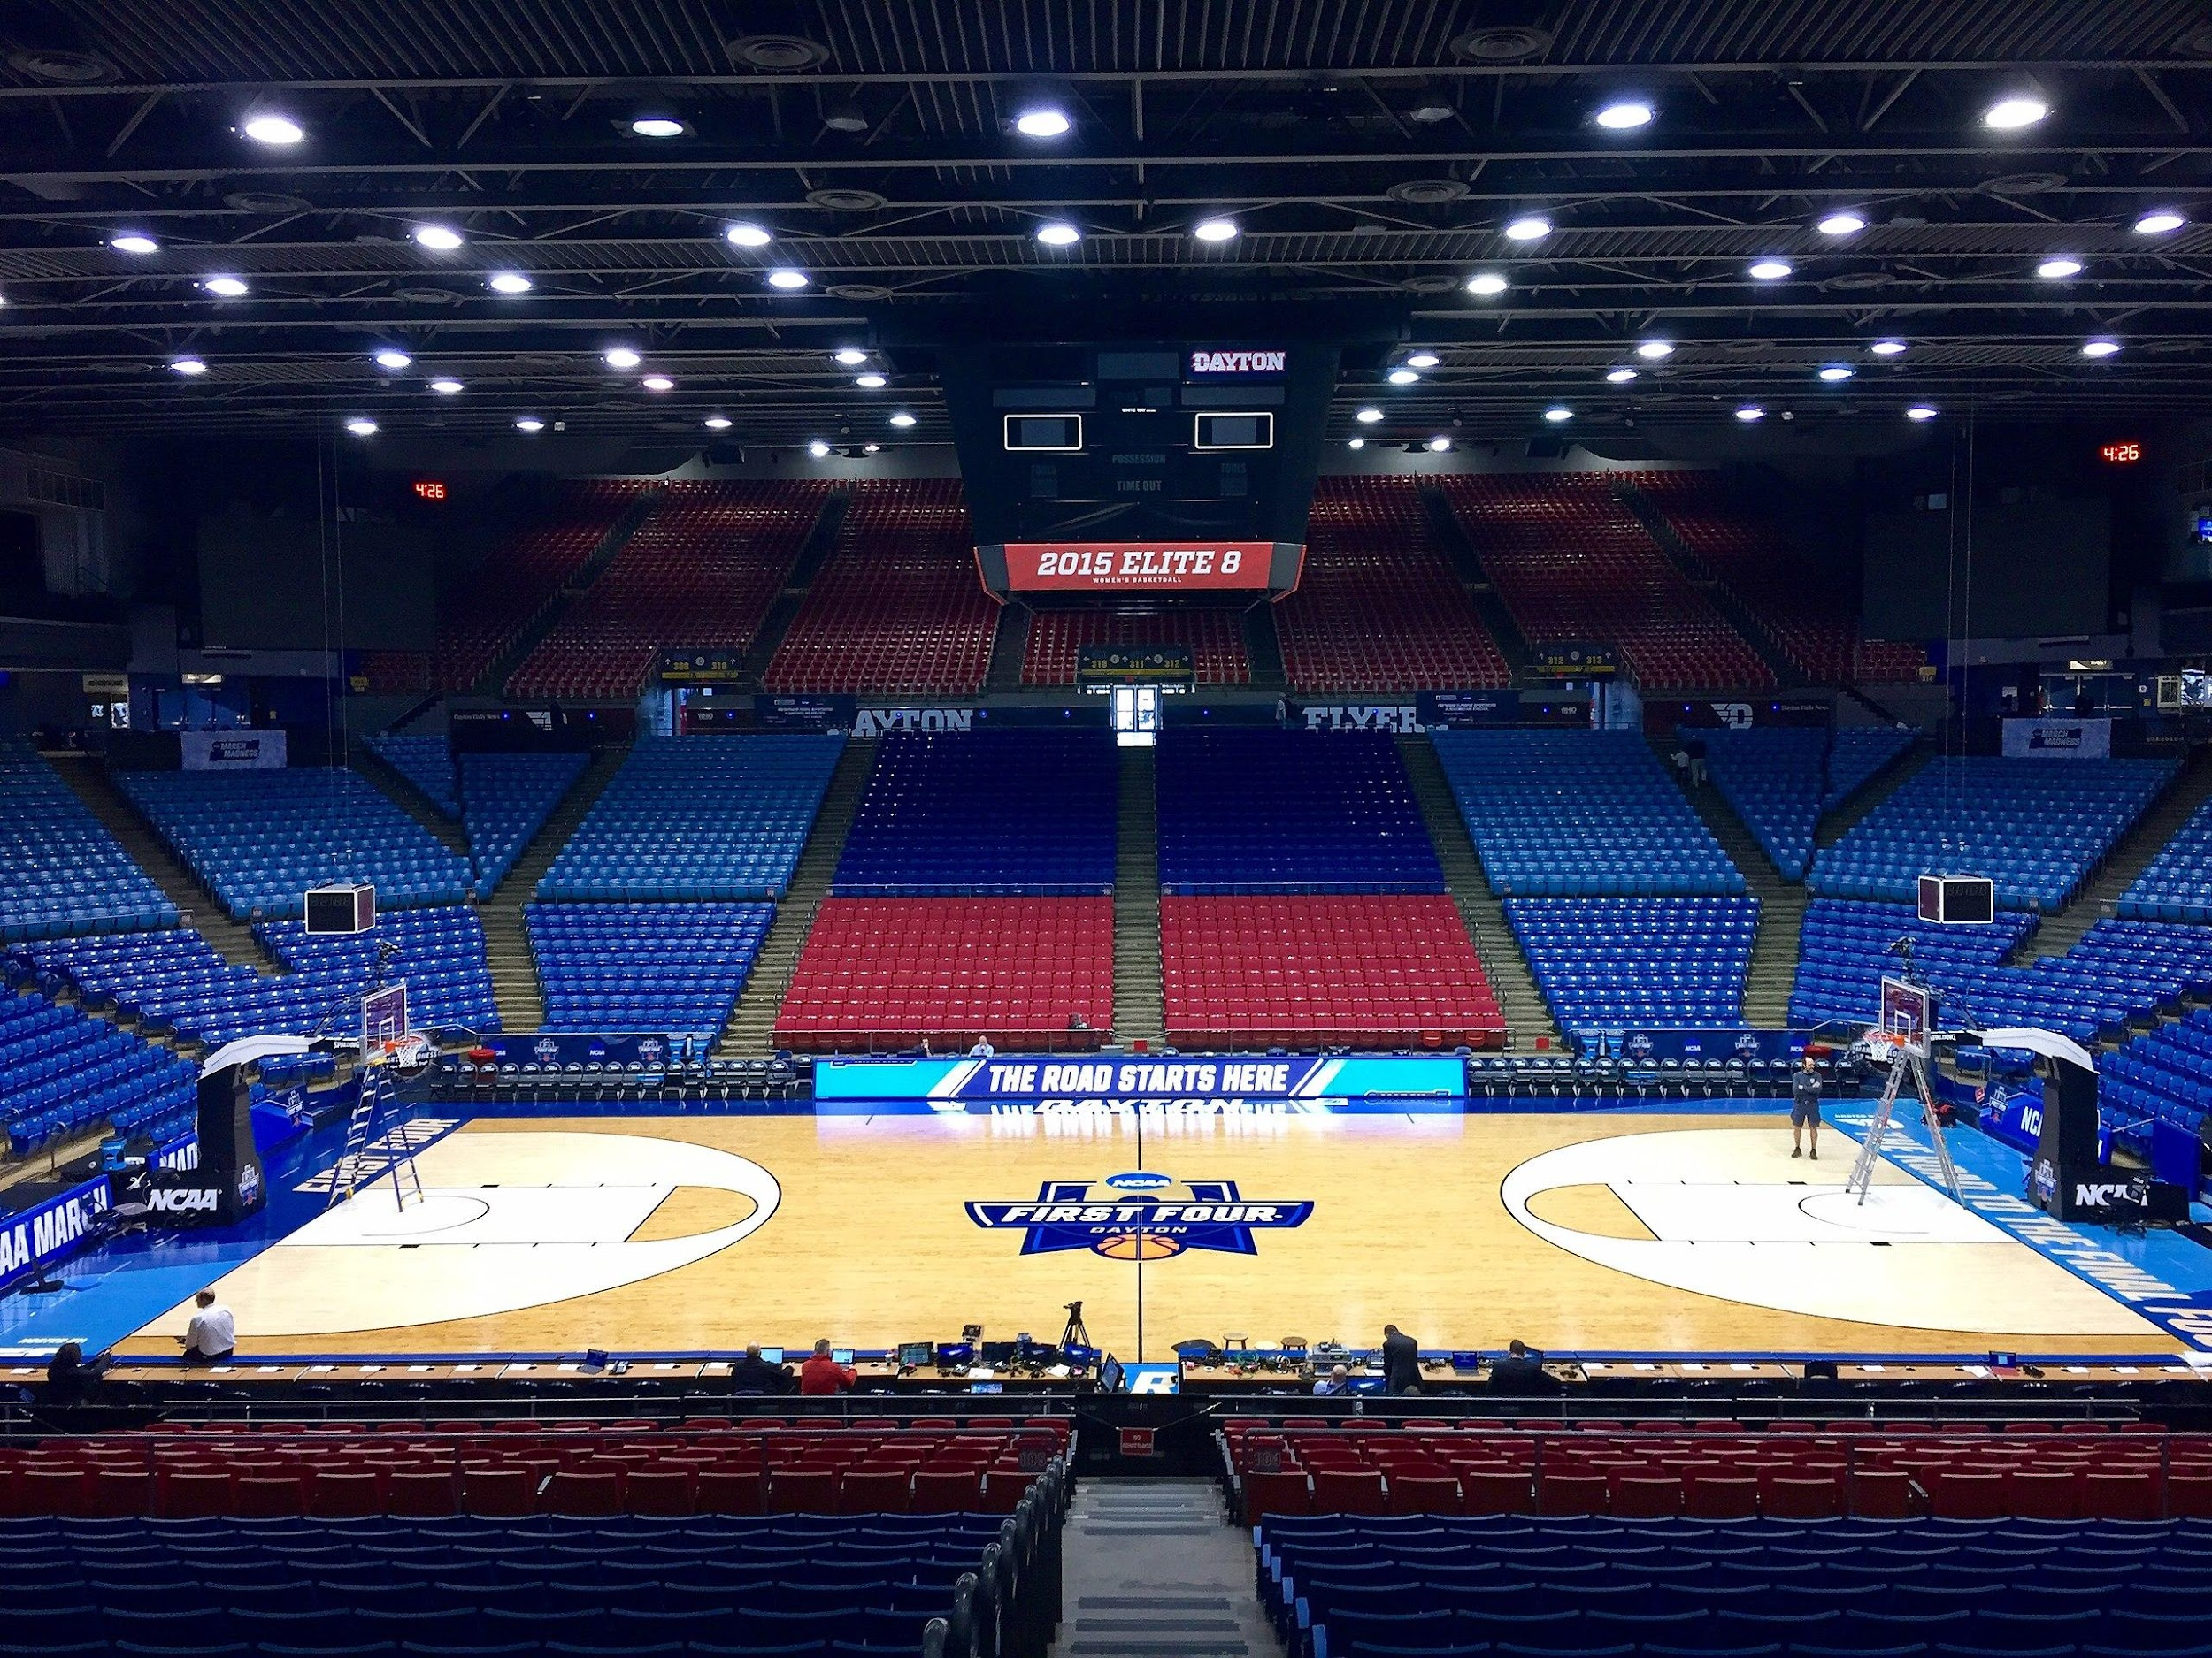
129
The University of Dayton has hosted 129 NCAA tournament games since 1970—more than any arena in the nation.
Dayton has been home to the tournament’s play-in and First Four games since 2001. Their current NCAA contract will keep the First Four in Dayton through 2026.
$30 million
According to the Dayton Daily News, over the past 10 years, the overall economic impact of the NCAA Men’s Basketball Tournament on the city could be as much as $30 million, with $5.9 million in direct spending alone in 2023. This includes spending in restaurants, hotels, and retail.

Slide 49
ECONOMIC IMPACT: FINAL FOUR
State Farm Stadium in Glendale, Arizona (just outside of Phoenix) will host the 2024 NCAA Men’s Final Four and National Championship Game.
The precedent set by hosting Super Bowl LVII in 2023 suggests that the Phoenix area can anticipate substantial economic benefits.
According to an economic impact study done by Arizona State University, when the city hosted the NCAA Final Four in 2017, the event generated $324.5 million for the region, including $122 million in direct spending from visitors.

Slide 50
$270 MILLION
The estimated economic impact on the city of Houston for hosting the 2023 Final Four was approximately $270 million.
This number represents increased tourism spending in restaurants and hotels, transportation companies like Lyft and Uber, and spending at other local businesses.

Slide 51
MARCH MADNESS MONEY ﻿TRAIL
GAMING & GAMBLING

Slide 52
$15.5 BILLION
Even though the Super Bowl is the most wagered-on sporting event, the NCAA Tournament is a close second.
According to Forbes, Americans wagered an estimated $16 billion on the Big Game and $15.5 billion on March Madness in 2023.

Slide 53
70 MILLION
According to the American Gaming Association, roughly 70 million brackets are filled out each year. They estimated that 40 million Americans take part in predicting the NCAA Tournament, with the majority submitting more than one bracket.
SOURCE: NCAA

Slide 54
ONE IN 9.2 QUINTILLION
The odds of someone filling out a perfect bracket, correctly picking the winners of every game in the tournament are 1 in 9.2 quintillion.
In other words, it is nearly impossible.
A person is TWO TIMES more likely to win BACK-TO-BACK Mega Millions lottery jackpots than they are filling out a perfect tournament bracket!

Slide 55
$16.3 BILLION
According to WalletHub, this year’s tournament could cost employers roughly $16.3 billion in lost productivity from people spending time filling out brackets and watching games while on the job.
81%
81% of HR professionals say their organizations do not have policies in place that address regulation of office gambling pools.

Slide 56
MARCH MADNESS
DISCUSSION QUESTIONS

Slide 57
MARCH MADNESS DISCUSSION QUESTIONS
How do you think March Madness contributes to a drop in worker productivity in the American workplace?
Only 3% of collegiate basketball programs generate a revenue surplus according to CBS News. Why do you think they continue playing if that is the case?
Why is social media important to the tournament?
Why do you think tracking the number of consumers who follow the tournament via some form of social media is important to the NCAA? To a broadcast company like CBS or Turner Sports? What about for advertisers/marketing professionals?
What are broadcast rights? Why do you think CBS and Turner invested so much in the rights to the NCAA Tournament?
What types of companies sponsor the NCAA Tournament? What demographic are they targeting?
What is economic impact? Why is it an important concept when it relates to mega events like the Super Bowl, Olympic Games and NCAA Tournament?
Why do you think college athletes don’t get paid? How might NIL rules change the future of the sport?
Will you watch any games this year? If so, will you watch on TV, stream on your device, or both? Will you watch with friends? Why might an advertiser or sponsor be interested to know that information?
Who do you think will win this year’s championship?

Slide 58
SOURCES
http://www.nysportsjournalism.com/record-spend-for-march-madness/tag/ncaa
https://wallethub.com/blog/march-madness-statistics/11016
https://www.cnn.com/2015/07/08/us/gallery/ncaa-by-the-numbers/index.html
https://www.collegesimply.com/colleges/north-carolina/duke-university/price/
https://www.kantarmedia.com/us/newsroom/press-releases/march-madness-release
https://www.kantarmedia.com/us/thinking-and-resources/blog/whos-on-top-32017-32617
https://www.ncaa.com/news/basketball-men/article/2017-04-07/2017-final-four-viewership-attendance-numbers
https://money.yahoo.com/richest-college-basketball-programs-america-210045624.html
https://www.bizjournals.com/sanantonio/news/2018/02/16/ncaa-final-fours-local-economic-impact-expected-to.html
https://www.usatoday.com/story/sports/ncaab/2022/03/11/college-basketball-bill-self-first-10-million-season/9425924002/?gnt-cfr=1
http://fs.ncaa.org/Docs/stats/m_basketball_RB/2024/Attend.pdf

