Slide 1




MARKETING
STUNTS 2024
Copyright Sports Career Consulting - Marketing Insights from SCC

Slide 2
MARKETING
STUNTS 2024
Every year on April Fools’ Day, brands launch creative product innovations and collaborations online and through social media channels. We call this practice a publicity or marketing "stunt."
In this presentation, we will review several examples. See if you can guess if the product launch is an actual product or brand collaboration or if it is just an April Fools' Day marketing prank.
Copyright Sports Career Consulting - Marketing Insights from SCC

Slide 3
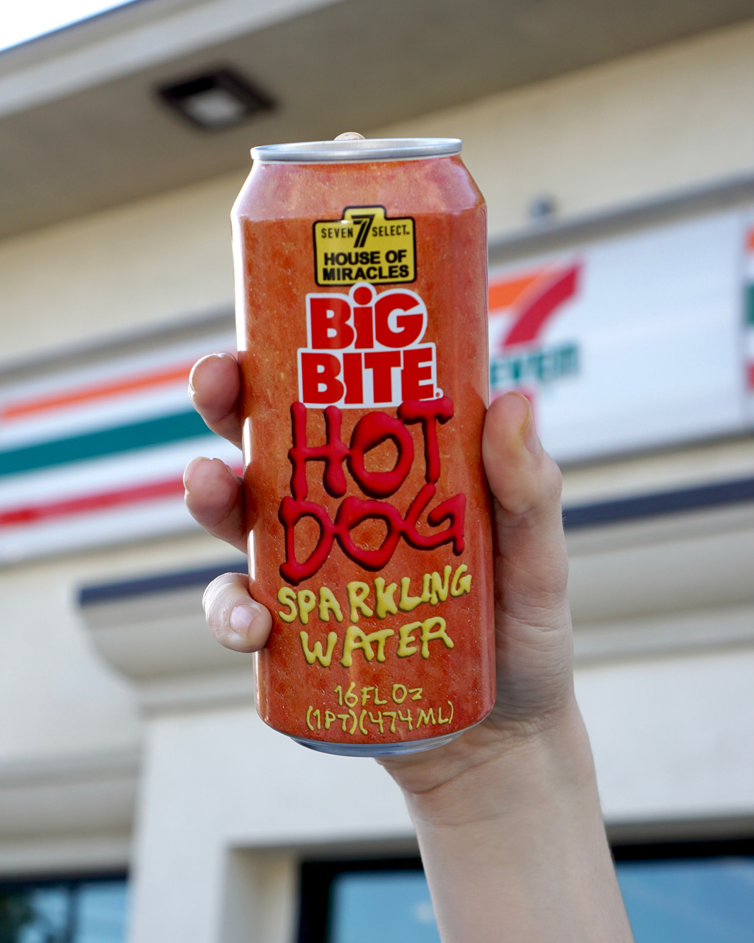
7-Eleven
Hot Dog Flavored
Sparkling Water
MARKETING
STUNTS 2024
7-Eleven is introducing a new line of sparkling water flavors, including lemon-lime, green apple, sweet orange, and hot dog, in honor of the chain's popular Big Bite Hot Dogs. The company teamed up with the beverage brand Miracle Seltzer to create the new drinks.
Copyright Sports Career Consulting - Marketing Insights from SCC

Slide 4
APRIL FOOLS!
Copyright Sports Career Consulting - Marketing Insights from SCC

Slide 5
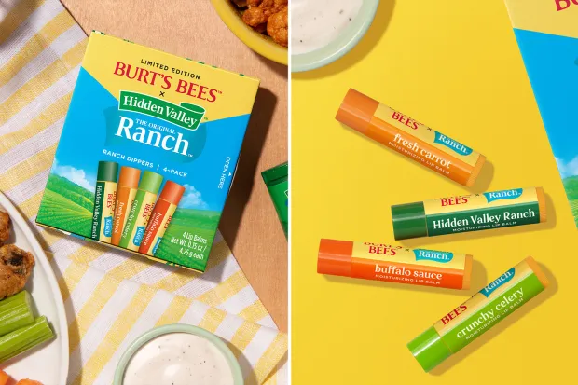
Ranch and Buffalo Sauce Flavored
Lip Balm
MARKETING
STUNTS 2024
Burt’s Bees collaborated with Hidden Valley to introduce a limited-edition series of lip balm with four Hidden Valley themed flavors, including Crunchy Celery, Fresh Carrot, Buffalo Sauce, and Hidden Valley Ranch.
Copyright Sports Career Consulting - Marketing Insights from SCC

Slide 6
REAL PRODUCT!
Copyright Sports Career Consulting - Marketing Insights from SCC

Slide 7
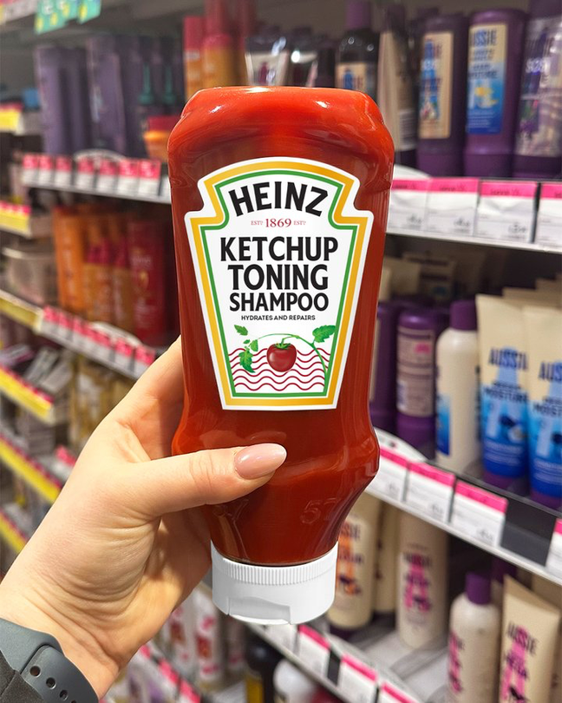
Ketchup
Shampoo
MARKETING
STUNTS 2024
Heinz announced on Twitter (X): “We’ve been solving your hair disasters since 1876, so we thought it was time for Heinz Ketchup to officially make its way from the fridge to the shower Introducing Heinz Ketchup Toning Shampoo, coming soon to the beauty aisle.”
Copyright Sports Career Consulting - Marketing Insights from SCC

Slide 8
APRIL FOOLS!
Copyright Sports Career Consulting - Marketing Insights from SCC

Slide 9
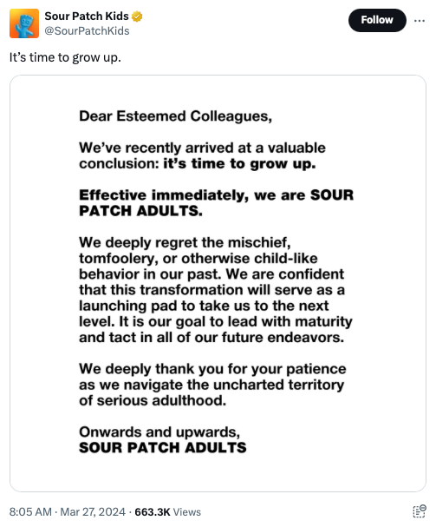
Sour Patch Kids
Grow Up
MARKETING
STUNTS 2024
Sour Patch Kids announced a rebrand on social media, posting a transformation from Sour Patch “Kids” to Sour Patch “Adults” in a tweet that read: “We’ve recently arrived at a valuable conclusion: It’s time to grow up. Effectively immediately, we are Sour Patch Adults.”
Copyright Sports Career Consulting - Marketing Insights from SCC

Slide 10
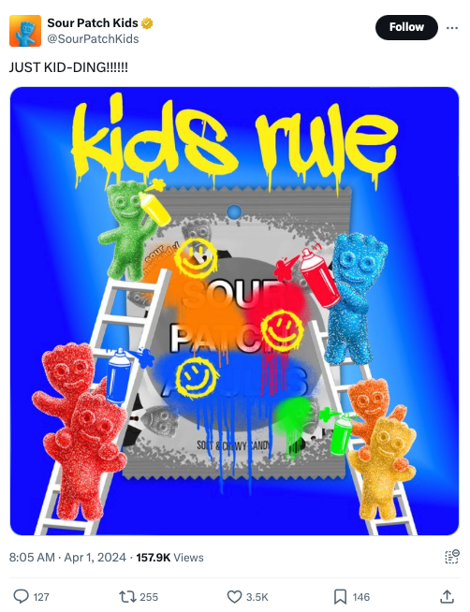
APRIL FOOLS!
Copyright Sports Career Consulting - Marketing Insights from SCC

Slide 11
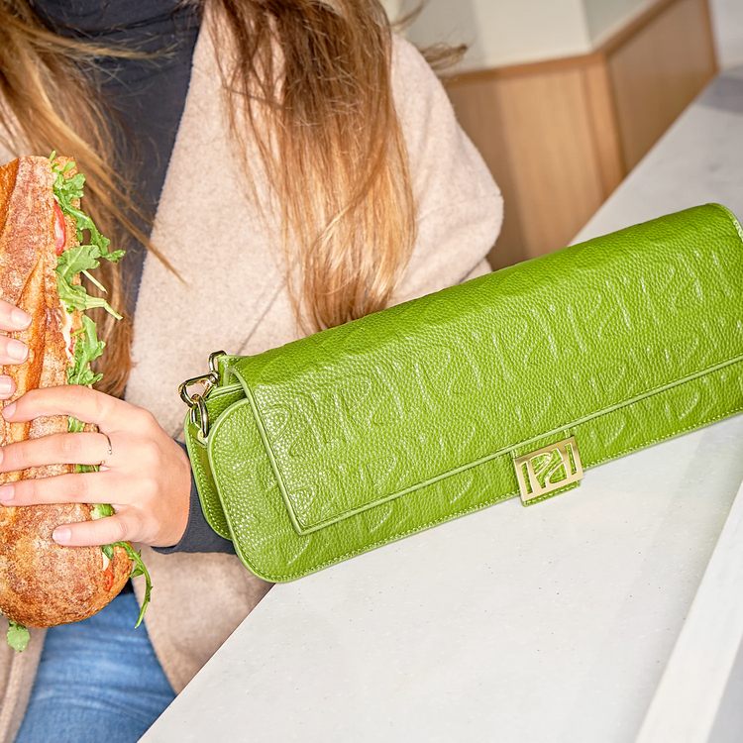
Panera’s
BAGuette Purse
MARKETING
STUNTS 2024
Last year, to promote a new product, Panera created a stylish purse accessory. As described by the brand, "At 12” long, the BAGuette is the perfect size to carry one of our new Toasted Baguette sandwiches."
Copyright Sports Career Consulting - Marketing Insights from SCC

Slide 12
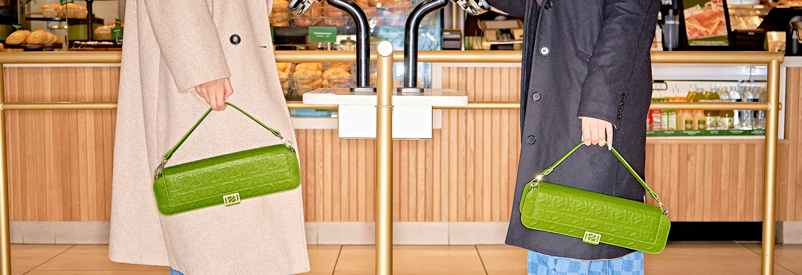
REAL PRODUCT!
Copyright Sports Career Consulting - Marketing Insights from SCC

Slide 13
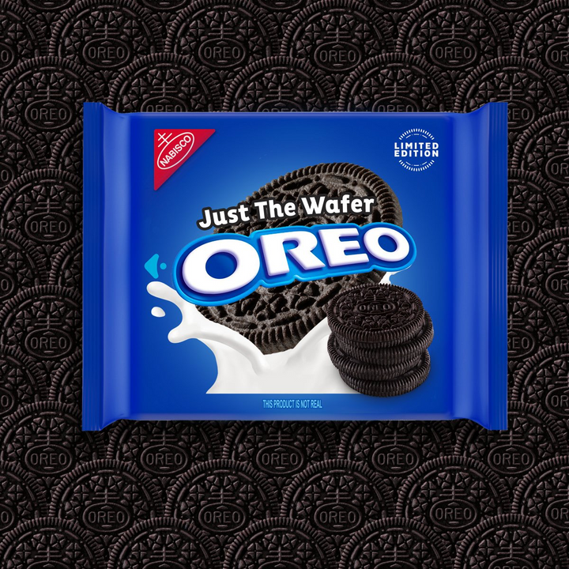
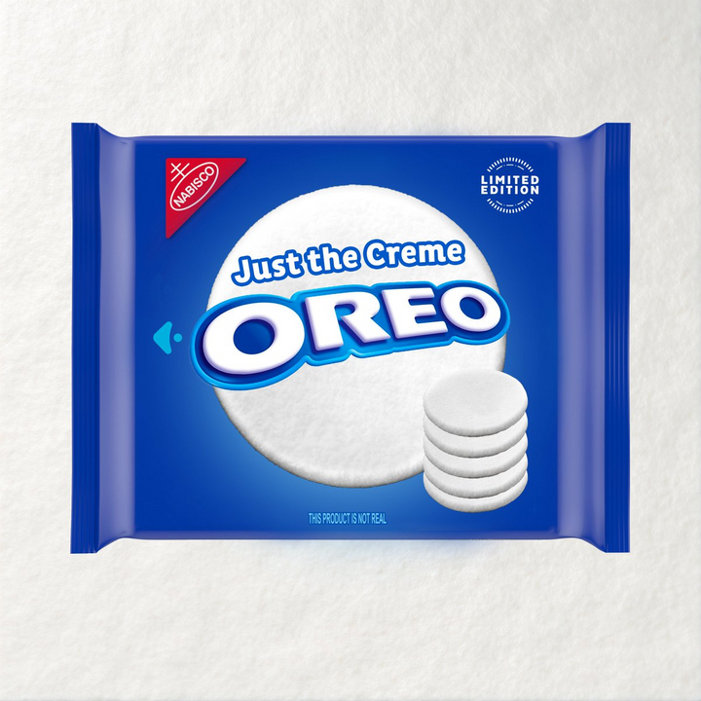
OREO’s Cookie Splits with its Cream
MARKETING
STUNTS 2024
OREO announced that they would separate the cookie and cream, and sell them independently as “Just the Wafer” and “Just the Creme” with the new products hitting store shelves on 4/31.
Copyright Sports Career Consulting - Marketing Insights from SCC

Slide 14
APRIL FOOLS!
Copyright Sports Career Consulting - Marketing Insights from SCC

Slide 15
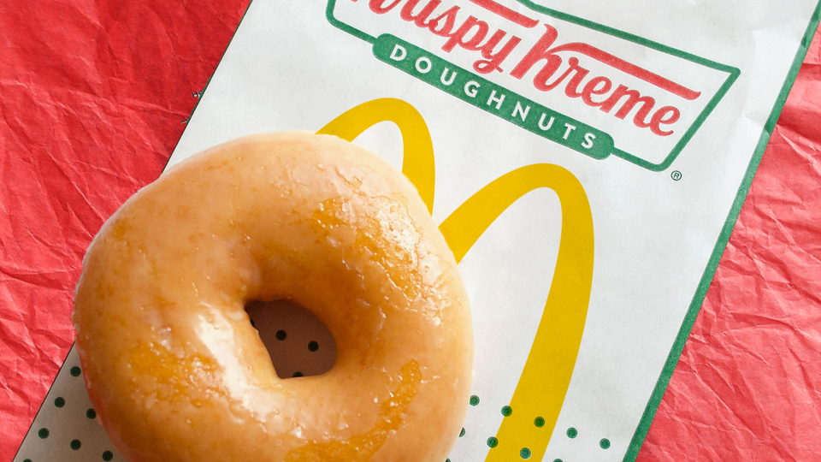
Krispy Kreme Donuts at McDonald’s
MARKETING
STUNTS 2024
McDonald’s and Krispy Kreme announced a partnership that will allow customers to buy Krispy Kreme donuts at locations throughout the United States
Copyright Sports Career Consulting - Marketing Insights from SCC

Slide 16
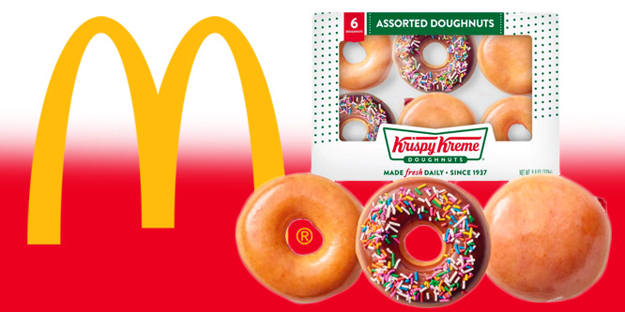
REAL PARTNERSHIP!
Copyright Sports Career Consulting - Marketing Insights from SCC

Slide 17
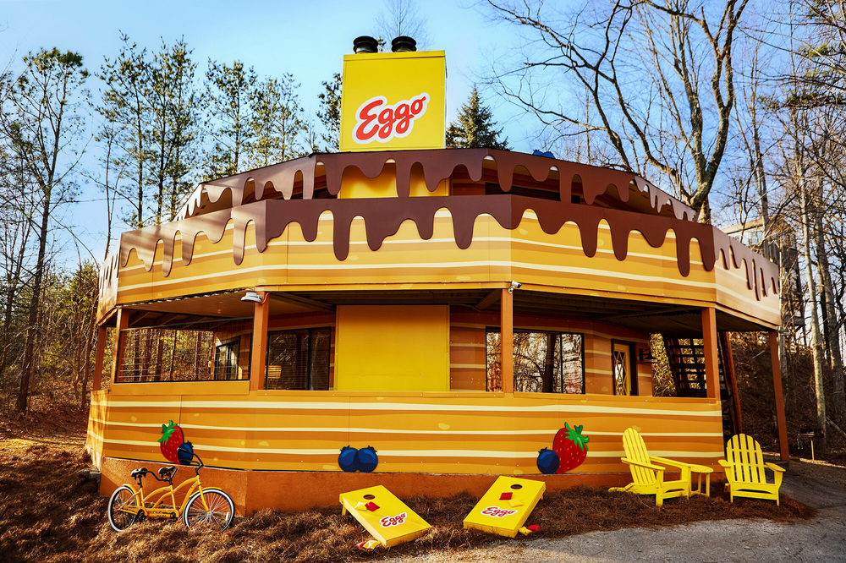
Eggo Opens “House of Pancakes” Rental Property
MARKETING
STUNTS 2024
Eggo partnered with HomeToGo.com to open a literal “Pancake House” in Tennessee, available for booking exclusively on HomesToGo.com.
Copyright Sports Career Consulting - Marketing Insights from SCC

Slide 18

REAL PARTNERSHIP!
Copyright Sports Career Consulting - Marketing Insights from SCC

Slide 19
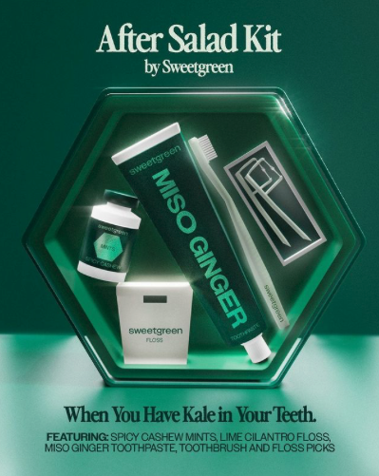
Sweetgreen’s “After Salad” Dental Kit
MARKETING
STUNTS 2024
Sweetgreen’s After Salad Kit is a dental care package designed for anyone who tends to get a little kale stuck in their teeth after lunch. It includes floss picks, Lime Cilantro Dental Floss, Spicy Cashew Mints, and more, inspired by the chain’s dressings.
Copyright Sports Career Consulting - Marketing Insights from SCC

Slide 20
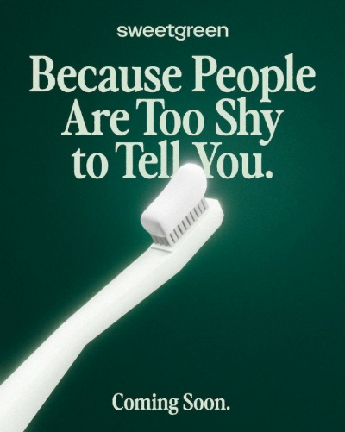
APRIL FOOLS!
Copyright Sports Career Consulting - Marketing Insights from SCC

Slide 21
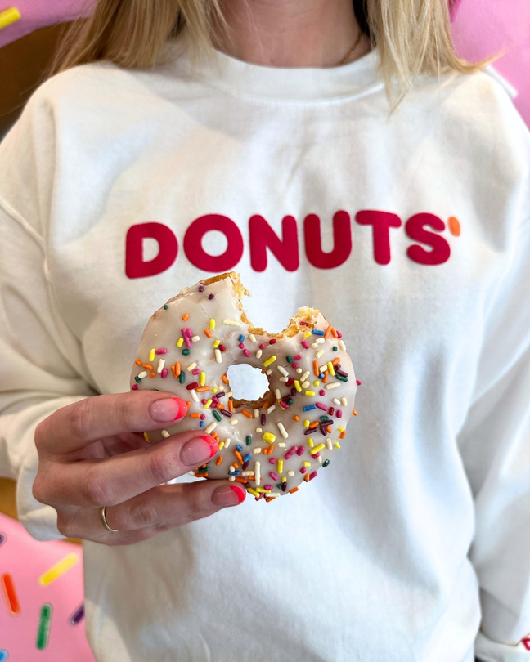
Dunkin’
Rebrands Again
MARKETING
STUNTS 2024
Dunkin’ announced it was officially changing its name to Donuts’, reclaiming the second half of its original name. The chain last announced a name change in 2019, when it dropped the “Donuts.”
Copyright Sports Career Consulting - Marketing Insights from SCC

Slide 22
APRIL FOOLS!
Copyright Sports Career Consulting - Marketing Insights from SCC

Slide 23
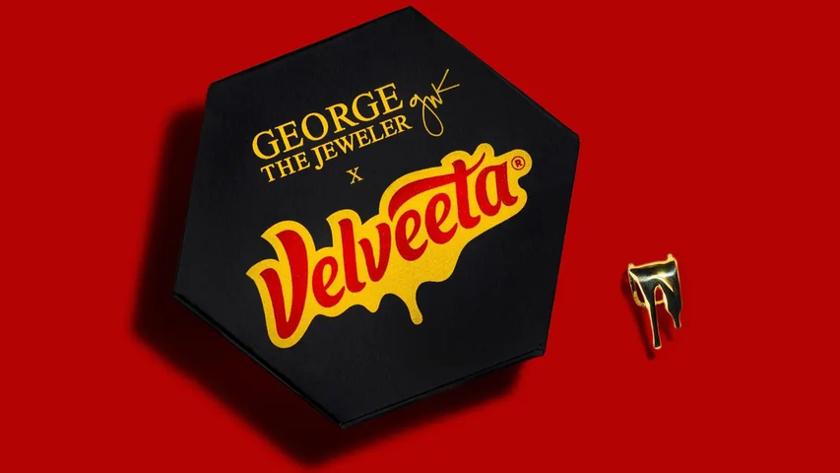
Velveeta x George the Jeweler 14K gold Lip Cuff
MARKETING
STUNTS 2024
Velveeta and George the Jeweler encourage consumers to "live by your own rules" with this 14K gold lip cuff inspired by Velveeta's iconic drip.
Copyright Sports Career Consulting - Marketing Insights from SCC

Slide 24
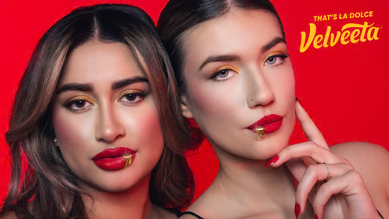
REAL PRODUCT!
Copyright Sports Career Consulting - Marketing Insights from SCC

Slide 25
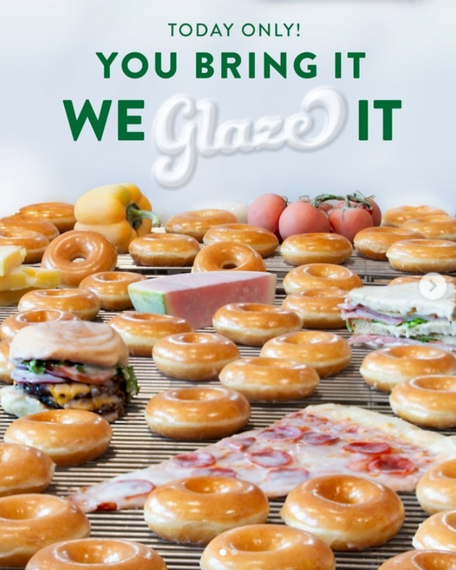
Krispy Kreme “Glazes Anything”
MARKETING
STUNTS 2024
For a one-day-only promotion on April 1st, Krispy Kreme announced that they would “glaze” anything, posting a photo to Instagram with images of donuts, pizza, cheeseburgers, peppers, and more.
Copyright Sports Career Consulting - Marketing Insights from SCC

Slide 26
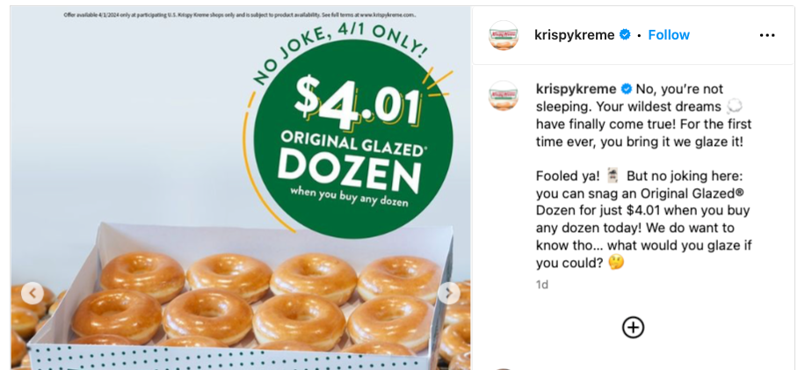
APRIL FOOLS!
Copyright Sports Career Consulting - Marketing Insights from SCC

Slide 27
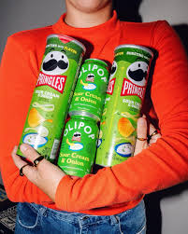
Olipop x Pringles Sour Cream & Onion Soda Flavor
MARKETING
STUNTS 2024
Olipop and Pringles teamed up to introduce a unique flavor combination with “Sour Cream and Onion” soda with an announcement posted to Olipop’s Instagram page
Copyright Sports Career Consulting - Marketing Insights from SCC

Slide 28
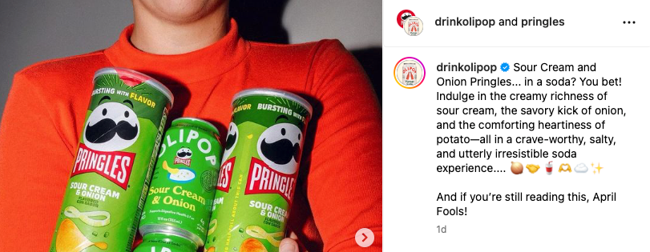
APRIL FOOLS!
Copyright Sports Career Consulting - Marketing Insights from SCC

Slide 29
MARKETING
STUNTS DISCUSSION QUESTIONS
Copyright Sports Career Consulting - Marketing Insights from SCC

Slide 30
MARKETING
STUNTS 2024
1) What is a "stunt" from a marketing perspective?
2) What is a collaboration?
3) Why do brands collaborate?
4) What is publicity?
5) Why do you think brands engage in "stunts" as a marketing strategy?
6) Do you think there is any risk associated with this strategy? Why or why not?
Copyright Sports Career Consulting - Marketing Insights from SCC

Slide 31
STUDENT ACTIVITY
Copyright Sports Career Consulting - Marketing Insights from SCC

Slide 32
STUDENT ACTIVITY
  Split into small groups or pairs.
  Choose a brand (or brands) and create a unique new collaboration, flavor, product, or service as an April Fools’ prank.
  Determine the best way to deliver the prank, being sure to consider any potential customer backlash if the prank doesn’t go over well with the public.
  Present your idea to the class.
  Explain how the brand (or brands) will benefit from the publicity generated by the marketing stunt you created.
Copyright Sports Career Consulting - Marketing Insights from SCC

Slide 33
kktv.com/2024/04/02/7-elevens-hot-dog-flavored-sparkling-water-was-an-april-fools-day-prank
thesun.co.uk/fabulous/27061324/ranch-flavored-lip-balm-burts-bees-review
twitter.com/HeinzUK/status/1774678117254144470
https://twitter.com/SourPatchKids
investors.krispykreme.com/news/news-releases/news-details/2024/McDonalds-USA-and-Krispy-Kreme-Announce-Expanded-National-Partnership/default.aspx
panerabaguettebag.com
today.com/food/trends/april-fools-day-food-pranks-2024-rcna145861
prnewswire.com/news-releases/eggo-house-of-pancakes-is-here-a-literal-pancake-house-you-can-stay-in-302071130.html
linkedin.com/pulse/blending-worlds-top-5-best-brand-collaborations-2024-so-meredith-post-rrbyc
SOURCES
Copyright Sports Career Consulting - Marketing Insights from SCC

