Slide 1
THE BUSINESS OF SPORTS AND ENTERTAINMENT
KENTUCKY DERBY FUN FACTS 2024
Sports Career Consulting

Slide 2
HISTORY & TRADITION
150
The event has been held every consecutive year since 1875, making it the oldest continuously held sporting event in United States History.
This year’s race marks the historic 150th running of the Kentucky Derby.

Slide 3
BRAND & LEGACY
2
The event lasts just two minutes, which is why the Kentucky Derby is known as the “Greatest 2 Minutes in Sports.” This moniker is often used in marketing campaigns and has become part of the event’s brand identity.

Slide 4
BRAND & LEGACY
564
You will also hear the Kentucky Derby called "The Run for the Roses" because a lush blanket of 564 red roses is awarded to the Kentucky Derby winner yearly. This, too, is part of the event's rich heritage and brand identity.​

Slide 5
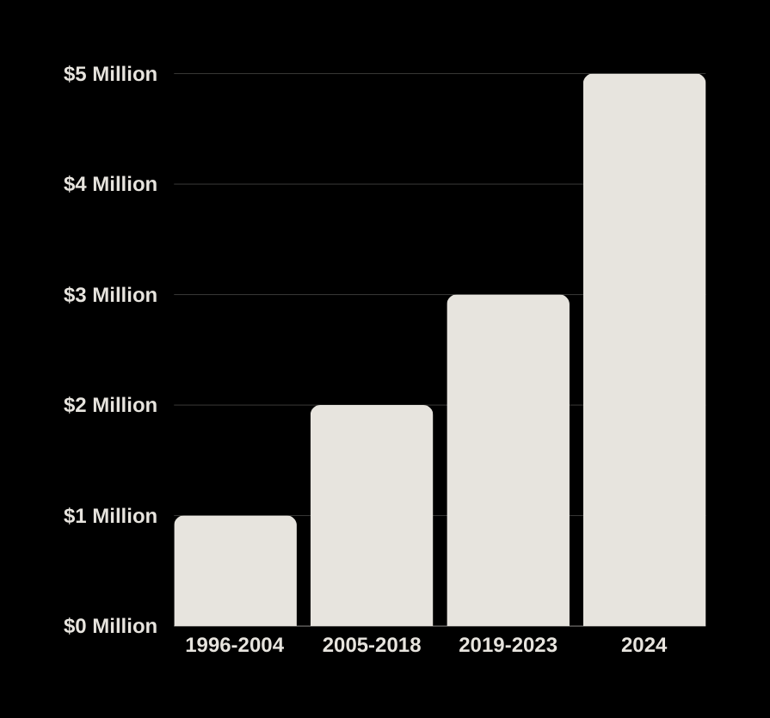
$5 Million
The total prize purse for this year’s Kentucky Derby is $5 million, up from $3 million last year. In 1954, it was just $100,000.

Slide 6
TROPHY VALUE
$200,000
The winner of the race will receive a gold trophy estimated to be worth nearly $200,000 (nearly double the value of the entire prize purse from 1954).

Slide 7
ECONOMIC IMPACT
$6.5B
The horse industry, or equine industry, is the economic activity associated with horses. In the state of Kentucky, it is an industry worth $6.5 billion annually.

Slide 8
Economic Impact
238K
60
77
60,494
Horse Population
Jobs
Recreation
Employment
In Kentucky, more than 60 job categories are related to the horse industry, including veterinarians, farmers, and breeders.
There are 77 different horse-related attractions throughout the state of Kentucky.
The equine industry creates 60,494 jobs every year in Kentucky.
In the state of Kentucky, there are more than 238,000 horses; roughly one for every 18 people.
The Business of Sports & Entertainment

Slide 9
256,000
$405 MILLION
An estimated 256,000 visitors will descend upon Churchill Downs for the 2024 Kentucky Oaks and Derby, according to Louisville Tourism, the official destination marketing organization for Louisville.
The organization also estimates that the events will have an estimated $405 million in economic impact—the direct effects of visitor spending on the metro area.

Slide 10
ECONOMIC IMPACT
61 K
On Derby Day, the number of people inside the track at Churchill Downs is nearly double the entire population of Kentucky’s third-largest city (Bowling Green has 61,000 residents).

Slide 11
150,335
DERBY ATTENDANCE IN 2023
10,000
170,513
15
In 1875, the inaugural race drew 10,000 spectators​.
The attendance record of 170,513 was set in 2015.
Attendance topped 150,000 last year for the first time since the pandemic but was still lower than each of the 15 Derbys from 2005 to 2019.
The Business of Sports & Entertainment

Slide 12
FAN EXPERIENCE
0
Burgoo, a thick stew of beef, chicken, pork, and vegetables, is a popular dish throughout the state of Kentucky. However, Derby-goers won’t eat any at this year’s event, as it is noticeably absent from the official on-track menu. ​

Slide 13
Fan Experience
10,000
9,000
20,000
Derby fans will consume 10,000 pounds of smoked brisket at the track this year.
Horse racing fans will down an estimated 9,000 pounds of shrimp at Churchill Downs on race day.
Kentucky Derby attendees will eat more than 20,000 pieces of assorted desserts at this year’s event.
The Business of Sports & Entertainment

Slide 14
$500-$1000
FAN EXPERIENCE
One of the most historic traditions in sports is the attire of Kentucky Derby spectators, who wear elaborate hats to the event. One designer says she sells custom hats that typically sell for between $500 and $1,000.

Slide 15
FAN EXPERIENCE
3X
The LED screen installed at Churchill Downs in 2018 is larger than three NBA courts and weighs more than 1 million pounds. ​ Cnet.com says “The images are so clear they almost look three-dimensional.”​

Slide 16
$200 Million
FAN EXPERIENCE
After two years of construction, Churchill Downs will showcase its $200 million Paddock renovations this year, its most transformative change at the track. The Paddock area is where horses are saddled and paraded before being taken onto the track on race day.
According to the property’s website, “The re-envisioned Paddock of Churchill Downs is designed to enhance the heart of the fan experience at the track by providing additional seating and improved views of our Paddock.”
Image source: Churchill Downs website
The Business of Sports & Entertainment

Slide 17
SPONSORSHIP
2004
The 2004 Derby marked the first time that jockeys, as a result of a court order, were allowed to wear corporate advertising logos on their clothing

Slide 18
Sponsorship
47
2023
13
The official Kentucky Derby website thanks its advertising and sponsorship partners. It lists 47 official partners.
Last year, Churchill Downs and the Kentucky Derby partnered with FanDuel, making it the track’s official wagering partner.
Last year’s event featured 13 brands with “top-tier” sponsor status.
1999
$1,000
2017
Woodward Reserve, a brand of alcohol, has been a Derby partners since 1999, making it s one of the longest-tenured event sponsors.
Woodford Reserve will continue as the presenting sponsor of the Kentucky Derby through 2027, and last year featured their famous $1,000 mint julep as part of its activation strategy.
Coca-Cola became an official sponsor in 2017; its Dasani brand is also the official bottled water of the Kentucky Derby.
The Business of Sports & Entertainment

Slide 19
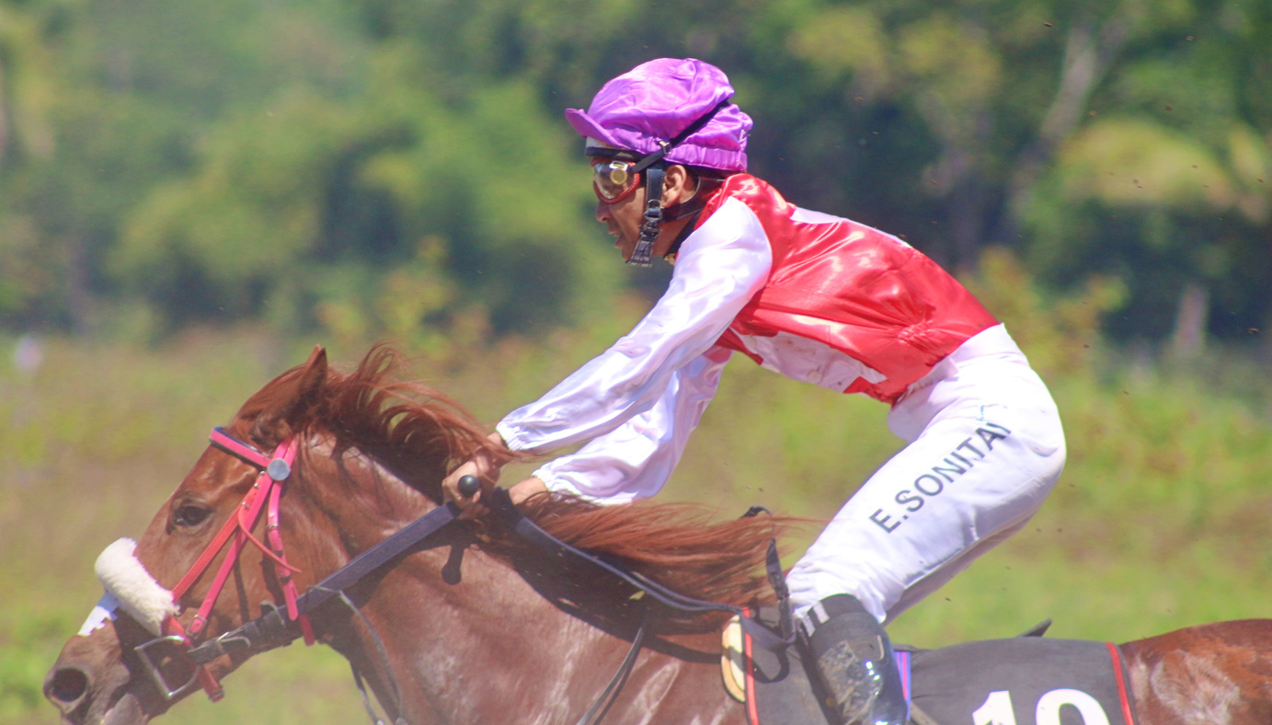
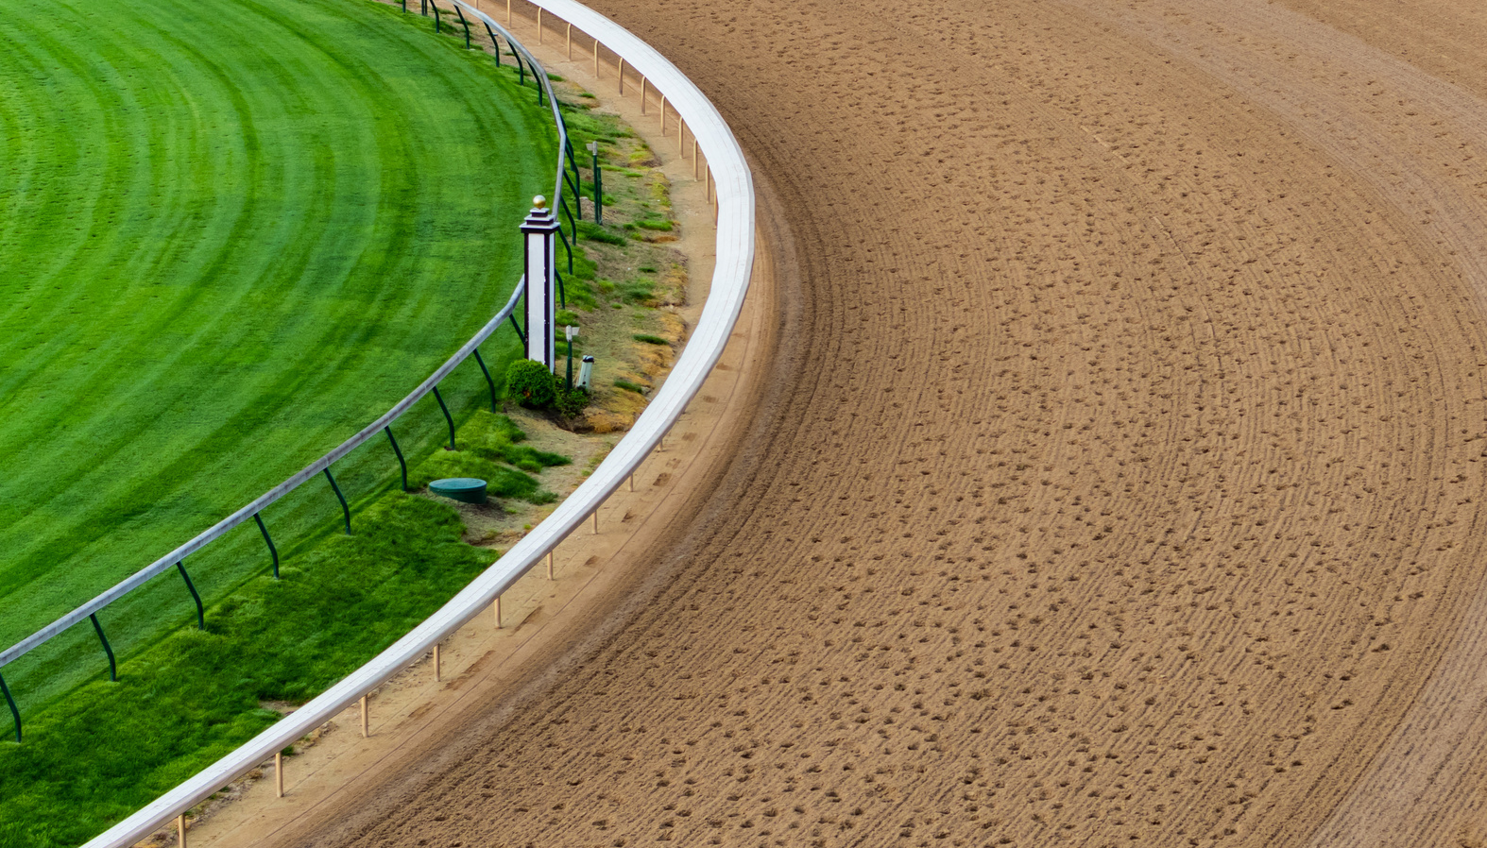
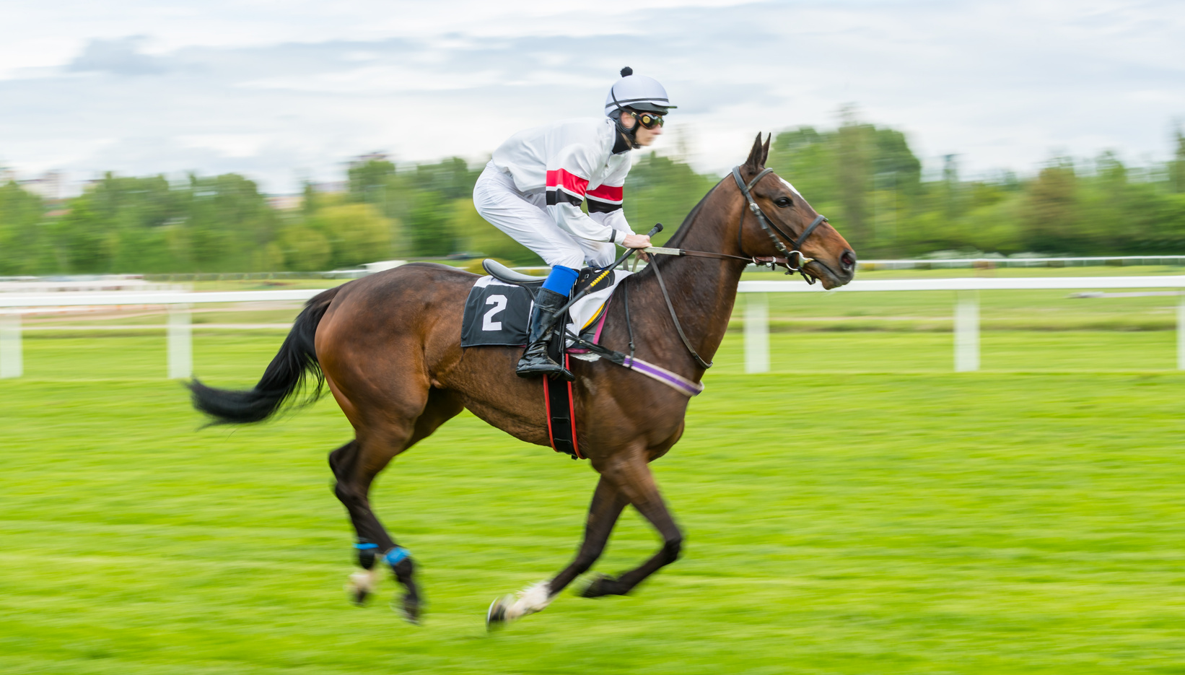
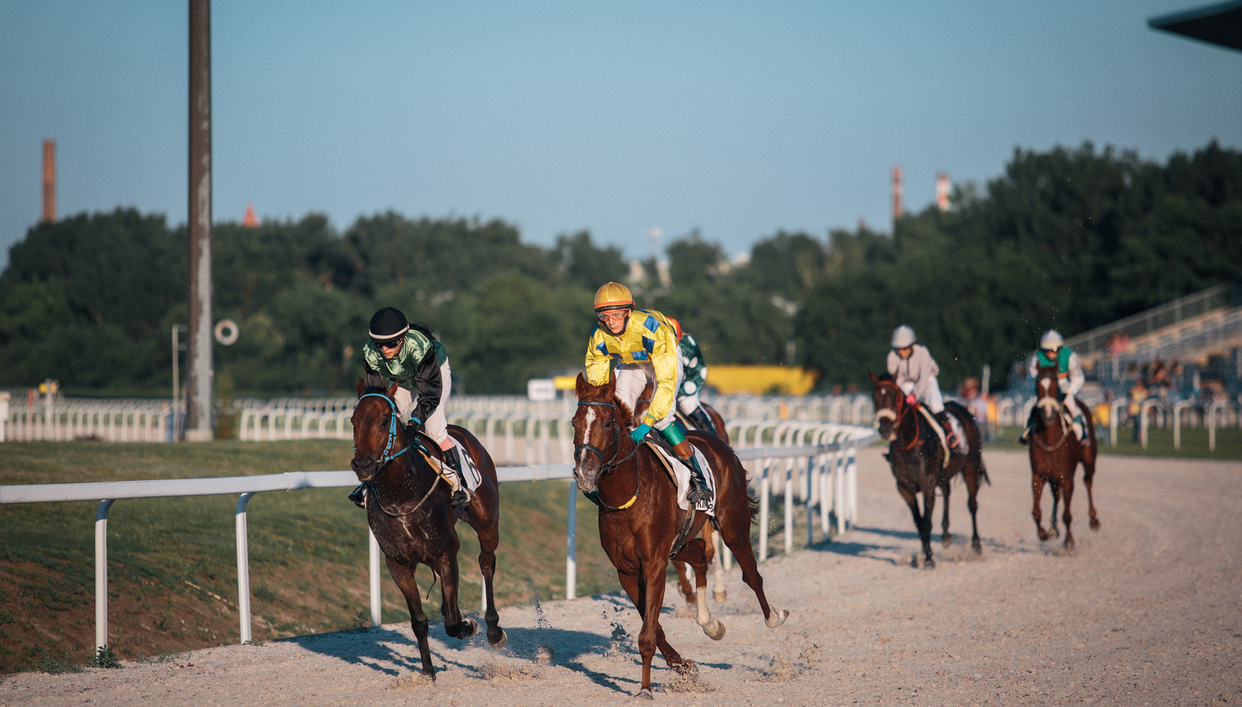
5
New Churchill Downs partners for this year’s Kentucky Derby include Sports Illustrated, The Unwell Network, PopCorners, Q Mixers, Tractor Beverage Co.

Slide 20
Broadcast Rights
20
12.5 HOURS
170
NBC has held the broadcast rights to the Kentucky Derby for more than 20 years. The contract is up in 2025.
This year, NBC will broadcast a record 12.5 hours of Kentucky Derby coverage on NBC, Peacock and USA Network over two days.
NBC Sports will have 16 different international networks covering the race in more than 170 countries, up from six networks/broadcasters in 2023.
The Business of Sports & Entertainment

Slide 21
8X
14.8 MILLION
In eight of NBC’s 22 broadcasts, the network topped 15 million viewers (including streaming). Since 2010, NBC Sports has been averaging 15.6 million viewers for the Derby across all platforms in May, excluding the 2020 COVID event, which took place in September.
Last year's race drew an average of 14.8 million viewers, down from 16-million in 2022. However, the Kentucky Derby still represented the second-most-watched sporting event on TV of the year as of May.

Slide 22
GAMBLING
$300M
Last year, a record $274 million was wagered on the Kentucky Derby, compared to $126 million in 2021.​ This year, experts predict that figure will surpass $300 million, thanks in part to legalized gambling around the U.S.

Slide 23
Viewership
Kentucky Derby Discussion Questions
Ratings were down last year. What does that mean, and why does it matter?
What can NBC and other marketers do to try to increase ratings this year? Do you think the fact that this year is the 150th year of the Kentucky Derby could provide some marketing opportunities? Why or why not?
Traditions & the Fan Experience
What is fan experience? What are “traditions” in sports and entertainment? Do you think traditions add any value to sporting events for ​spectators?
How might that impact the fan experience?​
The Business of Sports & Entertainment

Slide 24
Economic Impact
Kentucky Derby Discussion Questions
What is the equine industry and how important is it to the state of Kentucky?
What is economic impact? How might the Kentucky Derby provide the Louisville area with both direct and indirect economic effects? What types of businesses might benefit most from the event?
Your Interest
Have you ever watched the Kentucky Derby? Who did you watch with? How did you watch, on TV with friends or casually streaming while engaged in some other activity? Will you watch this year? If not, what could good marketing capture your interest?
The Business of Sports & Entertainment

Slide 25
Sponsorship
Kentucky Derby Discussion Questions
What is sponsorship? How do you think businesses and brands decide which sports and entertainment properties to sponsor?
Do you think any brand would benefit from a partnership with Churchill Downs and the Kentucky Derby? Why or why not? If not, which brands might benefit most and why?​
​
Target Market
What is a target market? Why do you think it is important for businesses and brands to identify and understand their target market? What type of consumer might attend or watch the Kentucky Derby, and how might that impact sponsorship-related decisions?
The Business of Sports & Entertainment

Slide 26
Sources
www.cbsnews.com/news/150th-kentucky-derby-history-and-spectacle-at-churchill-downs
www.kentuckyderby.com/horses/news/kentucky-derby-purse-raised-to-record-5-million
https://www.gotolouisville.com/media/news-stories/louisvilles-2024-gameplan-emphasizes-sports-segment
www.kentuckybred.org/kentucky-equine-industry-impact
www.prnewswire.com/news-releases/churchill-downs-racetrack-releases-the-official-food-and-beverage-menu-for-the-milestone-150th-kentucky-derby-302088707.html
https://www.sportsbusinessjournal.com/Daily/Issues/2023/05/04/Marketing-and-Sponsorship/kentucky-derby-sponsors.aspx
https://www.kentuckyderby.com/advertising-sponsorship-opportunities
www.sportsbusinessjournal.com/Articles/2024/04/29/kentucky-derby#
www.courier-journal.com/story/sports/horses/kentucky-derby/2024/04/25/kentucky-derby-2024-betting-churchill-downs-sportsbooks/73097649007
www.churchilldowns.com/featured-building-projects
https://www.sportsmediawatch.com/2023/05/kentucky-derby-ratings-viewership-decline-nbc
https://www.prnewswire.com/news-releases/churchill-downs-racetrack-announces-lineup-of-partnerships-and-experiences-for-historic-150th-running-of-the-kentucky-derby-302128640.html
The Business of Sports & Entertainment

